Slide 1



Chapter 8: Single-Area OSPF
Routing & Switching
Instructor:
Nguyen Anh Minh
M.Sc CCNP TOGAF
Presentation_ID
© 2008 Cisco Systems, Inc. All rights reserved.
Cisco Confidential
<number>

Slide 2
Chapter 8
Characteristics of OSPF
Configuring Single-area OSPFv2
Configure Single-area OSPFv3
Presentation_ID
© 2008 Cisco Systems, Inc. All rights reserved.
Cisco Confidential
<number>

Slide 3
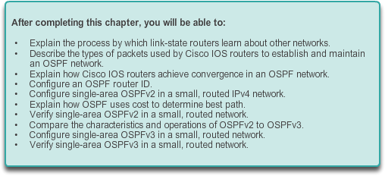
Chapter 8: Objectives
Presentation_ID
© 2008 Cisco Systems, Inc. All rights reserved.
Cisco Confidential
<number>

Slide 4
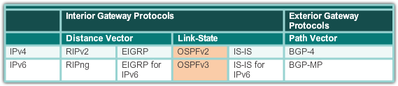
Open Shortest Path First
Evolution of OSPF
Interior Gateway Protocols
1989
updated in 2008
1988
Presentation_ID
© 2008 Cisco Systems, Inc. All rights reserved.
Cisco Confidential
<number>

Slide 5
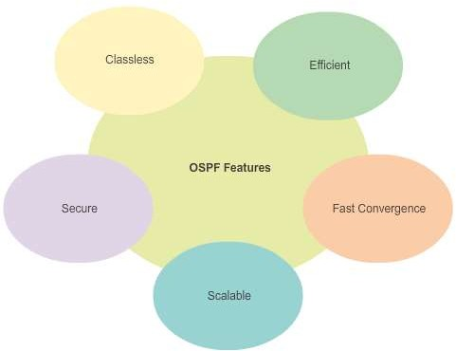
Open Shortest Path First
Features of OSPF
Presentation_ID
© 2008 Cisco Systems, Inc. All rights reserved.
Cisco Confidential
<number>

Slide 6
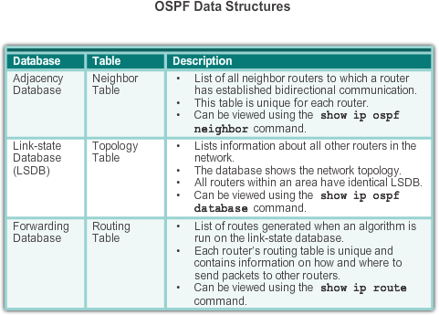
Open Shortest Path First
Components of OSPF
Presentation_ID
© 2008 Cisco Systems, Inc. All rights reserved.
Cisco Confidential
<number>

Slide 7
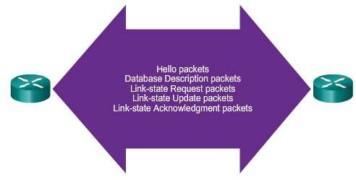
Open Shortest Path First
Components of OSPF (cont.)
OSPF Routers Exchange Packets - These packets are used to discover neighboring routers and also to exchange routing information to maintain accurate information about the network.
Presentation_ID
© 2008 Cisco Systems, Inc. All rights reserved.
Cisco Confidential
<number>

Slide 8
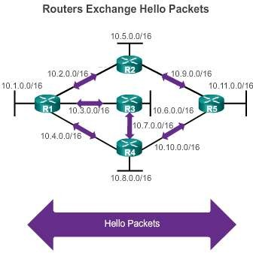
Open Shortest Path First
Link-State Operation
If a neighbor is present, the OSPF-enabled router attempts to establish a neighbor adjacency with that neighbor
Presentation_ID
© 2008 Cisco Systems, Inc. All rights reserved.
Cisco Confidential
<number>

Slide 9
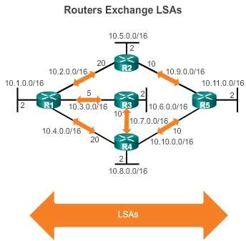
Open Shortest Path First
Link-State Operation (cont.)
LSAs contain the state and cost of each directly connected link.
Routers flood their LSAs
to adjacent neighbors.
Adjacent neighbors receiving the LSA immediately flood the LSA to other directly connected neighbors, until all routers in the area have all LSAs.
Presentation_ID
© 2008 Cisco Systems, Inc. All rights reserved.
Cisco Confidential
<number>

Slide 10
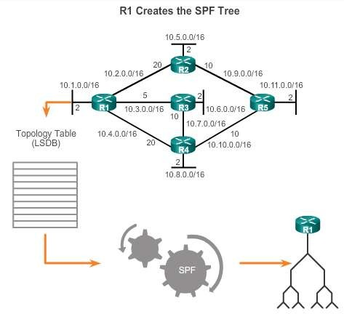
Open Shortest Path First
Link-State Operation
Build the topology table based on the received LSAs.
This database eventually holds all the information about the topology of the network.
Execute the SPF
Algorithm.
Presentation_ID
© 2008 Cisco Systems, Inc. All rights reserved.
Cisco Confidential
<number>

Slide 11
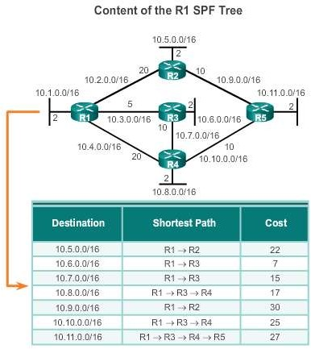
Open Shortest Path First
Link-State Operation (cont.)
From the SPF tree, the best paths are inserted into the routing table.
Presentation_ID
© 2008 Cisco Systems, Inc. All rights reserved.
Cisco Confidential
<number>

Slide 12
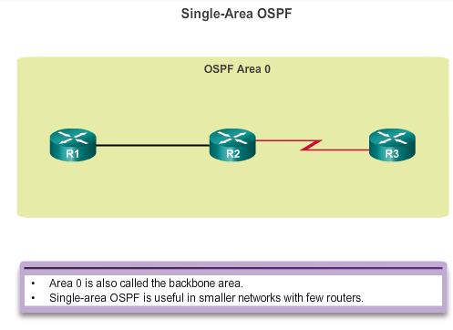
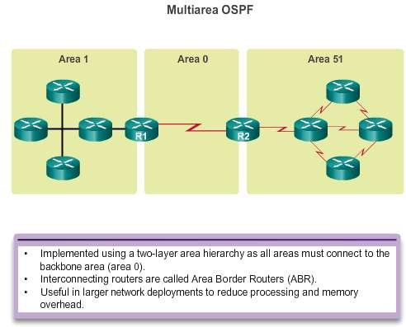
Open Shortest Path First
Single-area and Multiarea OSPF
Presentation_ID
© 2008 Cisco Systems, Inc. All rights reserved.
Cisco Confidential
<number>

Slide 13
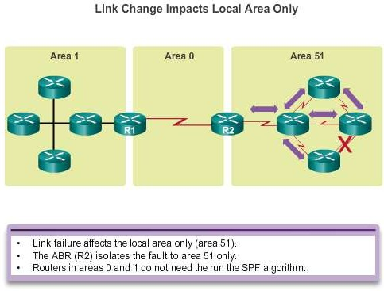
Open Shortest Path First
Single-area and Multiarea OSPF (cont.)
Presentation_ID
© 2008 Cisco Systems, Inc. All rights reserved.
Cisco Confidential
<number>

Slide 14
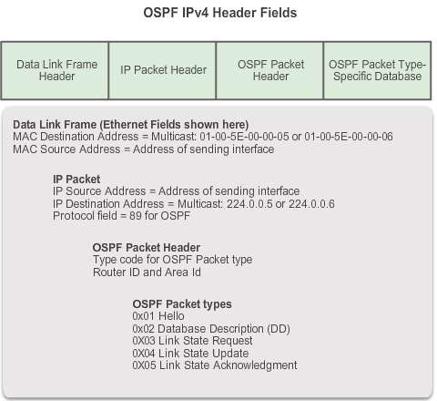
OSPF Messages
Encapsulating OSPF Messages
Presentation_ID
© 2008 Cisco Systems, Inc. All rights reserved.
Cisco Confidential
<number>

Slide 15
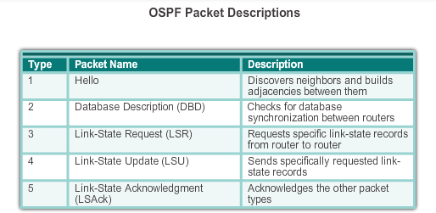
OSPF Messages
Types of OSPF Packets
Presentation_ID
© 2008 Cisco Systems, Inc. All rights reserved.
Cisco Confidential
<number>

Slide 16
OSPF Messages
Hello Packet
OSPF Type 1 packet = Hello packet:
Discover OSPF neighbors and establish neighbor adjacencies.
Advertise parameters on which two routers
must agree to become neighbors.
Elect the Designated Router (DR) and Backup Designated Router (BDR) on multiaccess networks like Ethernet and Frame Relay.
Presentation_ID
© 2008 Cisco Systems, Inc. All rights reserved.
Cisco Confidential
<number>

Slide 17
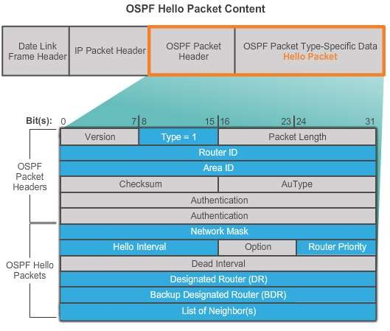
OSPF Messages
Hello Packet (cont.)
Presentation_ID
© 2008 Cisco Systems, Inc. All rights reserved.
Cisco Confidential
<number>

Slide 18
OSPF Messages
Hello Packet Intervals
OSPF Hello packets are transmitted:
To 224.0.0.5 in IPv4 and FF02::5 in IPv6 (all OSPF routers)
Every 10 seconds (default on multiaccess and point-to-
point networks)
Every 30 seconds (default on non-broadcast multiaccess [NBMA] networks)
Dead interval is the period that the router waits to
receive a Hello packet before declaring the neighbor down
Router floods the LSDB with information about down neighbors out all OSPF enabled interfaces
Cisco’s default is 4 times the Hello interval
Presentation_ID
© 2008 Cisco Systems, Inc. All rights reserved.
Cisco Confidential
<number>

Slide 19
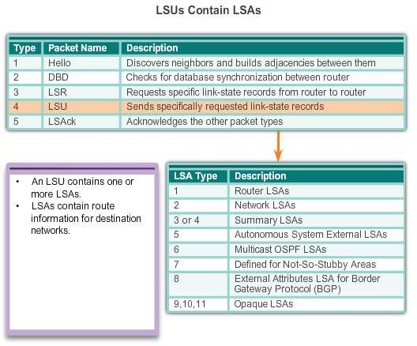
OSPF Messages
Link-State Updates
Presentation_ID
© 2008 Cisco Systems, Inc. All rights reserved.
Cisco Confidential
<number>

Slide 20
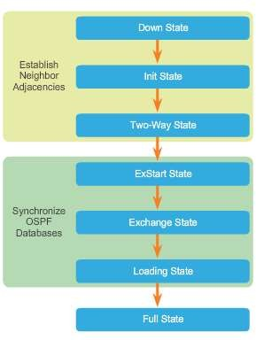
OSPF Operation
OSPF Operational States
When an OSPF router is initially connected to a network, it attempts to:
Create adjacencies with neighbors
Exchange routing information
Calculate the best routes
Reach convergence
OSPF progresses through several states while attempting to reach convergence.
Presentation_ID
© 2008 Cisco Systems, Inc. All rights reserved.
Cisco Confidential
<number>

Slide 21
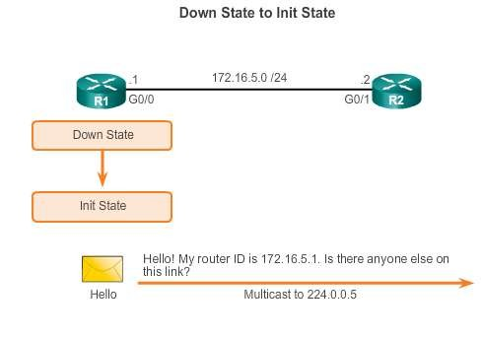
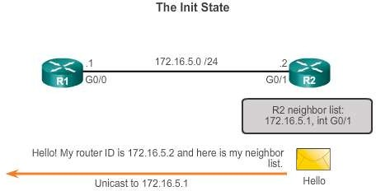
OSPF Operation
Establish Neighbor Adjacencies
Presentation_ID
© 2008 Cisco Systems, Inc. All rights reserved.
Cisco Confidential
<number>

Slide 22
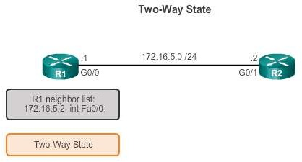
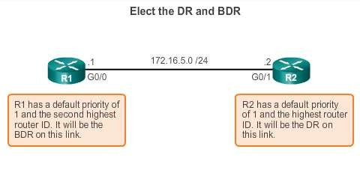
OSPF Operation Establish Neighbor Adjacencies (cont.)
DR and BDR election only occurs on multi-access networks such as Ethernet LANs.
Presentation_ID
© 2008 Cisco Systems, Inc. All rights reserved.
Cisco Confidential
<number>

Slide 23
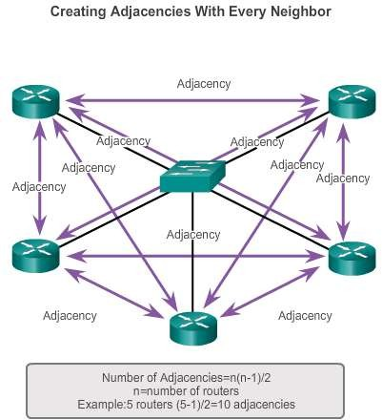
OSPF Operation
OSPF DR and BDR
Presentation_ID
© 2008 Cisco Systems, Inc. All rights reserved.
Cisco Confidential
<number>

Slide 24
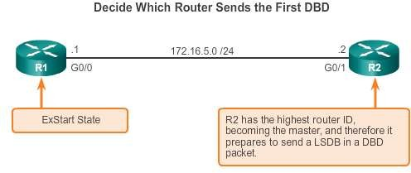
OSPF Operation
Synchronizing OSPF Database
Presentation_ID
© 2008 Cisco Systems, Inc. All rights reserved.
Cisco Confidential
<number>

Slide 25
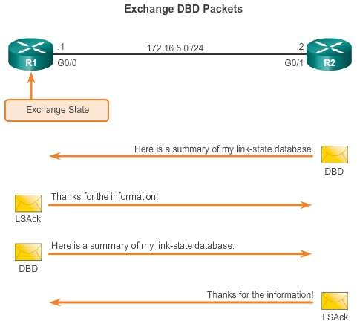
OSPF Operation
Synchronizing OSPF Database (cont.)
Presentation_ID
© 2008 Cisco Systems, Inc. All rights reserved.
Cisco Confidential
<number>

Slide 26
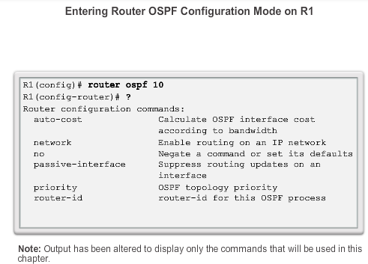
OSPF Router ID
OSPF Network Topology
Presentation_ID
© 2008 Cisco Systems, Inc. All rights reserved.
Cisco Confidential
<number>

Slide 27
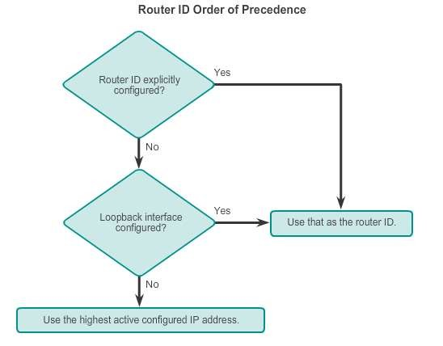
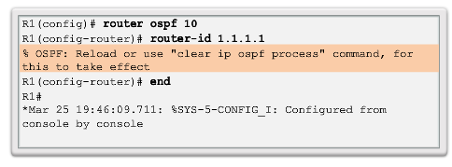
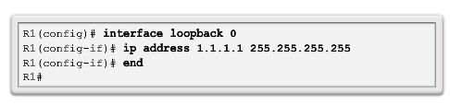
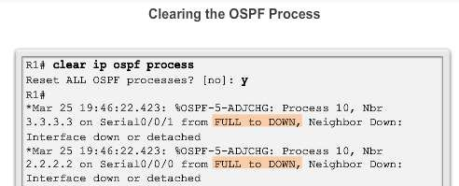
OSPF Router ID
Router IDs
Presentation_ID
© 2008 Cisco Systems, Inc. All rights reserved.
Cisco Confidential
<number>

Slide 28
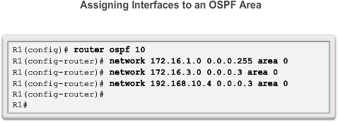
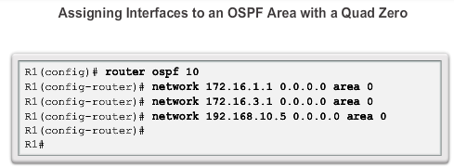
Configure Single-area OSPFv2
The network Command
Presentation_ID
© 2008 Cisco Systems, Inc. All rights reserved.
Cisco Confidential
<number>

Slide 29
Configure Single-Area OSPFv2
Passive Interface
By default, OSPF messages are forwarded out all OSPF-enabled interfaces. However, these messages really only need to be sent out interfaces connecting to other OSPF-enabled routers.
Sending out unneeded messages on a LAN affects the network in three ways:
Inefficient Use of Bandwidth
Inefficient Use of Resources
Increased Security Risk
The Passive Interface feature helps limiting the scope of routing updates advertisements.
Presentation_ID
© 2008 Cisco Systems, Inc. All rights reserved.
Cisco Confidential
<number>

Slide 30
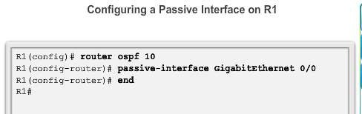
Configure Single-area OSPFv2
Configuring Passive Interfaces
Use the passive-interface router configuration mode command to prevent the transmission of routing messages through a router interface, but still allow that network to be advertised to other routers.
Presentation_ID
© 2008 Cisco Systems, Inc. All rights reserved.
Cisco Confidential
<number>

Slide 31
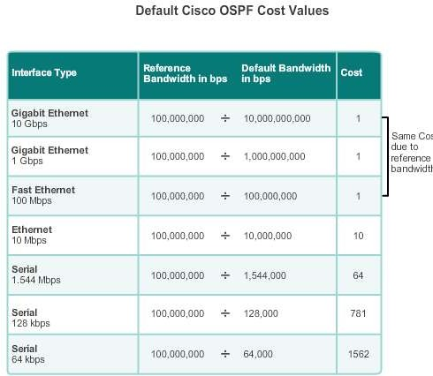
OSPF Cost
OSPF Metric = Cost
Cost = reference bandwidth / interface bandwidth
(default reference bandwidth is 10^8)
Cost = 100,000,000 bps / interface bandwidth in bps
Presentation_ID
© 2008 Cisco Systems, Inc. All rights reserved.
Cisco Confidential
<number>

Slide 32
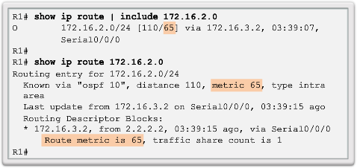
OSPF Cost
OSPF Accumulates Costs
Cost of an OSPF route is the accumulated value from one router to the
destination network.
Presentation_ID
© 2008 Cisco Systems, Inc. All rights reserved.
Cisco Confidential
<number>

Slide 33
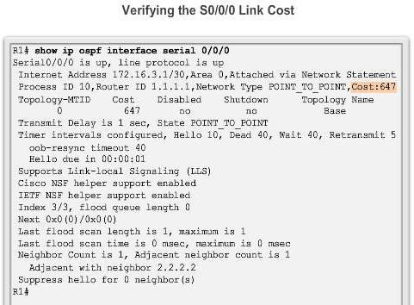
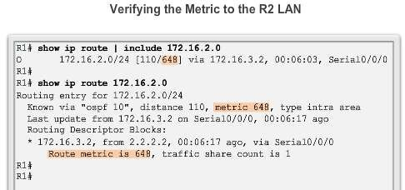
OSPF Cost
Adjusting the Reference Bandwidth
Use the command - auto-cost reference-bandwidth
Must be configured on every router in the OSPF domain
Notice that the value is expressed in Mb/s:
Gigabit Ethernet - auto-cost reference-bandwidth 1000
10 Gigabit Ethernet - auto-cost reference-bandwidth 10000
Presentation_ID
© 2008 Cisco Systems, Inc. All rights reserved.
Cisco Confidential
<number>

Slide 34
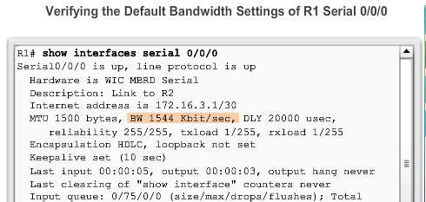
OSPF Cost
Default Interface Bandwidths
On Cisco routers, the default bandwidth on most serial interfaces is set to
1.544 Mb/s.
Presentation_ID
© 2008 Cisco Systems, Inc. All rights reserved.
Cisco Confidential
<number>

Slide 35
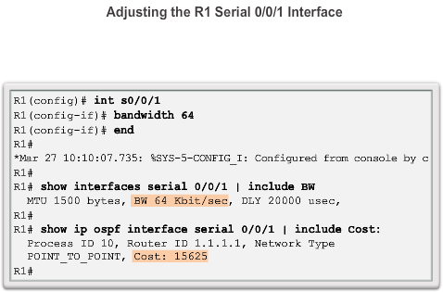
OSPF Cost
Adjusting the Interface Bandwidths
Presentation_ID
© 2008 Cisco Systems, Inc. All rights reserved.
Cisco Confidential
<number>

Slide 36
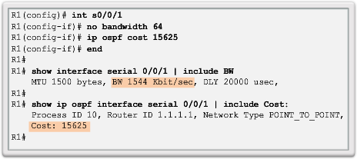
OSPF Cost
Manually Setting the OSPF Cost
Both the bandwidth interface command and the ip ospf cost interface command achieve the same result, which is to provide an accurate value for use by OSPF in determining the best route.
Presentation_ID
© 2008 Cisco Systems, Inc. All rights reserved.
Cisco Confidential
<number>

Slide 37
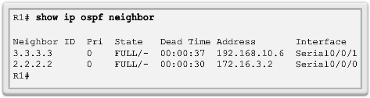
Verify OSPF
Verify OSPF Neighbors
Verify that the router has formed an adjacency with its neighboring routers.
Presentation_ID
© 2008 Cisco Systems, Inc. All rights reserved.
Cisco Confidential
<number>

Slide 38
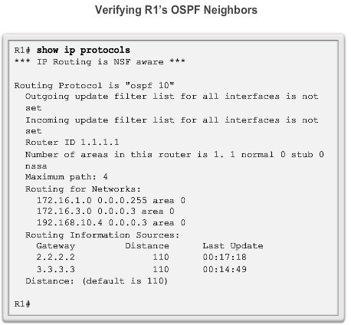
Verify OSPF
Verify OSPF Protocol Settings
Presentation_ID
© 2008 Cisco Systems, Inc. All rights reserved.
Cisco Confidential
<number>

Slide 39
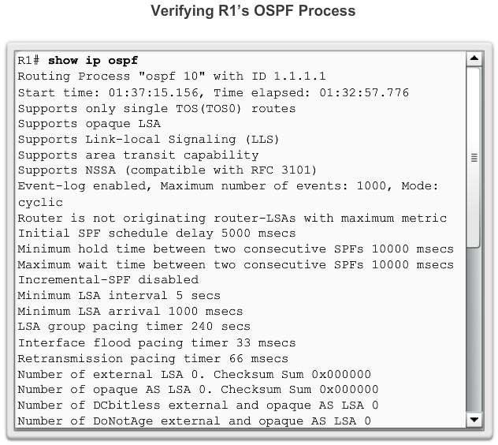
Verify OSPF
Verify OSPF Process Information
Presentation_ID
© 2008 Cisco Systems, Inc. All rights reserved.
Cisco Confidential
<number>

Slide 40
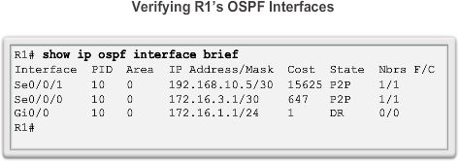
Verify OSPF
Verify OSPF Interface Settings
Presentation_ID
© 2008 Cisco Systems, Inc. All rights reserved.
Cisco Confidential
<number>

Slide 41
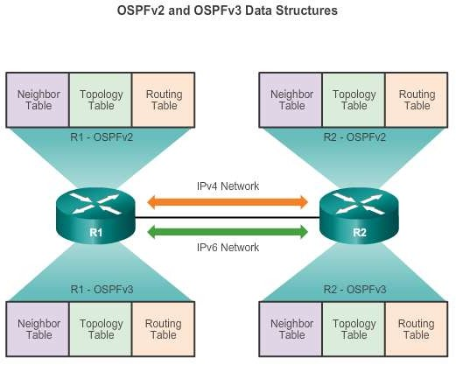
OSPFv2 vs. OSPFv3
OSPFv3
Presentation_ID
© 2008 Cisco Systems, Inc. All rights reserved.
Cisco Confidential
<number>

Slide 42
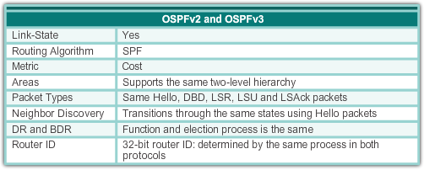
OSPFv2 vs. OSPFv3
Similarities Between OSPFv2 to OSPFv3
Presentation_ID
© 2008 Cisco Systems, Inc. All rights reserved.
Cisco Confidential
<number>

Slide 43
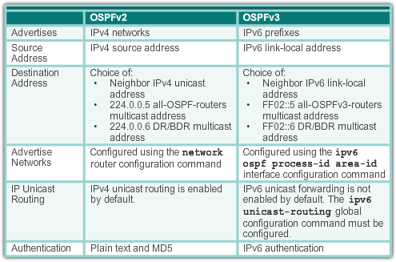
OSPFv2 vs. OSPFv3
Differences Between OSPFv2 to OSPFv3
Presentation_ID
© 2008 Cisco Systems, Inc. All rights reserved.
Cisco Confidential
<number>

Slide 44
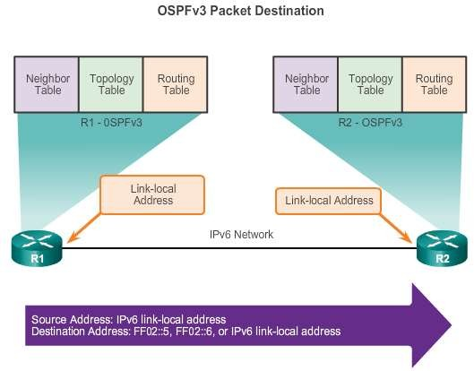
OSPFv2 vs. OSPFv3
Link-Local Addresses
FF02::5 address is the all OSPF router address
FF02::6 is the DR/BDR multicast address
Presentation_ID
© 2008 Cisco Systems, Inc. All rights reserved.
Cisco Confidential
<number>

Slide 45
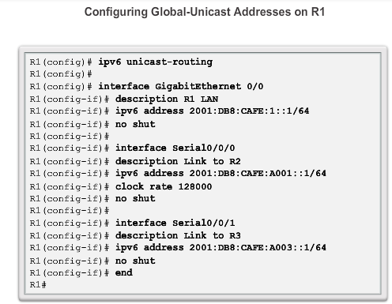
Configuring OSFPv3
OSPFv3 Network Topology
Presentation_ID
© 2008 Cisco Systems, Inc. All rights reserved.
Cisco Confidential
<number>

Slide 46
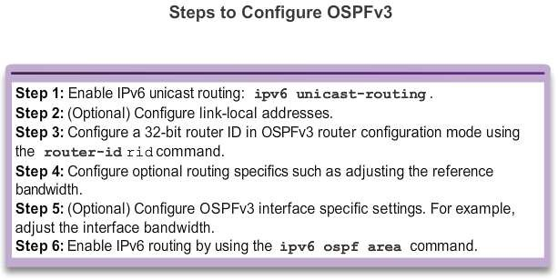
Configuring OSFPv3
OSPFv3 Network Topology (cont.)
Presentation_ID
© 2008 Cisco Systems, Inc. All rights reserved.
Cisco Confidential
<number>

Slide 47
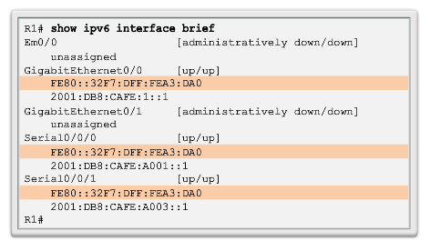
Configuring OSFPv3
Link-Local Addresses
Link-local addresses are automatically created when an IPv6 global unicast address is assigned to the interface (required).
Global unicast addresses are not required.
Cisco routers create the link-local address using FE80::/10 prefix and the EUI-64 process unless the router is configured manually,
EUI-64 involves using the 48-bit Ethernet MAC address, inserting FFFE in
the middle and flipping the seventh bit. For serial interfaces, Cisco uses the MAC address of an Ethernet interface.
Notice in the figure that all three interfaces are using the same link-local
address.
Presentation_ID
© 2008 Cisco Systems, Inc. All rights reserved.
Cisco Confidential
<number>

Slide 48


Configuring OSFPv3
Assigning Link-Local Addresses
Manually configuring the link- local address provides the ability to create an address that is recognizable and easier to remember.
Presentation_ID
© 2008 Cisco Systems, Inc. All rights reserved.
Cisco Confidential
<number>

Slide 49

Configuring OSFPv3
Configuring the OSPFv3 Router ID
Presentation_ID
© 2008 Cisco Systems, Inc. All rights reserved.
Cisco Confidential
<number>

Slide 50

Configuring OSFPv3
Configuring the OSPFv3 Router ID (cont.)
Presentation_ID
© 2008 Cisco Systems, Inc. All rights reserved.
Cisco Confidential
<number>

Slide 51


Configuring OSFPv3
Modifying an OSPFv3 Router ID
Presentation_ID
© 2008 Cisco Systems, Inc. All rights reserved.
Cisco Confidential
<number>

Slide 52

OSPF Configuring OSFPv3
Enabling OSPFv3 on Interfaces
Instead of using the network router configuration mode command to specify matching interface addresses, OSPFv3 is configured directly on the interface.
Presentation_ID
© 2008 Cisco Systems, Inc. All rights reserved.
Cisco Confidential
<number>

Slide 53


Verify OSPFv3
Verify OSPFv3 Neighbors/Protocol Settings
Presentation_ID
© 2008 Cisco Systems, Inc. All rights reserved.
Cisco Confidential
<number>

Slide 54

Verify OSPFv3
Verify OSPFv3 Interfaces
Presentation_ID
© 2008 Cisco Systems, Inc. All rights reserved.
Cisco Confidential
<number>

Slide 55

Verify OSPFv3
Verify IPv6 Routing Table
Presentation_ID
© 2008 Cisco Systems, Inc. All rights reserved.
Cisco Confidential
<number>

Slide 56
Chapter 8: Summary
OSPF:
For IPv4 is OSPFv2
For IPv6 is OSPFv3
Classless, link-state routing protocol with a default administrative distance of 110, and is denoted in the routing table with a route source code of O
OSPFv2 is enabled with the router ospf process-id global configuration mode command. The process-id value is locally significant, which means that it does not need to match other OSPF routers to establish adjacencies with those neighbors.
Network command uses the wildcard-mask value which is the inverse of the subnet mask, and the area-id value
Presentation_ID
© 2008 Cisco Systems, Inc. All rights reserved.
Cisco Confidential
<number>

Slide 57
Chapter 8: Summary (cont.)
OSPF:
By default, OSPF Hello packets are sent every 10 seconds on multiaccess and point-to-point segments and every 30 seconds on NBMA segments (Frame Relay, X.25, ATM), and are used by OSPF to establish neighbor adjacencies. The Dead interval is four times the Hello interval, by default.
For routers to become adjacent, their Hello interval, Dead interval, network types, and subnet masks must match. Use the show ip ospf neighborscommand to verify OSPF adjacencies.
In a multiaccess network, OSPF elects a DR to act as collection and distribution point for LSAs sent and received. A BDR is elected to assume the role of the DR should the DR fail. All other routers are known as DROTHERs. All routers send their LSAs to the DR, which then floods the LSA to all other routers in the multiaccess network.
Presentation_ID
© 2008 Cisco Systems, Inc. All rights reserved.
Cisco Confidential
<number>

Slide 58
Chapter 8: Summary (cont.)
OSPF:
In multiaccess networks, the router with the highest router ID is the DR, and the router with the second highest router ID is the BDR. This can be superseded by the ip ospf priority command on that interface. The router with the highest priority value is the DR, and next-highest the BDR.
The show ip protocols command is used to verify important OSPF configuration information, including the OSPF process ID, the router ID, and the networks the router is advertising.
OSPFv3 is enabled on an interface and not under router configuration mode. OSPFv3 needs link-local addresses to be configured. IPv6 Unicast routing must be enabled for OSPFv3. A 32- bit router-ID is required before an interface can be enabled for OSPFv3.
Presentation_ID
© 2008 Cisco Systems, Inc. All rights reserved.
Cisco Confidential
<number>

Slide 59
Chapter 8: Summary (cont.)
OSPF:
The show ip protocols command is used to verify important OSPFv2 configuration information, including the OSPF process ID, the router ID, and the networks the router is advertising.
OSPFv3
Enabled on an interface and not under router configuration mode
Needs link-local addresses to be configured. IPv6
Unicast routing must be enabled for OSPFv3
32-bit router-ID is required before an interface can be enabled for OSPFv3
show ipv6 protocols command is a quick way to verify configuration information (OSPF process ID, the router ID, and the interfaces enabled for OSPFv3)
Presentation_ID
© 2008 Cisco Systems, Inc. All rights reserved.
Cisco Confidential
<number>

Slide 60
Presentation_ID
© 2008 Cisco Systems, Inc. All rights reserved.
Cisco Confidential
<number>

