Slide 1



Chapter 4: Routing Concepts
Routing & Switching
Instructor:
Nguyen Anh Minh
M.Sc CCNP TOGAF
Presentation_ID
© 2008 Cisco Systems, Inc. All rights reserved.
Cisco Confidential
<number>

Slide 2
Chapter 4
Routing Concepts
Initial Configuration of a Router
Routing Decisions
Router Operation
Summary
Presentation_ID
© 2008 Cisco Systems, Inc. All rights reserved.
Cisco Confidential
<number>

Slide 3
Chapter 4: Objectives
Configure a router to route between multiple directly connected networks
Describe the primary functions and features of a router.
Explain how routers use information in data packets to make forwarding decisions in a small- to medium-sized business network.
Explain the encapsulation and de-encapsulation process used by
routers when switching packets between interfaces.
Compare ways in which a router builds a routing table when operating in a small- to medium-sized business network.
Explain routing table entries for directly connected networks.
Explain how a router builds a routing table of directly connected networks.
Presentation_ID
© 2008 Cisco Systems, Inc. All rights reserved.
Cisco Confidential
<number>

Slide 4
Chapter 4: Objectives (cont.)
Explain how a router builds a routing table using static routes.
Explain how a router builds a routing table using a dynamic routing
protocol.
Presentation_ID
© 2008 Cisco Systems, Inc. All rights reserved.
Cisco Confidential
<number>

Slide 5
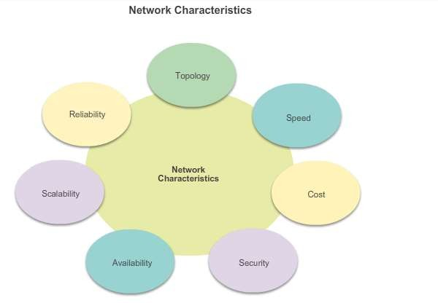
Functions of a Router
Characteristics of a Network
Presentation_ID
© 2008 Cisco Systems, Inc. All rights reserved.
Cisco Confidential
<number>

Slide 6
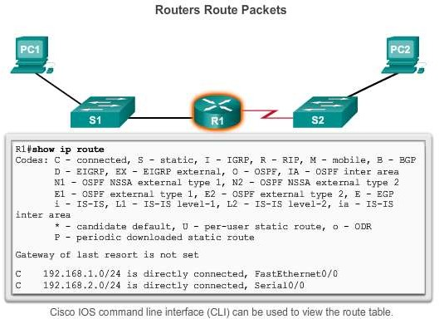
Functions of a Router
Why Routing?
The router is responsible for the routing of traffic between networks.
Presentation_ID
© 2008 Cisco Systems, Inc. All rights reserved.
Cisco Confidential
<number>

Slide 7
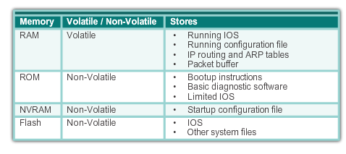
Functions of a Router
Routers are Computers
Routers are specialized computers containing the
following required components to operate:
Central processing unit (CPU)
Operating system (OS) - Routers use Cisco IOS
Memory and storage (RAM, ROM, NVRAM, Flash, hard drive)
Presentation_ID
© 2008 Cisco Systems, Inc. All rights reserved.
Cisco Confidential
<number>

Slide 8
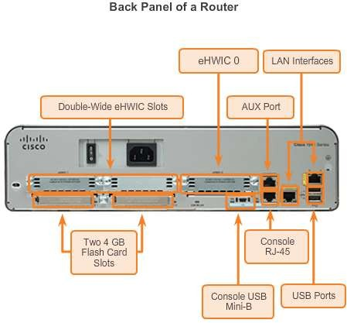
Functions of a Router
Routers are Computers
Routers use specialized ports and network interface cards to interconnect to other networks.
Presentation_ID
© 2008 Cisco Systems, Inc. All rights reserved.
Cisco Confidential
<number>

Slide 9
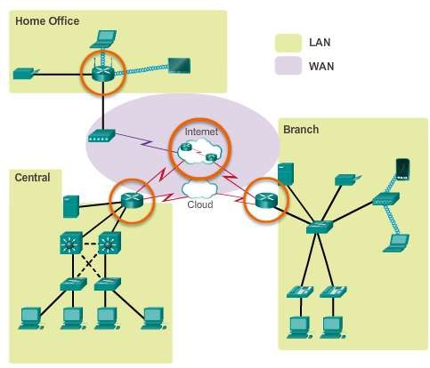
Functions of a Router
Routers Interconnect Networks
Routers can connect multiple networks.
Routers have multiple interfaces, each on a different
IP network.
Presentation_ID
© 2008 Cisco Systems, Inc. All rights reserved.
Cisco Confidential
<number>

Slide 10
Functions of a Router
Routers Choose Best Paths
Routers use static routes and dynamic routing protocols to learn about remote networks and build their routing tables.
Routers use routing tables to determine the best path to send packets.
Routers encapsulate the packet and forward it to the interface indicated in routing table.
Presentation_ID
© 2008 Cisco Systems, Inc. All rights reserved.
Cisco Confidential
<number>

Slide 11
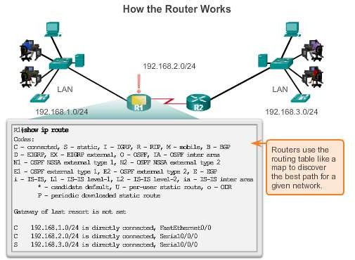
Functions of a Router
Routers Choose Best Paths
Presentation_ID
© 2008 Cisco Systems, Inc. All rights reserved.
Cisco Confidential
<number>

Slide 12
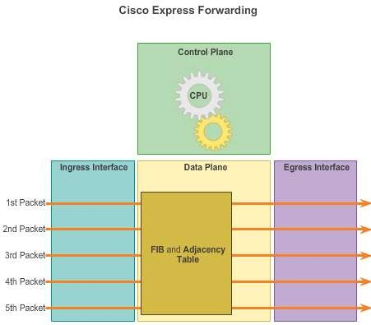
Functions of a Router
Packet Forwarding Methods
Process switching – An older packet forwarding mechanism still available for Cisco routers.
Fast switching – A common packet forwarding mechanism which uses a fast-switching cache to store next hop information.
Cisco Express Forwarding (CEF) – The most recent, fastest, and preferred Cisco IOS packet-forwarding mechanism. Table entries are not packet-triggered like fast switching but change-triggered.
Presentation_ID
© 2008 Cisco Systems, Inc. All rights reserved.
Cisco Confidential
<number>

Slide 13
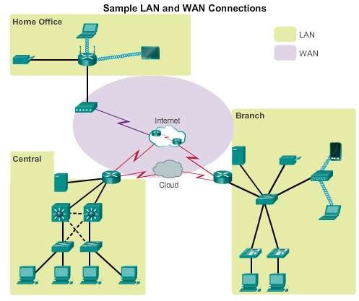
Connect Devices
Connect to a Network
Presentation_ID
© 2008 Cisco Systems, Inc. All rights reserved.
Cisco Confidential
<number>

Slide 14
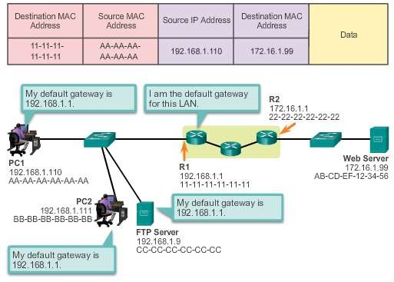
Connect Devices
Default Gateways
To enable network access devices must be configured with the following IP address information
IP address - Identifies a unique host on a local network.
Subnet mask - Identifies the host’s network subnet.
Default gateway - Identifies the router a packet is sent to to when the destination is not on the same local network subnet.
Presentation_ID
© 2008 Cisco Systems, Inc. All rights reserved.
Cisco Confidential
<number>

Slide 15
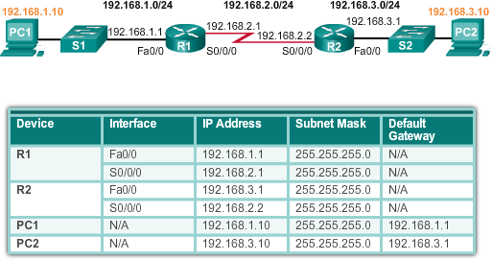
Connect Devices
Document Network Addressing
Network Documentation should include at least the following in a topology diagram and addressing table:
Device names
Interfaces
IP addresses and subnet mask
Default gateways
Presentation_ID
© 2008 Cisco Systems, Inc. All rights reserved.
Cisco Confidential
<number>

Slide 16
Connect Devices
Enable IP on a Host
Statically Assigned IP address – The host is manually assigned an IP address, subnet mask and default gateway. A DNS server IP address can also be assigned.
Used to identify specific network resources such as
network servers and printers.
Can be used in very small networks with few hosts.
Dynamically Assigned IP Address – IP Address information is dynamically assigned by a server using Dynamic Host Configuration Protocol (DHCP).
Most hosts acquire their IP address information through DHCP.
DHCP services can be provided by Cisco routers.
Presentation_ID
© 2008 Cisco Systems, Inc. All rights reserved.
Cisco Confidential
<number>

Slide 17
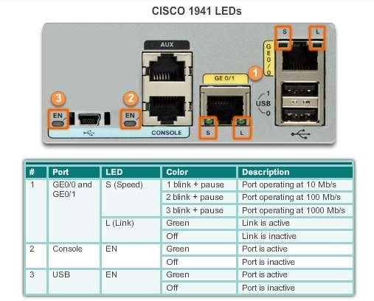
Connect Devices
Device LEDs
Presentation_ID
© 2008 Cisco Systems, Inc. All rights reserved.
Cisco Confidential
<number>

Slide 18
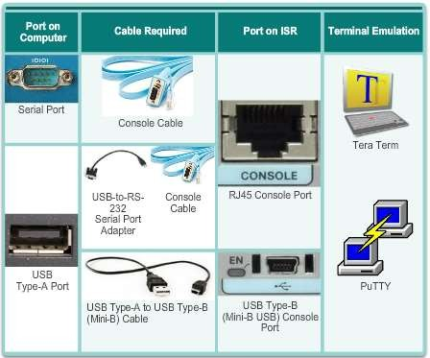
Connect Devices
Console Access
Console access requires:
Console cable – RJ-45-to-DB-9 console cable
Terminal emulation software – Tera Term, PuTTY, HyperTerminal
Presentation_ID
© 2008 Cisco Systems, Inc. All rights reserved.
Cisco Confidential
<number>

Slide 19
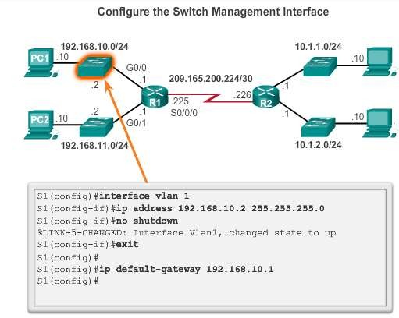
Connect Devices
Enable IP on a Switch
Network infrastructure devices require IP addresses to enable
remote management.
On a switch, the management IP address is assigned on a virtual interface.
Presentation_ID
© 2008 Cisco Systems, Inc. All rights reserved.
Cisco Confidential
<number>

Slide 20
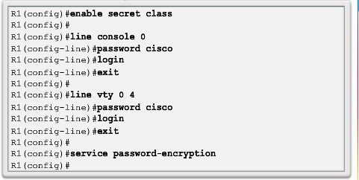
Basic Settings on a Router
Configure Basic Router Settings
Basics tasks that should be first configured on a Cisco Router and Cisco Switch:
Name the device – Distinguishes it from other routers
Secure management access – Secures privileged EXEC, user EXEC, and Telnet access, and encrypts passwords to their highest level
Configure a banner – Provides legal notification of
unauthorized access.
Save the Configuration
Presentation_ID
© 2008 Cisco Systems, Inc. All rights reserved.
Cisco Confidential
<number>

Slide 21
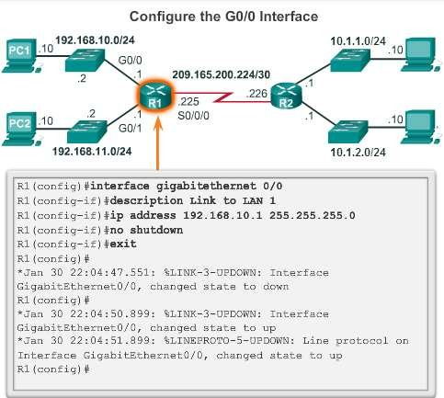
Basic Settings on a Router
Configure an IPv4 Router Interface
To be available, a router interface must be:
Configured with an address and
subnet mask .
Must be activated using no shutdown command. By default LAN and WAN interfaces are not activated.
Serial cable end labeled DCE must be configured with the clock rate command.
Optional description can be included.
Presentation_ID
© 2008 Cisco Systems, Inc. All rights reserved.
Cisco Confidential
<number>

Slide 22
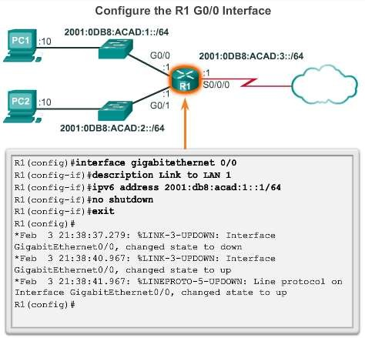
Basic Settings on a Router
Configure an IPv6 Router Interface
To configure interface with IPv6 address and subnet mask:
Use the ipv6 address ipv6- address/ipv6-length [link-local | eui- 64]interface configuration command.
Activate using the no shutdown command.
IPv6 interfaces can support more than
one address:
Configure a specified global unicast -
ipv6-address /ipv6-length
Configure a global IPv6 address with an interface identifier (ID) in the low- order 64 bits - ipv6-address /ipv6- length eui-64
Configure a link-local address - ipv6-
address /ipv6-length link-local
Presentation_ID
© 2008 Cisco Systems, Inc. All rights reserved.
Cisco Confidential
22

Slide 23
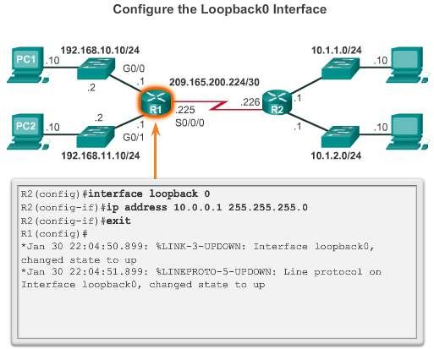
Basic Settings on a Router
Configure a Loopback Interface
A loopback interface is a logical interface that is internal to the router:
It is not assigned to a physical port, it is considered a software interface that is automatically in an UP state.
A loopback interface is useful for testing.
It is important in the OSPF routing process.
Presentation_ID
© 2008 Cisco Systems, Inc. All rights reserved.
Cisco Confidential
<number>

Slide 24
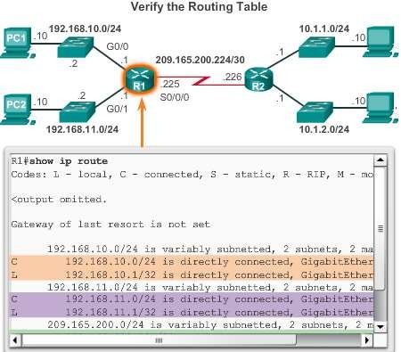
Verify Connectivity of Directly Connected Networks
Verify Interface Settings
Show commands are used to verify operation and configuration of interface:
show ip interfaces brief
show ip route
show running-config
Show commands are used to gather more detailed interface information:
show interfaces
show ip interfaces
Presentation_ID
© 2008 Cisco Systems, Inc. All rights reserved.
Cisco Confidential
<number>

Slide 25
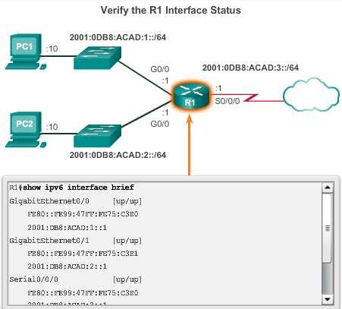
Verify Connectivity of Directly Connected Networks
Verify Interface Settings
Some of the common commands to verify the IPv6 interface configuration are:
show ipv6 interface brief - displays a summary for each of the interfaces.
show ipv6 interface gigabitethernet 0/0 - displays the interface status and all the IPv6 addresses for this interface.
show ipv6 route - verifies that IPv6 networks and specific IPv6 interface addresses have been installed in the IPv6 routing table.
Presentation_ID
© 2008 Cisco Systems, Inc. All rights reserved.
Cisco Confidential
<number>

Slide 26
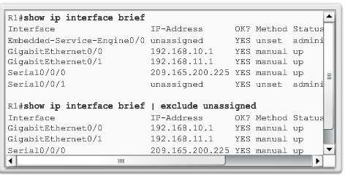
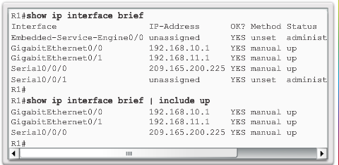
Verify Connectivity of Directly Connected Networks
Filter Show Command Output
Show command output can be managed using the following command and
filters:
Use the terminal length number command to specify the number of lines to be displayed. A value of 0 (zero) prevents the router from pausing between screens of output.
To filter specific output of commands use the (|)pipe character after show
command. Parameters that can be used after pipe include:
section, include, exclude, begin
Presentation_ID
© 2008 Cisco Systems, Inc. All rights reserved.
Cisco Confidential
<number>

Slide 27
Verify Connectivity of Directly Connected Networks
Command History Feature
The command history feature temporarily stores a list of executed
commands for access:
To recall commands press Ctrl+P or the UP Arrow.
To return to more recent commands press Ctrl+N or the Down Arrow.
By default, command history is enabled and the system captures the last 10 commands in the buffer. Use the show history privileged EXEC command to display the buffer contents.
Use the terminal history size user EXEC command to increase or
decrease size of the buffer.
Presentation_ID
© 2008 Cisco Systems, Inc. All rights reserved.
Cisco Confidential
<number>

Slide 28
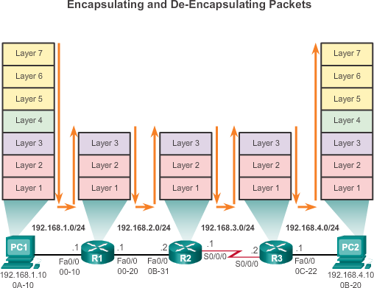
Switching Packets between Networks
Router Switching Functions
Presentation_ID
© 2008 Cisco Systems, Inc. All rights reserved.
Cisco Confidential
<number>

Slide 29
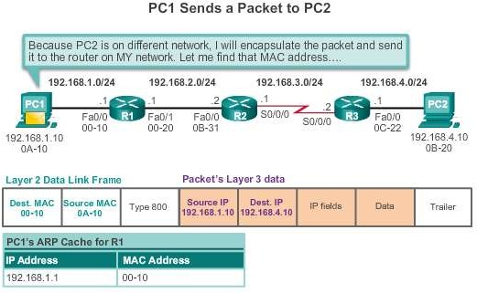
Switching Packets between Networks
Send a Packet
Presentation_ID
© 2008 Cisco Systems, Inc. All rights reserved.
Cisco Confidential
<number>

Slide 30
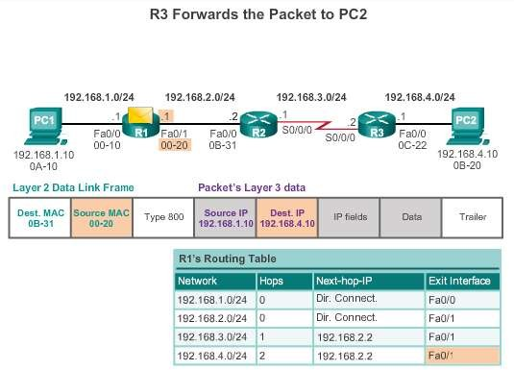
Switching Packets between Networks
Forward to the Next Hop
Presentation_ID
© 2008 Cisco Systems, Inc. All rights reserved.
Cisco Confidential
<number>

Slide 31
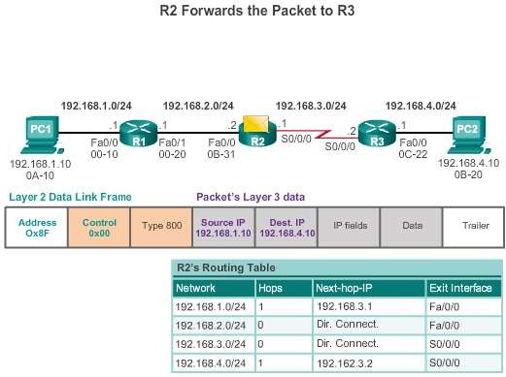
Switching Packets between Networks
Packet Routing
Presentation_ID
© 2008 Cisco Systems, Inc. All rights reserved.
Cisco Confidential
<number>

Slide 32
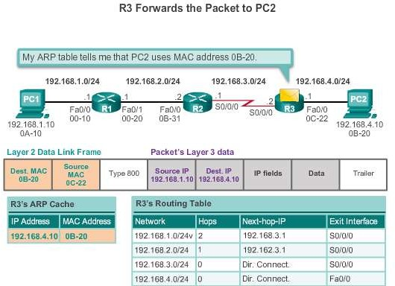
Switching Packets between Networks
Reach the Destination
Presentation_ID
© 2008 Cisco Systems, Inc. All rights reserved.
Cisco Confidential
<number>

Slide 33
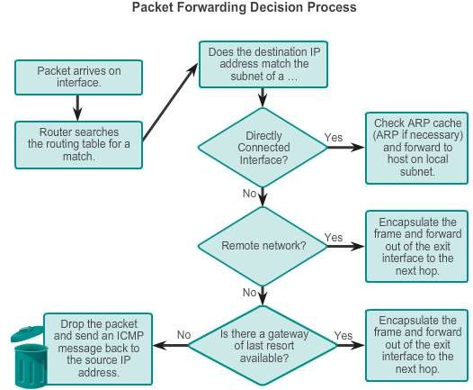
Path Determination
Routing Decisions
Presentation_ID
© 2008 Cisco Systems, Inc. All rights reserved.
Cisco Confidential
<number>

Slide 34
Path Determination
Best Path
Best path is selected by a routing protocol based on the value or metric it uses to determine the distance to reach a network:
A metric is the value used to measure the distance to a given
network.
Best path to a network is the path with the lowest metric.
Dynamic routing protocols use their own rules and metrics to build and update routing tables:
Routing Information Protocol (RIP) - Hop count
Open Shortest Path First (OSPF) - Cost based on cumulative bandwidth from source to destination
Enhanced Interior Gateway Routing Protocol (EIGRP) - Bandwidth, delay, load, reliability
Presentation_ID
© 2008 Cisco Systems, Inc. All rights reserved.
Cisco Confidential
<number>

Slide 35
Path Determination
Load Balancing
When a router has two or more paths to a destination with equal cost metrics, then the router forwards the packets using both paths equally:
Equal cost load balancing can improve network performance.
Equal cost load balancing can be configured to use both dynamic routing protocols and static routes.
RIP, OSPF and EIGRP support equal cost load balancing.
Presentation_ID
© 2008 Cisco Systems, Inc. All rights reserved.
Cisco Confidential
<number>

Slide 36
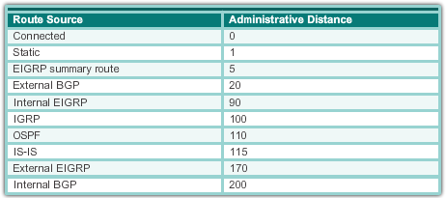
Path Determination of the route
Administrative Distance
If multiple paths to a destination are configured on a router, the path installed in the routing table is the one with the lowest Administrative Distance (AD):
A static route with an AD of 1 is more reliable than an EIGRP- discovered route with an AD of 90.
A directly connected route with an AD of 0 is more reliable than a
static route with an AD of 1.
Presentation_ID
© 2008 Cisco Systems, Inc. All rights reserved.
Cisco Confidential
<number>

Slide 37
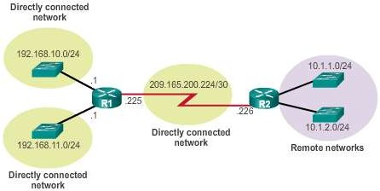
The Routing Table
The Routing Table
A routing table is a file stored in RAM that contains information about:
Directly connected routes
Remote routes
Network or next hop associations
Presentation_ID
© 2008 Cisco Systems, Inc. All rights reserved.
Cisco Confidential
<number>

Slide 38
The Routing Table
Routing Table Sources
The show ip route command is used to display the contents of the routing table:
Local route interfaces - Added to the routing table when an interface is configured. (displayed in IOS 15 or newer)
Directly connected interfaces - Added to the routing table when an interface is configured and active.
Static routes - Added when a route is manually configured and the exit interface is active.
Dynamic routing protocol - Added when EIGRP or OSPF are implemented and networks are identified.
Presentation_ID
© 2008 Cisco Systems, Inc. All rights reserved.
Cisco Confidential
<number>

Slide 39
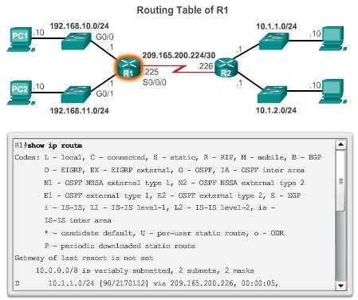
The Routing Table
Routing Table Sources
Presentation_ID
© 2008 Cisco Systems, Inc. All rights reserved.
Cisco Confidential
<number>

Slide 40
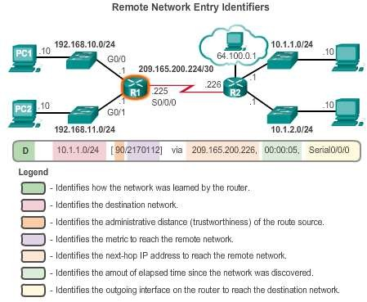
The Routing Table
Remote Network Routing Entries
Interpreting the entries in the routing table.
Presentation_ID
© 2008 Cisco Systems, Inc. All rights reserved.
Cisco Confidential
<number>

Slide 41
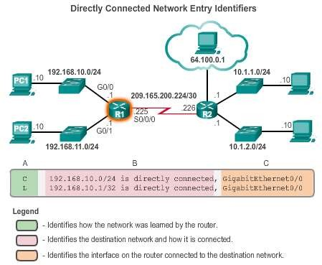
Directly Connected Routes
Directly Connected Interfaces
A newly deployed router, without any configured interfaces, has an empty routing table. An active, configured, directly connected interface creates two routing table entries:
Link Local (L)
Directly Connected (C)
Presentation_ID
© 2008 Cisco Systems, Inc. All rights reserved.
Cisco Confidential
<number>

Slide 42
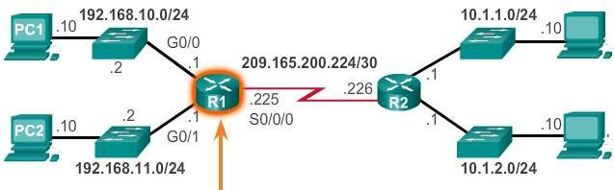
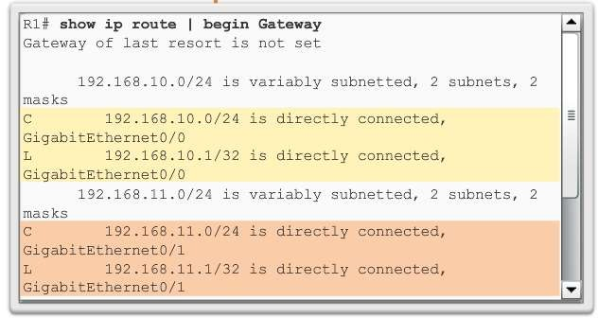
Directly Connected Routes
Directly Connected Example
A routing table with the directly connected interfaces of R1 configured and activated.
Presentation_ID
© 2008 Cisco Systems, Inc. All rights reserved.
Cisco Confidential
<number>

Slide 43
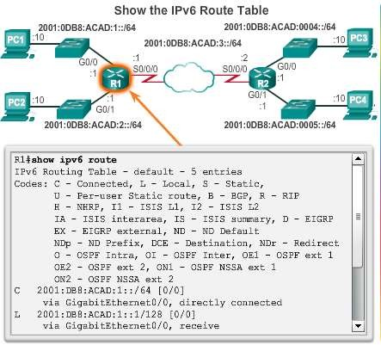
Directly Connected Routes
Directly Connected IPv6 Example
The show ipv6 route command shows the ipv6 networks and routes installed in the routing table.
Presentation_ID
© 2008 Cisco Systems, Inc. All rights reserved.
Cisco Confidential
<number>

Slide 44
Statically Learned Routes
Static Routes
Static routes and default static routes can be implemented after directly connected interfaces are added to the routing table:
Static routes are manually configured
They define an explicit path between two networking devices.
Static routes must be manually updated if the topology changes.
Their benefits include improved security and control of resources.
Configure a static route to a specific network using the ip route
network mask {next-hop-ip | exit-intf} command.
A default static route is used when the routing table does not contain a path for a destination network.
Configure a default static route using the ip route 0.0.0.0
0.0.0.0 {exit-intf | next-hop-ip} command.
Presentation_ID
© 2008 Cisco Systems, Inc. All rights reserved.
Cisco Confidential
<number>

Slide 45
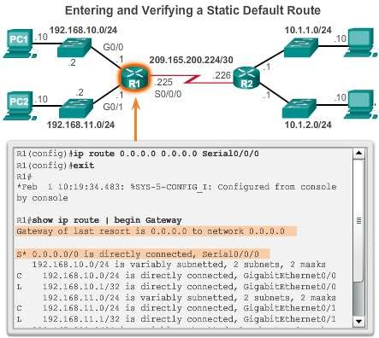
Statically Learned Routes
Default Static Routes Example
Presentation_ID
© 2008 Cisco Systems, Inc. All rights reserved.
Cisco Confidential
<number>

Slide 46
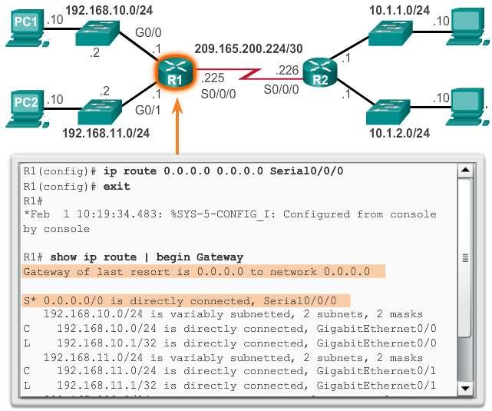
Statically Learned Routes
Static Routes Example
Presentation_ID
© 2008 Cisco Systems, Inc. All rights reserved.
Cisco Confidential
<number>

Slide 47
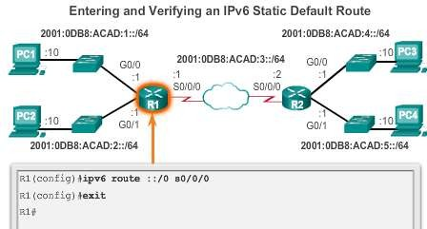
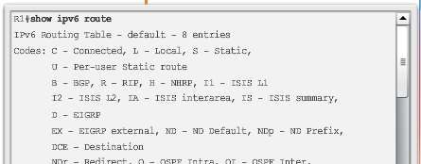
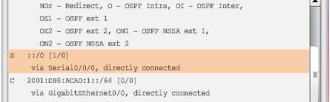
Statically Learned Routes
Static IPv6 Routes Example
Presentation_ID
© 2008 Cisco Systems, Inc. All rights reserved.
Cisco Confidential
<number>

Slide 48
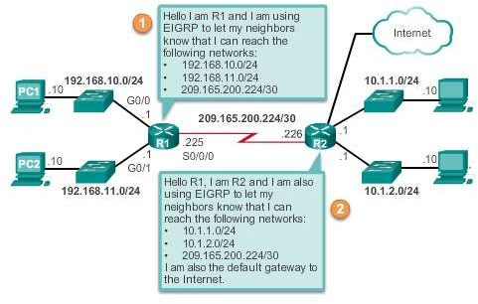
Dynamic Routing Protocols
Dynamic Routing
Dynamic routing is used by routers to share information about the reachability and status of remote networks. It performs network discovery and maintains routing tables.
Presentation_ID
© 2008 Cisco Systems, Inc. All rights reserved.
Cisco Confidential
<number>

Slide 49
Dynamic Routing Protocols
IPv4 Routing Protocols
Cisco ISR routers can support a variety of dynamic IPv4 routing protocols including:
EIGRP – Enhanced Interior Gateway Routing Protocol
OSPF – Open Shortest Path First
IS-IS – Intermediate System-to-Intermediate System
RIP – Routing Information Protocol
Presentation_ID
© 2008 Cisco Systems, Inc. All rights reserved.
Cisco Confidential
<number>

Slide 50
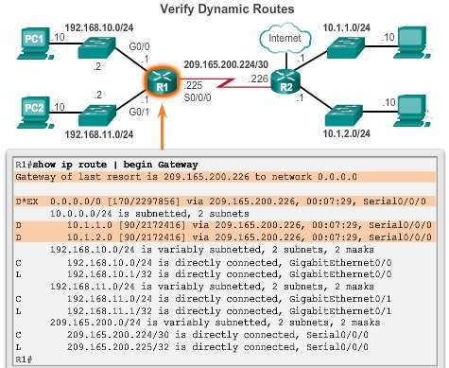
Dynamic Routing Protocols
IPv4 Routing Protocols
Presentation_ID
© 2008 Cisco Systems, Inc. All rights reserved.
Cisco Confidential
<number>

Slide 51
Dynamic Routing Protocols
IPv6 Routing Protocols
Cisco ISR routers can support a variety of dynamic IPv6 routing
protocols including:
RIPng - RIP next generation
OSPFv3
EIGRP for IPv6
MP-BGP4 - Multicast Protocol-Border Gateway Protocol
Presentation_ID
© 2008 Cisco Systems, Inc. All rights reserved.
Cisco Confidential
<number>

Slide 52
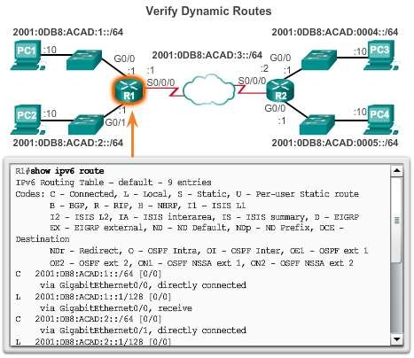
Dynamic Routing Protocols
IPv6 Routing Protocols
Presentation_ID
© 2008 Cisco Systems, Inc. All rights reserved.
Cisco Confidential
<number>

Slide 53
Chapter 4: Summary
There are many key structures and performance-related characteristics referred to when discussing networks: topology, speed, cost, security, availability, scalability, and reliability.
Cisco routers and Cisco switches have many similarities. They support a similar modal operating system, similar command structures, and many of the same commands.
One distinguishing feature between switches and routers is the type
of interfaces supported by each.
The main purpose of a router is to connect multiple networks and forward packets from one network to the next. This means that a router typically has multiple interfaces. Each interface is a member or host on a different IP network.
Presentation_ID
© 2008 Cisco Systems, Inc. All rights reserved.
Cisco Confidential
<number>

Slide 54
Chapter 4: Summary (cont.)
The routing table is a list of networks known by the router.
A remote network is a network that can only be reached by
forwarding the packet to another router.
Remote networks are added to the routing table in two ways: either by the network administrator manually configuring static routes or by implementing a dynamic routing protocol.
Static routes do not have as much overhead as dynamic routing protocols; however, static routes can require more maintenance if the topology is constantly changing or is unstable.
Dynamic routing protocols automatically adjust to changes without any intervention from the network administrator. Dynamic routing protocols require more CPU processing and also use a certain amount of link capacity for routing updates and messages.
Presentation_ID
© 2008 Cisco Systems, Inc. All rights reserved.
Cisco Confidential
<number>

Slide 55
Chapter 4: Summary (cont.)
Routers make their primary forwarding decision at Layer 3, the Network layer. However, router interfaces participate in Layers 1, 2, and 3. Layer 3 IP packets are encapsulated into a Layer 2 data link frame and encoded into bits at Layer 1.
Router interfaces participate in Layer 2 processes associated with their encapsulation. For example, an Ethernet interface on a router participates in the ARP process like other hosts on that LAN.
Components of the IPv6 routing table are very similar to the IPv4 routing table. For instance, it is populated using directly connected interfaces, static routes and dynamically learned routes.
Presentation_ID
© 2008 Cisco Systems, Inc. All rights reserved.
Cisco Confidential
<number>

Slide 56
Presentation_ID
© 2008 Cisco Systems, Inc. All rights reserved.
Cisco Confidential
<number>

