Slide 1



Chapter 10: DHCP
Routing & Switching
Instructor:
Nguyen Anh Minh
M.Sc CCNP TOGAF
Presentation_ID
© 2008 Cisco Systems, Inc. All rights reserved.
Cisco Confidential
<number>

Slide 2
Chapter 10
Introduction
Dynamic Host Configuration Protocol v4
Dynamic Host Configuration Protocol v6
Summary
Presentation_ID
© 2008 Cisco Systems, Inc. All rights reserved.
Cisco Confidential
<number>

Slide 3
Chapter 10: Objectives
Describe the operation of DHCPv4 in a small-to-medium-sized
business network.
Configure a router as a DHCPv4 server.
Configure a router as a DHCPv4 client.
Troubleshoot a DHCP configuration for IPv4 in a switched network.
Explain the operation of DHCPv6.
Configure a stateless DHCPv6 for a small-to-medium-sized business.
Configure a stateful DHCPv6 for a small-to-medium-sized
business.
Troubleshoot a DHCP configuration for IPv6 in a switched network.
Presentation_ID
© 2008 Cisco Systems, Inc. All rights reserved.
Cisco Confidential
<number>

Slide 4
10.1 Dynamic Host Configuration Protocol v4
Presentation_ID
© 2008 Cisco Systems, Inc. All rights reserved.
Cisco Confidential
<number>

Slide 5
DHCPv4 Operation
Introducing DHCPv4
DHCPv4 uses three different address allocation methods:
Manual Allocation – The administrator assigns a pre-allocated IPv4 address to the client, and DHCPv4 communicates only the IPv4 address to the device.
Automatic Allocation – DHCPv4 automatically assigns a static IPv4 address permanently to a device, selecting it from a pool of available addresses.
Dynamic Allocation – DHCPv4 dynamically assigns, or leases, an IPv4 address from a pool of addresses for a limited period of time chosen by the server, or until the client no longer needs the address. This method is the most commonly used.
Presentation_ID
© 2008 Cisco Systems, Inc. All rights reserved.
Cisco Confidential
<number>

Slide 6
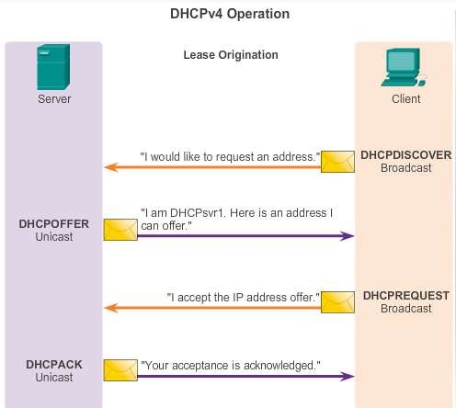
DHCPv4 Operation
DHCPv4 Operation
Presentation_ID
© 2008 Cisco Systems, Inc. All rights reserved.
Cisco Confidential
<number>

Slide 7
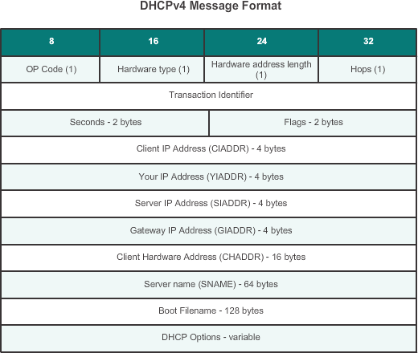
DHCPv4 Operation
DHCPv4 Message Format
Presentation_ID
© 2008 Cisco Systems, Inc. All rights reserved.
Cisco Confidential
<number>

Slide 8
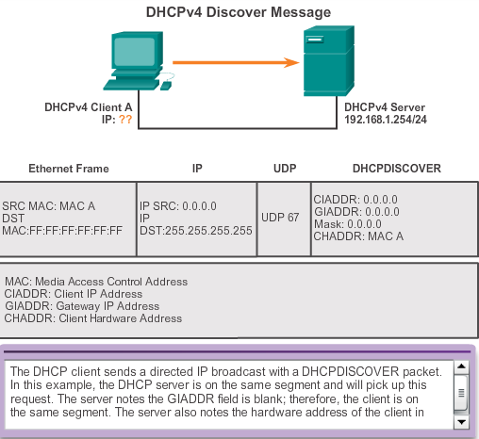
DHCPv4 Operation
Format DHCPv4 Discover and Offer Messages
Presentation_ID
© 2008 Cisco Systems, Inc. All rights reserved.
Cisco Confidential
<number>

Slide 9
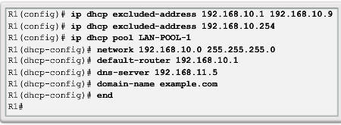
DHCPv4 Operation
Configuring a DHCPv4 Server
A Cisco router running the Cisco IOS software can be configured to act as a DHCPv4 server. To set up DHCP:
Exclude addresses from the pool.
Set up the DHCP pool name.
Define the range of addresses and subnet mask. Use the default-router command for the default gateway. Optional parameters that can be included in the pool – dns server, domain-name.
To disable DHCP, use the no service dhcp command.
Presentation_ID
© 2008 Cisco Systems, Inc. All rights reserved.
Cisco Confidential
<number>

Slide 10
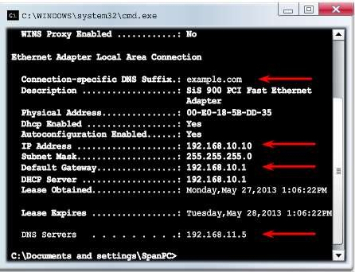
DHCPv4 Operation
Verifying a DHCPv4 Server
Commands to verify DHCP:
show running-config | section dhcp
show ip dhcp binding
show ip dhcp server statistics
On the PC, issue the ipconfig /all command.
Presentation_ID
© 2008 Cisco Systems, Inc. All rights reserved.
Cisco Confidential
<number>

Slide 11
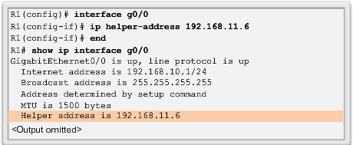
DHCPv4 Operation
DHCPv4 Relay
Using an IP helper address enables a router to forward DHCPv4 broadcasts to the DHCPv4 server. Acting as a relay.
Presentation_ID
© 2008 Cisco Systems, Inc. All rights reserved.
Cisco Confidential
<number>

Slide 12
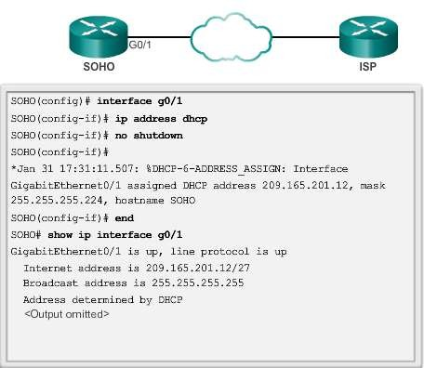
Configuring a DHCPv4 Client
Configuring a Router as a DHCPv4 Client
Presentation_ID
© 2008 Cisco Systems, Inc. All rights reserved.
Cisco Confidential
<number>

Slide 13
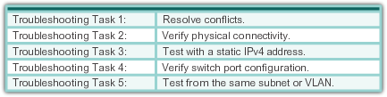
Troubleshoot DHCPv4
Troubleshooting Tasks
Presentation_ID
© 2008 Cisco Systems, Inc. All rights reserved.
Cisco Confidential
<number>

Slide 14
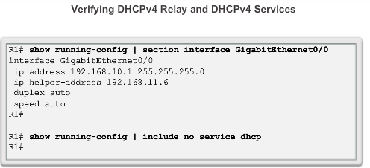
Troubleshoot DHCPv4
Verifying the Router DHCPv4 Configuration
Presentation_ID
© 2008 Cisco Systems, Inc. All rights reserved.
Cisco Confidential
<number>

Slide 15
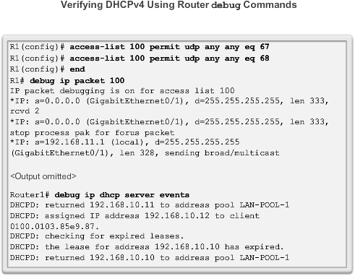
Troubleshoot DHCPv4
Debugging DHCPv4
Presentation_ID
© 2008 Cisco Systems, Inc. All rights reserved.
Cisco Confidential
<number>

Slide 16
10.2 Dynamic Host Configuration Protocol v6
Presentation_ID
© 2008 Cisco Systems, Inc. All rights reserved.
Cisco Confidential
<number>

Slide 17
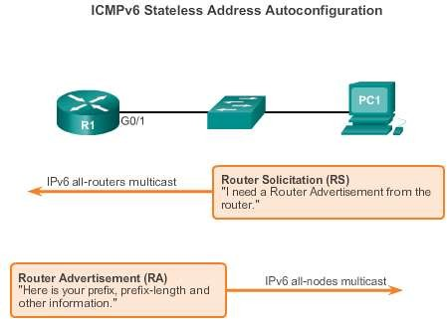
SLAAC and DHCPv6
Stateless Address Autoconfiguration
Stateless Address Autoconfiguration (SLAAC) is a method in which a device can obtain an IPv6 global unicast address without the services of a DHCPv6 server.
Presentation_ID
© 2008 Cisco Systems, Inc. All rights reserved.
Cisco Confidential
<number>

Slide 18
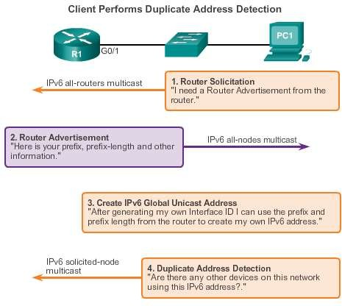
SLAAC and DHCPv6
SLAAC Operation
Presentation_ID
© 2008 Cisco Systems, Inc. All rights reserved.
Cisco Confidential
<number>

Slide 19
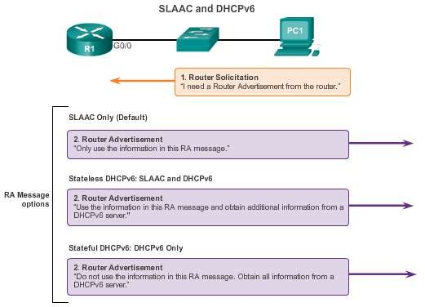
SLAAC and DHCPv6
SLAAC and DHCPv6
Presentation_ID
© 2008 Cisco Systems, Inc. All rights reserved.
Cisco Confidential
<number>

Slide 20
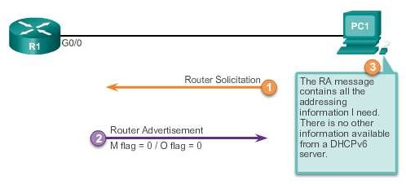
SLAAC and DHCPv6
SLAAC Option
Presentation_ID
© 2008 Cisco Systems, Inc. All rights reserved.
Cisco Confidential
<number>

Slide 21
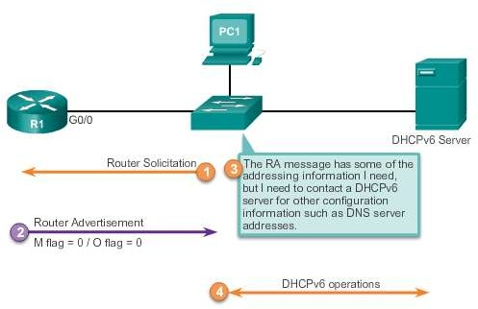
SLAAC and DHCPv6
Stateless DHCP Option
Presentation_ID
© 2008 Cisco Systems, Inc. All rights reserved.
Cisco Confidential
<number>

Slide 22
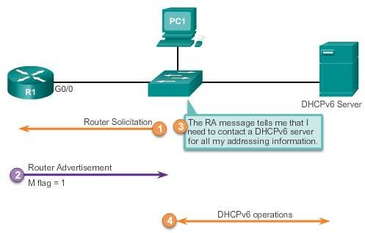
SLAAC and DHCPv6
Stateful DHCP Option
Presentation_ID
© 2008 Cisco Systems, Inc. All rights reserved.
Cisco Confidential
<number>

Slide 23
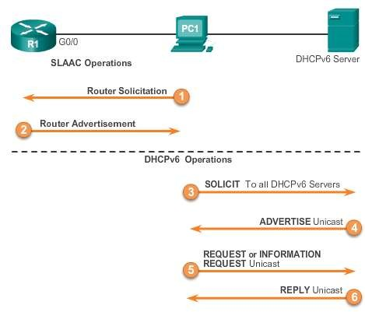
SLAAC and DHCPv6
DHCPv6 Operations
Presentation_ID
© 2008 Cisco Systems, Inc. All rights reserved.
Cisco Confidential
<number>

Slide 24
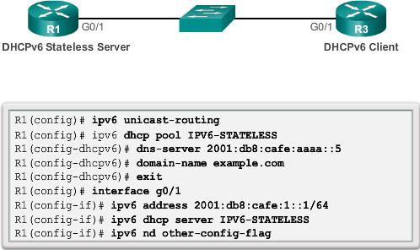
Stateless DHCPv6
Configuring a Router as a Stateless DHCPv6 Server
Presentation_ID
© 2008 Cisco Systems, Inc. All rights reserved.
Cisco Confidential
<number>

Slide 25
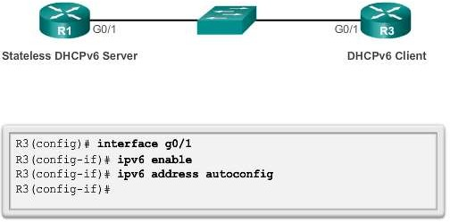
Stateless DHCPv6
Configuring a Router as a Stateless DHCPv6 Client
Presentation_ID
© 2008 Cisco Systems, Inc. All rights reserved.
Cisco Confidential
<number>

Slide 26
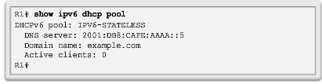
Stateless DHCPv6
Verifying Stateless DHCPv6
Verify the stateless DHCP client using the following commands:
show IPv6 interface
debug ipv6 dhcp detail
Presentation_ID
© 2008 Cisco Systems, Inc. All rights reserved.
Cisco Confidential
<number>

Slide 27
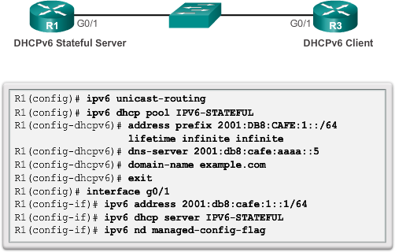
Stateful DHCPv6
Configuring a Router as a Stateful DHCPv6 Server
Presentation_ID
© 2008 Cisco Systems, Inc. All rights reserved.
Cisco Confidential
<number>

Slide 28
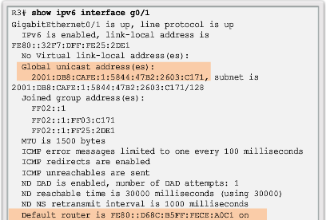
Stateful DHCPv6
Verifying Stateful DHCPv6
Verify the stateful DHCPv6 server using the following commands:
show ipv6 dhcp pool
show ipv6 dhcp binding
Verify the stateful DHCPv6 client using the show ipv6 interface command.
Presentation_ID
© 2008 Cisco Systems, Inc. All rights reserved.
Cisco Confidential
<number>

Slide 29
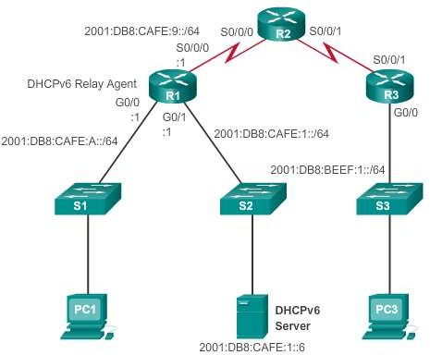
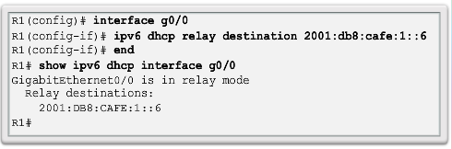
Stateful DHCPv6
Configuring a Router as a Stateful DHCPv6 Relay Agent
Presentation_ID
© 2008 Cisco Systems, Inc. All rights reserved.
Cisco Confidential
<number>

Slide 30
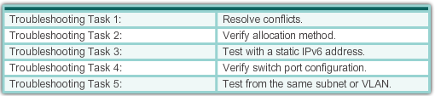
Troubleshooting DHCPv6
Troubleshooting Tasks
Presentation_ID
© 2008 Cisco Systems, Inc. All rights reserved.
Cisco Confidential
<number>

Slide 31
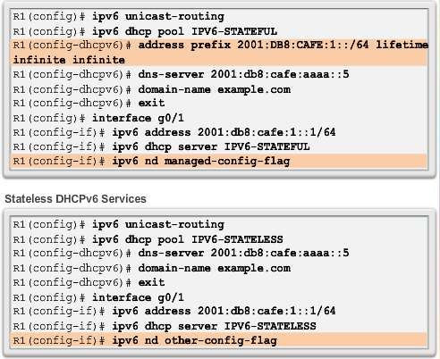
Troubleshooting DHCPv6
Verifying the Router DHCPv6 Configuration
Presentation_ID
© 2008 Cisco Systems, Inc. All rights reserved.
Cisco Confidential
<number>

Slide 32
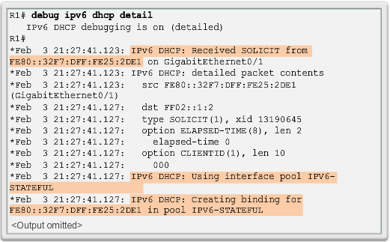
Troubleshooting DHCPv6
Debugging DHCPv6
Presentation_ID
© 2008 Cisco Systems, Inc. All rights reserved.
Cisco Confidential
<number>

Slide 33
10.3 Summary
Presentation_ID
© 2008 Cisco Systems, Inc. All rights reserved.
Cisco Confidential
<number>

Slide 34
Chapter 10: Summary
All nodes on a network require a unique IP address to communicate with other devices.
DHCPv4 includes three different address allocation methods:
Manual Allocation Automatic Allocation Dynamic Allocation
There are two methods available for the dynamic configuration of IPv6 global unicast addresses:
Stateless Address Autoconfiguration (SLAAC) Dynamic Host Configuration Protocol for IPv6 (Stateful
DHCPv6)
Presentation_ID
© 2008 Cisco Systems, Inc. All rights reserved.
Cisco Confidential
<number>

Slide 35
Chapter 10: Summary (cont.)
The same tasks are involved when troubleshooting DHCPv4 and
DHCPv6:
Resolve address conflicts.
Verify physical connectivity.
Test connectivity using a static IP address.
Verify the switch port configuration.
Test the operation on the same subnet or VLAN.
Presentation_ID
© 2008 Cisco Systems, Inc. All rights reserved.
Cisco Confidential
<number>

Slide 36
Presentation_ID
© 2008 Cisco Systems, Inc. All rights reserved.
Cisco Confidential
<number>

