Slide 1



Chapter 11: Network Address Translation for IPv4
Routing & Switching
Instructor:
Nguyen Anh Minh
M.Sc CCNP TOGAF
Presentation_ID
© 2008 Cisco Systems, Inc. All rights reserved.
Cisco Confidential
<number>

Slide 2
Chapter 11
NAT Operation
Configuring NAT
Troubleshooting NAT
Summary
Presentation_ID
© 2008 Cisco Systems, Inc. All rights reserved.
Cisco Confidential
<number>

Slide 3
Chapter 11: Objectives
Describe NAT characteristics.
Describe the benefits and drawbacks of NAT.
Configure static NAT using the CLI.
Configure dynamic NAT using the CLI.
Configure PAT using the CLI.
Configure port forwarding using the CLI.
Configure NAT64.
Use show commands to verify NAT operation.
Presentation_ID
© 2008 Cisco Systems, Inc. All rights reserved.
Cisco Confidential
<number>

Slide 4
11.1 NAT Operation
Presentation_ID
© 2008 Cisco Systems, Inc. All rights reserved.
Cisco Confidential
<number>

Slide 5
NAT Characteristics
IPv4 Private Address Space
IPv4 address space is not big enough to uniquely address all the devices that must be connected to the Internet.
Network private addresses are described in RFC 1918 and are to
designed to be used within an organization or site only.
Private addresses are not routed by Internet routers while public addresses are.
Private addresses can alleviate IPv4 scarcity, but because they aren’t
routed by Internet devices, they first need to be translated.
NAT is process used to perform such translation.
Presentation_ID
© 2008 Cisco Systems, Inc. All rights reserved.
Cisco Confidential
<number>

Slide 6
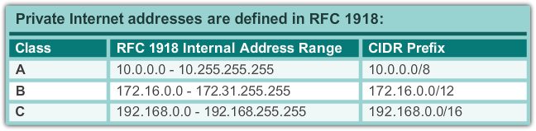
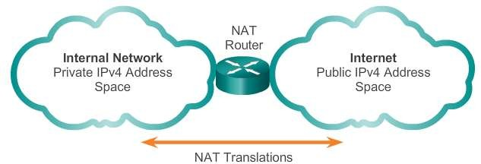
NAT Characteristics
IPv4 Private Address Space
Presentation_ID
© 2008 Cisco Systems, Inc. All rights reserved.
Cisco Confidential
<number>

Slide 7
NAT Characteristics
What is NAT?
NAT is a process used to translate network addresses.
NAT’s primary use is to conserve public IPv4 addresses.
NAT is usually implemented at border network devices, such as
firewalls or routers.
NAT allows the networks to use private addresses internally, only translating to public addresses when needed.
Devices within the organization can be assigned private addresses
and operate with locally unique addresses.
When traffic must be sent or received to or from other organizations or the Internet, the border router translates the addresses to a public and globally unique address.
Presentation_ID
© 2008 Cisco Systems, Inc. All rights reserved.
Cisco Confidential
<number>

Slide 8
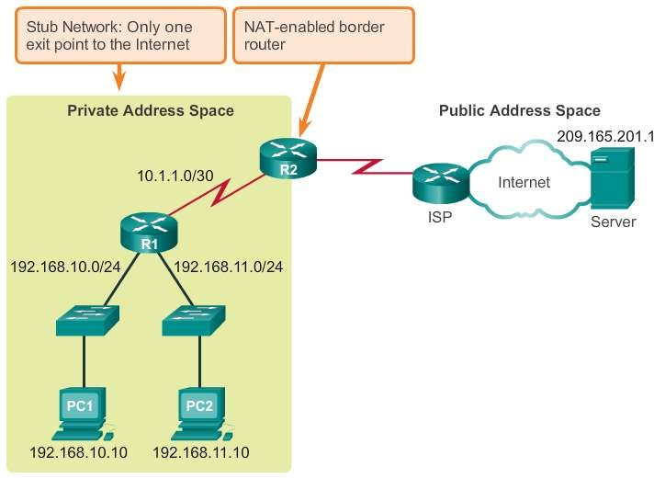
NAT Characteristics
What is NAT? (cont.)
Presentation_ID
© 2008 Cisco Systems, Inc. All rights reserved.
Cisco Confidential
<number>

Slide 9
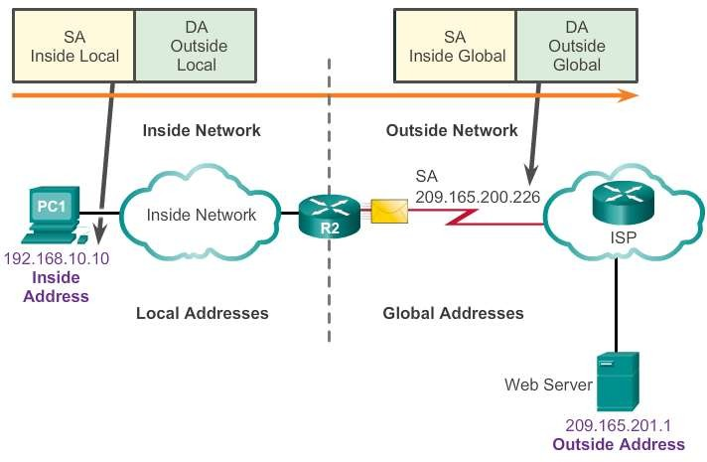
NAT Characteristics
NAT Terminology
Inside network is the set of devices using private addresses
Outside network refers to all
other networks
NAT includes four types of addresses:
Inside local address
Inside global address
Outside local address
Outside global address
Presentation_ID
© 2008 Cisco Systems, Inc. All rights reserved.
Cisco Confidential
<number>

Slide 10
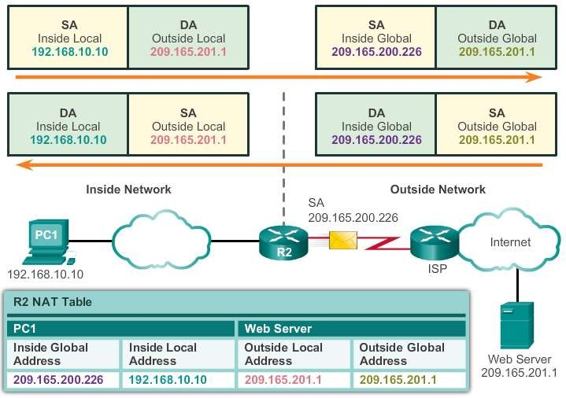
NAT Characteristics
NAT Terminology (cont.)
Presentation_ID
© 2008 Cisco Systems, Inc. All rights reserved.
Cisco Confidential
<number>

Slide 11
Types of NAT
Static NAT
Static NAT uses a one-to-one mapping of local and global addresses.
These mappings are configured by the network administrator and remain constant.
Static NAT is particularly useful when servers hosted in the inside
network must be accessible from the outside network.
A network administrator can SSH to a server in the inside network by pointing the SSH client to the proper inside global address.
Presentation_ID
© 2008 Cisco Systems, Inc. All rights reserved.
Cisco Confidential
<number>

Slide 12
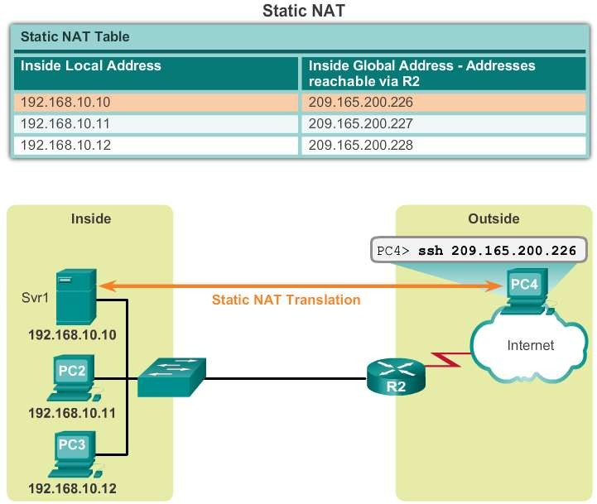
Types of NAT
Static NAT (cont.)
Presentation_ID
© 2008 Cisco Systems, Inc. All rights reserved.
Cisco Confidential
<number>

Slide 13
Types of NAT
Dynamic NAT
Dynamic NAT uses a pool of public addresses and assigns them on a first-come, first-served basis.
When an inside device requests access to an outside network, dynamic NAT assigns an available public IPv4 address from the pool.
Dynamic NAT requires that enough public addresses are available to satisfy the total number of simultaneous user sessions.
Presentation_ID
© 2008 Cisco Systems, Inc. All rights reserved.
Cisco Confidential
<number>

Slide 14
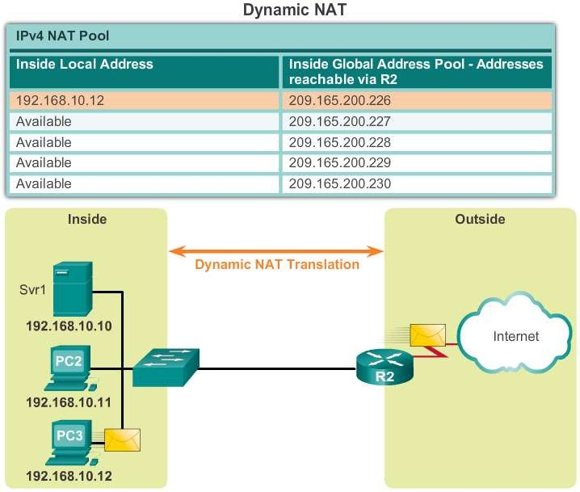
Types of NAT
Dynamic NAT (cont.)
Presentation_ID
© 2008 Cisco Systems, Inc. All rights reserved.
Cisco Confidential
<number>

Slide 15
Types of NAT
Port Address Translation
Port Address Translation (PAT) maps multiple private IPv4 addresses to a single public IPv4 address or a few addresses.
PAT uses the pair source port and source IP address to keep track
of what traffic belongs to what internal client.
PAT is also known as NAT overload.
By also using the port number, PAT forwards the response packets to the correct internal device.
The PAT process also validates that the incoming packets were
requested, thus adding a degree of security to the session.
Presentation_ID
© 2008 Cisco Systems, Inc. All rights reserved.
Cisco Confidential
<number>

Slide 16
Types of NAT
Comparing NAT and PAT
NAT translates IPv4 addresses on a 1:1 basis between private IPv4
addresses and public IPv4 addresses.
PAT modifies both the address and the port number.
NAT forwards incoming packets to their inside destination by referring to the incoming source IPv4 address provided by the host on the public network.
With PAT, there is generally only one or a very few publicly exposed IPv4 addresses.
PAT is able to translate protocols that do not use port numbers, such as ICMP; each one of these protocols is supported differently by PAT.
Presentation_ID
© 2008 Cisco Systems, Inc. All rights reserved.
Cisco Confidential
<number>

Slide 17
Benefits of NAT
Benefits of NAT
Conserves the legally registered addressing scheme
Increases the flexibility of connections to the public network
Provides consistency for internal network addressing schemes
Provides network security
Presentation_ID
© 2008 Cisco Systems, Inc. All rights reserved.
Cisco Confidential
<number>

Slide 18
Benefits of NAT
Disadvantages of NAT
Performance is degraded
End-to-end functionality is degraded
End-to-end IP traceability is lost
Tunneling is more complicated
Initiating TCP connections can be disrupted
Presentation_ID
© 2008 Cisco Systems, Inc. All rights reserved.
Cisco Confidential
<number>

Slide 19
11.2 Configuring NAT
Presentation_ID
© 2008 Cisco Systems, Inc. All rights reserved.
Cisco Confidential
<number>

Slide 20
Configuring Static NAT
Configuring Static NAT
There are two basic tasks to perform when configuring static NAT translations:
Create the mapping between the inside local and outside local addresses.
Define which interfaces belong to the inside network and which belong to the outside network.
Presentation_ID
© 2008 Cisco Systems, Inc. All rights reserved.
Cisco Confidential
<number>

Slide 21
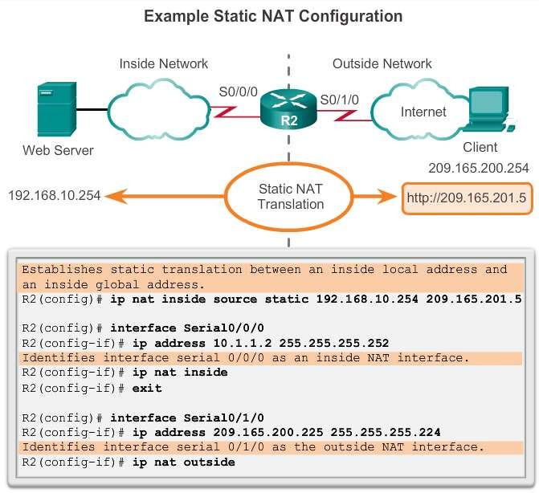
Configuring Static NAT
Configuring Static NAT
Presentation_ID
© 2008 Cisco Systems, Inc. All rights reserved.
Cisco Confidential
<number>

Slide 22
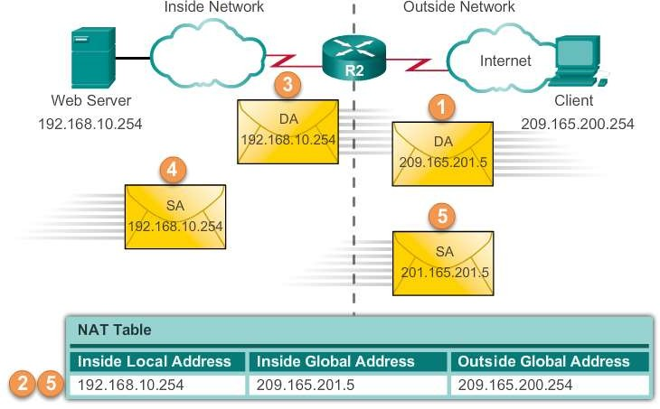
Configuring Static NAT
Analyzing Static NAT
Presentation_ID
© 2008 Cisco Systems, Inc. All rights reserved.
Cisco Confidential
<number>

Slide 23
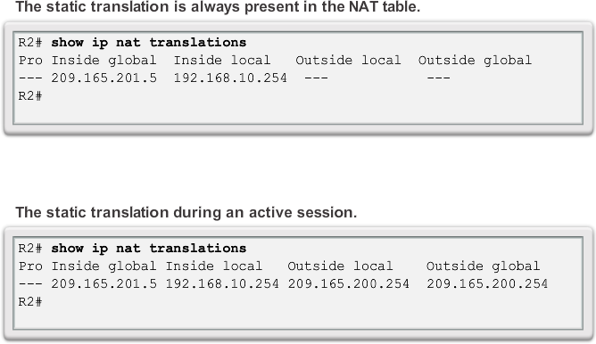
Configuring Static NAT
Verifying Static NAT
Presentation_ID
© 2008 Cisco Systems, Inc. All rights reserved.
Cisco Confidential
<number>

Slide 24
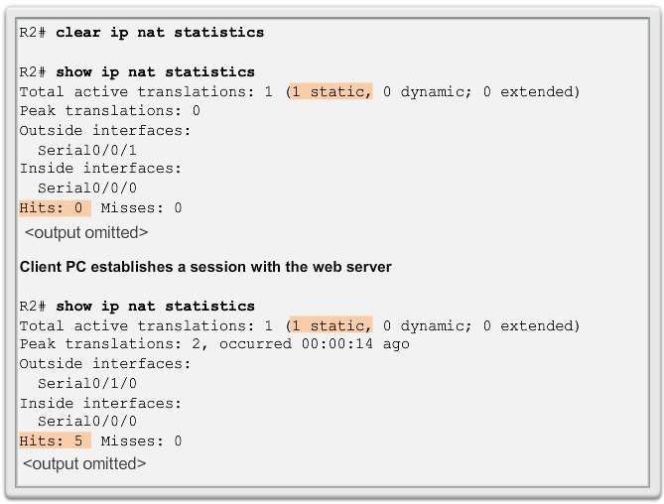
Configuring Static NAT
Verifying Static NAT (cont.)
Presentation_ID
© 2008 Cisco Systems, Inc. All rights reserved.
Cisco Confidential
<number>

Slide 25
Configuring Dynamic NAT
Dynamic NAT Operation
The pool of public IPv4 addresses (inside global address pool) is available to any device on the inside network on a first-come, first- served basis.
With dynamic NAT, a single inside address is translated to a single
outside address.
The pool must be large enough to accommodate all inside devices.
A device is unable to communicate to any external networks if no
addresses are available in the pool.
Presentation_ID
© 2008 Cisco Systems, Inc. All rights reserved.
Cisco Confidential
<number>

Slide 26
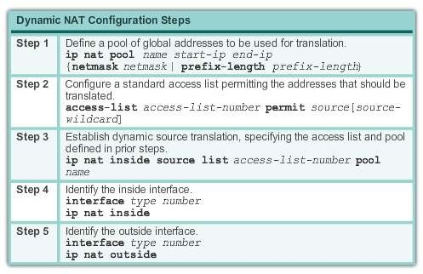
Configuring Dynamic NAT
Configuring Dynamic NAT
Presentation_ID
© 2008 Cisco Systems, Inc. All rights reserved.
Cisco Confidential
<number>

Slide 27
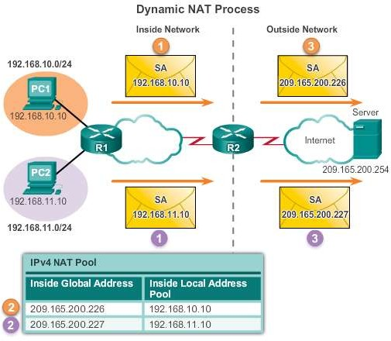
Configuring Dynamic NAT
Analyzing Dynamic NAT
Presentation_ID
© 2008 Cisco Systems, Inc. All rights reserved.
Cisco Confidential
<number>

Slide 28
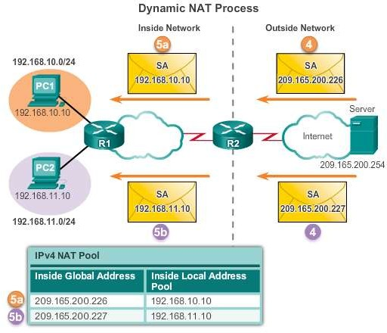
Configuring Dynamic NAT
Analyzing Dynamic NAT
Presentation_ID
© 2008 Cisco Systems, Inc. All rights reserved.
Cisco Confidential
<number>

Slide 29
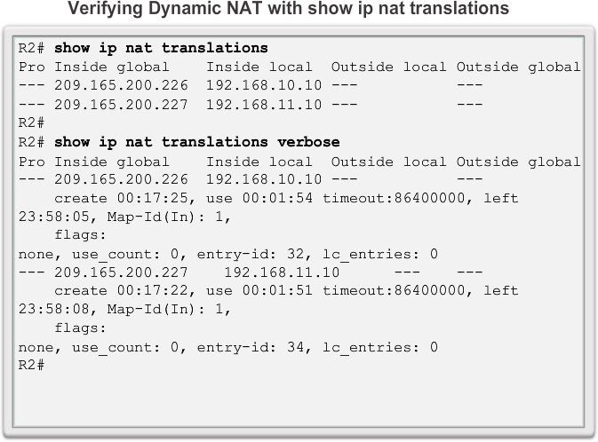
Configuring Dynamic NAT
Verifying Dynamic NAT
Presentation_ID
© 2008 Cisco Systems, Inc. All rights reserved.
Cisco Confidential
<number>

Slide 30
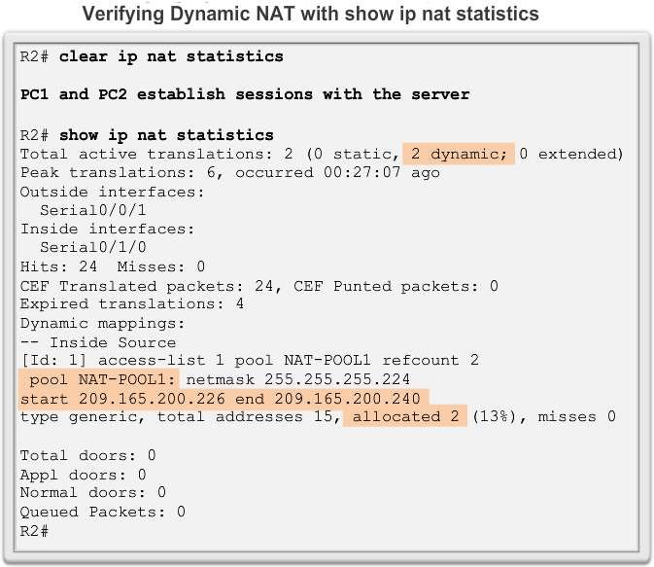
Configuring Dynamic NAT
Verifying Dynamic NAT
Presentation_ID
© 2008 Cisco Systems, Inc. All rights reserved.
Cisco Confidential
<number>

Slide 31
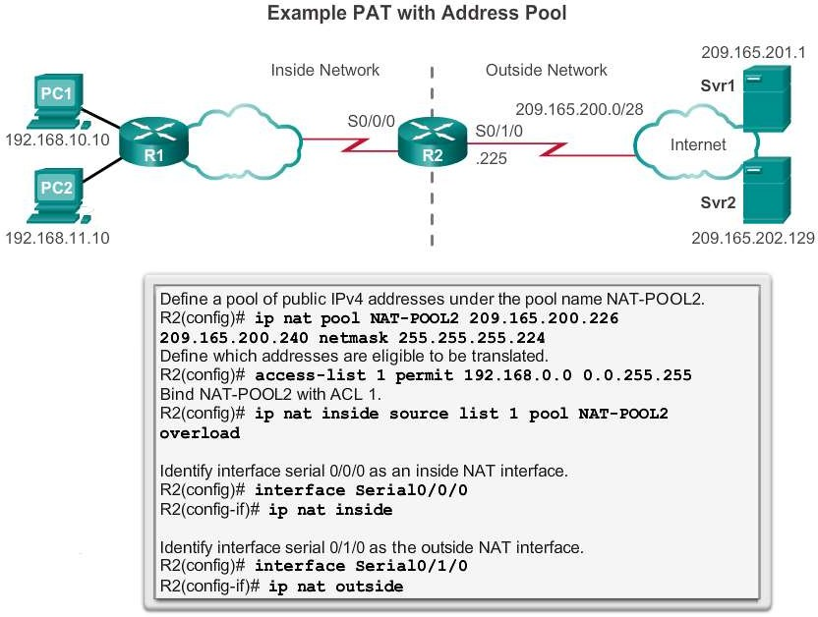
Configuring PAT
Configuring PAT: Address Pool
Presentation_ID
© 2008 Cisco Systems, Inc. All rights reserved. Cisco Confidential
<number>

Slide 32
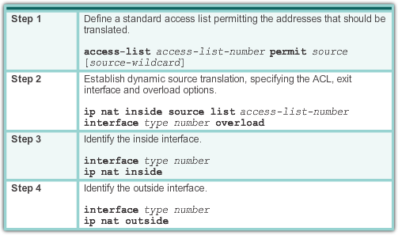
Configuring PAT
Configuring PAT: Single Address
Presentation_ID
© 2008 Cisco Systems, Inc. All rights reserved.
Cisco Confidential
<number>

Slide 33
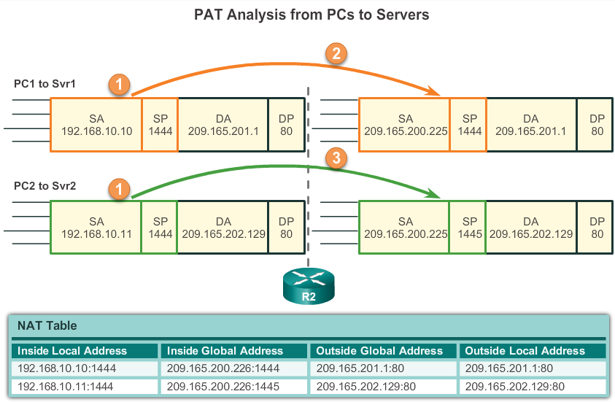
Configuring PAT
Analyzing PAT
Presentation_ID
© 2008 Cisco Systems, Inc. All rights reserved.
Cisco Confidential
<number>

Slide 34
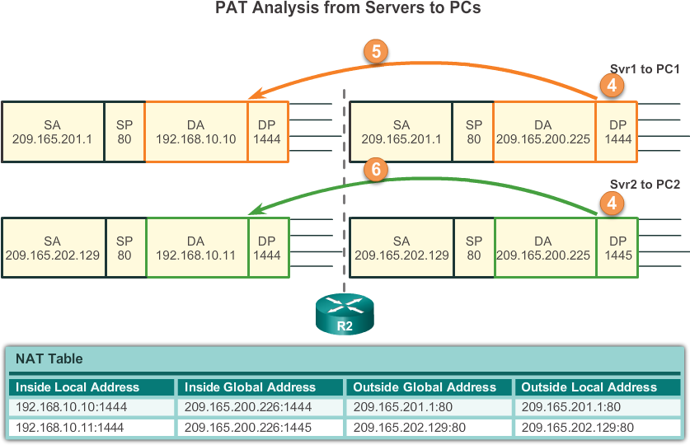
Configuring PAT
Analyzing PAT
Presentation_ID
© 2008 Cisco Systems, Inc. All rights reserved.
Cisco Confidential
<number>

Slide 35
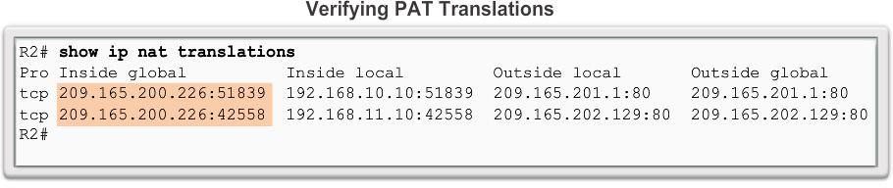
Configuring PAT
Verifying PAT Translations
Presentation_ID
© 2008 Cisco Systems, Inc. All rights reserved.
Cisco Confidential
<number>

Slide 36
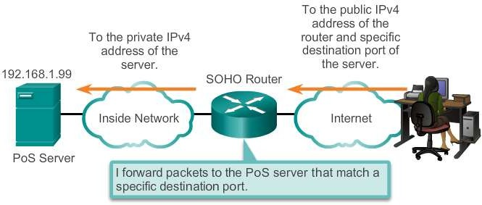
Port Forwarding
Port Forwarding
Port forwarding is the act of forwarding a network port from one
network node to another.
A packet sent to the public IP address and port of a router can be forwarded to a private IP address and port in inside network.
Port forwarding is helpful in situations where servers have private
addresses, not reachable from the outside networks.
Presentation_ID
© 2008 Cisco Systems, Inc. All rights reserved.
Cisco Confidential
<number>

Slide 37
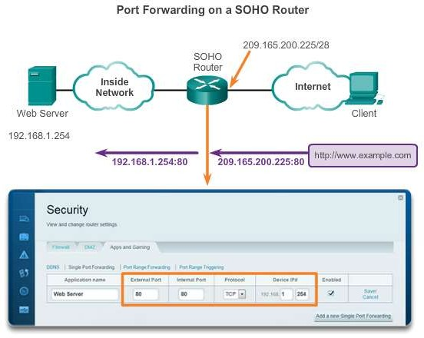
Port Forwarding
SOHO Example
Presentation_ID
© 2008 Cisco Systems, Inc. All rights reserved.
Cisco Confidential
<number>

Slide 38
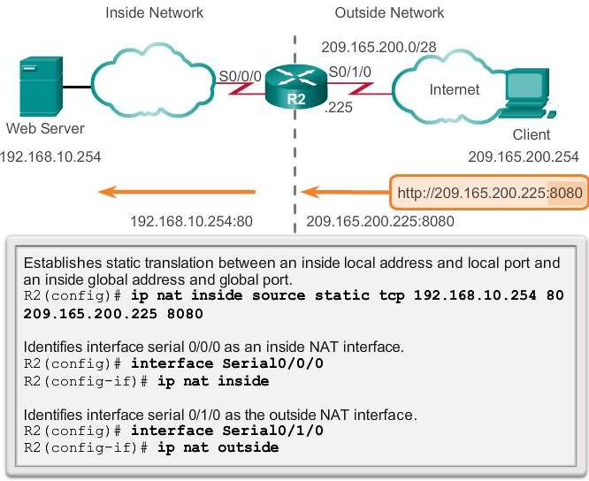
Port Forwarding
Configuring Port Forwarding with IOS
In IOS, Port forwarding is essentially a static NAT translation with a specified TCP or UDP port number.
Presentation_ID
© 2008 Cisco Systems, Inc. All rights reserved.
Cisco Confidential
<number>

Slide 39
Configuring NAT and IPv6
NAT for IPv6?
NAT is a workaround for IPv4 address scarcity.
IPv6 with a 128-bit address provides 340 undecillion addresses.
Address space is not an issue for IPv6.
IPv6 makes IPv4 public-private NAT unnecessary by design; however, IPv6 does implement a form of private addresses, and it is implemented differently than they are for IPv4.
Presentation_ID
© 2008 Cisco Systems, Inc. All rights reserved.
Cisco Confidential
<number>

Slide 40
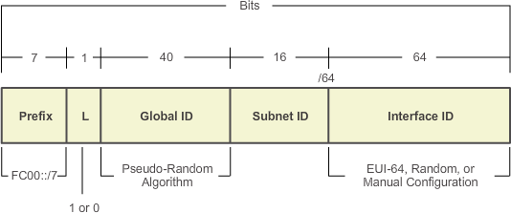
Configuring NAT and IPv6
IPv6 Unique Local Addresses
IPv6 unique local addresses (ULAs) are designed to allow IPv6 communications within a local site.
ULAs are not meant to provide additional IPv6 address space.
ULAs have the prefix FC00::/7, which results in a first hextet range
of FC00 to FDFF.
ULAs are also known as local IPv6 addresses (not to be confused with IPv6 link-local addresses).
Presentation_ID
© 2008 Cisco Systems, Inc. All rights reserved.
Cisco Confidential
<number>

Slide 41
Configuring NAT and IPv6
NAT for IPv6
IPv6 also uses NAT, but in a much different context.
In IPv6, NAT is used to provide transparent communication between IPv6 and IPv4.
NAT64 is not intended to be a permanent solution; it is meant to be a transition mechanism.
Network Address Translation-Protocol Translation (NAT-PT) was another NAT-based transition mechanism for IPv6, but is now deprecated by IETF.
NAT64 is now recommended.
Presentation_ID
© 2008 Cisco Systems, Inc. All rights reserved.
Cisco Confidential
<number>

Slide 42
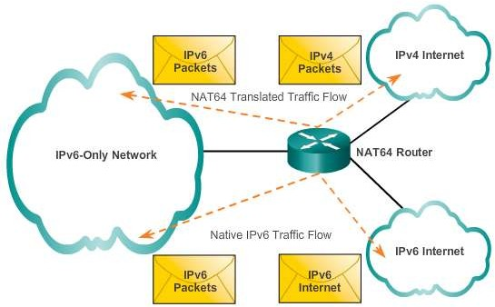
Configuring NAT and IPv6
NAT for IPv6
Presentation_ID
© 2008 Cisco Systems, Inc. All rights reserved.
Cisco Confidential
<number>

Slide 43
11.3 Troubleshooting NAT
Presentation_ID
© 2008 Cisco Systems, Inc. All rights reserved.
Cisco Confidential
<number>

Slide 44
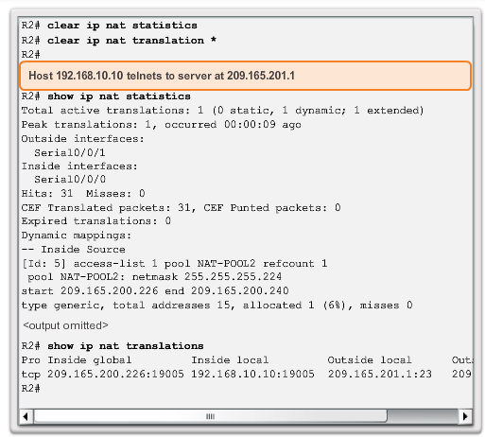
Configuring NAT and IPv6
Troubleshooting NAT: show commands
Presentation_ID
© 2008 Cisco Systems, Inc. All rights reserved.
Cisco Confidential
<number>

Slide 45
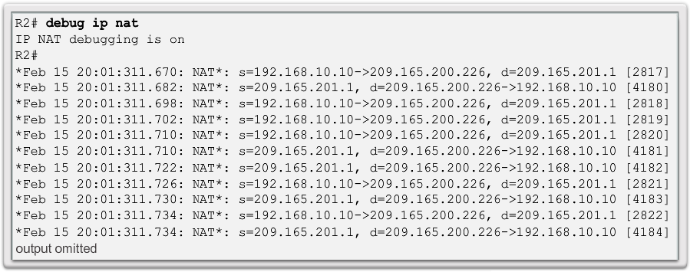
Configuring NAT and IPv6
Troubleshooting NAT: debug command
Presentation_ID
© 2008 Cisco Systems, Inc. All rights reserved.
Cisco Confidential
<number>

Slide 46
Chapter 11: Summary
This chapter has outlined:
How NAT is used to help alleviate the depletion of the IPv4 address space.
NAT conserves public address space and saves considerable administrative overhead in managing adds, moves, and changes.
NAT for IPv4, including:
NAT characteristics, terminology, and general operations
Different types of NAT, including static NAT, dynamic NAT, and
NAT with overloading
Benefits and disadvantages of NAT
The configuration, verification, and analysis of static NAT, dynamic NAT, and NAT with overloading.
Presentation_ID
© 2008 Cisco Systems, Inc. All rights reserved.
Cisco Confidential
<number>

Slide 47
Chapter 11: Summary (cont.)
How port forwarding can be used to access an internal devices from
the Internet.
Troubleshooting NAT using show and debug commands.
How NAT for IPv6 is used to translate between IPv6 addresses and IPv4 addresses.
Presentation_ID
© 2008 Cisco Systems, Inc. All rights reserved.
Cisco Confidential
<number>

Slide 48
Presentation_ID
© 2008 Cisco Systems, Inc. All rights reserved.
Cisco Confidential
<number>

