Slide 1



Chapter 3:
Network Protocols and Communications
Introduction to Networks
Instructor:
Nguyen Anh Minh
M.Sc CCNP TOGAF
Cisco Confidential

Slide 2
Chapter 3: Objectives
After completing this chapter, you will be able to:
Explain how rules are used to facilitate communication.
Explain the role of protocols and standards organizations in facilitating interoperability in network communications.
Explain how devices on a LAN access resources in a small to
medium-sized business network.
Cisco Confidential

Slide 3
Chapter 3
Rules of Communication
Network Protocols and Standards
Moving Data in the Network
Summary
Cisco Confidential

Slide 4
3.1 Rules of Communication
Cisco Confidential

Slide 5
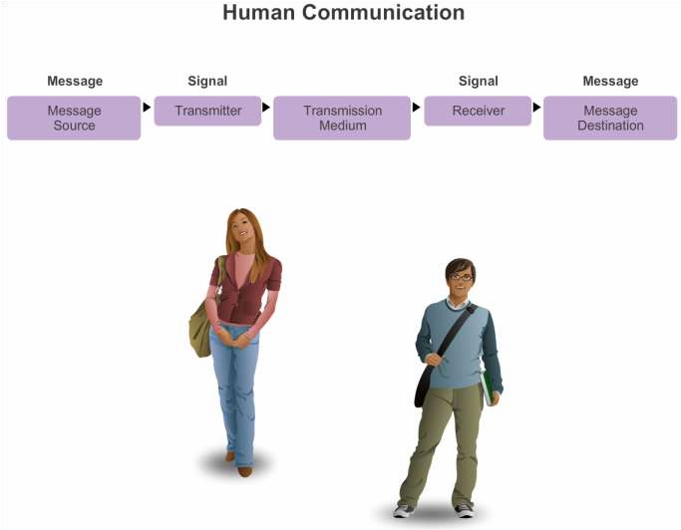
What is Communication?
The Rules
Cisco Confidential

Slide 6
Establishing the Rules
The Rules
An identified sender and receiver
Agreed upon method of communicating (face-to-face, telephone, letter,
photograph)
Common language and grammar
Speed and timing of delivery
Confirmation or acknowledgment requirements
Cisco Confidential

Slide 7
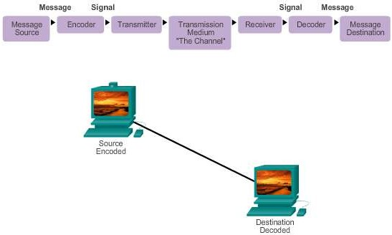
Message Encoding
The Rules
Cisco Confidential

Slide 8

Message Formatting and Encapsulation
The Rules
Example: Personal letter contains the following elements:
Identifier of the recipient’s location
Identifier of the sender’s location
Salutation or greeting
Recipient identifier
The message content
Source identifier
End of message indicator
Cisco Confidential

Slide 9
Message Size
The Rules
An overview of the segmenting process:
The size restrictions of frames require the source host to break a long message into individual pieces (or segments) that meet both the minimum and maximum size requirements.
Each segment is encapsulated in a separate frame with the address information, and is sent over the network.
At the receiving host, the messages are de-encapsulated and put back
together to be processed and interpreted.
Cisco Confidential

Slide 10
Message Timing
The Rules
Access Method
Flow Control
Response Timeout
Cisco Confidential

Slide 11
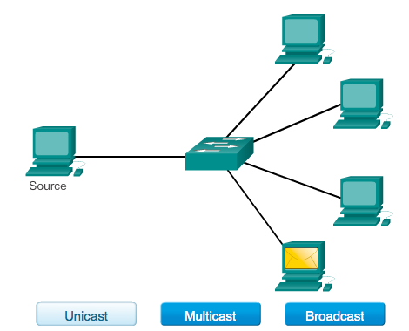
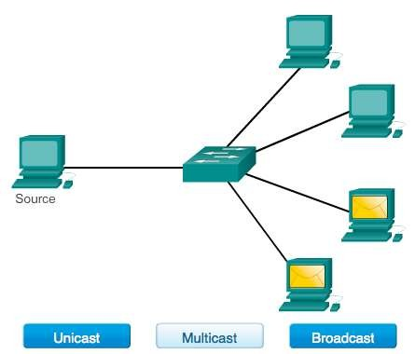
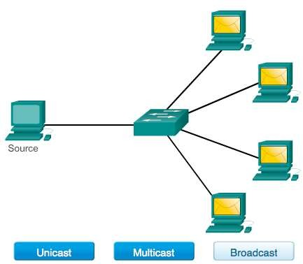
Message Delivery Options
The Rules
Cisco Confidential

Slide 12
3.2 Network Protocols and Standards
Cisco Confidential

Slide 13
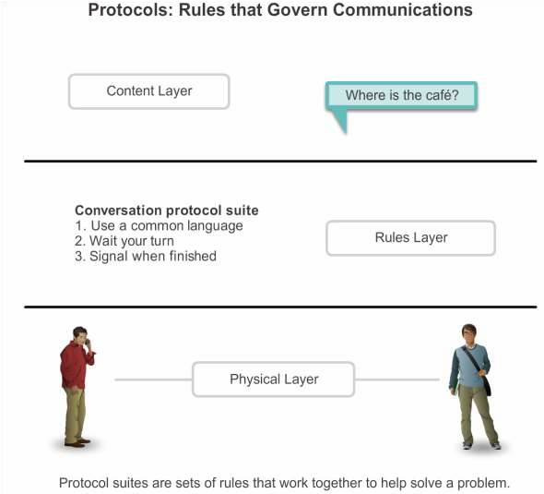
Rules that Govern Communications
Protocols
Cisco Confidential

Slide 14
Network Protocols
Protocols
How the message is formatted or structured
The process by which networking devices share information about
pathways with other networks
How and when error and system messages are passed between devices
The setup and termination of data transfer sessions
Cisco Confidential

Slide 15
Interaction of Protocols
Protocols
Application Protocol – Hypertext Transfer Protocol (HTTP)
Transport Protocol – Transmission Control Protocol (TCP)
Internet Protocol – Internet Protocol (IP)
Network Access Protocols – Data link & physical layers
Cisco Confidential

Slide 16
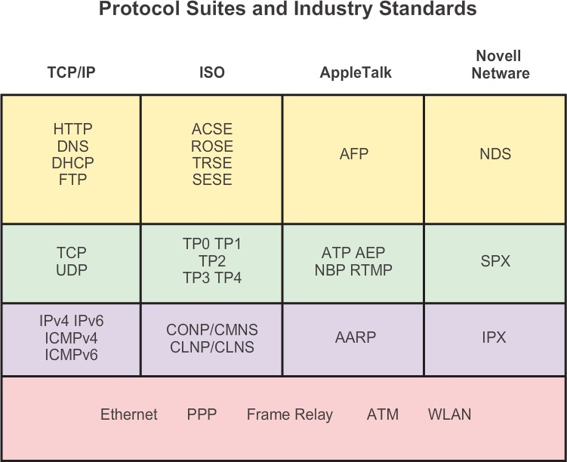
Protocol Suites and Industry Standards
Protocol Suites
Cisco Confidential

Slide 17
Creation of Internet, Development of TCP/IP
Protocol Suites
The first packet switching network and predecessor to today’s Internet was the Advanced Research Projects Agency Network (ARPANET), which came to life in 1969 by connecting mainframe computers at four locations.
ARPANET was funded by the U.S. Department of Defense for use by universities and research laboratories. Bolt, Beranek and Newman (BBN) was the contractor that did much of the initial development of the ARPANET, including creating the first router known as an Interface Message Processor (IMP).
In 1973, Robert Kahn and Vinton Cerf began work on TCP to develop the next generation of the ARPANET. TCP was designed to replace
ARPANET’s current Network Control Program (NCP).
In 1978, TCP was divided into two protocols: TCP and IP. Later, other protocols were added to the TCP/IP suite of protocols including Telnet, FTP, DNS, and many others.
Cisco Confidential

Slide 18
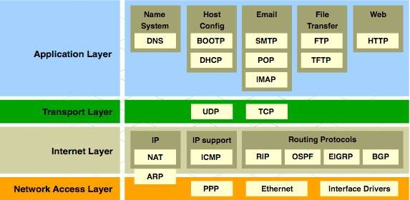
TCP/IP Protocol Suite and Communication
Protocol Suites
Cisco Confidential

Slide 19







Open Standards
Standards Organizations
The Internet Society (ISOC)
The Internet Architecture Board (IAB)
The Internet Engineering Task Force (IETF)
Institute of Electrical and Electronics Engineers (IEEE)
The International Organization for Standards (ISO)
Cisco Confidential

Slide 20

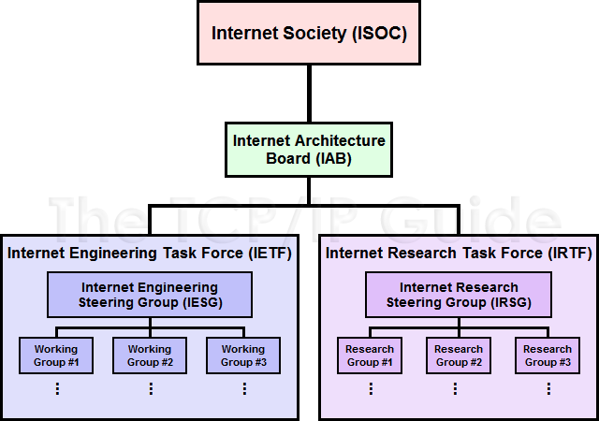



ISOC, IAB, and IETF
Standards Organizations
Cisco Confidential

Slide 21
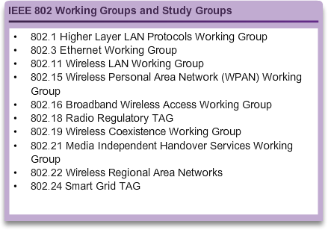
IEEE
Standards Organizations
38 societies
130 journals
1,300 conferences each year
1,300 standards and projects
400,000 members
160 countries
IEEE 802.3
IEEE 802.11
Cisco Confidential

Slide 22

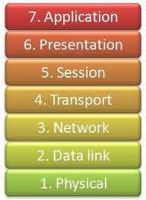
ISO
Standards Organizations
OSI Model
Cisco Confidential

Slide 23
Other Standards Organization
Standards Organizations
The Electronic Industries Alliance (EIA)
The Telecommunications Industry Association (TIA)
The International Telecommunications Union – Telecommunications
Standardization Sector (ITU-T)
The Internet Corporation for Assigned Names and Numbers (ICANN)
The Internet Assigned Numbers Authority (IANA)
Cisco Confidential

Slide 24
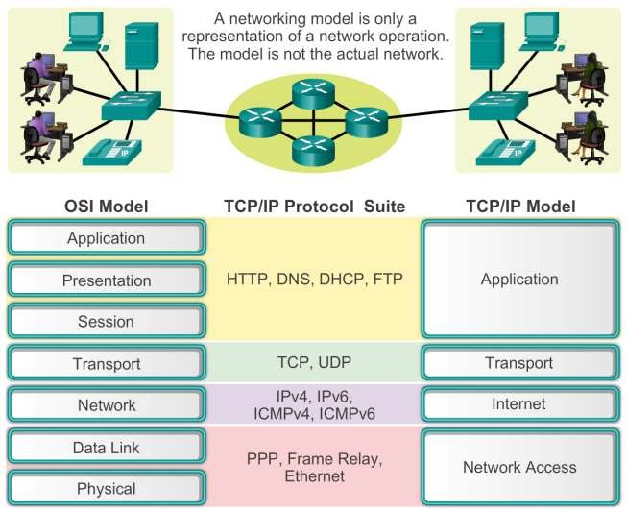
Benefits of Using a Layered Model
Reference Models
Cisco Confidential

Slide 25
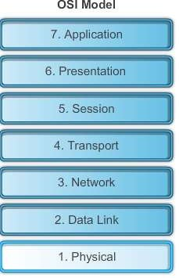
The OSI Reference Model
Reference Models
Cisco Confidential

Slide 26
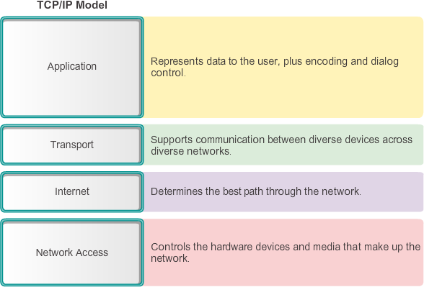
The TCP/IP Reference Model
Reference Models
Cisco Confidential

Slide 27
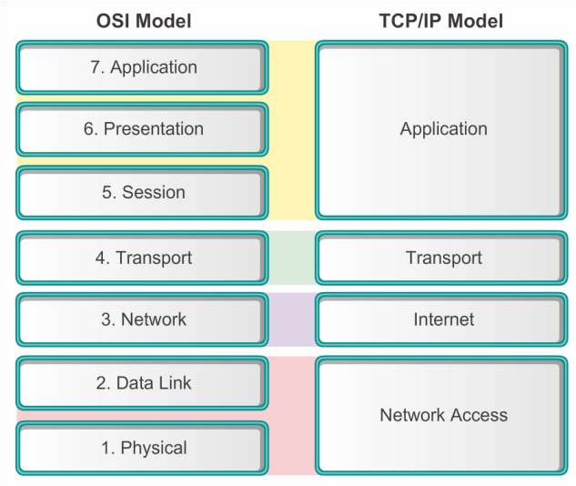
Comparing the OSI and TCP/IP Models
Reference Models
Cisco Confidential

Slide 28
3.3 Moving Data in the Network
Cisco Confidential

Slide 29
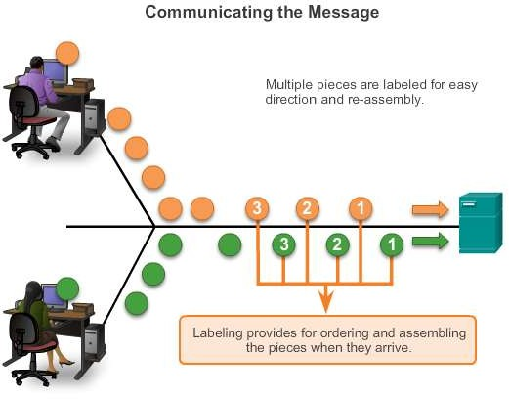
Communicating the Messages
Data Encapsulation
Segmenting message benefits
Different conversations can be interleaved
Increased reliability of network communications
Segmenting message disadvantage
Increased level of complexity
Cisco Confidential

Slide 30
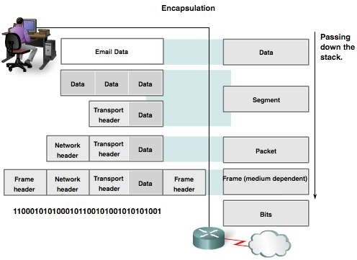
Protocol Data Units (PDUs)
Data Encapsulation
Data
Segment
Packet
Frame
Bits
Cisco Confidential

Slide 31
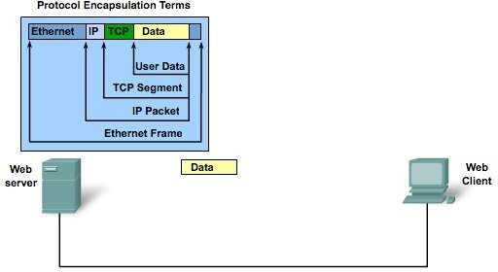
Protocol Encapsulation
Data Encapsulation
Cisco Confidential

Slide 32
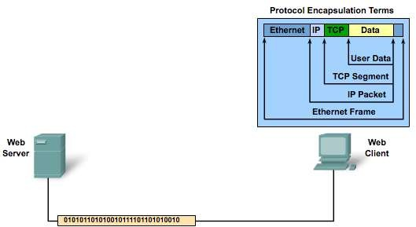
Protocol De-encapsulation
Data Encapsulation
Cisco Confidential

Slide 33
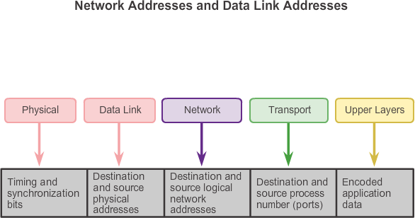
Accessing Local Resources
Moving Data in the Network
Cisco Confidential

Slide 34
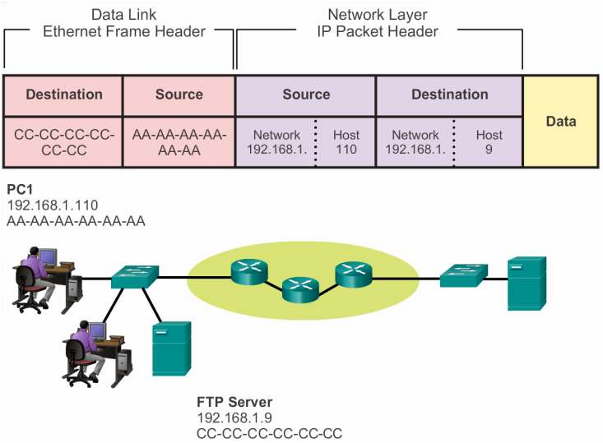
Communicating with Device / Same Network
Accessing Local Resources
© 2008 Cisco Systems, Inc. All r
ights reserved. Cisco Confidential 3
4

Slide 35





Accessing Local Resources
MAC and IP Addresses
R1 192.168.1.1
11-11-11-11-11-11
ARP
Request
PC1 192.168.1.110
AA-AA-AA-AA-AA-AA
S1
R1
PC2 192.168.1.111
BB-BB-BB-BB-BB-BB
FTP Server 192.168.1.9
CC-CC-CC-CC-CC-CC
Presentation_ID
© 2008 Cisco Systems, Inc. All rights reserved.
Cisco Confidential
35

Slide 36
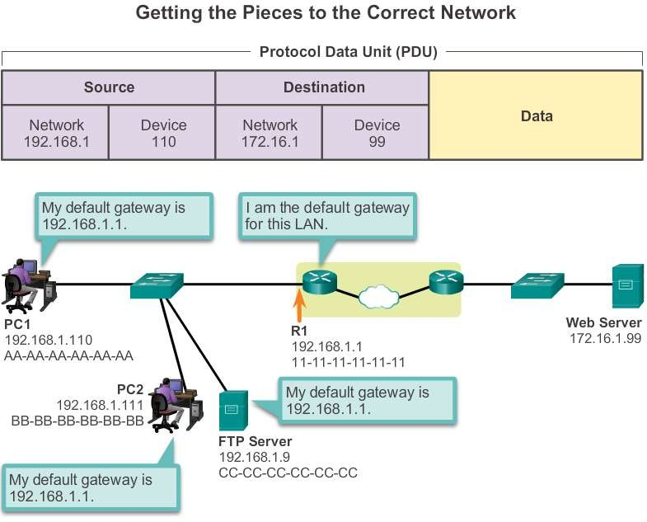
Default Gateway
Accessing Remote Resources
Presentation_ID
© 2008 Cisco Systems, Inc. All rights reserved. Cisco Confidential
36

Slide 37
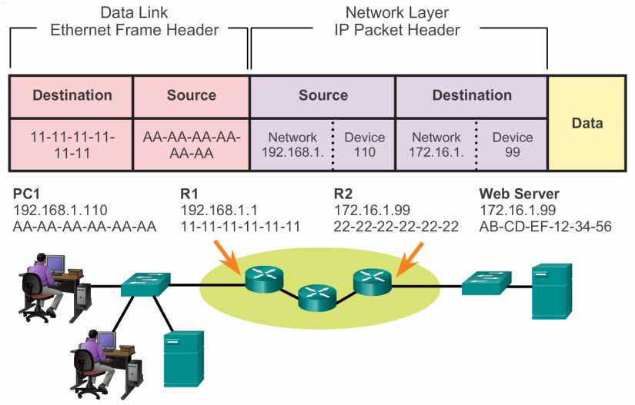
Communicating Device / Remote Network
Accessing Remote Resources
Cisco Confidential
37

Slide 38
Summary
Network Protocols and Communications
In this chapter, you learned:
Data networks are systems of end devices, intermediary devices, and the media connecting the devices. For communication to occur, these devices must know how to communicate.
These devices must comply with communication rules and protocols. TCP/IP is an example of a protocol suite.
Most protocols are created by a standards organization such as the IETF
or IEEE.
The most widely-used networking models are the OSI and TCP/IP models.
Data that passes down the stack of the OSI model is segmented into pieces and encapsulated with addresses and other labels. The process is reversed as the pieces are de-encapsulated and passed up the destination protocol stack.
Cisco Confidential
38

Slide 39
Summary (cont.)
Network Protocols and Communications
In this chapter, you learned:
The OSI model describes the processes of encoding, formatting,
segmenting, and encapsulating data for transmission over the network.
The TCP/IP protocol suite is an open standard protocol that has been endorsed by the networking industry and ratified, or approved, by a standards organization.
The Internet Protocol Suite is a suite of protocols required for transmitting
and receiving information using the Internet.
Protocol Data Units (PDUs) are named according to the protocols of the TCP/IP suite: data, segment, packet, frame, and bits.
Applying models allows individuals, companies, and trade associations to
analyze current networks and plan the networks of the future.
Cisco Confidential
39

Slide 40
Cisco Confidential
40

