Slide 1
Chapter 5: Inter-VLAN Routing
Routing & Switching
Instructor:
Nguyen Anh Minh
M.Sc CCNP TOGAF
Cisco Confidential
1

Slide 2
Chapter 5
Inter-VLAN Routing Configuration
Troubleshooting Inter-VLAN Routing
Layer 3 Switching
Summary
Cisco Confidential
2

Slide 3
Chapter 5: Objectives
Describe the three primary options for enabling inter-VLAN routing.
Configure legacy inter-VLAN routing.
Configure router-on-a-stick inter-VLAN routing.
Troubleshoot common inter-VLAN configuration issues.
Troubleshoot common IP addressing issues in an inter-VLAN-routed environment.
Configure inter-VLAN routing using Layer 3 switching.
Troubleshoot inter-VLAN routing in a Layer 3-switched environment.
Cisco Confidential
3

Slide 4



5.1 Inter-VLAN Routing Configuration
Cisco Confidential
4

Slide 5
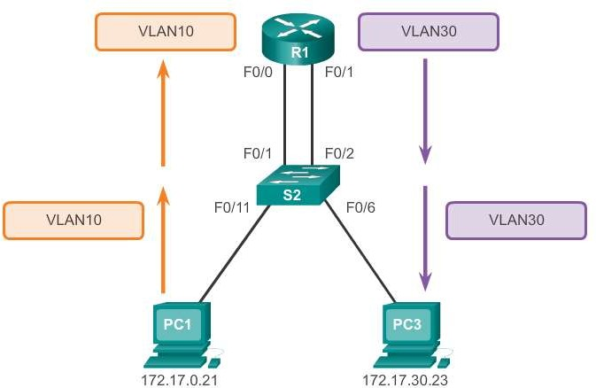
What is Inter-VLAN routing?
Inter-VLAN Routing Operation
Layer 2 switches cannot forward traffic between VLANs without the assistance of a router.
Inter-VLAN routing is a process for forwarding network traffic from
one VLAN to another, using a router.
Cisco Confidential
5

Slide 6
Legacy Inter-VLAN Routing
Inter-VLAN Routing Operation
In the past:
Actual routers were used to route between VLANs.
Each VLAN was connected to a different physical router interface.
Packets would arrive on the router through one through interface, be routed and leave through another.
Because the router interfaces were connected to VLANs and had IP addresses from that specific VLAN, routing between VLANs was achieved.
Large networks with large number of VLANs required many router interfaces.
Cisco Confidential
6

Slide 7
Router-on-a-Stick Inter-VLAN Routing
Inter-VLAN Routing Operation
The router-on-a-stick approach uses a different path to route between VLANs.
One of the router’s physical interfaces is configured as a 802.1Q
trunk port so it can understand VLAN tags.
Logical subinterfaces are created; one subinterface per VLAN.
Each subinterface is configured with an IP address from the VLAN it
represents.
VLAN members (hosts) are configured to use the subinterface address as a default gateway.
Only one of the router’s physical interface is used.
Cisco Confidential
7

Slide 8
Multilayer Switch Inter-VLAN Routing
Inter-VLAN Routing Operation
Multilayer switches can perform Layer 2 and Layer 3 functions, replacing the need for dedicated routers.
Multilayer switches support dynamic routing and inter-VLAN routing.
The multilayer switch must have IP routing enabled.
A switch virtual interface (SVI) exists for VLAN 1 by default. On a multilayer switch, a logical (layer 3) interface can be configured for any VLAN.
The switch understands network-layer PDUs; therefore, can route between its SVIs, just as a router routes between its interfaces.
With a multilayer switch, traffic is routed internal to the switch device.
This routing process is a suitable and scalable solution.
Cisco Confidential
8

Slide 9
Preparation
Configure Legacy Inter-VLAN Routing
Legacy inter-VLAN routing requires routers to have multiple
physical interfaces.
Each one of the router’s physical interfaces is connected to a unique VLAN.
Each interface is also configured with an IP address for the subnet
associated with the particular VLAN.
Network devices use the router as a gateway to access the devices connected to the other VLANs.
Cisco Confidential
9

Slide 10
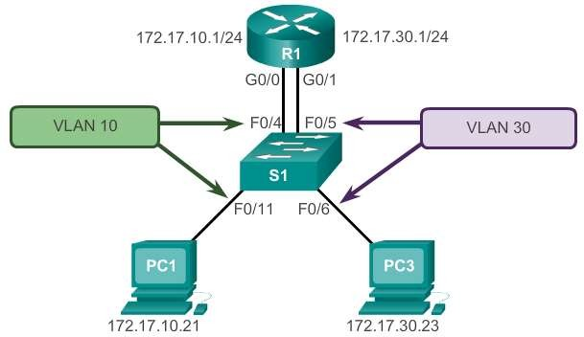
Preparation (cont.)
Configure Legacy Inter-VLAN Routing
Cisco Confidential
10

Slide 11
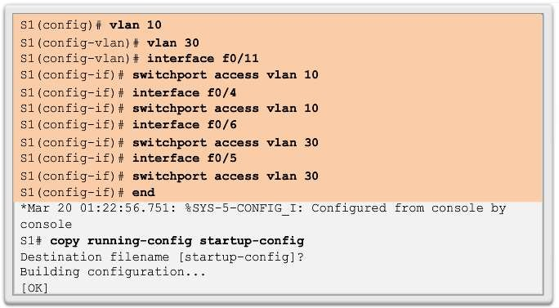
Switch Configuration
Configure Legacy Inter-VLAN Routing
Cisco Confidential
11

Slide 12
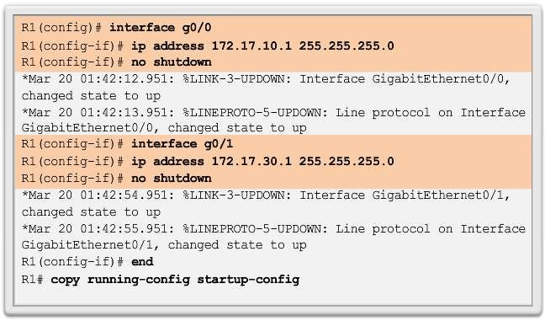
Router Interface Configuration
Configure Legacy Inter-VLAN Routing
Cisco Confidential
12

Slide 13
Preparation
Configure Router-on-a-Stick
An alternative to legacy inter-VLAN routing is to use VLAN trunking
and subinterfaces.
VLAN trunking allows a single physical router interface to route traffic for multiple VLANs.
The physical interface of the router must be connected to a trunk
link on the adjacent switch.
On the router, subinterfaces are created for each unique VLAN.
Each subinterface is assigned an IP address specific to its subnet or VLAN and is also configured to tag frames for that VLAN.
Cisco Confidential
13

Slide 14
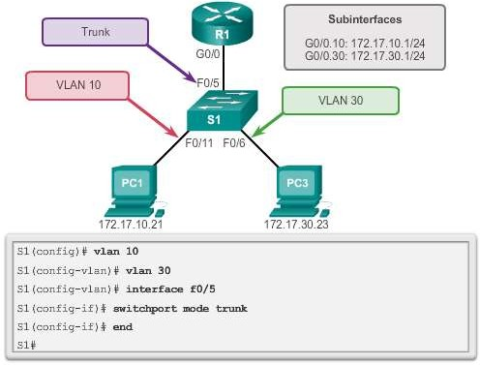
Switch Configuration
Configure Router-on-a-Stick
© 2008 Cisco Systems, Inc. All rights reserved. Cisco Confidential

Slide 15
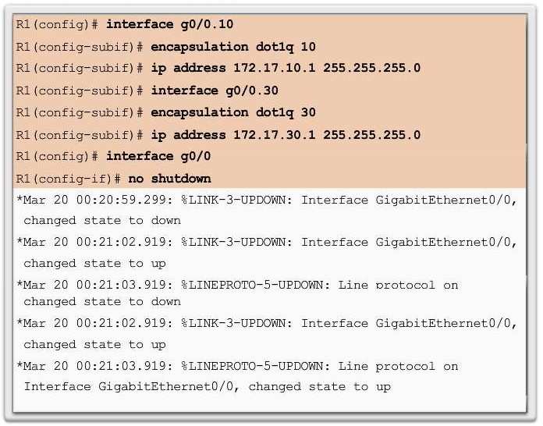
Router Subinterface Configuration
Configure Router-on-a-Stick
Cisco Confidential

Slide 16
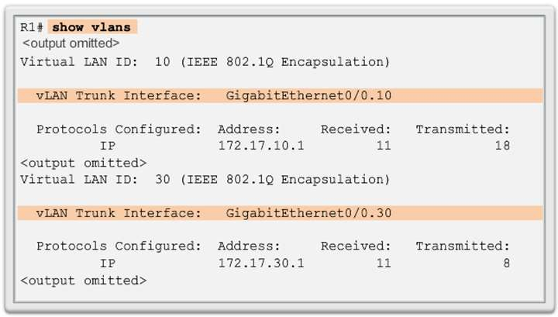
Verifying Subinterfaces
Configure Router-on-a-Stick
Cisco Confidential

Slide 17
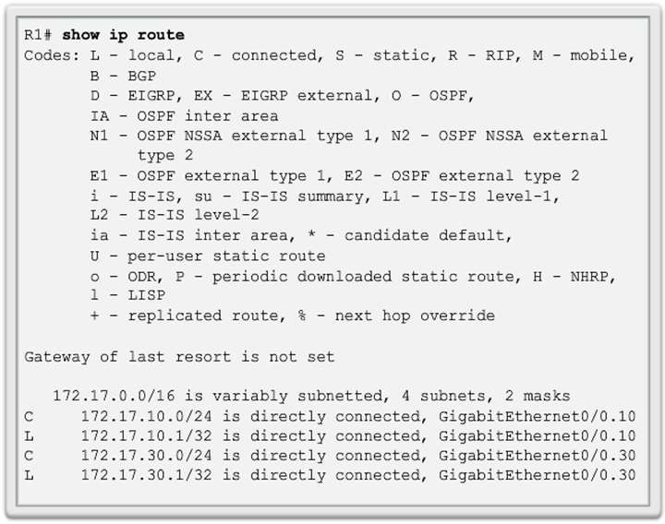
Verifying Subinterfaces (cont.)
Configure Router-on-a-Stick
Cisco Confidential

Slide 18
Verifying Routing
Configure Router-on-a-Stick
Access to devices on remote VLANs can be tested using
the ping command.
The ping command sends an ICMP echo request to the destination address.
When a host receives an ICMP echo request, it responds with an
ICMP echo reply.
Tracert is a useful utility for confirming the routed path taken between two devices.
Cisco Confidential

Slide 19
6.2 Troubleshoot Inter- VLAN Routing
Cisco Confidential

Slide 20
Switch Port Issues
Inter-VLAN Configuration Issues
When using the legacy routing model, ensure that the switch ports connect to the router interfaces and are configured with the correct VLANs.
Use the switchport access vlan [appropriate vlan#]
command to correct any erroneous VLAN port assignment.
Ensure that the router is connected to the correct switch port.
When using router-on-a-stick, ensure that the switch port
connected to the router is configured as a trunk link.
Use the switchport mode trunk command to make the switch port a trunk.
Cisco Confidential

Slide 21
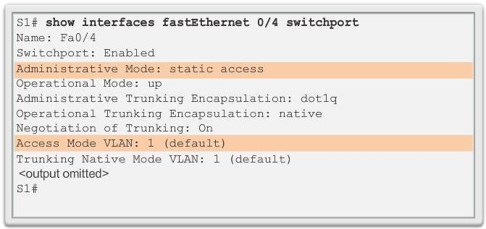
Verify Switch Configuration
Inter-VLAN Configuration Issues
Cisco Confidential

Slide 22
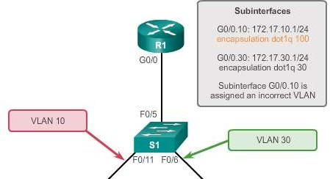
Verify Router Configuration
Inter-VLAN Configuration Issues
With router-on-a-stick configurations, a common problem is
assigning the wrong VLAN ID to the subinterface.
The show interface command can help detect this problem.
If this is the case, use the encapsulation dot1q <vlan_id>
interface command to fix the problem.
Cisco Confidential

Slide 23
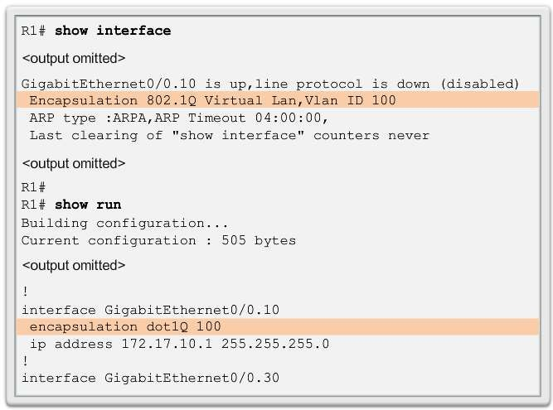
Verify Router Configuration (cont.)
Inter-VLAN Configuration Issues
Cisco Confidential

Slide 24
Errors with IP Address and Subnet Masks
IP Addressing Issues
When using legacy inter-VLAN routing, ensure that the router has the correct IP address and mask on the interfaces connecting to the switch.
Ensure that the network devices are configured with the correct IP address and mask.
In the router, use the ip address command to fix any erroneous IP assignments.
In the PCs, refer to the installed operating system documentation to properly change IP information.
Cisco Confidential

Slide 25
Verifying IP Address and Subnet Mask Configuration Issues
IP Addressing Issues
Use the show ip interface command to verify if the correct IP
address is configured in the router.
Use the show running-config when troubleshooting router- related problems.
When troubleshooting addressing issues, ensure that the
subinterface is configured with the correct address for that VLAN.
Subinterface IDs are often configured to match the VLAN number, which makes it easier to manage inter-VLAN configuration, but this is not a requirement.
Cisco Confidential

Slide 26
5.3 Layer 3 Switching
Cisco Confidential

Slide 27
Introduction to Layer 3 Switching
Layer 3 Switching Operation and Configuration
Layer 3 switches usually have packet-switching throughputs in the
millions of packets per second (pps).
All Catalyst multilayer switches support the following types of Layer 3 interfaces:
Routed port
Switch virtual interface (SVI)
High-performance switches, such as the Catalyst 6500 and Catalyst 4500, are able to perform most of the router’s functions.
Several models of Catalyst switches require enhanced software for
specific routing protocol features.
Cisco Confidential

Slide 28
Inter-VLAN Routing with Switch Virtual Interfaces
Layer 3 Switching Operation and Configuration
Today’s routing has become faster and cheaper and can be performed at hardware speed.
Routing can be transferred to core and distribution devices with
little to no impact on network performance.
Many users are in separate VLANs, and each VLAN is usually a separate subnet. This implies that each distribution switch must have IP addresses matching each access switch VLAN.
Layer 3 (routed) ports are normally implemented between the distribution and the core layer. This model is less dependent on spanning tree, because there are no loops in the Layer 2 portion of the topology.
Cisco Confidential

Slide 29
Inter-VLAN Routing with SVIs (Cont.)
Layer 3 Switching Operation and Configuration
By default, an SVI is created for the default VLAN (VLAN 1). This allows for remote switch administration.
Any additional SVIs must be created by the administrator.
SVIs are created the first time the VLAN interface configuration
mode is entered for a particular VLAN SVI.
Enter the interface vlan 10 command to create an SVI named VLAN 10.
The VLAN number used corresponds to the VLAN tag associated
with data frames on an 802.1Q encapsulated trunk.
When the SVI is created, ensure that the specific VLAN is present in the VLAN database.
Cisco Confidential

Slide 30
Inter-VLAN Routing with SVIs (Cont.)
Layer 3 Switching Operation and Configuration
SVIs advantages include:
Much faster than router-on-a-stick, because everything is hardware-switched and routed.
No need for external links from the switch to the router for
routing.
Not limited to one link. Layer 2 EtherChannels can be used between the switches to get more bandwidth.
Latency is much lower, because it does not need to leave the
switch.
Cisco Confidential

Slide 31
Inter-VLAN Routing with Routed Ports
Layer 3 Switching Operation and Configuration
A routed port is a physical port that acts similarly to an interface on a router.
Routed ports are not associated with any VLANs.
Layer 2 protocols, such as STP, do not function on a routed interface.
Routed ports on a Cisco IOS switch do not support subinterfaces.
To configure routed ports, use the no switchport interface
configuration mode command.
Note: Routed ports are not supported on Catalyst 2960 Series switches.
Cisco Confidential

Slide 32
Configuring Static Routes on a Catalyst 2960
Layer 3 Switching Operation and Configuration
The Cisco Switch Database Manager (SDM) provides multiple
templates for the Cisco Catalyst 2960 switch.
The SDM lanbase-routing template can be enabled to allow the switch to route between VLANs and to support static routing.
Use the show sdm prefer command to verify which template is
in use.
The SDM template can be changed in global configuration mode with the sdm prefer command.
Cisco Confidential

Slide 33
Layer 3 Switch Configuration Issues
Troubleshooting Layer 3 Switching
To troubleshoot Layer 3 switching issues, verify the following for accuracy:
VLANs
VLANs must be defined across all the switches.
VLANs must be enabled on the trunk ports.
Ports must be in the right VLANs.
SVIs
SVIs must have the correct IP address or subnet mask.
SVIs must be up.
SVIs must match with the VLAN number.
Cisco Confidential

Slide 34
Layer 3 Switching Configuration Issues (Cont.)
Troubleshooting Layer 3 Switching
To troubleshoot Layer 3 switching issues, verify the following for accuracy:
Routing
Routing must be enabled.
Each interface or network should be added to the routing protocol.
Hosts
Hosts must have the correct IP address or subnet mask.
Hosts must have a default gateway associated with an SVI or routed port.
Cisco Confidential

Slide 35
Chapter 5: Summary
This chapter described and explained the following concepts:
Inter-VLAN routing, the process of routing traffic between different VLANs, using either a dedicated router or a multilayer switch
Legacy, router-on-a-stick, and multilayer switch inter-VLAN routing
Layer 3 switching, SVIs, and routed ports
Troubleshooting inter-VLAN routing with a router or a Layer 3
switch
Common errors involving VLAN, trunk, Layer 3 interface, and IP address configurations
Cisco Confidential

Slide 36
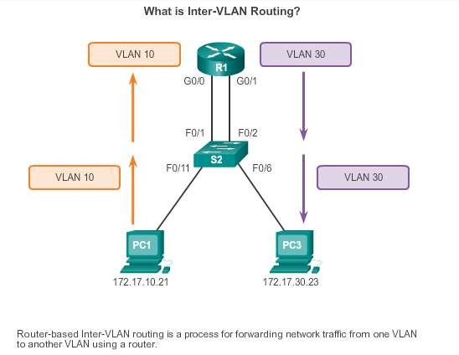
Chapter 5: Summary
Cisco Confidential

Slide 37
Cisco Confidential

