Slide 1
Residual Multi-Head Mixing GAT
Semi-Supervised Node Classification on Cora
Graph ML Project — Hanoi University of Science and Technology
Do Tuan Minh · Tran Tien Dung · Tran Manh Tien · Hoang Huy Chien · Nguyen Tien Duc

Slide 2
Problem: Semi-Supervised Node Classification
Problem
• Given graph G = (V, E) — Cora citation network
• 2708 nodes (papers) · 5278 edges (citations)
• Each node: 1433-dim bag-of-words features
• Only 140 nodes have training labels (5.2%)
• Classify into 7 classes (research topics)
Why Graph Neural Networks?
• Citation structure carries important information
• Papers in the same field tend to cite each other
• MLP ignores graph structure → loses information
• GNN: message passing between neighbors
• Expectation: GNN >> MLP on this task

Slide 3
Dataset: Cora Citation Network
Cora Statistics
• Nodes (papers): 2,708
• Edges (citations): 5,278 (directed) → 10,556 (undirected)
• Features: 1,433 (bag-of-words, binary)
• Classes: 7 (research topics)
• Train / Val / Test: 140 / 500 / 1,000
• Sparsity: ~0.14% (very sparse graph)
Data Preparation:
• Planetoid loader (PyG) — standard Cora split
• NormalizeFeatures transform — row-normalize
• Fixed train/val/test mask (reproducible)

Slide 4
Baseline Models
4 Baseline Models
▸ MLP
2-layer fully connected, ignores graph structure. Weakest baseline.
▸ GCN
Graph Convolutional Network. Spectral convolution with normalized adjacency matrix.
▸ GraphSAGE
SAmple and aggreGatE. Inductive learning with mean aggregator.
▸ GAT
Graph Attention Network. Learned attention weights, multi-head attention.

Slide 5
Proposed Model: Residual Multi-Head Mixing GAT
Architecture
H₀ = X # Raw features (1433-dim)
H₁ = ELU( GATv2_multi(H₀, E) ) # 8 heads, concat → 64-dim
H₂ = GATv2_single(H₁, E) # Single head → 7-dim
Z = H₂ + H₀ · W_skip # Residual skip → logits
3 Key Contributions:
▸ GATv2 (replacing GAT)
Dynamic attention coefficients, avoids static ranking problem
▸ Residual Skip Connection
H0·W_skip: direct gradient flow, counteracts over-smoothing
▸ DropEdge (p=0.2)
Random edge removal during training → structural augmentation

Slide 6
Experimental Setup
Hyperparameters
• Optimizer: Adam
• Learning rate: 0.005
• Weight decay: 5×10⁻⁴
• Epochs: 200
• Early stopping: patience=100
• Dropout: 0.6
• Hidden dim (GCN/SAGE): 64
• GAT heads: 8 (per-head=8)
Protocol
• 5 random seeds (42-46)
• Report: mean ± std
• Model selection: best val accuracy
• Report: test acc at best-val epoch
• Standard Cora split: 140/500/1000
• NormalizeFeatures transform
• PyTorch 2.13 + PyG 2.8
• Full reproducibility: seed all RNGs

Slide 7
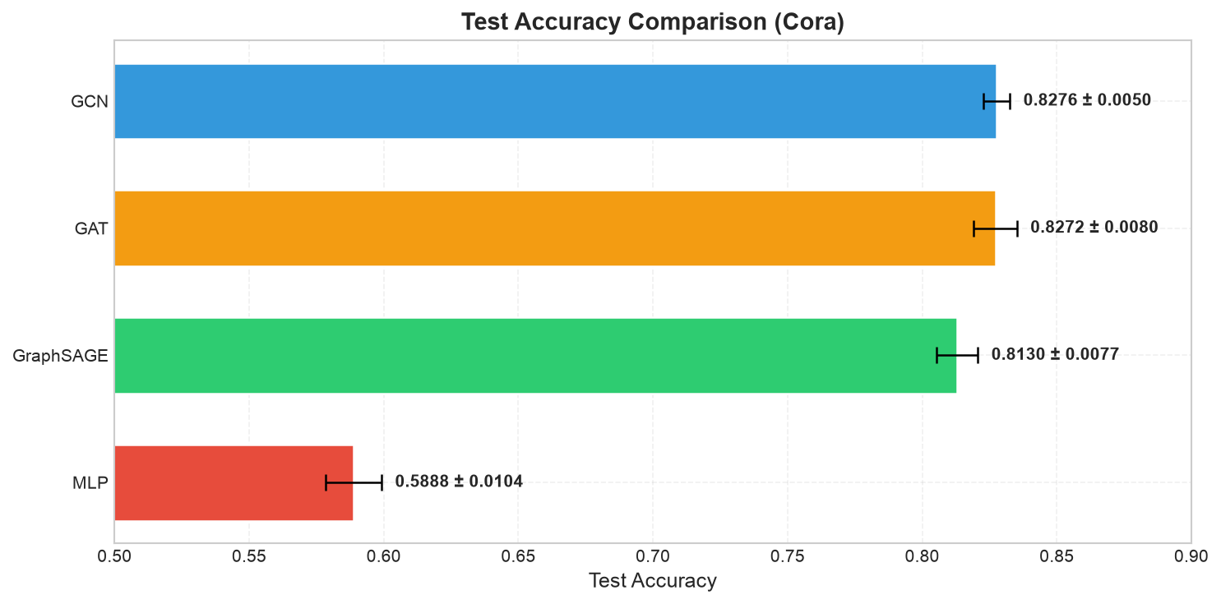
Results: Model Comparison
Results (5 seeds, 200 epochs)
• MLP: 0.5888 ± 0.0104
• GraphSAGE: 0.8130 ± 0.0077
• GAT: 0.8272 ± 0.0080
• GCN: 0.8276 ± 0.0050
• Proposed ★: 0.8326 ± 0.0080
Key Takeaways:
• MLP → GNN: +24% (graph structure is crucial)
• Proposed outperforms GAT by +0.5%
• Low std → stable training

Slide 8
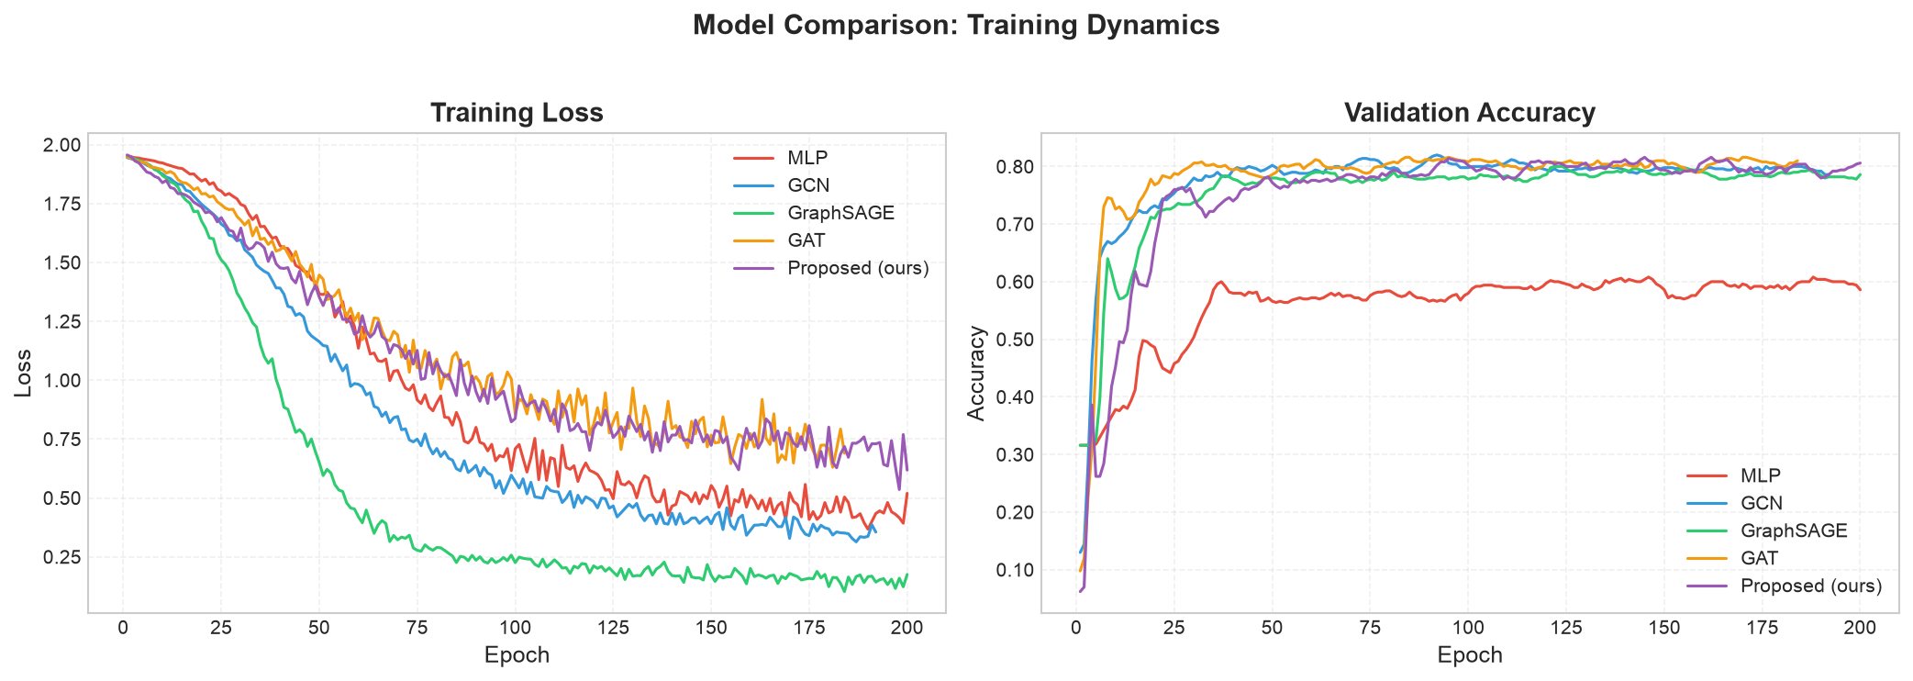
Training Curves: Loss & Validation Accuracy

Slide 9
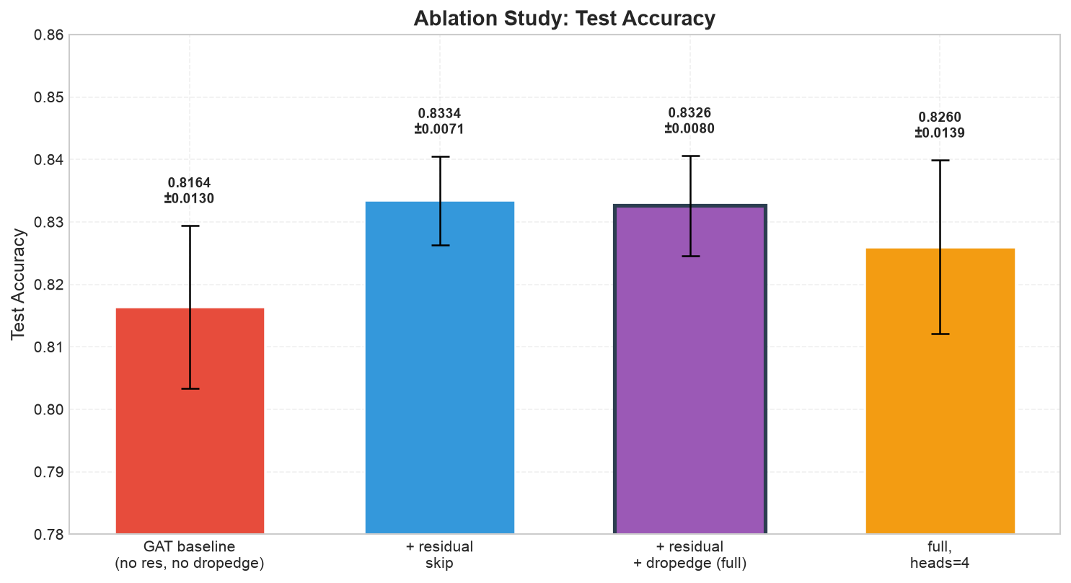
Ablation Study: Residual Multi-Head Mixing GAT
Component Analysis
• GAT (base): 0.8164 (—)
• + residual: 0.8334 (+1.7% ✓)
• + res + dropedge: 0.8326 (+1.6%)
• full, heads=4: 0.8260 (+1.0%)
Findings:
✓ Residual skip: +1.7% — main contribution
≈ DropEdge: −0.1% — negligible on small graph
↓ Heads 8→4: −0.7% — more heads help

Slide 10
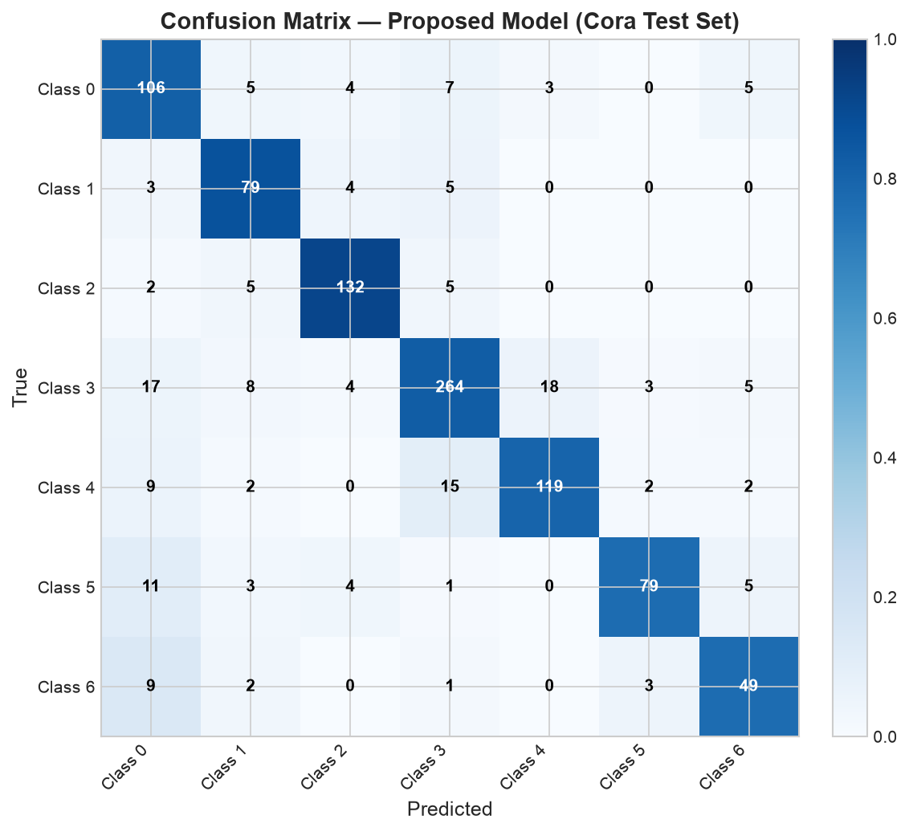
Confusion Matrix: Proposed Model on Test Set

Slide 11
Discussion
Key Findings
✓ Graph structure is crucial: MLP 0.59 → GNN 0.82 (+24%)
✓ Residual skip connection works: +1.7% test accuracy
✓ Stable training: low std (0.005-0.014)
✓ Val-test gap ~1-2%: no severe overfitting
Surprises
✗ GCN ≈ GAT
Attention does not outperform simple mean aggregation on Cora
✗ DropEdge ≈ 0
Regularization unnecessary on such a small graph
Explanation:
Cora is small (2708 nodes) and homogeneous → simple GNNs are already sufficient. DropEdge and attention shine on larger graphs.

Slide 12
Limitations & Future Work
Limitations
• Single dataset only (Cora, 2708 nodes)
• Shallow architecture (2 layers)
• No systematic hyperparameter tuning
• Accuracy metric only (no F1, AUC)
• Limited regularization study (no Mixup, Label Smoothing)
Future Work
→ Citeseer, Pubmed, Arxiv, OGB datasets
→ Deeper GNN (3-5 layers) + Jumping Knowledge
→ Graph Transformer (global attention)
→ Attention weight visualization
→ Real-world apps: recommendation, social networks

Slide 13
Conclusion
Summary
0.8326 — Best test accuracy (Proposed model)
+1.7% — Residual skip connection improvement
+24% — Graph structure vs MLP improvement
Residual Multi-Head Mixing GAT successfully combines multi-head attention with an input-feature skip connection.
Thank You & Q&A
Code: github.com/minhdo2207/GraphMl

