Slide 1

C Programming Basic – week 11
Sorting II
Lecturers :
Cao Tuan Dung
Le Duc Trung
Dept of Software Engineering
Hanoi University of Technology

Slide 2
Topics of this week
Advanced Sorting Algorithm
  Quick sort
  Merge sort
  Recursive processing
Exercises

Slide 3
Quicksort Algorithm
Given an array of n elements (e.g., integers):
If array only contains one element, return
Else
  pick one element to use as pivot.
  Partition elements into two sub-arrays:
    Elements less than or equal to pivot
    Elements greater than pivot
  Quicksort two sub-arrays
  Return results

Slide 4
Example
We are given array of n integers to sort:
40
20
10
80
60
50
7
30
100

Slide 5
Quick Sort (Hoare)
Given (R₀, R₁, …, R_{n-1})
K_{i}: pivot key
if K_{i} is placed in S(i),
then K_{j} ≤ K_{s(i)} for j < S(i),
K_{j} ≥ K_{s(i)} for j > S(i).
R₀, …, R_{S(i)-1}, R_{S(i)}, R_{S(i)+1}, …, R_{S(n-1)}
two partitions

Slide 6
Partitioning Array
Given a pivot, partition the elements of the array such that the resulting array consists of:
1. One sub-array that contains elements >= pivot
2. Another sub-array that contains elements < pivot
The sub-arrays are stored in the original data array.
Partitioning loops through, swapping elements below/above pivot.

Slide 7
Partition Result
7
20
10
30
40
50
60
80
100
[0]
[1]
[2]
[3]
[4]
[5]
[6]
[7]
[8]
<= data[pivot]
> data[pivot]

Slide 8
Recursion: Quicksort Subarrays
7
20
10
30
40
50
60
80
100
[0]
[1]
[2]
[3]
[4]
[5]
[6]
[7]
[8]
<= data[pivot]
> data[pivot]

Slide 9
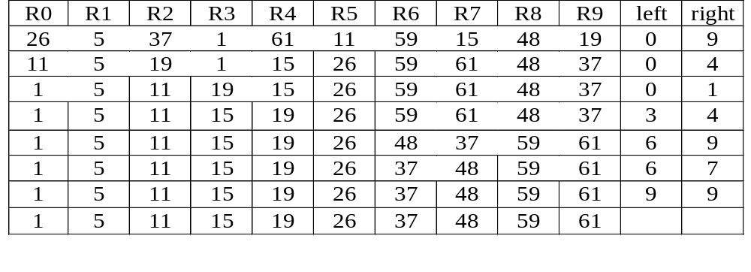
Example for Quick Sort
{
}
{
}
{
}
{
}
{
}
{
}
{
}
{
}
{
}
{
}

Slide 10
Quick Sort
void quicksort(element list[],int left,int right)
{
int pivot, i, j;
element temp;
if (left < right)
{
i = left; j = right+1;
pivot = list[left].key;
do {
do i++; while (list[i].key < pivot);
do j--; while (list[j].key > pivot);
if (i < j) swap(list[i], list[j], temp);
} while (i < j);
swap(list[left], list[j], temp);
quicksort(list, left, j-1);
quicksort(list, j+1, right);
}
}

Slide 11
Exercise 11-1: Quick sort
We assume that you make a mobile phone’s address book.
At the very least, you should declare the structure that can store “name”, “phone number” and “e-mail address”. And, you should declare the array that can store about 100 data that have this structure.
You write a program that reads about 10 data from an input file to the array and writes the data to an output file after sorting in ascending order for name.
You must use Quick sort for sorting.

Slide 12
Exercise 11-2
Initiate an array of n random integers. n is entered by user.
Sort the array with the insertion sort
And using quicksort
Compare the execution time of two algorithms.
Run the program with various values of n to view the effect.

Slide 13
Exercise 11-3 Combination of quick sort and insertion sort
When a program sorts a little number of the data, a program using insertion sort is faster than a program using quick sort and so on. So, a program sorts efficiently, if a program changes sorting algorithms by the number of data.
You write a function that selects sorting algorithms – If number of the data is more than x numbers, the function selects quick sort. If not so, it selects insertion sort.
Note: get the number “x” as the program argument.
Read the text file that has more than 100 characters, sort the first 100 characters, and show the result by standard output.

Slide 14
Merge Sort
Problem: Given n elements, sort elements into non-decreasing order
Apply divide-and-conquer to sorting problem
  If n=1 terminate (every one-element list is already sorted)
  If n>1, partition elements into two sub-arrays; sort each; combine into a single sorted array

Slide 15
Algorithm
MergeSort (E[ 0 .. N])
if N < threshold
InsertionSort ( E[0..N] )
else
copy E[0.. N/2] to U[0.. N/2]
copy E[N/2 .. N] to V[0 .. N-N/2]
MergeSort(U[0 .. N/2])
MergeSort(V[0 .. N-N/2])
Merge( U[0 .. N/2], V[0 .. N-N/2}, E[0 .. N] )

Slide 16
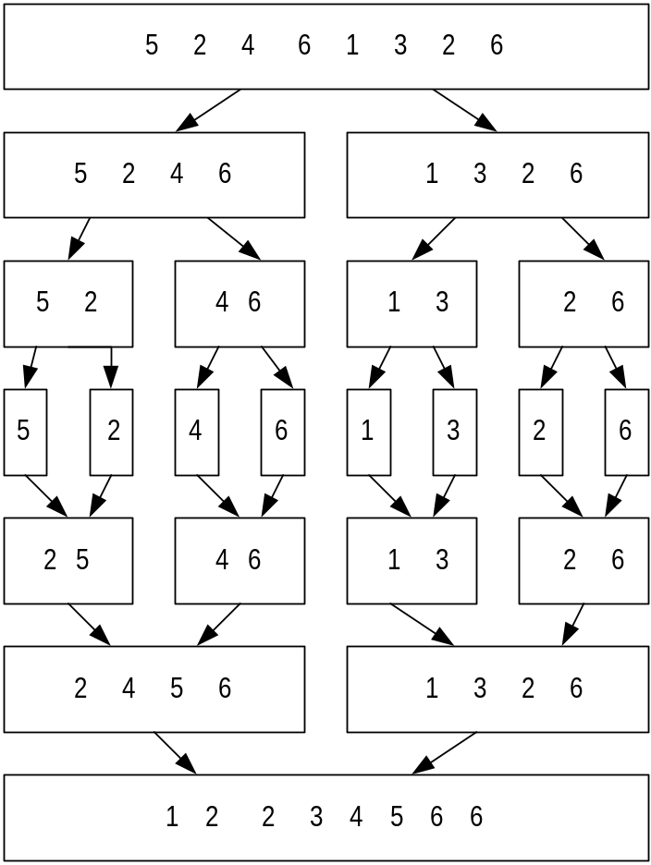
Merge Sort: Example

Slide 17
Process of merge
3
5
7
8
10
3
5
7
8
10
1
2
4
6
9
2
4
6
9
1
3
5
7
8
10
5
7
8
10
4
6
9
4
6
9
1
2
1
2
3
5
7
8
10
6
9
1
2
3
4

Slide 18
Merge algorithm
Merge(U[0..m],V[0..n],E[0..n+m])
i = 0 , j = 0
k = 0
while k < n+m
if U[i] < V [j]
E[k] = U[i] , i++
else
E[k] = V[j] , j++
k++

Slide 19
Exercise: 11-3 Merge sort
We assume that you make a mobile phone’s address book.
At the very least, you should declare the structure that can store “name”, “phone number” and “e-mail address”. And, you should declare the singly-linked list that can store about 100 data that have this structure.
You write a program that reads about 10 data from an input file to the list and writes the data to an output file after sorting in ascending order for name.
You must use Merge sort for sorting.

Slide 20
Exercise: Recursive Processing
Write a recursive algorithm for dealing a deck of cards. The parameters should be (i) the deck of undealt cards, and (ii) the person who is to receive the next card. Assume:
the players are seated around a table;
dealing begins with the player to the dealer’s left;
each dealing step involves dealing one card to a player, then the dealer’s attention moves to the next player to the left; and
dealing continues until no cards are left in the deck.

Slide 21
Exercise: Recursive Processing
Write a recursive function void recurTriangle ( int n, char ch ) which prints out an upside-down triangle. The parameter ch is the character to be used for drawing the triangle, and n is the number of characters on the first row. For example, if n is 7 and ch is ’+’, then the output of the function should be:
  +++++++
  ++++++
  +++++
  ++++
  +++
  ++
  +

Slide 22
Hints
You can write a program that processes in the following order.
  1. Declare char data[10].
  2. Read every 1 word from the standard input by fgetc( ) function and load it on the array “data”.
  3. Do the insertion sort to the array “data”
  4. Output every 1 word of the value of the sorted array ”sort” by fputc( ) function.

Slide 23
Exercise 11-4: String sorting
Write a program that sorts strings with quick sort by alphabetical order based on the following instructions.

Slide 24
I. Compare the character strings
Write the function “preceding()” to search which of two character strings comes before by alphabetical order.
int preceding(char *first, char *second)
A return value is by alphabetical order
  Case that the character string of the argument “first” is before the character string of the argument “second” : 1
  Case that the character string of the argument “first” is equal to the character string of the argument “second” : 0
  Case that the character string of the argument “first” is after the character string of the argument “second” : -1

Slide 25
II. Input the character string from the file
Write the function “setup_nameList()” to read the name of more than 2 persons and less than 25 persons from the file and set them to the array “nameList[]” of a character string (in fact, the array of the pointer to the character string )
int setup_nameList(char *namelist[], char *filename)

Slide 26
III. Implement Quicksort
Write the function “qsort_name()” to sort the character string of the array “namelist[]” by alphabetical order with quick sort using the function you made ever.

