Slide 1

C Programming Basic – week 10
Sorting
Lecturers :
Cao Tuan Dung
Le Duc Trung
Dept of Software Engineering
Hanoi University of Technology

Slide 2
Topics of this week
Elementary Sorting Algorithm
  Insertion
  Selection
  Bubble (exchange)
Heap sort Algorithm

Slide 3

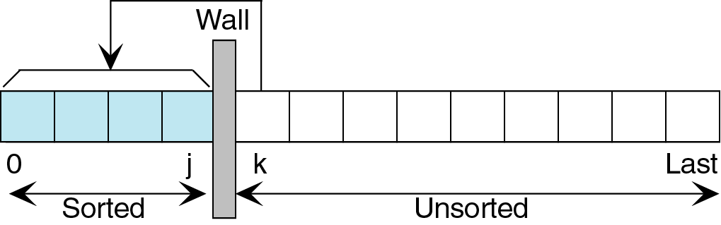
Insertion sort
Strategy of Card Players
Sorts list by
  Finding first unsorted element in list
  Moving it to its proper position
  Efficiency: O(n²)

Slide 4
Original List
23
78
45
8
32
56
8
23
45
78
32
56
Apter step 3
unsorted
sorted
unsorted
Apter step 1
Apter step 4
23
78
45
8
32
56
8
23
32
45
78
56
unsorted
sorted
unsorted
Apter step 2
Apter step 5
23
45
78
8
32
56
8
23
32
45
56
78
sorted
unsorted
unsorted

Slide 5
Insertion Sort
void insertionSort(element list[], int n)
{
int i, j;
element next;
for (i=1; i<n; i++)
{
next= list[i];
for(j=i-1;j>=0 && next.key < list[j].key;j--)
list[j+1] = list[j];
list[j+1] = next;
}
}

Slide 6
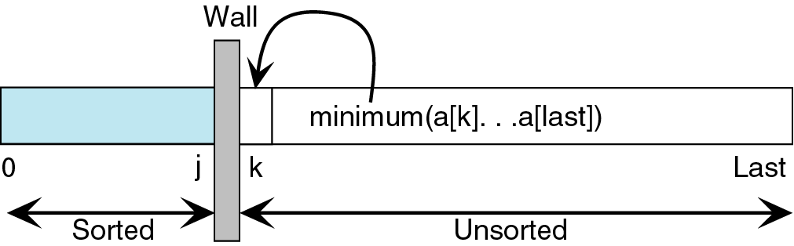
Selection sort
Sorts list by
  Finding smallest (or equivalently largest) element in the list
  Moving it to the beginning (or end) of the list by swapping it with element in beginning (or end) position

Slide 7
Selection sort
void selection(element a[], int n)
{ int i, j, min, tmp;
for (i = 0; i < n-1; i++)
{
min = i;
for (j = i+1; j <=n-1 ; j++)
if ( a[j].key < a[min].key)
min = j;
tmp= a[i];
a[i]= a[min]);
a[min] = tmp;
}
}

Slide 8
Exercise
We assume that you make a mobile phone’s address book.
At least, we want to write a program that can store about 100 structure data with name and phone number and e-mail address.
Read about 10 data from an input file to this structure, and write the data that is sorted in ascending order into an output file.
Use the insertion sort and selection sort
(1) Write a program that uses array of structure
(2) Write a program that uses singly-linked list or doubly-linked list.
In both program, print out the number of comparisons made during the sorting process of each algorithm.

Slide 9
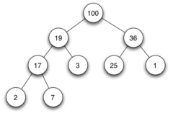
Heap sort
Heap: a binary tree which
  The root is guaranteed to hold largest node in tree
  Smaller values can be on either right or left sub-tree
  The tree is complete or nearly complete
  Key value of each node is >= to key value in each descendent

Slide 10
Heap sort
Array interpreted as a binary tree
1 2 3 4 5 6 7 8 9 10
26 5 77 1 61 11 59 15 48 19
[1]
26
input file
[2]
5
[3]
77
[4]
1
[5]
61
[6]
11
[7]
59
[8]
15
[9]
48
[10]
19

Slide 11
Heap sort illustration
[1]
61
[2]
48
[3]
59
15
19
11
[7]
26
[4]
[5]
[6]
[8]
5
[9]
1
[10]
77
(a)
[1]
59
[2]
48
[3]
26
15
19
11
[7]
1
[4]
[5]
[6]
[8]
5
[9]
61
[10]
77
(b)

Slide 12
Heap sort illustration
[1]
48
[2]
19
[3]
26
15
5
11
[7]
1
[4]
[5]
[6]
59
59
61
[8]
[9]
61
[10]
77
(c)
[1]
26
[2]
19
[3]
11
48
15
5
1
[7]
48
[4]
[5]
[6]
59
[8]
59
[9]
61
[10]
77
(d)

Slide 13
Heap sort
void adjust(element list[], int root, int n)
{
int child, rootkey;
element temp;
temp=list[root];
rootkey=list[root].key;
child=2*root;
while (child <= n)
{
if ((child < n) &&
(list[child].key < list[child+1].key))
child++;
if (rootkey > list[child].key) break;
else {
list[child/2] = list[child];
child *= 2; }
}
list[child/2] = temp;
}
i
2i
2i+1
2i

Slide 14
Heap sort
void heapSort(element list[], int n)
{
int i, j;
element temp;
for (i=n/2; i>0; i--) adjust(list, i, n);
for (i=n-1; i>0; i--)
{
swap(list[1], list[i+1], temp);
adjust(list, 1, i);
}
}
ascending order (max heap)
bottom-up
n-1 cylces
top-down

Slide 15
Heap sort
Max heap following first for loop of heapsort
initial heap
[1]
77
[2]
61
[3]
59
exchange
[4]
48
[5]
19
[6]
11
[7]
26
[8]
15
[9]
1
[10]
5

Slide 16
Exercise
We assume that you make a mobile phone’s address book.
At least, we want to write a program that can store the declared about 100 structure data with name and phone number and e-mail address.
Read the about 10 data from an input file to this structure, and write the data that is sorted in ascending order into an output file.
Use the heap sort. Print out the number of comparisons.

Slide 17
Exercise: Comparison of running time
Write a program to initiate an array of 500 integers by using random function.
Sort this array using insertion sort and heap sort. Calculate the running time of program in each case and print out the results.

Slide 18
Help
function for generating random numbers: srand(time(NULL))and rand()
Time functions
#include <time.h>
time_t t1,t2;
time(&t1);
/* Do something */
time(&t2);
durationinseconds = (int) t2 –t1;

Slide 19
Exercise
Input 10 words from the standard input, and load them to a character type array.
Sort the array by insertion sort, and output the sorted array into the standard output.

Slide 20
Hints
You can write a program that processes in the following order.
  1. Declare char data[10].
  2. Read every 1 word from the standard input by fgetc( ) function and load it on the array “data”.
  3. Do the insertion sort to the array “data”
  4. Output every 1 word of the value of the sorted array ”sort” by fputc( ) function.

