Slide 1

C Programming Basic – week 4,5
For Data Structure and Algorithms
Lecturers :
Cao Tuan Dung
Le Duc Trung
Dept of Software Engineering
Hanoi University of Technology

Slide 2
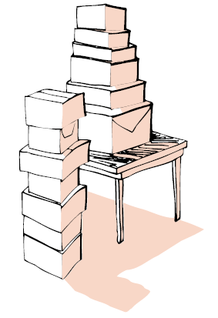
Topics of this week
Data structure: Stack
  Implementation of stack using array
  Implementation of stack using linked list
Data structure Queue
  Implementation of circular queue using array
  Implementation of queue using linked list
Exercises on Stack and Queue

Slide 3
Stack
A stack is a linear data structure which can be accessed only at one of its ends for storing and retrieving data.
A LIFO (Last In First Out) structure
B
A
C
B
A
D
C
B
A
E
D
C
B
A
top
D
C
B
A
top
top
top
top
top
Inserting and deleting elements in a stack

Slide 4
Operations on a stack
initialize(stack) --- clear the stack
empty(stack) --- check to see if the stack is empty
full(stack) --- check to see if the stack is full
push(el,stack) --- put the element el on the top of the stack
pop(stack) --- take the topmost element from the stack
How to implement a stack?
pop
push
full
O
F
I
L
empty

Slide 5
Separate implementation from specification
INTERFACE: specify the allowed operations
IMPLEMENTATION: provide code for operations
CLIENT: code that uses them.
Could use either array or linked list to implement stack
Client can work at higher level of abstraction

Slide 6
Implementation using array
0
1
2
3
4
5
6
7
S
10
5
8
9
T: top
Each element is stored as an array's element.
stack is empty: top= 0
stack is full: top = Max_Element

Slide 7
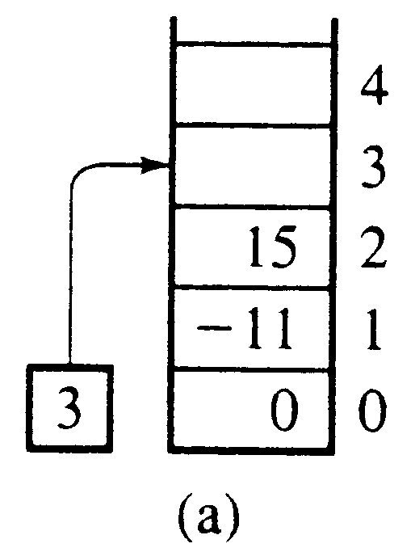
Stack specification (stack.h)
Top of stack
#define Max 50
typedef int Eltype;
typedef Eltype StackType[Max];
int top;
void Initialize(StackType stack);
int empty(StackType stack);
int full(StackType stack);
void push(Eltype el, StackType stack);
Eltype pop(StackType stack);

Slide 8
array implementation of stack (stack.c)
Initialize(StackType stack) push(Eltype el, StackType stack)
{ {
top = 0; if (full(*stack))
} printf(“stack overflow”);
empty(StackType stack) else stack[top++] = el;
{ }
return top == 0; Eltype pop(StackType stack)
} {
full(StackType stack) if (empty(stack))
{ printf(“stack underflow”);
return top == Max; else return stack[--top];
} }

Slide 9
stack implementation using structure
Implementation (c): stack is declared as a structure with two fields: one for storage, one for keeping track of the topmost position
  #define Max 50
  typedef int Eltype;
  typedef struct StackRec
  {
  Eltype storage[Max];
  int top;
  };
  typedef struct StackRec StackType;

Slide 10
stack implementation using structure
Initialize(StackType *stack) push(Eltype el, StackType *stack)
{ {
(*stack).top=0; if (full(*stack))
} printf(“stack overflow”);
empty(StackType stack) else (*stack).storage[
(*stack).top++]=el;
{ }
return stack.top == 1; Eltype pop(StackType *stack)
} {
full(StackType stack) if (empty(*stack))
{ printf(“stack underflow”);
return stack.top == Max; else return
(*stack).storage[--(*stack).top];;
} }

Slide 11
Compile file with library
You'got stack.h, stack.c and test.c
You need to insert this line:
#include "stack.h"
into stack.c and test.c
gcc – c stack.c
gcc –c test.c
gcc – o test.out test.o stack.o

Slide 12
Implementation using linked list
Implementation of stacks using linked lists are very simple
The difference between a normal linked list and a stack using a linked list is that some of the linked list operations are not available for stacks
Being a stack we have only one insert operation called push().
– In many ways push is the same as insert in the front
We have also one delete operation called pop()
  – This operation is the same as the operation delete from the front

Slide 13
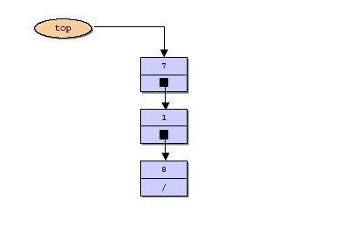
Pictorial view of stack
struct node
{
int data;
struct node *link;
};

Slide 14
Push
top
Temp
struct node *push(struct node *p, int value)
{
struct node *temp;
temp=(struct node *)malloc(sizeof(struct node));
if(temp==NULL)
{
printf("No Memory available Error\n");
exit(0);
}
temp->data = value;
temp->link = p;
p = temp;
return(p);
}
7
45
1
8
\

Slide 15
Push
Temp
top
45
struct node *push(struct node *p, int value)
{
struct node *temp;
temp=(struct node *)malloc(sizeof(struct node));
if(temp==NULL)
{
printf("No Memory available Error\n");
exit(0);
}
temp->data = value;
temp->link = p;
p = temp;
return(p);
}
7
1
8
\

Slide 16
Push
Temp
top
45
struct node *push(struct node *p, int value)
{
struct node *temp;
temp=(struct node *)malloc(sizeof(struct node));
if(temp==NULL) {
printf("No Memory available Error\n");
exit(0);
}
temp->data = value;
temp->link = p;
p = temp;
return(p);
}
7
1
8
\

Slide 17
Pop (linked list)
top
Temp
45
struct node *pop(struct node *p, int *value)
{
struct node *temp;
if(p==NULL)
{
printf(" The stack is empty can not pop Error\n");
exit(0);
}
*value = p->data;
temp = p;
p = p->link;
free(temp);
return(p);
}
7
1
8
\
Value at top element need
to be save before pop operation

Slide 18
Pop (linked list)
top
Temp
45
struct node *pop(struct node *p, int *value)
{
struct node *temp;
if(p==NULL)
{
printf(" The stack is empty can not pop Error\n");
exit(0);
}
*value = p->data;
temp = p;
p = p->link;
free(temp);
return(p);
}
7
1
8
\

Slide 19
Pop (linked list)
top
Temp
struct node *pop(struct node *p, int *value)
{
struct node *temp;
if(p==NULL)
{
printf(" The stack is empty can not pop Error\n");
exit(0);
}
*value = p->data;
temp = p;
p = p->link;
free(temp);
return(p);
}
7
1
8
\

Slide 20
Using stack in program
# include <stdio.h>
# include <stdlib.h>
void main()
{
struct node *top = NULL;
int n,value;
do
{
do
{
printf("Enter the element
to be pushed\n");
scanf("%d",&value);
top = push(top,value);
printf("Enter 1 to continue\n");
scanf("%d",&n);
} while(n == 1);
printf("Enter 1 to pop an element\n");
scanf("%d",&n);
while( n == 1)
{
top = pop(top,&value);
printf("The value poped is %d\n",value);
printf("Enter 1 to pop an element\n");
scanf("%d",&n);
}
printf("Enter 1 to continue\n");
scanf("%d",&n);
} while(n == 1);
}

Slide 21
Using stack in program
printf("Enter 1 to pop an element\n");
scanf("%d",&n);
while( n == 1)
{
top = pop(top,&value);
printf("The value poped is %d\n",value);
printf("Enter 1 to pop an element\n");
scanf("%d",&n);
}
printf("Enter 1 to continue\n");
scanf("%d",&n);
} while(n == 1);
}

Slide 22
Exercises
Test the "stack" type that you've defined in a program that read from user a string, then reverse it.

Slide 23
Adding very large numbers
Treat these numbers as strings of numerals, store the numbers corresponding to these numerals on two stacks, and then perform addition by popping numbers from the stacks
1
2
9
4
3
2
3
+
=
7
6
6
8
5
1
8732 + 5629 = 14361

Slide 24
Adding very large numbers: detail algorithm
Read the numerals of the first number and store the numbers corresponding to them on one stack;
Read the numerals of the second number and store the numbers corresponding to them on another stack;
result=0;
while at least one stack is not empty
pop a number from each non-empty stack and add them;
push the sum (minus 10 if necessary) on the result stack;
store carry in result;
push carry on the result stack if it is not zero;
pop numbers from the result stack and display them;

Slide 25
Exercise 4.1 Stack using array
We assume that you make a mobile phone’s address book.
Declare a structure "Address" that can hold at least "name", "telephone number" and "e-mail address".
Write a program that copies data of an address book from a file to another file using a stack. First, read data of the address book from the file and push them on a stack. Then pop data from the stack and write them to the file in the order of popped. In other words, data read first should be read out last and data read last should be read out first.

Slide 26
Exercise 4-2: Conversion to Reverse Polish Notation Using Stacks
Write a program that converts an expression in the infix notation to an expression in the reverse polish notation. An expression consists of single-digit positive numbers (from 1 to 9) and four operators (+, -, *, /). Read an expression in the infix notation from the standard input, convert it to the reverse polish notation, and output an expression to the standard output. Refer to the textbook for more details about the Reverse Polish Notation.
For example,
3+5*4
is input, the following will be output.
3 5 4 * +

Slide 27
STACK.h
void STACKinit(int);
int STACKempty();
void STACKpush(Item);
Item STACKpop();

Slide 28
STACK.c
#include <stdlib.h>
#include "Item.h"
#include "STACK.h"
static Item *s;
static int N;
void STACKinit(int maxN)
{ s = malloc(maxN*sizeof(Item)); N = 0; }
int STACKempty()
{ return N == 0; }
void STACKpush(Item item)
{ s[N++] = item; }
Item STACKpop()
{ return s[--N]; }

Slide 29
Solution
#include <stdio.h>
#include <string.h>
#include "Item.h"
#include "STACK.h"
main(int argc, char *argv[])
{ char *a = argv[1]; int i, N = strlen(a);
STACKinit(N);
for (i = 0; i < N; i++)
{
if (a[i] == ')')
printf("%c ", STACKpop());
if ((a[i] == '+') || (a[i] == '*'))
STACKpush(a[i]);
if ((a[i] >= '0') && (a[i] <= '9'))
printf("%c ", a[i]);
}
printf("\n");
}

Slide 30
Postfix expression evaluation
Write a program that reads any postfix expression involving multiplication and addition of interger.
For example
./posteval 5 4 + 6 * => 54

Slide 31
STACK.H
void STACKinit(int);
int STACKempty();
void STACKpush(Item);
Item STACKpop();

Slide 32
Solution
#include <stdio.h>
#include <string.h>
#include "Item.h"
#include "STACK.h"
main(int argc, char *argv[])
{ char *a = argv[1]; int i, N = strlen(a);
STACKinit(N);
for (i = 0; i < N; i++)
{
if (a[i] == '+')
STACKpush(STACKpop()+STACKpop());
if (a[i] == '*')
STACKpush(STACKpop()*STACKpop());
if ((a[i] >= '0') && (a[i] <= '9'))
STACKpush(0);
while ((a[i] >= '0') && (a[i] <= '9'))
STACKpush(10*STACKpop() + (a[i++]-'0'));
}
printf("%d \n", STACKpop());
}

Slide 33
Solution: polish.h
#include <assert.h>
#include <ctype.h>
#include <stdio.h>
#include <stdlib.h>
#define EMPTY 0
#define FULL 10000
struct data
{
enum {operator, value} kind;
union
{
char op;
int val;
}u;
};
typedef struct data data;
typedef enum {false, true} boolean;
struct elem {
/* an element on the stack */
data d;
struct elem *next;
};

Slide 34
Solution: polish.h
typedef struct elem elem;
struct stack {
int cnt; /* a count of the elements */
elem *top; /* ptr to the top element */
};
typedef struct stack stack;
boolean empty(const stack *stk);
int evaluate(stack *polish);
void fill(stack *stk, const char *str);
boolean full(const stack *stk);
void initialize(stack *stk);
data pop(stack *stk);
void prn_data(data *dp);
void prn_stack(stack *stk);
void push(data d, stack *stk);
data top(stack *stk);

Slide 35
Solution: eval.c
#include "polish.h"
int evaluate(stack *polish)
{
data d, d1, d2;
stack eval;
initialize(&eval);
while (!empty(polish)) {
d = pop(polish);
switch (d.kind) {
case value:
push(d, &eval);
break;
case operator:
d2 = pop(&eval);
d1 = pop(&eval);
d.kind = value;
/* begin overwriting d */
switch (d.u.op) {
case '+':
d.u.val = d1.u.val + d2.u.val;
break;
case '-':
d.u.val = d1.u.val - d2.u.val;
break;
case '*':
d.u.val = d1.u.val * d2.u.val;
}
push(d, &eval);
}
}
d = pop(&eval);
return d.u.val;
}

Slide 36
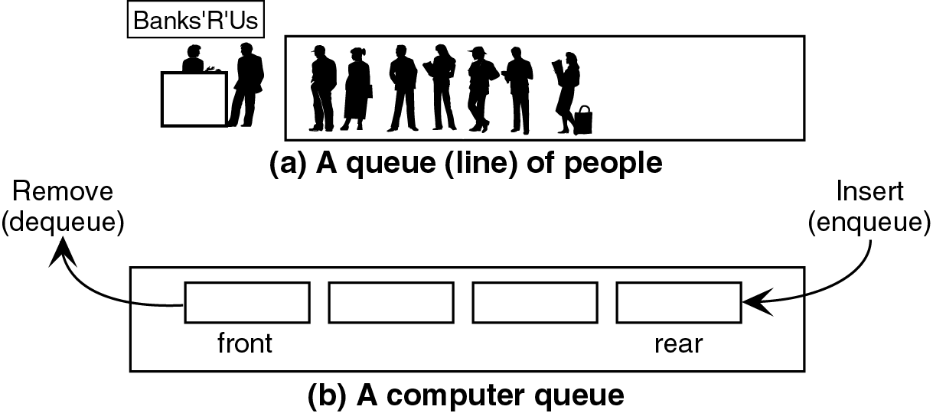
Queue
A queue is a waiting line
Both ends are used: one for adding elements and one for removing them.
Data is inserted (enqueued) at the rear, and removed (dequeued) at the front

Slide 37
Data structure FIFO
Queue items are removed in exactly the same order as they were added to the queue
  FIFO structure: First in, First out
front
rear

Slide 38
Operations on queue
Queue CreateQ(max_queue_size) ::=
create an empty queue whose maximum size is
max_queue_size
Boolean IsFullQ(queue, max_queue_size) ::=
if(number of elements in queue == max_queue_size)
return TRUE
else return FALSE

Slide 39
Operations on queue
Queue EnQ(queue, item) ::=
if (IsFullQ(queue)) queue_full
else insert item at rear of queue and return queue
Boolean IsEmptyQ(queue) ::=
if (queue ==CreateQ(max_queue_size))
return TRUE
else return FALSE
Element DeQ(queue) ::=
if (IsEmptyQ(queue)) return
else remove and return the item at front of queue.

Slide 40
Implementation using array and structure
#define MaxLength 100
typedef ... ElementType;
typedef struct {
ElementType Elements[MaxLength];
//Store the elements
int Front, Rear;
} Queue;

Slide 41
Initialize and check the status
void MakeNull_Queue(Queue *Q){
Q->Front=-1;
Q->Rear=-1;
}
int Empty_Queue(Queue Q){
return Q.Front==-1;
}
int Full_Queue(Queue Q){
return (Q.Rear-Q.Front+1)==MaxLength;
}

Slide 42
Enqueue
void EnQueue(ElementType X,Queue *Q){
if (!Full_Queue(*Q)){
if (Empty_Queue(*Q)) Q->Front=0;
Q->Rear=Q->Rear+1;
Q->Element[Q->Rear]=X;
}
else printf("Queue is full!");
}

Slide 43
Dequeue
void DeQueue(Queue *Q){
if (!Empty_Queue(*Q)){
Q->Front=Q->Front+1;
if (Q->Front > Q->Rear) MakeNull_Queue(Q);
// Queue become empty
}
else printf("Queue is empty!");
}

Slide 44
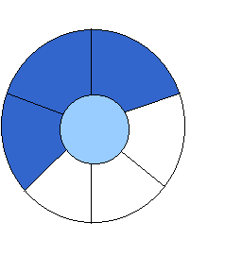
Implementation 2: regard an array as a circular queue
front: one position counterclockwise from the first element
rear: current end
EMPTY QUEUE
[2]
[3] [2] [3]
J2
J3
[1] [4] [1] [4]
J1
[0] [5] [0] [5]
front = 0 front = 0
rear = 0 rear = 3

Slide 45

Problem: one space is left when queue is full
FULL QUEUE FULL QUEUE
[2] [3] [2] [3]
J2 J3
J8 J9
J7
[1] [4][1] [4]
J1 J4
J5
J6 J5
[0] [5] [0] [5]
front =0
rear = 5
front =4
rear =3

Slide 46
Queue is full or not?
int Full_Queue(Queue Q){
return (Q.Rear-Q.Front+1) % MaxLength==0;
}

Slide 47
Dequeue
void DeQueue(Queue *Q){
if (!Empty_Queue(*Q)){
//if queue contain only one element
if (Q->Front==Q->Rear) MakeNull_Queue(Q);
else Q->Front=(Q->Front+1) % MaxLength;
}
else printf("Queue is empty!");
}

Slide 48
Enqueue
void EnQueue(ElementType X,Queue *Q){
if (!Full_Queue(*Q)){
if (Empty_Queue(*Q)) Q->Front=0;
Q->Rear=(Q->Rear+1) % MaxLength;
Q->Elements[Q->Rear]=X;
} else printf("Queue is full!");
}

Slide 49
Implementation using a List
Exercise: A Queue, is a list specific. Implement operations on queue by reusing implemented operations of list.

Slide 50
Implementation using a List
typedef ... ElementType;
typedef struct Node{
ElementType Element;
Node* Next; //pointer to next element
};
typedef Node* Position;
typedef struct{
Position Front, Rear;
} Queue;

Slide 51
Initialize an empty queue
void MakeNullQueue(Queue *Q){
Position Header; Header=(Node*)malloc(sizeof(Node)); //Allocation Header
Header->Next=NULL;
Q->Front=Header;
Q->Rear=Header;
}

Slide 52
Is-Empty
int EmptyQueue(Queue Q){
return (Q.Front==Q.Rear);
}

Slide 53
EnQueue
void EnQueue(ElementType X, Queue *Q){
Q->Rear->Next=
(Node*)malloc(sizeof(Node));
Q->Rear=Q->Rear->Next;
Q->Rear->Element=X;
Q->Rear->Next=NULL;
}

Slide 54
DeqQueue
void DeQueue(Queue *Q){
if (!Empty_Queue(Q)){
Position T;
T=Q->Front;
Q->Front=Q->Front->Next;
free(T);
}
else printf(”Error: Queue is empty.”);
}

Slide 55
Exercise 4-3: Queues Using Lists
We assume that you write a mobile phone’s address book.
Declare a structure "Address" that can hold at least "name", "telephone number" and "e-mail address".
Write a program that copies data of an address book from the file to other file using a queue. First, read data of the address book from the file and add them to the queue. Then retrieve data from the queue and write them to the file in the order of retrieved. In other words, data read in first should be read out first and data read in last should be read out last.

Slide 56
Exercises
Make a queue that holds integers. The size of the queue is fixed to 10.
Read integers separated by spaces from the standard input, and add them to the queue. When the program reads the 11th integer, the queue is already full. So the program removes the first integer and adds the 11th integer. Print the removed integer to the standard output.
Process all the integers in this way.

Slide 57
Exercise:To Do List
By using a queue, write a To Do List management program with a menu for adding, deleting, modifying elements in the list.
A work has the following fields:
  Time
  Place
  People
  Description.
The time field can be the system time at the moment of input.

Slide 58
Another implementation using array
Queue CreateQ(max_queue_size) ::=
# define MAX_QUEUE_SIZE 100
typedef struct {
int key; /* other fields */
} element;
element queue[MAX_QUEUE_SIZE];
int rear = -1;
int front = -1;
Boolean IsEmpty(queue) ::= front == rear
Boolean IsFullQ(queue) ::= rear == MAX_QUEUE_SIZE-1

Slide 59
Enqueue
void enq(int *rear, element item)
{
/* add an item to the queue */
if (*rear == MAX_QUEUE_SIZE_1) {
queue_full( );
return;
}
queue [++*rear] = item;
}

Slide 60
Dequeue
element deq(int *front, int rear)
{
if ( *front == rear)
return queue_empty( );
/* return an error key */
return queue [++ *front];
}

Slide 61
Enqueue
void addq(int front, int *rear, element item)
{
*rear = (*rear +1) % MAX_QUEUE_SIZE;
if (front == *rear) /* reset rear and print error */
return;
}
queue[*rear] = item;
}

Slide 62
Dequeue
element deleteq(int* front, int rear)
{
element item;
if (*front == rear)
return queue_empty( );
/* queue_empty returns an error key */
*front = (*front+1) % MAX_QUEUE_SIZE;
return queue[*front];
}

