Slide 1

Back-end development

Slide 2
Objectives
What is Front-End, Back-End, FullStack?
Understand the basic of Data Structures and Algorithms.
Understand the basic of Programming language and Framework.
What is Web Hosting?
What is CI/CD?

Slide 3
What is Front-End Develoment
Front End development and Front End programming languages create what a user interacts.
HTML, CSS, and JavaScript are the three Front End languages
Each language has a specific function.
Developers use frameworks and code libraries for efficiency as BootStrap, Jquery,…

Slide 4
What is Back-End Develoment
A Back End dev uses a set of Back End developer languages to bring the Front End language of a developer to life.
Back End dev is creating the brains and logic of the website.
Back End languages retrieve information from a database stored in a server that’s then processed through an application

Slide 5
What is Full Stack?
Full Stack development covers the full range of web development
Full Stack devs are not experts in both Front End and Back End development
Startups and smaller companies have popularized the role

Slide 6
Front End vs. Back End vs. Full Stack
Three very popular developer roles
Front End and Back End are specialized while Full Stack is generalized
Full Stack uses Front End and Back End programming languages

Slide 7
Back End Developer Skills
Array of skills are needed to be successful as a backend developer:
Python
Java
PHP
SQL
Git
HTML
CSS
JavaScript
Communication

Slide 8
Back-End Tool and Technology
Servers
The server is the engine of the network out of the four parts of your back-end stack, whether it's on-premises or in the cloud.
These powerful computers provide the shared resources such as file storage, security and encryption, databases, email, and web services that networks require to function.
Databases
Databases serve as the brains that give websites their dynamic nature
SQL vs. NoSQL
How to choose the right database for your web application

Slide 9
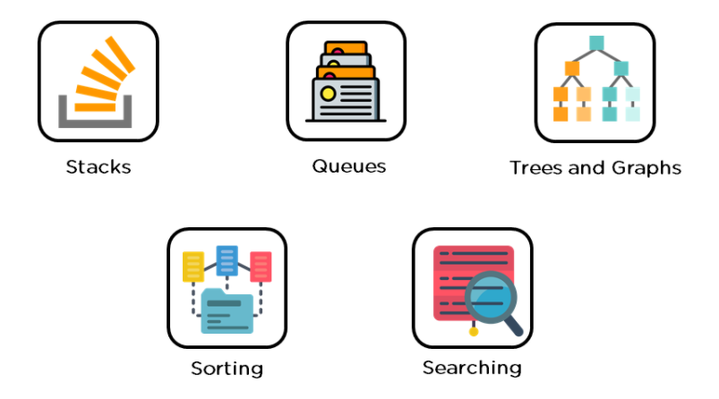
Data Structures and Algorithms
A backend developer creates code that does relational mapping to retrieve data from a database.
MySQL, PostgreSQL, SQL SERVER, MongoDB, and Oracle Database are some of the most widely used DBMS. It's crucial to have a good understanding of how they work.

Slide 10
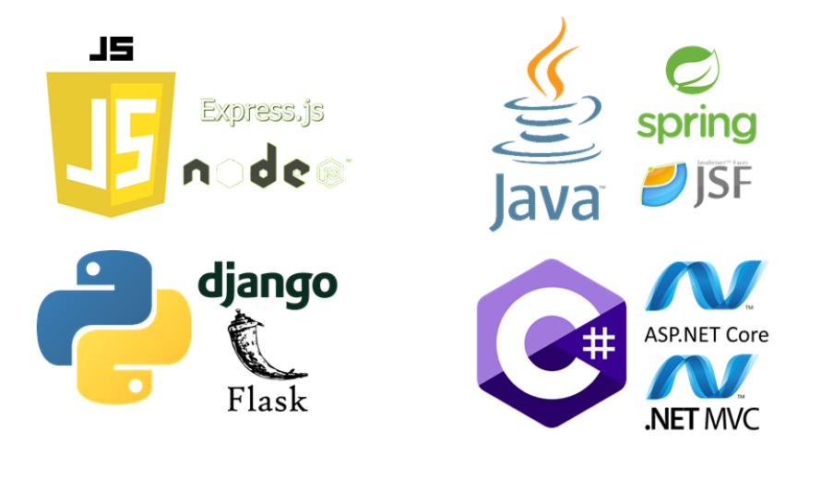
Programming Languages and Frameworks
Programming languages and frameworks are next on the list.
An in-depth understanding of backend programming languages is one of the most important skills of a backend developer. This comprises the items listed below.

Slide 11
Programming Languages and Frameworks – cont’d
NodeJS and ExpressJS are examples of JavaScript environments.
Java, in particular, was designed from the start to be used on the server. Spring and Java Server Faces are two popular Java frameworks.
Python is the most widely used programming language. It's adaptable and simple to use. Backend development is done with Python frameworks like Django and Flask.
C# language is the recommended architecture for backend programming.
PHP, Perl, and Ruby are some of the other languages available. Because backend and frontend developers collaborate so closely, having a basic understanding of front-end web technologies like HTML and CSS is also beneficial.

Slide 12

Version Control
Version control systems aid in the management of project files and the tracking of the user's whole history. Git, GitHub, and Subversion are some of the most popular ones.
Git aids in the management of project files. It maintains track of everything the user has worked on in the past. GitHub is a web-based version control service using Git.
The user can examine other people's code, spot errors, and even suggest modifications.

Slide 13
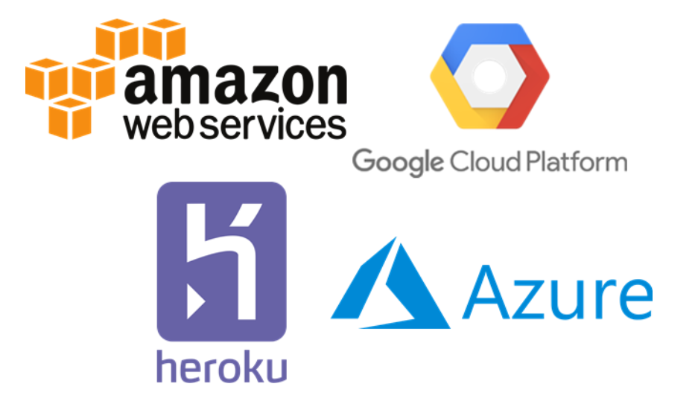
Web Hosting Platforms
Web hosting solutions enable you to place your product on a cloud service provider and access it via the internet.
Amazon Web Services(AWS)
Google Cloud Platform(GCP)
Microsoft Azure.
Heroku.
Firebase.
Notes:
A backend developer should, of course, have non-technical skills such as problem-solving, critical thinking, effective communication, and analytical abilities. It is important for a backend developer to also be able to work both as part of a team, and independently.

Slide 14
Back-End Developer Tasks
Back-end developers are required to have technical expertise, analytical thinking, and excellent collaboration skills. Here’s what many back-end developers do on a day-to-day basis:
Build and maintain websites
Write high-quality code
Perform quality assurance (QA) testing
Assess efficiency and speed
Troubleshoot and debug
Train and support
Notes:
Some of the popular Backend developer roles are as follows-
Back End Developer
Java Developer
Full-Stack Developer
DevOps Engineer
Software Engineer
iOS Developer

Slide 15
Back End Developer Responsibilities
To design effective and efficient solutions
Application Programming Interfaces (APIs) development and administration.
Develop data acceptance and storage solutions for websites, particularly for those involved in payment processing.
Write, test, and maintain development solutions for code-related problems are all part of the job.
To identify new features, communicate effectively with developers, designers, and system administrators.
Create a website architecture by utilizing correct product lifecycle approaches, such as Agile Scrum and frameworks.
Organize the system logic.
Provide remedies to difficulties with the system.
Debug and troubleshoot apps.

Slide 16
Common skills needed for Back-End Development
Having a fundamental understanding of HTML, JavaScript, and CSS.
Practical experience with back-end development (configuration, administration, and management of databases and servers).
Languages used on servers, such as JavaScript (Node.js), PHP, C#, and Java.
Database engineering (e.g., MySQL and SQL).
Best practices for security and authentication. Proficiency in creating RESTful APIs

Slide 17
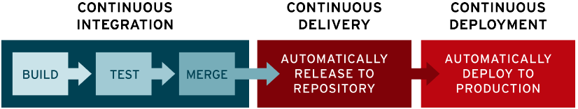
What is CI/CD?
CI/CD, which stands for continuous integration and continuous delivery/deployment, aims to streamline and accelerate the software development lifecycle.
Continuous integration (CI) refers to the practice of automatically and frequently integrating code changes into a shared source code repository.
Continuous delivery and/or deployment (CD) is a 2 part process that refers to the integration, testing, and delivery of code changes.

Slide 18
Summary
Concepts were introduced:
What is Front-End?
What is Back-End?
What is FullStack?
Understand the basic of Data Structures and Algorithms.
Understand the basic of Programming language and Framework.
What is Web Hosting?
What is CI/CD?

