Slide 1

Server-side Development with NodeJS, Express and MongoDB

Slide 2
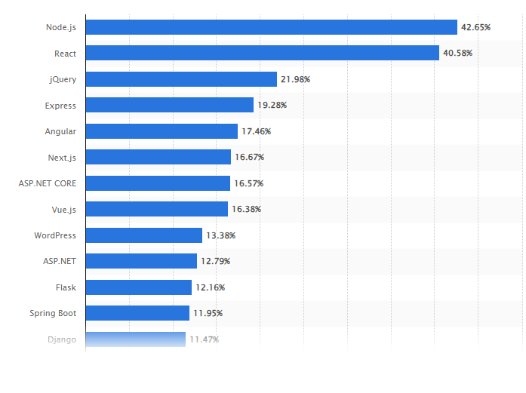
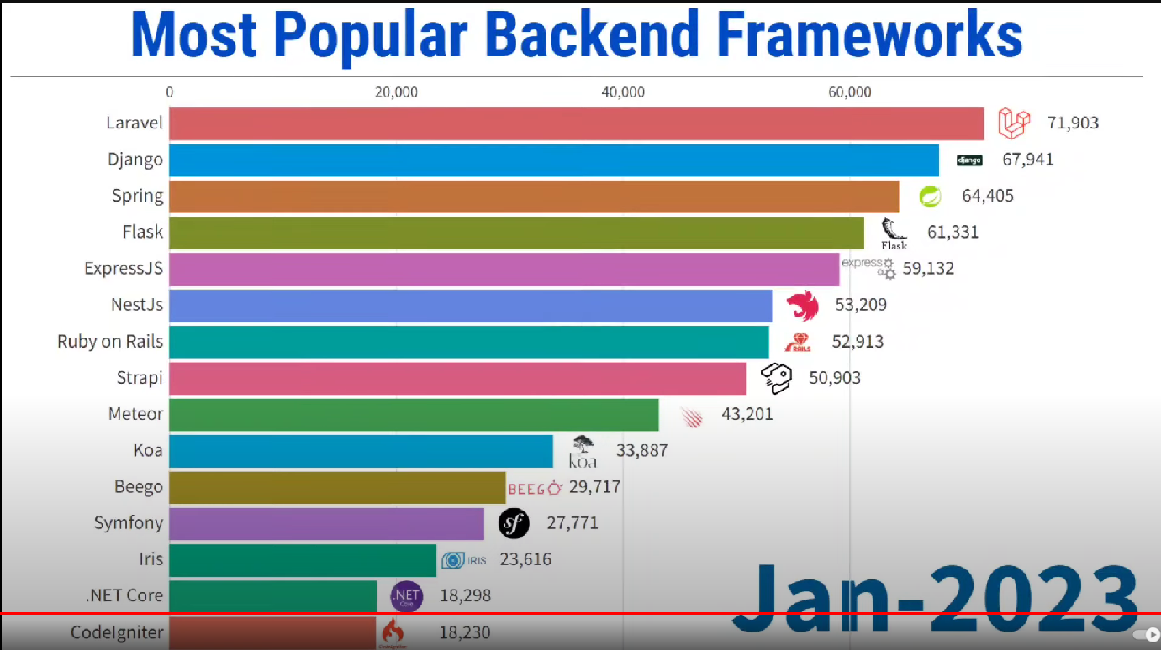
Why should you study this course?
Source: https://statisticsanddata.org/data/most-popular-backend-frameworks-2012-2023/
Most used web frameworks among developers worldwide, as of 2023
Source: https://www.statista.com/statistics/1124699/worldwide-developer-survey-most-used-frameworks-web/

Slide 3
Prerequisites
Completed:
DBI202; FER202

Slide 4
Course Objectives
Demonstrate an understanding of server-side concepts, CRUD, and REST
Build and configure a backend server using the NodeJS framework
Build a RESTful API for the front-end to access backend services

Slide 5
Course Description
Why should you learn Node.js and take this course?
Node.js will allow you to use your JavaScript skills to build applications on the back-end. That itself is a huge gain, which makes your full-stack development process so much easier and faster.
Popularity and opportunities for Node.js are off the charts. It's a modern, proven, and reliable technology, used by tech giants (and 6-figure-salary-paying companies) like Netflix, PayPal, Uber, and many more.

Slide 6
Course Description
Overview of Web protocols: HTTP and HTTPS.
Introduction of NodeJS and NodeJS: Express modules to build a web server.
Deploy the application on a web server with basic CRUD operations. Work with NoSQL databases, specifically MongoDB and Mongoose, to access MongoDB from NodeJS, MVC Pattern.
Overview of REST and building a RESTful API.
Learn Authentication and security-related issues for web applications.

Slide 7
Course Description
After finishing this course, you will:
Be building your own fast, scalable, and powerful Node.js RESTful APIs or web applications;
Truly understand how Node.js works behind the scenes;
Be able to work with NoSQL data and model data in real-world situations (a hugely important skill);
Know how modern back-end development works, and how all the different technologies fit together;
Have experience in professionally used tools and libraries like Express, Mongoose, Atlas, Compass, Git, Render, Vercel, and many more;
Have built a complete application, which is a perfect starting point for your own applications in the future.
Please note that this course is NOT for absolute web development beginners, so you should already be familiar with basic JavaScript. NO back-end experience required though!

Slide 8
Course Plan
See course plan on FLM
(https://flm.fpt.edu.vn)

Slide 9
Materials/ References
Full Stack Web Development Guide_ Everything Node JS, Express, APIs, EJS, React JS, Database Fundamentals, SQL Databases
Ultimate Full-Stack Web Development with MERN_ Design, Build, Test and Deploy Production-Grade Web Applications with MongoDB, Express, React and NodeJS-Orange Education PVT Ltd (2023)
https://www.mongodb.com/
https://ejs.co/
https://expressjs.com/
https://nodejs.org/docs/latest/api/
https://handlebarsjs.com/
NestJS - A progressive Node.js framework
Hono - Ultrafast web framework for the Edges
LMS forum

Slide 10
Learning Environments
NodeJS – v20.12.2
NPM (Node Package Management) – v10.5.0
Express - v4.19.2
Postman
MongoDB (Community) - v6.0
Visual Studio Code (version 1.88 or later) (https://code.visualstudio.com/Download)
A Notebook for reports of labs and assignments.

Slide 11
Course Rules
How to conduct
Prepare contents of the next session at home
Following lessons in classroom
Completing module assessments in time and Quizzes (via LMS)
Write reports of all exercises and assignments to your notebook
Communication
Class
Interchange by FU LMS, Forum
Discussing actively in your team and classroom
Free to question and answer
Others
Off phone, no game, no chat in class
Use laptop under teacher’s instruction

Slide 12
Evaluation Strategy
Must attend more than 80% of contact hours (if not, not allow to take exam).
Evaluating
03 Progress Test (PT: 15%)
04 Assignment (AS: 20%)
01 Project (PR: 15%)
01 Practical Exam (PE: 25%)
Final Exam (FE: 25%)
Final result = 15%(PT) + 20%(AS) + 15%(PR) + 25%(PE) + 25% (FE)
Pass:
Every on-going assessment component > 0
Final Exam score >= 4, Practical Exam score >= 4
Final result >= 5
Final exam retake only when not passed

Slide 13
How to study
This course is complex knowledge (however, it’s attractive and exciting), so you need to keep a tight grip on it
Read
On the books to get the general concept
Reference, study, collection from anywhere else (internet, your classmate, forum …)
Attend lectures
Listen, understand, then make your notes
Give your explanation about some topic in lectures
Ask questions
Give some examples that do not exist in your book
Practice all the exercises, demo to make your sense
After classes
Discuss your classmate indirectly, on the forum
Analyze, design, and implement exercise and assignment. Write reports in your notebook
Build your team in yourselves to support together in studying

Slide 14
Academic policy
Cheating, plagiarism and breach of copyright are serious offenses under this Policy.
Cheating
Cheating during a test or exam is construed as talking, peeking at another student’s paper or any other clandestine method of transmitting information.
Plagiarism
Plagiarism is using the work of others without citing it; that is, holding the work of others out as your own work.
Breach of Copyright
If you photocopy a textbook without the copyright holder's permission, you violate copyright law.

Slide 15
Install tools for programming if needed
Q&A

