Slide 1
Computer Graphics and Human Computer Interaction
Lecture 10 CSCW
Manasawee Kaenampornpan
manasaweek@gmail.com
http://www.italpha.msu.ac.th/manasawee

Slide 2
About this course
Purpose
This subject examines the design, evaluation and implementation of interactive computing systems for human use (HCI) and the major phenomena surrounding them. Also considered are joint performance of tasks by humans and machines, structure of human machine communication, social and organizational interactions with machine design, human capabilities to use machines including their learn ability, engineering concerns that arise in designing interfaces, the process of specification design, implementation and evaluation of interfaces and design tradeoffs.
Assessment
  Individual courseworks (40%)
  Quiz (10%)
  Final (50%)

Slide 3
About this course
Topics
  Introduction
  Frameworks for Cognition and Theories
  Usability
  Graphics and Sound
  Design Methods and Process
  Usability testing
  CSCW
  Mobile and Ubiquitous Interaction

Slide 4
What Is CSCW?
Computer Supported C--------- Work
  Cooperative
  Collaborative
  Competitive
Design and evaluation of new technologies to support social work processes
Fusion of sociology and computing
Creation of groupware systems

Slide 5
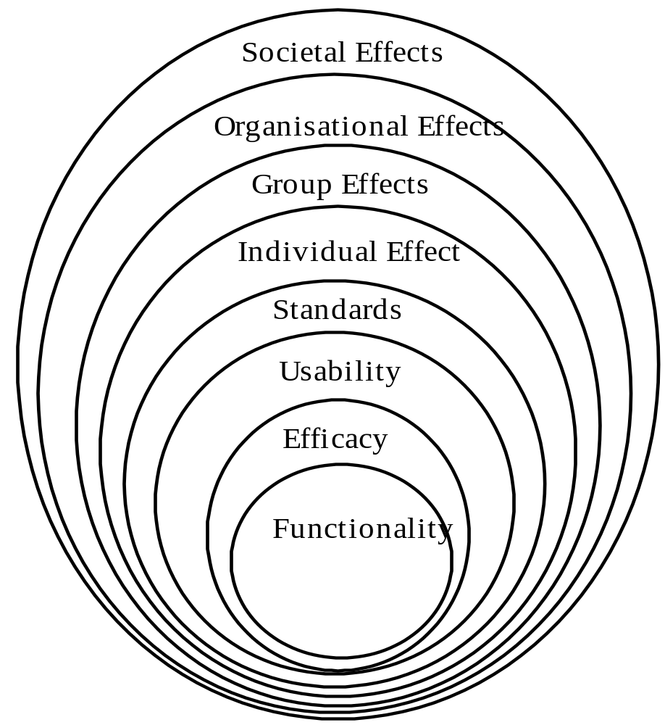
Layers of CSCW (the onion)
Proposed by Ramage

Slide 6
Questions about work & CSCW
Does it work? (functionality)
Does it work well enough? (efficacy)
Is it workable with? (usability)
Does it follow appropriate standards?
What does it do to those who work with it? (individual effects)
What does it do to their work? (group effects)
What does it do to those they work with and for? (organisational effects)
What does it do to the world beyond work? (societal effects)

Slide 7
Social
Psychology
Organisational
theory
Cognitive
Psychology
Cognitive
Psychology
Sociology
Sociology
Sociology
HCI
Software engineering

Slide 8
Cooperation is… (1)
“working together” (Latin: co = together, operari = work)
conducted between two or more people
usually (not necessarily) for common gain
also see Michael Argyle (1991): Cooperation: The Basis of Sociability
“acting together, in a coordinated way at work, leisure or social relationships, in pursuit of a shared goal, the enjoyment of the social activity, or simply furthering the relationship”

Slide 9
Cooperation is… (2)
requires communication between those co-operating
requires shared understanding
often some kind of benefit for all those taking part
requires effort on all parts to maintain
awareness of others' actions, thoughts and feelings is important

Slide 10
Is cooperation always good?
Often posed as the opposite of conflict
But this ignores political & economic differences between co-operators
  e.g. between workers & managers, or between departments with different agenda
The Mafia is one of the most cooperative group there is! (within itself)

Slide 11
Cooperative work (1)
Marx: “multiple individuals working together in the same production process or in different but connected production processes”
What other kind of work is there?

Slide 12
Cooperative work (2)
Marx: “Production by an isolated individual - a rare exception which may well occur when a civilized person in whom the social forces are dynamically present is cast by accident into the wilderness - is as much an absurdity as is the development of language without individuals living together and talking to each other”

Slide 13
Kinds of cooperative work
Assembly line
Web of activity

Slide 14
What is a cooperative system?
Ramage’s definition: “a combination of technology, people and organisations that facilitates the communication and coordination necessary for a group to effectively work together in the pursuit of a shared goal, and to achieve gain for all its members.”

Slide 15
Points noted by Ramage
Technology (hardware and/or software) is one part, equally important are the human structures necessary for cooperation.
The Co-operative System is a means to an end which may just be the process of cooperation
Without a shared goal and gain for all, we cannot say that co-operation is taking place

Slide 16
Groupware
Groupware is technology designed to facilitate the work of groups.
This technology may be used to communicate, cooperate, coordinate, solve problems, compete, or negotiate.
While traditional technologies like the telephone qualify as groupware, the term is ordinarily used to refer to a specific class of technologies relying on modern computer networks, such as email, newsgroups, videophones, or chat.
Watch VDO: - Cutouts workspace Mgt for tabletop groupware

Slide 17
CSCW Space-Time Matrix
 | Same Time | Different Time
Same Place | Face to Face (classes, meetings) | Asynchronous interaction (Post it notes, group notice board)
Different Place | Sync distributed (shared editors, chat system, multi player games) | Asynchronous distributed (Email, mailing list, online group calendar)

Slide 18
Asynchronous Distributed
(Different Time, Different Place)
Email
  Delivery occurs in seconds or minutes
  Multimedia becoming widespread
Mailing list
  Leverage email to send to many people
Newsgroups
  Alternate forum facilitates longer (threaded) discussions, larger amounts of information

Slide 19
Asynchronous Interaction
(Different Time, Same Place)
Computer artifacts
  Understand what previous users did or will do
  Foster informal discussions via artifacts
  Post-it notes, bathroom walls, room schedules
  Notification Collage
Place as a metaphor
  Create and leverage virtual place much like physical place
  other virtual worlds

Slide 20
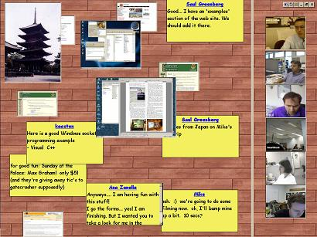
Notification Collage
Users can post notes and pictures to NC
Information appears on a large-screen display in a shared area
Goal is to foster community and future discussions

Slide 21
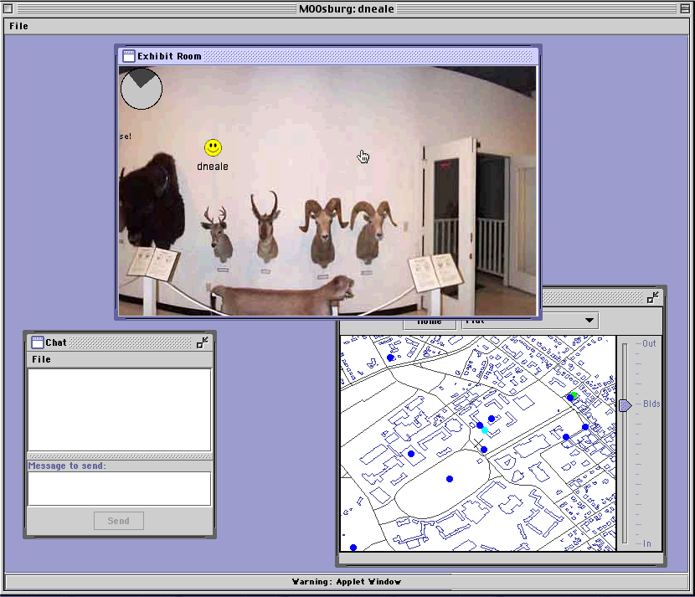
Moosburg
Synchronous chat augmented by ability to leave comments
Future visitors can see who has been at a place and what their reactions were

Slide 22
Synchronous Distributed
(Same Time, Different Place)
Initial interfaces included telephone and television
Networked computers facilitate distributed applications that update in real-time
Must address issues of ownership and control of information

Slide 23
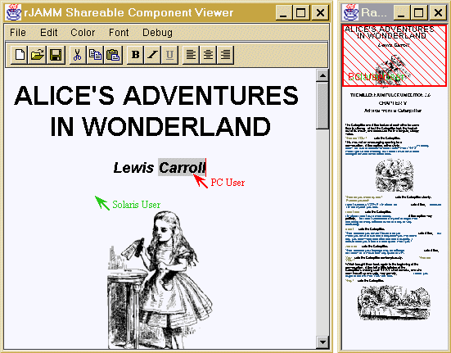
Shared Editors
Collaboration-aware shared editors
Provide several insertion points
Show who is editing document and where
Include locking protocols or turn-taking
Watch VDO: Introducing a new Google Docs

Slide 24
Face To Face
(Same Time, Same Place)
Teams often work together using complex shared technology
  Pilots, co-pilots
  Air traffic controllers
  Stock market trading rooms
  Offices and classrooms

Slide 25
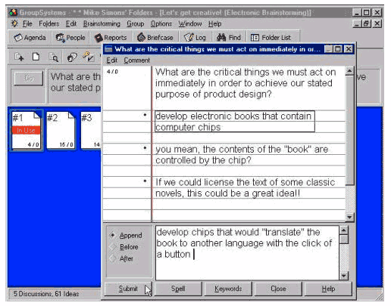
GroupSystems
Facilitates file sharing, shared workspace, and group activities
Users can submit information, take surveys, or present ideas
Watch VDO: Groupware tool

Slide 26
Evaluating Groupware
Complexities of human-human communication and group working make evaluation difficult
Finding large numbers of groups is difficult, leading to smaller numbers and less chance for significant results

Slide 27
Experimental Studies
Subject groups
  Requires more subjects for longer times
  Times and places often difficult to arrange
Experimental task
  Decision games test creativity, interaction, structure, leadership (desert survival, diplomacy)
Data gathering
  Logging not sufficient as human-human interaction is important
  Multiple video shots often used to focus on individuals
Analysis
  Anecdotal analysis common (field/ethnographic studies)
  Within-subject analysis, microanalysis common

Slide 28
Why Does Groupware Fail?
Disparity between who does work and who gets benefit
Threats to existing power structures
Insufficient critical mass of users
Violation of social taboos
Arguments over measures of success

Slide 29
Why CSCW Applications Fail
Consider group calendar scheduling
  What are its advantages?
  What are its disadvantages
  Who does it support?

Slide 30
Why CSCW Applications Fail
Consider voicemail
  What are its advantages?
  What are its disadvantages
  Who does it support?

Slide 31
Why CSCW Applications Fail
Consider Hi5 vs Facebook
  What are their advantages?
  What are their disadvantages?
  Who do they support?

Slide 32
Why Does Groupware Fail?
Disparity between who does work and who gets benefit
Threats to existing power structures
Insufficient critical mass of users
Violation of social taboos
Arguments over measures of success

Slide 33
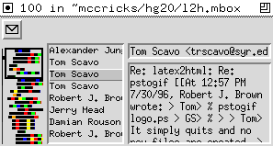
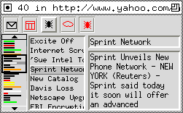
Case Study: Irwin
Monitors Internet resources (email, Usenet news, Web pages, weather)
Uses graphical, textual, and audio communication mechanisms
Effective use of limited screen space

Slide 34
Positives from Irwin
People seem receptive to concept of information awareness devices
Significant variation among users for informational goals and communication mechanisms
Examine the power of a single display mechanism in raising awareness

Slide 35


Case Study: What’s Happening
Goal: promote community awareness and expand social capital with glance-ables
WH communication-bar unobtrusively and calmly sits in a corner cycling through news and chats
Content from:
  Users
  Calendars
  Web pages

Slide 36
WH Lessons
At most 30 users in a community of 300
Usage required frequent reminders and urging by the developer
Occasional bursts of use followed by extended passive observation
Chatting rare but occasionally animated, typically in response to an article

Slide 37

Case Study: Sideshow
Difficult to keep track of asynchronous, distributed info
Sideshow is “a peripheral awareness interface designed to help users stay aware of people and info”
Design principles
  Make it always present
  Minimize motion
  Make it personal
  Make it extensible
  Support quick drill-down and escape
  Make it scalable (up to dozens of items)

Slide 38


Sideshow Components
Included are:
  Meeting timers
  Mailbox updates
  Buddy lists
  Video chat lists
  Stock quotes
  Bug reports
  Weather forecast
  Traffic pics/maps
  Ticket button
Mouseovers show “tooltip grandes” (large interactive tooltips)
Tickets on Web pages allow content to be added
Internal study: Sideshow distracting but worth it (?)

Slide 39
What Is the Biggest CSCW Success Story? What’s Next?
Email
Instant messages
World Wide Web
Mobile telephones
Video conferencing
Irwin? WH? Sideshow?

Slide 40
Why groupware?
to facilitate communication: make it faster, clearer, more persuasive
to enable communication where it wouldn't otherwise be possible
to enable telecommuting
to cut down on travel costs
to bring together multiple perspectives and expertise
to form groups with common interests where it wouldn't be possible to gather a sufficient number of people face-to-face
to save time and cost in coordinating group work
to facilitate group problem-solving
to enable new modes of communication, such as anonymous interchanges or structured interactions

Slide 41
Summary
What is CSCW?
Groupware
CSCW Space-Time Matrix
Examples
Why groupware?
Research paper: Human computation tasks with global constraints http://dx.doi.org/10.1145/2207676.2207708
Co-reading: investigating collaborative group reading http://dx.doi.org/10.1145/2232817.2232876
Beyond the LAN: Techniques from Network Games for Improving Groupware Performance http://dx.doi.org/10.1145/1316624.1316669
Exploring display techniques for mobile collaborative learning in developing regions http://dx.doi.org/10.1145/2037373.2037388

Slide 42
Sources
Druin, A. (In Press). The Role of Children in the Design of New Technology. BIT.
ftp://ftp.cs.umd.edu/pub/hcil/Reports-Abstracts-Bibliography/99-23html/99-23.html
Saul Greenberg “User Centered Design and Prototyping” http://pages.cpsc.ucalgary.ca/~saul/hci_topics/topics/prototyping.html
Magnus Ramage’s on-line essay, “On Cooperative Systems”, also see Ramage’s description of his Evaluation of Cooperative Systems project

Slide 43
Lecture 11 Mobile & Ubiquitous Interaction
Dr. Manasawee Kaenampornpan

Slide 44
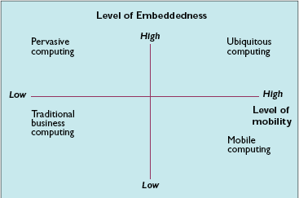
Watch VDO: Future in 2030

Slide 45
Mobile Computing
The application of small, portable, and wireless computing and communication devices
Being able to use a computing device even when being on the move (and thus changing environment)
Portability is one aspect of mobile computing – portable vs. mobile
Mobile telephony in particular allows you to make and receive voice calls on the move

Slide 46
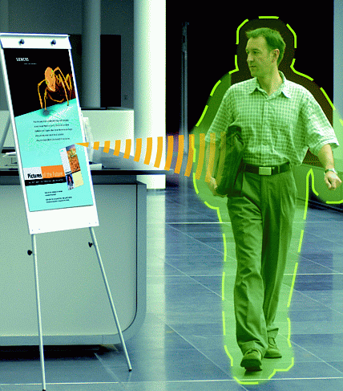
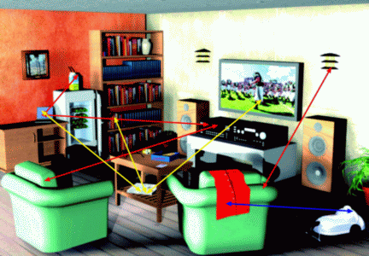
Pervasive Computing
Embedded into environment
Watch VDO: -T4 Touch Screen Restaurant Table
-Adobe Interactive wall at Union Square
- iBar – largest multitouch touchscreen

Slide 47
Ubiquitous Computing
Dictionary definition:
being or seeming to be everywhere at the same time;
omnipresent;
found in large quantities everywhere;
"all over the place.“
Term introduced by Mark Weiser (but others have also described the vision, notably Ken Sakamura)
Computers camouflaged as non-computers, i.e. invisible computers

Slide 48
Ubiquitous computing
– activates the world,
– is invisible, everywhere computing that does not live on a personal device of any sort, but is in the woodwork everywhere,
– makes a computer so imbedded, so fitting, so natural, that we use it without even thinking about it.
Also called: pervasive, deeply embedded, 4G mobile or sentient computing, and ambient intelligence.

Slide 49
Ingredients
Device
– laptop, PDA, mobile phone, tablet, smart phone
Network
– cellular telephony, data over cellular, wi-fi, Bluetooth,
Zigbee, infra-red, 3G, 4G
System support
– routing, billing, voice mail, data routing

Slide 50
Devices Issues
Mobility – doh!
Connectivity – stability, bandwidth
Components – keyboard, display etc
Input and output
Memory, processor and storage
Startup time

Slide 51
The invisible interface - not
Mobility implies freedom
– from a fixed location
– from trailing cables
– of hands (and feet)
Interaction not interface
With GUIs output is visual & input is direct manipulation
Input: voice, gesture, haptic, kinaesthetic?
Output: voice/audio, haptic, visual?

Slide 52
Making information mobile
Assuming you have an application with a UI for a desktop or notebook
To make it mobile, there are essentially 3 options
– Resize
– Reformat
– Reformulate
Resizing isn’t useful for the small screens of handhelds and endless scrolling is a nuisance
Reformatting means adapting the information presentation to the mobile device without fundamentally redesigning the interaction
Reformulating means changing the user’s interaction with the application. This is a bigger design problem

Slide 53
Interaction Space
Tools, representations, artefacts & devices create interaction spaces
The interaction space is the volume within which the device (or whatever) may readily be used
People interact with each other and with devices in participation frameworks
For successful collaboration, the interaction space must contain all the participation frameworks which occur in the course of the collaboration
A device/application (or other artefact) should be designed to create an interaction space which will contain all potential participation frameworks for a given task

Slide 54
Enabling Technologies
Wireless (data) communication
– higher bandwidth
– lower power
– commodity (readily available and secure)
Small form factor devices
– shrinking electronics
– better displays
– new input methods
Personalisation
– Machine learning
– Inference

Slide 55
Enabling Technologies (Cont.)
Automatic identification
– RFID, numbering schemes, network information services
Sensing and actuation
– mechanical, chemical, electric, bio
Context awareness
– physical: properties of objects
– Information: data, profile, provider
– social: identity, situation, role
Ambient displays
– public screens, interaction
Tangible interfaces
Watch VDO: Putting the FUN into RFID from facebook and Coca-cola

Slide 56
Design
How can we enhance [everyday] activities by connecting them to a computational infrastructure?
What computational infrastructure do we need?
Applications are a good way to explore a new paradigm before we have a complete specification of the problems/open questions

Slide 57
Interaction Design
The interface
– Very small interface
– Tangible interface
– No interface
– Everywhere interface
Overcoming real-estate shortage
– new devices, voice / video input (e.g gestures)
– intelligence
How to address many systems rather than computers (without going insane)
Context-awareness

Slide 58
Hardware Design
Small size, low weight, low power
May have to be deployed in harsh environments
Production: extreme cost sensitivity
Fast product cycles
New sensing capabilities

Slide 59
Context-Awareness
The physical environment: user location, presence of other persons or objects in the same location, and the environmental conditions observed.
Time — for example, whether a particular person is occupied by professional or personal concerns.
Device and network characteristics
Information context is the semantic knowledge regarding the domain being investigated—for example, the short term information needs of the user as they might be expressed in a query. Information context also includes the user profiles that reveal long-term interests
Social context

Slide 60
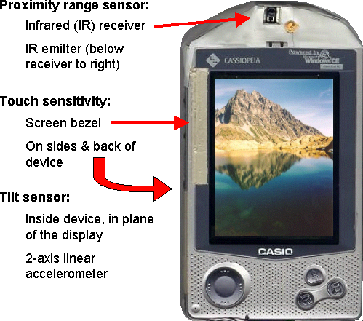
Can Sensors Enhance PocketPC UI?
Sensors:
  Tilt
  Touch
  Proximity
  ~$3.00 parts cost
Sensors will be free & everywhere:
  What new SW features?

Slide 61
Summary
Mobile Computing
Ubiquitous Computing
Issues
Design
Context awareness
Watch VDO: - Putting the FUN into RFID from facebook and Coca-cola
- i-Land Roomware Second Generation
- Project Glass Google Social Networking Headset !
- The Future of Augmented Reality

Slide 62
Sources
http://www.dcs.bbk.ac.uk/~gr/muc/session_1.pdf
http://www.cs.bath.ac.uk/hci/units/ug/cm20143/3MobileInteractionb_w.pdf
Research paper: Supporting active reading on pen and touch-operated tabletops http://dx.doi.org/10.1145/2254556.2254669
Mid-air pan-and-zoom on wall-sized displays http://dx.doi.org/10.1145/1978942.1978969
Findings of e-ESAS: a mobile based symptom monitoring system for breast cancer patients in rural Bangladesh http://dx.doi.org/10.1145/2207676.2208532
Envisioning ubiquitous computing http://dx.doi.org/10.1145/2207676.2208278

Slide 63
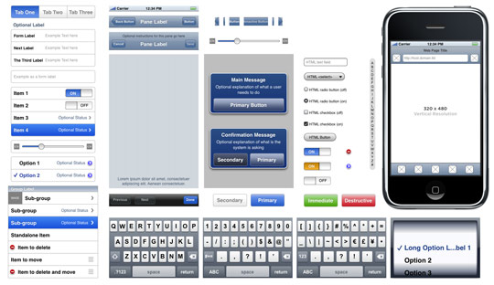
iOS - Objective-C code
Below is a small list of interface elements. This is not an exhaustive collection but should give you an idea of the basic starting points.
status bar
navigation bar
tabs/tab bar
sliders and switches
input fields
table lists

Slide 64
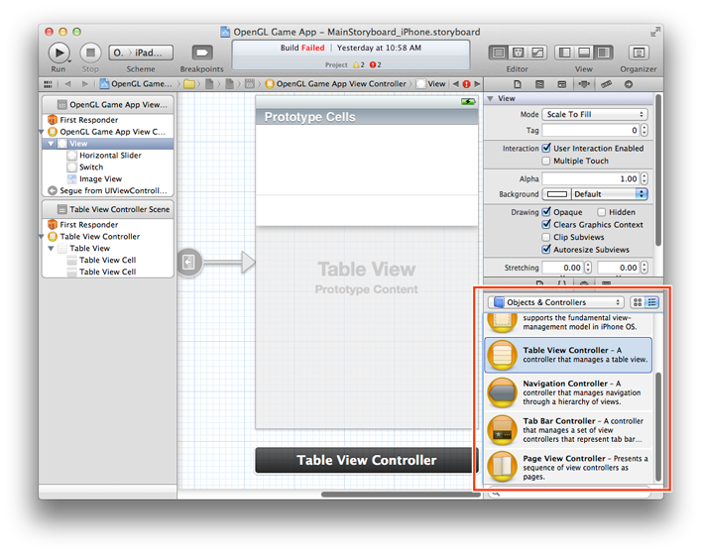
Xcode

Slide 65
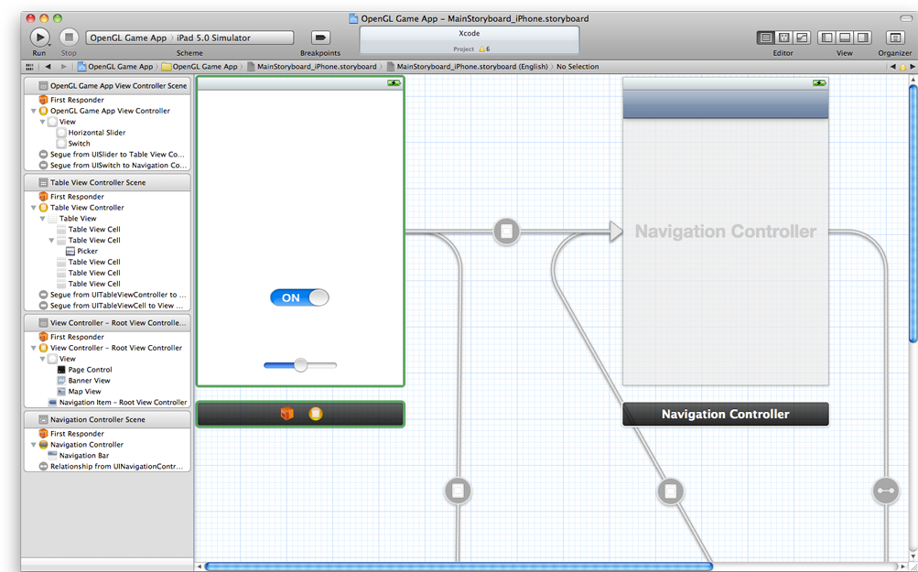

Slide 66
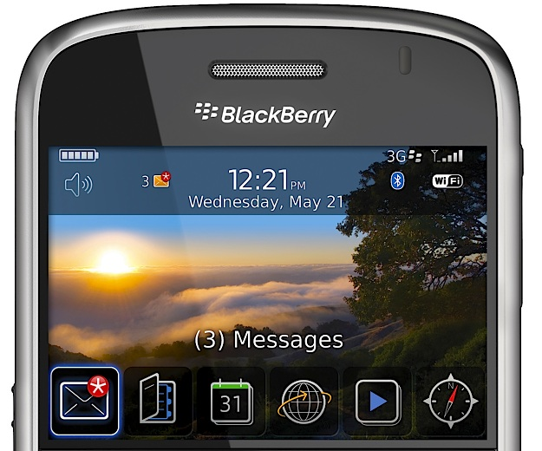
Blackberry
APIs:
  For BlackBerry Java® applications, use the BlackBerry UI APIs.
  For MIDlets, use the MIDP UI APIs.
  A BlackBerry application is an application that uses
    BlackBerry APIs
    CLDC APIs
    MIDP APIs (in some cases)

Slide 67
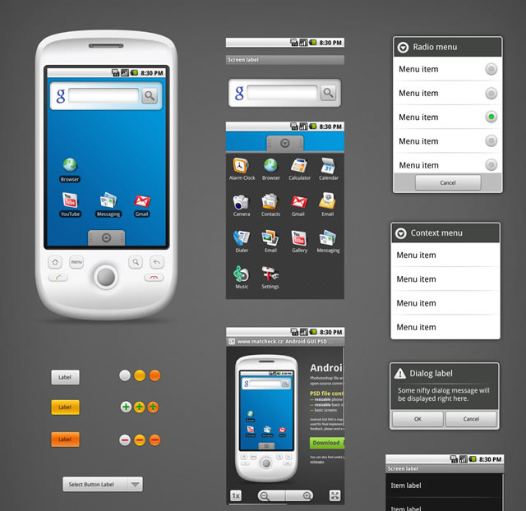
Android

Slide 68
Group work
  For your project >> Write down:
    Functional and Non Functional requirements
    Persona & Scenarios
    Usability and User Experience Goals with the reason for choosing it. Also the measurement values.
    Create prototype of your first design: discuss about your design and the reason of your chosen method for the first prototype
    Discuss result of Card sorting of your first design
    Redesign Version 2 and Create Paper prototype of the whole application
    Do the evaluation of your design: discuss the reason of your picked evaluation method
    Redesign rom the result of your previous evaluation
    And so on….
    Report of your evaluation

