Slide 1
Vibe Coding
Github Copilot

Slide 2
Table of Contents
Github copilot overview
Design UI
Planning
Implement
Unit test

Slide 3
Github copilot overview
Github copilot is an AI-powered coding assistant, offering assistance throughout your software development journey. Leveraging large languare models, it offers suggestions via code completions, ask, plan and agent mode

Slide 4
Github copilot overview
Feature | Free | Pro | Pro+
Price (per month) | $0 | $10 | $39
Code Completion | 2,000 /mo | Unlimited | Unlimited
Chat & Agent Mode | 50 requests/mo | Unlimited (Basic)
Premium Requests | 50 /mo | 300 /mo
Model Choice | Limited | GPT, Claude, Gemini | All (Opus, Gemini)
Key Advantage | Casual use | Best value | Power users

Slide 5
Github copilot overview
Code Completion: suggests code as you type
Copilot Chat: Highlight a block of code and ask, "What does this do?". No edit code
Copilot Agents: Instead of one-off answers, you give a high-level goal (e.g., "Add a dark mode toggle"). The agent plans the steps, edits multiple files, runs terminal commands (like npm install), and checks for errors until the task is done.

Slide 6
Design UI with Google Stitch
https://stitch.withgoogle.com
Google Stitch (recently out of Google Labs as of early 2026) is an AI-native platform focused on "Vibe Design"
Models: Gemini

Slide 7
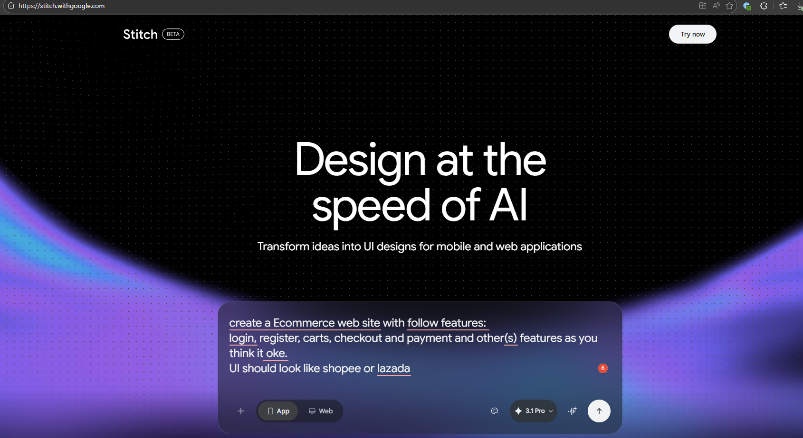
Design UI with Google Stitch

Slide 8
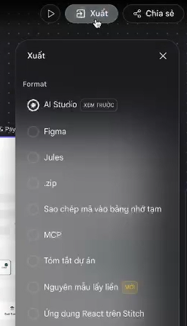
Export UI for Github Copilot

Slide 9
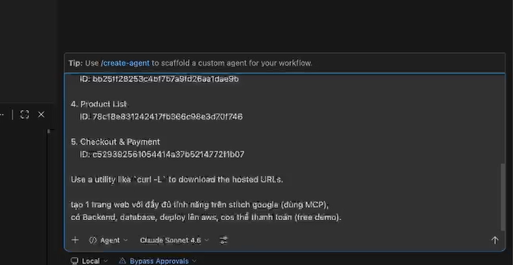
Start Vibe Coding
Open VS Code then paste MCP info to Github chat

Slide 10
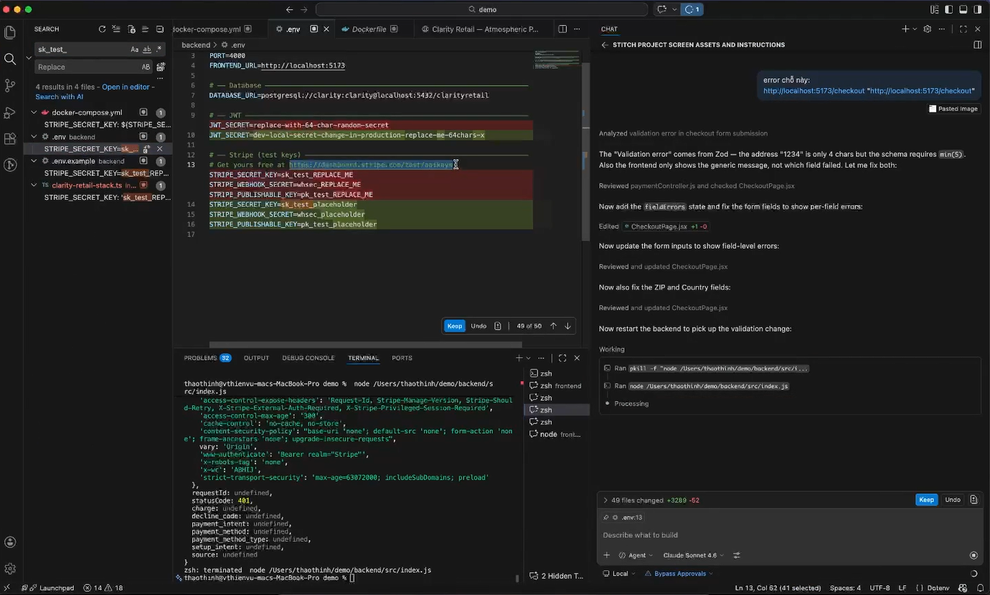

Slide 11
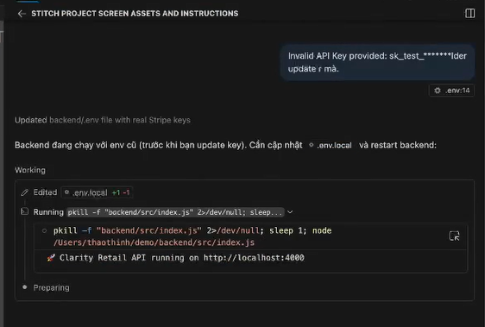
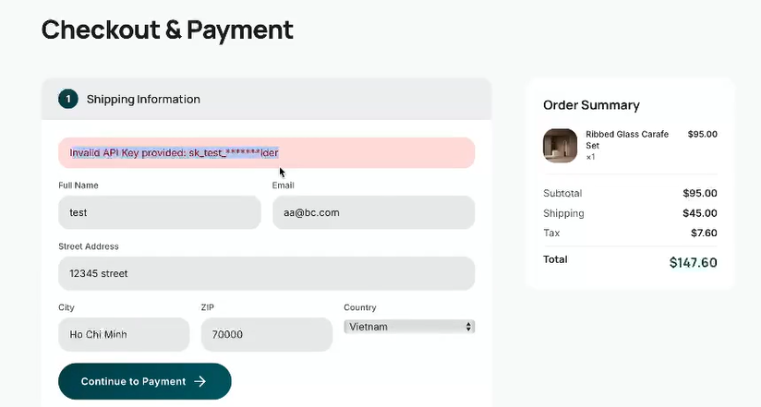
Fix bug
Just copy error and paste to github copilot chat:

