Slide 1
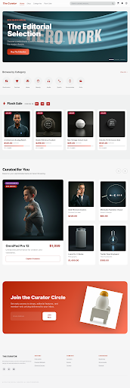
Vibe Coding
Codex
Stitch Commerce OS
Customer storefront, checkout, order history, and admin views packaged into the same artifact layout as sample-1.

Slide 2
Source Brief
What came from docs.webarchive
The imported webarchive describes a broader commerce brief than sample-3: auth, storefront, account, checkout, and admin coverage in one system.
Functional scope
Artifact packaging applied
Deck content uses the webarchive brief plus extracted Stitch screenshots preserved in source assets.
Auth screens: login and register entry flows
Storefront: homepage, search, detail, cart, checkout
User account: orders and post-purchase visibility
Operations: admin dashboard and product management
demo/
docs/
slide/
source/

Slide 3
Architecture
Next.js + Prisma + Stripe
A single Next.js App Router codebase handles the buyer journey, session-bound data, and admin views against PostgreSQL.
Stack
Next.js 14 App Router for customer and admin routes
Prisma schema for users, categories, products, cart, and orders
Stripe Checkout for payment handoff and reconciliation
Shared cached query layer in source/src/lib/store.ts
Browser
-> App Router
-> Prisma
-> PostgreSQL
-> Stripe Checkout
Routes surfaced
Persistence
Payments
Artifacts
10 screens
Prisma + Postgres
Stripe Checkout
demo/docs/slide/source

Slide 4
Structure
Artifact layout aligned with sample-1
The runnable app was moved under source, while walkthrough artifacts now live in top-level demo, docs, and slide folders.
sample-4-codex-2
├── demo
│ ├── README.md
│ └── images
├── docs
│ ├── ARCHITECTURE.md
│ ├── DESIGN_BASIC.md
│ ├── DESIGN_DETAILED.md
│ └── docs.webarchive
├── slide
│ ├── generate_stitch_commerce_os.js
│ └── vibe_coding_with_codex_sample_4.pptx
└── source
├── src
├── prisma
├── public
└── .stitch
This makes the deliverable easier to review in the same way as sample-1-github-copilot, without losing the original Stitch export references.

Slide 5
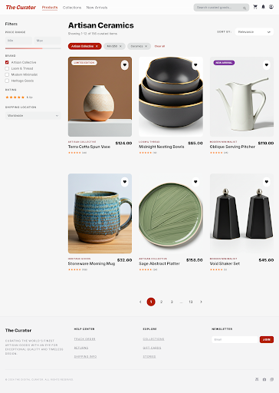
Demo
Storefront entry
Homepage and search are both backed by Prisma queries rather than hard-coded cards.
Homepage
Search results

Slide 6
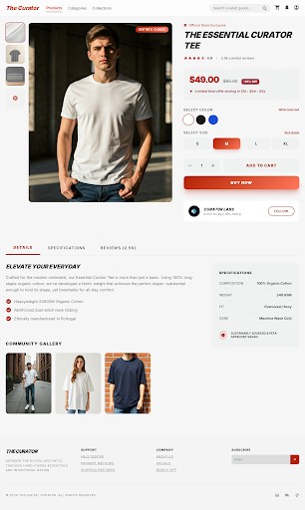
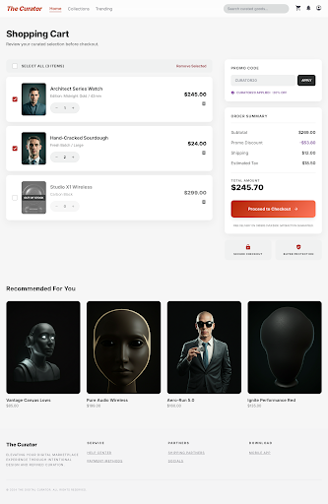
Demo
Product to basket
The detail page and cart keep the same coral editorial brand language.
Product detail
Shopping cart

Slide 7
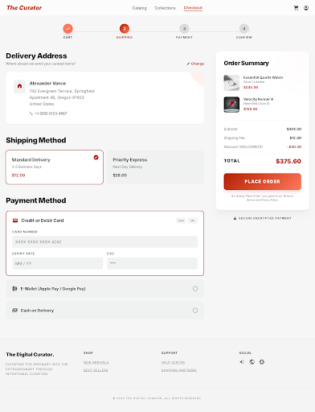
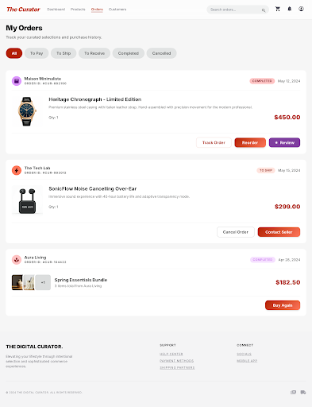
Demo
Checkout to retention
Checkout closes the purchase loop while orders provides the post-purchase state users expect.
Checkout
Orders

Slide 8
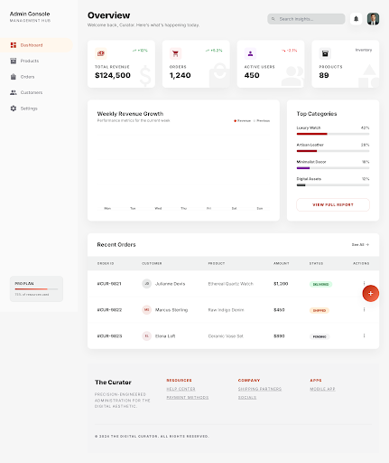
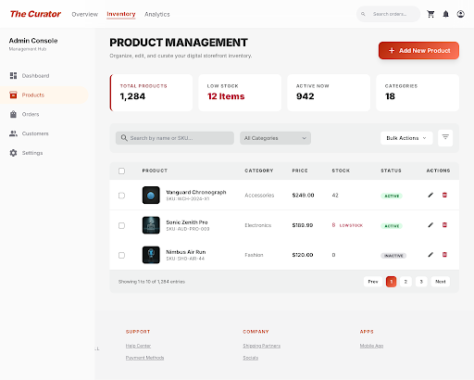
Demo
Admin coverage
The sample also demonstrates operator-facing views for monitoring and inventory storytelling.
Admin dashboard
Product management

