Slide 1
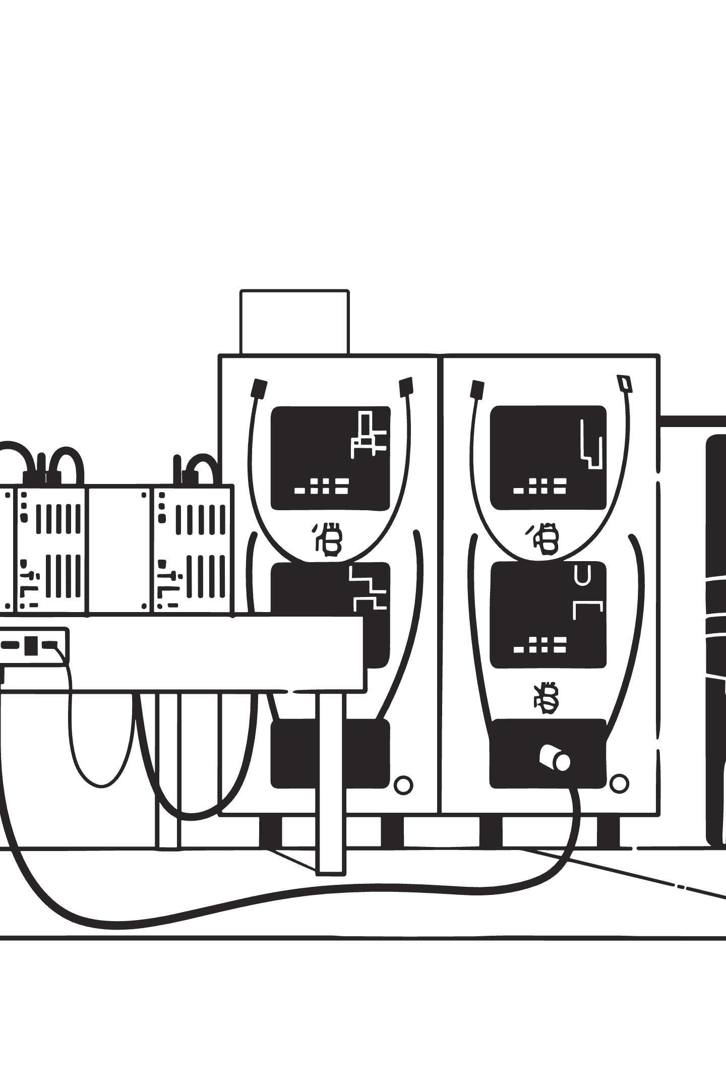
WEEK 4
SYSTEM INTEGRATION
Full System Integration
Bringing it all together: ESP32-S3, multi-sensor array, and real-time LCD output in one unified prototype.

Slide 2
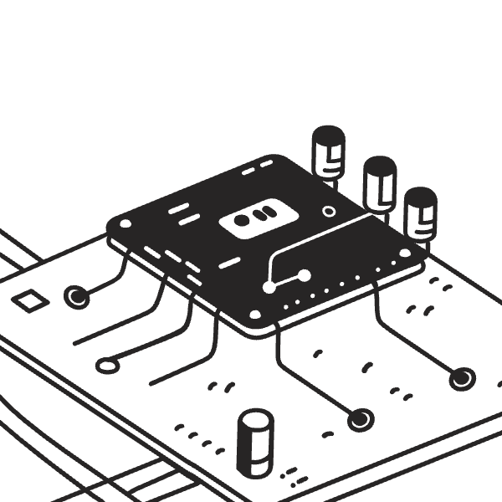
The Integrated Stack
Every module connected and talking through a single MCU hub.
ESP32-S3 — central processor, data aggregation
DHT / VOC sensor — temperature & gas concentration
PM2.5 sensor — particulate matter readings
16×2 LCD — live status display
Serial Monitor — granular debug data

Slide 3

Data Flow Pipeline
From raw analog signals to actionable air-quality insight.
ESP32-S3 Processing
Sensor Readings
LCD Display
Each stage adds fidelity — the LCD shows what the user needs; the Serial Monitor shows what the engineer needs.

Slide 4

Stabilizing Readings
Noisy Sensor Data
Readings fluctuated beyond usable tolerance
Raw sensor output wasn't reliable enough for a functional prototype. Signal jitter threatened the entire data pipeline.
The fix required iterative debugging — adjusting polling intervals, inserting strategic delays between reads, and re-testing across multiple environments to confirm consistency.
Code-Level Adjustments
Tuned sampling logic, added strategic delays
Multi-Environment Testing
Validated stability across varying conditions

Slide 5

RESULTS
NEXT STEPS
Prototype Verified — What's Next
4
1
Sensor Channels
Unified System
Temperature, gas, PM2.5, air status
All modules on a single ESP32-S3
2
Future Upgrades
Wi-Fi monitoring & warning alerts
The prototype is functional and serves as a solid foundation for Io T-enabled air quality tracking.

