Slide 1

WEEK 2
Hardware Connection
Connecting sensors and display to the ESP32-S3 backbone

Slide 2
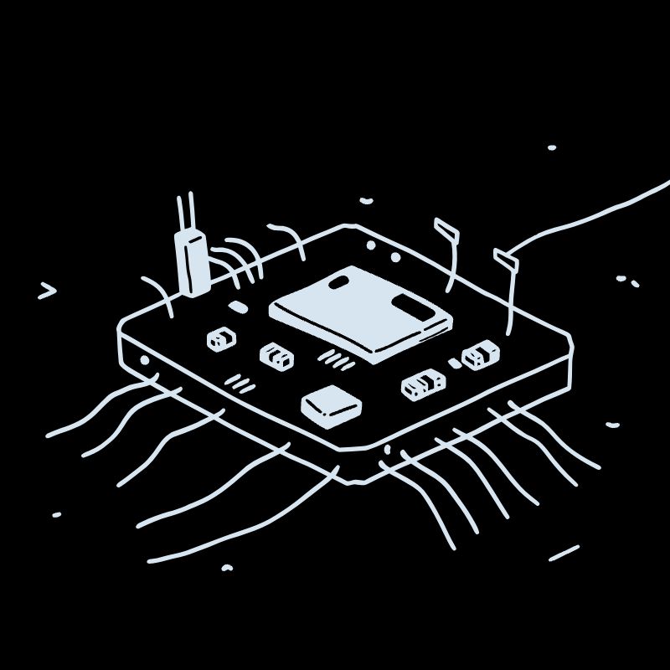
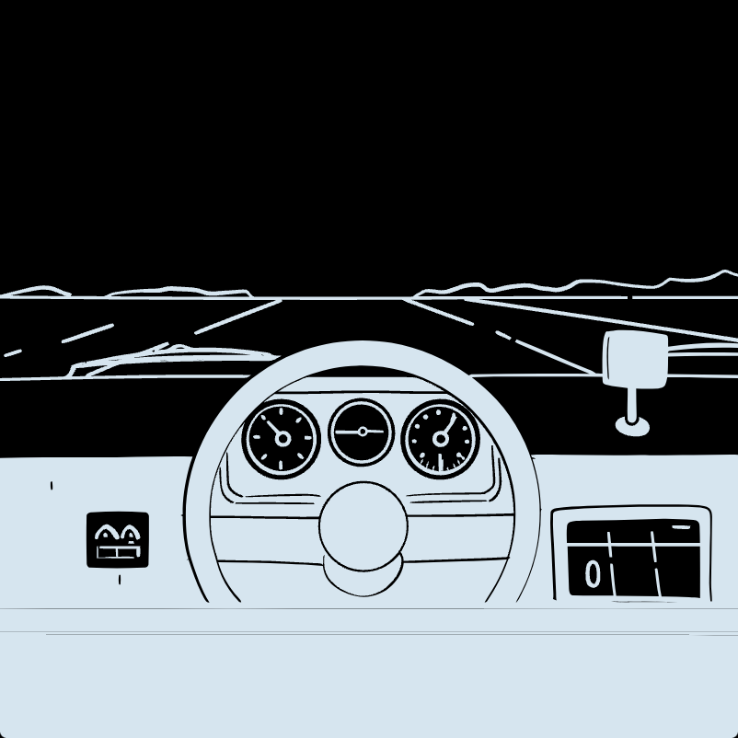


Components Connected This Week
ESP32-S3 Board
LCD1602 I2C
MQ135 Gas Sensor
Grove Temp Sensor
Tested and verified as the project's microcontroller core
16×2 character display wired via I2C bus for output
Air quality sensor connected to an analog input pin
Mounted to a second analog pin for climate readings

Slide 3

Wiring Sequence
The ESP32-S3 served as the central hub. The LCD1602 was connected first via the I2C bus. Sensors followed on analog input pins.
The APM2000 dust sensor wiring plan was also drafted for the next phase.
Power ESP32-S3
Wire LCD1602 I2C
Connect MQ135 & Temp

Slide 4

Two Roadblocks Hit
Troubleshooting Steps
LCD wiring confusion: Some pins were unclear, and the display stayed blank at first.
APM2000 ambiguity: Dust sensor pinout required extra planning before soldering.
Re-checked every I2C connection for loose or swapped wires
Scanned for the LCD's correct I2C address using a utility sketch
Cross-referenced APM2000 datasheet to map its pinout correctly
Tip: Always run an I2C scanner sketch before assuming a dead display.

Slide 5

Week 2 Takeaways
Sensors Live
MQ135 and Grove temperature sensor wired and responding on analog pins
Display Fixed
LCD now shows data after I2C address verification and wiring correction
Dust Sensor Next
APM2000 wiring plan finalized — ready for assembly and testing next week

