Slide 1

WEEK 1
PROJECT PLANNING
Smart Air Quality Monitoring System
Project kickoff: topic selection, component research, and initial system architecture planning.

Slide 2
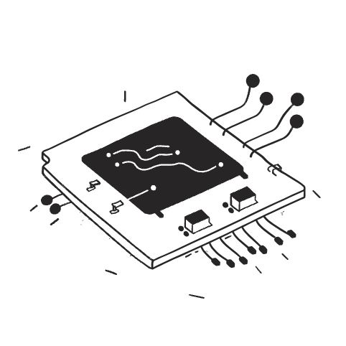

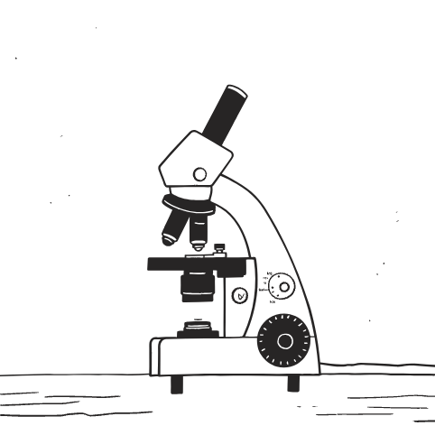


RESEARCH
Core Components Identified
Five key hardware elements selected to form the foundation of our monitoring system.
ESP32-S3
LCD1602 I2C
MQ135 Gas Sensor
Grove Temp Sensor
Main microcontroller handling processing and wireless communication.
Display module for real-time air quality data output.
Detects harmful gases including NH3, NOx, and CO2 levels.
Monitors ambient temperature with reliable accuracy.
APM2000 Dust Sensor
Measures particulate matter concentration in the air.

Slide 3

ARCHITECTURE
System Design Plan
Each sensor feeds data to the ESP32-S3 microcontroller, which processes readings and outputs real-time results to the LCD display.
Sensors
ESP32-S3
LCD Display
Sensors capture environmental data
ESP32-S3 aggregates and processes signals
LCD1602 displays live readings

Slide 4
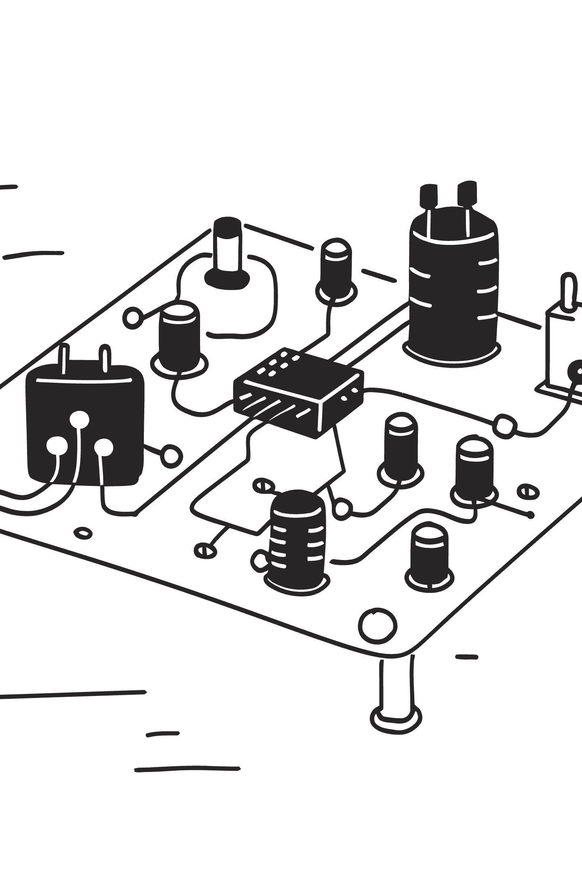


CHALLENGES
Week 1 Roadblock
APM2000 Dust Sensor
More pins and communication options than other components — required extra study.
Sensor Function Research
Understanding each sensor's role and integration path took significant effort.
Key learning: mastering the APM2000 was critical — it's the most complex component in our system.

