Slide 1
The consumption of non-renewable and renewable energies in USA
Minh D. Vo
December 2018
https://github.com/minhdvo/SpringboardDS/tree/master/project-I

Slide 2
Contents
Introduction
Dataset
EDA
Results
Conclusions

Slide 3
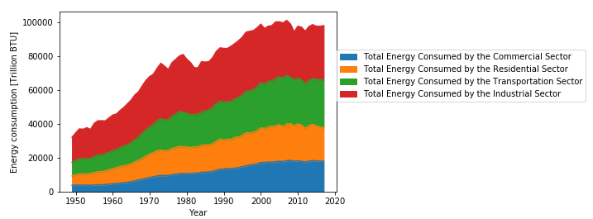
1. Introduction
The aim of this project is to predict the USA energy consumption of non-renewable and renewable energies in the next 5 years.
Due to the environmental issues → reducing greenhouse gas emission.
Fossil fuels → major imported sources of U.S.

Slide 4

2. Dataset
All data for my report were imported from website of U.S. Energy Information Administration (EIA) (https://www.eia.gov/).
Total energy consumption of non-renewable and renewable energies in USA from 1960-2016 will be used for further analysis.

Slide 5
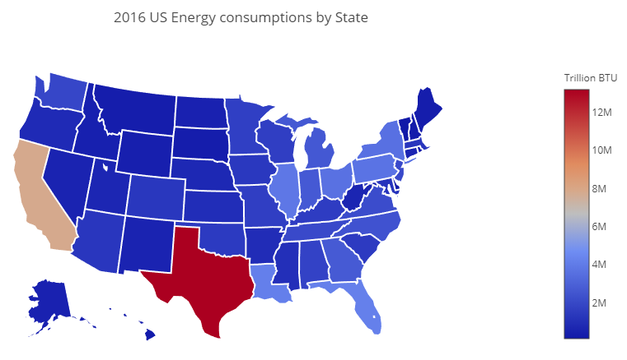
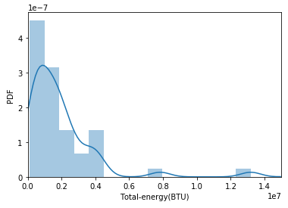
3. EDA
Top five highest energy consumption states are Texas, California, Florida, Louisiana and Illinois.
Top five lowest energy consumption state are Vermont, Columbia (DC), Island, Delaware and Hawaii.
Low (smaller than 2 million BTU)
Medium (from 2 to 6 million BTU)
High (larger than 6 million BTU)

Slide 6
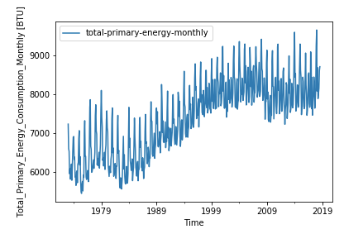
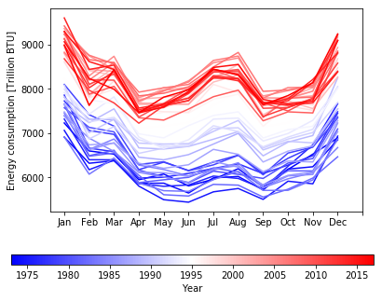
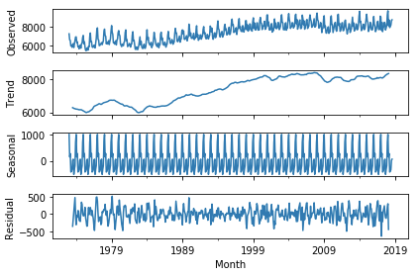
3. EDA
Non-renewable energy
Decomposition of monthly energy consumption

Slide 7
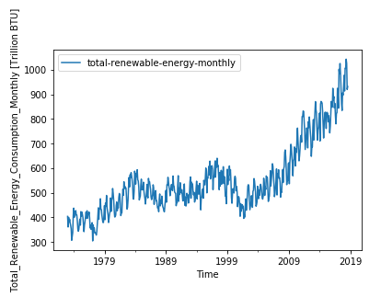
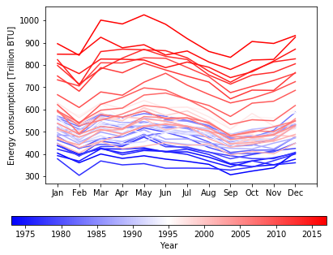
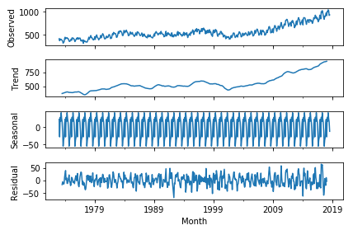
3. EDA
Renewable energy
Decomposition of monthly energy consumption

Slide 8
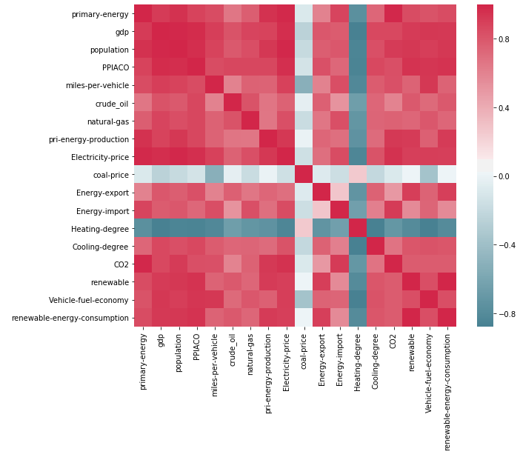
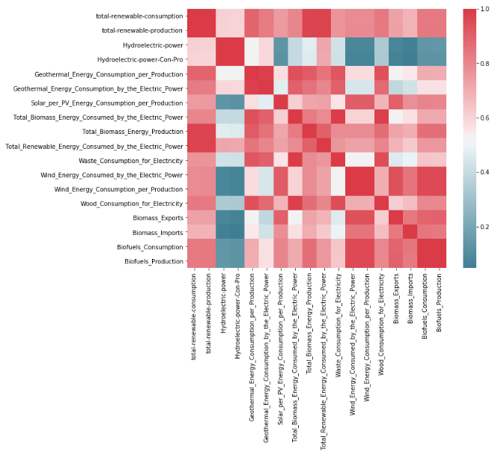
3. EDA
Renewable energy
Non-renewable energy

Slide 9
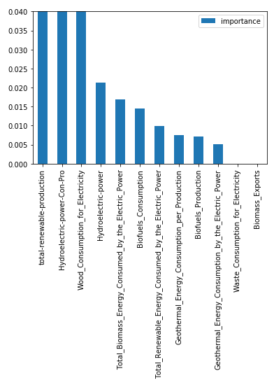
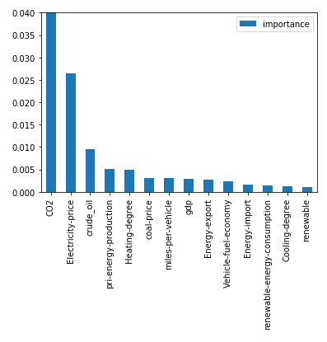
4. Results
Random forest regressor
Non-renewable energy
Renewable energy

Slide 10
4. Results
Univariate time series (annual energy consumption)
ARIMA model
VAR model
Multivariate time series (monthly energy consumption)
Seasonal ARIMA
Fbprophet

Slide 11
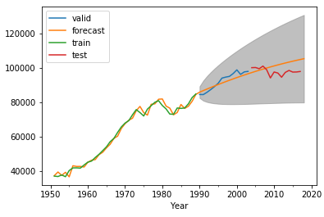
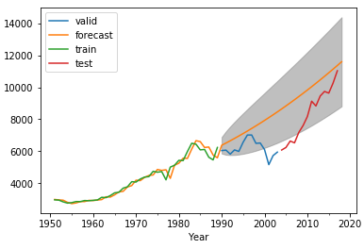
ARIMA model
Non-renewable energy
Renewable energy

Slide 12
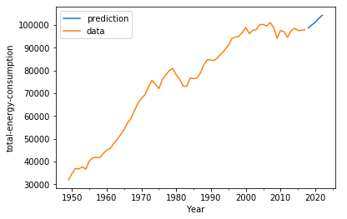
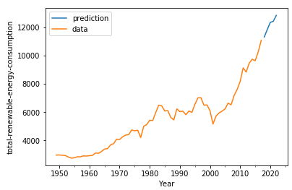
VAR model
Non-renewable energy
Renewable energy

Slide 13
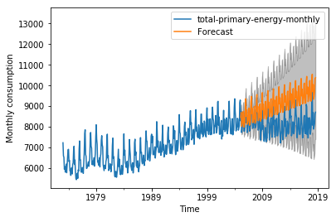
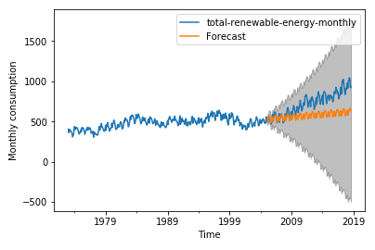
Seasonal ARIMA
Non-renewable energy
Renewable energy

Slide 14
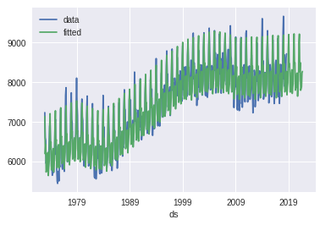
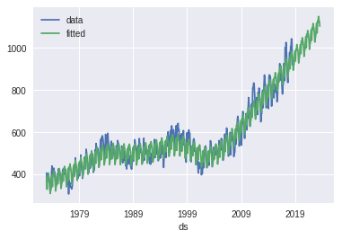
Prophet
Non-renewable energy
Renewable energy

Slide 15
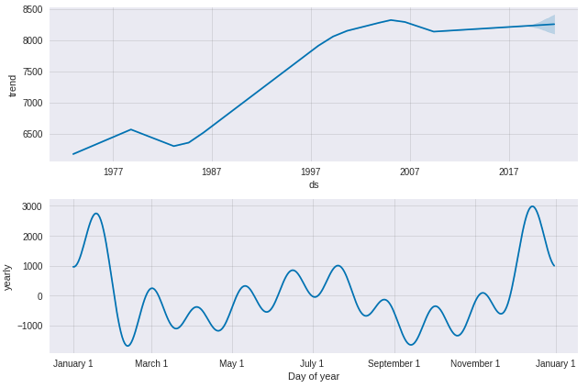
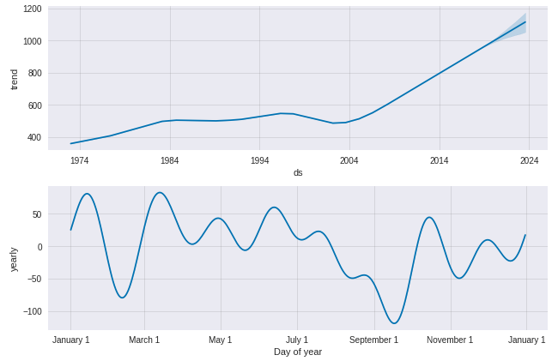
Prophet (trend and pattern)
Non-renewable energy
Renewable energy

Slide 16
Conclusions
Multivariate and univariate time series models
Both total energy and renewable energy consumption still keep increasing.
In respect of monthly energy consumption, the total energy has currently been in the stable condition and expected to be in the steady state in next 5 years. For renewable energy, the monthly consumption has gone into the growing steps and predicted to be enlarged in the future.
CO₂ emission, electricity price, crude oil price are the important features for total energy consumption.
Total renewable production, hydroelectric power consumption per production, wood consumption for electricity generation are the most influenced features for total renewable energy consumption.
The forecast values indicated that fbprophet is the good model for predict seasonal time series problem.

