Slide 1
Salt Identification in subsurface of reservoir
Minh D. Vo
January 2019
https://github.com/minhdvo/SpringboardDS/tree/master/project-II

Slide 2
Contents
Introduction
Dataset
EDA
Model
Results
Conclusions

Slide 3
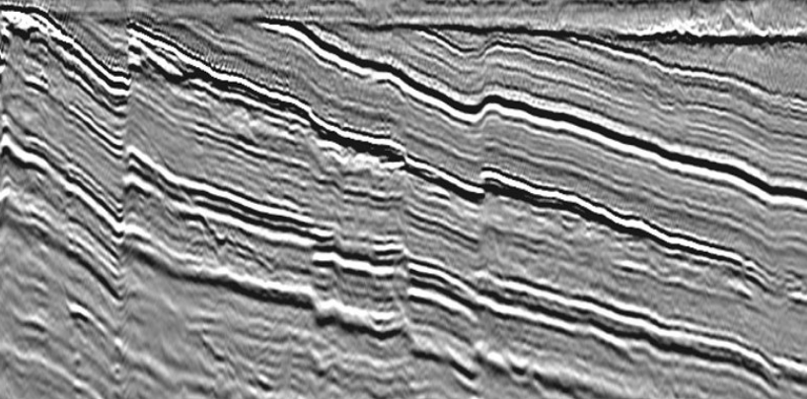
1. Introduction
A seismic image is produced from imaging the reflection coming from rock boundaries. The seismic image shows the boundaries between different rock types.
One of the challenges of seismic imaging is to identify the part of subsurface which is salt.
The aim of this study is to build a good model to identify if a subsurface target is salt or not.
http://pcable.com/default.dmx

Slide 4
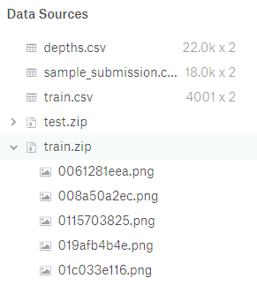
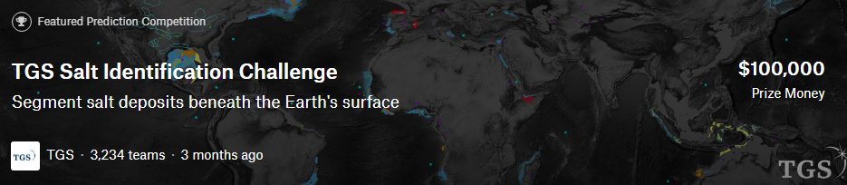
2. Dataset
The data is a set of images chosen at different locations and random in the subsurface. The images are 101 x 101 pixels and each pixel is classified as either salt or sediment. In addition, the depth of the imaged location is provided for each image.

Slide 5
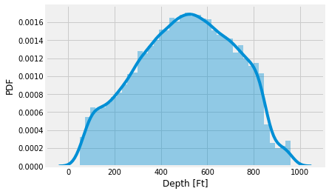
2. Dataset
train.csv file → file id and run-length encoded format (rle_mask)
depth.csv file → depth value in feet of all image (including both training and test set)

Slide 6
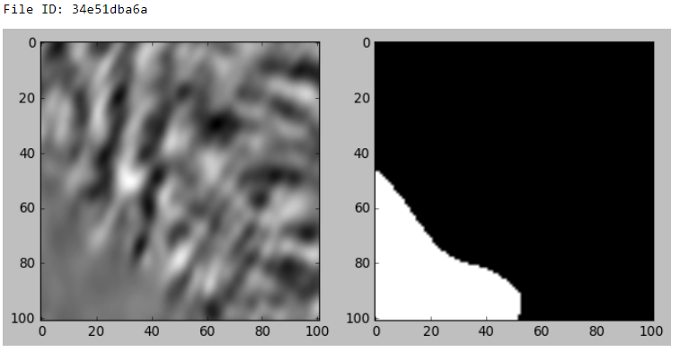
2. Dataset
22000 seismic images
Training set: 4000 seismic images and 4000 mask images.
For test set: 22000 seismic images that need to determine whether the presence of salt is.

Slide 7
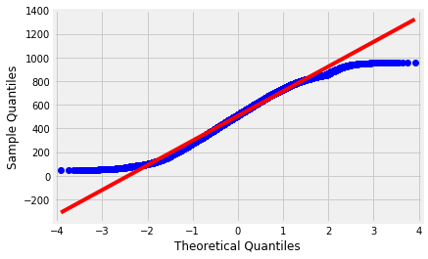
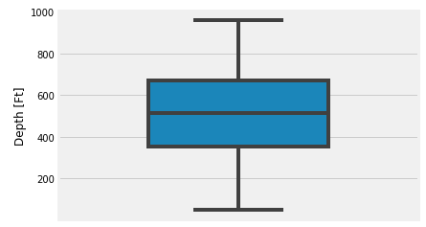
3. EDA
Depth of all data
Skewness: -0.128

Slide 8
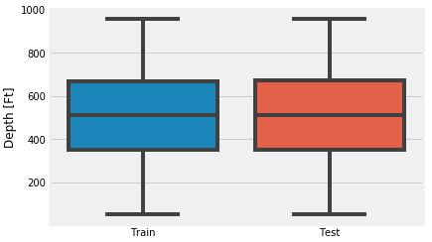
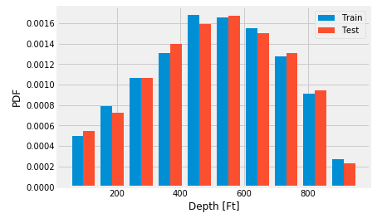
3. EDA

Slide 9
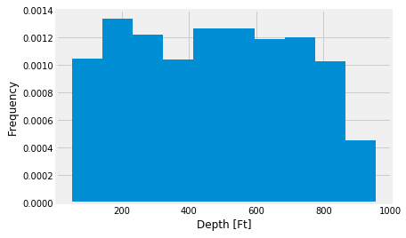
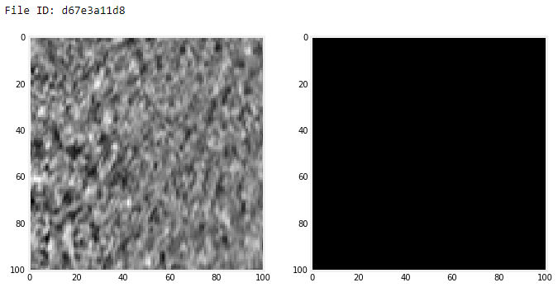
3. EDA
Depth distribution of training images without salt

Slide 10
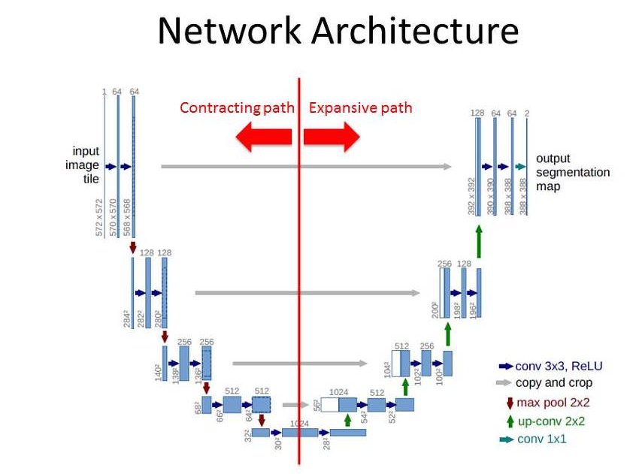
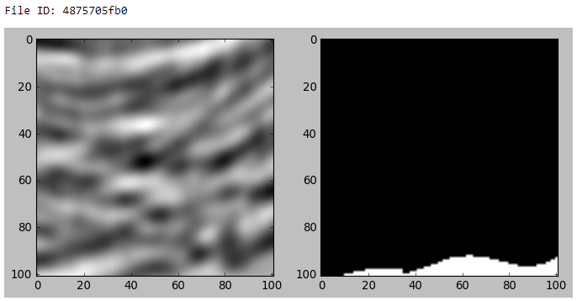
4. Model
Image segmentation -dividing an image into multiple parts.
U-Net is a generic deep-learning solution
Olaf Ronneberger, Philipp Fischer, Thomas Brox,
Medical Image Computing and Computer-Assisted Intervention (MICCAI), Springer, LNCS, Vol.9351: 234--241, 2015

Slide 11
4. Model
Validation and train ratio: 0.3.
The U-net model was built with following information:
Weights initialization: random normal
Learning rate: 1e-4
Optimizer: ‘Adam’
Loss function: binary crossentrpoy
Batch size: 32
Dropout ratio: 0.5
Filter sizes: 3x3 and 2x2
Number of epochs for training: 60

Slide 12
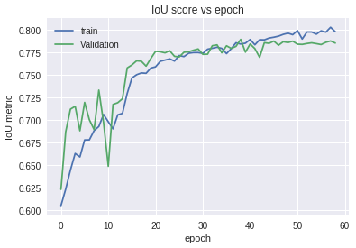
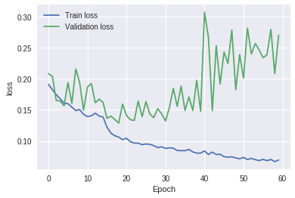
5. Results

Slide 13
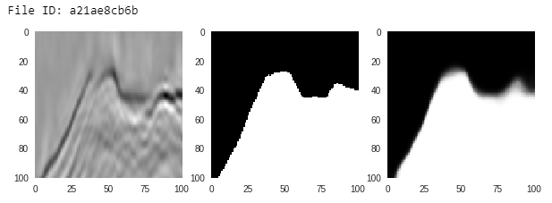
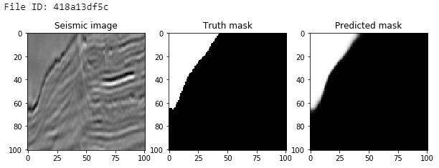
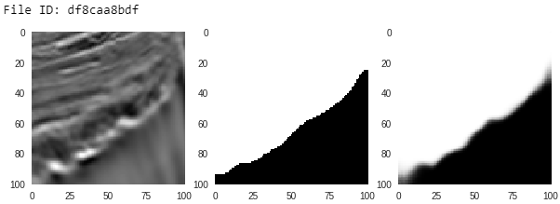
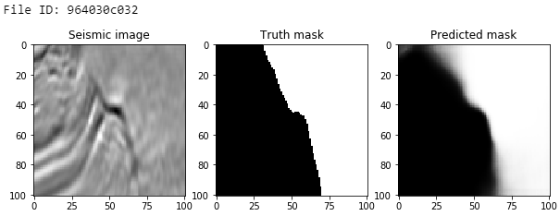
5. Results

Slide 14
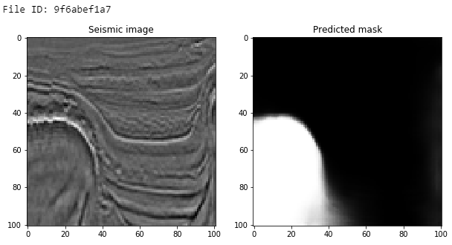
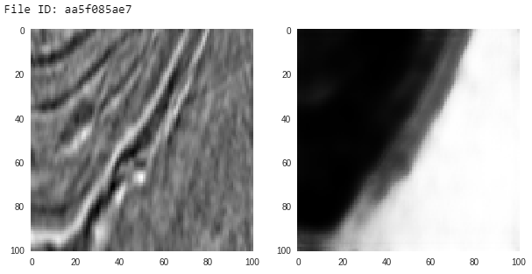
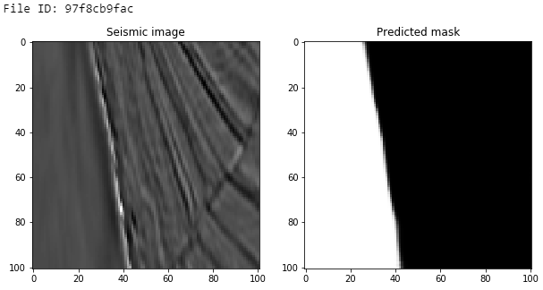
5. Results
The accuracy score of this model for test set is 0.795

Slide 15
6. Conclusions
Convolutional neutral network (U-net) for identifying whether the salt presents in subsurface of reservoir.
The modeling results showed the advantages of U-net model for solving image processing problem. This algorithm was proved and applied in many practical application such as biomedical image segmentation, brain image segmentation …
The improvement:
Image resize
Other deep learning models (like ResNet34, fastai…)

