Slide 1
Show and Tell
Minheng Wu

Slide 2
Data Used
State Farm Distracted Driver Detection:
https://www.kaggle.com/c/state-farm-distracted-driver-detection/data
25k+ pictures with 10 labels labeling actions of the driver
MSCOCO:
http://mscoco.org/
80k+ pictures with corresponding captions.

Slide 3
Agenda
Experiment how a pre-trained model worked on a completely new data set
Preprocess data input and output to an easy to train form
Build an img2txt model
Compare different hyper-parameter choice
Result
Take away

Slide 4
BaseLine
KNN on 1000 samples from State Farm data set
Flatten an image to a 1XN vectors
Calculate Euclidean distance of the testing data to each of the training data
With 5-neighbor training geting 65% accuracy
Not a good model
Very computationally heavy

Slide 5
Resnet
Developed by Microsoft.* and won the ImageNet competition
Replace the last few fully connected layers with one fully connected layer that matched my output dimension(10)
Freeze all the parameters except for the ones in the last Dense layer
Basically Resnet is extracting features from pictures
The output of from Resnet is a vector representation of features in feature space
The last Dense layer is a mapping from feature space to output space
Train only the last Dense layer to improve the mapping.
Source: https://arxiv.org/pdf/1512.03385.pdf

Slide 6
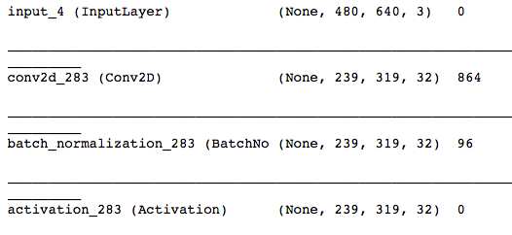
Structure of Resnet
Many Level of Conv, Norm,Act
99% validation accuracy after two epochs
No hyper parameter search needed

Slide 7
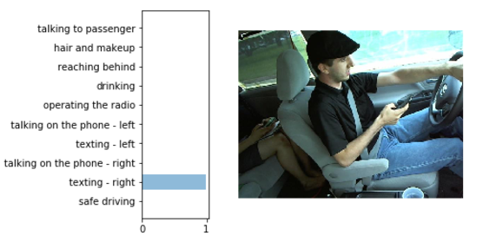
Result on Stat Farm Testing Data
Very High Confidence!!

Slide 8
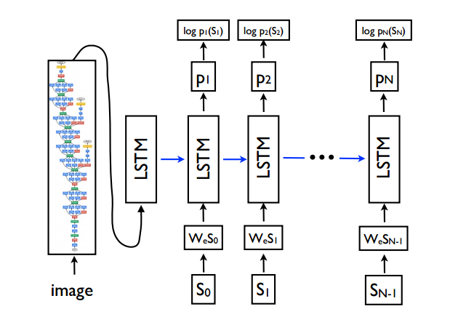
Show and Tell
Developed by Google:
https://arxiv.org/pdf/1411.4555.pdf
Trained for image captioning

Slide 9

Show and Tell Modified
Since Keras does not support output to input LSTM, need to modified the model a little bit

Slide 10
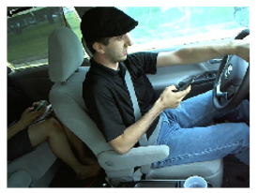
Preprocessing Inputs
Pre-trained model had proven to be very good at extracting features
Use inception v3 suggested by the google paper
So instead of inputting pictures inputting picture feature vector
Each pictures is converted to 1X2048 vector representation
Essentially fixing the weights of the CNN
Save a lot of memory.
[24,25,12,14,58,19,……,19,11,4]

Slide 11
Preprocessing Output
Output is caption(text), need to vectorize them:
Count the occurrence of words in all captions
Pick out the 5000 words that occurred the most, give them the corresponding index
Convert each captions to the index representation
Pad each captions to a fixed length(25)
Vectorize them:
Use word embedding, output size will be in embedding space. Use a pre-train model to save time.
One hot encode the index, output size will be the vocabulary size(heavy computation)

Slide 12
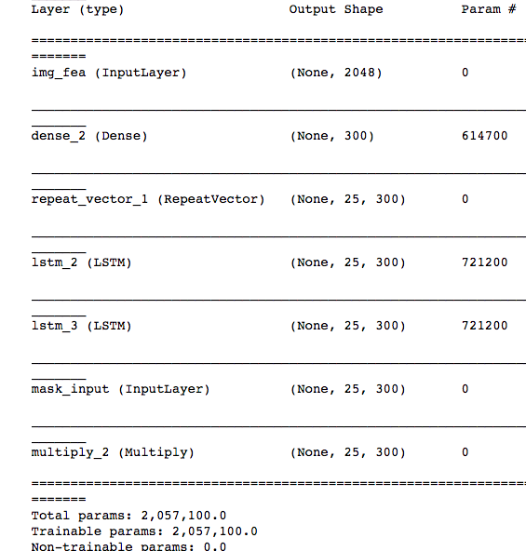
Model Structure
Added an extra LSTM layer to try to capture the relationship between words
Added a mask at the end to avoid calculating loss for the padded zeros

Slide 13
Parameter choice
Learning rate:
Initial value is 2, exponentially decay at rate .5 after 8 epochs
Suggested in the google paper
Loss:
Since output in embedding space with continuous numbers, entropoy is not a good choice, use mean square error instead.
Metric:
Same reason as above, accuracy is not a good choice, use R-square.

Slide 14
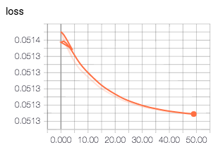
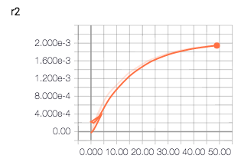
Results
Trained for 50 epochs
Loss decrease from 0.0514 to 0.0513
R-square increases from slighly negative to slighty positive
Ouputing the word index of 1 for every word.
Not promising
Probably need to adjust the decay
and the number of epochs.

Slide 15
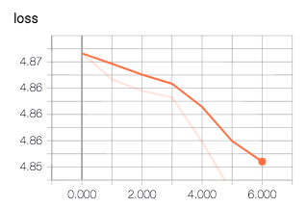
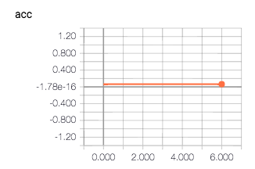
Another Approach
One hot encode the caption index vector,
added <start> and <end> token.
Change loss to categorical cross-entropy and metrics to accuracy but stick to the same model structure except for output dimension
Significantly increase the amount
of parameters(over 140 million)
Ran a few epochs

Slide 16
Take Away
Keras is too high level and is not good for flexible model building.
Tensorflow is a better choice
This type of model requires a lot of computing power and time to train
Search for hyper parameter to optimize the efficiency of training

Slide 17
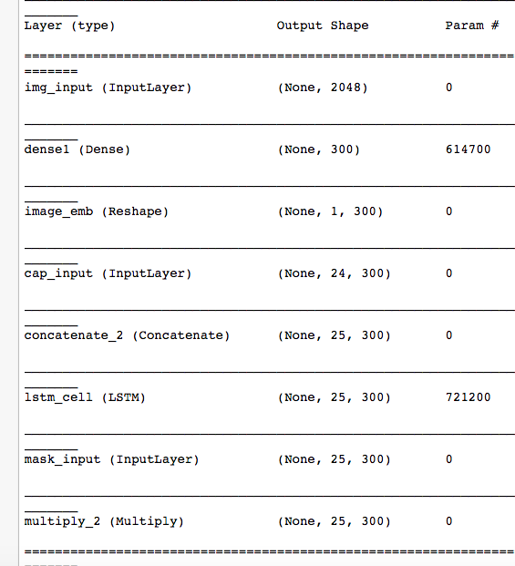
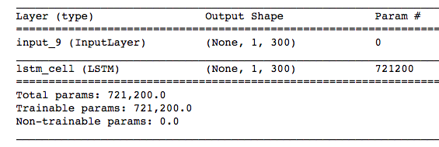
Future
Training Testing

