Slide 1
Project WinForm Topic: Dorm management
Full name: Đào Nhật Minh
Id: HE176775
Class: SE1752-NET
Subject: PRN211 Lecture: CuongNT

Slide 2
Table of contents
Introduction
Database diagram
Main function
Form design
Conclusion
Notes:
Why & how to identify desired business benefits?
The business requirements set the context for, and enable the measurement of, the benefits the business hopes to achieve from undertaking a project.
- Organizations should not initiate any project without a clear understanding of the value it will add to the business.
- Set measurable targets with business objectives, and then define success metrics that allow you to measure whether you are on track to meet those objectives
Business requirements might come from funding sponsors, corporate executives, marketing managers, or product visionaries.
The business benefit has to represent a true value for the project’s sponsors and to the product’s customers.

Slide 3
I. Introduction
The student dormitory management system makes the management of the dormitory easier and simpler for the management board in the process of managing students and the dormitory system.

Slide 4
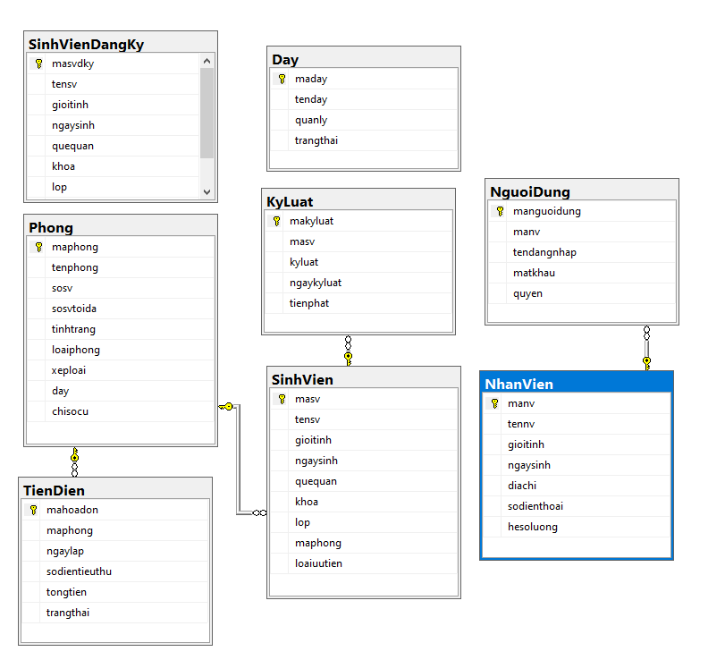
II. Database diagram

Slide 5

III. Main function
Students login/register in the dormitory (For students): students register in the dormitory by entering their information.
Student management: Function that allows staff to review students, add, edit, delete
search information.
Employee management: Function allows users to view, Add, Edit, Delete, Search for employee information in the dormitory.
User management: Function that allows users to interact with user information (login accounts). Only users with Admin rights can access this function.
Room management: has features for adding, editing, deleting and room status
Rule management: Add corrections and deletions as well as set penalties for violating students
Manage bills: create bills for each rooms. Invoices are in 2 statuses: "Unpaid" and "Paid".

Slide 6
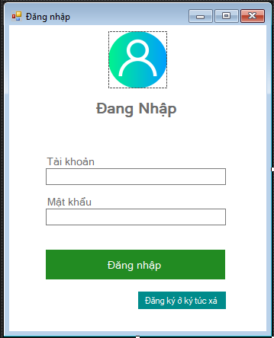
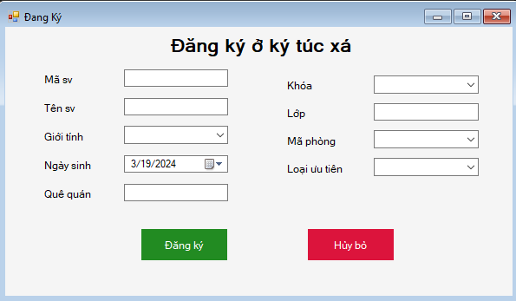
IV. Form design

Slide 7
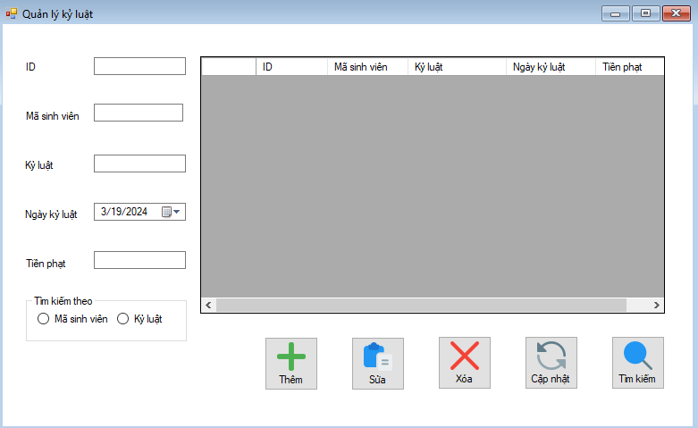
IV. Form design

Slide 8
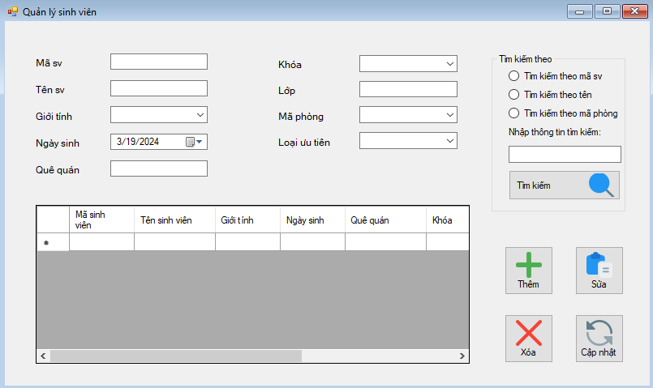
IV. Form design

Slide 9
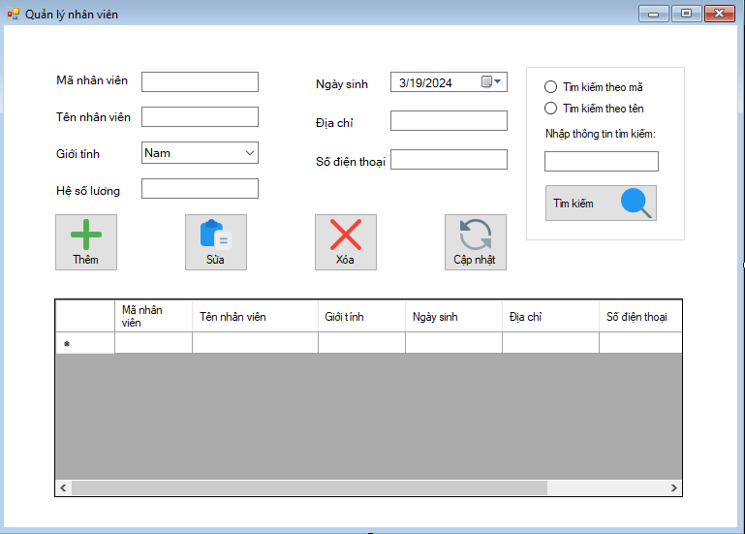
IV. Form design

Slide 10
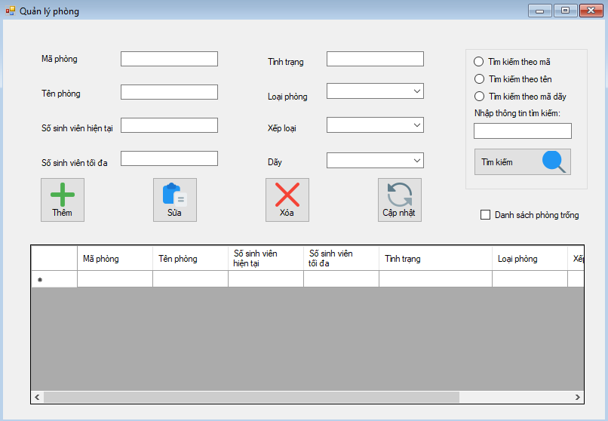
IV. Form design

Slide 11
IV. Conclusion
Ưu điểm
Chương trình gọn nhẹ, dễ sử dụng.
Giao diện thân thiện với người dùng.
Đầy đủ các chức năng quản lí chính.
Nhược điểm
Vẫn còn vài sai sót trong hệ thống.
Chức năng chưa linh động muốn áp dụng thực tế phải chỉnh sửa nhiều.
Hướng phát triển.
Hoàn thiện đầy đủ chương trình.
Nâng cao tính linh động.
Thêm các chức năng mới.
Bảo mật dữ liệu tốt hơn.

Slide 12
Thanks For Watching

