Slide 1

Java II

Slide 2

J2EE
JavaServer Pages

Slide 3
JavaServer Pages: background

Slide 4
JavaServer Pages: background
• As we saw in the last lecture, it is possible to generate dynamic HTML entirely within a Servlet.
• But when you get to a fairly complicated page, that starts to look like trouble.
• Also, one of the most important Design Patterns (MVC or Model-View-Controller) tells us we should strive to separate the code that creates the page we see [View] from the logic that makes decisions [Controller] and the code that stores that data [Model].

Slide 5
JavaServer Pages: background
• JSPs were invented to take care of the View.
• JSPs allow you to mix static (non-changing) HTML with snippets of Java code.
• You first generate the HTML page (giving it the .htm extension) and then, when you have decided what parts should have dynamic content, you add in the Java portions and rename the file .jsp.

Slide 6
JavaServer Pages: background
• Converting a web page from .htm to .jsp is as simple as renaming the file.
• In the web application server, you can place a .jsp file anywhere you place an .htm file.
• You do not even need to compile a .jsp!
• No bothering with packages
• No bothering with CLASSPATHs

Slide 7
JavaServer Pages: background
• In fact, to use a JSP, all you need is a web server that is a web application server—meaning one that is configured to handle JSPs.

Slide 8
JavaServer Pages:
Behind the Scenes

Slide 9
JavaServer Pages: Behind the Scenes
• Outside of your view, the web application server is compiling your JSP.
• When a JSP is compiled, it is turned into a Servlet.
• In other words, a JSP is a Servlet in disguise.

Slide 10
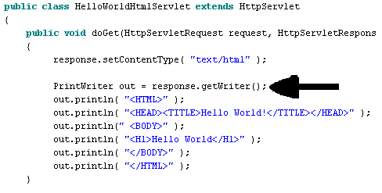
JavaServer Pages: Behind the Scenes
• Recall in the case of Servlets, we were just writing HTML code to the output stream.

Slide 11
JavaServer Pages: Behind the Scenes
• In the case of a JSP, the exact same thing is happening, but instead of you having the tedious chore of writing all that HTML, it is automated.
• So, when we get ready to execute our JSPs, we should go and look for these generated files so we understand what is happening behind the scenes.

Slide 12
JavaServer Pages: Behind the Scenes
• It is important to do so in case you have an error in your JSP. The JSP you wrote is two steps away from its final destination.
• Because of this two-step translation process, it can be hard to debug these unless you understand what is happening.

Slide 13
JavaServer Pages:
Our First JSP

Slide 14
JavaServer Pages: Our First JSP
• To start, let’s define a JSP that does exactly nothing.
• We’ll start off with the simplest HTML page, and do nothing but change its name to .jsp.
• Then, let’s see what happens to it.

Slide 15
• This page is called BasicHtml.htm
<HTML>
<HEAD>
<TITLE>This is raw html</TITLE>
</HEAD>
<BODY>
This is the part that displays in the page.
</BODY>
</HTML>

Slide 16
• This page is called BasicJSP.jsp
<HTML>
<HEAD>
<TITLE>This is raw html</TITLE>
</HEAD>
<BODY>
This is the part that displays in the page.
</BODY>
</HTML>

Slide 17
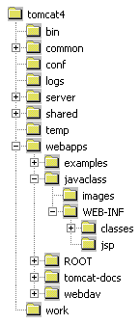
JavaServer Pages: Our First JSP
• Before we view this page,
let’s take a tour of some directories
we haven’t looked at yet.
This work* directory is the one we are curious about. What is it for? What does it contain?
* This folder may have a different name for different vendors.

Slide 18
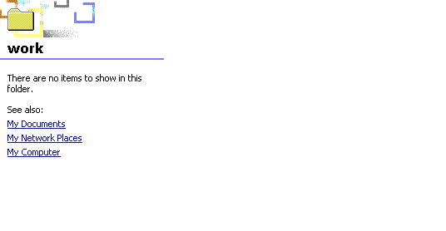
JavaServer Pages: Our First JSP
• Well, right now it is empty.
• So, we’ll keep an eye on it and see what happens to it.

Slide 19
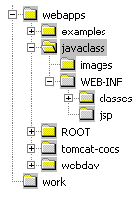
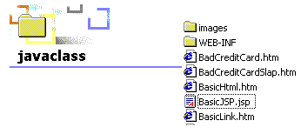
JavaServer Pages: Our First JSP
• Next, we’re going to place our BasicJSP.jsp file (which we recall is just a plain vanilla HTML page) into the same place where we would put an HTML page.

Slide 20
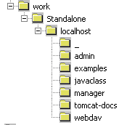
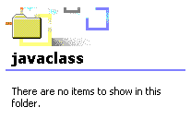
JavaServer Pages: Our First JSP
• So, I will start up my Tomcat4 web application server.
• Next, let’s check back with our work directory and see if it has changed.
Ah, interesting. We see that the WAS on its own filled this work directory with subdirectories for every Web Application that was listed in our WEB-INF directory.
However, please trust me that all of them are still empty, especially the javaclass directory we care about.

Slide 21
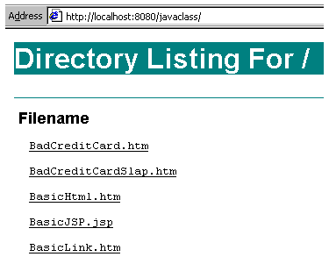
JavaServer Pages: Our First JSP
• Now, since our WAS is up and running, let’s invoke our JSP (ask our JSP to be displayed).
• To do that, we fire up a browser.
• When we examine our javaclass directory, we see our JSP displayed just like the html files.

Slide 22

JavaServer Pages: Our First JSP
• We just enter the name of the JSP and hit enter.
• You notice it takes a little longer than usual but still, everything looks normal on the page.
• We also notice that we just called it with its name.

Slide 23
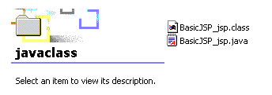
JavaServer Pages: Our First JSP
• Oh, by the way, let’s go and look at our work directory to see what mischief the Web Application Server [WAS] has been up to.
• Well! Bust my buttons… what are these two files doing here? A .java and a .class, with a name slightly like the name of our JSP? What’s going on here?

Slide 24
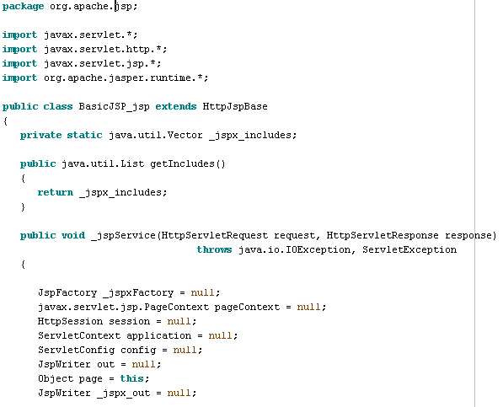
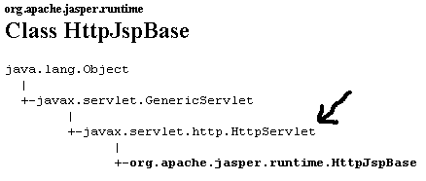
Wow! All this for a little ol’ do-nothing HTML page?
Yes. Recall that I said all JSPs are converted into Servlets?
This method _jspService() does most of the work.

Slide 25
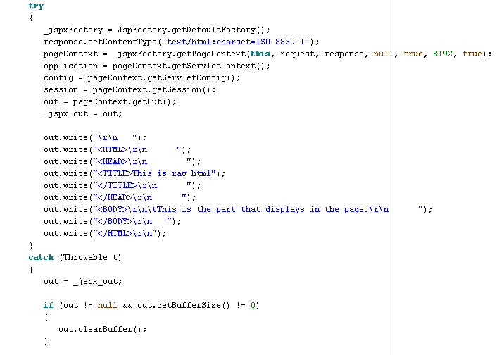
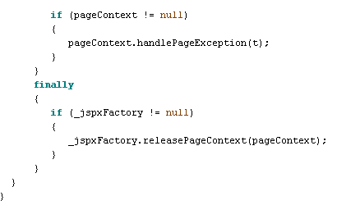
Here we see the HTML being created, as we were expecting.
(The \r\n is just a new line and carriage return so our HTML looks pretty.)

Slide 26
JavaServer Pages: Our First JSP
• Don’t be frightened by the previous two slides.
• You are not allowed to touch that generated Servlet.
• But, if you get a funky error, you now know enough to go look at it. This generated JSP must be able to be compiled just like any other Java class.
• But, the WAS will compile the generated JSP by itself—the first time somebody asks for the page—and so you don’t have to be concerned with it.

Slide 27
JavaServer Pages:
Adding Java code
to our JSP

Slide 28
JavaServer Pages: Adding Java code to our JSP
• The whole point of using a JSP is that it allows you to insert bits of Java code into your JSP.
• There are three different kinds of Java code you can add to a JSP:
→ Declarations
→ Scriptlets
→ Expressions

Slide 29
JavaServer Pages: Adding Java code to our JSP
• Declarations—when Tomcat generates the JSP (Servlet), these are inserted into the body of the Servlet, outside of any method.
• To add a declaration to your JSP, you put it in this form:
<%! Code goes here; %>
• As the name “declarations” would suggest, these are used for declaring an instance variable that you want to use all through your JSP.
<%! String x; %> or
<%! String x = new String( “hello” ); %>

Slide 30
JavaServer Pages: Adding Java code to our JSP
• Scriptlet—when Tomcat generates the JSP (Servlet), these are inserted into the method _jspService().
• To add a scriptlet to your JSP, you put it in this form:
<% Code goes here; %>
• A Scriptlet must be a complete Java statement, meaning it ends in a semicolon. You can declare a variable here, but it will be a local variable, not an instance variable.
<% String x; %> or
<% x = x + “ from JSPLand”; %>

Slide 31
JavaServer Pages: Adding Java code to our JSP
• Expression—these are evaluated and inserted into the output of the Servlet. These are commonly used to insert dynamic content into a parameter of an HTML tag.
• To add an expression to your JSP, you put it in this form:
<%=Code goes here %>
• Notice that an expression is not a complete Java statement and so it does not end in a semicolon.
<%=x %>
No Semicolon!

Slide 32
JavaServer Pages:
A Declaration

Slide 33
JavaServer Pages: A Declaration
• Now, let’s follow the same process as before, we’ll add a declaration to our JSP and see what impact it has on the generated JSP source.

Slide 34

• This page is called BasicDeclaration.jsp
<%! String x; %>
<%! int y; %>
<%! String z = new String( “hello” ); %>
<HTML>
<HEAD>
<TITLE>This is raw html</TITLE>
</HEAD>
<BODY>
This is the part that displays in the page.
</BODY>
</HTML>

Slide 35
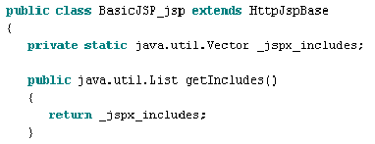
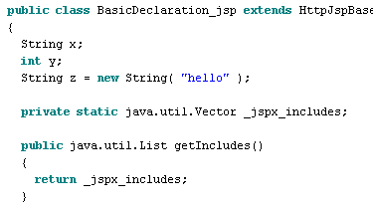
JavaServer Pages: A Declaration
• Here we make a comparison between the previous generated source and the one with the declaration.
BasicJSP_jsp.java
BasicDeclaration_jsp.java
Now, we see that adding declarations did exactly what we expected. It added instance variables exactly as I said.

Slide 36
JavaServer Pages: A Declaration
• Note: since a Declaration does not appear in the _jspService() method, it is NOT POSSIBLE for a declaration to produce any output!

Slide 37
JavaServer Pages: A Declaration
• When a Servlet [a JSP is one] is executed, there is only one instance of the Servlet loaded.
• So, if 5 people on the World Wide Web call up your JSP, then only one instance of your Servlet was instantiated, but each of the 5 people get their own thread that contains basically the _jspService() method.
• So… that means any variables you declare in a declaration are instance variables—and all five people are sharing that single copy of that instance variable.
• Moral of the story? Because of the way a Servlet is used on the server, it behaves almost as if it were a static variable.

Slide 38
JavaServer Pages:
A Scriptlet

Slide 39
JavaServer Pages: A Scriptlet
• Now, again, let’s add a Scriptlet to our JSP and see what impact it has on the generated JSP source.

Slide 40

• This page is called BasicScriptlet.jsp
<% String joe = new String( “hello” ); %>
<HTML>
<HEAD>
<TITLE>This is raw html</TITLE>
</HEAD>
<BODY>
This is the part that displays in the page.
</BODY>
</HTML>

Slide 41
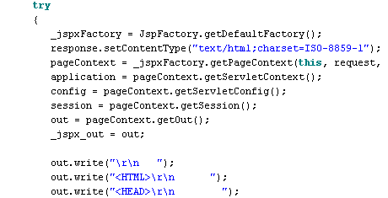
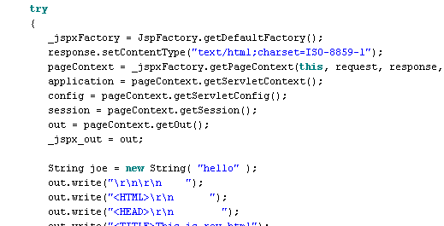
JavaServer Pages: A Declaration
• Here we see the quote from the _jspService() method for the BasicJSP_jsp.jsp versus the BasicScriptlet_jsp.jsp.
BasicJSP_jsp.java
BasicScriptlet_jsp.java

Slide 42
JavaServer Pages:
An Expression

Slide 43
JavaServer Pages: An Expression
• Lastly, we will add an expression to our JSP and see what it does.

Slide 44

• This page is called BasicExpression.jsp
<%=“I’m outside of the page” %>
<HTML>
<HEAD>
<TITLE>This is raw html</TITLE>
</HEAD>
<BODY>
This is the part that displays in the page.
</BODY>
</HTML>

Slide 45
JavaServer Pages: An Expression
• That was kind of strange. We added a Scriptlet that outside of the HTML page but it still rendered.
• Let’s compare the HTML we sent in with the source of the actual HTML that was generated.

Slide 46
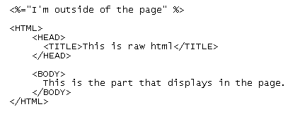
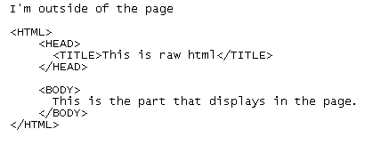
BasicExpression.jsp
←Original we wrote
BasicExpression.jsp
←Source reported by Internet Explorer

Slide 47
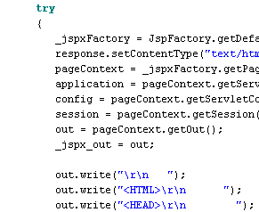
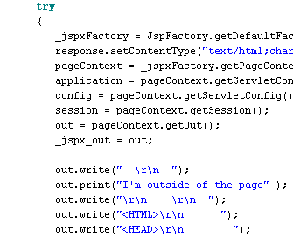
JavaServer Pages: An Expression
• And when we quote from the _jspService() method for the BasicJSP_jsp.jsp versus the BasicExpression_jsp.jsp.
BasicJSP_jsp.java
BasicExpression.jsp

Slide 48
JavaServer Pages:
Predefined Variables

Slide 49
JavaServer Pages: Predefined Variables
• When we looked at the Java source that was generated for our JSP, we noticed a lot of instance and local variables that were created automatically.
• These are known as “predefined variables.”
• These are available for you to use in expressions or scriptlets. There are eight predefined variables.
request—the HttpServletRequest object
response—the HttpServletResponse object
session—the HttpSession object
out—the PrintWriter object

Slide 50
JavaServer Pages: Predefined Variables
• For example, let’ see how you would use one of these predefined variables:
Your host name: <%= request.getRemoteHost() %>

Slide 51
JavaServer Pages: Predefined Variables
• A scriptlet will allow you to insert arbitrary code into the _jspService() method.
• If you want some output to appear in the HTML page that is generated, you would use the predefined variable out, as in this example:
<%
String queryData = request.getQueryString();
out.println( “Attached GET data: ” + queryData );
%>
Or, another way of doing the same thing:
<%= request.getQueryString() %>

Slide 52
JavaServer Pages: Predefined Variables
• Let’s take another example, that shows how a local variable declared in a scriptlet can be used later on the same page in an expression:

Slide 53
• This page is called ScriptAndExpressionShare.jsp
<HTML><HEAD><TITLE>Using Both</TITLE></HEAD>
<%
String bgColor = request.getParameter( “bgColor” );
boolean hasExplicitColor;
if( bgColor != null )
{
hasExplicitColor = true;
}
else
{
hasExplicitColor = false;
}
%>
Here’s some text
<%
if( hasExplicitColor )
{
%>
<BODY BGCOLOR=‘<%=bgColor %>’>
<%
}
else
{
%>
<BODY>
<%
}
%>
</BODY>
</HTML>
To see the effects of this, we need to insert the parameter ‘bgColor’ into the page request. To achieve that, we use the following URL:
http://localhost:8080/javaclass/ScriptAndExpressionShare.jsp?bgColor=C0C0C0

Slide 54
JavaServer Pages: Predefined Variables
• Finally, to be thorough, let’s see how the code looks in the Servlet that was generated from the JSP.

Slide 55
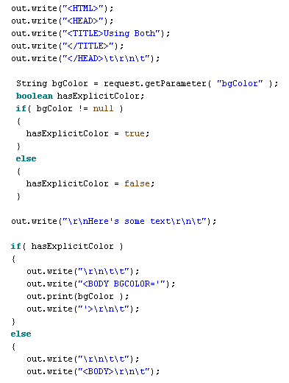
JavaServer Pages: Predefined Variables

Slide 56
JavaServer Pages: Predefined Variables
• As I said, there are eight predefined variables available.
• In addition to the four just described, there is another one that is useful called application.
• This variable is called the “ServletContext” and is obtained via getServletContext().getContext().
• Servlets and JSPs can store persistent data in the ServletContext object rather than in an Instance Variable (via a declaration).
• The important difference is this: when you store data in the application variable, that data is shared by All Servlets in the servlet engine.

Slide 57
JavaServer Pages:
Comments and Escape Characters

Slide 58
JavaServer Pages: Comments and Escape Characters
• You can use JSP comments in JSP pages.
<%-- This is a comment --%>
All the text between the start and end tags is ignored by the web container and not included in the response.

Slide 59
JavaServer Pages: Comments and Escape Characters
• Since certain character sequences have special meaning, if you want them to appear on your web page output, you have to take another step to allow them to appear.
• For example, if you wanted to have the character sequence: %> appear on your web page, you would have to do it like this: %\>
<% String message = “Literal %\> must be escaped; %>

Slide 60
JavaServer Pages: Comments and Escape Characters
• Other escape character sequences are:
To have this character appear You need this:
‘ \’
“ \”
\ \\
%> %\>
<% <\%

Slide 61
JavaServer Pages:
XML Syntax for Expressions

Slide 62
JavaServer Pages: XML Syntax for Expressions
• This is very commonly used, especially when using taglibs.
Traditional Expression Way
<%=“Hello World” %>
XML Equivalent
<jsp:expression>
Hello World
</jsp:expression>

Slide 63
JavaServer Pages:
XML Syntax for Scriptlets

Slide 64
JavaServer Pages: XML Syntax for Scriptlets
• This is very commonly used, especially when using taglibs.
Traditional Scriptlet Way
<% String x = “Hello World”; %>
XML Equivalent
<jsp:scriptlet>
String x = “Hello World”;
</jsp:scriptlet>

Slide 65
JavaServer Pages:
XML Syntax for Declarations

Slide 66
JavaServer Pages: XML Syntax for Declarations
• This is very commonly used, especially when using taglibs.
Traditional Declaration Way
<%! String x = “Hello World”; %>
XML Equivalent
<jsp:declaration>
String x = “Hello World”;
</jsp:declaration>

Slide 67
JavaServer Pages:
Standard Action Elements

Slide 68
JavaServer Pages: Standard Action Elements
• Actions are executed when a client requests a JSP page.
• They also use the same XML syntax that we will see being used more and more.
• They do things such as:
→ Input Validation
→ Database Access
→ Passing Control to Another Page.

Slide 69
JavaServer Pages: Standard Action Elements
• An Action Element consists of a Start Tag, a Body and an End Tag.
<jsp:forward page=“nextPage.jsp”>
<jsp:param name=“aParam” value=“aValue” />
</jsp:forward>
• If the Action Element does not have a body, you can use a shorthand notation:
<jsp:forward page=“nextPage.jsp” />
• The <jsp:forward> action passes the request processing control to another JSP or Servlet in the same web application. Execution of the current page is terminated at that point.
The <jsp:param> action in the body of a <jsp:forward> is used to specify additional request parameters for the target resource.

Slide 70
JavaServer Pages: Standard Action Elements
• Action Elements, also called “tags”, are grouped into Tag Libraries.
• An Action name is composed of two parts, a library prefix and the name of the action within the library, separated by a colon.
jsp:forward
• All actions in the JSP standard library use the prefix jsp, while custom tags can use any made-up prefix with the exception of: jsp, jspx, java, javax, servlet, sun or sunw.
Library prefix
Name of the action

Slide 71
JavaServer Pages:
Directives

Slide 72
JavaServer Pages: Directives
• A JSP Directive affects the overall structure of the Servlet that results from the JSP page.
• Let’s recall the previous kinds:
<%! %> —declaration
<% %> —scriptlet
<%= %> —expression
• A directive takes this form:
<%@ %> —directive

Slide 73
JavaServer Pages: Directives
• There are three commonly used directives:
→ page
→ include
→ taglib

Slide 74
JavaServer Pages: Directives
• There are three commonly used directives:
→ page—this lets you import classes, customize the servlet’s superclass, set the content type, etc.
• This directive can be used anywhere in the page but normally it is placed first.

Slide 75
JavaServer Pages: Directives
• There are three commonly used directives:
→ include—this lets you insert a file into the servlet class at the time the JSP is converted into a servlet.
• This directive is placed in the JSP file at the place where you want the file to be inserted.

Slide 76
JavaServer Pages: Directives
• There are three commonly used directives:
→ taglib*—this is used to define custom markup tags.
* This is used in Struts extensively. This is covered in a separate lecture, Java II, Lecture 6.

Slide 77
JavaServer Pages:
Directives—page

Slide 78
JavaServer Pages: Directives—page
• When you have declared a page directive, there are several attributes you can use:
import
contentType
isThreadSafe
session
buffer
autoflush
extends
info
errorPage
isErrorPage
language

Slide 79
JavaServer Pages: Directives—page
• When you have declared a page directive, there are several attributes you can use:
import—specify which packages to import when your JSP is converted into a Servlet.
<%@ page import=“java.util.*” %>
Or
<%@ page import=“my.package.*, my.other.package.*“ %>
• This is the only directive that can appear multiple times within your JSP.
• By custom, this appears first in your JSP.

Slide 80
JavaServer Pages: Directives—page
• When you have declared a page directive, there are several attributes you can use:
contentType—this sets the content type response header, telling the MIME type of the document being sent to the client.
<%@ page contentType=“text/plain” %>
• For a JSP, the default MIME type is text/plain.
• The above statement works just like this:
<% response.setContentType( “text/plain” ); %>

Slide 81
JavaServer Pages: Directives—page
• When you have declared a page directive, there are several attributes you can use:
isThreadSafe—This controls whether or not the servlet that results from the JSP page will implement the SingleThreadModel interface.
• Remember, with a normal servlet, simultaneous user requests result in multiple threads concurrently accessing the service() method of the same servlet instance.
• If a Servlet implements the SingleThreadModel interface, then the server makes simultaneous requests wait in line to use the single copy of the servlet.
<%@ page isThreadSafe=“false” %>

Slide 82
JavaServer Pages: Directives—page
• When you have declared a page directive, there are several attributes you can use:
session—This controls whether or not the page participates in HTTP sessions. The default on this is true.
This is very commonly used.
<%@ page session=“false” %>
• When this is true, it means that predefined variable session should be bound to the existing session if one exists. If one does not exist, one should be created and bound to the reference session.

Slide 83
JavaServer Pages: Directives—page
• When you have declared a page directive, there are several attributes you can use:
buffer—This specifies the size of the buffer used by the out variable. This is used if your page is large and you want to make sure the entire page is rendered in memory before the user sees it.
<%@ page buffer=“29kb” %>

Slide 84
JavaServer Pages: Directives—page
• When you have declared a page directive, there are several attributes you can use:
autoflush—This controls whether the output buffer should be automatically flushed when it is full or whether it should be allowed to overflow (and throw an exception when it does.)
<%@ page autoflush=“true” %> (the default)
• Normally, it’s a good idea not to tamper with this unless you have a good reason.

Slide 85
JavaServer Pages: Directives—page
• When you have declared a page directive, there are several attributes you can use:
extends—This specifies the Superclass of the servlet that will be generated for the JSP.
<%@ page extends=“my.package.MySuperclass” %>
• This is rarely used.

Slide 86
JavaServer Pages: Directives—page
• When you have declared a page directive, there are several attributes you can use:
info—This defines a string that can be retrieved from the servlet by means of the method getServletInfo().
<%@ page info=“Hello, I’ll be your servlet today” %>

Slide 87
JavaServer Pages: Directives—page
• When you have declared a page directive, there are several attributes you can use:
errorPage—This identifies which JSP page should be used if an error occurs. That means if an exception was thrown on the page (and not caught), the user will be sent to this page.
<%@ page errorPage=“/errorJSP.jsp” %>
• This uses a relative URL.
• It is a good idea to always use this.
• If you don’t, it’s possible for the user to see a stack dump (which looks pretty lame—and I’ve seen it happen too.)

Slide 88
JavaServer Pages: Directives—page
• When you have declared a page directive, there are several attributes you can use:
isErrorPage—This works in concert with the previous attribute. This means the current JSP can act as an Error Page.
<%@ page isErrorPage=“true” %>
• The default is false.
• This would be used on a JSP that is devoted to dealing with errors.

Slide 89
JavaServer Pages: Directives—page
• When you have declared a page directive, there are several attributes you can use:
language—This is a little-used attribute. Originally, the creators of JavaServer Pages hoped that JSPs would be used for multiple languages.
<%@ page language=“Java” %>
• However, the only legal choice is Java—which is the default anyway.

Slide 90
JavaServer Pages: Directives—page
• Finally, there is an XML equivalent for directives:
<%@ page import=“java.util.*” %>
Is equivalent to:
<jsp:directive.page import=“java.util.*” />

Slide 91
JavaServer Pages:
Directives—include

Slide 92
JavaServer Pages: Directives—include
• This useful directive lets you include other JSPs in your JSP. That might consists of a footer, a header or other things you want.
• The files are included in the JSP before it is converted into a servlet so you can include executable content.
<%@ include file=“/my.jsp” %>
Remember, the leading slash means “relative” URL.

Slide 93
JavaServer Pages: Directives—include
• Remember, this syntax means the JSP file in included in the main JSP document at the time when the JSP is translated into a servlet.
<%@ include file=“/my.jsp” %>
Include happens at page translation time.
• By contrast, there is another syntax:
<jsp:include page=“/my.html” flush=“true” />
• The XML jsp:include syntax is translated
at request time—when someone actually asks for the page. {However, some servers will allow Java in the jsp:include! }
Include happens at page request time.

Slide 94
• This page is called IncludedPage.jsp
<%@ page import=“java.util.Date” %>
<%!
private int accessCount = 0;
private Date accessDate = new Date();
private String accessHost = “<I>No previous access</I>”;
%>
This page has been accessed:
<%=++accessCount %> times since the server was rebooted. <BR>
It was last accessed from <%=accessHost %> at <%=accessDate %>.
<%
accessHost = request.getRemoteHost();
accessDate = new Date();
%>

Slide 95
• This page is called MainPage.jsp
<HTML>
<HEAD><TITLE>Main Page</TITLE></HEAD>
<BODY>
This text is in the body of the MainPage
<TABLE>
<TR>
<TD>
<%@ include file=“IncludedPage.jsp” %>
</TD>
</TR>
</TABLE>
This text is after the end of the table.
</BODY>
</HTML>

Slide 96
JavaServer Pages: Directives—include
• As we see, using the include directive allows us to pull in our page.
• However, once the MainPage.jsp has been compiled, it will not bother to pull in the IncludedPage.jsp again unless the modification date on the MainPage.jsp changes.
• It doesn’t care if the IncludedPage.jsp changes because it has already finished with it at that point.

Slide 97
JavaServer Pages: Directives—include
• Now, we will try the other way, using the XML syntax, which pulls in the include at request time.
• There is one significant difference also: the jsp:include action includes files at the time of the client request and thus does not require you to update the main file when the included file changes.
• Unfortunately, by request time, the main page has already been transformed into a servlet. That means a file pulled in using the jsp:include cannot contain any JSP code.

Slide 98
JavaServer Pages: Directives—include
• Moral of the story? If your include needs to contain JSP (Java) code—use:
<%@ include file=“IncludedPage.jsp” %>
If your include does NOT need to contain JSP (Java) code—use:
<jsp:include page=“/my.htm” flush=“true” />
• Your jsp:include file can use a file that ends in .jsp but usually that is not used because it leads to the assumption that more JSP-type code can be included—which is false.

Slide 99
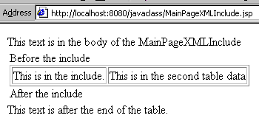
• This page is called MainPageXMLInclude.jsp
<HTML>
<HEAD><TITLE>Main Page</TITLE></HEAD>
<BODY>
This text is in the body of the MainPage
<TABLE>
<TR>
<TD>
Before the include
<jsp:include page=“/my.htm” flush=“true” />
After the include
</TD>
</TR>
</TABLE>
This text is after the end of the table.
</BODY>
</HTML>
• This page is called my.htm
<TABLE BORDER=“1”>
<TR>
<TD>
This is in the include.
</TD>
<TD>
This is in the second table data
</TD>
</TR>
</TABLE>

Slide 100
JavaServer Pages:
JavaBeans

Slide 101
Sidebar: JavaBeans
Briefly, let’s review what a JavaBean is:
Not to be confused with an Enterprise JavaBean
Must have a default (no-argument) constructor
Must have methods that correspond to the exact names of the instance variables.
Must implement the Serializable interface, which just means the state of the instance variables can be written to a hard-drive and saved.

Slide 102
Sidebar: JavaBeans
public class Myclass implements Serializable
{
private String myVariable = “”;
public Myclass()
{
}
public void setMyVariable( String m )
{
myVariable = m;
}
public String getMyVariable()
{
return myVariable;
}
}
This JavaBean is said to have a “property” of “myVariable”.

Slide 103
JavaServer Pages: JavaBeans
• Using the important jsp:useBean action.
• This action allows you to load a bean into your JSP.
<jsp:useBean id=“mine” class=“package.Myclass” />
• This syntax means: “instantiate an object of type Myclass, and bind it to a reference variable called “mine”.
• It is very similar to this:
<% Myclass mine = new Myclass(); %>
• However, the jsp:useBean can do more that the scriptlet example can.

Slide 104
JavaServer Pages: JavaBeans
• Whereas the scriptlet version is always limited to one page, the jsp:useBean tag has a scope attribute that you can set for the entire application.
• Also, when you use this jsp:useBean tag, the JSP will first look to see if there is an existing bean of the same name in scope. If it doesn’t find one in scope, then and only then will it instantiate a new bean.

Slide 105
JavaServer Pages: JavaBeans
• scope can have four values:
page—(default) This means the servlet can access the variable
application—Means the variable is stored in the ServletContext. It will be available through the predefined application variable. That means multiple servlets can access it. This also allows a servlet to create a variable that the JSP can access.
session—This means it will be stored in the HttpSession object associated with the current request. The page must participate in a session for this to work.
request—This means the bean will be stored in the ServletRequest object.

Slide 106
JavaServer Pages: JavaBeans
• Once you have a bean using this syntax—
<jsp:useBean id=“mine” class=“package.Myclass” />
—you can access its properties with
<jsp:getProperty name=“mine” property=“myVariable” />
Which is the same as doing this:
<%=mine.getMyVariable() %>
(The same except for the ability of the jsp:useBean to span more than one page.)

Slide 107
JavaServer Pages: JavaBeans
• To set a property, you would use this:
<jsp:setProperty name=“mine”
property=“myVariable”
value=“This is my variable” />
• The above code is nearly identical to this:
<% mine.setMyVariable( “This is my variable” ); %>

Slide 108
JavaServer Pages: JavaBeans
• A common approach is this:
<jsp:setProperty name=“mine”
property=“myVariable”
value=‘<%=request.getParameter(“myVariable”) %>’/>

