Slide 1
Arrhythmia prediction using QRS complex detection with genetic data
By Ryan Chow, Janya Kavit Pandya, Minh Hieu Nguyen, Soham Dighe and Wesley Zhang

Slide 2
Roles of each group member
Soham - data preprocessing
Janya and Minh - literature review
Ryan and Wesley - practical models and algorithm

Slide 3

Client/Domain and Problem Statement
In this project we are taking ECG and genetical data into consideration to detect the occurrence of 2 specific arrhythmias so as to understand the role of genetics behind the occurrence of those arrhythmias.

Slide 4
Data description
PhysioNet, is an open source data repository for biomedical research data, managed by the MIT Laboratory for Computational Physiology. On the clients recommendation we are using this as our dataset for the project. Some of the key points are as follows:
We were provided with data for 84 patients with long term Atrial Fibrillation(AF).
For each patient we get 4 files each.
The data file with ECG with 2 stream of values to provide a stable reading.
Header files tell us the background information about conditions present during the recording of the data.
Manually annotated file is available in the atr file.
Machine identified QRS labels are available in the qrs file.

Slide 5
Preliminary analysis
On taking a closer look at the data provided we saw some interesting things like:
The annotations were present only for a few selected samples from the whole.
The symbols we were looking for were sparse in nature in the annotated file itself.
We had about 900,000 samples for every patient and each sample was about 0.46 seconds in duration.
We were mainly interested in the “+” symbol since it signifies rhythm change and makes for a good marker for an incoming AF rhythm.

Slide 6
Summary of the findings to date
Signal Generation:
Holter Systems
Patch type ECG recorders
Signal Pre-Processing:
Band Pass Filtering
Wavelet Decomposition
Differentiation, integration, squaring
Signal Analysis: QRS Complex Detection:
Pan Tompkins (PT)
GR Algorithm
Feature Extraction
Is the rhythm regular or irregular?
Are QRS complex narrow?
Is the Rate Normal?
Do Waves and Complexes Proceed in Normal Sequence?

Slide 7
Non-traditional model
Detection of Arrhythmias based on ECG image
Model: Processing lite with YOLO based network with long duration ECG signal.
State of the art: object detection via image model
=> Achieved great result in real time.

Slide 8
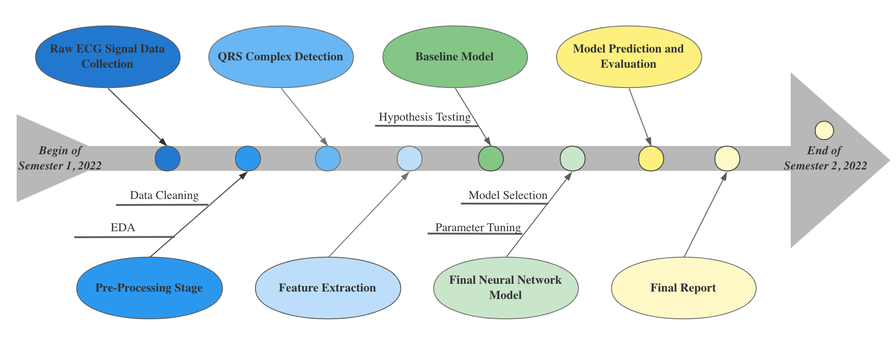
what stage(s) of the data science pipeline will you focus on?
Notes:
we will continue to focus on data preprocessing and implement new methods. Then feature extraction and QRS detection will be followed. After that, baseline models will be built to examine our assumptions. Finally, a neural network model will be used for predictions and evaluations. Error analysis will be examined as well.
• what statistical / machine learning models will you examine?
Real time object detection using image recognition by the Yolo model will be used as a QRS detector.
After the feature extraction, LSTM is under consideration. We continue to explore other models to achieve high accuracy.

Slide 9
Key challenges we are facing
Insufficient data
High requirement of accuracy
Notes:
• what are the key challenges?
-lack of data
Our sample size is limited to 84, and we don’t have sample-related genetic data. The normality of our model and the accuracy of the model may be affected
-accuracy of 99%/ finding correct models
The client needs a 99% model accuracy. Therefore, precise selection of models is needed. avoiding overfitting or underfitting is important.

Slide 10
Timeline
Period | Lead | Task
July - Aug | Sohan | Data preprocessing
Aug - Mid Sep | Janya and Minh | QRS detection and feature extraction
Mid Sep - Mid Oct | Ryan and Wesley | Finalize model and fine tune
Oct - End of semester | All teammates | Final report
Notes:
• who is the ‘lead’ for each task? what is the timeline?
Preprocessing - Soham
Qrs detection - Janya and Minh
Model - Ryan and Wesley
Timeline:
july pre-processing using various methods
August to september: Working on qrs detection and feature extraction
September to October: Finalizing Models and fine tuning
October to End of Semester: Final report

Slide 11
Thank you for watching!
See you in the next semester.
Notes:
This is our current plan for next semester. The actual situation may be completed earlier than planned, since we hope to leave enough time to negotiate and improve the details with the client.

