Slide 1

Deep Learning for Coders with fastai and PyTorch
AI Applications Without a PhD
Jeremy Howard and Sylvain Gugger

Slide 2
Chapter 1: Your Deep Learning Journey
Deep Learning Is for Everyone
What you don’t need for deep learning
Myth (don’t need) | Trust
Lots of math | High school math is sufficient.
Lots of math | We’ve seen record-breaking results with <50 items of data.
Lots of expensive computers | You can get what you need for state-of-the-art work for free.
Deep learning is a computer technique to extract and transform data by using multiple layers of neural networks. Each of these layers takes its inputs from previous layers and progressively refines them. The layers are trained by algorithms that minimize their errors and improve their accuracy.
Applications of deep learning
Natural language processing (NPL) | Computer vision | Medicine | Biology
Image generation | Recommendation systems | Playing games | Robotics

Slide 3
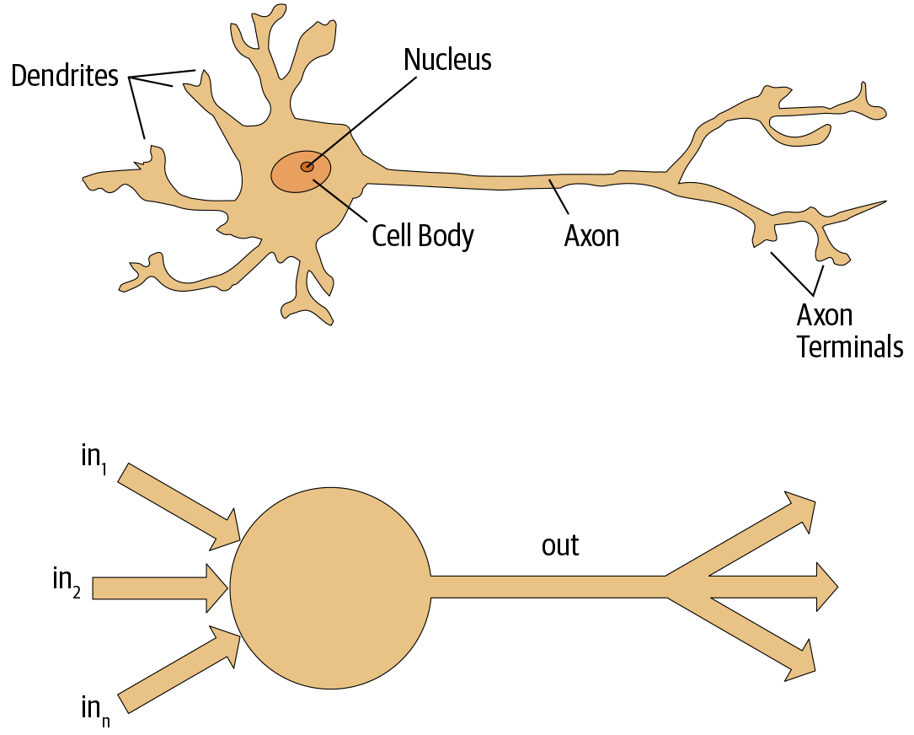
Chapter 1: Your Deep Learning Journey
Neural Networks: A Brief History
In 1943 Warren McCulloch and Walter Pitts realized that a simplified model of a real neuron could be represented using simple addition and thresholding.
Rosenblatt further developed the artificial neuron to give it the ability to learn. The perceptron was built and was able to successfully recognize simple shapes.
Marvin Minsky along with Seymour Papert, wrote a book showed that a single layer of these devices was unable to learn some simple but critical mathematical functions (such as XOR).
In the 1980s, most models were built with a second layer of neurons, thus avoiding the problem that had been identified by Minsky and Papert but in practice such networks were often too big and too slow to be useful.
Neural networks are now finally living up to their potential, thanks to the use of more layers, coupled with the capacity to do so because of improvements in computer hardware, increases in data availability, and algorithmic tweaks that allow NN to be trained faster.
Figure 1-1. Natural and artificial neurons

Slide 4
Chapter 1: Your Deep Learning Journey
How to Learn Deep Learning
Throughout this book, we follow these principles:
Teaching the whole game
  We’ll start off by showing you how to use a complete, working, usable, state-of-the-art deep learning network to solve real-world problems using simple, expressive tools. And then we’ll gradually dig deeper and deeper into understanding how those tools are made, and how the tools that make those tools are made, and so on…
Always teaching through examples
  We’ll ensure that there is a context and a purpose that you can understand intuitively, rather than starting with algebraic symbol manipulation.
Simplifying as much as possible
  We’ve spent years building tools and teaching methods that make previously complex topics simple.
Removing barriers
  Deep learning has, until now, been an exclusive game. We’re breaking it open and ensuring that everyone can play.

Slide 5
Chapter 1: Your Deep Learning Journey
Your First Model
Getting a GPU Deep Learning Server
Graphics processing uni is a special kind of processor in your computer that can handle thousands of single tasks at the same time. we suggest you rent access to a computer that already has everything you need preinstalled and ready to go.
Running Your First Notebook
A dataset called the Oxford-IIIT Pet Dataset that contains 7,349 images of cats and dogs from 37 breeds
A pretrained model that has already been trained on 1.3 million images
The pretrained model will be fine-tuned using the latest advances in transfer learning to create a model
What Is Machine Learning?
Machine learning is, like regular programming, a way to get computers to complete a specific task.
Arthur Samuel basic idea was this: instead of telling the computer the exact steps required to solve a problem, show it examples of the problem to solve, and let it figure out how to solve it itself

Slide 6
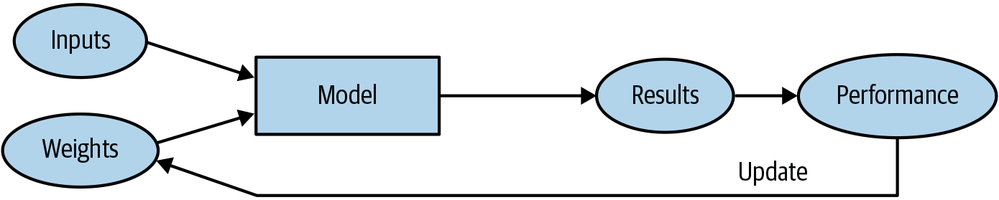
Chapter 1: Your Deep Learning Journey
What Is Machine Learning?
Weights are just variables, and a weight assignment is a particular choice of values for those variables. The program’s inputs are values that it processes in order to produce its results
Model is a special kind of program: it’s one that can do many different things, depending on the weights. It can be implemented in many different ways.
we need an automatic means of testing the effectiveness of any current weight assignment in terms of actual performance.
Learning would become entirely automatic when the adjustment of the weights was also relied on an automated mechanism that produced adjustments based on performance.
Figure 1-2. Training a machine learning model

Slide 7
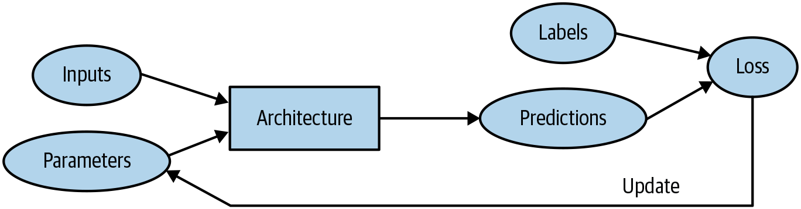
Chapter 1: Your Deep Learning Journey
What Is a Neural Network?
That is, if you regard a neural network as a mathematical function, it turns out to be a function that is extremely flexible depending on its weights. A mathematical proof called the universal approximation theorem shows that this function can solve any problem to any level of accuracy, in theory
Neural network is a particular kind of machine learning model. Neural networks are special because they are highly flexible, which means they can solve an unusually wide range of problems just by finding the right weights. This is powerful, because stochastic gradient descent provides us a way to find those weight values automatically.
Figure 1-3. Detailed training loop

Slide 8
Chapter 1: Your Deep Learning Journey
Limitations Inherent to Machine Learning
A model cannot be created without data.
A model can learn to operate on only the patterns seen in the input data used to train it.
This learning approach creates only predictions, not recommended actions.
It’s not enough to just have examples of input data; we need labels for that data too (e.g., pictures of dogs and cats aren’t enough to train a model; we need a label for each one, saying which ones are dogs and which are cats).
we’ve seen that most organizations that say they don’t have enough data actually mean they don’t have enough labeled data.

Slide 9
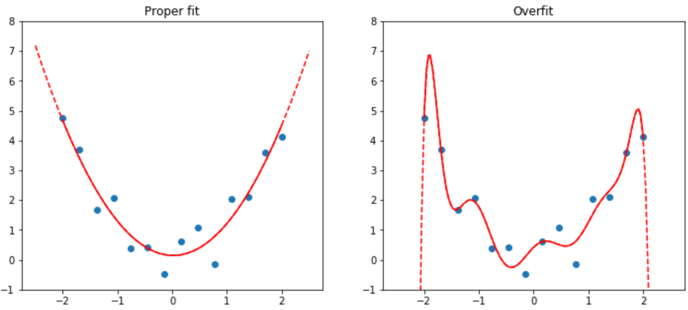
Chapter 1: Your Deep Learning Journey
Overfitting
As a result, the longer you train for, the better your accuracy will get on the training set; the validation set accuracy will also improve for a while, but eventually it will start getting worse as the model starts to memorize the training set rather than finding generalizable underlying patterns in the data. When this happens, we say that the model is overfitting.
Overfitting is the single most important and challenging issue when training for all machine learning practitioners, and all algorithms. As you will see, it is easy to create a model that does a great job at making predictions on the exact data it has been trained on, but it is much harder to make accurate predictions on data the model has never seen before.
Figure 1-4. Example of overfitting

Slide 10
Chapter 1: Your Deep Learning Journey
Validation set
When you train a model, you must always have both a training set and a validation set, and you must measure the accuracy of your model only on the validation set. If you train for too long, with not enough data, you will see the accuracy of your model start to get worse; this is called overfitting. fastai defaults valid_pct to 0.2, so even if you forget, fastai will create a validation set for you!
Metric
A metric is a function that measures the quality of the model’s predictions using the validation set, and will be printed at the end of each epoch.
The concept of a metric may remind you of loss, but there is an important distinction. The entire purpose of loss is to define a “measure of performance” that the training system can use to update weights automatically
Pre-train
A model that has weights that have already been trained on another dataset is called a pretrained model. You should nearly always use a pretrained model, because it means that your model, before you’ve even shown it any of your data, is already very capable.

Slide 11
Chapter 1: Your Deep Learning Journey
Transfer learning
Using a pretrained model for a task different from what it was originally trained for is known as transfer learning.
A transfer learning technique that updates the parameters of a pretrained model by training for additional epochs using a different task from that used for pretraining.
Epochs
To fit a model, we have to provide at least one piece of information: how many times to look at each image (known as number of epochs). The number of epochs you select will largely depend on how much time you have available, and how long you find it takes in practice to fit your model. If you select a number that is too small, you can always train for more epochs later.
An epoch is one complete pass through the dataset. After calling fit, the results after each epoch are printed, showing the epoch number, the training and validation set losses (the “measure of performance” used for training the model), and any metrics you’ve requested.

Slide 12
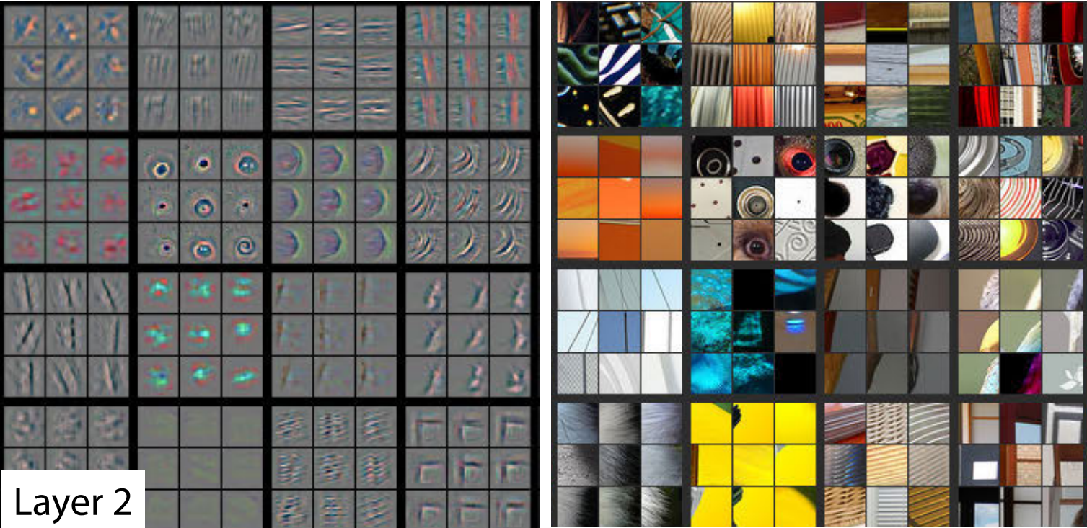
Chapter 1: Your Deep Learning Journey
What Our Image Recognizer Learned
At this stage, we have an image recognizer that is working well, but we have no idea what it is doing! Although many people complain that deep learning results in impenetrable “black box” models (that is, something that gives predictions but that no one can understand)
When we fine-tuned our pretrained model earlier, we adapted what those last layers focus on (flowers, humans, animals) to specialize on the cats versus dogs problem. More generally, we could specialize such a pretrained model on many different tasks.
Paper: Visualizing and Understanding Convolutional Networks
Figure 1-5. Activations of the second layer of a CNN

Slide 13
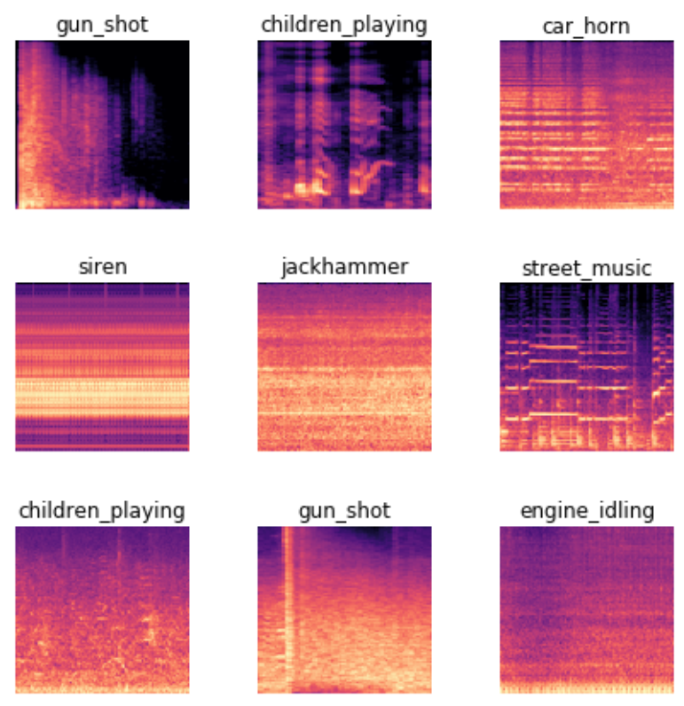
Chapter 1: Your Deep Learning Journey
Image Recognizers Can Tackle Non-Image Tasks
An image recognizer can, as its name suggests, only recognize images. But a lot of things can be represented as images, which means that an image recognizer can learn to complete many tasks
For instance, a sound can be converted to a spectrogram, which is a chart that shows the amount of each frequency at each time in an audio file. Fast.ai student Ethan Sutin used this approach to easily beat the published accuracy of a state-of-the-art environmental sound detection model using a dataset of 8,732 urban sounds
Web: Great results on audio classification with fastai library
Figure 1-6. show_batch with spectrograms of sounds

Slide 14
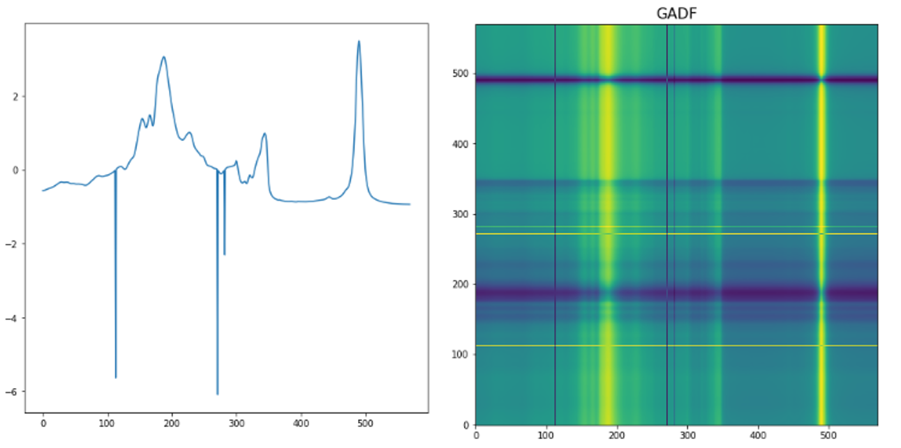
Chapter 1: Your Deep Learning Journey
Image Recognizers Can Tackle Non-Image Tasks
A time series can easily be converted into an image by simply plotting the time series on a graph. However, it is often a good idea to try to represent your data in a way that makes it as easy as possible to pull out the most important components. In a time series, things like seasonality and anomalies are most likely to be of interest.
For instance, fast.ai student Ignacio Oguiza created images from a time series dataset for olive oil classification, using a technique called Gramian Angular Difference Field (GADF)
His results, despite having only 30 training set images, were well over 90% accurate, and close to the state of the art.
Figure 1-7. Converting a time series into an image

Slide 15
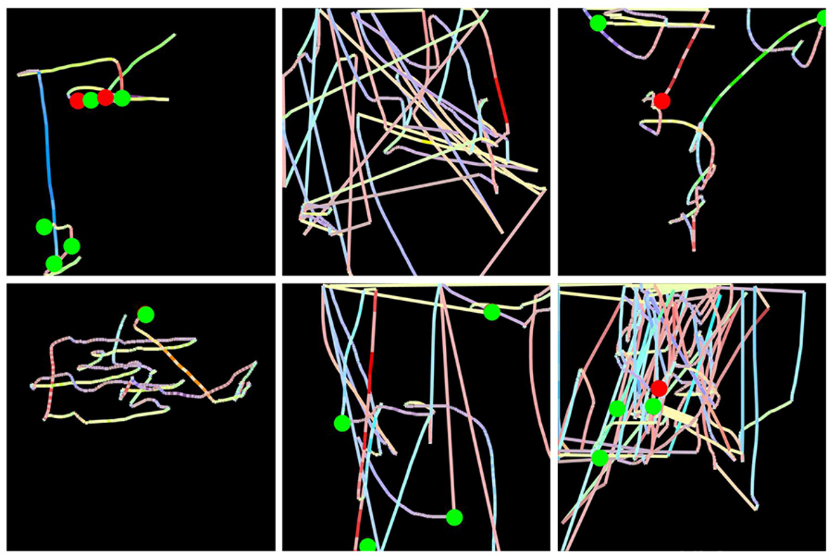
Chapter 1: Your Deep Learning Journey
Image Recognizers Can Tackle Non-Image Tasks
Gleb Esman was working on fraud detection at Splunk, using a dataset of users’ mouse movements and mouse clicks. He turned these into pictures by drawing an image displaying the position, speed, and acceleration of the mouse pointer by using colored lines, and the clicks were displayed using small colored circles. He fed this into an image recognition model just like the one we’ve used in this chapter, and it worked so well that it led to a patent for this approach to fraud analytics!
Web: Splunk and Tensorflow for Security: Catching the Fraudster with Behavior Biometrics
Figure 1-8. Converting computer mouse behavior to an image

Slide 16
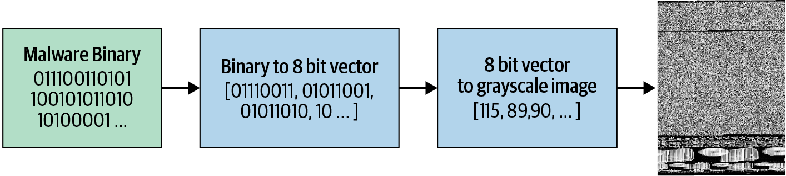
Chapter 1: Your Deep Learning Journey
Image Recognizers Can Tackle Non-Image Tasks
Mahmoud Kalash et al., which explains that “the malware binary file is divided into 8-bit sequences which are then converted to equivalent decimal values. This decimal vector is reshaped and [a] gray-scale image is generated that represent[s] the malware sample
As you can see, the different types of malware look very distinctive to the human eye. The model the researchers trained based on this image representation was more accurate at malware classification than any previous approach shown in the academic literature.
Paper: Malware Classification with Deep Convolutional Neural Networks
Figure 1-9. Malware classification process

Slide 17
Chapter 1: Your Deep Learning Journey
Jargon Recap
Term | Meaning
Label | The data that we’re trying to predict, such as “dog” or “cat”
Architecture | The template of the model that we’re trying to fit; i.e., the actual mathematical function that we’re passing the input data and parameters to
Model | The combination of the architecture with a particular set of parameters
Parameters | The values in the model that change what task it can do and that are updated through model training
Fit | Update the parameters of the model such that the predictions of the model using the input data match the target labels
Train | A synonym for fit
Pretrained model | A model that has already been trained, generally using a large dataset, and will be fine-tuned
Fine-tune | Update a pretrained model for a different task

Slide 18
Chapter 1: Your Deep Learning Journey
Jargon Recap
Term | Meaning
Epoch | One complete pass through the input data
Loss | A measure of how good the model is, chosen to drive training via SGD
Metric | A measurement of how good the model is using the validation set, chosen for human consumption
Validation set | A set of data held out from training, used only for measuring how good the model is
Training set | The data used for fitting the model; does not include any data from the validation set
Overfitting | Training a model in such a way that it remembers specific features of the input data, rather than generalizing well to data not seen during training
CNN | Convolutional neural network; a type of neural network that works particularly well for computer vision tasks

Slide 19
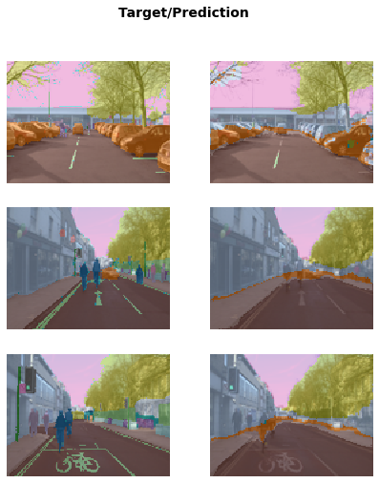
Chapter 1: Your Deep Learning Journey
Learning Is Not Just for Image Classification
Segmentation
let’s talk about something that is critically important for autonomous vehicles: localizing objects in a picture. If a self-driving car doesn’t know where a pedestrian is, then it doesn’t know how to avoid one! Creating a model that can recognize the content of every individual pixel in an image is called segmentation.
We can visualize how well it achieved its task by asking the model to color-code each pixel of an image. As you can see, it nearly perfectly classifies every pixel in every object.
Paper: Semantic object classes in video: A high-definition ground truth database

Slide 20
Chapter 1: Your Deep Learning Journey
Learning Is Not Just for Image Classification
Natural language processing
One other area where deep learning has dramatically improved in the last couple of years is natural language processing (NLP). Computers can now generate text, translate automatically from one language to another, analyze comments, label words in sentences, and much more.
This model is using the IMDb Large Movie Review dataset from “Learning Word Vectors for Sentiment Analysis” by Andrew Maas et al. It works well with movie reviews of many thousands of words.
Tabular
Data that is in the form of a table, such as from a spreadsheet, database, or a comma-separated values (CSV) file. A tabular model is a model that tries to predict one column of a table based on information in other columns of the table.
Recommendation systems are important, particularly in ecommerce. Companies like Amazon and Netflix try hard to recommend products or movies that users might like. Here’s how to train a model that will predict movies people might like based on their previous viewing habits, using the MovieLens dataset:

Slide 21
Chapter 1: Your Deep Learning Journey
Validation Sets and Test Sets
If we trained a model with all our data and then evaluated the model using that same data, we would not be able to tell how well our model can perform on data it hasn’t seen. Without this very valuable piece of information to guide us in training our model, there is a very good chance it would become good at making predictions about that data but would perform poorly on new data.
To avoid this, our first step was to split our dataset into two sets: the training set (which our model sees in training) and the validation set, also known as the development set (which is used only for evaluation). This lets us test that the model learns lessons from the training data that generalize to new data, the validation data.
This same discipline can be critical if you intend to hire a third party to perform modeling work on your behalf. A third party might not understand your requirements accurately, or their incentives might even encourage them to misunderstand them. A good test set can greatly mitigate these risks and let you evaluate whether their work solves your actual problem.

Slide 22
Chapter 1: Your Deep Learning Journey
Validation Sets and Test Sets
Use Judgment in Defining Test Sets
To do a good job of defining a validation set (and possibly a test set), you will sometimes want to do more than just randomly grab a fraction of your original dataset. Remember: a key property of the validation and test sets is that they must be representative of the new data you will see in the future. This may sound like an impossible order! By definition, you haven’t seen this data yet. But you usually still do know some things.

Slide 23
Chapter 1: Your Deep Learning Journey
Questionnaire
1. Do you need these for deep learning?
Lots of math T/F
Lots of data T/F
Lots of expensive computers T/F
A PhD T/F
2. Name five areas where deep learning is now the best tool in the world.
Natural Language Processing
Computer Vision
Recommendation systems
Medicine
Image generation/enhancement
3. What was the name of the first device that was based on the principle of the artificial neuron?
Mark I perceptron built by Frank Rosenblatt
4. Based on the book of the same name, what are the requirements for parallel distributed processing (PDP)?
A set of processing units
A state of activation
An output function for each unit
A pattern of connectivity among units
A propagation rule for propagating patterns of activities through the network of connectivities
An activation rule for combining the inputs impinging on a unit with the current state of that unit to produce a new level of activation for the unit
A learning rule whereby patterns of connectivity are modified by experience
An environment within which the system must operate

