Slide 1
Association Study of Drugs and Adverse Events
Minh Pham, Department of Mathematics & statistics, University of south Florida
Feng Cheng, Dept of Pharmaceutical Science & dept of Epidemiology & Biostatistics, University of south florida
Kandethody Ramachandran, Department of Mathematics & statistics, University of south Florida

Slide 2
What is the problem and why
Drug
D1
D2
Adverse Event
AE1
AE2
…
Dp
…
AEq
D3
AE3
Preliminary detection of drugs’ side effects
For regulators
For the public
Automate signal detection from the FAERS database
Which statistical method can drive this process?
Challenges:
Too many drugs and AEs
Sparseness of the data

Slide 3
What is the problem and why
primaryid | D1 | D2 | D3 | … | Dp | AE1 | AE2 | AE3 | … | Aeq
88438052 | 0 | 0 | 1 | … | 0 | 0 | 0 | 0 | … | 0
53841413 | 0 | 0 | 0 | … | 0 | 0 | 0 | 1 | … | 0
77175049 | 0 | 0 | 1 | … | 0 | 1 | 0 | 0 | … | 0
62598515 | 0 | 0 | 0 | … | 0 | 0 | 0 | 0 | … | 0
37699682 | 0 | 0 | 0 | … | 0 | 0 | 0 | 0 | … | 0
65866064 | 1 | 0 | 0 | … | 0 | 0 | 1 | 0 | … | 0
18502693 | 0 | 0 | 0 | … | 0 | 0 | 0 | 0 | … | 0
59014545 | 0 | 0 | 0 | … | 0 | 0 | 0 | 0 | … | 0

Slide 4
outline
Methods in the literature
A gold standard for comparison study
Results of comparison study
Future consideration

Slide 5
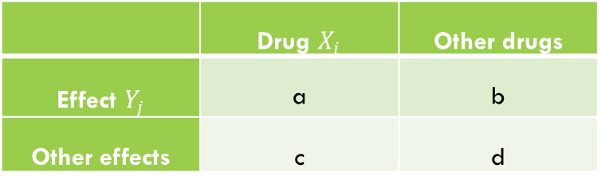

Methods in the literature
Disproportionality (Univariate) methods:
Proportional Reporting Ratio $PRR=\frac{a/(a+c)}{b/(b+d)}$
Reporting Odds Ratio $ROR=\frac{a/c}{b/d}$
 | Drug $X_{i}$ | Other drugs
Effect $Y_{j}$ | a | b
Other effects | c | d

Slide 6
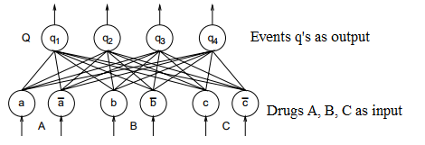
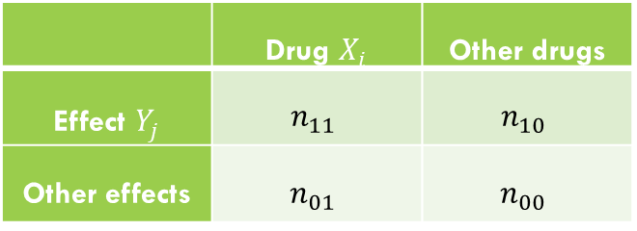

Methods in the literature
Bayesian Confidence Propagation Neural Network (BCPNN)
$P\left(n_{11},n_{10},n_{01},n_{00}|n,p_{11},p_{10},p_{01},p_{00}\right)=\frac{n!}{n_{11}!n_{10}!n_{01}!n_{00}!}p_{11}^{n_{11}}p_{10}^{n_{10}}p_{01}^{n_{01}}p_{00}^{n_{00}}$
$p_{11},p_{10},p_{01},p_{00} \sim Dir(α_{11}, α_{10}, α_{01},α_{00})$
$E(weight)=\log_{2}{(\frac{E(p_{11})}{E\left(p_{1.}\right)E(p_{.1})})}$
 | Drug $X_{i}$ | Other drugs
Effect $Y_{j}$ | $$n_{11}$$ | $$n_{10}$$
Other effects | $$n_{01}$$ | $$n_{00}$$

Slide 7
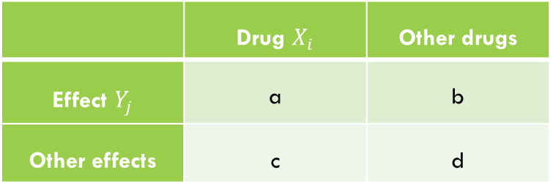

Methods in the literature
Gamma-Poisson Shrinkage model (GPS)
$N_{ij}=\sum_{l=1}^{n}{X_{il}Y_{jl}}$ : count of drug i and event j
$N_{ij}\sim Poisson\left(λ_{ij}∗E_{ij}\right)$
$λ \sim mixture of 2 Gamma distribution$
Use posterior distribution of $λ$ to raise signal
 | Drug $X_{i}$ | Other drugs
Effect $Y_{j}$ | a | b
Other effects | c | d

Slide 8
Methods in the literature
Disproportionality analysis:
Frequentist: PRR and ROR
Bayesian: BCPNN and GPS
Going multivariate:
Reason: multi-pharmarcy
primaryid | D1 | D2 | D3 | … | Dp | AE1 | AE2 | AE3 | … | Aeq
88438052 | 1 | 0 | 1 | … | 0 | 1 | 0 | 0 | … | 0

Slide 9

Methods in the literature
Logistic Regression (LR):
$$logit\left(P\left(Y_{j}=1\right)\right)=\log\left(\frac{P\left(Y_{j}=1\right)}{1−P\left(Y_{j}=1\right)}\right)=∑β_{i}X_{i}$$
Regression-adjusted Gamma-Poisson Shrinkage Model (RGPS):
$$E_{ij}=\frac{e^{∑β_{l}X_{l}−∑β_{i}X_{i}}}{1+e^{∑β_{l}X_{l}−∑β_{i}X_{i}}}$$
Then regular GPS

Slide 10
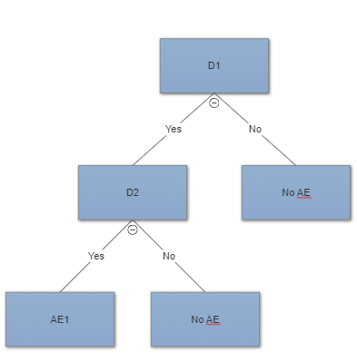

Methods in (OTHER) literature
Need improvement: drug interaction
Borrowed ideas from Genome-wide Association Study:
Random Forests: rank drugs by variable important
Monte Carlo Logic Regression:
$$logit\left(P\left(Y_{j}=1\right)\right)=β_{0}+\sum_{i=1}^{K}{β_{i}L_{i}}$$
$L_{i}=I\left(X_{1}=1 and X_{2}=1\right)$ or $L_{i}=I(\left(X_{1}≠1 and X_{2}=1\right) or X_{3}≠1)$

Slide 11
The testing bed
Observational Medical Outcomes Partnership (OMOP) Gold Standard
Made by expert consensus
165 positive controls
233 negative controls

Slide 12
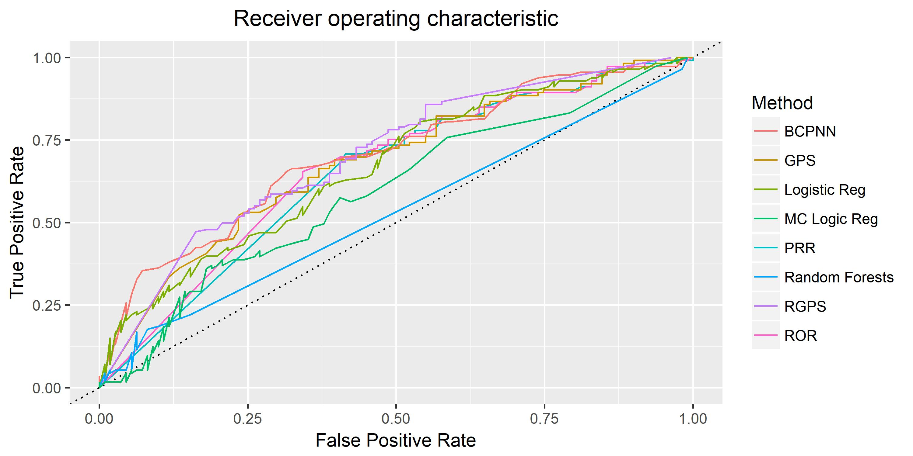

Slide 13
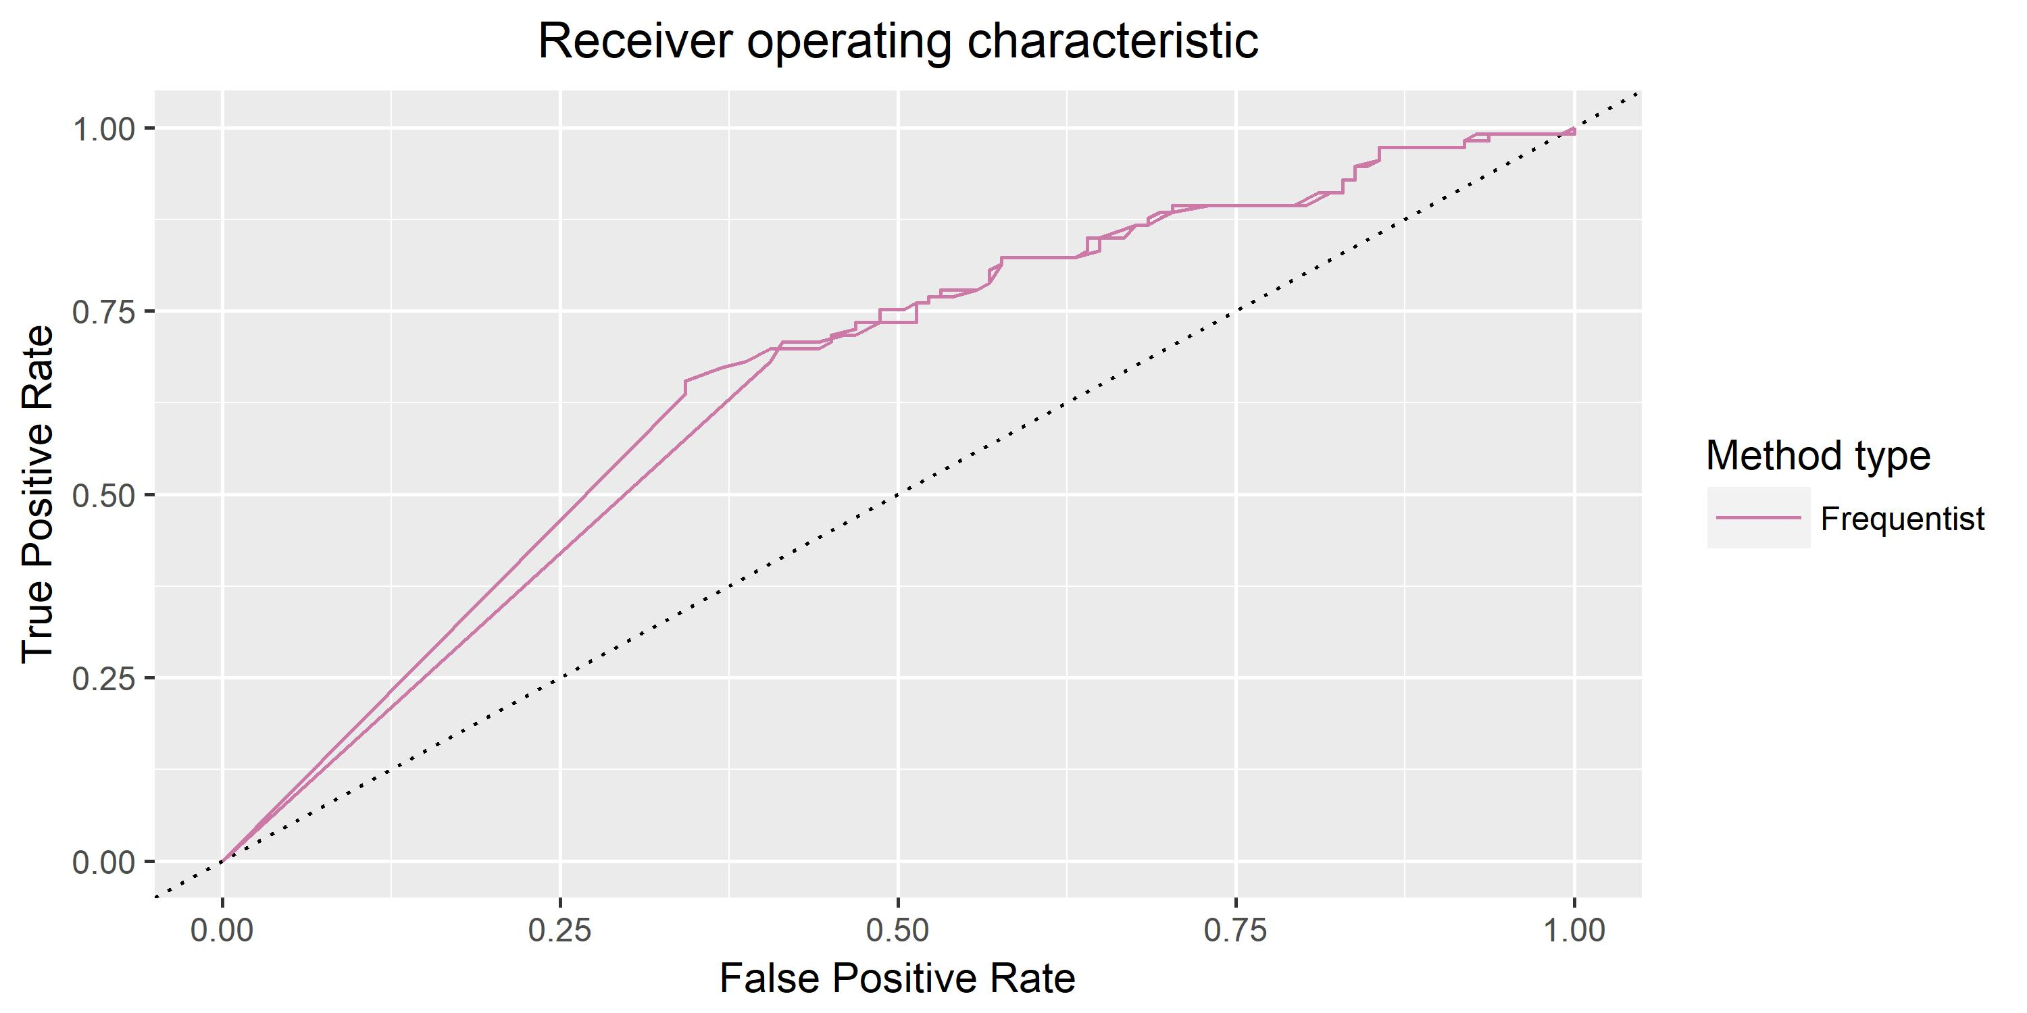

Slide 14
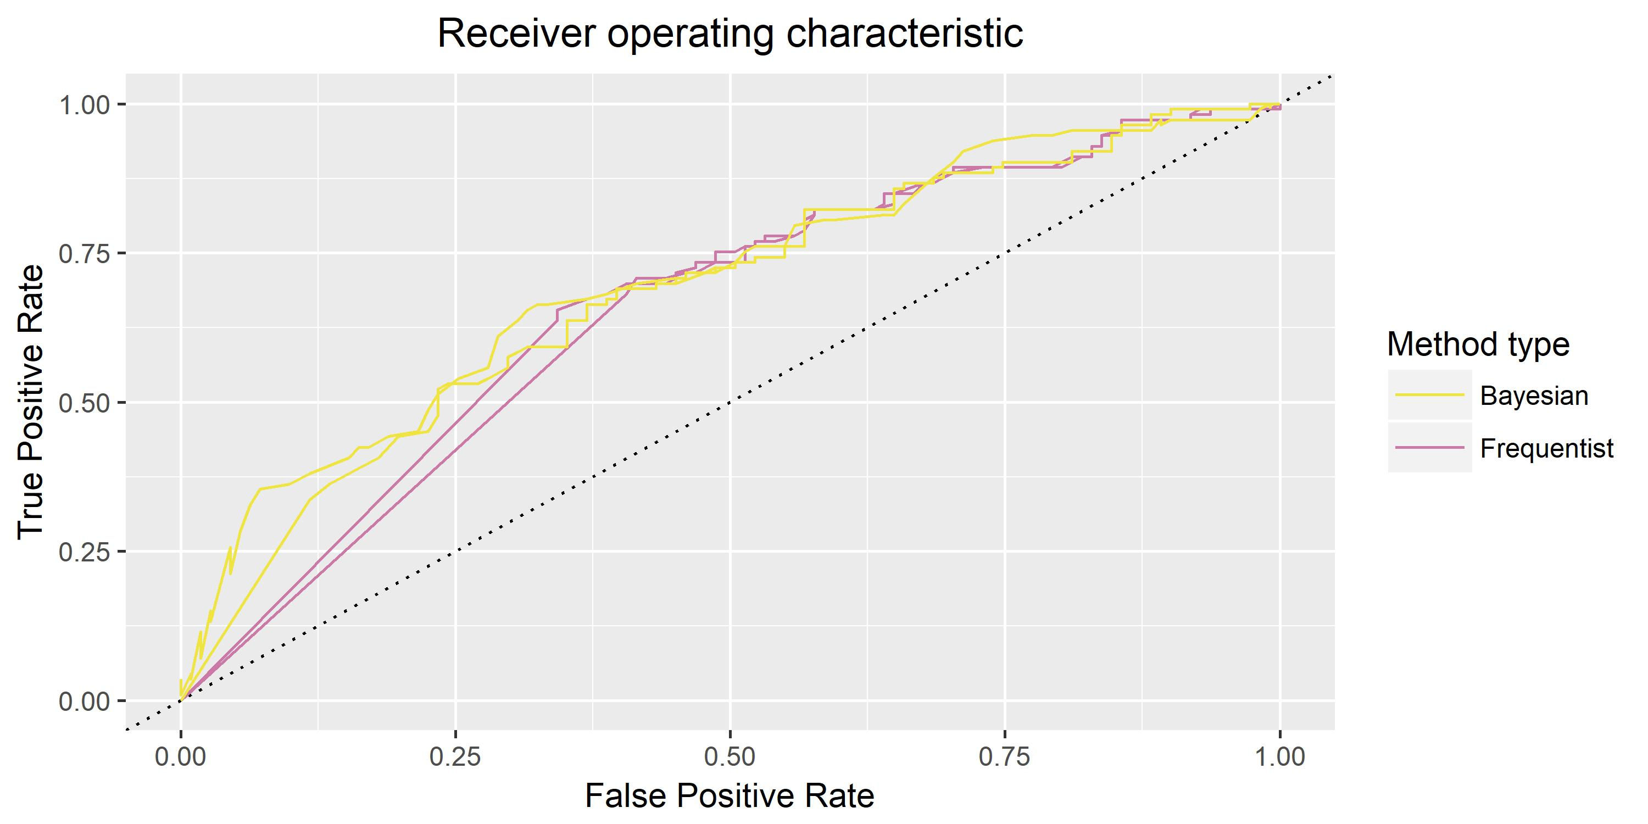

Slide 15
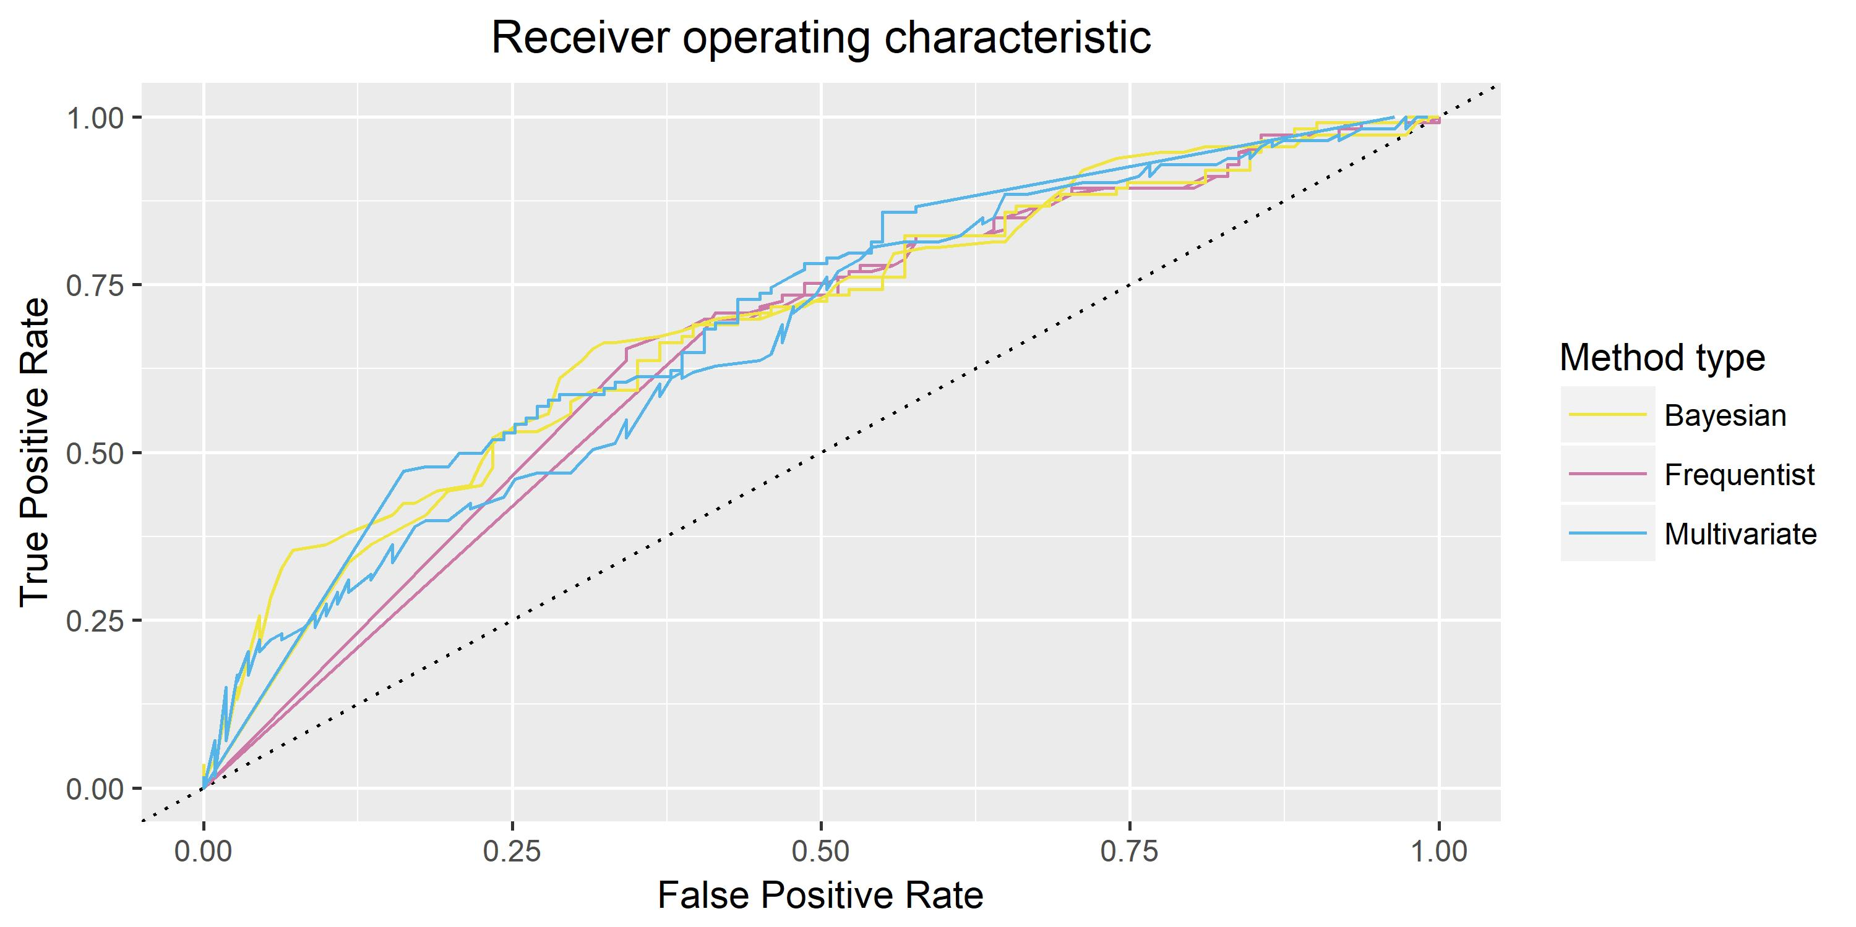

Slide 16
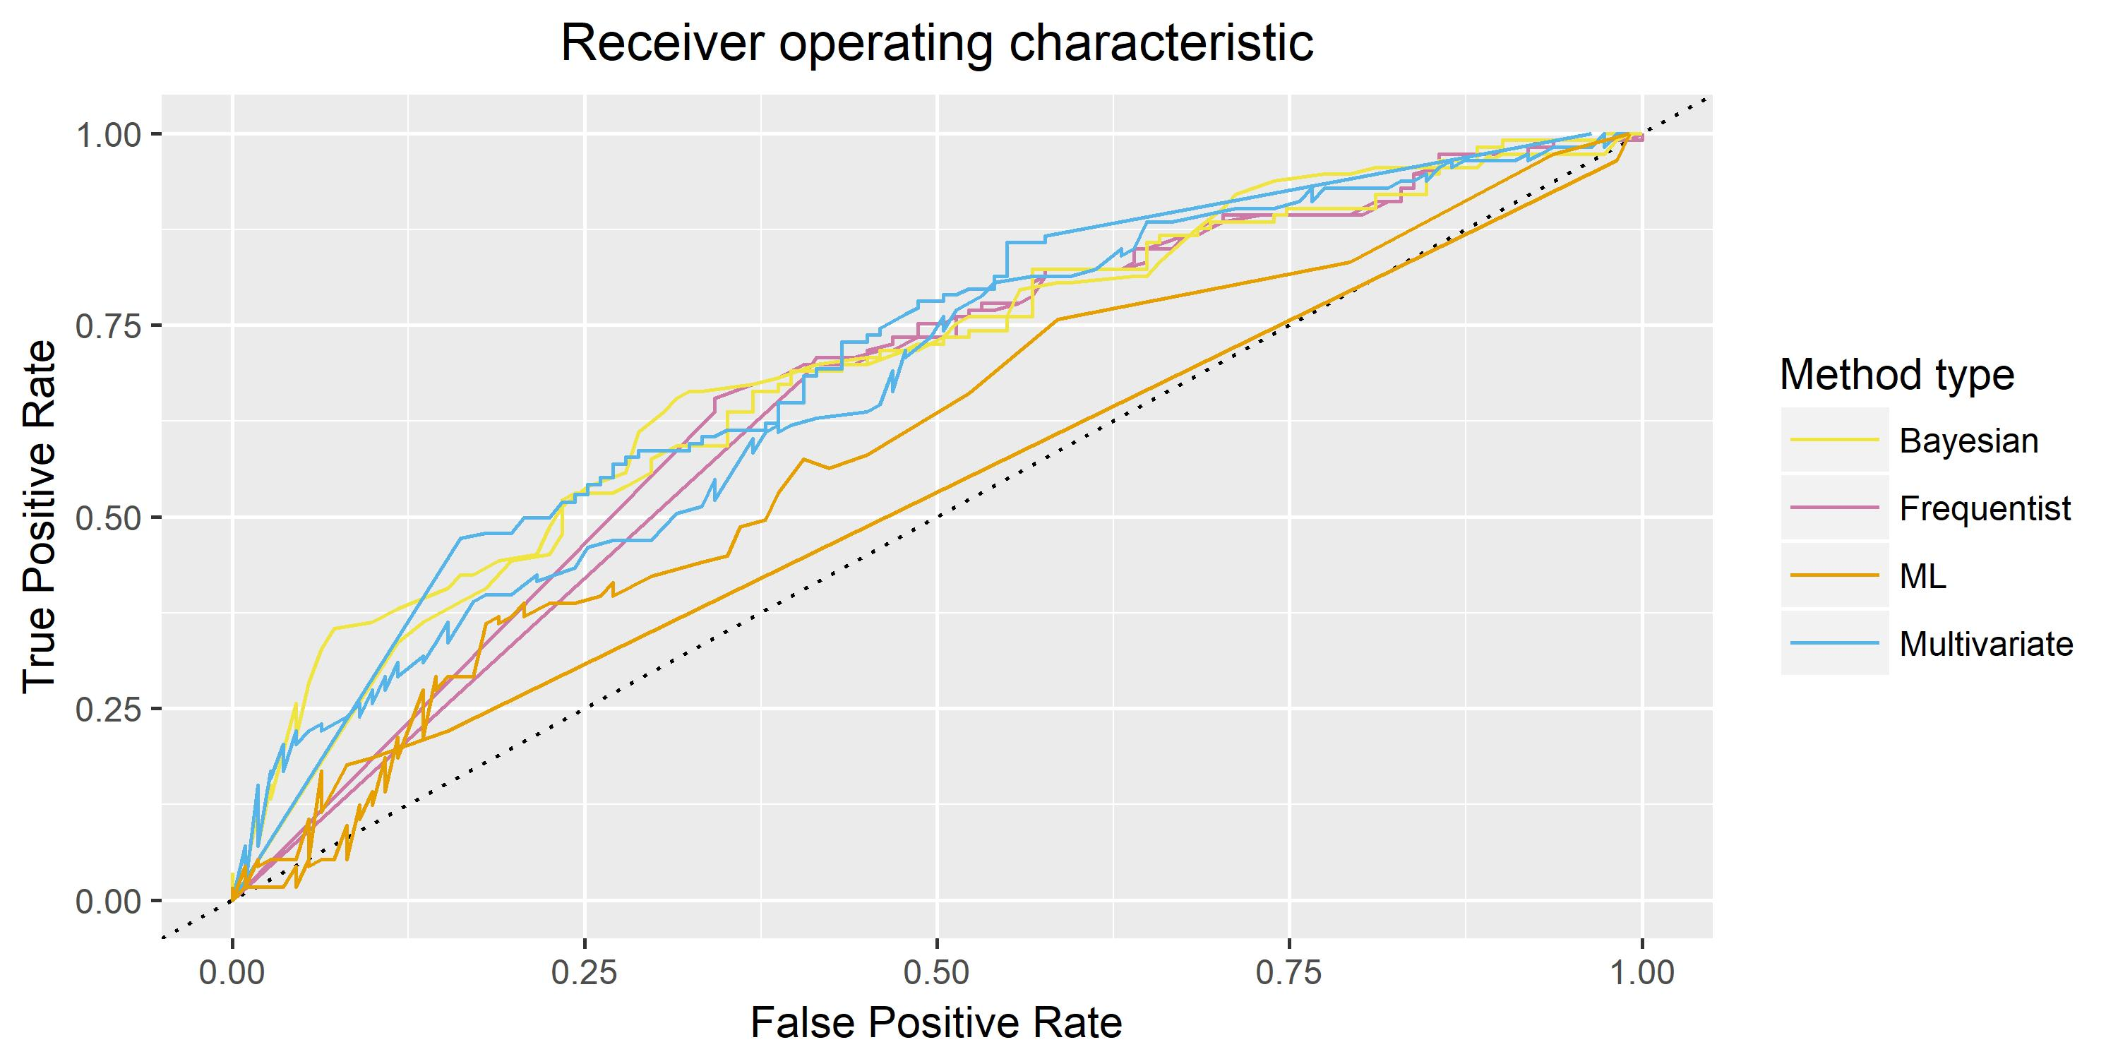

Slide 17
Area Under Curve & speed
Method | AUC
RGPS | 0.7091
BCPNN | 0.6939
GPS | 0.6803
ROR | 0.6653
Logistic Reg | 0.6604
PRR | 0.6514
MC Logic Reg | 0.5850
Random Forests | 0.5208
Method | Computing Time
Logistic Reg | 8.04 minutes
PRR | 12.73 minutes
ROR | 12.73 minutes
GPS | 12.73 minutes
BCPNN | 12.81 minutes
RGPS | 14.13 minutes
MC Logic Reg | 14.21 minutes
Random Forests | 8.17 hours

Slide 18
Future development
Methods to detect drug interactions without specifying
GPS and RGPS: can be improved by using EM algorithm to estimate parameters instead of Newton-type algorithm
Automate the screening process and make public

Slide 19
References
Evans, S. J. W., Waller, P. C., & Davis, S. (2001). Use of proportional reporting ratios (PRRs) for signal generation from spontaneous adverse drug reaction reports. Pharmacoepidemiology and drug safety, 10(6), 483-486.
Rothman, K. J., Lanes, S., & Sacks, S. T. (2004). The reporting odds ratio and its advantages over the proportional reporting ratio. Pharmacoepidemiology and drug safety, 13(8), 519-523.
Waller, P., Van Puijenbroek, E. P., Egberts, A. C. G., & Evans, S. (2004). The reporting odds ratio versus the proportional reporting ratio:'deuce'. Pharmacoepidemiology and drug safety, 13(8), 525-526.
DuMouchel, W., & Pregibon, D. (2001, August). Empirical bayes screening for multi-item associations. In Proceedings of the seventh ACM SIGKDD international conference on Knowledge discovery and data mining (pp. 67-76). ACM.
DuMouchel, W. (1999). Bayesian data mining in large frequency tables, with an application to the FDA spontaneous reporting system. The American Statistician, 53(3), 177-190.
DuMouchel, W., Fram, D., Yang, X., Mahmoud, R. A., Grogg, A. L., Engelhart, L., & Ramaswamy, K. (2008). Antipsychotics, glycemic disorders, and life-threatening diabetic events: a Bayesian data-mining analysis of the FDA adverse event reporting system (1968–2004). Annals of Clinical Psychiatry, 20(1), 21-31.
Ryan, P. B., Madigan, D., Stang, P. E., Marc Overhage, J., Racoosin, J. A., & Hartzema, A. G. (2012). Empirical assessment of methods for risk identification in healthcare data: results from the experiments of the Observational Medical Outcomes Partnership. Statistics in medicine, 31(30), 4401-4415.
A. Liaw and M. Wiener (2002). Classification and Regression by randomForest. R News 2(3), 18--22.
Kooperberg, C., & Ruczinski, I. (2011). LogicReg: Logic Regression. R package version, 1(10).
Bate, A., Lindquist, M., Edwards, I. R., Olsson, S., Orre, R., Lansner, A., & De Freitas, R. M. (1998). A Bayesian neural network method for adverse drug reaction signal generation. European journal of clinical pharmacology, 54(4), 315-321.

