Slide 1

CO2 Emissions
Group 2: Vu Tuyet Vy, Le Minh Huyen

Slide 2
Table of Contents
Data Description
Project Questions
Data Preprocessing and EDA
Data Visualization and Key Findings

Slide 3
Data Description
Variable | Class | Description
year | double | The year of the data point
parent_entity | character | The entity to whom the emissions are traced to
parent_type | character | The type of parent_entity. Can be one of: investor-owned company, state-owned entity, nation state.
commodity | character | Specifies which commodity the production refers to: Oil and NGL, Natural Gas, Anthracite Coal, Bituminous Coal, Lignite Coal, Metallurgical Coal, Sub-Bituminous Coal, Thermal Coal, or Cement.
production_value | double | The quantity of production
production _unit | character | The unit of production (Oil & NGL - million barrels, Natural Gas - billion cubic feet, Coal - million tonnes, Cement - million tonnes CO2 (see methodology for explanation)). Units - Billion cubic feet per year (Bcf/yr), Million barrels per year (Million bbl/yr), or Million tonnes per year (Million tonnes/yr).
total_emissions_MtCO2e | double | The total emissions traced to
Historical production data from 122 of the world’s largest oil, gas, coal, and cement producers.

Slide 4
Project Questions
How have the total emissions from major entities changed over the years, and what are the key trends across different commodities? Additionally, how do policy milestones (e.g., the Paris Agreement or COP commitments) align with observed changes in emissions over time?
Can natural clusters be identified among entities based on their production and emissions data, and what characteristics define these clusters?

Slide 5
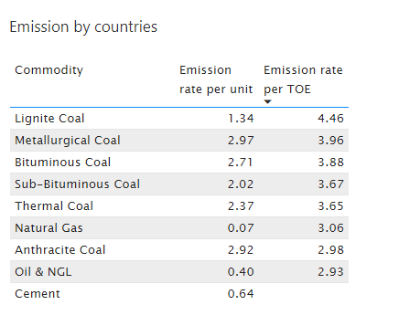
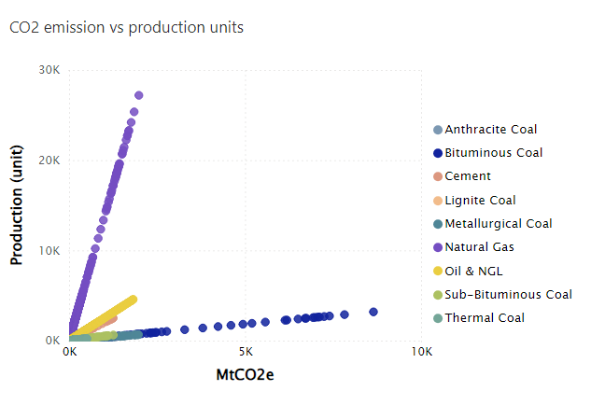
Data processing & EDA
External data: Country name of the company, Milestone for joining Kyoto and Paris agreement (COP)
Convert production volume to TOE

Slide 6
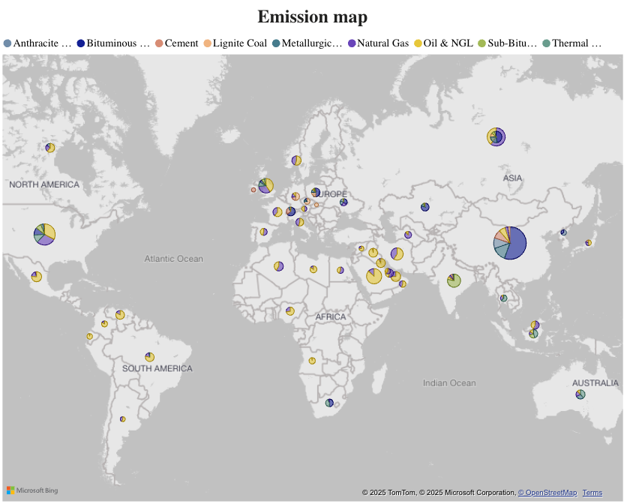
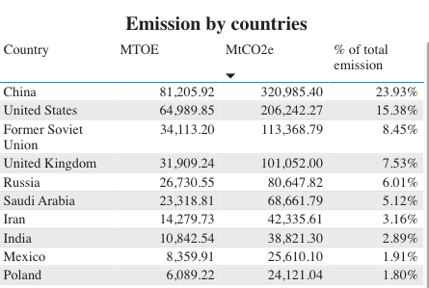
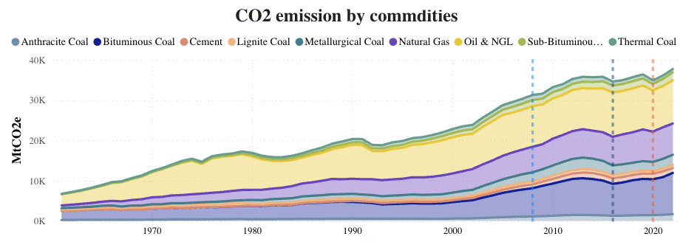
Question 1 - Key findings - Overall
Global Emissions Rising: Driven by oil, gas, and coal.
Company Location: Primarily South America, Europe, Africa, and parts of Asia.
Fuel Focus: Europe & Africa: Oil/Gas. Major emitters: Diverse fuels.
Top Emitters: USA, China, Russia, UK.
China's Coal: 25-30% of global coal emissions; coal is the largest emission source.

Slide 7
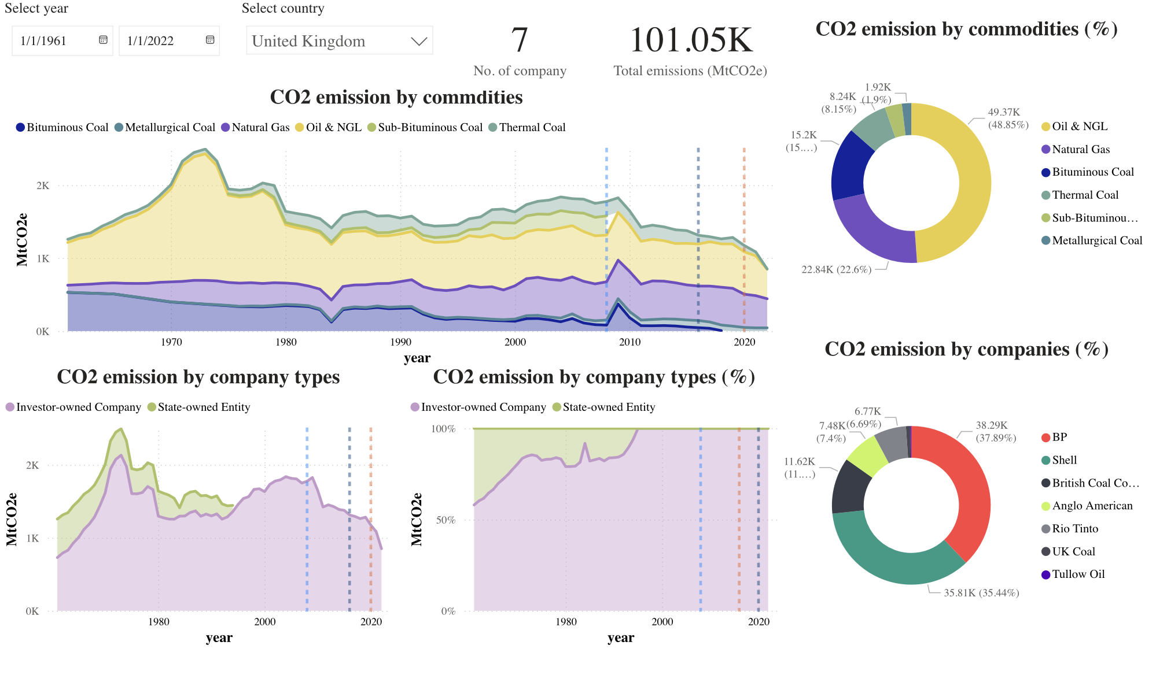
Question 1 - Key findings - Country-specific Analysis
China:
Kyoto & Paris participant, minimal impact.
Rising fuel production.
State-owned companies, energy security focus.
USA:
Paris Agreement participant, minimal impact.
Oil & gas dominant.
Free-market investment structure.
UK:
Significant emission decline.
High agreement compliance.
Private sector driven, free-market.
Other Nations:
Low compliance overall.
Reductions in war zones/developed Europe.
Possible shift to cleaner energy.
Visualisation of CO2 emission in UK
Notes:
UK’s CO2 emissions dropped significantly compared to the previous 10 years, possibly due to the ratification of the Kyoto Protocol and Paris Agreement. In the Kyoto Protocol, the UK is classified as an Annex I country, which means it has legally binding emission reduction targets.

Slide 8
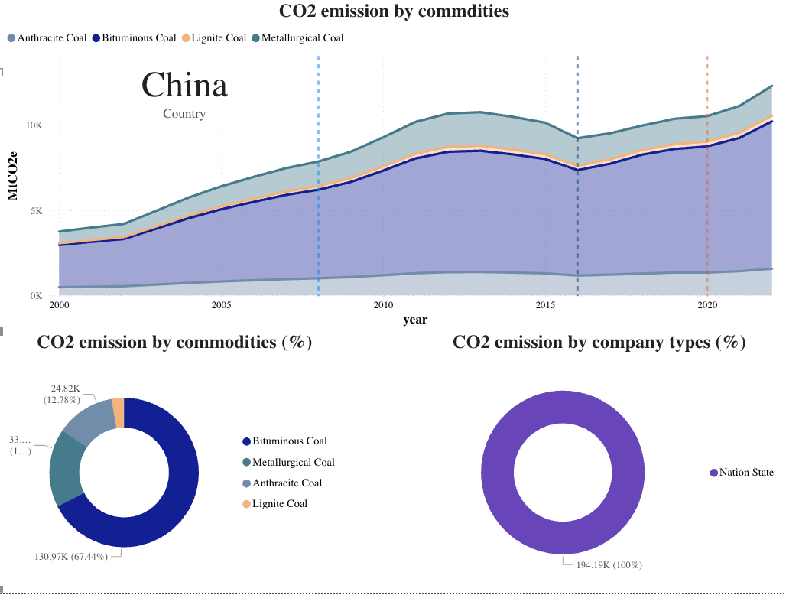
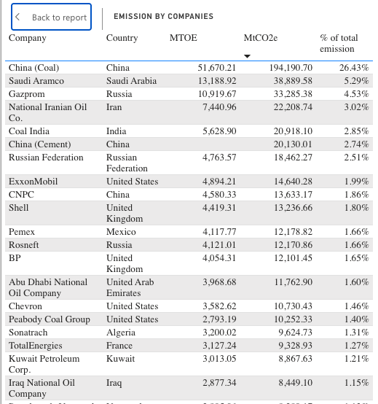
Question 1 - Key findings - Entity-specific Analysis
China Coal is Top 1 in CO2 emission, account for 26% of total emission
Top 5 company are all State-oưned company.
Oil & gas dominant
Notes:
UK’s CO2 emissions dropped significantly compared to the previous 10 years, possibly due to the ratification of the Kyoto Protocol and Paris Agreement. In the Kyoto Protocol, the UK is classified as an Annex I country, which means it has legally binding emission reduction targets.

Slide 9
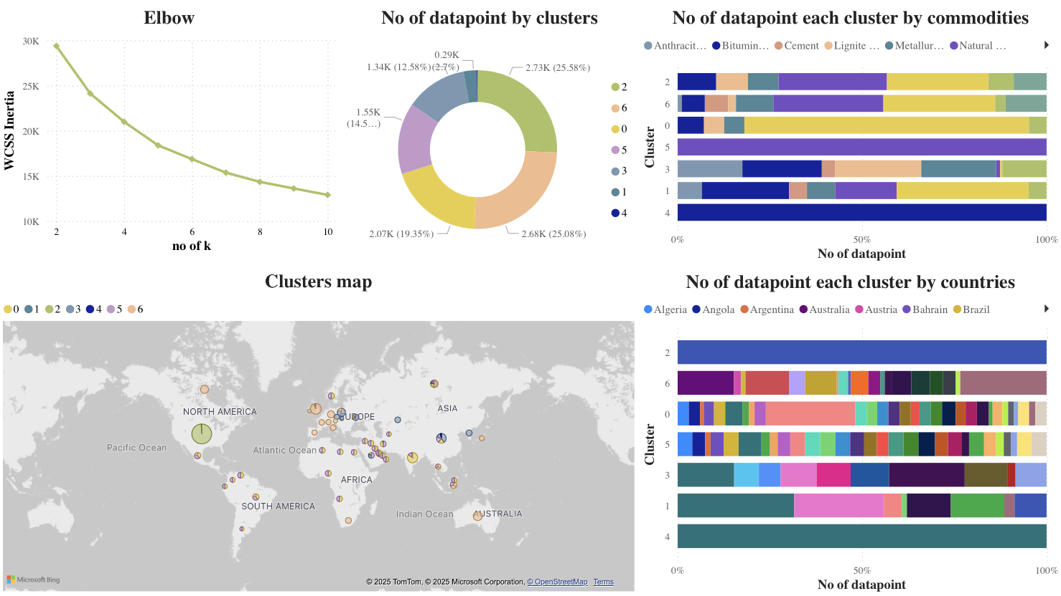
Question 2 - Key findings - K-mean Clustering
Datapoints were evenly distributed across clusters, except cluster 4.
Distinct cluster features identified:
Cluster 5 consisted entirely of natural gas data points
Cluster 4 exclusively comprised bituminous coal from China
Cluster 2 contained only US data.

Slide 10
Conclusion
Total emissions from major entities have steadily increased, mainly driven by oil, gas, and coal—especially coal in China.
Despite global policy milestones like the Kyoto and Paris Agreements, these have had limited impact on emission trends, particularly in large emitters like China and the US.
UK and other country in EU showed strong compliance, with noticeable emission reductions.
Yes, natural clusters were identified using K-Means clustering. These clusters reflect some patterns by fuel type and geography—for example, one cluster is dominated by natural gas data, another by coal from China, and another by US-based entities. This shows some alignment between emission profiles and national energy strategies.

Slide 11
Thank you!

