Slide 1


PYTHON FOR
DATA SCIENCE AND AI
OPENWEATHERMAP ONE CALL API
22229529 - HOANG KHAI MINH
23224577 - MAI ANH NGHIA

Slide 2


CONTENTS
01
02
03
04
05
INTRODUCTION
DETAILS
OF DATA
VISUALIZATIONS
HYPOTHESES
CONCLUSION

Slide 3


INTRODUCTION
Primary goal: analyze weather patterns in Tokyo using OpenWeatherMap API data → emperature trends and the relationships between temperature, humidity, and wind speed
Data Source: OpenWeatherMap 5-Day Forecast
Location: Tokyo, Japan (Lat: 35.6895, Lon: 139.6917)
Period: October 14 → October 18, 2025
Forecast Model: 3-hour interval predictions
=> Prediction weather of Tokyo in the next 5 days

Slide 4
IMPLICATION
Practical implication: Those findings can help people plan daily activities, like scheduling outdoor events, gardening, or exercising at optimal times.
Environmental implication: Understanding temperature and humidity trends could inform local climate adaptation strategies.
Policy implication: City planners or authorities might use the data to improve public safety during extreme weather.
Scientific implication: The results add to the knowledge of local climate patterns, which could support further research.

Slide 5
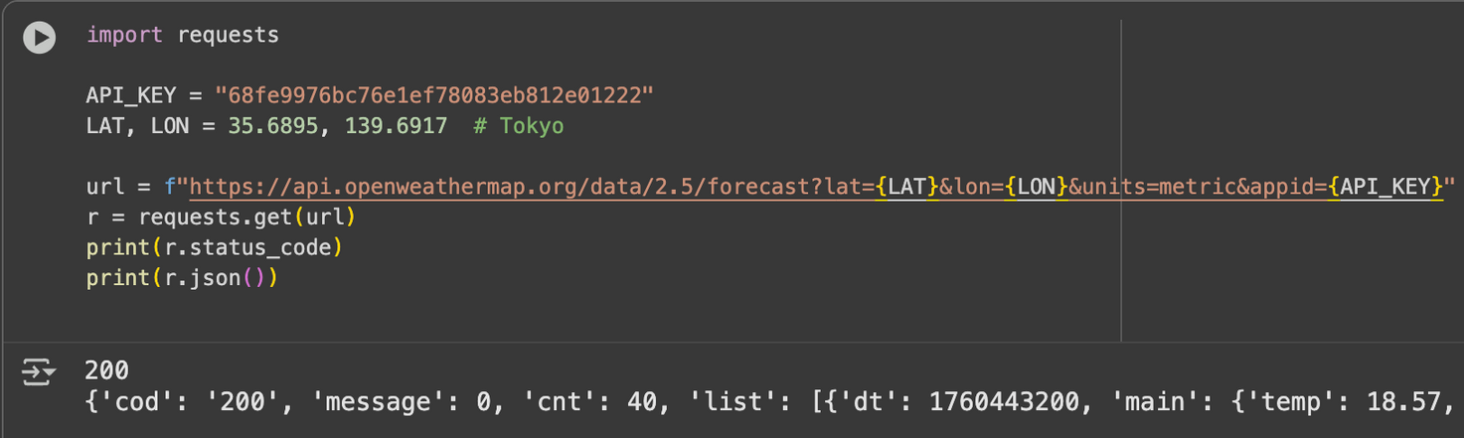
IMPORTING DATA AND MODULES
Cheking the API key
Onecall API 3.0 is not free → 2.5 version
Ensure the extraction of data
Using requests librabry to check status → cod = 200 means ok.

Slide 6
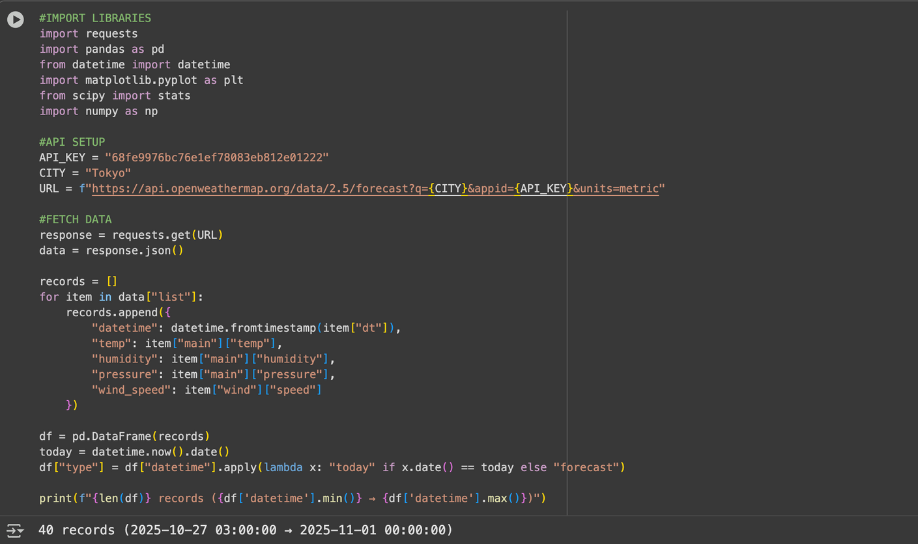
IMPORTING DATA AND MODULES
Import necessary library
Set up API key and city name
Combine into API URL to request 5-day weather forecasts in metric units
Receive weather data in JSON format → 3-hour interval over the next 5 days
Loop through data [“list”] for information
Convert list into Pandas DataFrame
Create collumn “type"

Slide 7
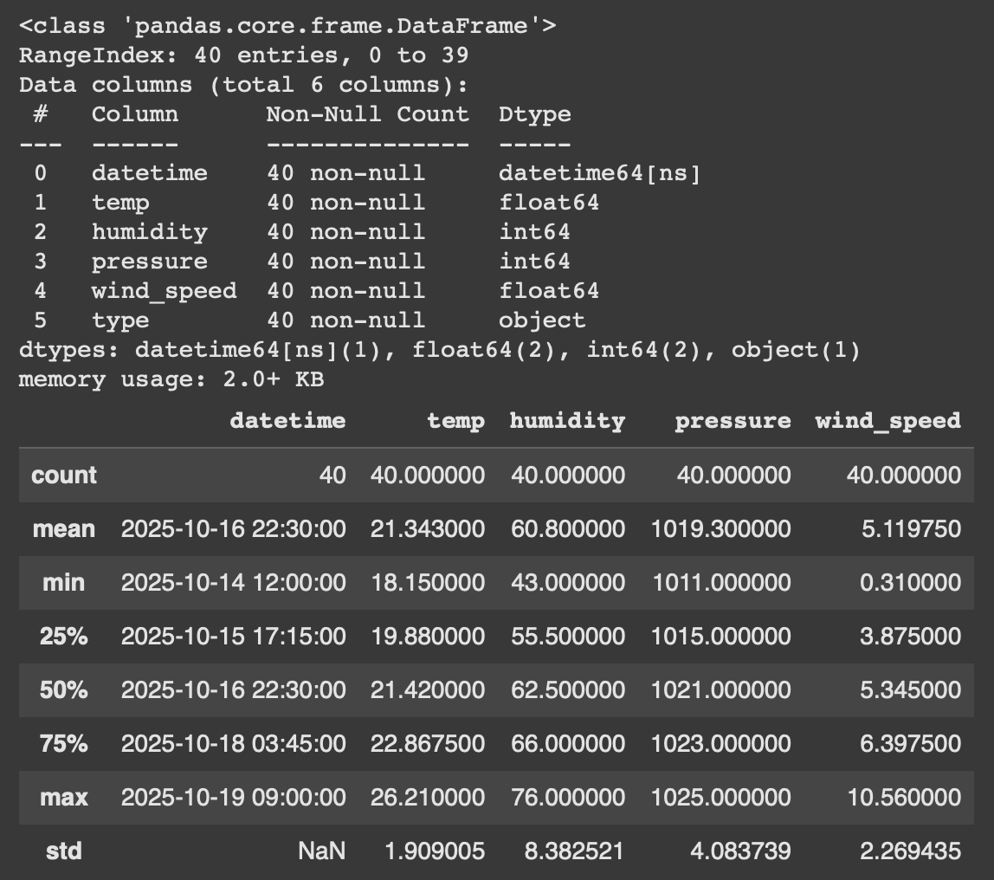
DETAILS OF DATA
Total records: 40
Time range: Oct 14 - 19, 2025
Mean values: Temp 21.3 °C | Humidity 61% | Pressure 1019 hPa | Wind 5.1 m/s
Temp: 18.1 – 26.2 °C → mild warming trend
Humidity: 43 – 76 % → moderate moisture
Pressure: 1011 – 1025 hPa → stable weather
Wind: 10.6 m/s → occasional breeze

Slide 8
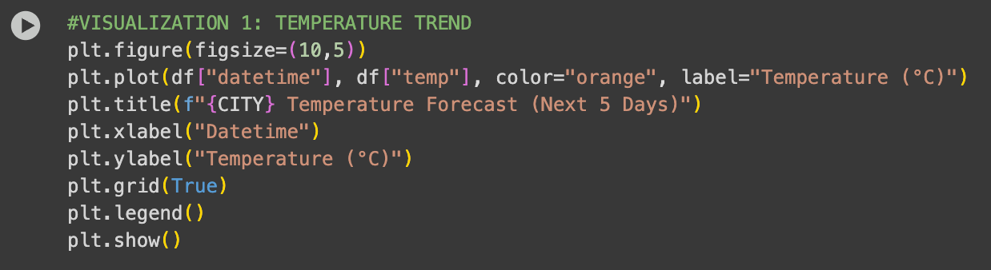
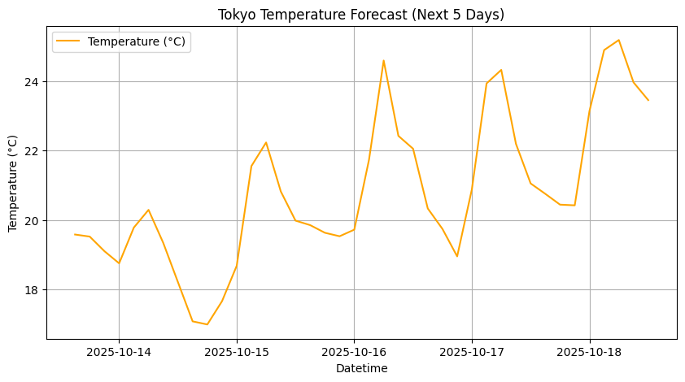
VISUALIZATIONS
TEMPERATURE TREND

Slide 9
TACTICS USED IN PROJECT
T-test (independent sample t-test)
→ To test if there is a significant difference between the means of two groups.
Interpretation: If p-value < 0.05 → reject H0 → there is a significant difference
Correlation Analysis (Using Pandas)
→ To measure the strength and direction of the relationship between weather variables.
Interpretation:
r > 0 → variables increase together
r < 0 → one increases while the other decreases

Slide 10
HYPOTHESIS 1: TODAY VS FORECAST TEMPERATURE
Research questions:
H0 (null): There is no significant difference between today’s and forecasted temperatures.
H1 (alternative): There is a significant difference between today’s and forecasted temperatures.

Slide 11
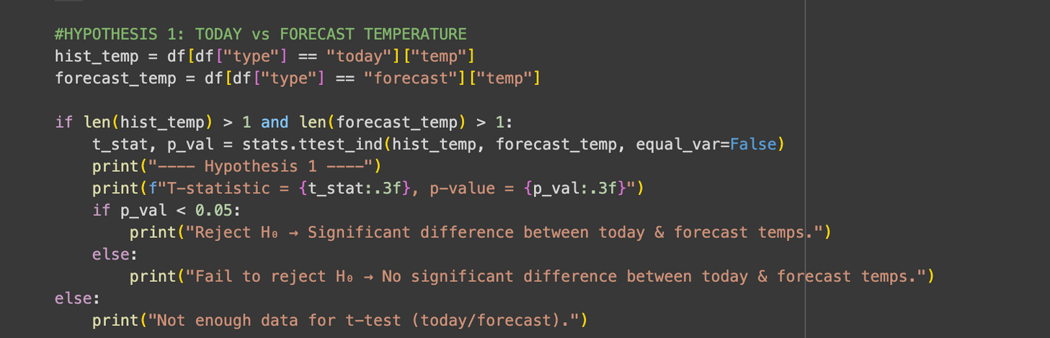
HYPOTHESIS 1: TODAY VS FORECAST TEMPERATURE
Result:
Since p < 0.05, we reject the null hypothesis.
→ There is a significant difference between today’s and forecasted temperatures.

Slide 12
HYPOTHESIS 2: TEMPERATURE VS HUMIDITY
Research questions:
H0: There is no significant differences between temperature and humidity.
H1: If the temperature increases, the humidity decreases.

Slide 13
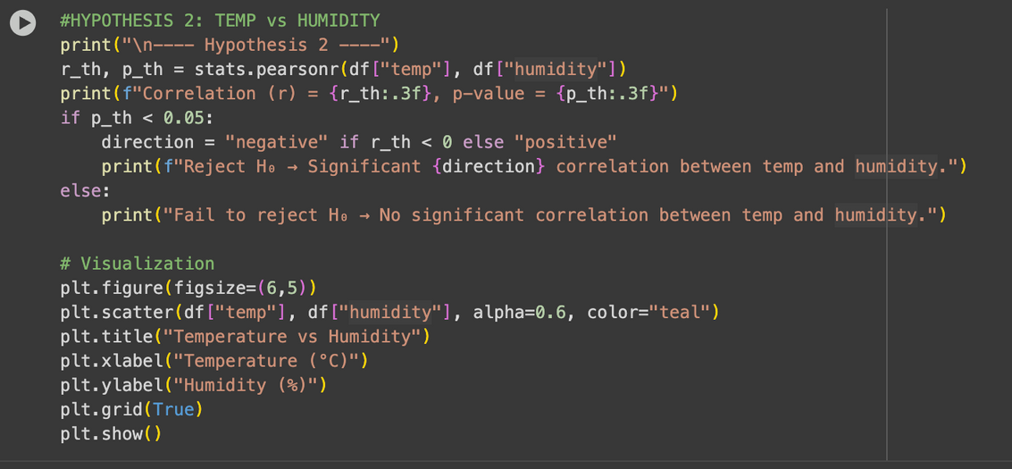
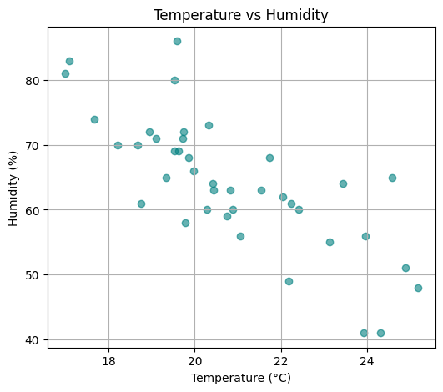
HYPOTHESIS 2: TEMPERATURE VS HUMIDITY
Result:
Correlation (r) = -0.764, p-value = 0.000
Reject H₀ → Significant negative correlation between temp and humidity.

Slide 14
HYPOTHESIS 3: TEMPERATURE VS WIND SPEED
Research questions:
H0: There is no significant differences between temperature and wind speed.
H1: If temperature increases, wind speed also increases.

Slide 15
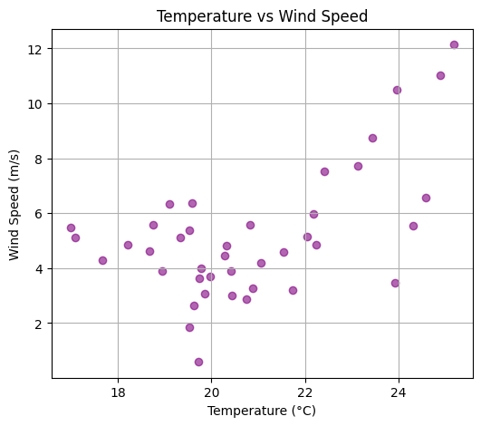
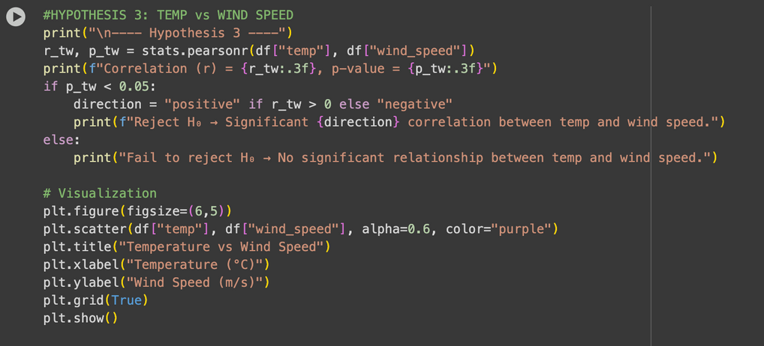
HYPOTHESIS 3: TEMPERATURE VS WIND SPEED
Result:
Correlation (r) = 0.566, p-value = 0.000 Reject H₀ → Significant positive correlation between temp and wind speed.

Slide 16
HYPOTHESIS 4: PRESSURE VARIATION
Research questions:
H0: Pressure remains stable across forecast period.
H1: Significant variation in daily pressure.

Slide 17
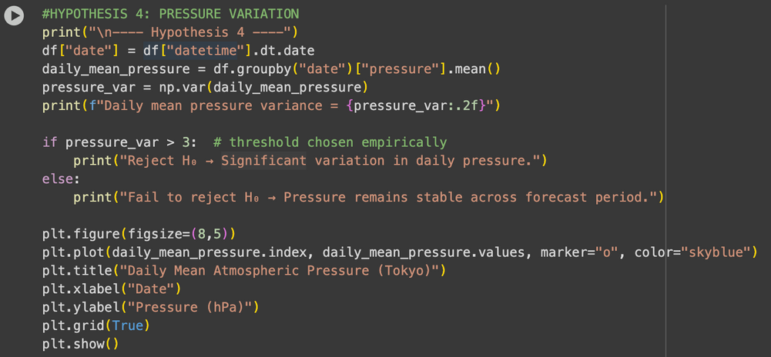
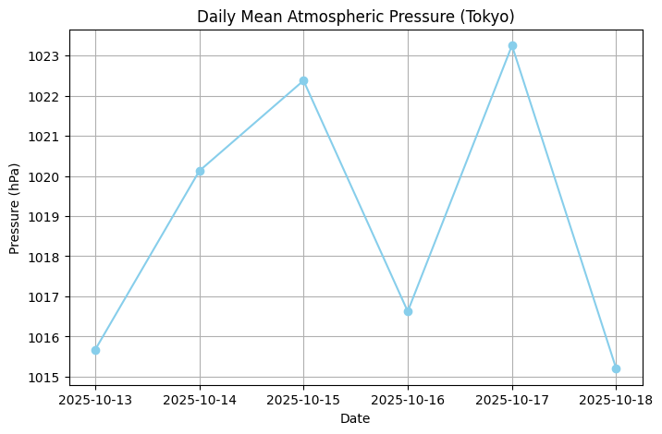
HYPOTHESIS 4: PRESSURE VARIATION
Result:
Daily mean pressure variance = 10.30 Reject H₀ → Significant variation in daily pressure.

Slide 18
CONCLUSION
This study analyzed Tokyo’s weather forecast over the next five days, focusing on temperature, humidity, wind speed, and pressure.
The temperature showed moderate variation, with no significant difference between today’s values and the forecasted period.
Humidity was negatively correlated with temperature, while wind speed showed little relationship with temperature.
Daily mean atmospheric pressure remained relatively stable, indicating consistent weather patterns during the forecast period.

Slide 19
REFERENCES
https://openweathermap.org/api
https://resources.eumetrain.org/data/1/15/. stability.htm#:~:text=Threshold%20values%20for%20thunderstorms%20vary%2C%20but%20generally,the%20possibility%20for%20heavy%20thunderstorms%20is%20inevitable.

Slide 20
THANKS FOR
ATTENTION

