Slide 1
Final Project Tanks 1990
Faculty of Information Technology, Hanoi University
Group 10:
Phạm Linh Chi
Nguyễn Hữu Đăng
Hoàng Sinh Hùng
Phan Khánh Huyền
Nguyễn Giang Minh

Slide 2

Table of Content
Project introduction
Core Functionalities and Techniques
Component Implementation
Enhancements for User Experience
Project result

Slide 3
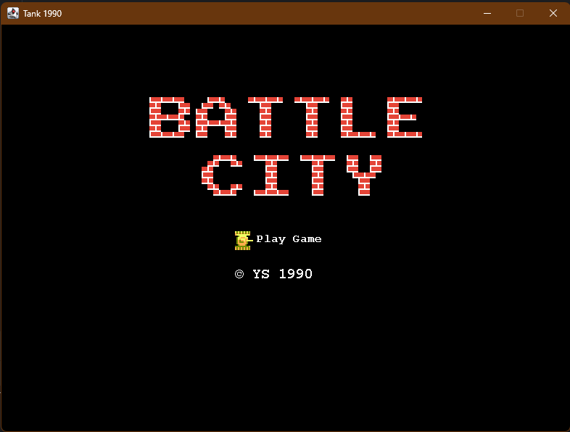
Project Introduction
The "Battle City" game is a modernized version of the classic arcade tank battle game, inspired by the popular 1990s game where players control tanks on various battlefields, facing off against enemy tanks. Our project aimed to develop a functional and engaging 2D tank game using Java and Java Swing while applying the core programming techniques learned throughout the course.

Slide 4
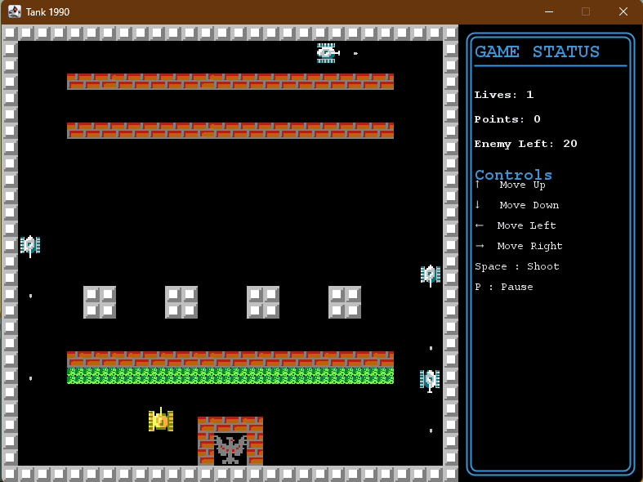
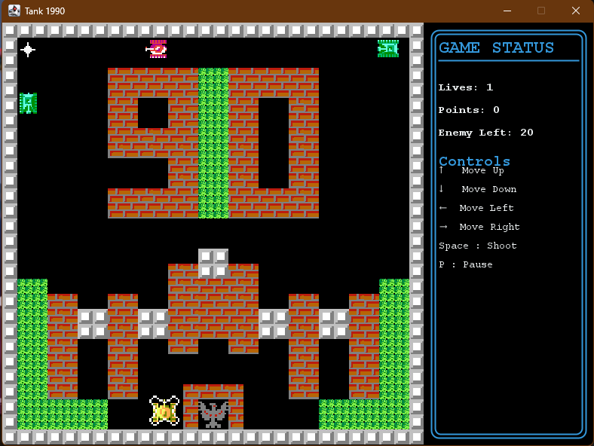
Project Introduction

Slide 5
Project introduction
Core Functionalities and Techniques
Component Implementation
Enhancements for User Experience
Project result

Slide 6
Core Functionalities and Techniques
We applied key course concepts to build our game:
OOP: Created modular classes for tanks, power-ups, and other components, making the code scalable and maintainable.
GUI Programming: Designed an intuitive interface with panels for game, menu, and status. Added sound and animation for immersive effects.
Collision Handling: Managed interactions between objects to trigger effects like breaking walls and collecting power-ups.
State Management: Used GameStateManager to handle game states (start, pause, level completion).
Multithreading & Timer: Improved performance by running updates on separate threads and used timers for periodic events and power-up durations.

Slide 7
Project introduction
Core Functionalities and Techniques
Component Implementation
Enhancements for User Experience
Project result

Slide 8
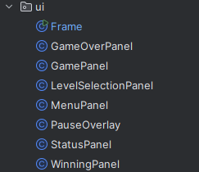
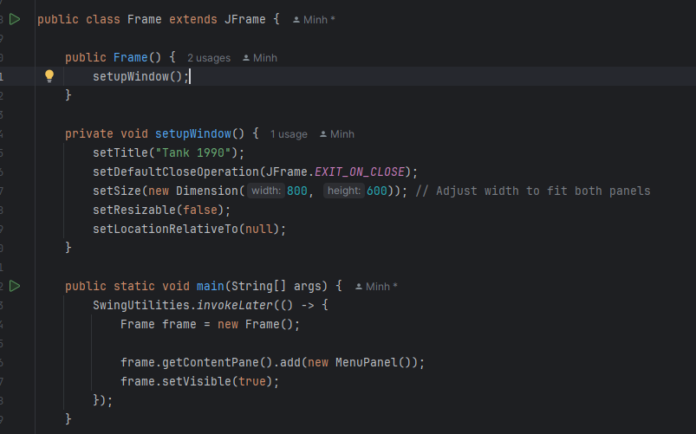
Component Implementation
The Frame class extends JFrame and serves as the main window for the game. It sets up a window titled "Tank 1990" with fixed dimensions (800x600) and contains all game panels like MenuPanel, GamePanel, LevelSelectionPanel, StatusPanel, and others. Each panel is added to this frame as needed, allowing seamless transitions between different game states within a single window. This structure keeps the game organized and ensures all panels are managed centrally in the Frame.

Slide 9
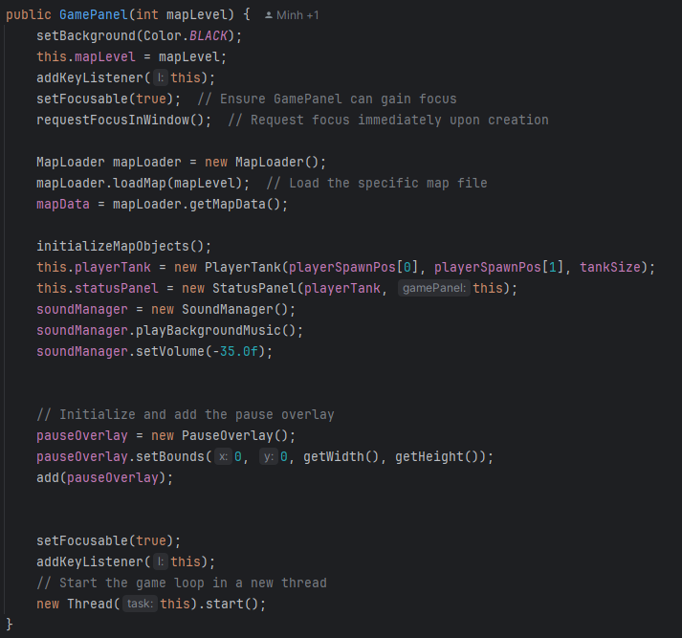
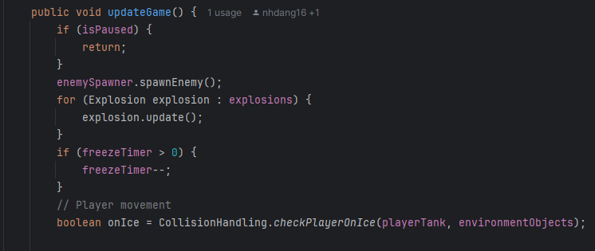
Component Implementation
The GamePanel serves as the main game screen, where maps, game objects, and sound are initialized and managed. It loads the map data, sets up the player and enemy tanks, and starts background music for an immersive experience.
For example, in the updateGame() method, GamePanel updates active elements like spawning enemies, handling explosions, and managing player movement based on conditions (e.g., checking if the player is on ice). It also controls pause and freeze effects to ensure smooth gameplay transitions.

Slide 10
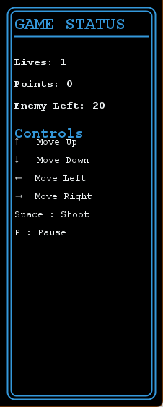
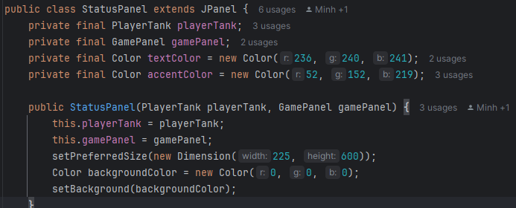
Component Implementation
The StatusPanel class displays essential game information, including the player’s lives, score, and remaining enemies. It also provides a guide to game controls, such as movement, shooting, and pausing. With a distinct background and color scheme, this panel keeps players informed and supports an intuitive gameplay experience.

Slide 11
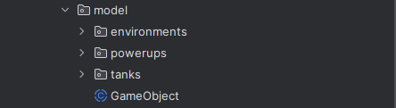
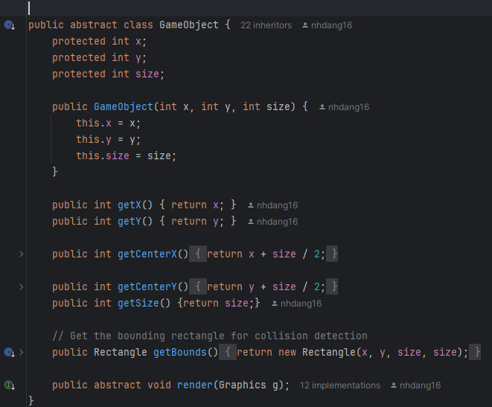
Component Implementation
The GameObject class serves as a base for all game components like enemy tank, player tank, power-ups, and bullets. It defines common properties (position x, y, size) and methods, including collision detection (getBounds()) and an abstract render() method for rendering. Each component extends GameObject to inherit these shared attributes and behaviors, making the code modular and organized.

Slide 12
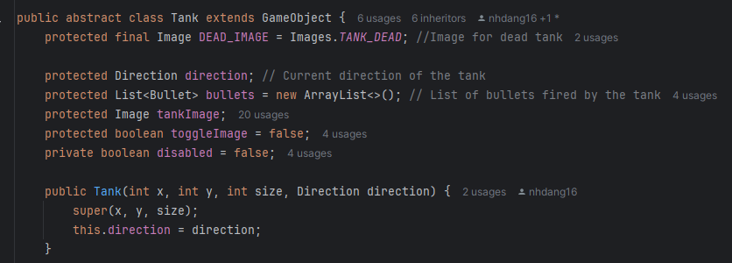
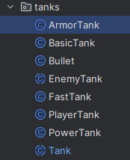
Component Implementation
The Tank class is an abstract base class that other tank types (e.g., ArmorTank, BasicTank, FastTank, PowerTank, PlayerTank) inherit from. It defines common attributes and behaviors, such as direction, image handling, shooting, and movement. Each specific tank type extends Tank to implement its unique characteristics while sharing the foundational functionalities provided by this class. This structure makes it easy to add different types of tanks with customized features, promoting code reusability and modularity.

Slide 13
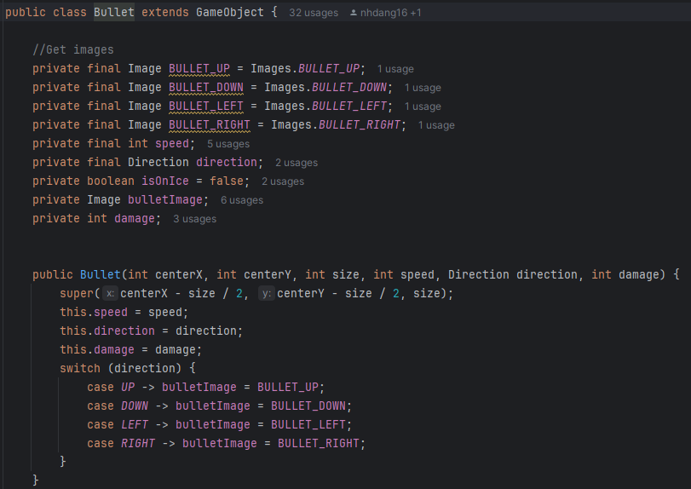
Component Implementation
The Bullet class represents bullets fired by tanks. Bullet of each tank have a specific direction, speed, and damage level. It also displays different images (BULLET_UP, BULLET_DOWN, BULLET_LEFT, BULLET_RIGHT) based on its movement direction. This design allows for customizable bullet behavior and appearance, making interactions in the game more dynamic and engaging.

Slide 14
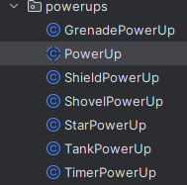
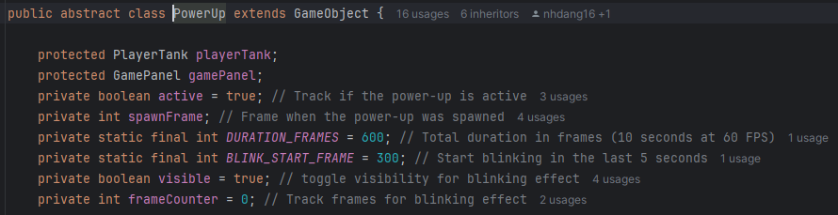
Component Implementation
The PowerUp class is an abstract base class that other power-up types (e.g., GrenadePowerUp, ShieldPowerUp, StarPowerUp, TankPowerUp, TimerPowerUp) inherit from. It defines common attributes and behaviors, such as activation status, lifespan, and visual blinking effect. Each specific power-up type extends PowerUp to implement unique effects while sharing the foundational functionalities provided by this class. This structure enables easy addition of diverse power-ups with customized features, enhancing code reusability and modularity.

Slide 15
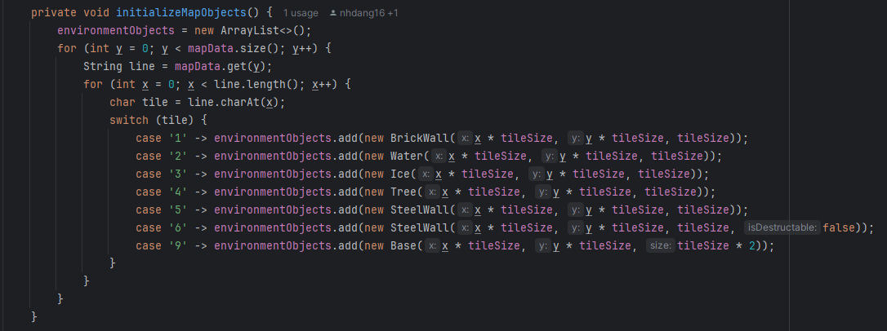
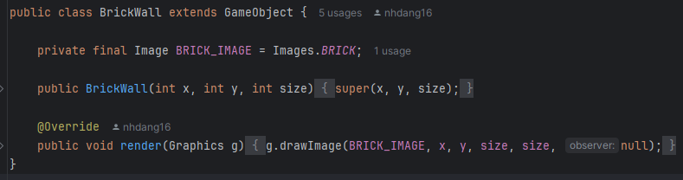
Component Implementation
The environment objects are created from individual classes, each containing the functionality to render the specific environment image. The initializeMapObjects method converts characters in the map data into corresponding environment objects (like BrickWall, Water, Tree, etc.) and places them in the correct position. Now, by using MapLoader to load .txt files with map layouts, different game levels can be easily created by changing the map data.

Slide 16
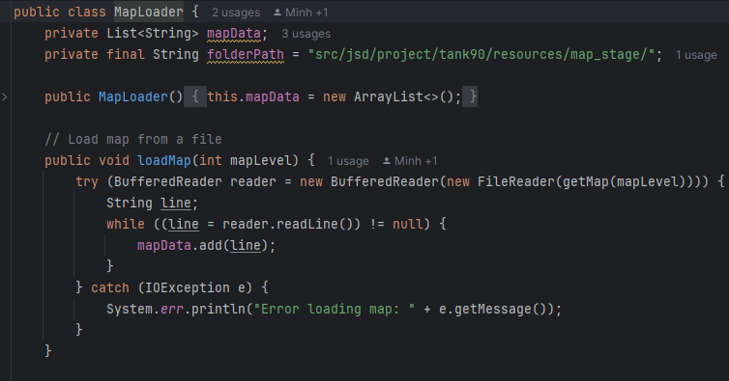
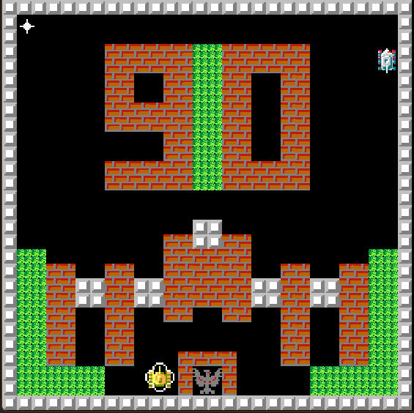
Component Implementation

Slide 17
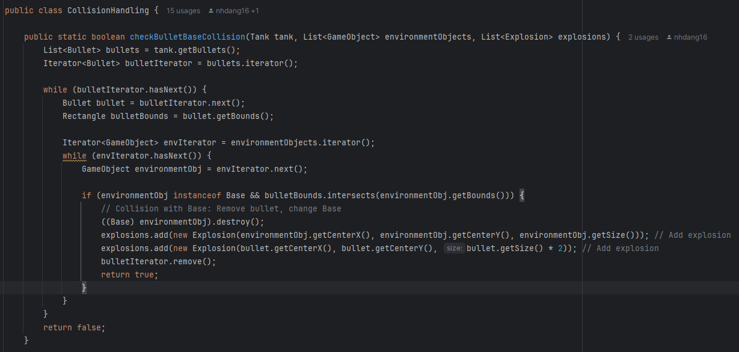
Component Implementation
Collision Handling
The CollisionHandling class is responsible for detecting and managing interactions between game objects. Key collision scenarios include:
Bullet and Environment: Handles bullets colliding with walls (BrickWall and SteelWall) and Base, removing bullets and triggering explosions.
Bullet and Tank: Manages collisions between bullets and both enemy and player tanks, applying damage and creating explosion effects.
Tank and Environment: Prevents tanks from moving through obstacles like walls and water.
Special Conditions: Checks if the player is on Ice (for slippery movement) or collects Power-ups, which activate boosts or abilities.

Slide 18
Project introduction
Core Functionalities and Techniques
Component Implementation
Enhancements for User Experience
Project result

Slide 19
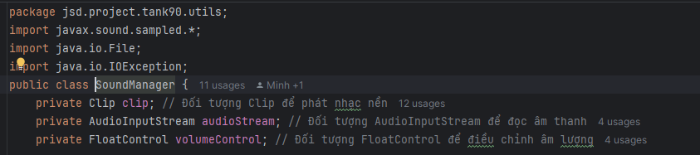
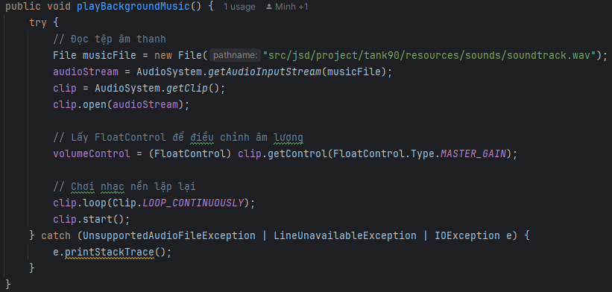
Enhancements for User Experience
The SoundManager class plays background music on a continuous loop. It loads the soundtrack.wav file, adjusts volume with FloatControl, and uses clip.loop(Clip.LOOP_CONTINUOUSLY) to keep the music playing, enhancing the game’s immersive experience.

Slide 20
Project introduction
Core Functionalities and Techniques
Component Implementation
Enhancements for User Experience
Project result

Slide 21
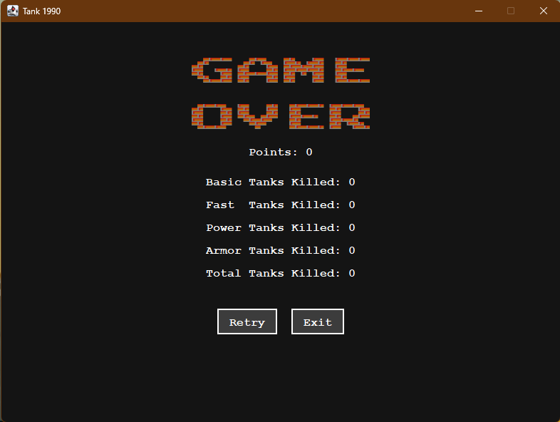
Project Result

Slide 22

Thank You
For Your Attention!
If you have any questions, feel free to ask!

