Slide 1

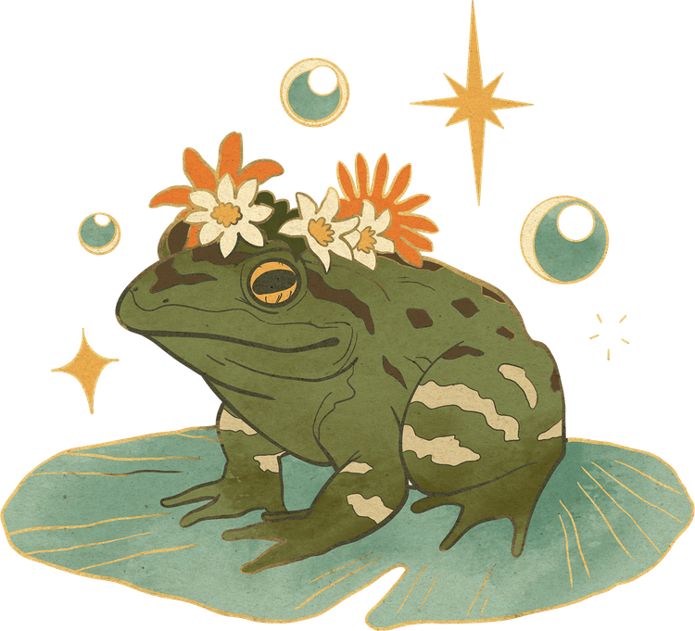

Let Him Rook
Chess you play with your hands
No controller. Just a webcam, you, and a friend.
Notes:
Hi. This is Let Him Rook. It is chess, but you play with your hands. You only need a webcam.

Slide 2
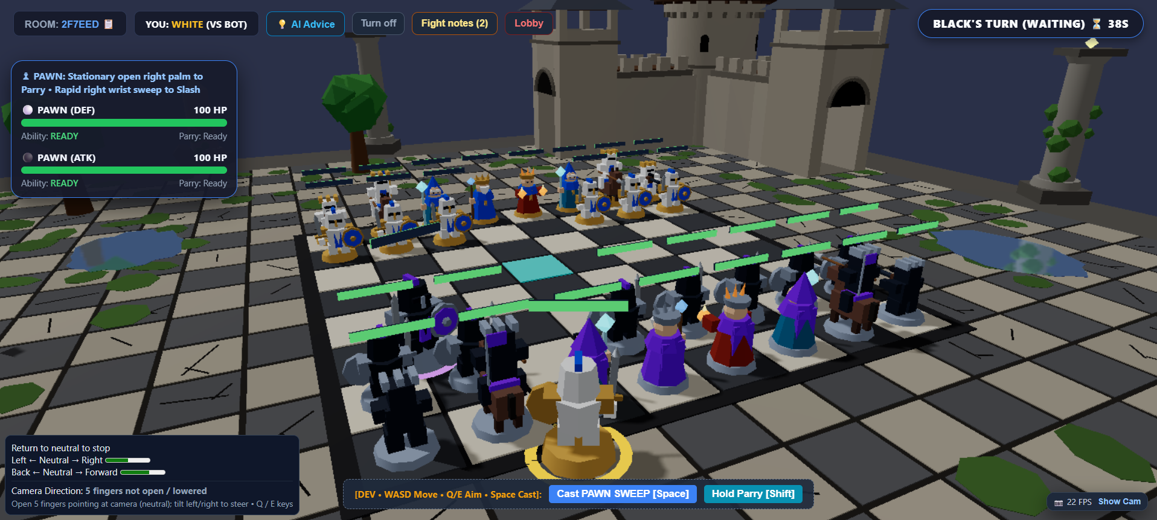
The Castle Arena
Notes:
This is the garden where the fights happen. Bright, warm, and easy to read.

Slide 3




The Problem
ONLINE CHESS CAN FEEL COLD
You click. You wait. You are alone.
Friends live far away now.
We miss playing face to face.
So we made a game that feels like one table again.
Notes:
Online chess is smart, but it feels cold. You click and wait, alone. We wanted the feeling of sitting at the same table with a friend.

Slide 4

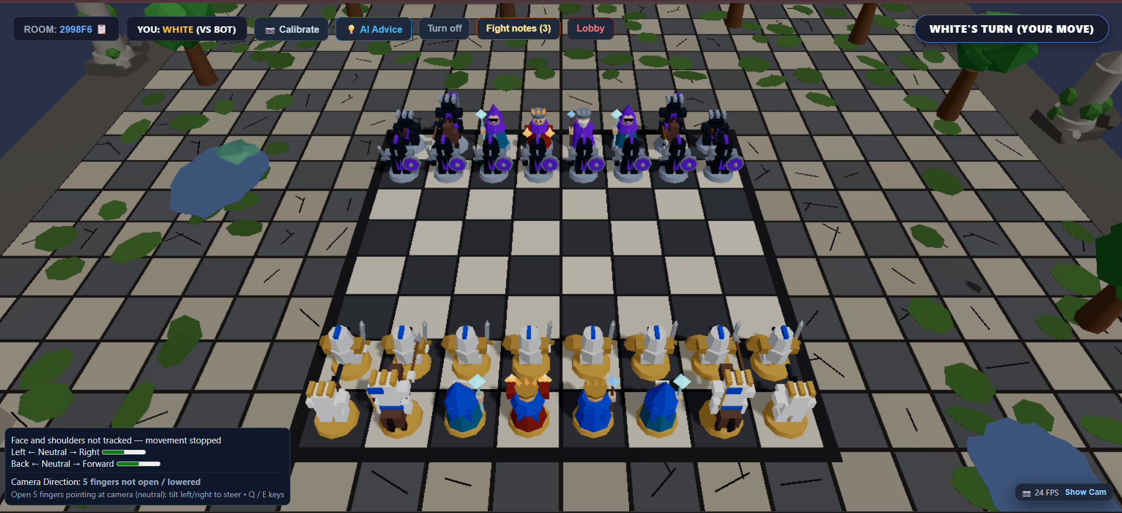
Our Idea
CHESS + A REAL FIGHT
Take normal chess.
Add a real fight for every capture.
Your body is the controller.
Lean to move. Use hand signs to play.
Notes:
So we mixed chess with a fighting game. When you take a piece, you do not just take it. You have to win a fight for it.

Slide 5
How to Play
FOUR EASY STEPS
JOIN
CALIBRATE
PLAY CHESS
FIGHT
Make a room, or use a friend's code.
Show the camera your hands. It takes five seconds.
Pinch a piece. Move it to a safe spot.
Take a piece? Now you fight for it.
Notes:
Four steps. Join a room. Show your hands to the camera. Play chess with a pinch. And when you take a piece, you fight.

Slide 6

Six Fighters
EVERY PIECE HAS ONE EASY SIGN
1
2
3
PAWN
Sweep your wrist
Fast sword slash
ROOK
Arm straight out
Cannon shot
KNIGHT
Raise and chop down
Jump and strike
4
5
6
BISHOP
Push your hand out
Ice shot that slows
QUEEN
Palm up, hold still
Three balls that chase
KING
Fist at your chest
Calls a helper
Notes:
Every piece fights in its own way. Each one has one easy hand sign. A pawn slashes. A rook shoots. A queen sends balls that chase you.

Slide 7
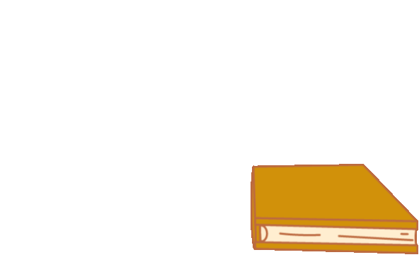
Thank You
COME PLAY WITH US — PAWNHUB.TECH
Notes:
Thank you. Come try it. It takes one minute to learn.

Slide 8
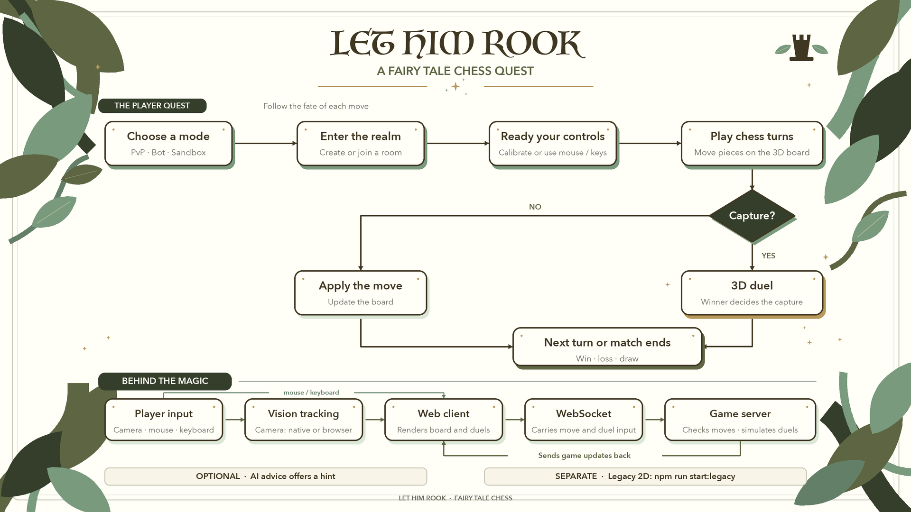
Notes:
Thank you. Come try it. It takes one minute to learn.

