Slide 1
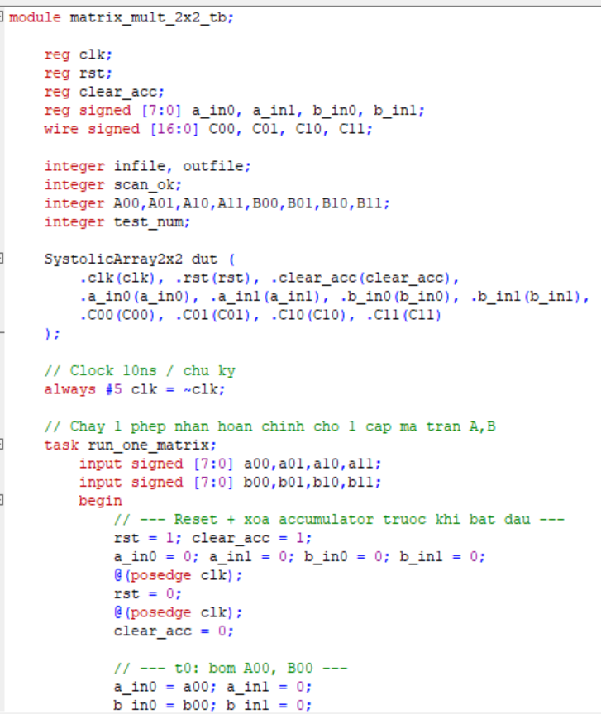
7. Proposed Verilog Design
matrix_mult_2x2
pe_mac
out_regs
clk, rst_n
Core Column Processing
start
Multiply–Accumulate
always @(posedge clk)
acc <= acc + a_in * b_in;
// After 2 MAC cycles: c_out <= acc
signed [7:0] A/B
signed [16:0] C
done / valid
Suggested File Structure
PROJECT TREE
src/
pe_mac.v
matrix_mult_2x2.v
sim/
tb_matrix_mult_2x2.v
gen_vectors.py
Add screenshots of the main RTL, project structure, or a successful terminal build.
FAP 201 • FPGA Matrix Multiplier
09

Slide 2
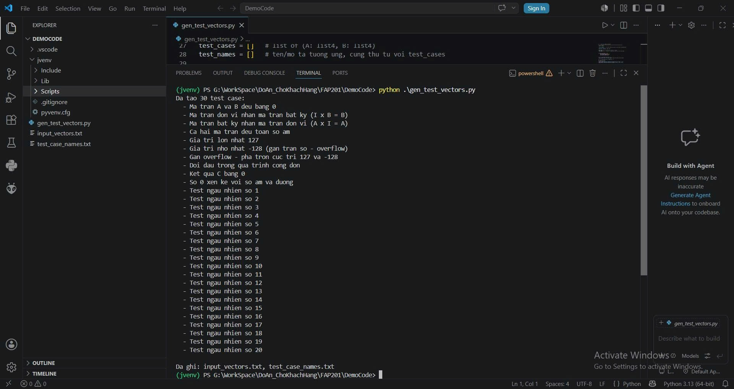
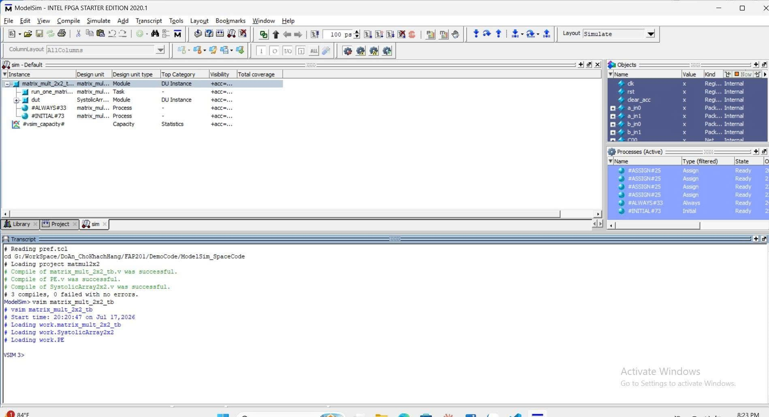
8. Testbench and Python Verification
Python
gen_vectors.py
Verilog
Testbench
DUT
2×2 Multiplier
Compare
Expected vs. Actual
Recommended Test Groups
✓
All-zero matrices
✓
Identity matrix
✓
All-positive values
✓
All-negative values
✓
Mixed signs
✓
Maximum / minimum values
✓
Zero result
✓
Near-overflow cases
FAP 201 • FPGA Matrix Multiplier
10

Slide 3
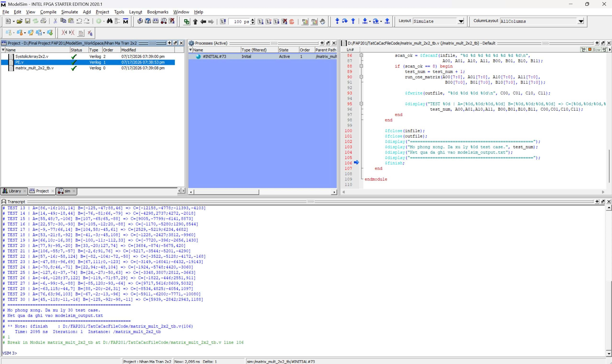
9. ModelSim Simulation Results
How to Read the Waveform
1
Reset returns the circuit to IDLE.
2
Set start = 1 to load matrices A and B.
3
After the MAC cycles, done = 1.
4
C00…C11 match the expected values.
Suggested caption: Matrix A = …, Matrix B = …, and Matrix C matches the Python result.
FAP 201 • FPGA Matrix Multiplier
11

Slide 4
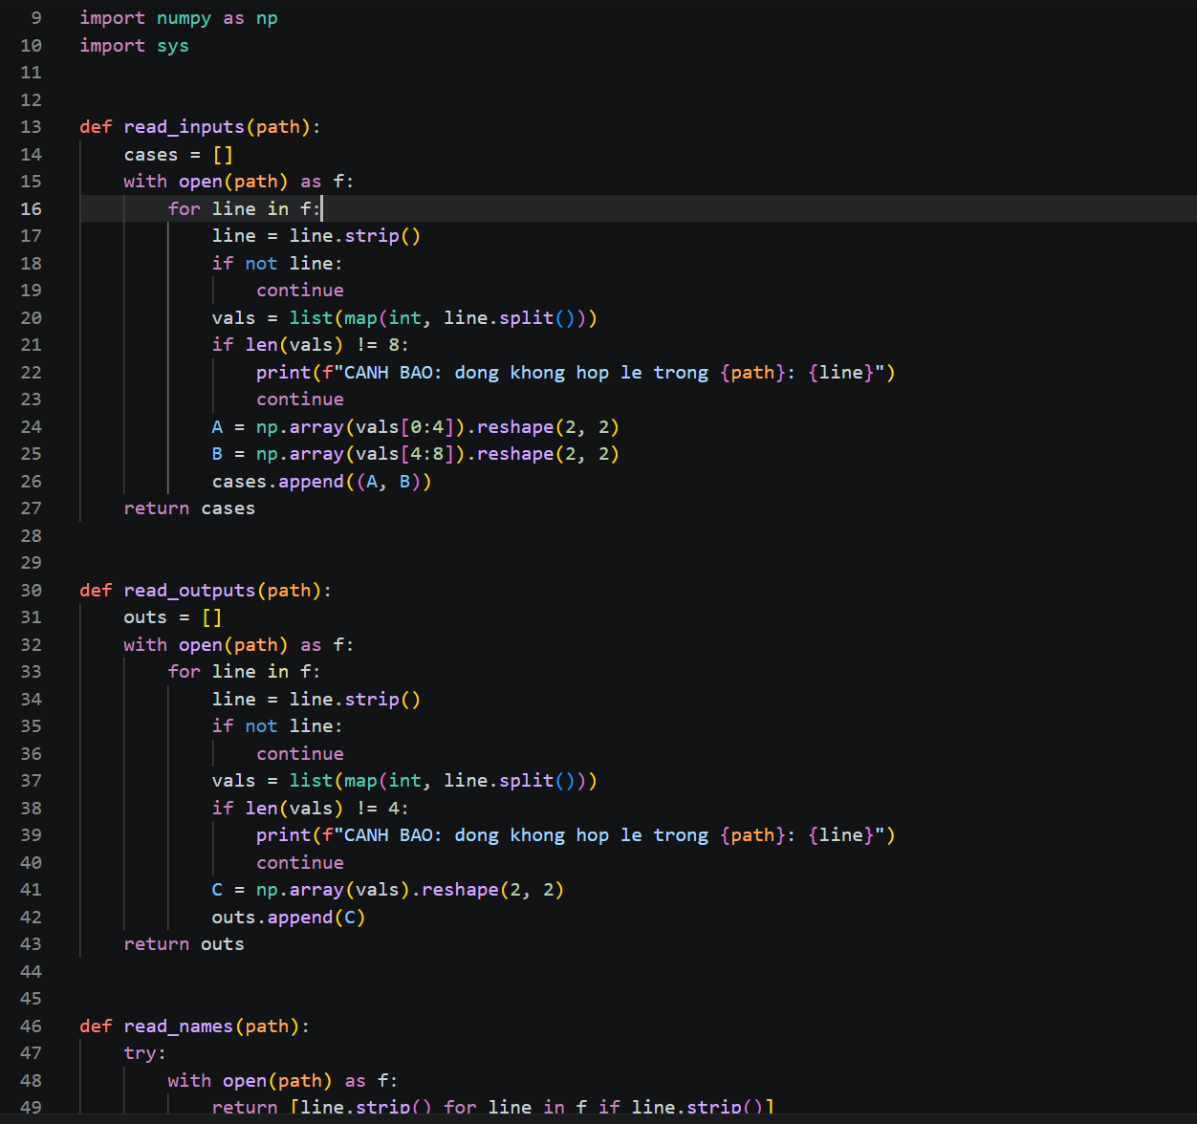
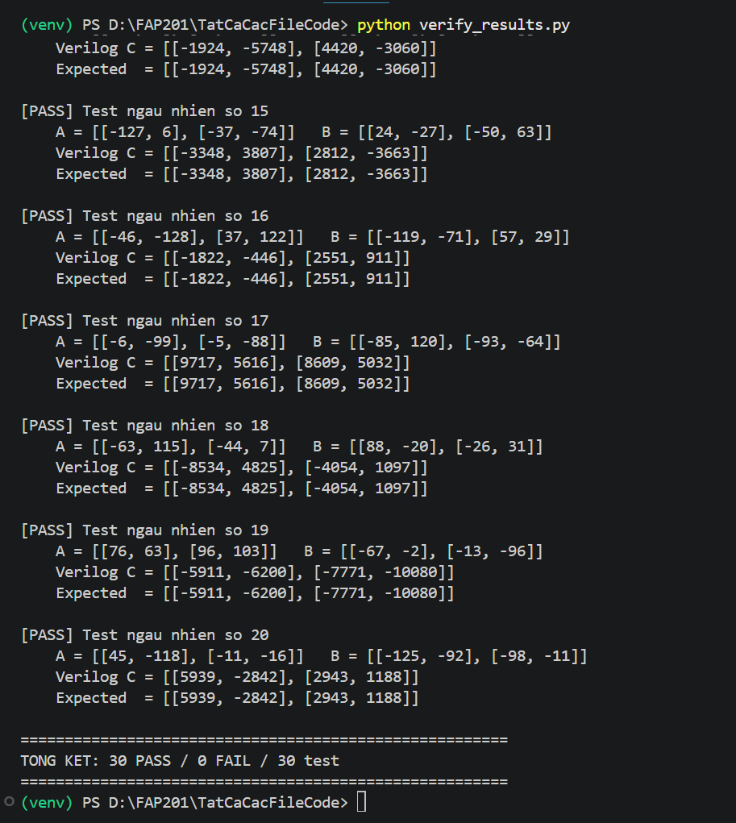
10. VS Code and Terminal Results
• Input matrices A and B
• Python expected result
• Actual DUT result
• Final PASS / FAIL status
The screenshot should show
FAP 201 • FPGA Matrix Multiplier
12

Slide 5
11. Conclusion
Summary of the 2×2 systolic-array matrix-multiplier design
Mathematically Correct
Hardware Correct
C[i][j] is the sum of two row-by-column products.
The design uses PE/MAC units, registers, and a clocked FSM.
Data Format Correct
Verification Correct
Signed 8-bit inputs, 16-bit products, and 17-bit outputs.
Python + testbench + ModelSim compare expected and actual results.
• Scale to 4×4 or N×N arrays
• Add deeper pipelining to increase throughput
• Use DSP blocks when supported by the target FPGA
• Add UART/AXI input from a host computer
Future Work
Thank you for listening.
FAP 201 • FPGA Matrix Multiplier
14

Slide 6
References
Sources used by the project team
1
2×2 Matrix Multiplier
Describes 2×2 matrix multiplication using registers, multipliers, adders, and multiplexers.
2
Getting Started with FPGAs
Introduces simulation, testbenches, synthesis, numeric representation, and arithmetic.
3
Using the ModelSim FPGA Simulator with Verilog Testbenches
Explains the DUT/testbench simulation workflow in ModelSim.
4
Research and Design of a Matrix Multiplier on FPGA
Provides context on FPGA multiplier architecture, resource use, and performance optimization.
5
Project design notes
Signed 8-bit inputs, 17-bit outputs, parallel/sequential architectures, and the Python + Verilog + ModelSim workflow.
FAP 201 • FPGA Matrix Multiplier
15

