Slide 1

2x2 Matrix Multiplication
Using a Systolic Array on FPGA
[ A ]
×
[ B ]
=
[ C ]
Verilog Implementation • Python & Testbench Verification • ModelSim Simulation
MAC
MAC
MAC
MAC
Group: 6
Class: IC2004
Master: Phạm Thế Vinh
2026
FAP 201 • FPGA Matrix Multiplier
01
Notes:
Mở đầu: giới thiệu đề tài, nhóm, mục tiêu chính: xây dựng mạch nhân ma trận 2x2 trên FPGA theo hướng systolic array và kiểm chứng bằng mô phỏng.

Slide 2
Presentation Outline
2×2 Matrix Multiplier: From Mathematical Formulation to FPGA Architecture and Simulation
01
Matrix Multiplication Problem & Formulation
02
Number Representation &
Bit-Width Selection
03
2×2 Systolic Array Architecture
04
Verilog Design, Testbench &
Python-Based Verification
05
Simulation Results &
Future Development
Final objective: to develop a 2×2 matrix multiplier that correctly supports signed inputs, includes a self-checking testbench, and is validated through simulation results.
FAP 201 • FPGA Matrix Multiplier
02
Notes:
Giới thiệu nhanh cấu trúc bài. Nhấn mạnh các slide sau có chừa khung để nhóm chèn waveform ModelSim, code VS Code và kết quả chạy Python.

Slide 3
1. 2x2 Matrix Multiplication Problem
Condition: the number of conlumns in matrix A must equal the number of rows in matrix B
[ a00 a01
a10 a11 ]
[ b00 b01
b10 b11 ]
[ c00 c01
c10 c11 ]
A =
B =
C = A × B =
c00 =
a00×b00 + a01×b10
c01 =
a00×b01 + a01×b11
c10 =
a10×b00 + a11×b10
c11 =
a10×b01 + a11×b11
Each output element $C\left[i\right]\left[j\right]$requires two multiplications and one addition. Therefore, a complete 2×2 matrix multiplication requires eight multiplications and four additions.
FAP 201 • FPGA Matrix Multiplier
03
Notes:
Giải thích quy tắc nhân ma trận: hàng i của A nhân cột j của B. Với 2x2 thì mỗi kết quả là tổng của hai tích.

Slide 4
2. Why Choose FPGA and a Systolic Array?
FPGAs are well suited for repetitive computations, parallel execution, and pipelined processing.
Parallel Processing
The four elements of matrix C can be computed concurrently instead of being calculated sequentially.
Pipelining
A
Matrix A data flows horizontally, while matrix B data flows vertically. Each processing element stores and updates its partial sum.
Systolic
Array 2×2
MAC Operation
C
Each processing element performs a Multiply–Accumulate operation:
: acc <= acc + A×B.
B
FPGA Resources
The Verilog design can be mapped onto FPGA resources such as LUTs, flip-flops, and DSP blocks during synthesis.
Main idea: instead of using a CPU to execute each operation sequentially, the computation is distributed across multiple hardware processing elements operating synchronously.
FAP 201 • FPGA Matrix Multiplier
04
Notes:
Nhấn mạnh sự khác nhau giữa lập trình tuần tự và thiết kế phần cứng song song. Systolic array phù hợp cho phép nhân ma trận vì dữ liệu được truyền theo nhịp.

Slide 5
3. Number Representation and Bit Width
The design supports signed numbers using two’s complement representation.
Input 8-bit signed
Multiplication
Addition
Value range: −128 → +127
The MSB is the sign bit: 0 positive value, 1 negative values
8-bit × 8-bit ⇒ 16-bit
Worst-case example:
−128 × −128 = 16384
C[i][j] = product 1 + product 2
One additional guard bit is required ⇒ 17-bit
Recommended Verilog Declarations
Coding Considerations
input signed [7:0] a00, a01, ...;
wire signed [15:0] p0, p1;
output signed [16:0] c00, c01, c10, c11;
Explicitly declare signals as signed
Perform sign extension before addition
Use a 17-bit output to prevent overflow
The report should clearly state: signed 8-bit inputs, 16-bit products, and 17-bit results.
FAP 201 • FPGA Matrix Multiplier
05
Notes:
Giải thích vì sao 17 bit là an toàn: một phần tử C là tổng của hai tích 16 bit. Với signed, phải chú ý signed casting và sign extension.

Slide 6
4. Overall System Architecture
Main blocks: input registers, PE/MAC array, control unit, and output registers
A registers
a00 a01 a10 a11
Control FSM
IDLE → LOAD → CALC → DONE
Output registers
c00 c01 c10 c11
done / valid
ready for testbench
B registers
b00 b01 b10 b11
PE array 2×2
4 MAC cells
PE = Processing Element
Each PE receives A and B values on every clock cycle, multiplies them, and accumulates the partial products to generate C[i][j].
FAP 201 • FPGA Matrix Multiplier
06
Notes:
Nói về các module chính. Nếu nhóm đã có tên module cụ thể, có thể thay trực tiếp trong slide này.

Slide 7
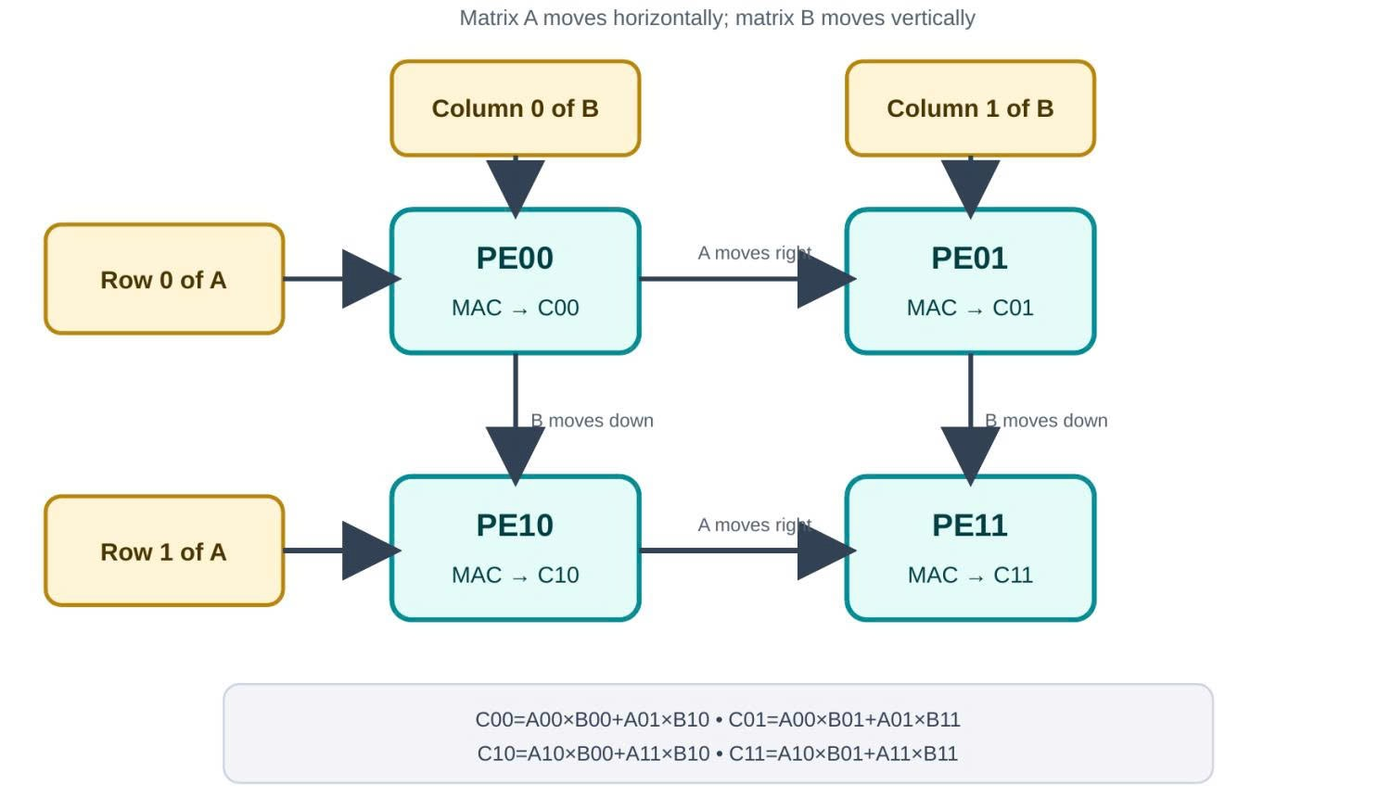
5. 2×2 Systolic Array: Dataflow
A truyền theo hàng, B truyền theo cột, PE tích lũy kết quả
B col 0
B col 1
Example Computation Cycle for Each PE
PE00
acc → c00
PE01
acc → c01
Cycle
Input Data to PE
Accumulator Update
A row 0
1
A[i][0], B[0][j]
acc = A[i][0]×B[0][j]
PE10
acc → c10
PE11
acc → c11
2
A[i][1], B[1][j]
acc += A[i][1]×B[1][j]
A row 1
3
—
C[i][j] = acc, valid = 1
For a 2×2 matrix, each PE performs two MAC operations. Once the pipeline is active, the array can accept a new matrix at a fixed interval.
FAP 201 • FPGA Matrix Multiplier
07
Notes:
Giải thích systolic: dữ liệu “đập nhịp” qua các PE. Mỗi PE tự tích lũy một phần tử C.

Slide 8
6. Two Implementation Architectures
Comparison between a fully parallel design and a sequential resource-sharing design
Parallel / Systolic Array
Sequential / Resource – Sharing Architecture
PE
PE
c00 → c01
→ c10 → c11
1 MAC
PE
PE
Advantages:
Lower hardware resource usage
Smaller implementation area
Disadvantages:
Higher latency
More complex control FSM
Advantages:
High processing speed
Well suited for pipelining
High throughput
Disadvantages:
Higher LUT, DSP, and flip-flop usage
Suitable for small FPGAs or area-optimized designs
Suitable when high throughput is required
FAP 201 • FPGA Matrix Multiplier
08
Notes:
Slide này giúp người nghe hiểu trade-off. Nếu nhóm đã triển khai loại tuần tự, có thể đổi trọng tâm sang “tuần tự chia sẻ tài nguyên”.

Slide 9
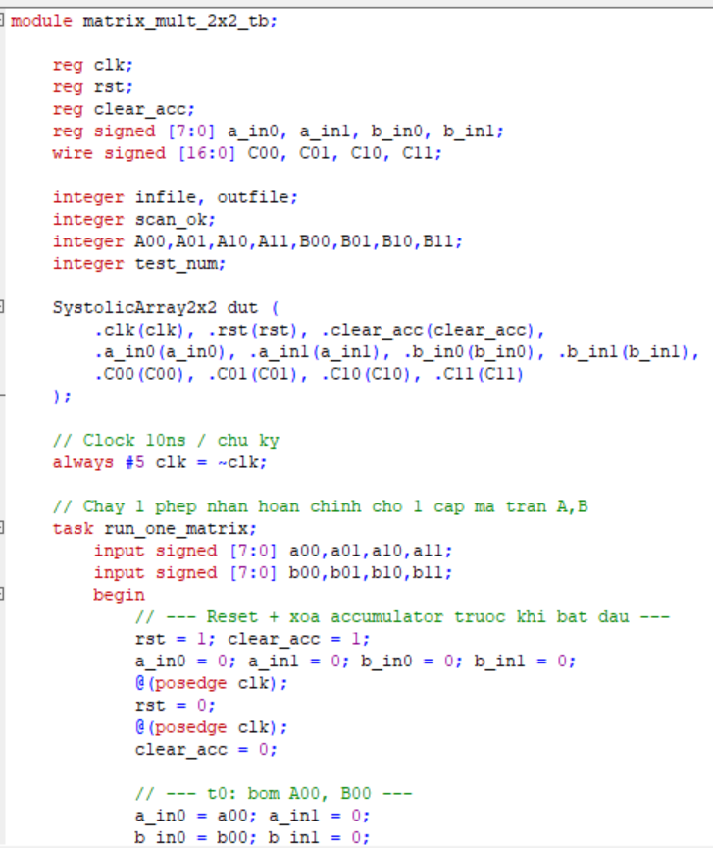
7. Proposed Verilog Design
matrix_mult_2x2
pe_mac
out_regs
clk, rst_n
Core Column Processing
start
Multiply–Accumulate
always @(posedge clk)
acc <= acc + a_in * b_in;
// After 2 MAC cycles: c_out <= acc
signed [7:0] A/B
signed [16:0] C
done / valid
Suggested File Structure
PROJECT TREE
src/
pe_mac.v
matrix_mult_2x2.v
sim/
tb_matrix_mult_2x2.v
gen_vectors.py
Add screenshots of the main RTL, project structure, or a successful terminal build.
FAP 201 • FPGA Matrix Multiplier
09

Slide 10
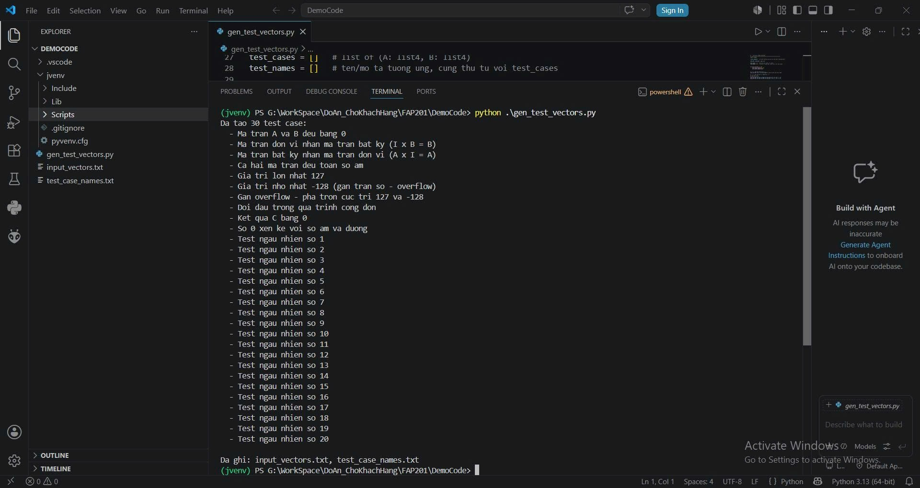
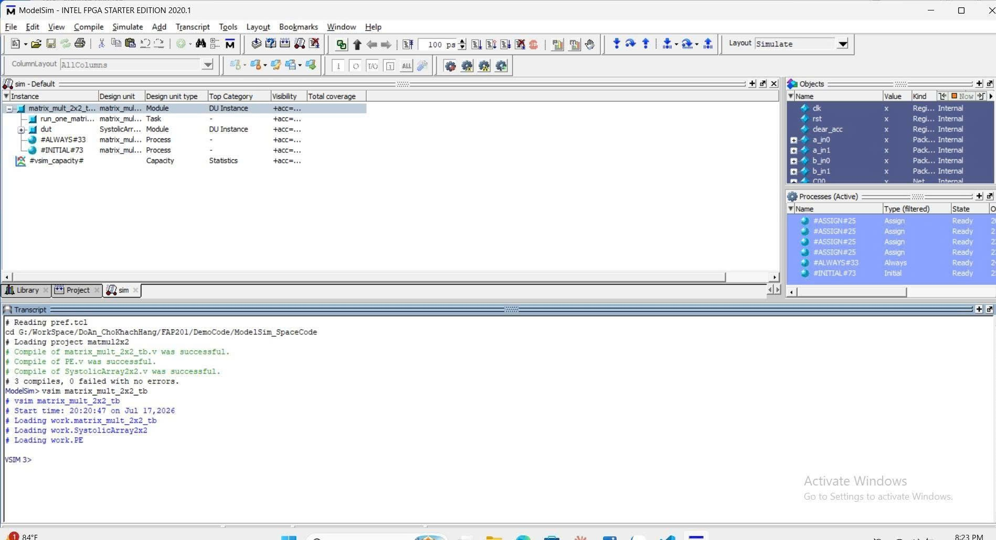
8. Testbench and Python Verification
Python
gen_vectors.py
Verilog
Testbench
DUT
2×2 Multiplier
Compare
Expected vs. Actual
Recommended Test Groups
✓
All-zero matrices
✓
Identity matrix
✓
All-positive values
✓
All-negative values
✓
Mixed signs
✓
Maximum / minimum values
✓
Zero result
✓
Near-overflow cases
FAP 201 • FPGA Matrix Multiplier
10

Slide 11
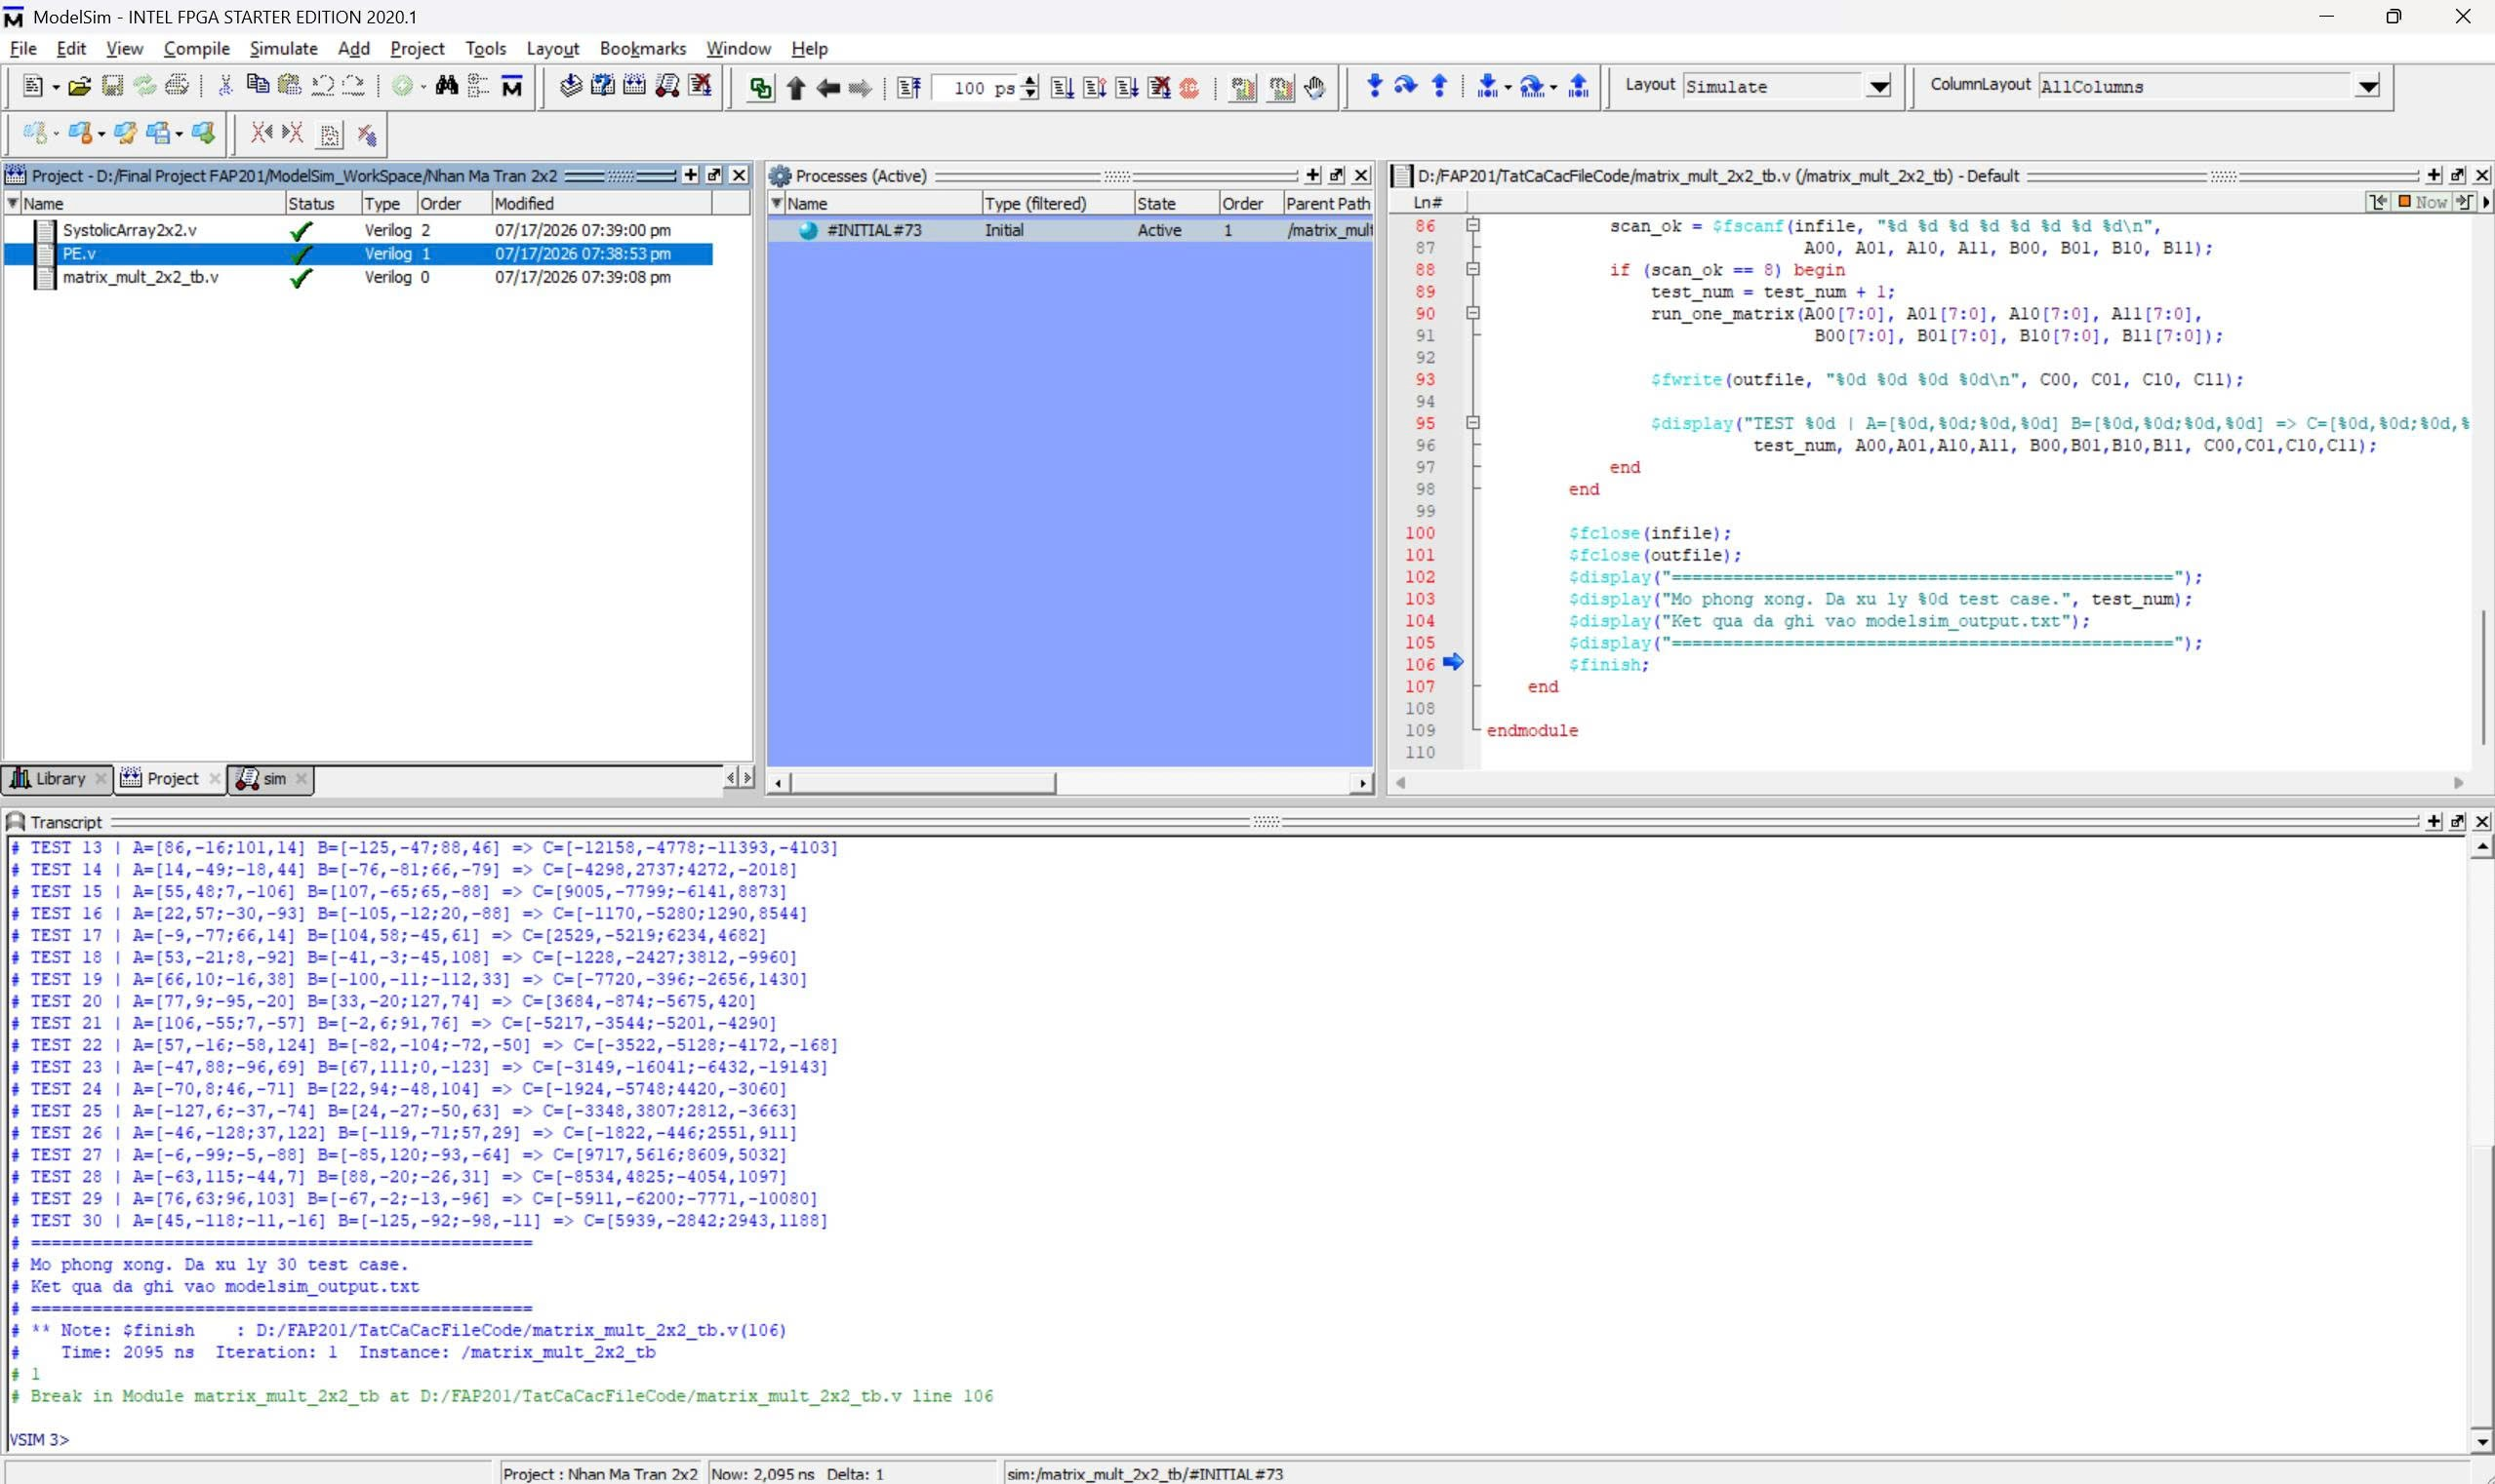
9. ModelSim Simulation Results
How to Read the Waveform
1
Reset returns the circuit to IDLE.
2
Set start = 1 to load matrices A and B.
3
After the MAC cycles, done = 1.
4
C00…C11 match the expected values.
Suggested caption: Matrix A = …, Matrix B = …, and Matrix C matches the Python result.
FAP 201 • FPGA Matrix Multiplier
11

Slide 12
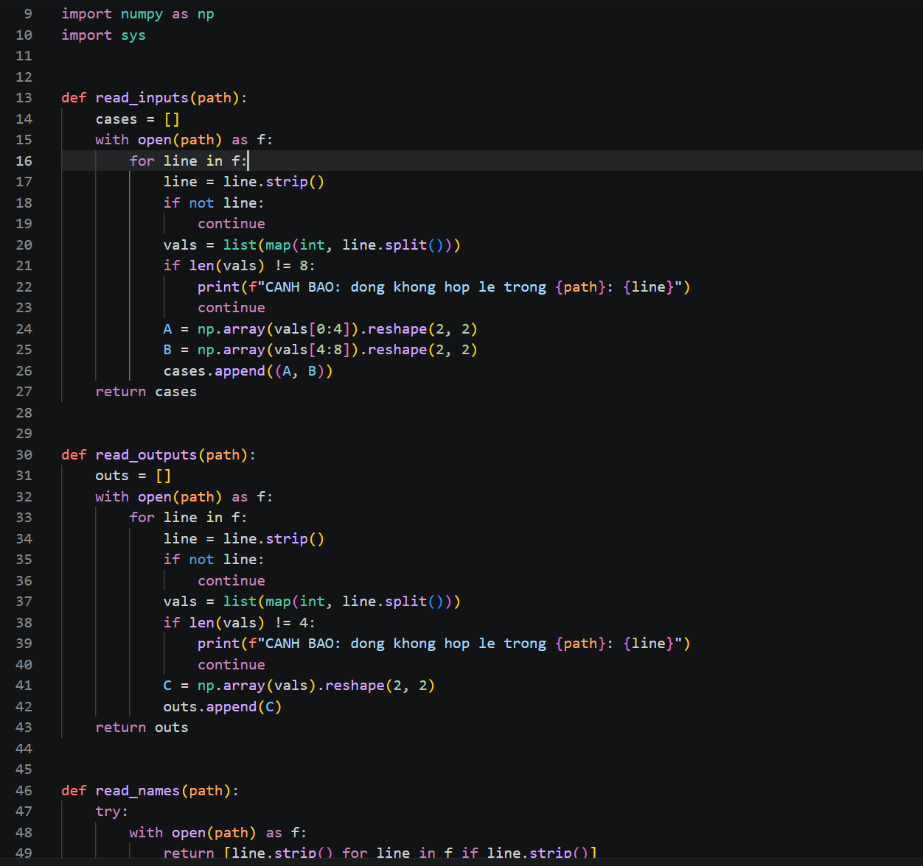
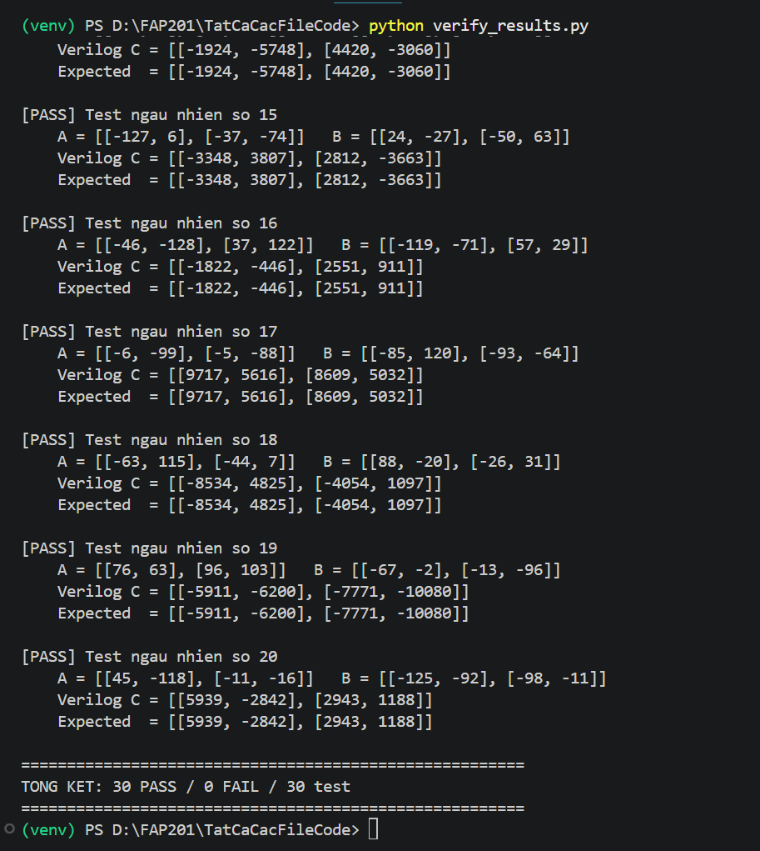
10. VS Code and Terminal Results
• Input matrices A and B
• Python expected result
• Actual DUT result
• Final PASS / FAIL status
The screenshot should show
FAP 201 • FPGA Matrix Multiplier
12

Slide 13
11. Conclusion
Summary of the 2×2 systolic-array matrix-multiplier design
Mathematically Correct
Hardware Correct
C[i][j] is the sum of two row-by-column products.
The design uses PE/MAC units, registers, and a clocked FSM.
Data Format Correct
Verification Correct
Signed 8-bit inputs, 16-bit products, and 17-bit outputs.
Python + testbench + ModelSim compare expected and actual results.
• Scale to 4×4 or N×N arrays
• Add deeper pipelining to increase throughput
• Use DSP blocks when supported by the target FPGA
• Add UART/AXI input from a host computer
Future Work
Thank you for listening.
FAP 201 • FPGA Matrix Multiplier
14

Slide 14
References
Sources used by the project team
1
2×2 Matrix Multiplier
A. Hill, B. Zarycky, E. Niezabytowski, and D. Melnikov, “2x2 Matrix Multiplier,” Oakland University.
2
Getting Started with FPGAs
I. H. Baek and D. Boeck, “FPGA Matrix Multiplier,” University of California, Los Angeles.
3
Using the ModelSim FPGA Simulator with Verilog Testbenches
I. Kogut, V. Hryha, B. Dzundza, L. Hryha, and I. Hatala, “Research and Design of a Matrix Multiplier on FPGA,” Advances in Cyber-Physical Systems, vol. 10, no. 1, 2025.
4
Research and Design of a Matrix Multiplier on FPGA
Provides context on FPGA multiplier architecture, resource use, and performance optimization.
5
Project design notes
Signed 8-bit inputs, 17-bit outputs, parallel/sequential architectures, and the Python + Verilog + ModelSim workflow.
FAP 201 • FPGA Matrix Multiplier
15

