Slide 1
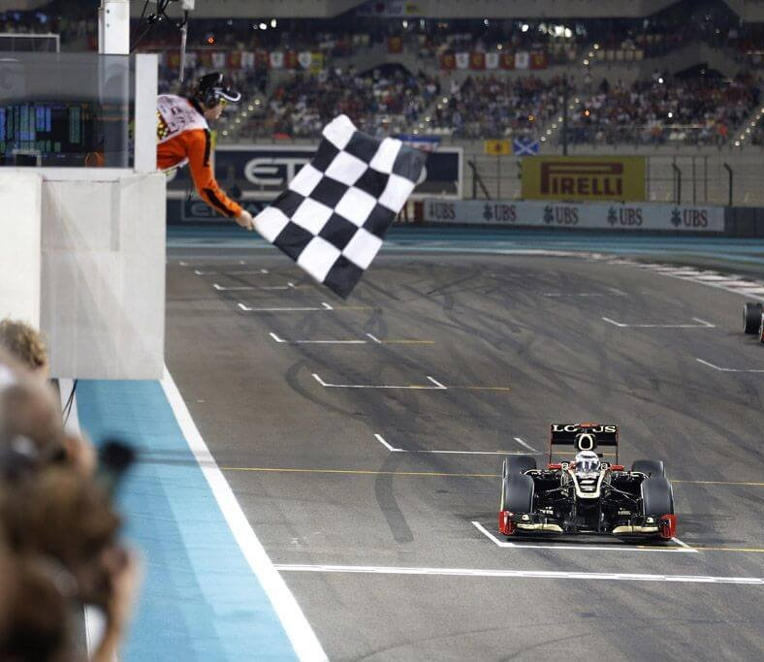

Which Car Performance & Race Strategy Factors Best Predict a Driver’s Finishing Position?
Minh Vo, Jewel Cooper, & Quang Nguyen

Slide 2
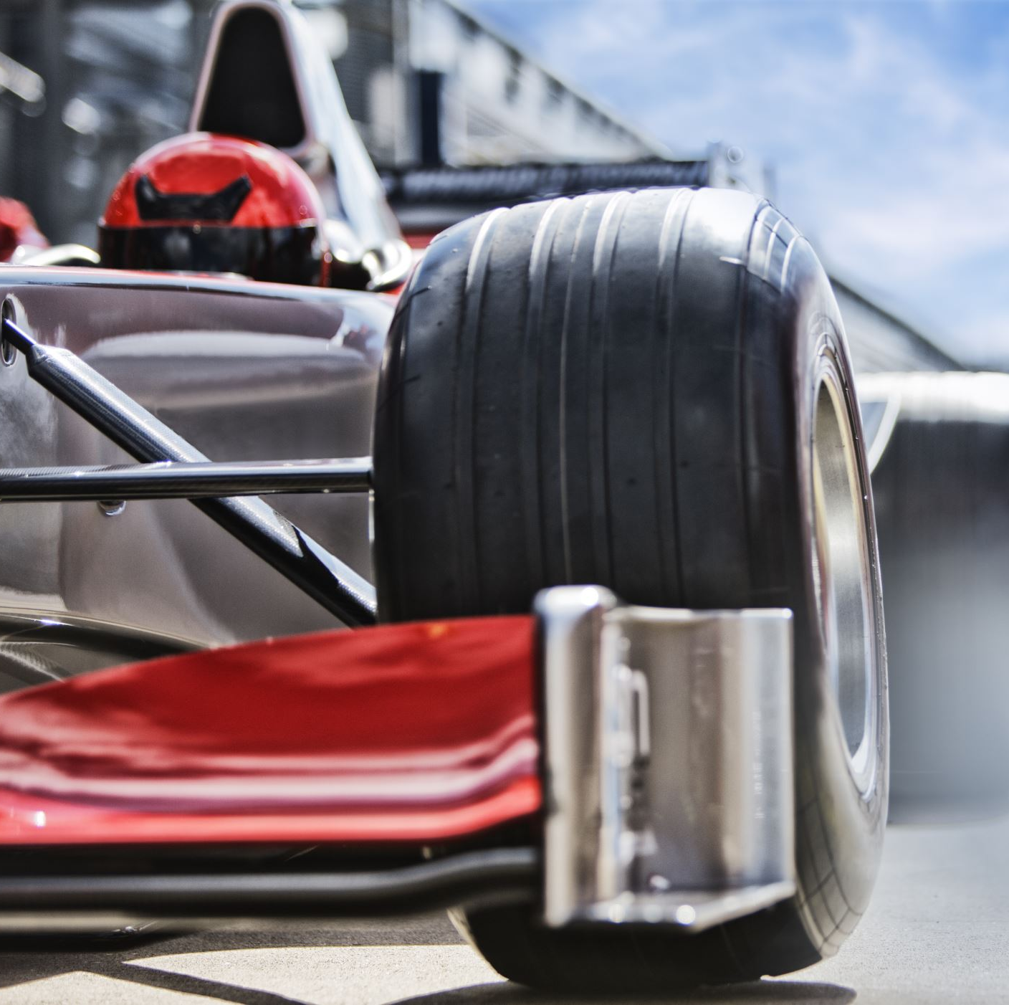
Overview
Goal: Identify patterns that contribute to successful race results
Examine how driver performance, tire strategy, and pit stop decisions influence race outcomes

Slide 3

Purpose of Dataset
Explore the relationship between performance metrics and final standings
Develop insights that can support predictive analytics in Formula 1 (F1)
Integrate multiple sources of race and telemetry data into a single data set
Notes:
By integrating these datasets, we created a foundation for analyzing how strategy and performance metrics influence race outcomes and future predictive modeling efforts.

Slide 4
Potential Users and Applications
Sports Broadcasters developing predictive models for future race performance outcomes
F1 Pit Crew optimizing race strategy, tire management, and pit stop timing.
Sports analytics researchers studying performance optimization
App developers creating predictive tools for fan engagement

Slide 5
Source of Data
Combined data from various sources to create a unified data set:
Telemetry and race performance data from 2023-2025 Formula 1’s OpenF1 API
Historical race results from StatsF1, who publish structured race results for each Grand Prix
Key Variables
Driver finishing position
Lap times
Tire compounds and strategy
Driver and team performance metrics
Notes:
The data was obtained from two primary sources.
The first is the OpenF1 API. It is an open-source API that provides telemetry and race performance data from the 2023 Formula 1 season. We pulled from multiple endpoints including drivers, laps, stints, pit stops, car telemetry, and final session results.
The second source is StatsF1, a site that publishes structured race result tables for every Grand Prix. We used this to supplement our API data with historical race context like laps completed and gap to the winner.
Our key variables across both sources are: driver finishing position — our target — as well as lap times, tire compounds and strategy, and driver and team performance metrics.

Slide 6
Approach to Acquiring Data
Queried multiple OpenF1 API endpoints (drivers, laps, stints, pit stops, positions, telemetry)
Scraped race classification tables from StatsF1
Merged datasets using common identifiers such as “race” and “driver”
Validated data quality and consistency before analysis

Slide 7

Approach to Preprocessing Data
Standardized variable names and formats across data sources
Removed duplicate and incomplete records
Handled missing values where necessary
Joined all sources into a single dataset

Slide 8

Distribution Approach
Examined distributions of finishing position, lap times, pit stops, and telemetry metrics
Evaluated skewness and potential outliers within race performance data
Identified trends, variability, and potential outliers
Evaluated feature distributions prior to modeling

Slide 9

Discussion of Access Rights
OpenF1 provides accessible motorsport data through its API
StatsF1 race results are publicly available online
No personally identifiable information was collected

Slide 10

Issues and Limitations
Some OpenF1 endpoints had incomplete coverage across sessions
Telemetry data is quite large, requiring aggregation
Weather, incidents, and mechanical failures may not be fully captured
Results are limited to the 2023 Formula 1 season

Slide 11
Team and Contributions
Minh Vo
Data acquisition and preprocessing
Data integration and cleaning
Jewel Cooper
Exploratory data analysis
Presentation development and project documentation
Quang Nguyen
Statistical analysis and modeling
Results interpretation and visualization

Slide 12
THANK YOU!

