Slide 1
The Turks and Caicos Islands
Truc Minh Nguyen

Slide 2
Overview
Key facts:
History
Geography
Government
Economy
Comparisons with Surrounding Islands
Strength, Weakness, Opportunities, Threats (SWOT)

Slide 3
History
500-900 AD:
The first known inhabitants, Lucayans, arrived via Hispaniola.
1500 - 1550s:
Spanish explorer Ponce de Leon stopped in the islands.
Complete disappearance of the Lucayans.
1764:
Britain claimed ownership of the TCI under UK colony of Jamaica.
1962
After Jamaican independence, the TCI remained a British Colony.

Slide 4
Geography
The TCI consists of 2 groups southeast of The Bahamas.
The Turks group:
Grand Turk Island, Salt Cay, and lesser cays.
The Caicos group located northwest of the Turks
South, East, Middle, North, and West Caicos
Providenciales (Provo)
Population mostly resides on South Caicos, Provo, and Grand Turk.
Capital: Cockburn Town, located in the Grand Turk.

Slide 5
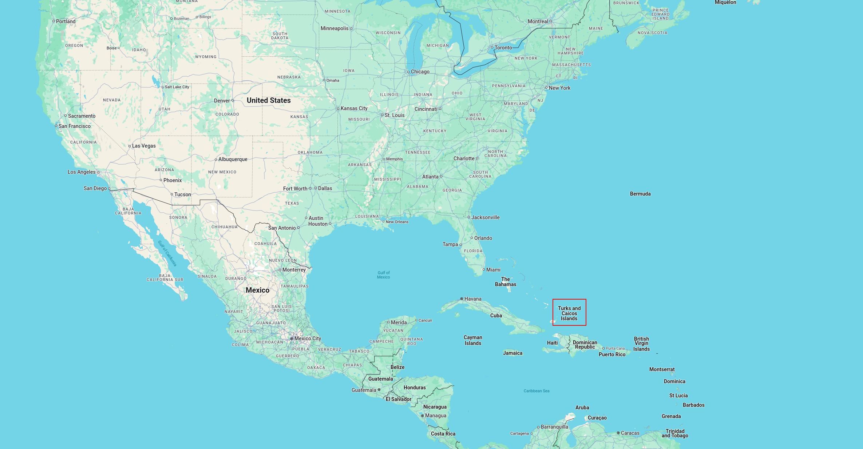
Map of the Turks and Caicos Islands - Surrounding
Reference Map

Slide 6
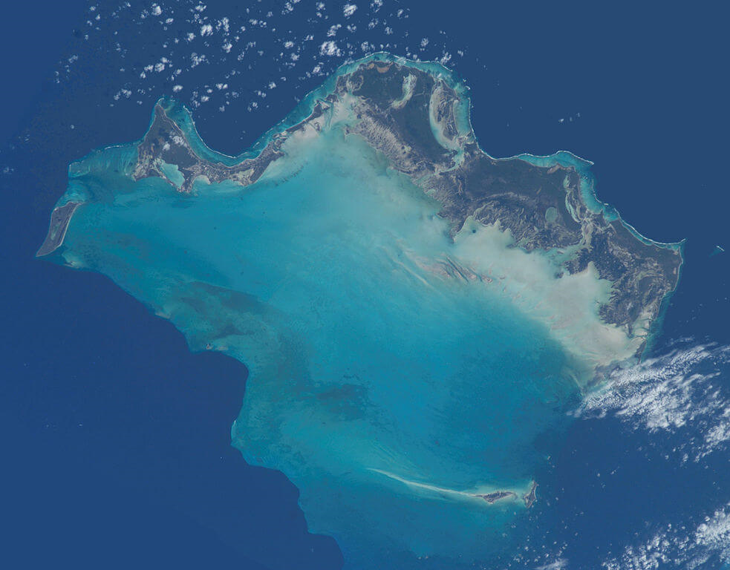
Map of the Turks and Caicos Islands - Satellite
Satellite Map

Slide 7
Government: 3 Branches
Executive:
Chief of State (Monarch of the UK)
Governor
Cabinet
Legislative:
House of Assembly (21 seats) and Legal System
Judicial:
Supreme Court (Chief Justice + judges)
Court of Appeal (Court President + 2 justices)
Magistrates’ Courts

Slide 8
Economy
Main Currency: USD
Main Revenue: Tourism
90.6% of GDP in the services industry as of 2017
Visitor counts decreased in 2020 due to the Covid-19 Pandemic
Unsure why the visitor count decreased in 2022

Slide 9
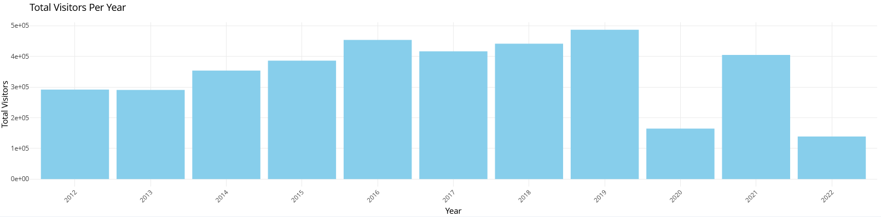
TCI Visitor Data over the Years
Turks and Caicos Per Capita Graph

Slide 10
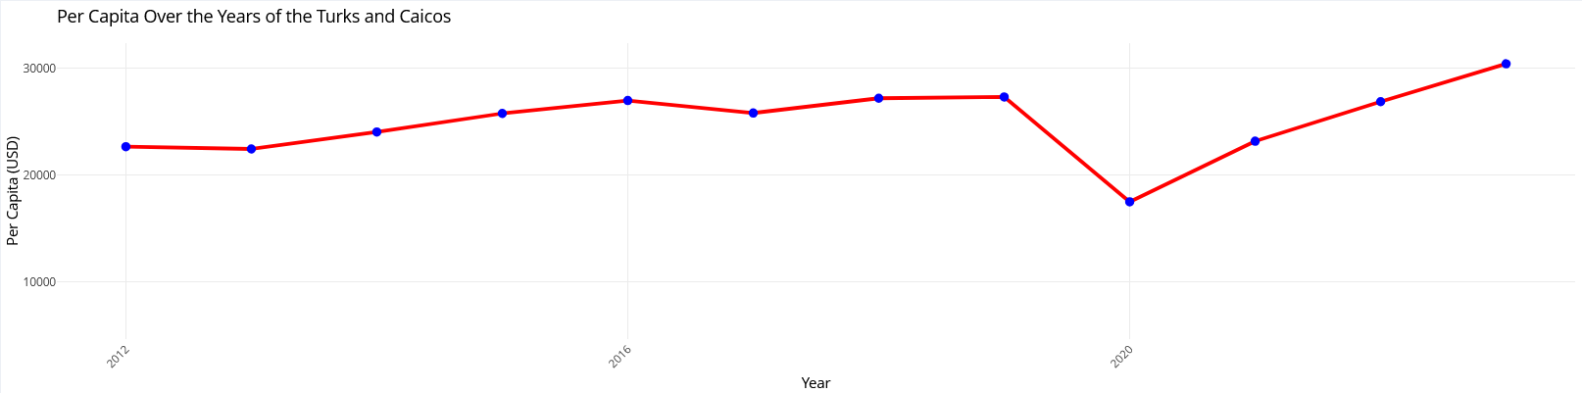
GDP per Capita - Turks and Caicos
Turks GDP

Slide 11
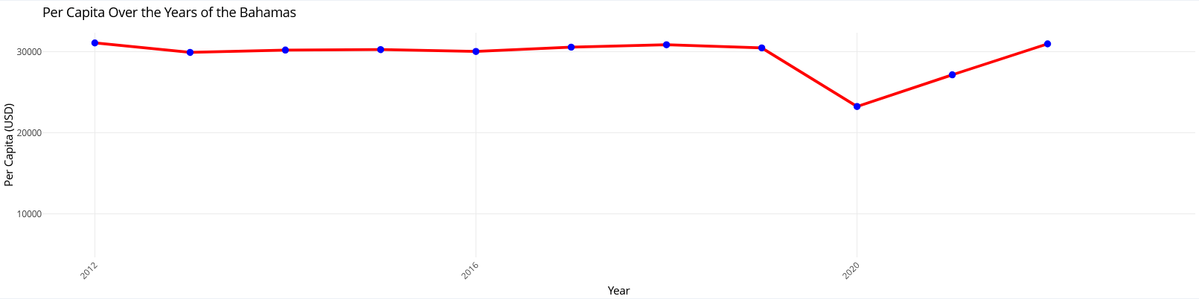
GDP per Capita - Bahamas
Bahamas GDP

Slide 12
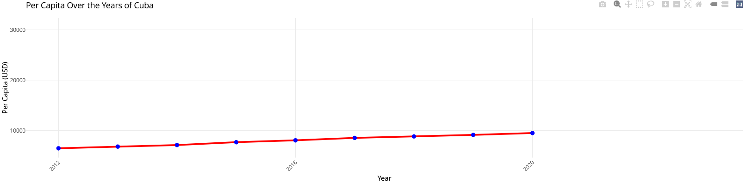
GDP per Capita - Cuba
Cuba GDP

Slide 13
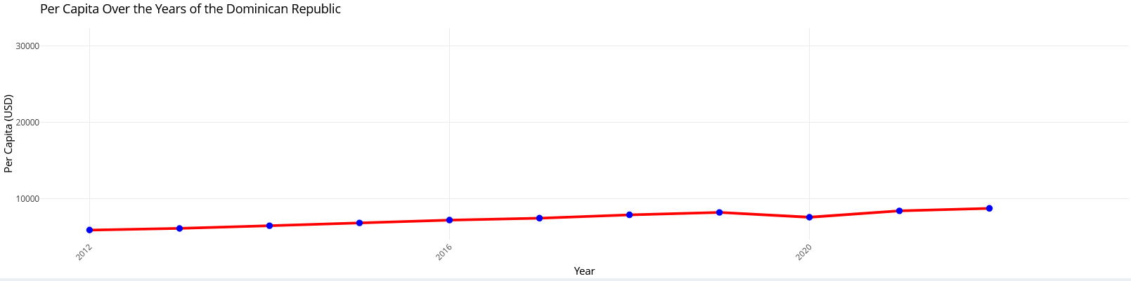
GDP per Capita - Dominican Republic
Dominican GDP

Slide 14
GDP Comparisons
It appears that the TCI’s GDP trend throughout the years is most similar to the Bahamas, making it a competitor to look out for. The values are close, however, it appears that the Bahamas generally has higher GDP per Capita overall than TCI.
TCI has much higher GDP per capita when compared to Cuba and the Dominican Republic. However, Cuba and Dominican Republic appear to have similar GDP per Capita trends. Perhaps this could be due to the location. The Turks and Caicos and Bahamas are located northeast compared to Cuba and Dominican Republic (southwest).

Slide 15
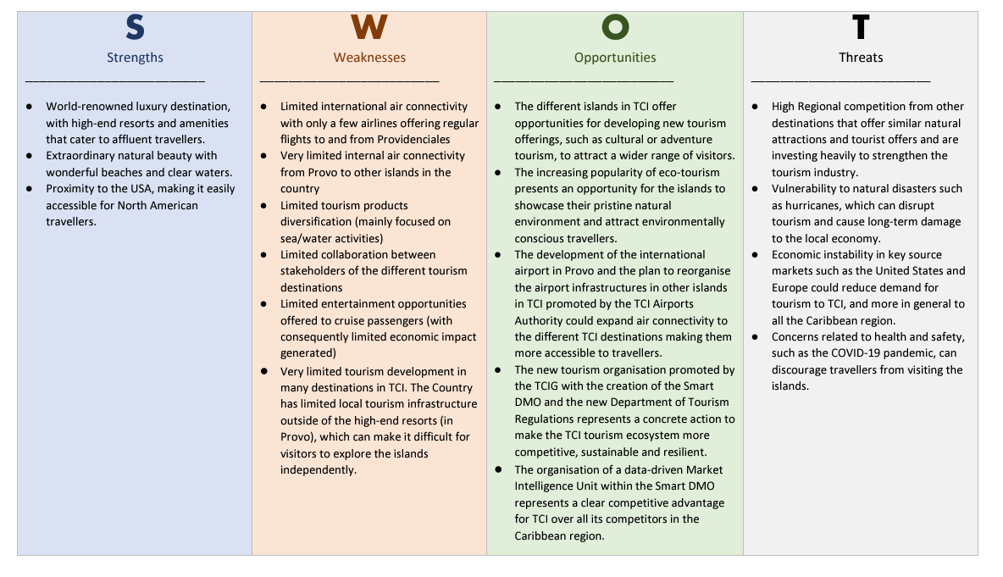
Strength, Weakness, Opportunities, Threats (SWOT)
SWOT Chart

Slide 16
Conclusion
TCI share similar government to the U.S (both originated from Britain)
Its GDP per Capita is competitive compared to surrounding islands
SWOT:
Strengths: high end beaches and resorts bring in tourism
Weaknesses: limited diversity of attractions (mainly sea activities)
Opportunities: The data-driven Market Intelligence Unit is utilizing data to place competitive edge for TCI over competitors
Threats: Vulnerable to natural disasters such as hurricanes

