Slide 1
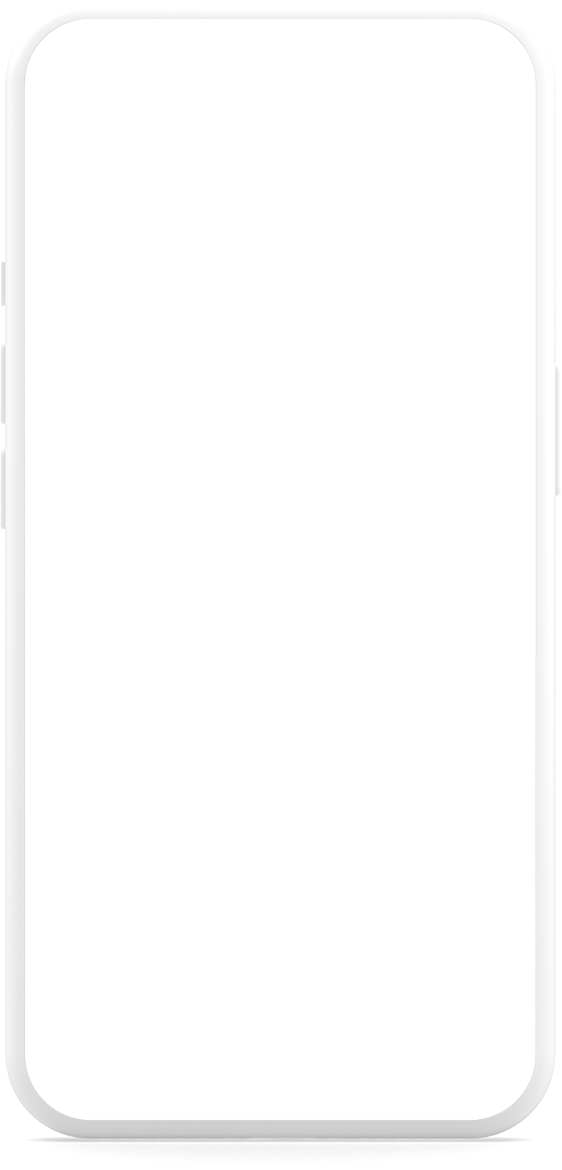
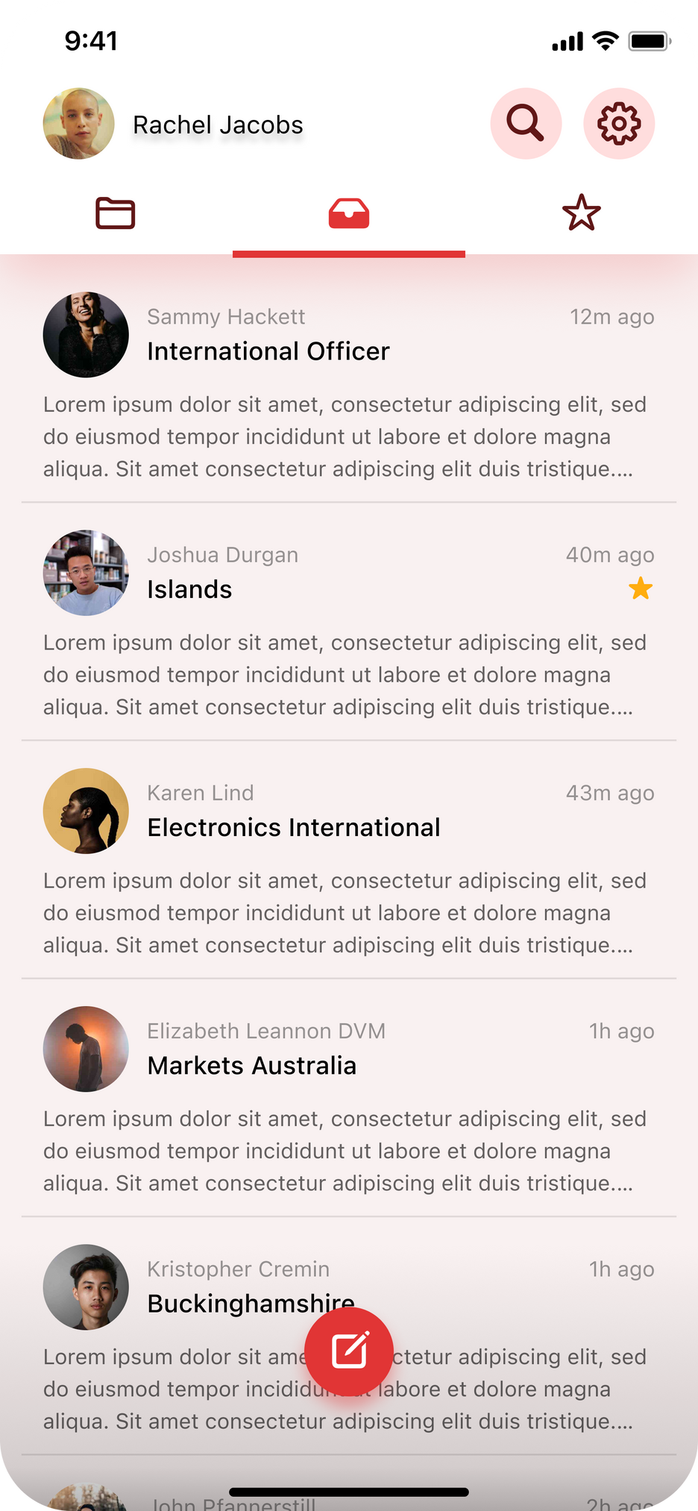
Group 5
Email
Client
2024
Mobile Application Development

Slide 2
Team members:
Nguyễn Thành Long - 22BI13264
Vũ Tuấn Minh - 22BI13317
Hoàng Long - 22BI13259
Nguyễn Quang Minh - 22BI13301
Phan Nguyễn Tuấn Minh - 22BI13307
Nguyễn Hà My - 22BI13318

Slide 3
Contents
1 . Introduction
2. Architecture
3. Activities
4. Showcase

Slide 4
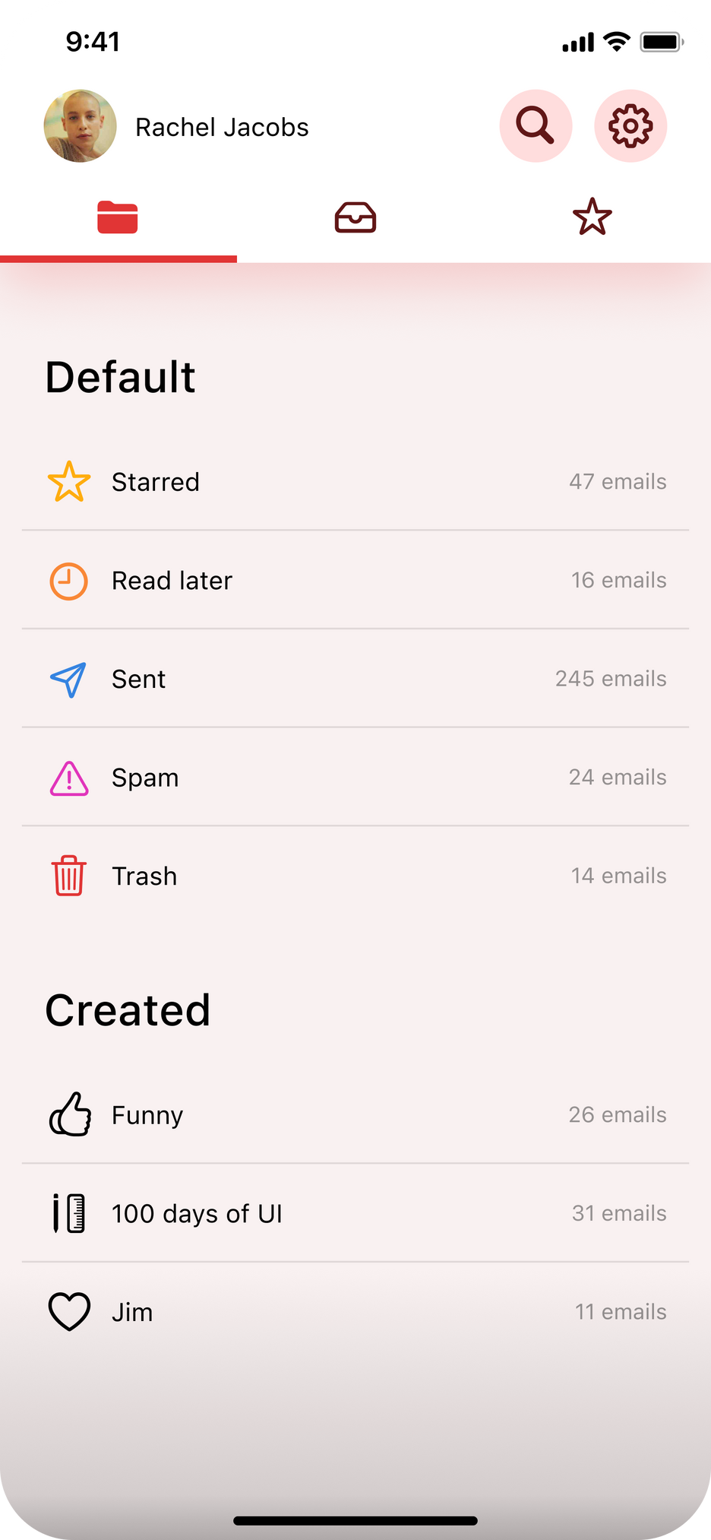
Intro-duction
Email is a communication method using computer network
Use:
Access, send and manage mail easily
User-friendly interface
Additional features: Filtering, spam protections, etc.

Slide 5
Login
Main
Topbar
Setting
Folder
Inbox
Starred
Search
Personal
folders
View mail
Option
Write mail
Architecture

Slide 6
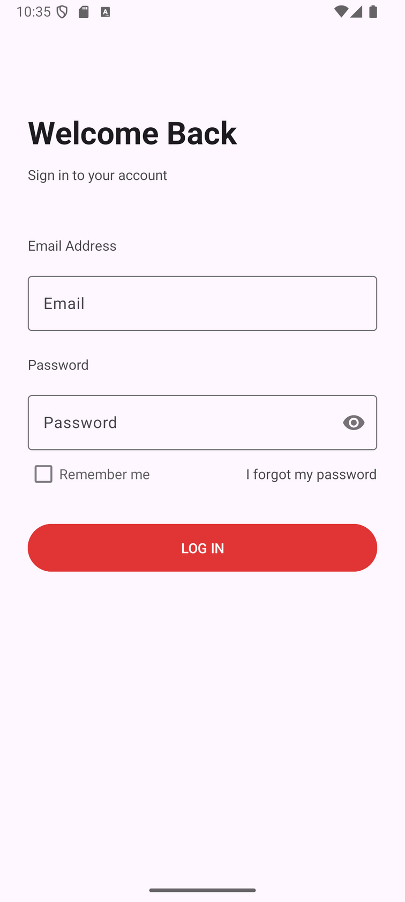
Login

Slide 7
Login
Main
Topbar
Setting
Folder
Inbox
Starred
Search
Personal
folders
View mail
Option
Write mail
Architecture

Slide 9
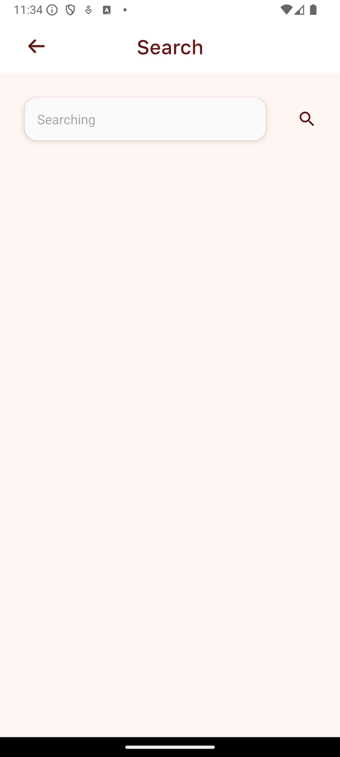
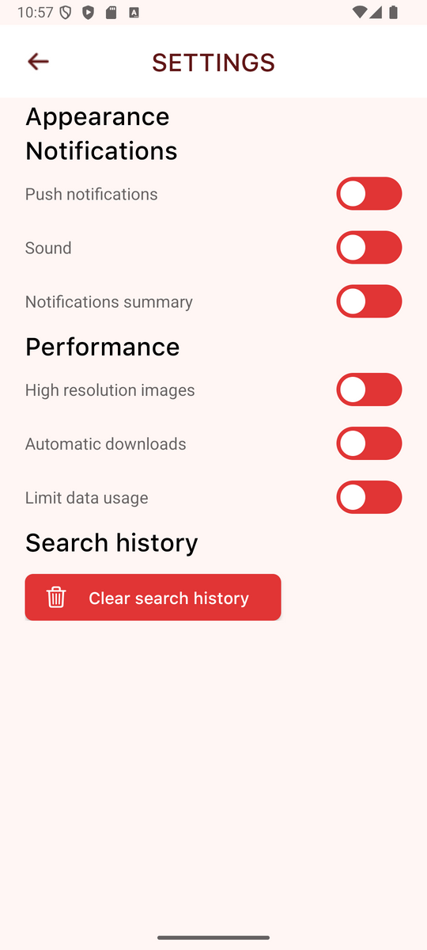
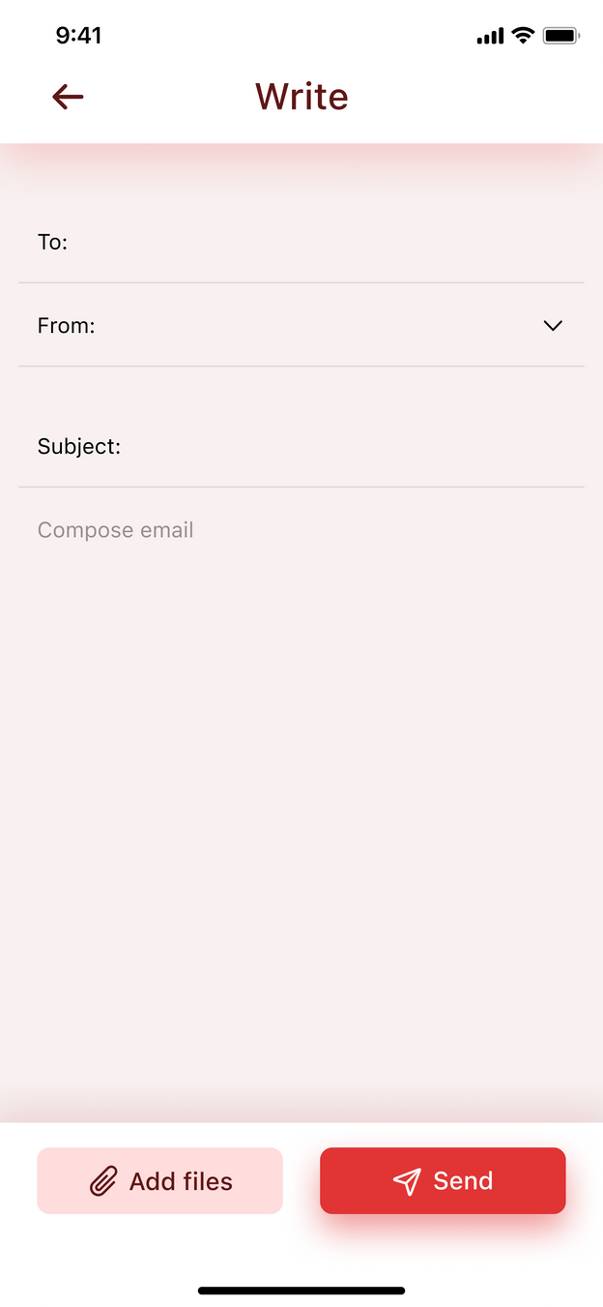

Slide 10
Login
Main
Topbar
Setting
Folder
Inbox
Starred
Search
Personal
folders
View mail
Option
Write mail
Architecture

Slide 11
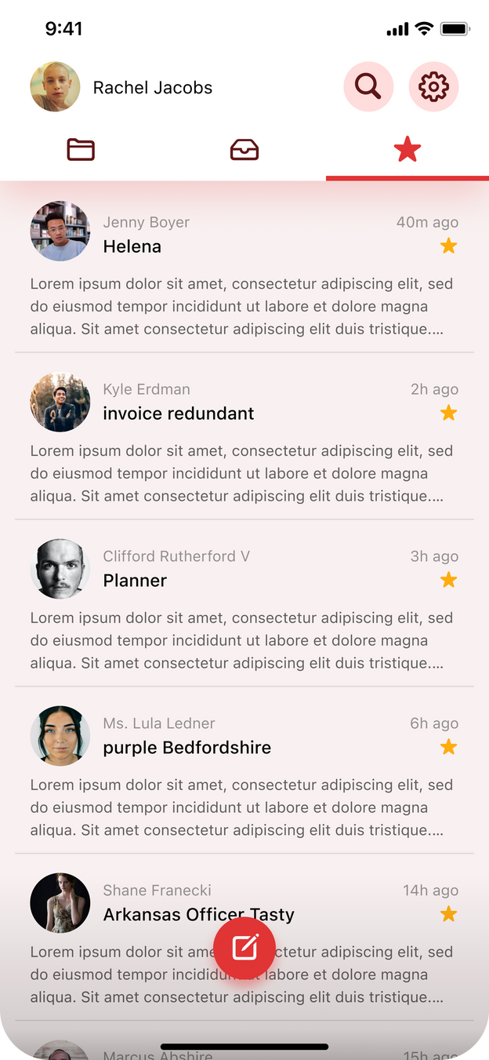
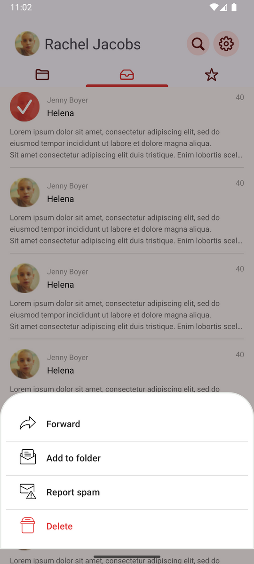

Slide 12
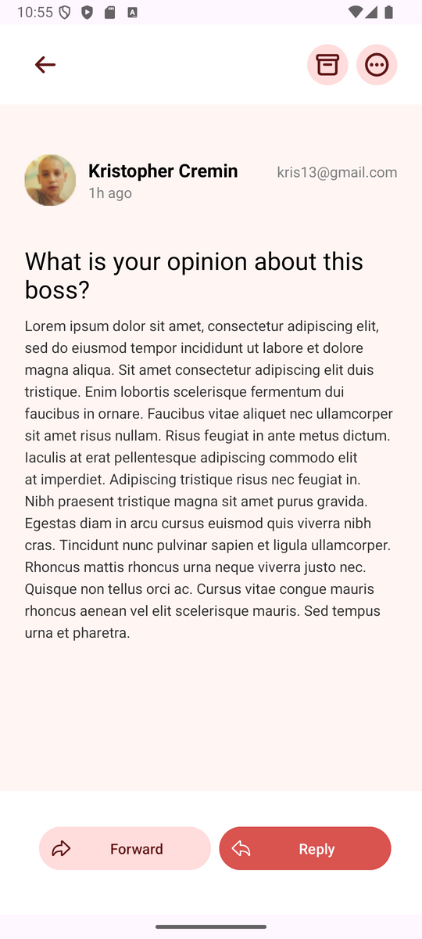
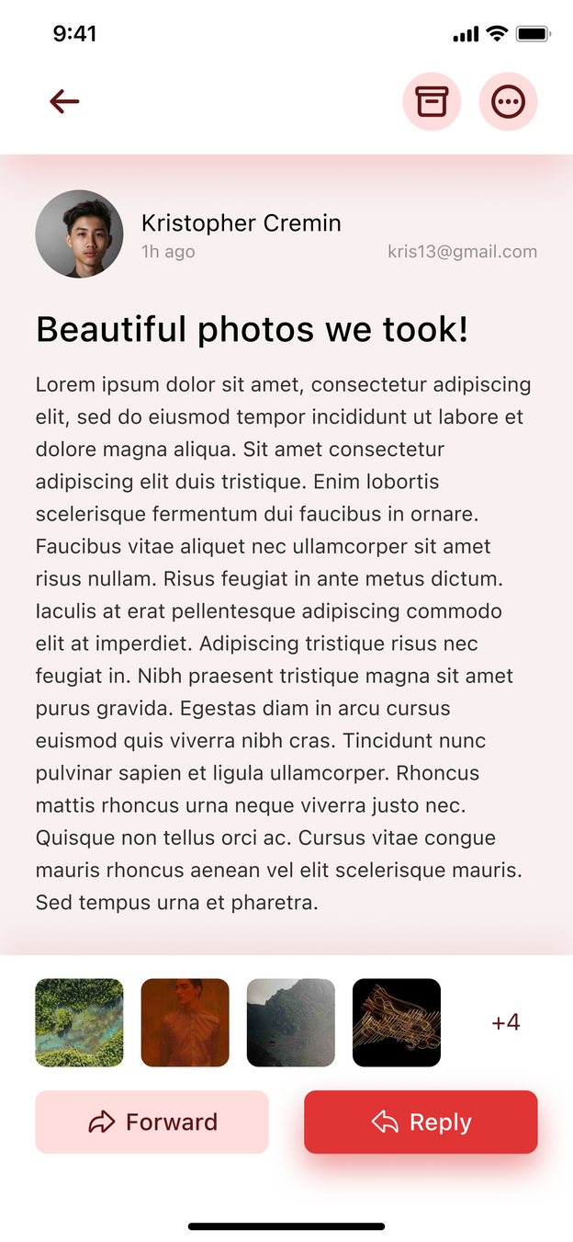

Slide 13
Login
Activies
Facilitates user authentication by allowing users to enter credentials (username and password).
Serves as the entry point

Slide 14
Tab bar
Using TabLayout, ViewPager2 and Adapters to displayed tabbed layout with swipeable pages.
Main
Activities

Slide 15
Search
Setting
FAB for composing emails (direct to WriteActivity), whose visibility changes depending on the active tab.
Topbar with buttons to navigate to different activities (SettingsActivity, SearchActivity)
Main
Activities
Write

Slide 16
Read
Mail
Activites
Using RecycleView to display the email list.
Retrieves the following data from Intents (Adapter). Including the sender’s name, profile image, email address, subject, and content.

Slide 17
Write
Activities

Slide 18
Future works:
Complete some unfinished functions including:
Add functions to buttons
Search activity
Register page
Add mails with files
Reply/forward function
Multi-selected mail
Creating folders and managing functions
Add mail to starred tab
Apply data
Conclusion
Done:
6 activities
10 screens

Slide 19
Thank you for listening!

