Slide 1
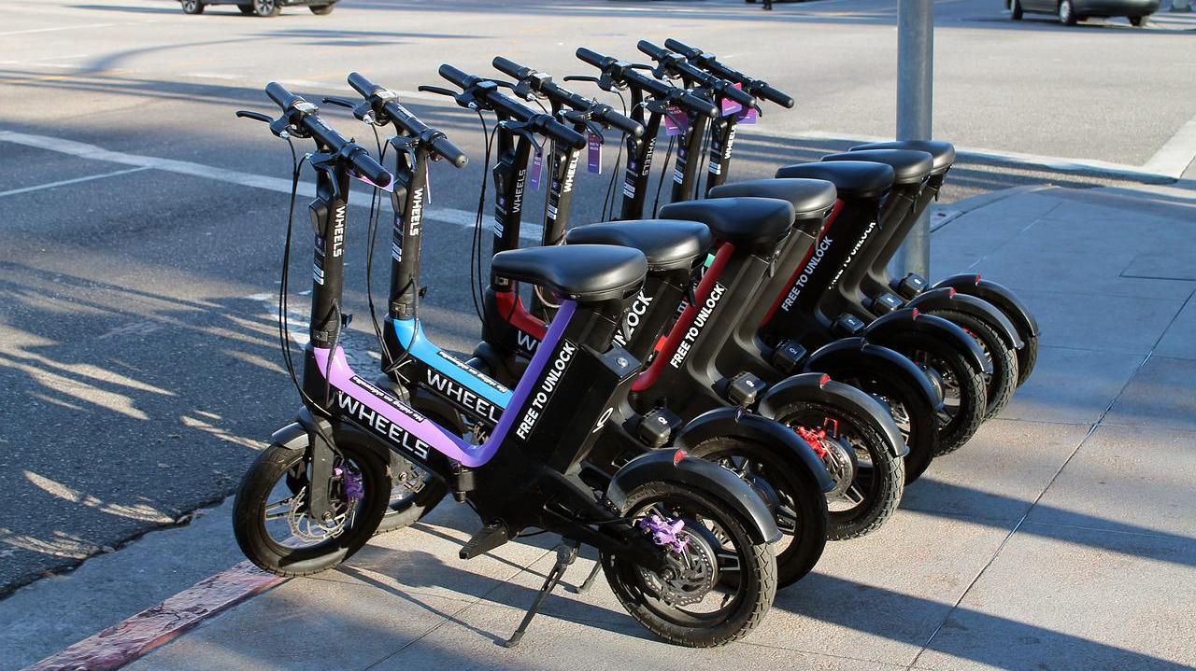
Electric Scooter Company
www.firstupconsultants.com

Slide 2
About Scooter Rentals
Leading the way with innovative business practices.
Developing new and exciting technologies to make business more efficient.
Family owned and operated for nearly two decades.
International recognition.

Slide 3
Profit by Department
Chart 1. Percent of company profit by department

Slide 4
Monthly Profit Fluctuations
Month | Tech. | Org. | Man. | Opt.
January | ↑4% | ↑3% | ↑13% | ↑4%
February | ↑1% | ↓15% | ↓2% | ↑6%
March | ↑2.5% | ↓4% | ↓4% | ↑10%
April | ↓3% | ↑25% | ↓1% | ↑5%
May | ↓0.5% | ↑6% | ↓6% | ↓3%
June | ↑1% | ↓3% | ↓2% | ↓3%
July | ↓1.5% | ↓1% | ↓7% | ↑6%
August | ↑3% | ↑7% | ↑5% | ↑1%
September | ↑5% | ↓5% | ↓3% | ↑5%
October | ↓6% | ↓1% | ↑10% | ↓4%
November | ↑10% | ↑12% | ↑16% | ↑10%
December | ↓15% | ↓3% | ↓2% | ↑7%
Table 1. Monthly profit increase/decrease by percent
Notes:
Profits for the Management department were actually up from last year, despite several months of shrinking profit.

Slide 5
Scooter Rentals
Our new scooters have improved stability, which minimizes crashes. We’ve come a long way from the electric scooters prototypes that crashed so often riders felt they had to wear a suit of armor to feel safe!

Slide 6
Scooter
Xiaomi
Huawei
Other

