Slide 1
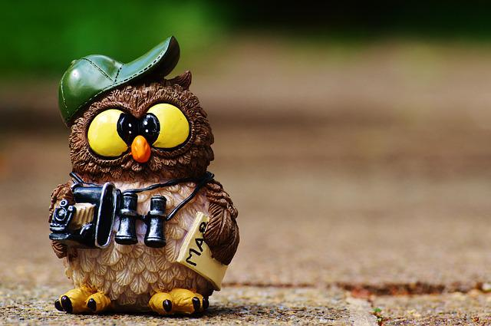
Beginning Bird Watching

Slide 2
Another Summer is Coming …
Beginning Bird Watching is growing in popularity:
10% more youth members (under 16 yrs. old)
12% increase in birds sighted
60% return members

Slide 3
Fundraiser was a success!
Birding Workshop - Approximately 30 middle and high school students attended.
Kids Day - 75 fifth grade students participated.
Monthly Audubon Society Lecture – has more adults attending that ever before!
Raised approximately $6,000.00 for local bird nesting and protection enhancements.

Slide 4
Gear for Bird Watching
Binoculars. Get 7x or 8x magnification. It’s a nice mix of power while still allowing you a wide enough view that your bird won’t be constantly hopping out of your image. Expect to spend $250 to $300.
Field Guide. To identify your birds, we recommend the Sibley Guide.
Bird Feeders. Bring the birds into your backyard to get the best looks! we recommend starting with a black-oil sunflower feeder, add a suet feeder in winter and a hummingbird feeder in summer.
Spotting scope. Get 20x to 60x. Useful for looking at ducks on the far side of a pond or a Golden Eagle perched on a tree limb a quarter-mile away.
Camera. A cell phone with an adapter will work! “Digiscoping” is attaching your camera to a spotting scope or binoculars.

Slide 5
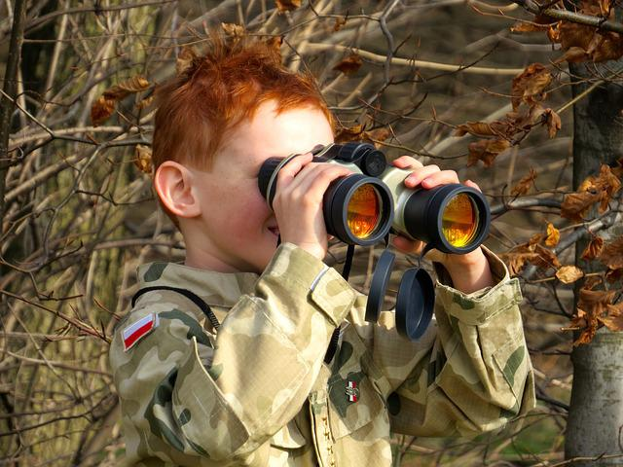
Summer is Coming!
Don’t forget. We offer excellent youth workshops for beginners. Enroll your child today!

Slide 6
Ready to Start Bird Watching?
Book a Workshop
Pack Your Binoculars
Watch some Birds!

