Slide 1
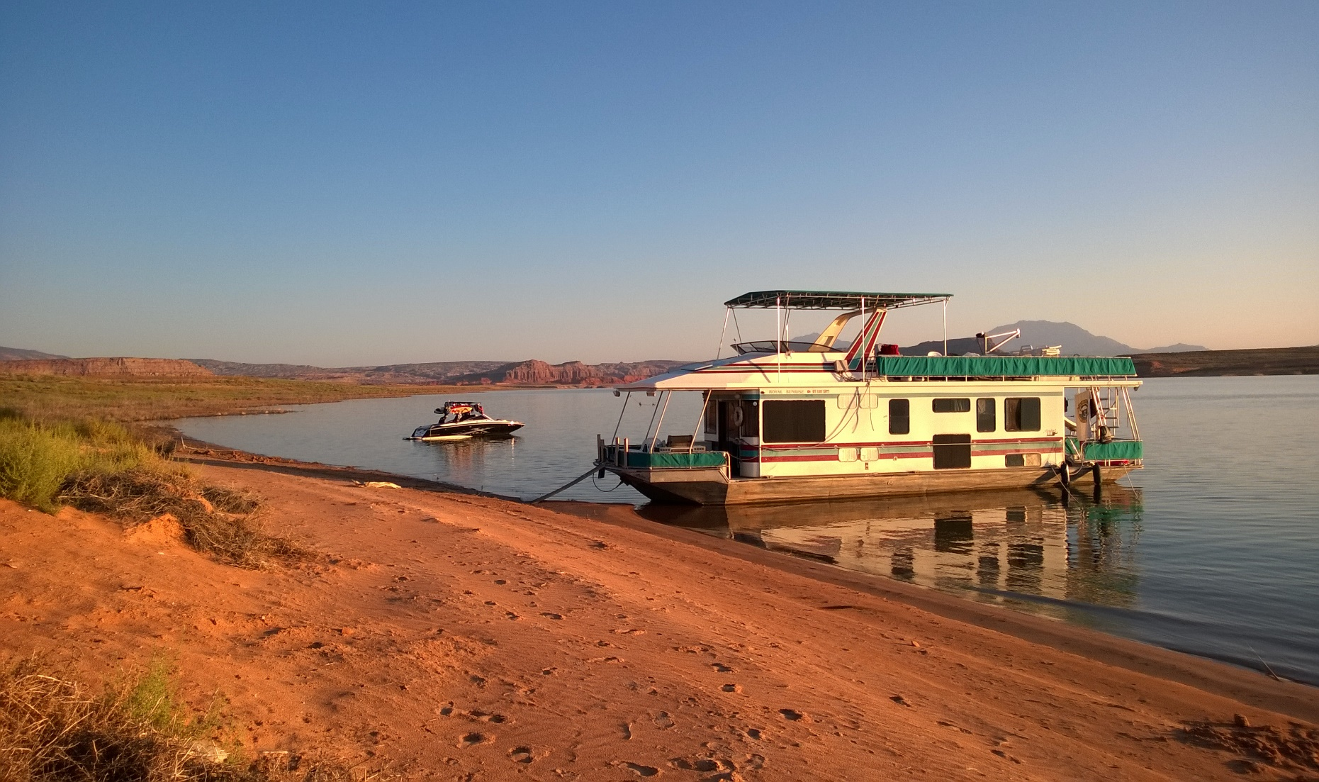
Houseboating

Slide 2

Why Rent a Houseboat?
Affordable compared to hotel vacations.
Luxury accommodations compared to camping.
Options to add water toys (i.e., boats, jet skis).

Slide 3
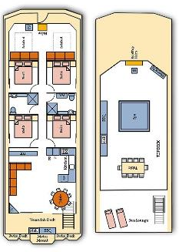
Spacious Floorplans
Outdoor Facilities
Upstairs helm with seating
Huge 8-10 person rooftop spa
Sun lounge
Outdoor dining table & chairs
Hooded gas BBQ upstairs & downstairs
Large undercover sundeck

Slide 4
Good Weather All Year
Table 1. Average Temperatures
Notes:
Explain that some water toys are not available during winter months.

Slide 5
Inventory Sample
Chart 1. Rental Wakeboards

Slide 6
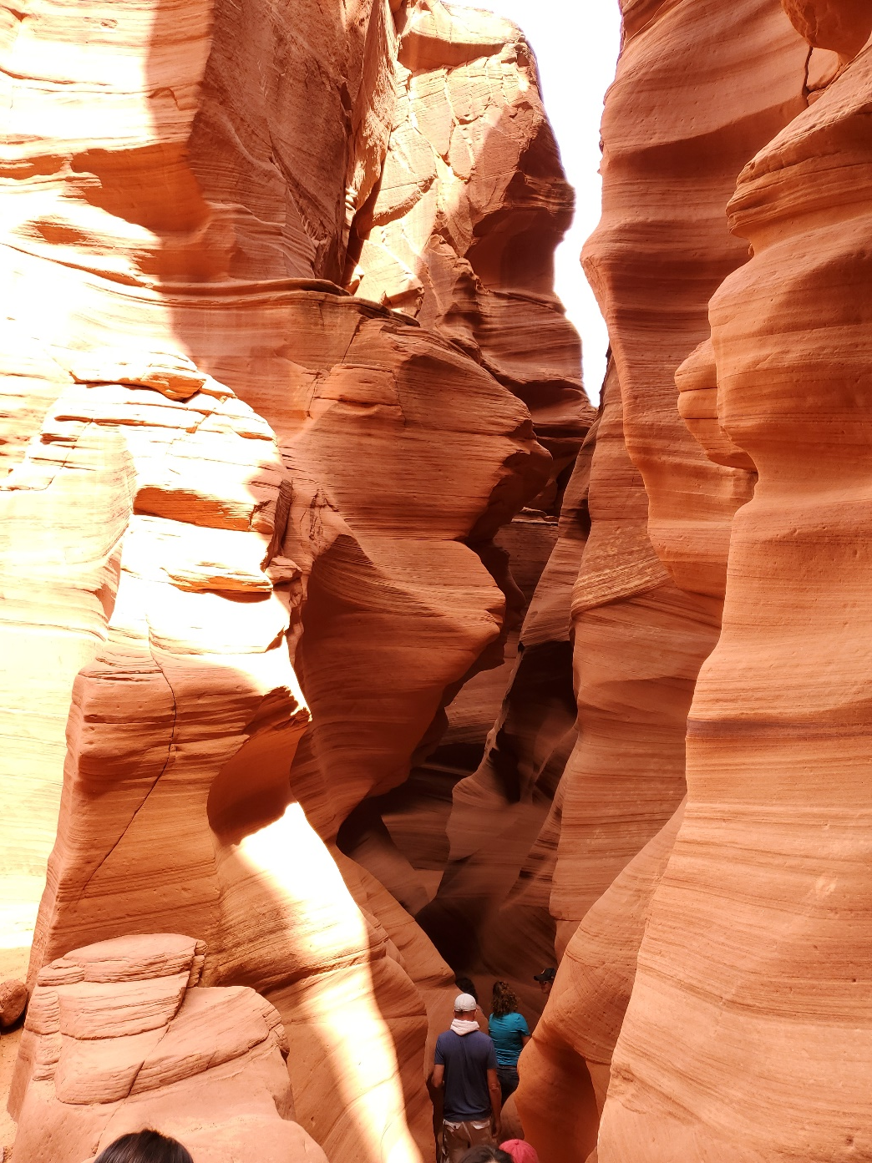
Other Activities!
Not everything has to be watersports. During your houseboat vacation, why not go hiking? Most lakes big enough to accommodate houseboats also have canyons for hiking.

Slide 7
Planning
Book a houseboat
Pack your bag
Have fun

