Slide 1
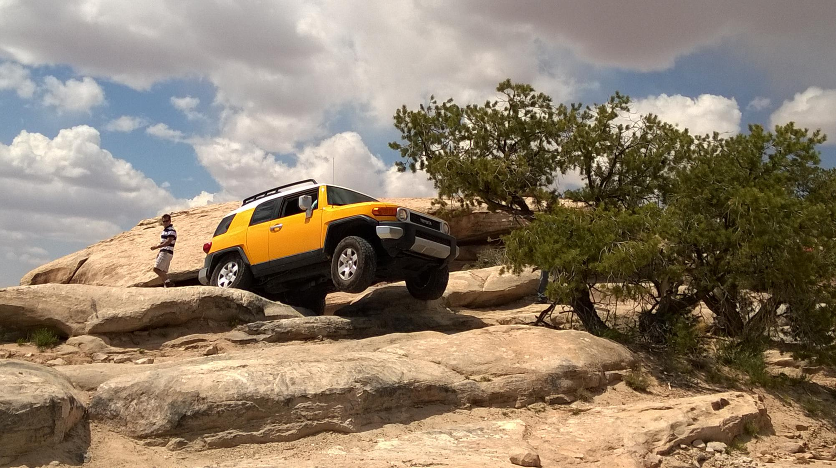
Rock Crawling
Moab, Utah

Slide 2
Rock Crawl

Slide 3

Why Rock Crawl in Moab, Utah?
Adventurous
Nearby Lodging and Restaurants
Affordable ($200-300/day vehicle rentals with hazard insurance)
Family Friendly
Incredible fun!

Slide 4
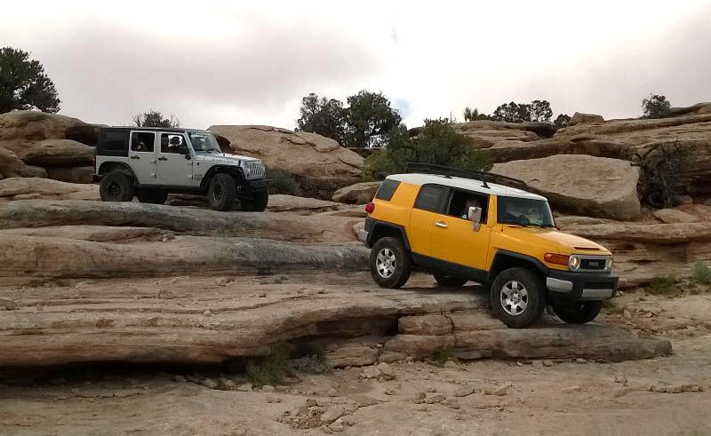
Adventurous Trails!
Trails range from easy 2-wheel scenic drives to the ultimate in challenging 4-wheel drive trails, providing opportunities for all to experience the beauty and solitude of an off road adventure.

Slide 5
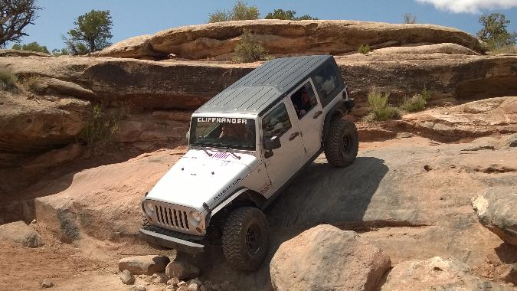
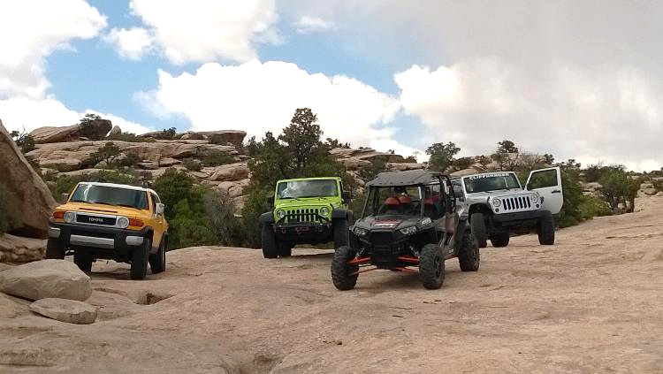
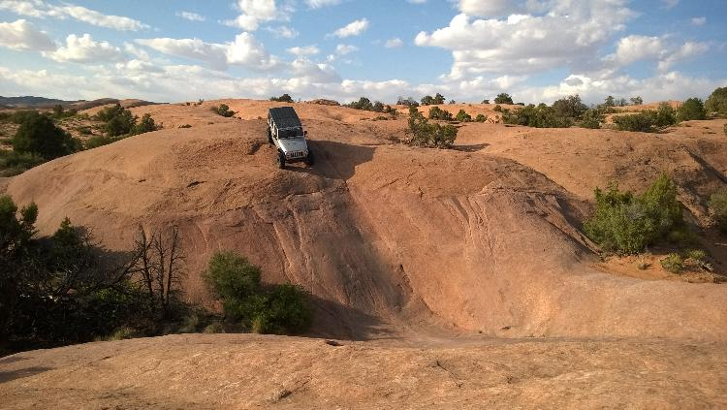
RockCrawling in Moab …
… is amazing fun!!!

Slide 6
Most Popular Trails
Trail Name | Round Trip from Moab | 4WD Road | Minimum Time | Difficulty
1. Chicken Comers | 54 miles | 43 miles | 3-1/2 hours | Hard
2. Gemini Bridges | 48 Miles | 14 miles | 2-1/2 hours | Easy
3. Poison Spider | 36 miles | 16 miles | 4 hours | Difficult
4. Moab Rim | 15 miles | 7 miles | 1-1/2 hours | Very Difficult

Slide 7
Nearby Lodging
Several campgrounds
Hostel
A few Bed and Breakfast
Motels/Hotels

Slide 8
Nearby Restaurants
Branded fast food
Local diners
Grills
Steakhouses
Ethnic food
Branded fast food
Local diners
Grills
Steakhouses
Ethnic food
Branded fast food
Local diners
Grills
Steakhouses
Ethnic food

Slide 9
Other Activities
Rafting
Mountain Biking
Hiking
Canyoneering
Photography

