Slide 1
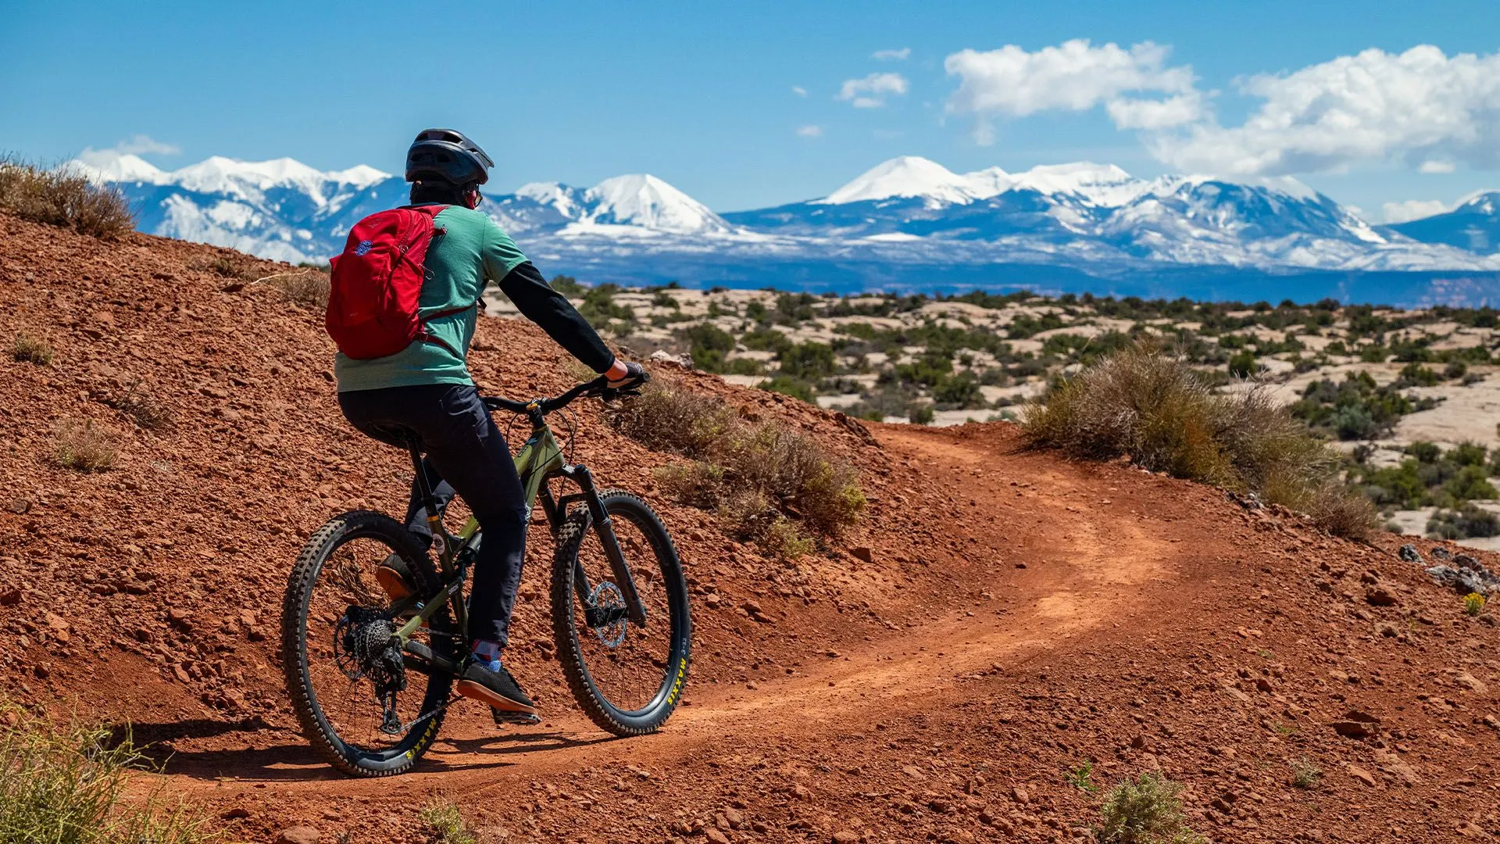
Mountian Biking
Moab, Utah

Slide 2
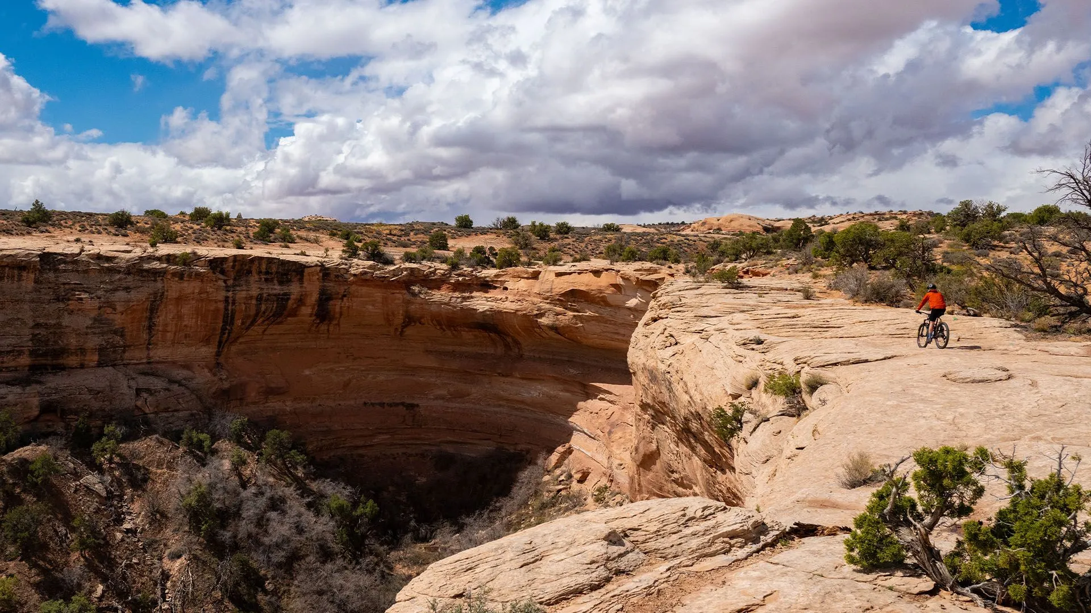
Adventurous Trails!
Trails range from easy scenic rides to the ultimate in challenging slickrock trails, providing opportunities for all to experience the beauty and solitude of a mountain biking adventure.

Slide 3
Why Mountain Bike Moab, Utah?
Way | Price
A | 230
B | 218
C | 192
D | 170

Slide 4
Most Popular
Trail Name | Route Map | Elevation | Terrain | Difficulty
1. Navajo Rocks | 17 miles | 5,606 ft. | All-mountain, downhill | Intermediate to Advanced
2. Slickrock | 5 miles | 4,623 ft. | Lots of Slickrock | Beginner to Intermediate
3. Whole Enchilada | 34 miles | 11,126 ft. | Everything! | Difficult to Expert
4. Captain Ahab | 4 miles | 4,689 ft. | Slickrock, ledges and dirt. | Intermediate to Advanced
5. Klondike Bluffs | 64 miles | 5,347 ft. | Singletrack, non-motorized trails | Beginner to Advanced

Slide 5
Other Activities
Rafting
Jeeping
Hiking
Canyoneering
Photography

