Slide 1
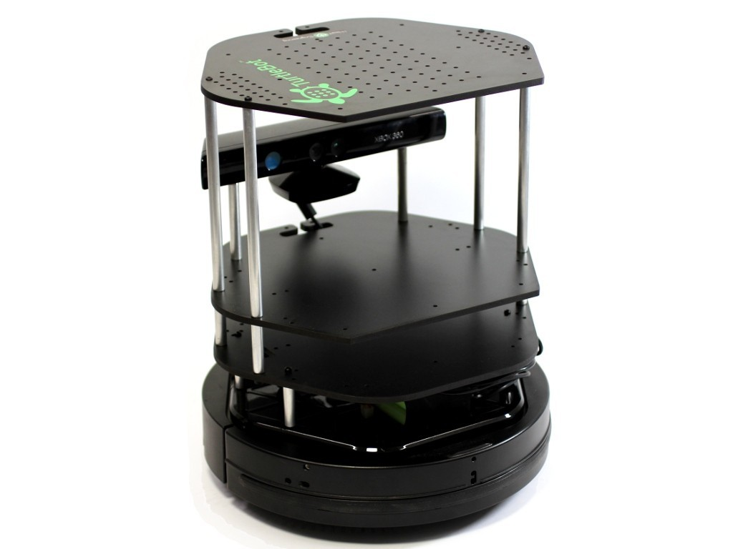
Occupancy Grid Map Generation from ORB-SLAM Map Points and Image Segmentation for
Autonomous Robot Navigation
Nhat Nguyen, Shrimanti Ghosh
University of Alberta

Slide 2
The Task
Denser 2D occupancy grid map generation from using ORB-SLAM map points
Path planning and autonomous robot navigation using that dense 2D grid map

Slide 3
Literature Review
ORB-SLAM paper by Raul Mur-Artal et al. (2015). The system consists of 3 parallel working threads; tracking, local mapping, loop closure.
Andre M. Santana et.al. (2011) presented an approach using planar information (homography matrix) to build a visual 2D occupancy grid map from monocular vision.
Hirschmüller et al. (2015) applied Computer Vision for mobile robot navigation.
Ghazouani et.al. (2010) used stereo vision using 3D grid map to navigate the robot.
Stephen Se et al. (2001) proposed a vision-based mobile robot localization and mapping algorithm that uses scale-invariant image features as landmarks in unmodified dynamic environments.
Felzenszwalb, Pedro F., and Daniel P. Huttenlocher. (2004) "Efficient graph-based image segmentation”.

Slide 4
Common Components
Novel Components

Slide 5
Common Components
Review literature on generation of grid map for mobile robotics
Installation of ORB-SLAM
Camera Calibration
Reproduction of results on KITTI dataset (Sequences 00 and 05) and TUM RGB-D SLAM dataset (fr3_walking_halfsphere) using ORB-SLAM
Production of 2D grid map using ORB-SLAM map points
Map visualization and robot navigation in Rviz

Slide 6
Novel Components
Created our own dataset (2nd floor, square rooms...) and build the map of these dataset.
  Will show in demo.
The maps are built live and in real time: Write Map Points of each Keyframe to files + Use some kind of atomic file reading programming technique.
  Not using ROS publisher/subscriber because we want to save the map points for later use.
  Can run in real time when building the map using only the points from ORB-SLAM.
  When use the generated extra map points, run time depend on the number of extra map points.
Use graph based image segmentation to create extra map points and make the map denser.
  Allow us to improve the quality of occupancy grid map.
  Will show how to create extra map points in later slides.

Slide 7
Create extra map points based on image segmentation
Idea: Populate the map with extra points in addition to key points (map points) from ORB-SLAM

Slide 8
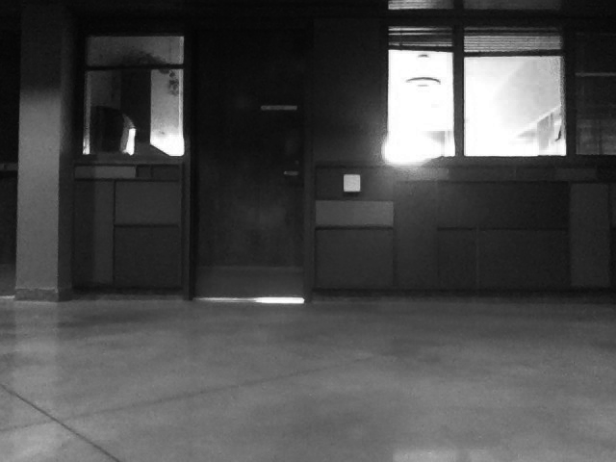

Slide 9
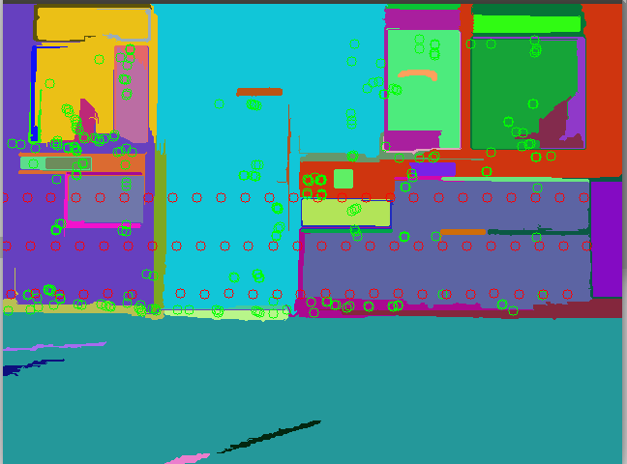
Green:
ORBSLAM
Map Points
Red:
Extra Map Points

Slide 10
Create extra map points based on image segmentation
Step 1: Segment the image into parts P₁, P₂,..., P_{N}
Step 2: Find 3D plane equation of each part P_{k}. Treat each part P_{k} as a 3D plane. For each P_{k} that contains at least 3 map points, find the best fitting plane equation for P_{k}.
Step 3: Choose some pixels in the image. Convert these pixel coordinates to 3d coordinates of extra map points.

Slide 11
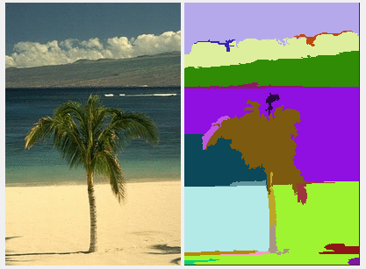
Create extra map points based on image segmentation
Step 1: Segment the image into parts P₁, P₂,..., P_{N}
Graph Based Image Segmentation
All points in each part usually
belongs to a planar surface.
Felzenszwalb, Pedro F., and Daniel P. Huttenlocher. "Efficient graph-based image segmentation." International journal of computer vision 59.2 (2004): 167-181.

Slide 12
Create extra map points based on image segmentation
Step 2: Find 3D plane equation of each part P_{k}. Treat each part P_{k} as a 3D plane. For each P_{k} that contains at least 3 map points, find the best fitting plane equation for P_{k}. -> Some part will not have plane equation (these will be ignored)
How to find best fitting plane equation for these map points?
-> Principal Component Analysis on 3D map points.
After doing PCA: Choose eigenvector with smallest eigenvalue as normal vector for the best fitting plane equation.

Slide 13
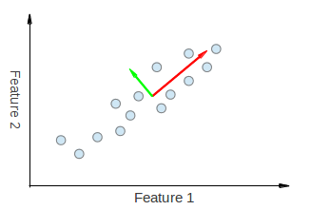
Create extra map points based on image segmentation
Eigenvectors = Directions of difference in data
Eigenvalues = Magnitude of difference
Eigenvector with smallest eigenvalue =
Direction of small difference/error
-> Best fitting plane will have this
eigenvector as normal vector
Notes:
PCA will basically decompose our data into direction with the first direction has the most error, the second direction has second greatest error… and so on, the last direction has the least error in the data.

Slide 14
Create extra map points based on image segmentation
Step 3: Choose some pixels in the image. Convert these pixel coordinates to 3D coordinates of extra map points.
Choose pixels: Pixels are chosen in a grid, in a the middle rows of the image where most obstacles are. Pixels rows are shifted a little bit based on location so that we cover as most 2D Oxz coordinates as possible.
Convert pixel coordinates to 3D coordinates:
  Based on the best fitting plane equations.

Slide 15
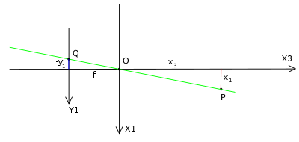
Create extra map points based on image segmentation
How to convert pixel coordinates to 3D world coordinates?
Pixel coordinate: (u, v). Need to convert to 3D point P(x^, y^, z^).
Check the segmentation to know which part P_{k*} pixel (u, v) belong to.
3D points that this pixel coordinate represents will be the intersection between the projection line and a best fitting plane of P_{k*}.
If the part (u, v) belong to does not have a plane equation, ignore this pixel

Slide 16
Create extra map points based on image segmentation
P(x^, y^, z^) belong to one projection line:
-> x^ = (u - cx) * z^ / fx, y^ = (v - cy) * z^ / fy
After this, substitute x^, y^ based on z^ into [x^, y^, z^, 1] and multiply it with camera-to-world-matrix T
P(x^, y^, z^) belong to a plane with plane equation of:
a * x + b * y + c * z + d = 0
We have 3 equations for x^, y^, z^. Solve them, we get x^, y^, z^

Slide 17
Observation on the extra map points
3D coordinates of the pixel are quite accurate.
Only contains “ordinary” points, no special points.
  Good for making the map denser when there are few ORB-SLAM points
  Not good for generating map extra information on the structure of the world

Slide 18
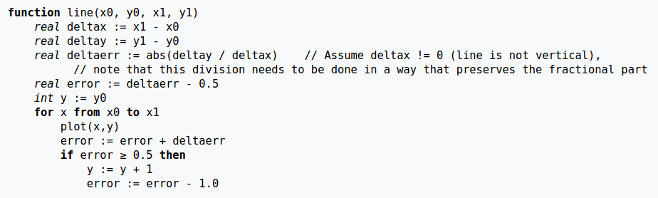
Generate Dense Occupancy Grid Map from Map Points (+ Extra Points)
Use 3D Bresenham’s Line Drawing Algorithm to update occupied and counts.
Remove noisy points using a 3x3 average convolution, thresholding based on counts

Slide 19
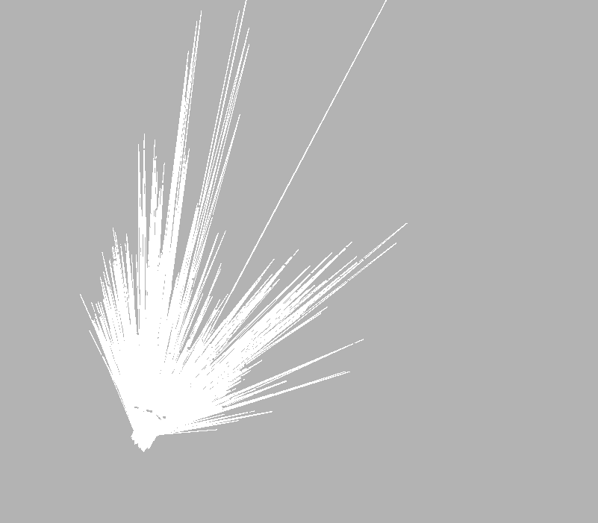

Result - TUM

Slide 20
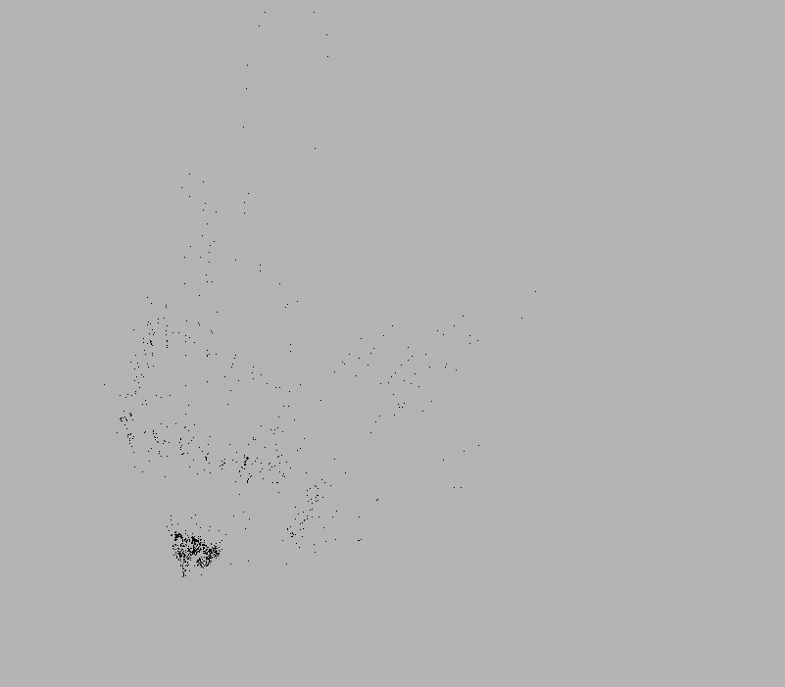
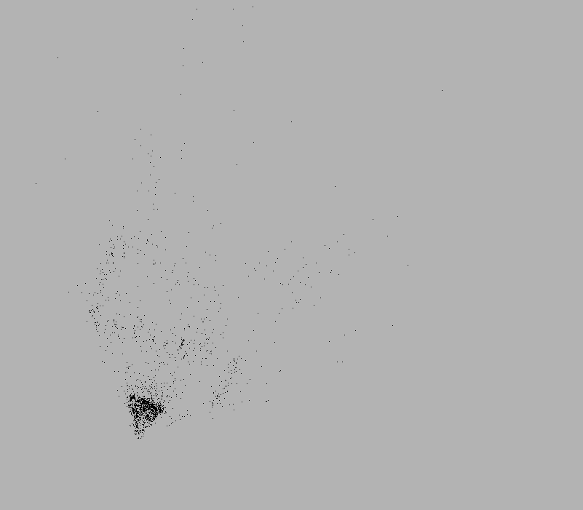
Result - TUM

Slide 21
Results - 2nd floor of CSC
Purposely threshold the map based on visit counts: Only pixels that have been visited more than 10 times are marked as occupied or unoccupied.
  Remove unwanted noisy points
  Also allow us to test the effect of our extra points on the map.

Slide 22

Results - 2nd floor of CSC
No Thresholding

Slide 23
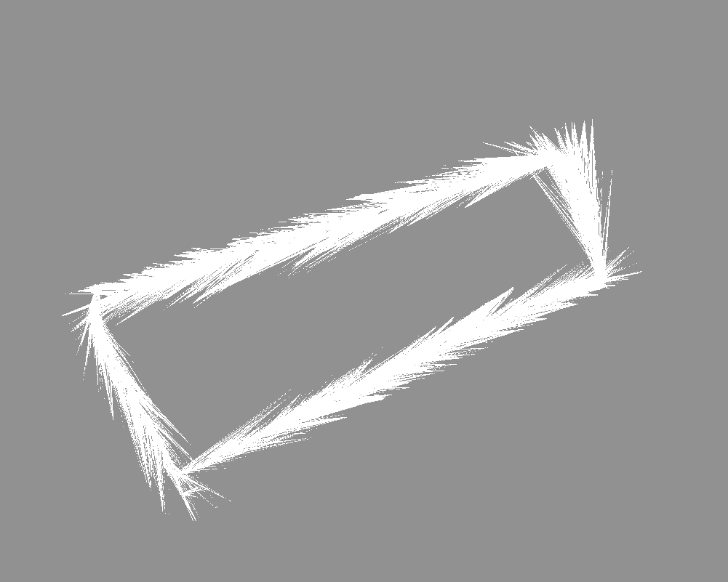
Results - 2nd floor of CSC
With Thresholding

Slide 24

Results - 2nd floor of CSC
With Thresholding
+
Extra Points

Slide 25
Results - 2nd floor of CSC
Extra map points are useful to improve the quality of the map
  Allow us to remove noisy and unwanted points while still keeping the map accurate and navigable by interpolating more points.

Slide 26
Demo
Build the map live
  Show segmentation + Extra points
Map visualization & Robot Navigation in Rviz
  Use the other old map that we generated.
  To demonstrate that we can navigate.

Slide 27
References
[1] Raul Mur-Artal, J. M. M. Montiel, and Juan D. Tardos. "ORB-SLAM: a Versatile and Accurate Monocular SLAM System". In: CoRR abs/1502.00956 (2015). url: http://arxiv.org/abs/1502.00956.
[2] Georg Klein and David Murray. "Parallel Tracking and Mapping for Small AR Workspaces". In: Proc. Sixth IEEE and ACM International Symposium on Mixed and Augmented Reality (ISMAR'07). Nara, Japan, Nov. 2007.
[3] Christian Forster, Matia Pizzoli, and Davide Scaramuzza. "SVO: Fast semi-direct monocular visual odometry". In: Robotics and Automation (ICRA), 2014 IEEE International Conference on. IEEE. 2014, pp. 15-22.
[4] Jakob Engel, Thomas Schops, and Daniel Cremers. "LSD-SLAM: Large-scale direct monocular SLAM". In: Computer Vision{ECCV 2014. Springer, 2014, pp. 834-849.
[5] Andre M. Santana et.al., “An Approach for 2D Visual Occupancy Grid Map Using Monocular Vision”, ENTCS, 2011.
[6] Hirschmüller et.al., “Computer Vision for Mobile Robot Navigation”, 2015.
[7] Haythem Ghazouani et.al., “Robot Navigation Map Building Using Stereo Vision Based 3D Occupancy Grid”, JAITA, Hyper Sciences, 2011.
[8] G. Macesanu et.al., “Computer Vision based Mobile Robot Navigation in Unknown Environments”, 2010.
[9] Stephen Se et.al., “Vision-based Mobile Robot Localization And Mapping using Scale-Invariant Features”, Robotics and Automation, 2001.
[10] Felzenszwalb, Pedro F., and Daniel P. Huttenlocher. "Efficient graph-based image segmentation", International journal of computer vision 59.2 (2004): 167-181.

Slide 28

Thank you!

