Slide 1
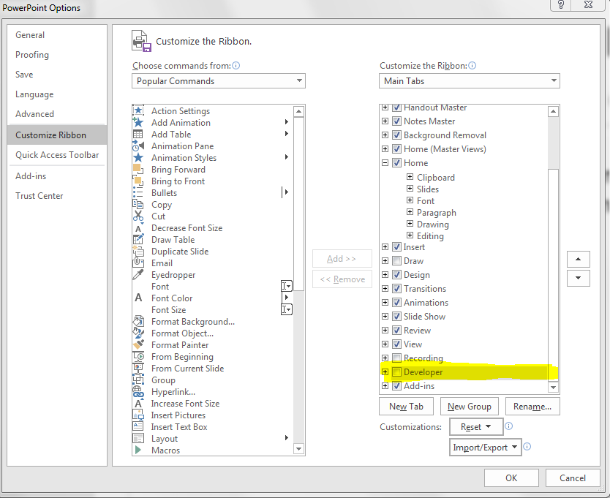
Social Rings Macro Tutorial
100%
75%
25%
To enable macro on PowerPoint.
  Click File >> Options >> Customize Ribbon
  On the second column, scroll to the bottom and check “Developer”
  “Developer” tab will now appear next to “View” tab
50%

Slide 2
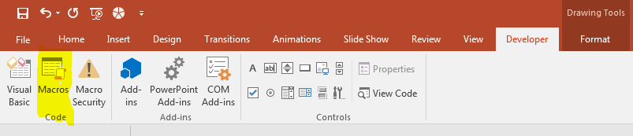
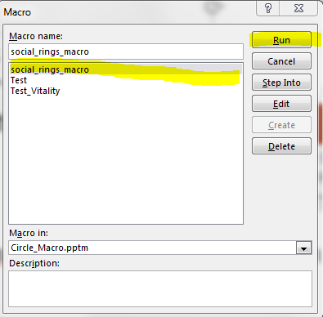
Social Rings Macro Tutorial
100%
75%
25%
To run the social rings macro
  Always keep this PowerPoint file open.
  Click on the “Developer” tab on the top of the screen, next to the “View” tab
  Click on the “macro” button
  Choose “social_rings_macro” and click on “Run” – an interface will appear
50%

Slide 3
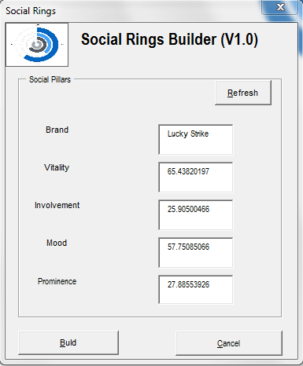
Social Rings Macro Tutorial
100%
75%
25%
How to use the social rings macro’s interface
  Just fill in all the pillar scores and brand name in the
  textboxes and click “Build” – that’s it!
  Click “Refresh” if you need to clear data from textboxes
50%

