Slide 1

BookWorm
A Python-Based Library Management System
CCGC 5003 • Phase 4 Demo

Slide 2
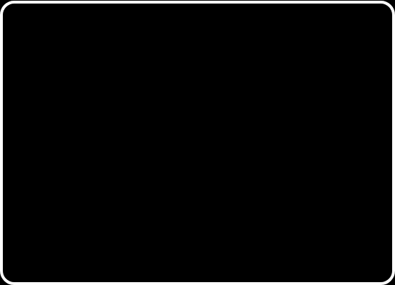

Project Overview
THE MISSION
Streamlining Library Ops
BookWorm is a full-stack application designed to modernize the tracking of books, members, and loans.
THE TECH STACK
•
Backend: Python & Django Framework
•
Database: MySQL (Relational Schema)
•
Frontend: HTML5, CSS3, Bootstrap
•
Payment: Stripe API Integration

Slide 3
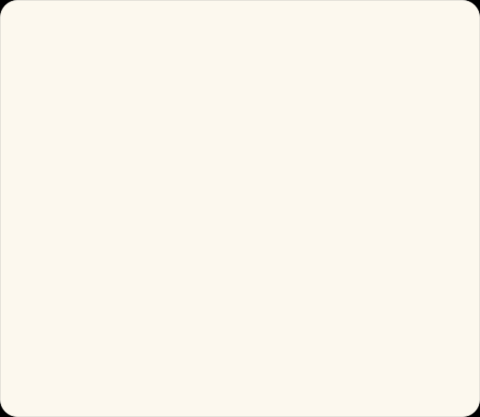
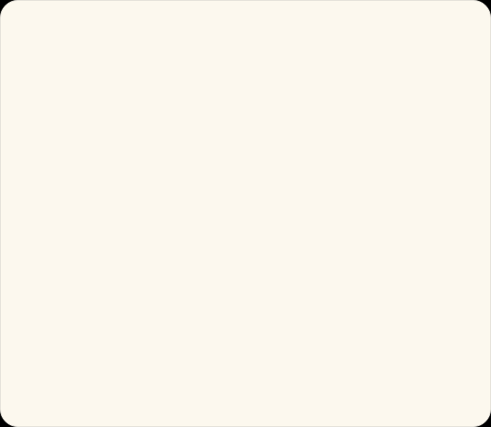
Scenario Implementation
CORE FEATURES
ADVANCED FEATURES
The foundation of the system, established in Phases 1-3.
New capabilities introduced in the final Phase 4 integration.
•
New Member Registration
•
Stripe Payment Processing
•
Book Check-Out & Return
•
Automated Email Notifications
•
Real-time Catalog Search
•
Dynamic Inventory Management
•
Fine Calculation Logic
•
Member Loan History & Dashboard

Slide 4

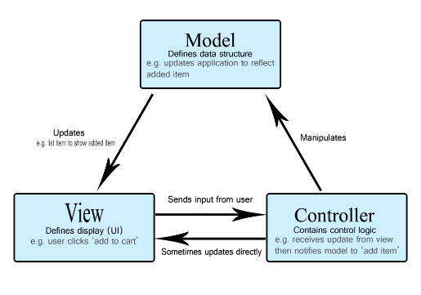
System Architecture
MVT Pattern
We utilized Django's Model-View-Template architecture to ensure modularity and security.
•
Model: 5 SQL Tables (Members, Books, Authors, Loans, Fines) defining the data structure.
•
View: Python logic in views.py handling business rules (e.g., date math for due dates).
•
Template: Dynamic HTML rendering user data using Django Template Language (DTL).

Slide 5
Live Demo
Switching to Application...
Scenarios 1-10

