Slide 1
Human Resources Management System
Class Name: SE1302
Group Name:Group 1
Member: Nguyen Hoang Minh

Slide 2
Objectives
1. Objective
This system is designed with the purpose of making human resource management easier.
It can manage volatility, learn everything about employees and jobs, the candidates applying to the business.
For employers, this is a system that makes work more stable and easier
For applicants, necessary information and tasks can be quickly updated

Slide 3
Introduction to Project
2. Introduction
This system will provide some basic features including: display CV, display employee and search for CV, employee
In addition, there are other extra features such as notification jobs open, filt candidate by CV

Slide 4
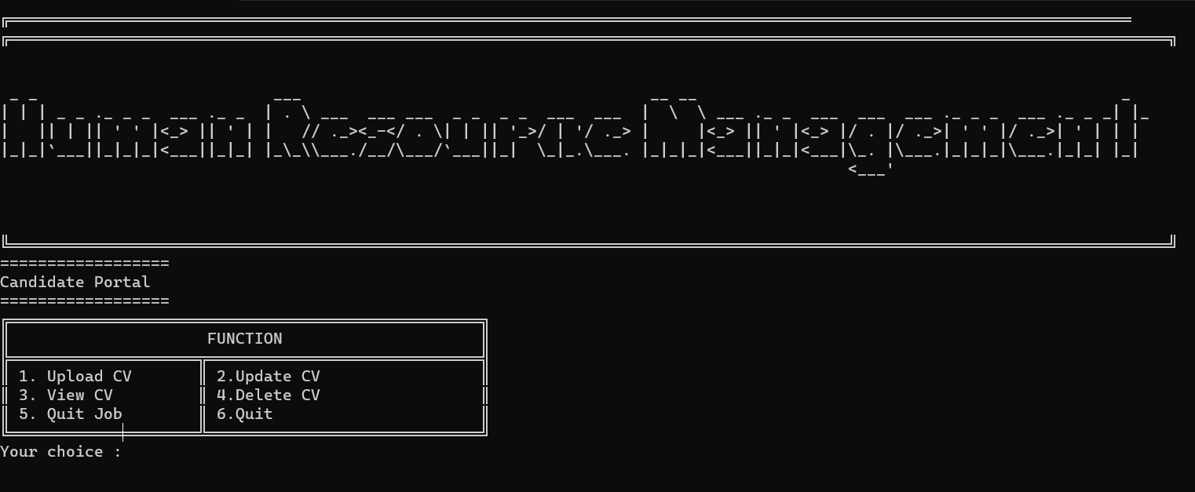
Customer Requirements
Intension
H1. Menu Candidate
- The system provides customers with a friendly interface, easy to use, can easily search for products and order, store customer information and purchase history.

Slide 5
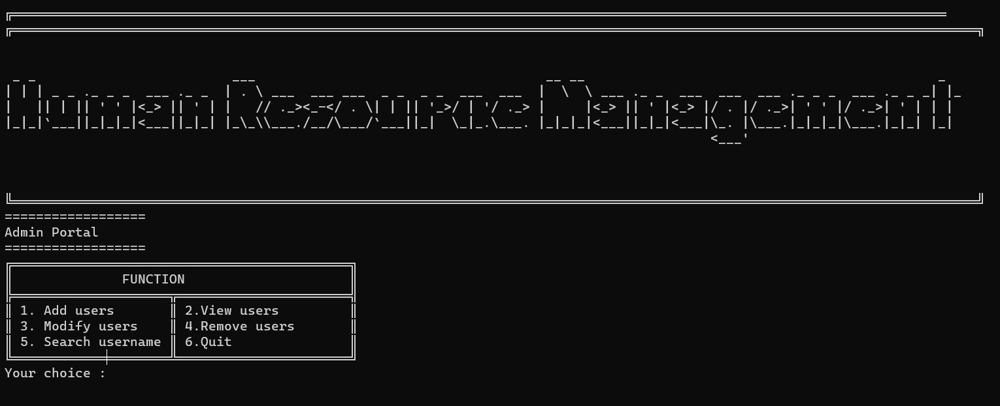
Staff Requirements
H2. Menu Staff
Intension
- The system provides admin with a friendly interface, easy to use, can easily search for jobs and apply, store candidate information

Slide 6
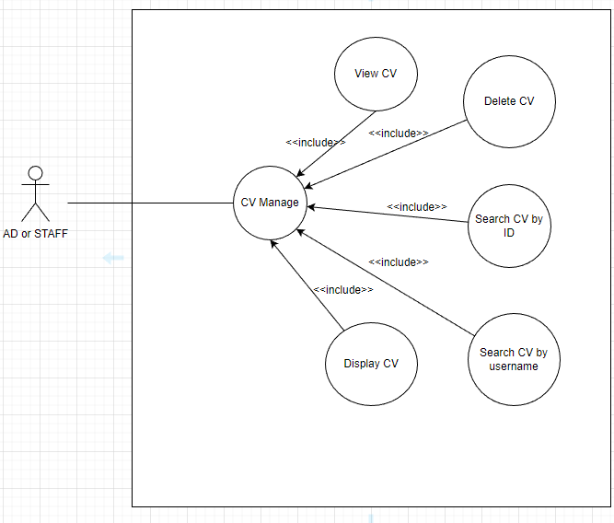
Use Case
- Admin or Staff
After login the administrator or staff account has the following functions:
- Account manage
- CV manage
- Staff information manage
- Team manage
- Recruitment plan manage

Slide 7
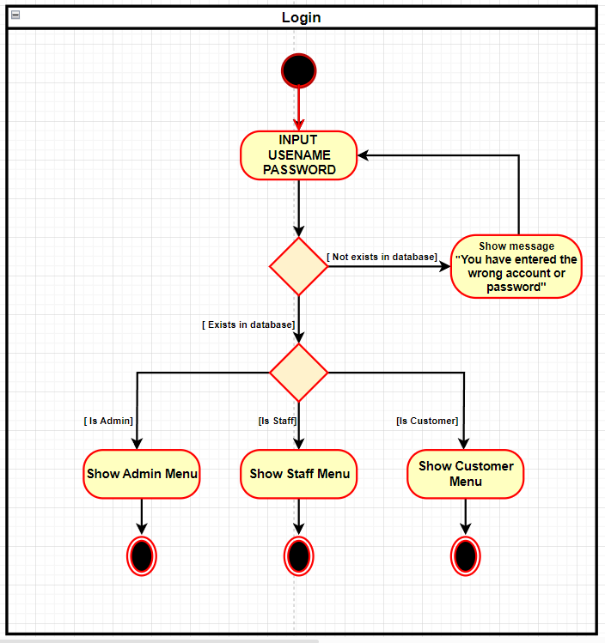
Activity Diagram

Slide 8
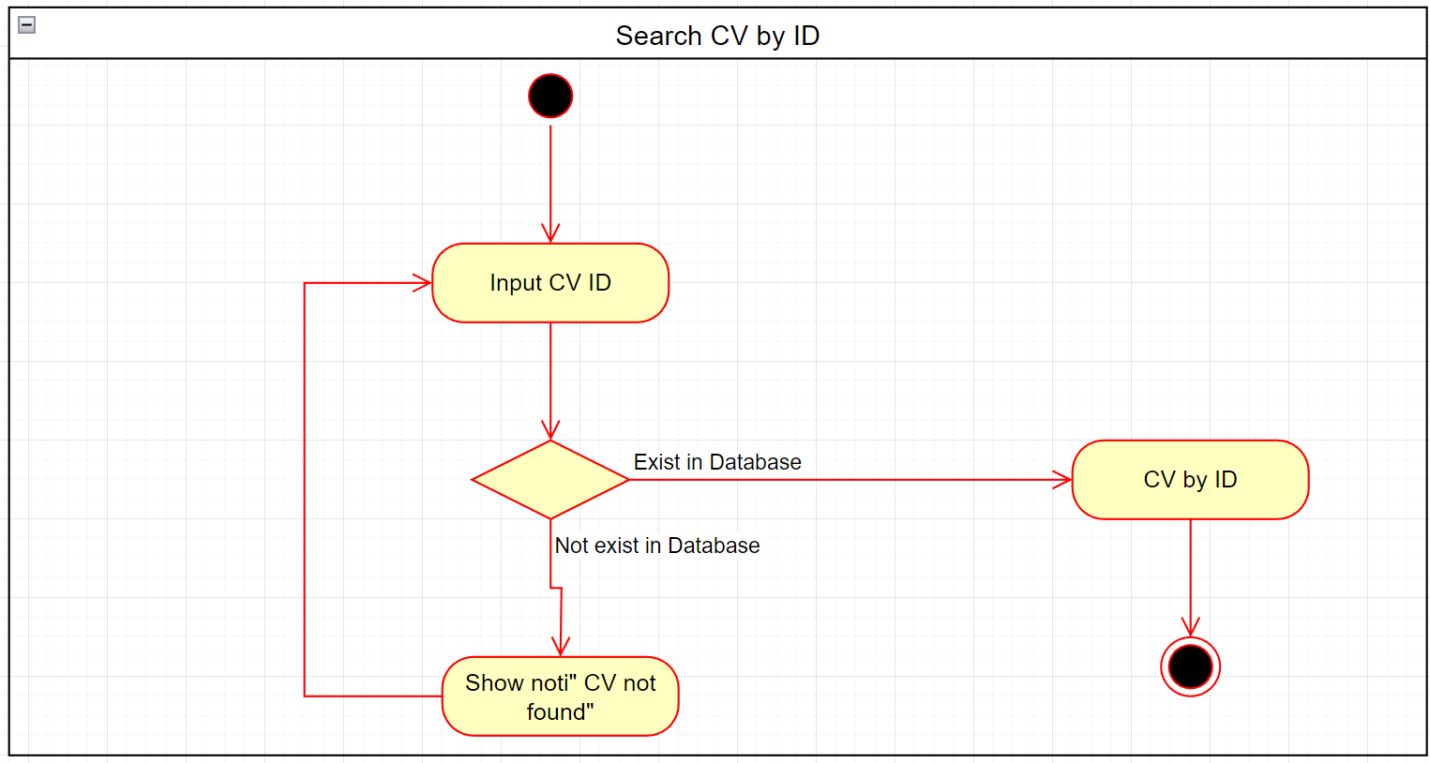
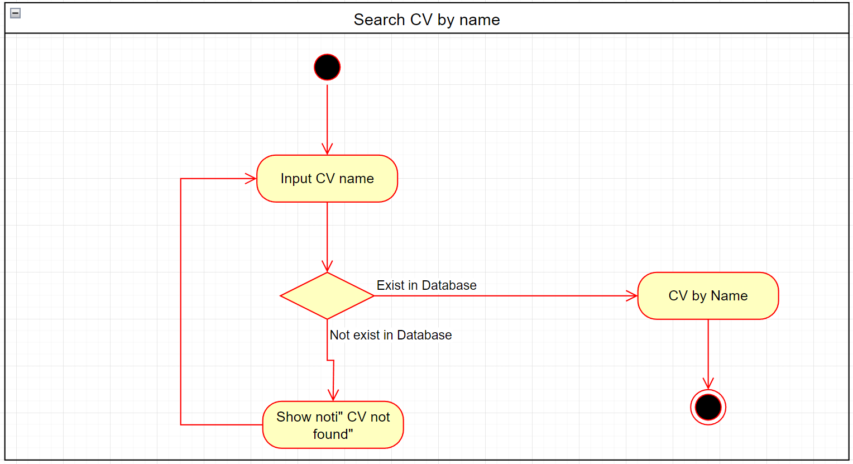
Activity Diagram

Slide 9
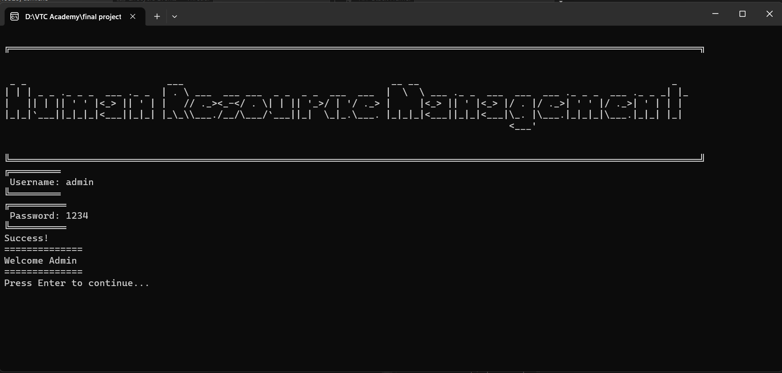
UI Design

Slide 10
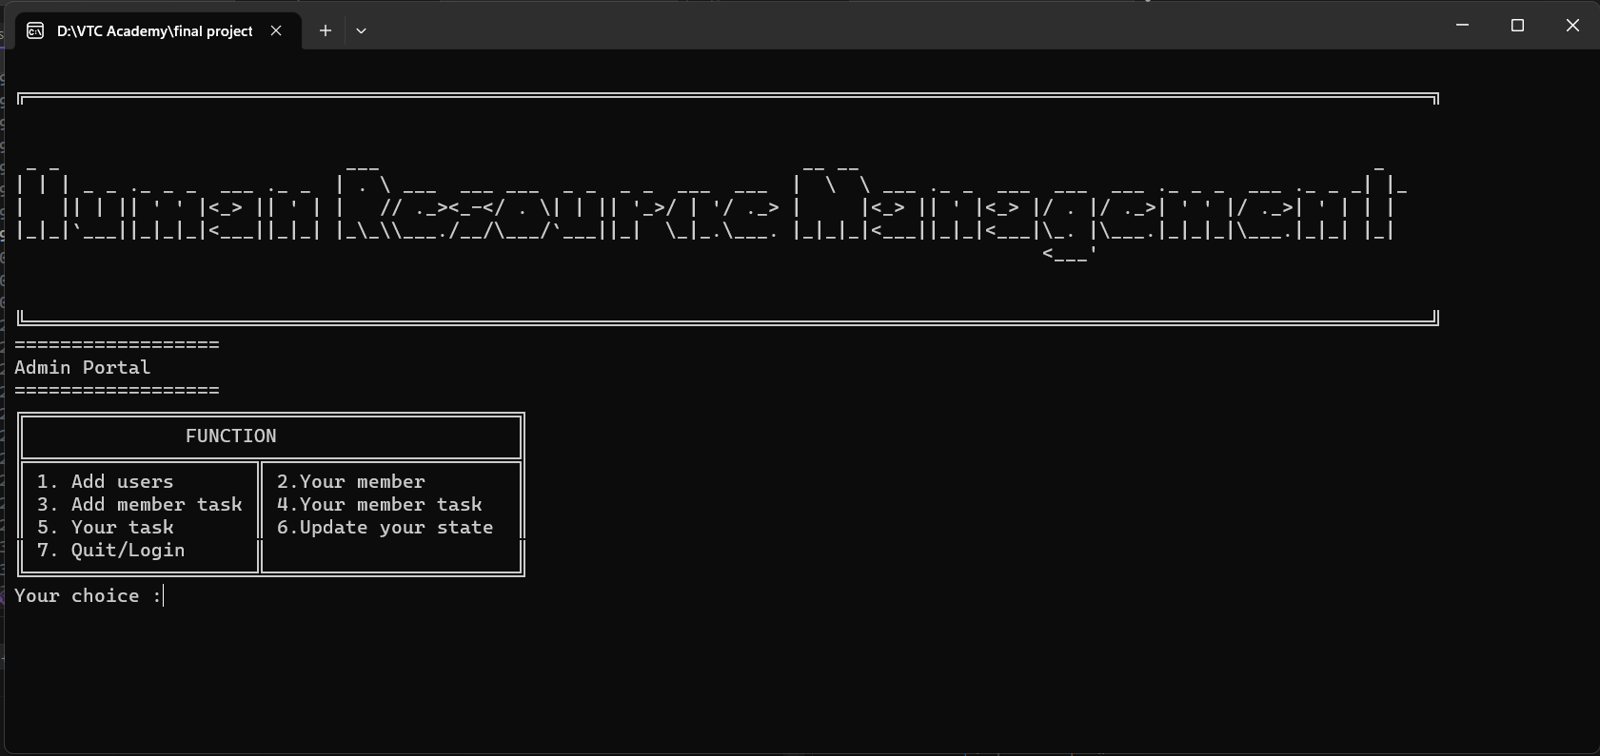
UI Design

Slide 11
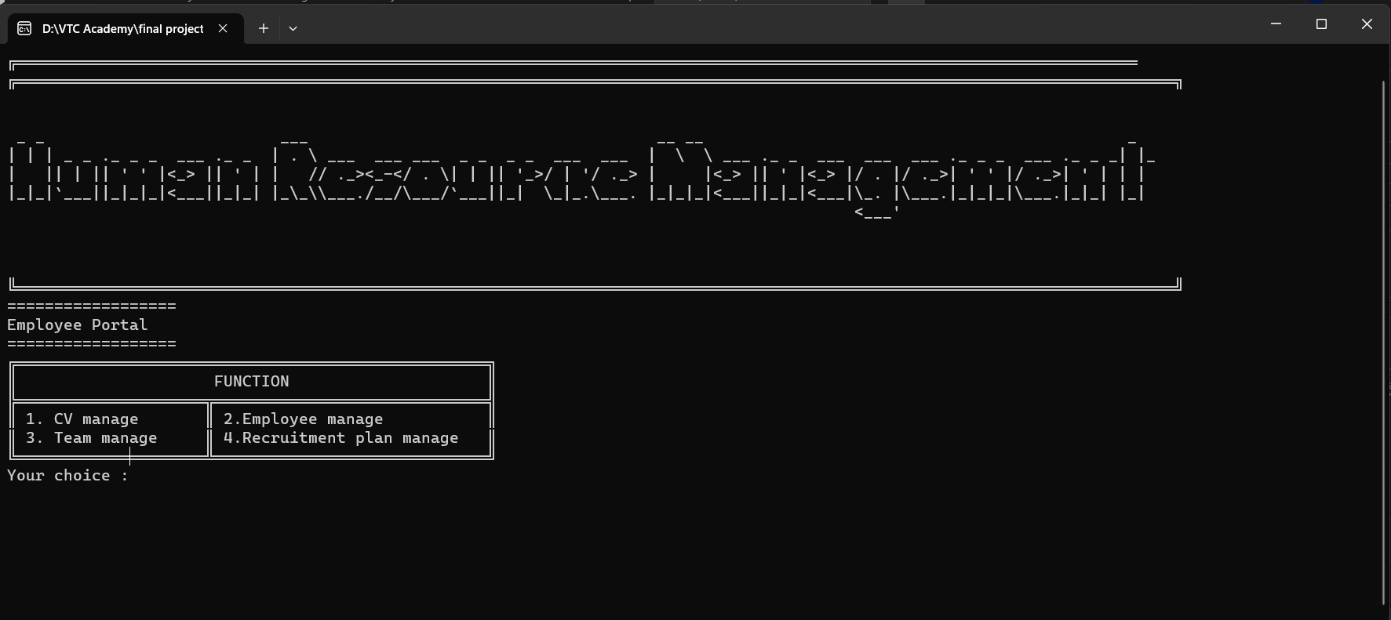
UI Design

Slide 12
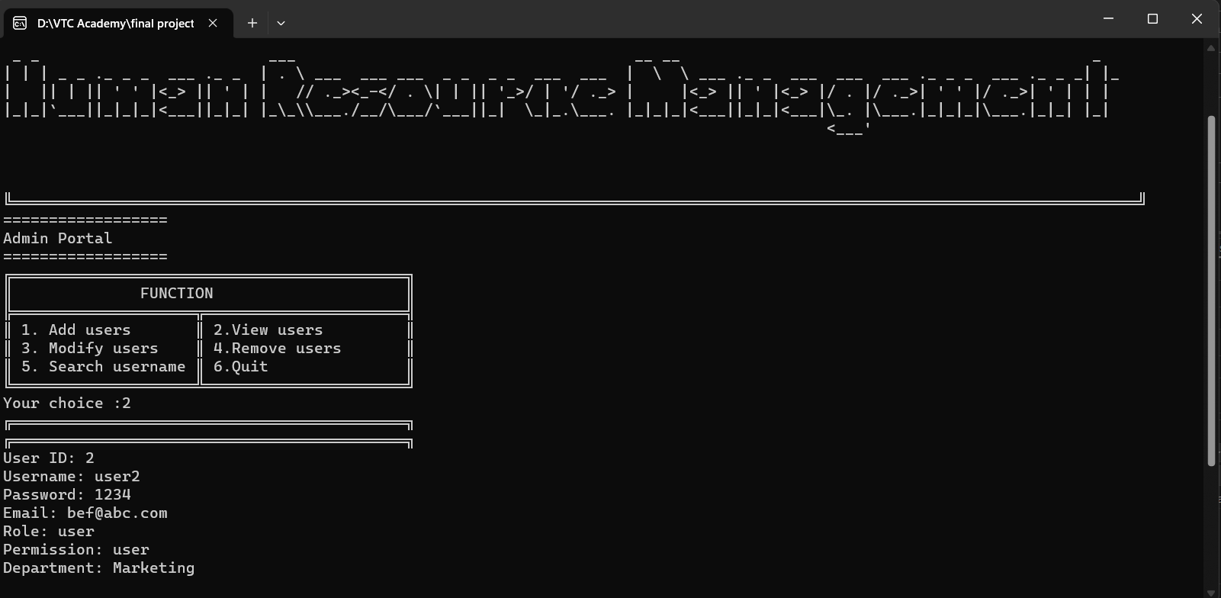
UI Design

Slide 13
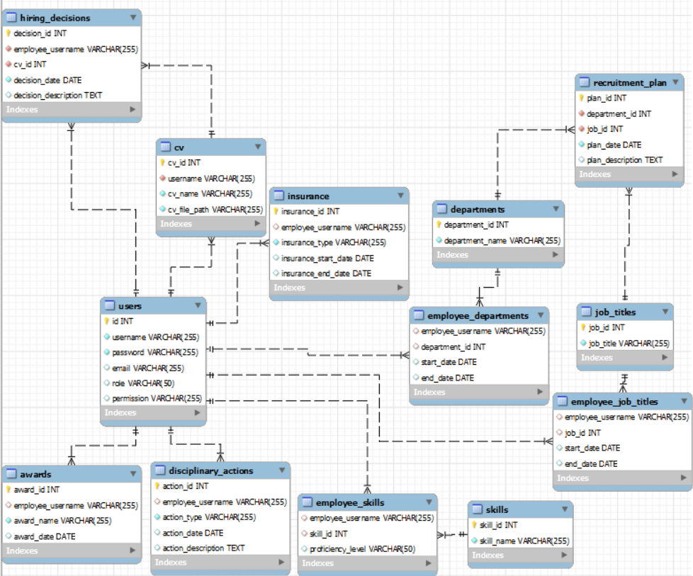
Class Diagram

Slide 14
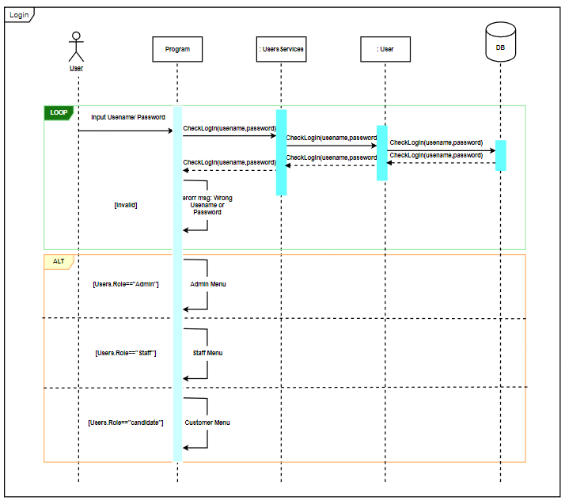
Sequence Diagram

Slide 15
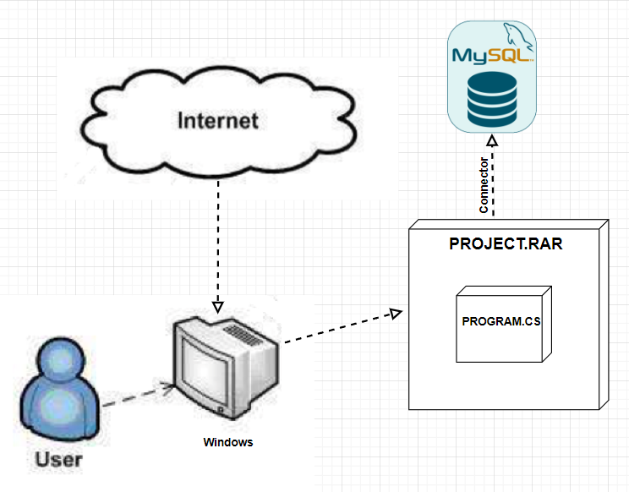

Deployment Diagram
11. Deployment Diagram

Slide 16
Experience Learned
13. Experience Learned
Data structures: Arrays, linked lists, trees, graphs.
Algorithms: Searching, sorting, recursion, dynamic programming.
Object-Oriented Programming: Classes, objects, inheritance,
polymorphism, encapsulation, abstraction.
Knowledge of network programming: TCP/IP, HTTP protocols.
Communication and data transmission over networks.
Relational Database Management Systems (RDBMS).
Creating, querying, updating, and deleting data from databases.
Relationships, SQL queries, optimization, and security.
Object-Oriented Analysis & Design (OOAD).
Requirements analysis, class diagrams, sequence diagrams, state diagrams.

Slide 17


Slide 18
Q & A

