Slide 1
數位IC設計
Introduction
陳培殷, Pei-Yin Chen, 國立成功大學資訊工程系
pychen@csie.ncku.edu.tw

Slide 2
Outline
Chapter 1: Introduction
Chapter 2: Semi Custom Design Flow
Chapter 3: RTL Coding-Part I
Chapter 4: RTL Coding-Part II
Chapter 5: Digital System Design
Chapter 6: Control Unit
Chapter 7: Datapath
Chapter 8: Case Study
Chapter 9: System on a Chip
Chapter 10: Low-Power Design

Slide 3
Hardware Implementation
Methods and Algorithms are used to solve some specific problems.
Methods or Algorithms can be implemented with
Hardware processor + suitable software programs (flexibility)
a. Pentium IV + suitable software programs (high-level language)
b. TI-DSP + suitable software programs
c. MCU(8051) + suitable software programs (low-level language)
Dedicated hardware circuits (faster)
a. old_PCBs (TTL SSI, MSI chips and wires)
b. new_PCBs(some devices, application specific integrated circuit-ASIC, wires)
Some hardware circuits + software programs (to solve more complex problems)
a. System on a board (memory, processor, ASIC, I/O, other devices)
b. System on a chip (SoC)
current and future work
memory
CPU
PCI
USB
UART
IEEE 1394
ASIC
I/O
RISC-ARM
ASIC

Slide 4
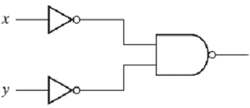
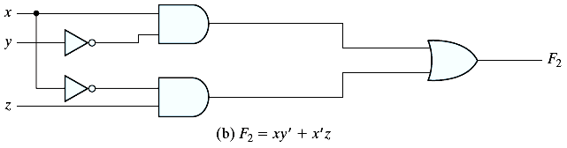
Digital System
input
digital circuit
0
1
1
0
digital circuit
digital circuit
digital circuit === IC (integrated circuit)
semiconductor

Slide 5
Circuits
Transistor
Gate ( 1 gate ~= 2~14 transistors)
A combination of interacting transistors
Circuit
A combination of interacting gates designed to accomplish a specific logical function
IC (Integrated Circuit)
System➔ PCB (printed circuit board)
SoC (system on a chip)

Slide 6
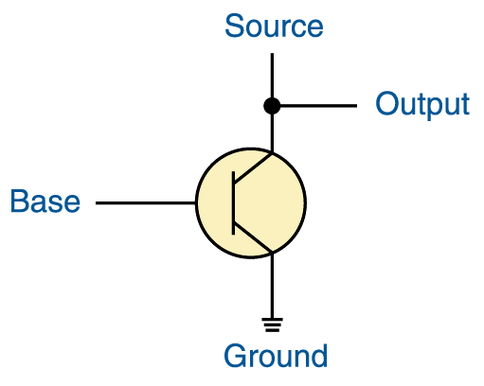
Transistor(電晶體)
+5 volts
A transistor has three terminals
  A source (feed with 5 volts)
  A base
  An emitter, typically connected to a ground wire
If the base signal is high (close to +5 volts), the source signal is grounded and the output signal is low (0). If the base signal is low (close to 0 volts), the source signal stays high and the output signal is high (1)

Slide 7
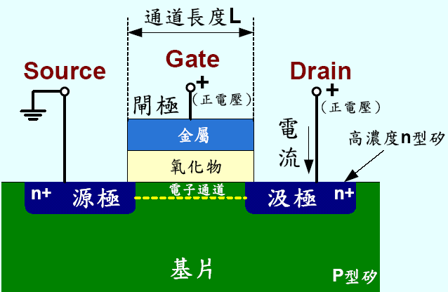
N-channel MOS Transistor
Transistor (電晶體)– Semiconductor(半導體)

Slide 8
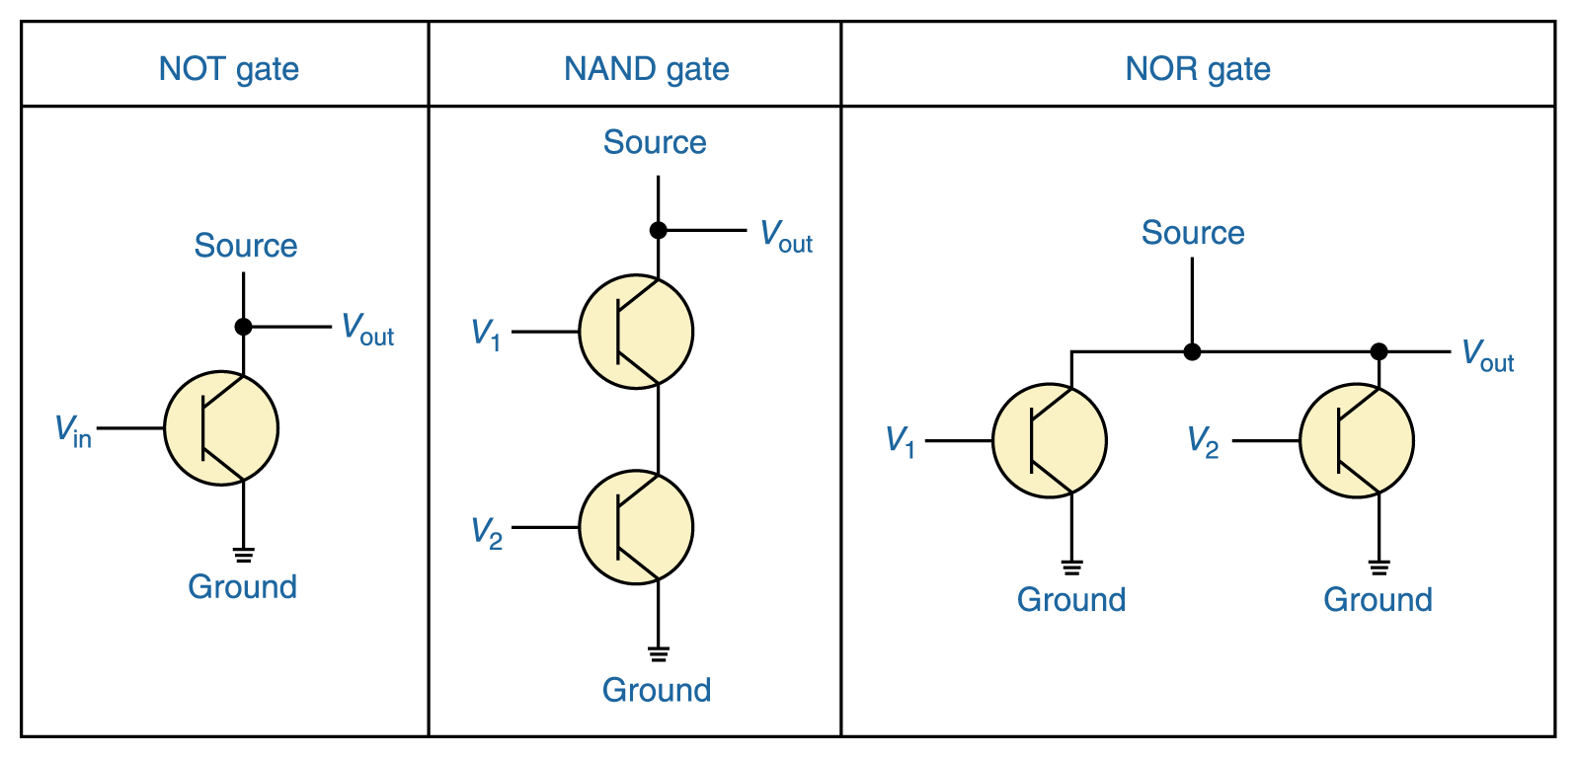
Constructing Gates (semiconductor)
It turns out that, because the way a transistor works, the easiest gates to create are the NOT, NAND, and NOR gates
V₁ V₂ V_{out}
0 0 1
0 1 1
1 0 1
1 1 0
V₁ V₂ V_{out}
0 0 1
0 1 0
1 0 0
1 1 0
V_{in} V_{out}
0 1
1 0

Slide 9
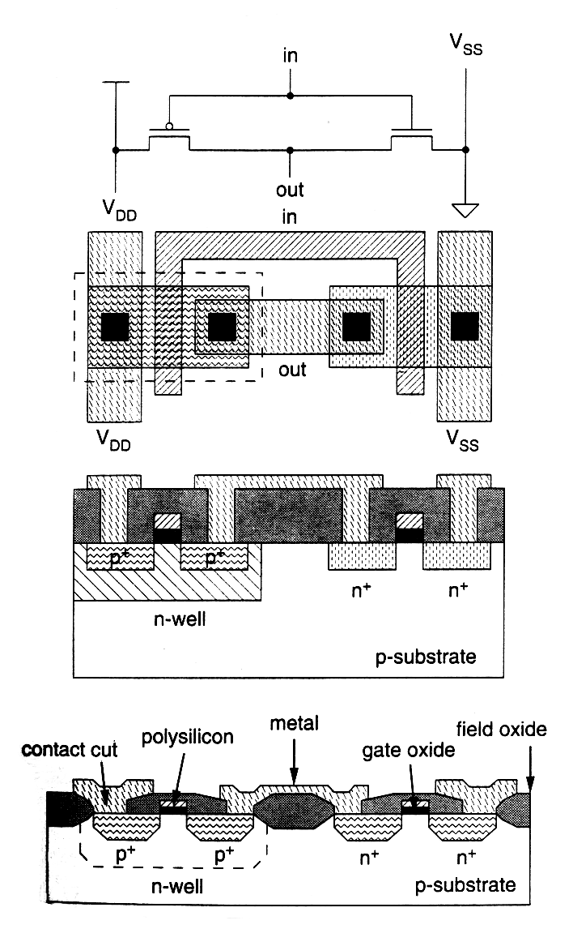
IC Design (with CMOS)
CMOS Inverter
in
out
One npn transistor
and one pnp transistor
are used to construct
one inverter.
done by
chip designer
masking
done by
TSMC, UMC
Packing, Testing

Slide 10
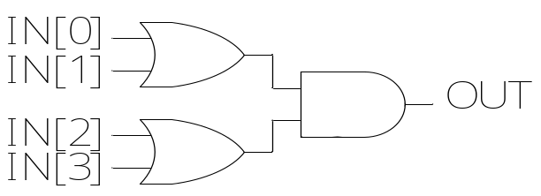
Design Entry for VLSI System
Choose the design entry method:
Schematic
    Gate level design
    Intuitive & easy to debug
    HDL (Hardware Description Language)
    Descriptive & portable
    Easy to modify
    Mixed HDL & Schematic
    …
  always @(IN)
  begin
  OUT = (IN[0] | IN[1]) & (IN[2] | IN[3]);
  end

Slide 11
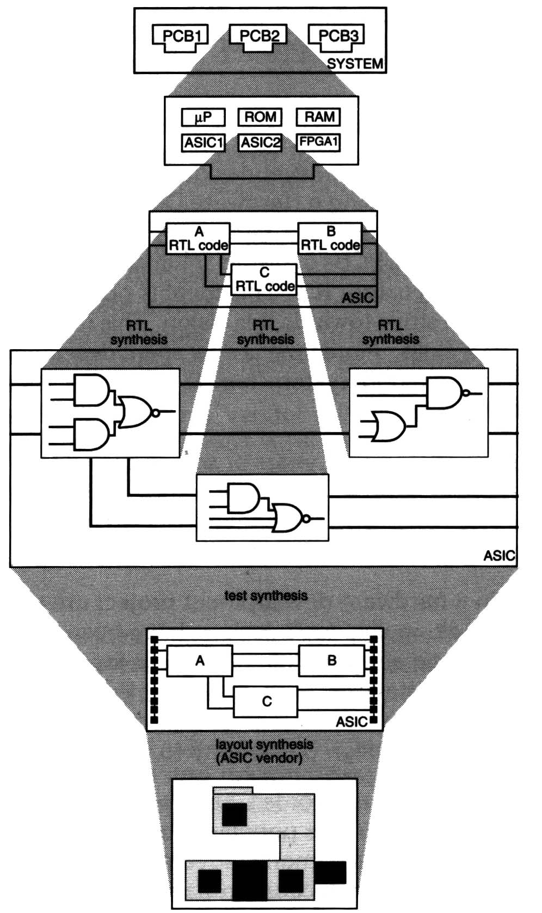
Hierarchical Components in PCB
Describe the circuits with
Hardware Description Language
(HDL硬體描述語言)
2. Synthesis (合成) the circuits
….
application specific integrated circuit
(ASIC晶片)
IC or chip

Slide 12
IC Design (with CMOS)
done by
chip designer
(半客戶設計)
+
Related software tools
Semi-custom design
Cell-based design
CMOS Inverter
in
out
done by
chip designer
(全客戶設計)
Full-custom design
One npn transistor
and one pnp transistor
are used to construct
one inverter.
masking
done by
TSMC, UMC
Packing, Testing

Slide 13
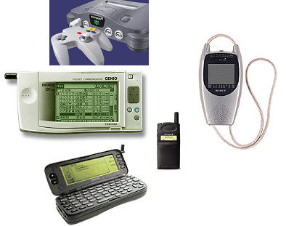
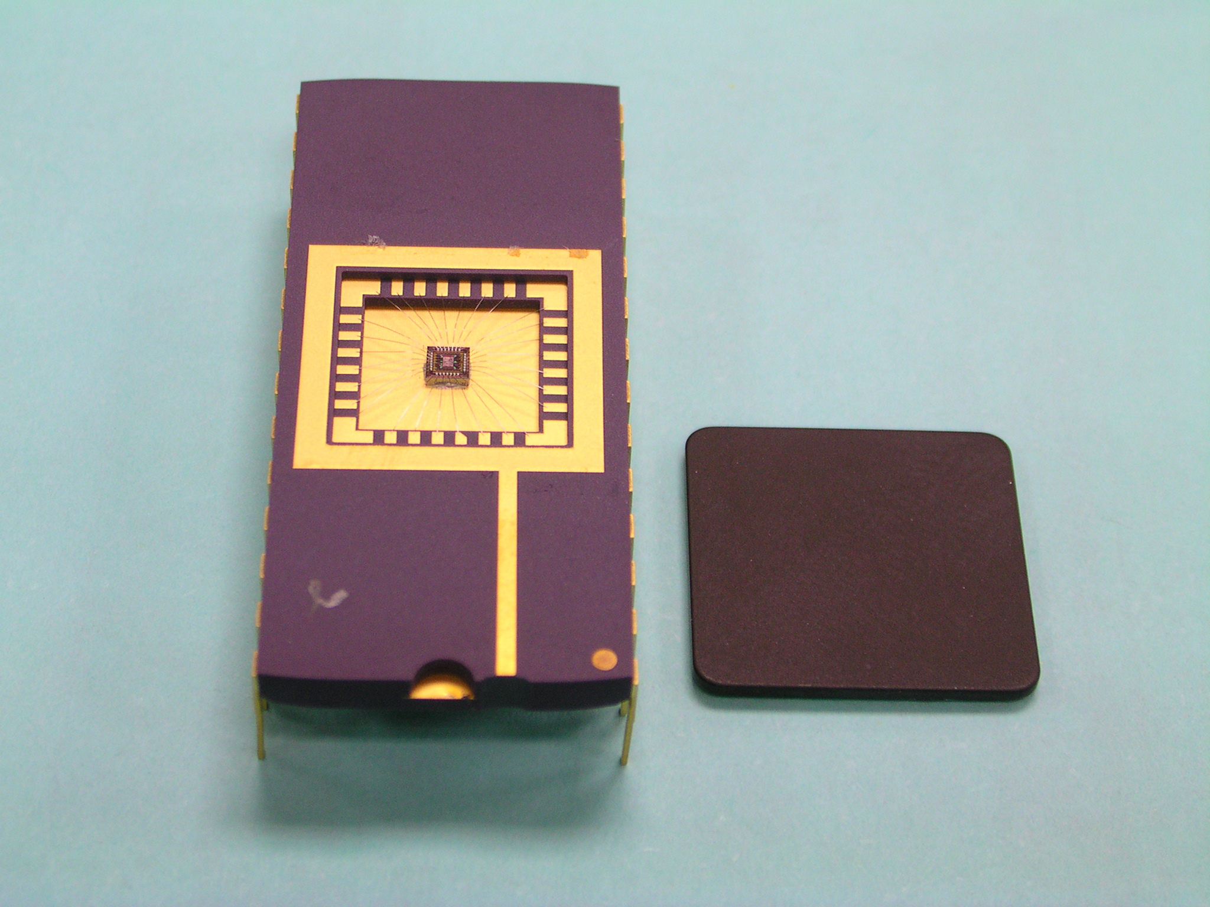
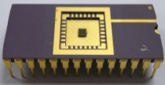


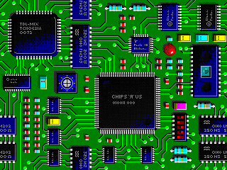
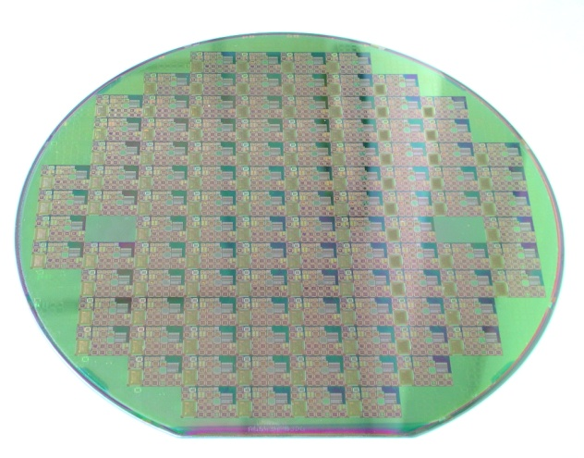
Chip/Circuit Everywhere!
Applications

Slide 14
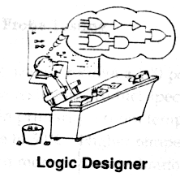
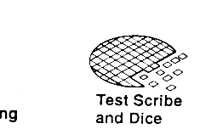
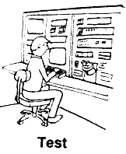

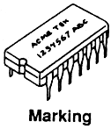
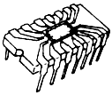

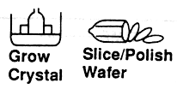
IC Industry in Taiwan
邏輯設計
光罩設計
晶粒測試及切割
封 裝
成品測試
設計
光罩
製造
封裝
測試
長晶
晶圓切割
導線架
晶圓
化學品

Slide 15
Historical Perspective
Evolution of IC
  1958: Single transistor 1
  1962+: SSI 10
  1967: MSI (Medium) 100
  1972: LSI 1000
  1978: VLSI 10⁵-10⁶
  1990: ULSI (Ultra) >10⁶
  2000: SOC (System on Chip)

Slide 16
積體電路 (IC) 分類
SSI (Small-Scaled Integrated Circuits)
  小型積體電路→含數十個元件 (1970s)
MSI (Medium-Scaled IC)
  中型積體電路→含數百個元件
LSI (Large-Scaled IC)
  大型積體電路→含數千個元件 (1980s)
VLSI (Very Large Scaled IC)
  超大型積體電路→含數萬個元件 (1990s)
SoC (System on a Chip)
  單晶片系統→含數百萬個元件 (2000s)

Slide 17
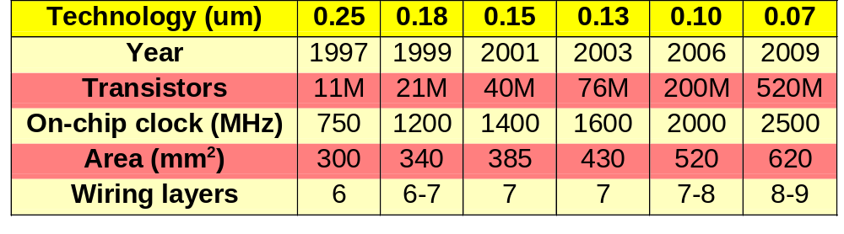
SIA Roadmap 1997
SIA : Semiconductor Industry

Slide 18
Circuit Design Process
System Spec.
Partitioning
Fabrication
VLSI Design/Sim/Ver
Wafer Test
Post-Layout Sim/Ver
Packaging
Masking
Final Test

Slide 19
IC Design flow
IC design flow
Full Custom
Semi Custom (Cell-Based Design)
Standard Cells:
TSMC, UMC-cells
b. FPGA or PLD Programmable logic:
Xilinx, Altera, Actel-cells
ASIC
Full (Fully) Custom Design:
For analog circuits and digital circuits requiring custom optimization
Gates, transistors and layout are designed and optimized by the engineer
Semi Custom Design:
For larger digital circuits
Real gates, transistors and layout are synthesized and optimized by
related software tools
c. Realization with hardware description language (HDL) such as VHDL and
Verilog

Slide 20
Full Custom Design (全客戶式設計)
CMOS Inverter
in
out
Digital circuits requiring custom optimization (smaller system)
Analog circuits
Long design cycle
(transistors and wires)
d. No CPLD or FPGA solutions
done by
chip designer
masking
done by
TSMC, UMC
Packing, Testing

Slide 21
Semi Custom Design (半客戶式設計)
Semi Custom Design
Product specification
Modeling with HDL
Synthesis (by using suitable standard cell)
Simulation and verification
Physical placement and layout
Tape-out (real chip)
Testing
-- implemented with
suitable tools
-- implemented by suitable Fab companies
-- implemented by suitable tools and mechanisms
more flexible, shorter design cycle, suitable for smaller production
PLD
Xilinx, Altera
FPGA or CPLD
Two different solutions :
Real ASIC chip
Standard cell
Fab (TSMC, UMC, ..)
less flexible, long design cycle, larger-scale production to reduce price

Slide 22
Standard Cells
Standard Cell
Cells are characterized and stored in library
Need update when technology advance
Need technology mapping before layout for each design
Macro Cells
Need parametrized capability in terms of speed and layout
Examples : FARADAY Memory Compile
User Interface : memaker
Single port RAM, Dual port RAM, ROM
Data sheet, Verilog simulation module, netlist simulation timing

Slide 23
Synthesis Flow of Semi Custom design (1/2)
Behavioral requirement
Synthesis
High level synthesis
Functional design
Verification and analysis
Behavioral simulation
Behavioral representation
Boolean equations and RTL
Verification and analysis
Logic verification, Logic simulation
Testing
Synthesis
Logic synthesis
Logic design
Structural representation
Logic gates, connections
Synthesis
Cell generators
Circuit design
Verification and analysis
Circuit simulation, Circuit analysis
Structural representation
Transistors and connections
Synthesis
Floorplanning,
Placement, Routing
Physical design
Verification and analysis
Design-rule checking
Circuit extraction
Physical representation
Mask layout rectangles

Slide 24
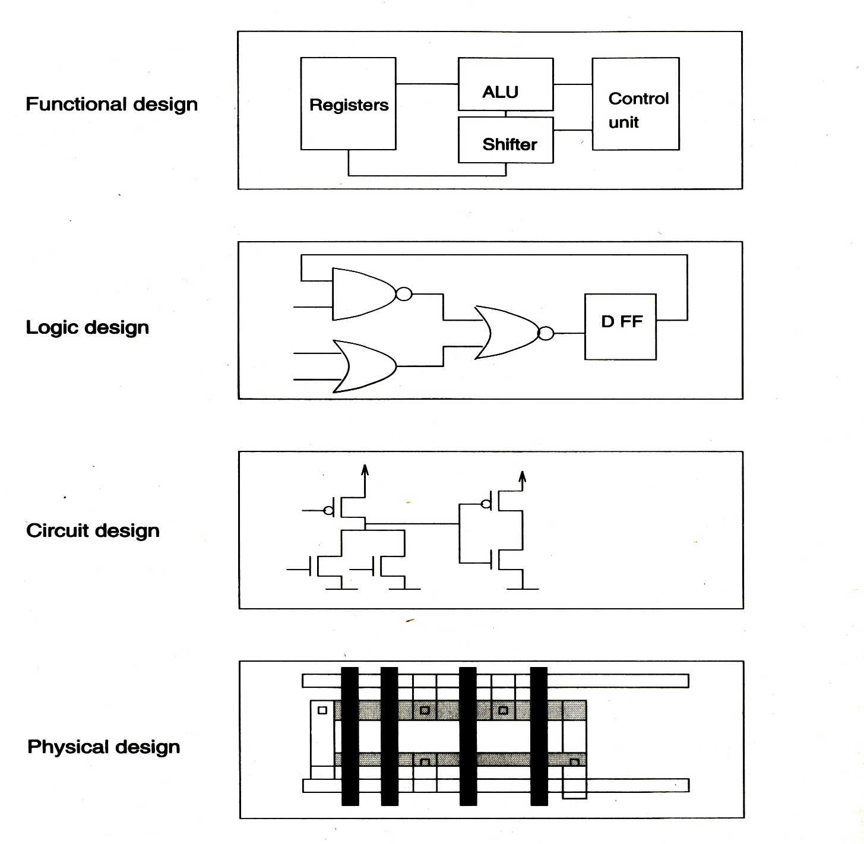
Synthesis Flow of Semi Custom design (2/2)

Slide 25
Synthesis (1/3)
Synthesis = Translation+Optimization+Mapping
always @(…)
if (a==b)
if (c==1)
d=f;
else
d=1;
else
d=0;
Translate into Boolean Representation
a
f
b
d
Optimize + Map
HDL Source
c
f
c
d
a
Process of logic synthesis
b
Target Technology

Slide 26
Synthesis (2/3)
Synthesis is constraint-driven
  You set the goals. Design Compiler optimizes design toward goals.
Large
Area
Small
Fast
Slow
Speed

Slide 27
Synthesis (3/3)
Providing an environment and various tools for the designers to produce circuits automatically and efficiently to meet the requirements of
  performance
  area
  testability

