Slide 1
數位IC設計
Semi Custom Design Flow

Slide 2
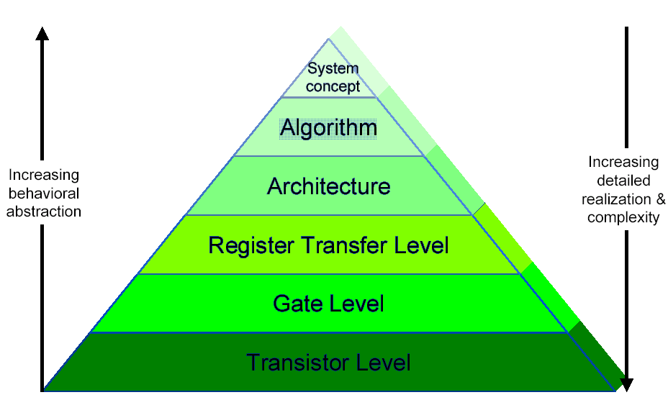
Top-Down Design Methodology

Slide 3
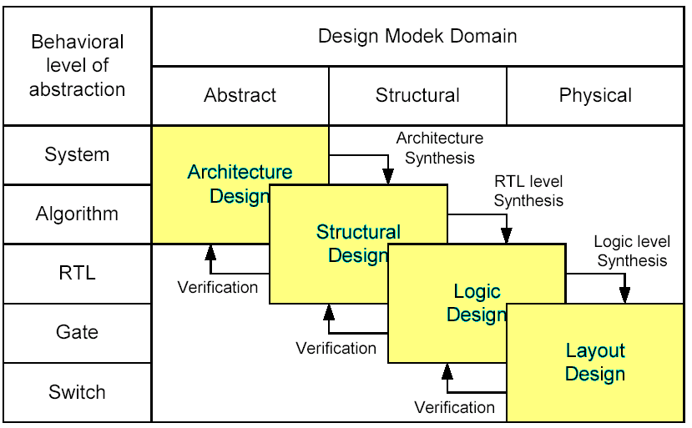
Design Domain
Register Transfer Level -- RTL

Slide 4
Cell-Based Design Flow (1/2)
Semi Custom Design
Product specification
Modeling with HDL
Synthesis (by using suitable standard cell)
Simulation and verification
Physical placement and layout
Tape-out (real chip)
Testing
-- implemented with
suitable tools
-- implemented by suitable Fab companies
-- implemented by suitable tools and mechanisms
more flexible, shorter design cycle, suitable for smaller production
PLD
Xilinx, Altera
FPGA or CPLD
Two different solutions :
Real ASIC chip
Standard cell
Fab (TSMC, UMC, ..)
less flexible, long design cycle, larger-scale production to reduce price

Slide 5
Cell-Based Design Flow (2/2)
Product Specification
Post-Layout simulation
Apollo (P & R)
Dracula
(DRC, ERC,LVS)
Pre-Layout simulation
Behavioral Level
Time Mill &
Power Mill
Vi (Text Editor)
Layout Level Design
RTL Level
Verilog-XL (Compiler)
nWave, Signalscan (waveform)
Back
.v
GDS-II
Tapeout
Logic and Circuit Design
Synopsys
(Design compiler)
Back to
RTL
Standard Cell
netlist (.vg)

Slide 6
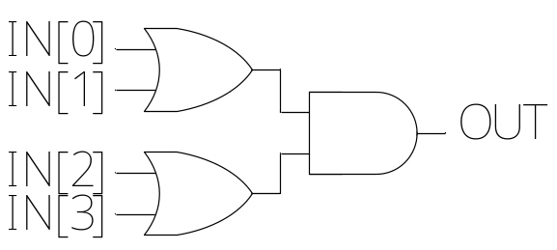
Hardware Description Language (1/3)
Structural description
  module OR_AND_STRUCTURAL(IN,OUT);
  input [3:0] IN;
  output OUT;
  wire [1:0] TEMP;
  or u1(TEMP[0], IN[0], IN[1]);
  or u2(TEMP[1], IN[2], IN[3]);
  and (OUT, TEMP[0], TEMP[1]);
  endmodule
Register Transfer Level -- RTL

Slide 7
Hardware Description Language (2/3)
Behavioral descrition
  module OR_AND_BEHAVIORAL(IN, OUT);
  input [3:0] IN;
  output OUT;
  reg OUT;
  always @(IN)
  begin
  OUT = (IN[0] | IN[1]) & (IN[2] | IN[3]);
  end
  endmodule
Register Transfer Level -- RTL

Slide 8
Hardware Description Language (3/3)
3 to 8 decoder
  always @(E or In)
  begin
  if(!E)
  Out = 8'h00;
  else
  begin
  case(In)
  3'b000: Out = 8'h01;
  3'b001: Out = 8'h02;
  3'b010: Out = 8'h04;
  3'b011: Out = 8'h08;
  3'b100: Out = 8'h10;
  3'b101: Out = 8'h20;
  3'b110: Out = 8'h40;
  default: Out = 8'h80;
  endcase
  end
  end
  endmodule
E | In[2] | In[1] | In[0] | Out
0 1 1 1 1 1 1 1 1 | X 0 0 0 0 1 1 1 1 | X 0 0 1 1 0 0 1 1 | X 0 1 0 1 0 1 0 1 | 00000000 00000001 00000010 00000100 00001000 00010000 00100000 01000000 10000000
  Behavioral description
  module Decoder_Behavioral (E, In, Out);
  Input E;
  input [2:0] In;
  output [7:0] Out;
  reg [7:0] Out;

Slide 9
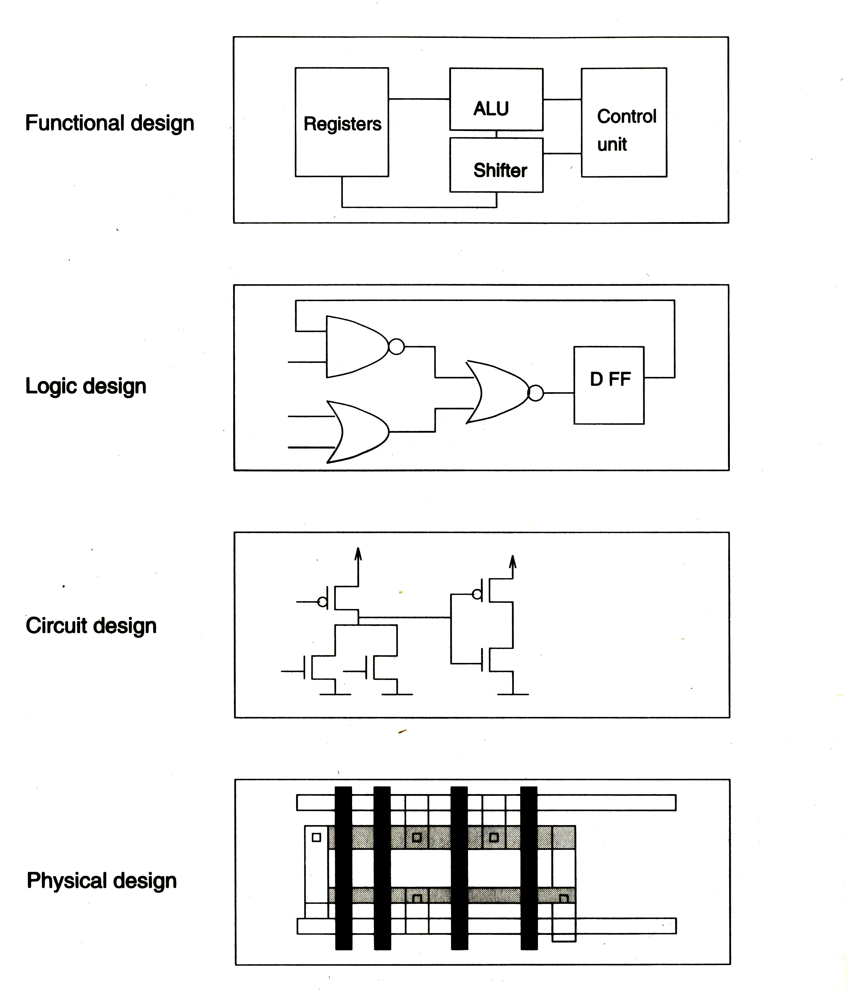
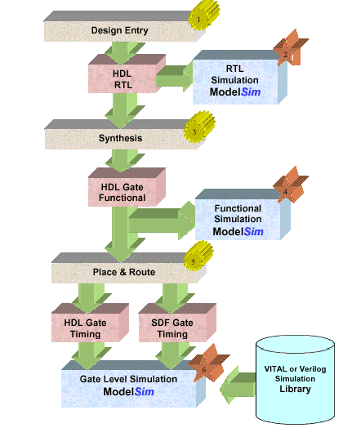
Design Flow Using ModelSim
HDL

Slide 10
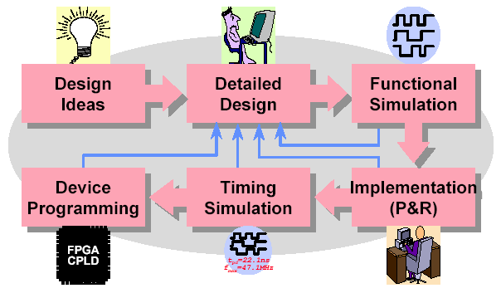
FPGA/CPLD Design Flow
Note: What is the difference between standard-cell
design and FPGA/CPLD design ? 何者相同?何者不同?
Flow, tool, cost, time, …

Slide 11
Design Ideas
Main design consideration
  Design feasibility?
  Design spec.?
  Cost?
  FPGA or standard-cell ASIC?
  FPGA vendor?
  Device family?
  Development time?

Slide 12
Programmable Logic Device
PLD (Programmable Logic Device)依其架構及密度可分成三類:
  SPLD（Simple Programmable Logic Device)
  CPLD（Complex Programmable Logic Device)
  FPGA ( Field Programmable Gate Array)

Slide 13
SPLD
SPLD（Simple Programmable Logic Device):
  邏輯閘約在數百閘左右
  IC腳位在28pin以內
  Bipolar process，只能作單次燒錄，資料無法抹除
  GAL process，多次燒錄，可縮短設計時程

Slide 14
CPLD
CPLD（Complex Programmable Logic Device)
  邏輯閘在800～5000之間
  IC腳位高於28pin
  44pin以上IC的封裝以PLCC為主
  CMOS設計技術
  多次燒錄抹除

Slide 15
FPGA
FPGA:(Field Programmable Gate Array)
  使用和CPLD不同的架構設計方式
  以暫存器居多，其密度在5K以上
  腳位數多
  Routing複雜，非固定式，延遲時間較長
FPGA的架構
  SRAM Base -可重覆燒錄但需外部電源維持資料
  Anti-fuse -只有一次燒錄，提供較佳保密性

Slide 16
Configurable VLSI
Advantages
  Short time-to-market
  Low tooling costs
  Low penalty on design changes
  Low testing cost
  Product advantage (new process, .35, .25, .18, .13)
Disadvantages
  capacity
  cost
  speed

Slide 17
Altera Devices
Products
  MAX3000/5000/7000/9000 devices family
  FELX6K/8K/10K devices family
  APEX20K devices family
  ACEX1K …..
Workbench
  MaxplusII & QuartusII
  FPGA express, Leonard Spectrum

Slide 18
Xilinx Devices
Products
  XC9500/4000,Coolrunner(XPLA3) ,Spartan,Vertex …..
Workbench
  Foundation & ISE
Virtex Architecture
Gate-array like architecture, Configurable logic blocks
  I/O blocks 16 signal standards, Block RAM
  On-chip memory for higher performance
Clocks & delay-locked loop, Interconnect resources

Slide 19
FPGA/CPLD Design Flow
Note: What is the main difference between cell-based
design and FPGA/CPLD design ? 何者相同?何者不同?
Flow, tool, cost, time, …

Slide 20

Detailed Design (1/2)
Choose the suitable architecture
  Algorithm, spec. to architecture mapping
  Parallel, pipeline, serial, DA, …..
Choose the design entry method
  Schematic
    Gate level design
    Intuitive & easy to debug
  HDL (Hardware Description Language), Verilog & VHDL
    Descriptive & portable
    Easy to modify
    RTL (register transfer level) coding
  Mixed HDL & schematic

Slide 21
Detailed Design (2/2)
Manage the design hierarchy
  Design partitioning
    Chip partitioning
    Logic partitioning
  Use vendor-supplied libraries or parameterized libraries to reduce design time
  Create & manage user-created libraries (circuits)

Slide 22

Functional Simulation
Preparation for simulation
  Generate simulation patterns
    Waveform entry
    HDL testbench
  Generate simulation netlist
Functional simulation
  To verify the functionality of your design only
Simulation results
  Waveform display
  Text output
Challenge
  Sufficient & efficient test patterns

Slide 23
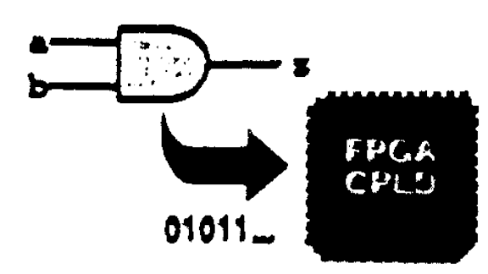
Design Implementation (1/2)
Implementation flow
  Natlist merging, flattening, data base building
  Design rule checking
  Logic optimization
  Block mapping & placement
  Net routing
  Configuration bitstream generation

Slide 24
Design Implementation (2/2)
Implementation results
  Design error or warnings
  Device utilization
  Timing reports
Challenge
  How to reach high performance & high utilization
  implementation?

Slide 25
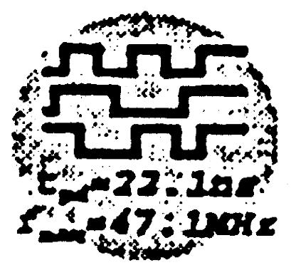
Timing Analysis & Simulation
Timing analysis
  Timing analysis is static, i.e., independent of input & output patterns
  To examine the timing constraints
  To show the detailed timing paths
  Can find the critical path
Timing simulation
  To verify both the functionality & timing of the design

Slide 26
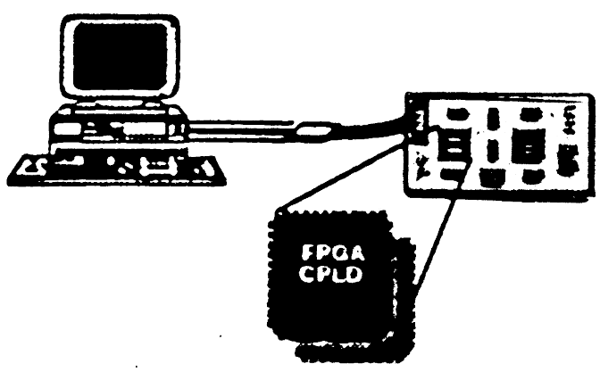
Device Programming (1/2)
Choose the appropriate configuration scheme
  SRAM-basedFPGA/CPLD devices
    Downloading the bitstream via a download cable
    Programming onto a non-volatile memory device & attaching it on the circuit board
  OTP, EPROM, EEPROM or Flash-based FPGA/CPLD devices
    Using hardware programmer
    ISP

Slide 27
Device Programming (2/2)
Finish the board design
Program the device
Challenge
  Board design
  System considerations

Slide 28
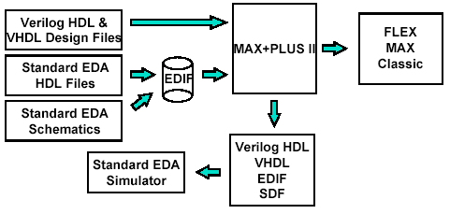
Altera Design Flow (Max-Plus II)
Operate seamlessly with other EDA tools

Slide 29
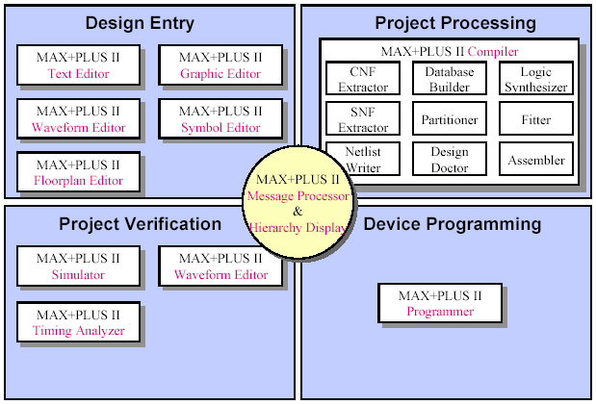
MAX+PLUS II Altera Fully-Integrated Development System

Slide 30
Design Entry (1/2)
MAX+PLUS II design entry tools
  Graphic Editor & Symbol Editor
    For schematic designs
  Text Editor
    For AHDL, Verilog HDL, and VHDL designs
  Waveform Editor
  Floorplan Editor
  Hierarchy Display

Slide 31
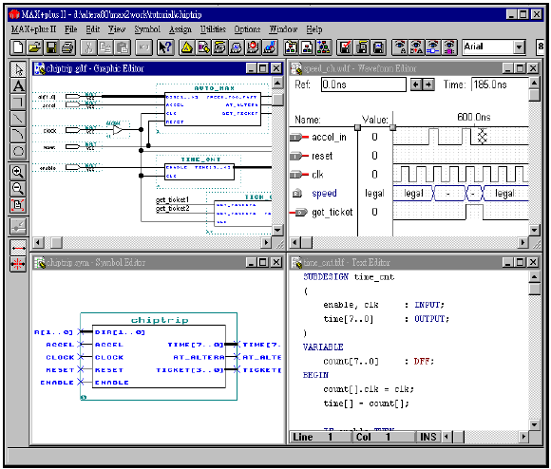
Design Entry (2/2)

Slide 32
Project Processing (1/2)
MAX+PLUS II tools for project processing (implementation)
  MAX+PLUS II Compiler
  MAX+PLUS II Floorplan Editor
    For pin, logic cell location assignments
  Message Processor
    For error detection & location

Slide 33
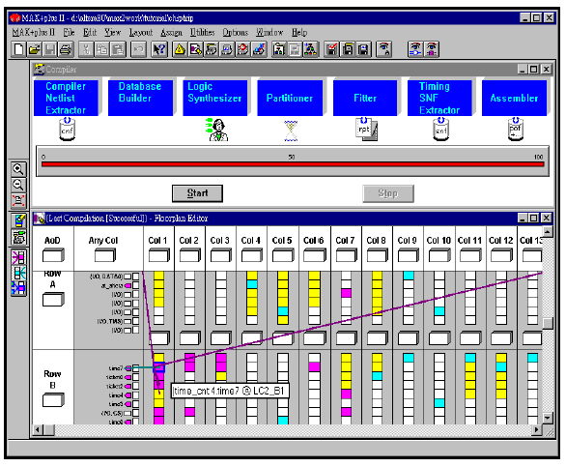
Project Processing (2/2)

Slide 34
Project Verification (1/2)
MAX+PLUS II tools for project verification
  MAX+PLUS II Simulator
  MAX+PLUS II Waveform Editor
  MAX+PLUS II Timing Analyzer

Slide 35
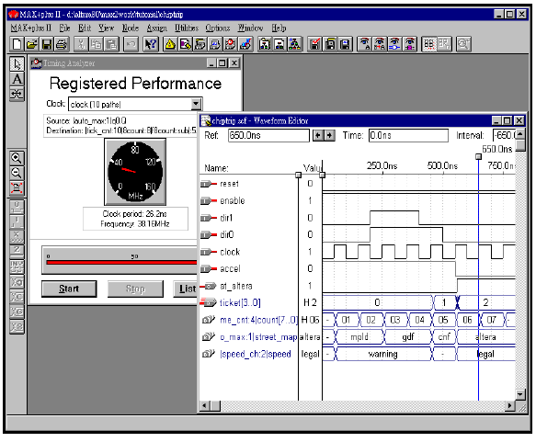
Project Verification (2/2)

Slide 36
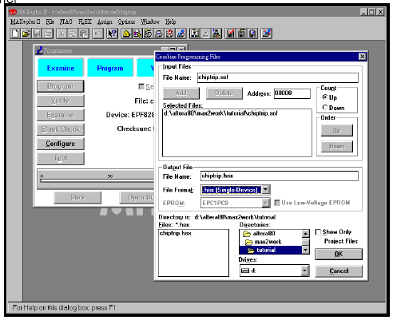
Device Programming
MAX+PLUS tool for device programming
  MAX+PLUS II Programmer

Slide 37
MAX+PLUS II Features (1/2)
MAX+PLUS II, Altera’s fully integrated design environment (jump to page 4)
  Schematic, text (AHDL, VHDL, and Verilog HDL), waveform design entry & hierarchy display
  Floorplan editing
  RC, logic synthesis & fitting, timing-driven compilation
  Multi-device partitioning
  Automatic error location

Slide 38
MAX+PLUS II Features (2/2)
  Functional simulation, timing simulation, and multi-device simulation
  Timing analysis
  Programming file generation & device programming
  EDA interface : industry-standard library support, EDA design entry & output formats (EDIF, Verilog & VHDL)
  On-line help

Slide 39
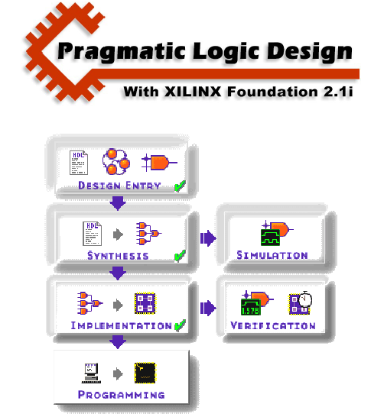
Xilinx Design Flow (Foundation)

Slide 40
References
http:// www.xilinx.com/xilinx FPGA.pdf
http://www.altera.com /alt_lab.pdf
http://www.cic.edu.tw/~steven/stratix.htm/
http://www.altera.com/literature/ds/acex.pdf
教育部P&L聯盟-FPGA系統設計實務(摘自陳漢臣老師部份)

