Slide 1
數位IC設計
RTL Coding – Part I

Slide 2
Optimization issues for VLSI Design
  Five optimization issues:
  1. Area (less silicon, less cost, high yield)
    2. Speed (design constraint, better
    timing performance)
    3. Power dissipation (cooling, battery)
    4. Testability (minimize the time spent to
    test a single chip)
    5. Design time (CAD tools)
Done by
designers
+ tools

Slide 3
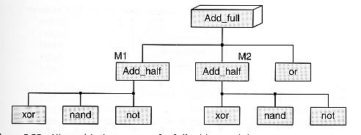
Top-Down Design Flow
Full-Adder
Design
Sub
block
Sub
block
Sub
block
Sub
block
Basic
Element
Basic
Element
Basic
Element
Basic
Element
Basic
Element
Basic
Element
Basic
Element
Basic
Element

Slide 4
Bottom-Up Design Flow
Design
Sub
block
Sub
block
Sub
block
Sub
block
Basic
Element
Basic
Element
Basic
Element
Basic
Element
Basic
Element
Basic
Element
Basic
Element
Basic
Element

Slide 5
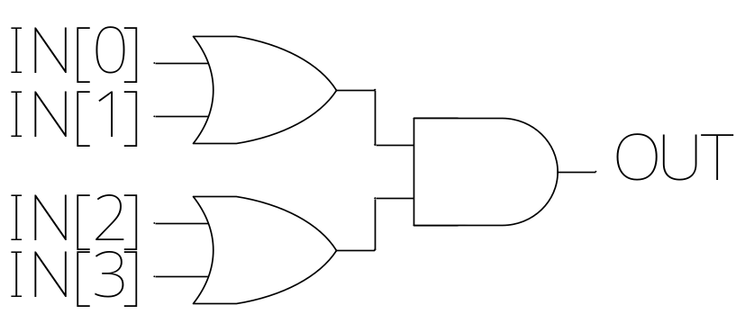
Design Entry for VLSI System
Choose the design entry method:
Schematic
    Gate level design
    Intuitive & easy to debug
    HDL (Hardware Description Language)
    Descriptive & portable
    Easy to modify
    Mixed HDL & Schematic
    …
  always @(IN)
  begin
  OUT = (IN[0] | IN[1]) & (IN[2] | IN[3]);
  end

Slide 6
Hardware Description Language (HDL)
Hardware description language allows you to describe circuit at different levels of abstractions, and allows you to mix any level of abstraction in the design
Two of the most popular HDLs
  -- Verilog -- VHDL
HDLs can be used for both the cell-based synthesis and FPGA/CPLD implementation
Only Verilog is introduced here

Slide 7
Why Verilog?
Verilog History
Verilog was written by gateway design automation in
the early 1980
2. Cadence acquired gateway in 1990
3. Cadence released Verilog to the public domain in 1991
4. In 1995, the language was ratified as IEEE standard 1364
Why Verilog ?
1. Choice of many design teams
2. Most of us are familiar with C- like syntax/semantics

Slide 8
Verilog Features
Features:
Procedural constructs for conditional, if-else, case and looping operations
Arithmetic, logical, bit-wise, and reduction operations for expression
Timing control
- Verilog Module - Identifier - Keyword
- Four Value Logic - Data Types - Numbers
- Port Mapping - Operator - Comments
Basics of Verilog Language:

Slide 9
Verilog Module (1/3)
Response
Generation
Stimulus
and
Control
Verilog
Module
Waveform,
test patterns
Waveform,
text reports
Verification
Test Bench

Slide 10
Verilog Module (2/3)
module module_name (port_name);
port declaration
data type declaration
module functionality or structure
endmodule
(1)
(2)
(3)
module Add_half(sum, c_out, a, b);
input a, b;
output sum, c_out;
wire c_out_bar;
xor (sum, a, b);
nand (c_out_bar, a, b);
not (c_out, c_out_bar);
endmodule
(1)
(2)
(3)
c_out_bar
c_out

Slide 11
Verilog Module (3/3)
Verilog Module: basic building block
module DFF
--------------------
--------------------
-------------------
-
-
-
------------------
------------------
endmodule
module ALU
--------------------
--------------------
-------------------
-
-
-
------------------
------------------
endmodule
module MUX
--------------------
--------------------
-------------------
-
-
-
------------------
------------------
endmodule

Slide 12
Structural Description
Verilog allows three kinds of descriptions for circuits:
Structural description (2) Data flow description
(3) Behavioral description
Structural description:
  module OR_AND_STRUCTURAL(IN,OUT);
  input [3:0] IN;
  output OUT;
  wire [1:0] TEMP;
  or u1(TEMP[0], IN[0], IN[1]);
  or u2(TEMP[1], IN[2], IN[3]);
  and (OUT, TEMP[0], TEMP[1]);
  endmodule
u1
TEMP[0]
u2
TEMP[1]
Synthesized (synthesis) +
optimized by tools

Slide 13
Data Flow Description
Data flow description
  module OR_AND_DATA_FLOW(IN, OUT);
  input [3:0] IN;
  output OUT;
  assign OUT = (IN[0] | IN[1]) & (IN[2] | IN[3]);
  endmodule
Synthesized and
optimized by tools
NOTE:
What is the difference between C and Verilog ?
C : only one iteration (once) is implemented for assignment
Verilog : hard-wired circuit for assignment

Slide 14
Behavioral (RTL) Description (1/2)
Behavioral description #1
  module OR_AND_BEHAVIORAL(IN, OUT);
  input [3:0] IN;
  output OUT;
  reg OUT;
  always @(IN)
  begin
  OUT = (IN[0] | IN[1]) & (IN[2] | IN[3]);
  end
  endmodule
Activate OUT while any voltage transition
(0 1 or 1 0) happens at signal IN

Slide 15
Behavioral (RTL) Description (2/2)
Behavioral description #2
module or_and(IN, OUT);
input [3:0] IN; output OUT; reg OUT; (Note)
always @(IN)
begin
case(IN)
4'b0000: OUT = 0; 4'b0001: OUT = 0;
4'b0010: OUT = 0; 4'b0011: OUT = 0;
4'b0100: OUT = 0; 4'b0101: OUT = 1;
4'b0110: OUT = 1; 4'b0111: OUT = 1;
4'b1000: OUT = 0; 4'b1001: OUT = 1;
4'b1010: OUT = 1; 4'b1011: OUT = 1;
4'b1100: OUT = 0; 4'b1101: OUT = 1;
4'b1110: OUT = 1; default: OUT = 1;
endcase
end
endmodule
Truth Table
IN[0] | IN[1] | IN[2] | IN[3] | OUT
0 0 0 0 0 0 0 0 1 1 1 1 1 1 1 1 | 0 0 0 0 1 1 1 1 0 0 0 0 1 1 1 1 | 0 0 1 1 0 0 1 1 0 0 1 1 0 0 1 1 | 0 1 0 1 0 1 0 1 0 1 0 1 0 1 0 1 | 0 0 0 0 0 1 1 1 0 1 1 1 0 1 1 1
Synthesized and
optimized by tools

Slide 16
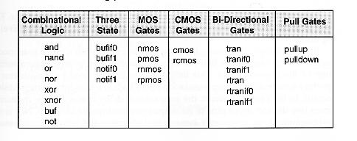
Verilog Primitives
Note: all primitives are simulatable (可模擬)
but not all synthesizable (可合成)

Slide 17
Instance Name
A module instance must have a name.
ex: OR_AND_STRUCTURAL
Note: naming skill is very important in Verilog
The use of an instance name with a primitive is optional.
ex: u1, u2
  or u1(TEMP[0], IN[0], IN[1]);
  or u2(TEMP[1], IN[2], IN[3]);
  and (OUT, TEMP[0], TEMP[1]);

Slide 18
Structural Description
for Cell-Based Implementation
Structural description (cell-based):
  module OR_AND_STRUCTURAL(IN,OUT);
  input [3:0] IN;
  output OUT;
  wire [1:0] TEMP;
  orf203 u1(TEMP[0], IN[0], IN[1]);
  orf203 u2(TEMP[1], IN[2], IN[3]);
  andf201 (OUT, TEMP[0], TEMP[1]);
  endmodule
Cell library from:
IBM, TSMC, UMC,..
This kind of design is not portable. Why ?
Bad design method !

Slide 19
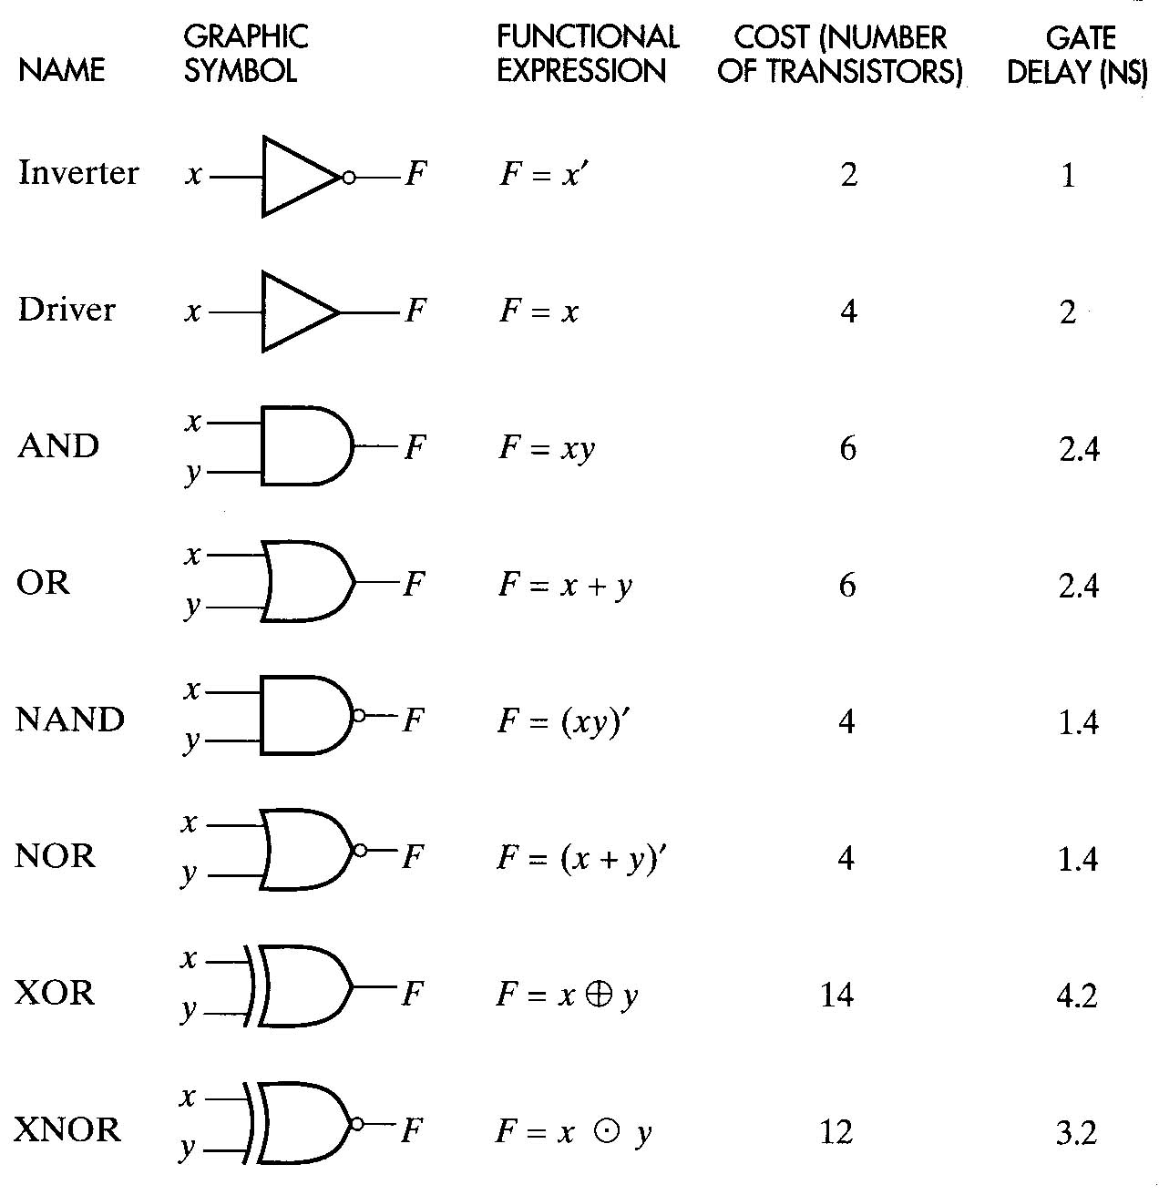
Gate Delay (1/3)
Cost (# of trans.)
Delay
Gate delay is dependent
on the VLSI technology
and the cell library.
Technology Mapping:
Convert the expression a’b’+c(a+b) into a logic
schematic using gates defined in the cell library
Translation + Optimization

Slide 20
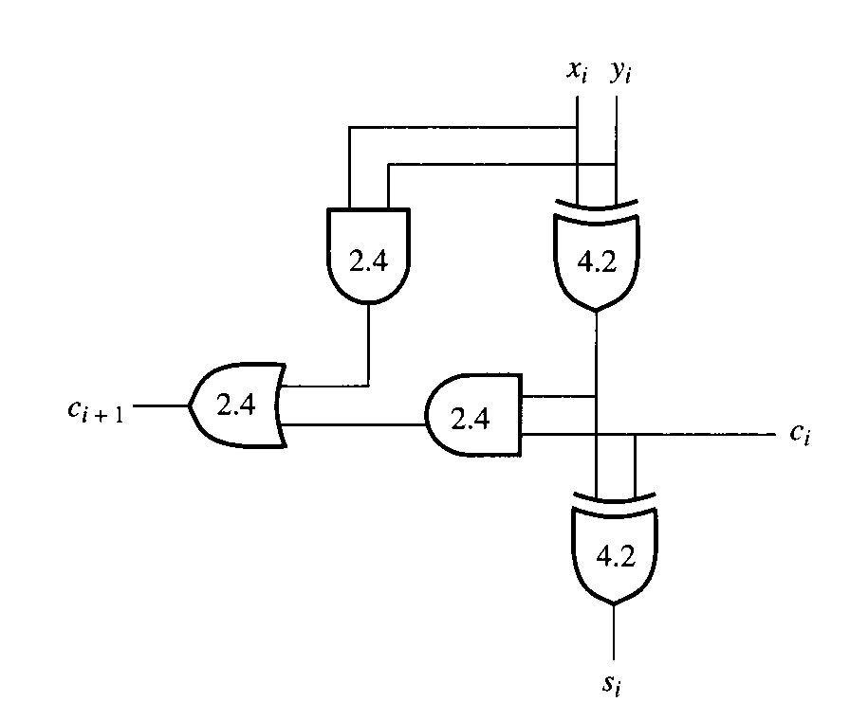
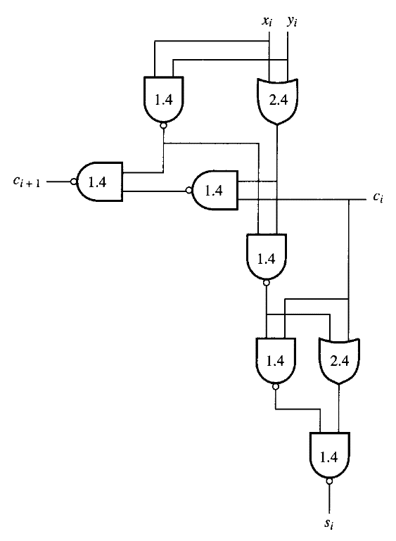
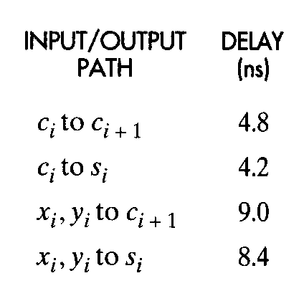
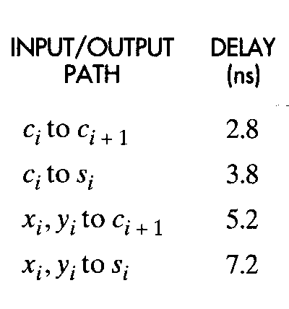
Gate Delay (2/3)
Full-adder
nand gate: 4 trans.
or gate: 6 trans.
and gate: 6 trans. xor gate: 14 trans.
Totally, 46 transistors
Totally, 36 transistors
Delay (critical path)
=7.6 ns
Delay (critical path)= 9.0 ns
7.6
Critical Path: the longest path (delay) in a circuit

Slide 21
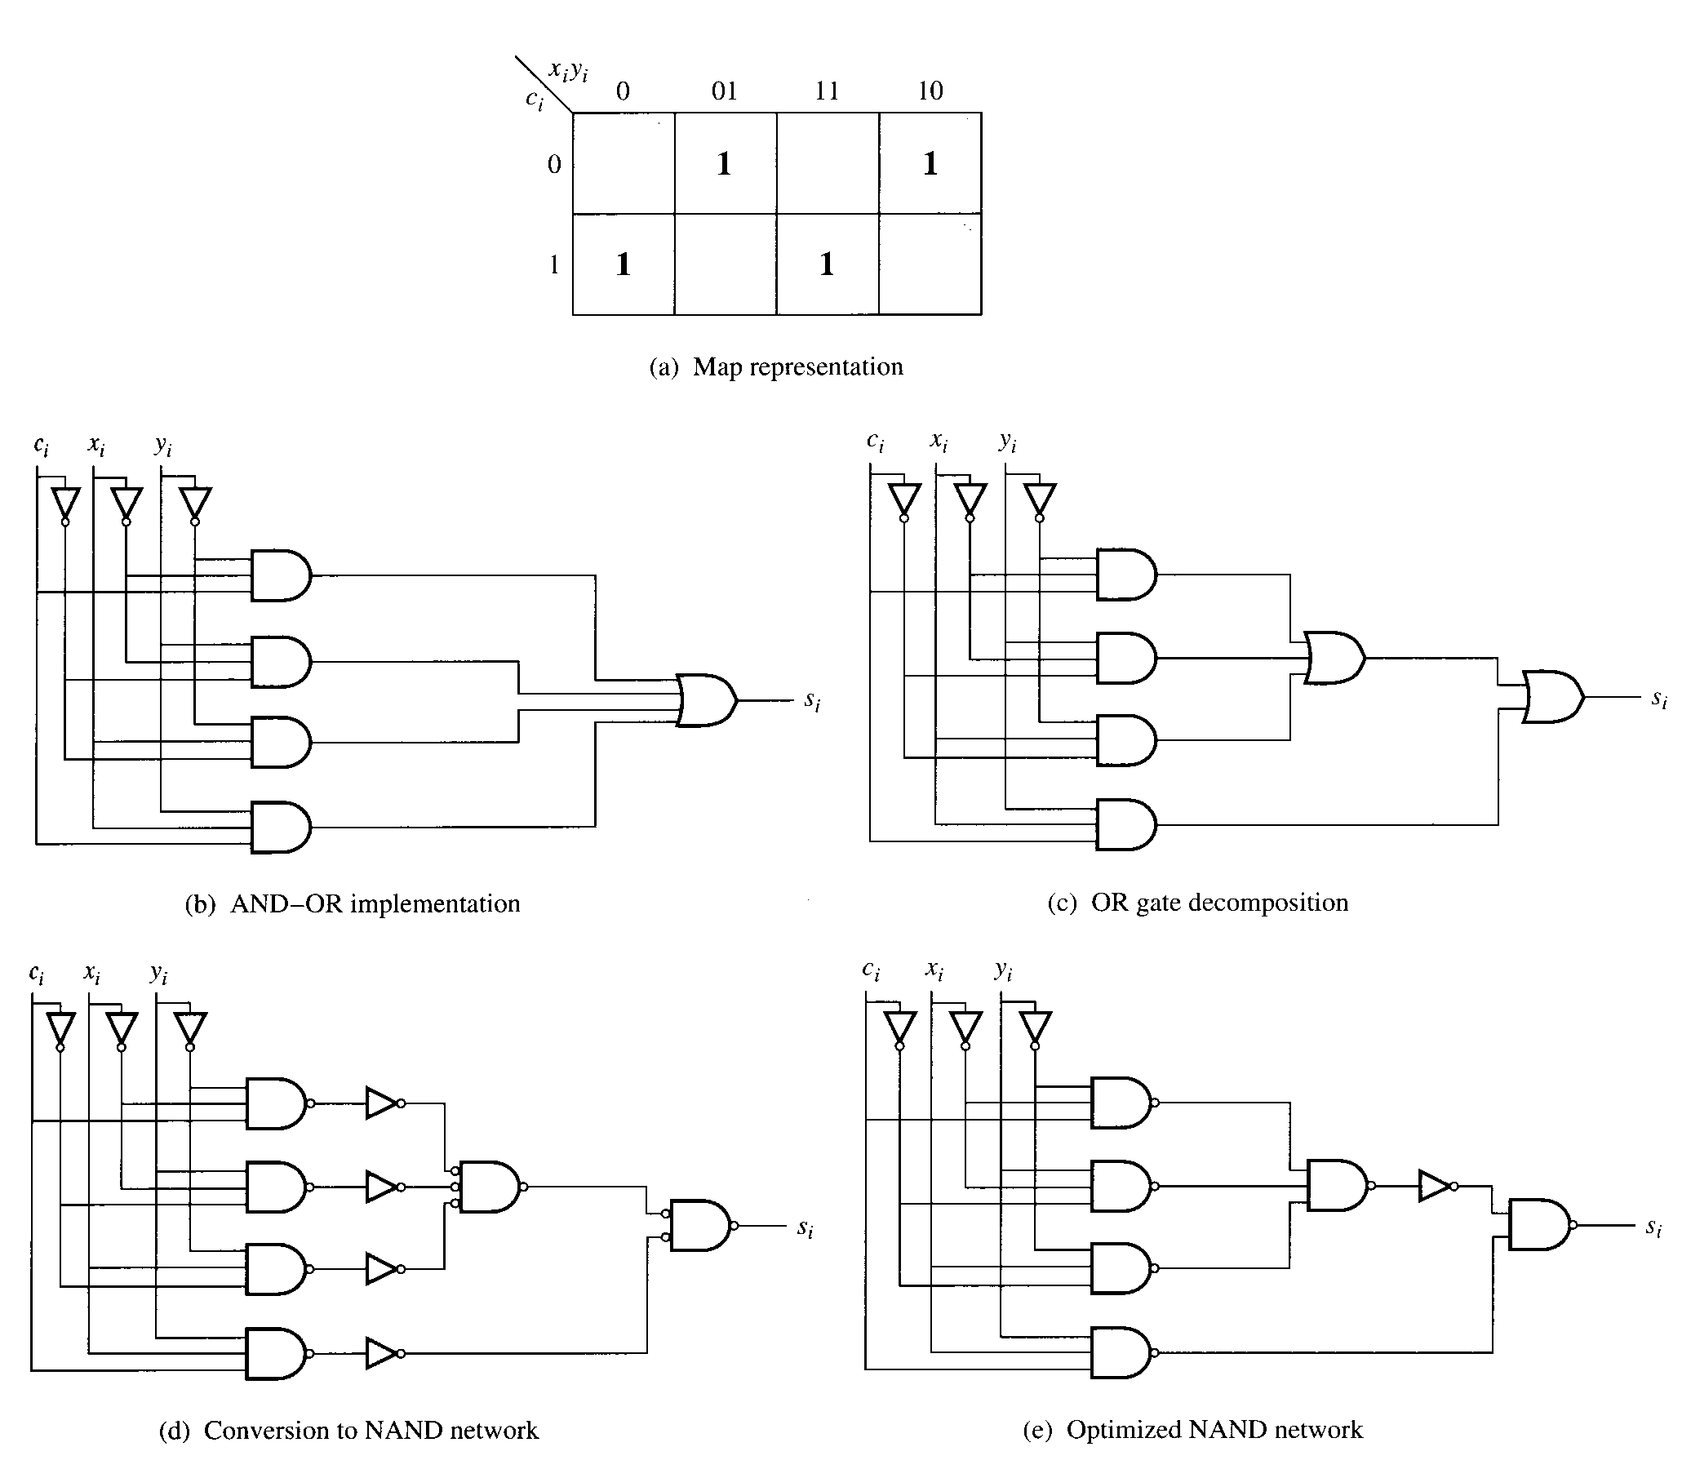
Gate Delay (3/3)
Technology Mapping (logic synthesis):
convert the expression into a logic
schematic using gates defined in the cell library
Translation + Optimization

Slide 22
Difference Between C and Verilog (1/2)
C language:
k=a+b;
d=k+e;
Verilog language:
k=a+b;
d=k+e;
a
+
k
or
b
+
d
a
e
b
e
adder
sel
Two adders
(higher cost, higher speed)
sel
k
multiplexer
reg
sel=0
execute a+b
sel=1
execute e+k
+
One adder
(lower cost, lower speed)
clock rate might be faster
d
C 語法中 變數k和d只被計算一次，欲多次計算需加上迴圈指令。
Verilog 語法中變數k和d需使用硬體元件來計算，感覺上該硬體永遠存在,
只要輸入值有任何改變， 相關聯的輸出會跟著改變 (軟體指令為sequential
process, 硬體則為一個彷彿永遠存在的實體) 。

Slide 23
Difference Between C and Verilog (2/2)
8-bit input wire, ?-bit adder, 2’s complement
(The number of bits (pins) required in a hardware design)
2. How about the critical path ?
a
e
b
a
sel
8
sel
k
+
multiplexer
critical path
reg
k
?
+
+
b
8
?
d
adder
e
critical path
d
Critical path is longer, so the period
is longer and the clock rate is slower
Critical path is shorter, so the period
is shorter and the clock rate is faster
Clock rate=1/period (If period is 15 ns, the clock rate is about 67 MHz)

Slide 24
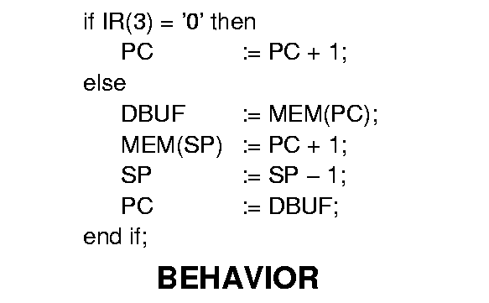
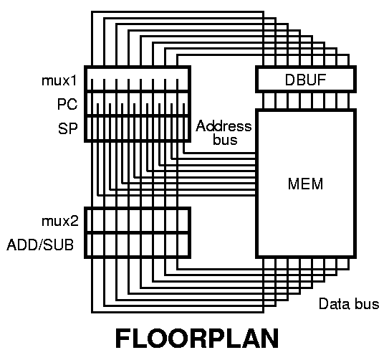
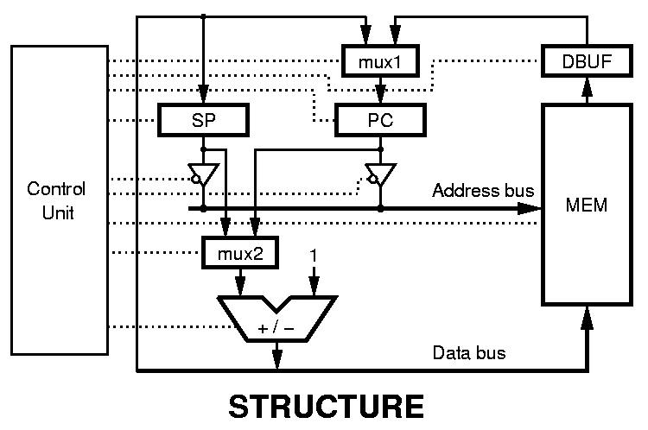
An Example

Slide 25
Identifier
Identifiers are names given to Verilog objects
Names of modules, ports and instances are all identifiers
First character must use a letter, and other character can use letter, number or “_”
Upper case and lower case letters are different
How to determine a suitable name ???

Slide 26
Keywords
Predefined identifiers to define the language constructs
All keywords are defined in lower case
Cannot be used as identifiers
Examples: module, initial, assign, always,
endmodule, …

Slide 27




Four Value Logic
0: logic 0 / false
1: logic 1 / true
X: unknown logic value
Z: high-impedance

Slide 28
Four Value Logic: Example
6'hCA 001010 truncated, not 11001010
6'hA 001010 filled with two '0' on left
16'bZZ
Z Z Z Z Z Z Z Z Z Z Z Z Z Z Z
filled with 16 Z's

Slide 29
Timescale in Verilog
The ‘timescale declares the time unit and its precision.
‘timescale <time_unit> / <time_precision>
ex: ‘timescale 10 ns / 1 ns
delay= 20 ns
  not #2 u1(cbar, c);
  or #2.54 u2(TEMP[1], IN[2], IN[3]);
  and # 3.55 (OUT, TEMP[0], TEMP[1]);
c
cbar
Delay=20 ns
Delay=25 ns
Delay=36 ns

Slide 30
Delay
Simulation Delay
Physical Delay:
1. Physical delay can be acquired
after synthesis process.
2. Physical delay is dependent on
the VLSI technology and cell lib.
(eg., 0.25, 0.18, 0.13, ….)
3. After synthesis, the instruction
such as # 3.55 becomes useless.
4. Timescale is used for simulation
not for physical circuit.
  ‘timescale 10 ns / 1 ns
  or #2.54 u1(TEMP[0], IN[0], IN[1]);
  or # 2.54 u2(TEMP[1], IN[2], IN[3]);
  and #3.55 (OUT, TEMP[0], TEMP[1]);
NOTE
D=25 ns
D=36 ns
Total_D=61 ns
If new IN[3] is activated at 10th ns, the simulated output OUT will be generated at 71th ns.
If new IN[1] is activated at 2th ns, the simulated output OUT will be generated at 63th ns.

Slide 31
Data Types
Nets
  physical connection between devices
Registers
  abstract storage devices
Parameters
  run-time constants
The positions of three data types define whether they are global to a module or local to a particular always statement
By default, net and register are one-bit wide (a scalar)
not multi-bit wide (a vector)

Slide 32
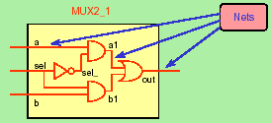
NETs
Connects between structural elements
Must be continuously driven by
  Continuous assignment
  Module or gate instantiation
Default initial value for a wire is “Z”

Slide 33
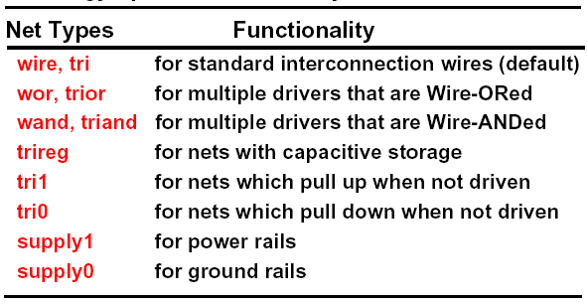
Types of Nets
Net declaration
<nettype> <range>? <delay_spec>? <<net_name> <,net_name>*>
Note: Some of those net types are un-synthesizable (不能電路合成的)

Slide 34
Nets (1/2)
wire, wand, wor, tri, supply0, supply1
wire k; // single-bit wire
wire [0:31] w1, w2; // Two 32-bit wires
wire w1;
assign w1=a;
assign w1=b; (error)
Method 1:
wand x;
assign x=j; assign x=i;
Method 2:
wor y;
assign y=o; assign y=p;
a
(error)
w1
b
i
(ok)
x
j
o
p
y
(ok)

Slide 35
Nets (2/2)
tri: all variables that drive the tri must have a value of Z
except one (ensured by the designer).
module tri-test(out, condition)
input [1:0] condition; output out;
reg a, b, c;
tri out;
always@(condition)
begin
a=1’bz; b=1’bz; c=1’bz;
case (condition)
2’b00: a=1’b1;
2’b01: b=1’b0;
2’b10: c=1’b1;
endcase
end
assign out=a; assign out=b; assign out=c;
endmodule
supply0 wires tied to logic 0 (ground)
supply1 wires tied to logic 1 (power)

Slide 36
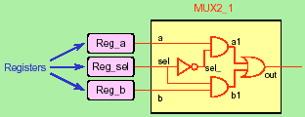
Registers
Represent abstract data storage elements
Hold its value until a new value is assigned to it
Registers are used extensively in behavioral modeling
Default initial value for a register is “X”

Slide 37
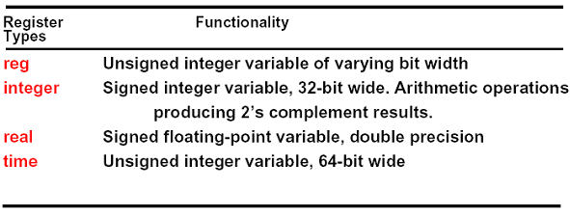
Types Of Registers
Register declaration
<register_type> <range>? <<register_name> <,register_name>*>
memory-block is an array of 256 registers,
each of which is 8 bits width. You can
access individual register, but you cannot
access individual bits of register directly.
reg a; // a scalar register
reg [3:0] b,c;// two 4-bit vector registers
reg [7:0] byte_reg; // a 8-bit registers
reg [7:0] memory_block [255:0];
byte_reg=memory_block [120];
bit=byte_reg [7]; // wire bit;

Slide 38
Numbers (1/2)
Numbers are integer or real constants.
Integer constants are written as
<size>’<base format><number>
Real number can be represented in decimal or scientific format.
A number may be sized or unsized

Slide 39
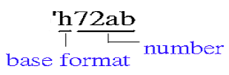
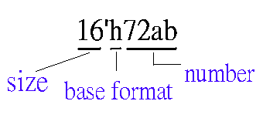
Numbers (2/2)
The base format indicates the type of number
  Decimal (d or D)
  Hex (h or H)
  Octal (o or O)
  Binary (b or B)
ex: unsize
size

Slide 40
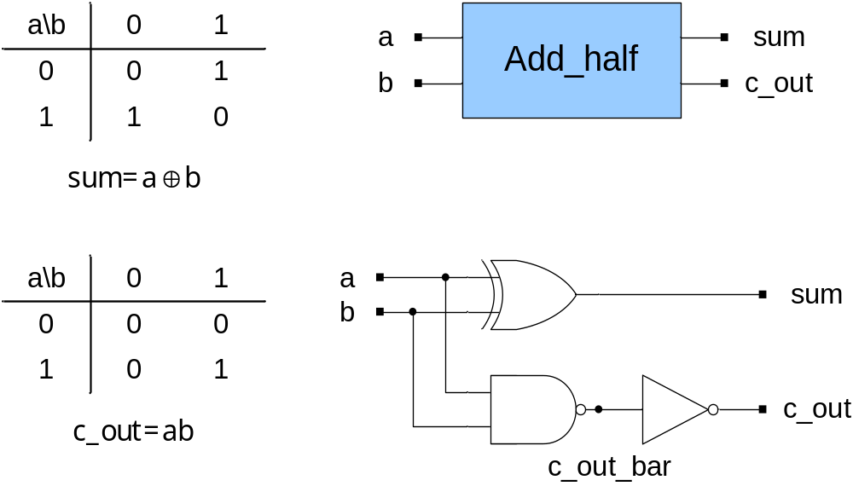
Half Adder (1/5)

Slide 41
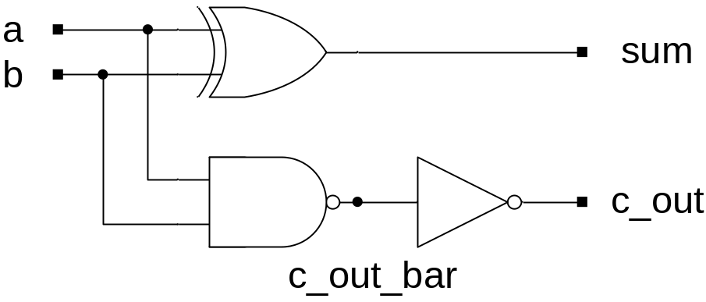
Half Adder (2/5)
Structural description
module Add_half(sum, c_out, a, b);
input a, b;
output sum, c_out;
wire c_out_bar;
xor (sum, a, b);
nand (c_out_bar, a, b);
not (c_out, c_out_bar);
endmodule
and (e, a, b,c,d);
a
b
c
d
e

Slide 42
Half Adder (3/5)
Data flow description
module Add_half(sum, c_out, a, b);
input a, b;
output sum, c_out;
assign {c_out, sum} = a + b;
endmodule
assign: continuous assignment
a
sum
half
adder
c_out
b
Synthesized and
optimized by tools

Slide 43
Half Adder (4/5)
Behavioral description #1
module Add_half(sum, c_out, a, b);
input a, b;
output sum, c_out;
reg sum, c_out;
always @ (a or b)
begin
sum = a ^ b;
c_out = a & b;
end
endmodule

Slide 44
Half Adder (5/5)
Behavioral description #2
module Add_half(sum, c_out, a, b);
input a, b;
output sum, c_out;
reg sum, c_out;
always @(a or b)
begin
case({a,b})
2'b00:begin
sum = 0;c_out = 0;
end
2'b01:begin
sum = 1; c_out = 0;
end
2'b10:begin
sum = 1; c_out = 0;
end
default:begin
sum = 0; c_out = 1;
end
endcase
end
endmodule
a\b
0 1
0
1
0 1
sum
1 0
a\b
0 1
0
1
0 0
c_out
0 1

Slide 45
Parameter
Parameter declaration
parameter<range>?<list_of_assignments>
You can use a parameter anywhere that you can use a literal.
ex: module mod(ina, inb,out);
……..
parameter m1=8;
….
wire [m1:0] w1;
……..
endmodule
w1 can be set as a (n+1)-bit wire if we change m1 to n
(i.e., m1=10 w1 becomes a 11-bit wire
m1=4 w1 becomes a 5-bit wire)

Slide 46
Parameterized Design (1/2)
module PARAM(A , B , C);
input [7 : 0] A , B;
output [7 : 0] C;
wire f;
or o1(f,A,B);
test #(4) u1(A , f , C);
endmodule
module test (a , b , c);
parameter width = 8;
input [width - 1 : 0] a, b;
output [width - 1 : 0] c;
assign c = a & b;
endmodule
Override the value of width when the test module is instantiated
Save the file as PARAM.v and compile (synthesis) it
the width value become 4

Slide 47
Parameterized Design (2/2)
module test_2(A , B , C , D);
parameter width = 8;
parameter height = 8;
parameter length = 8;
input [width - 1 : 0] A;
input [height - 1 : 0] B;
input [length- 1 : 0] C;
output [width : 0] D;
assign D = A + B + C;
endmodule
module PARAM_1(A , B , C , D);
input [4 : 0] A;
input [3 : 0] B;
input [3 : 0] C;
output [5 : 0] D;
test_2 #(5 , 4 , 4) u1(A , B , C , D);
endmodule
Override those values of many parameters when the test_2 module
is instantiated (width = 5; height = 4; length = 4)

Slide 48
Port Mapping
In Order
Mux Mux_1(Sel,x,y,Mux_Out);
Register8 Register8_1(Clock,Reset,Mux_Out,Reg_Out);
By Name
Mux Mux_1(.Sel(Sel),.x(x),.y(y),.out(Mux_Out));
Register8 Register8_1(.Clock(Clock), .Reset(Reset) ,.data(Mux_Out)
,.q(Reg_Out));

Slide 49
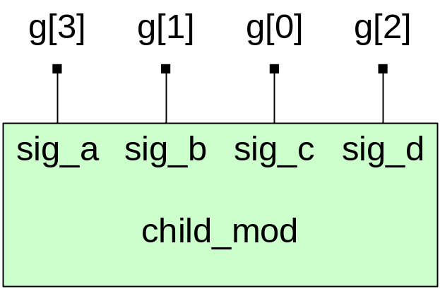
Port Mapping by Position Association
module parent_mod;
wire [3:0] g;
child_mod G1(g[3], g[1], g[0], g[2]);
endmodule
module child_mod(sig_a, sig_b, sig_c, sig_d);
input sig_c, sig_d;
output sig_a, sig_b;
module description
endmodule
in-order port mapping

Slide 50
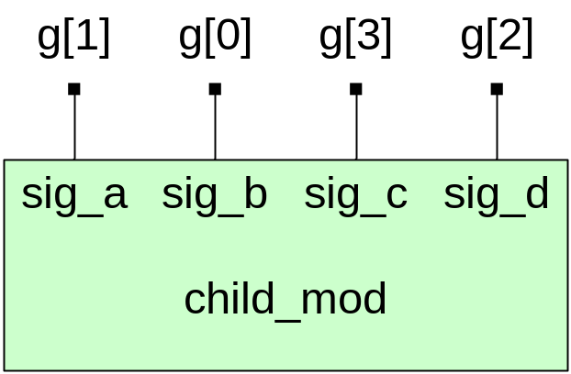
Port Mapping by Name Association
Name mapping is better, why ?
module parent_mod;
wire [3:0] g;
child_mod G1(.sig_c(g[3]), .sig_d(g[2]), .sig_b(g[0]),
.sig_a(g[1]));
endmodule
module child_mod(sig_a, sig_b, sig_c, sig_d);
input sig_c, sig_d;
output sig_a, sig_b;
module description
endmodule
naming port mapping

Slide 51
Expressions
An expression comprises of operators and operands, see Example, and are covered separately in the following two sections.
Example
expression
W<= X - Y + Z
operators
operands

Slide 52
Verilog Operands
Four data objects form the operands of an expression
Verilog Operands
Identifiers Literals string (bit & character) numeric (integer, real⁺) Function Call Index & Slice Names
4’b 1101
34
Identifiers
Verilog identifiers consists of letters, digits, underscores (_) and dollar sign ($)
Verilog is case sensitive, so upper and lower case identifier names are treated
as different identifiers

Slide 53
Identifier and Literal Operands (1/2)
module LITERALS(A1, A2, B1, B2, Y1, Y2);
input A1, A2, B1, B2;
output [7:0] Y1; output [5:0] Y2;
parameter CST = 4’b 1010, TF=25;
reg [7:0] Y1; reg [5:0] Y2;
always @(A1 or A2 or B1 or B2)
begin
if (A1 == 1)
Y1 = {CST, 4’b 0000};
else if (A2 == 1)
Y1 = {CST, 4’b 0101};
else
Y1 = {CST, 4’b 1111};
if (B1 == 0) Y2 = 10;
else if (B2 == 1) Y2 = 15;
else Y2 = TF +10 +15;
end
endmodule
Identifier
Bit string literals
Numeric (integer) literal
Identifier

Slide 54
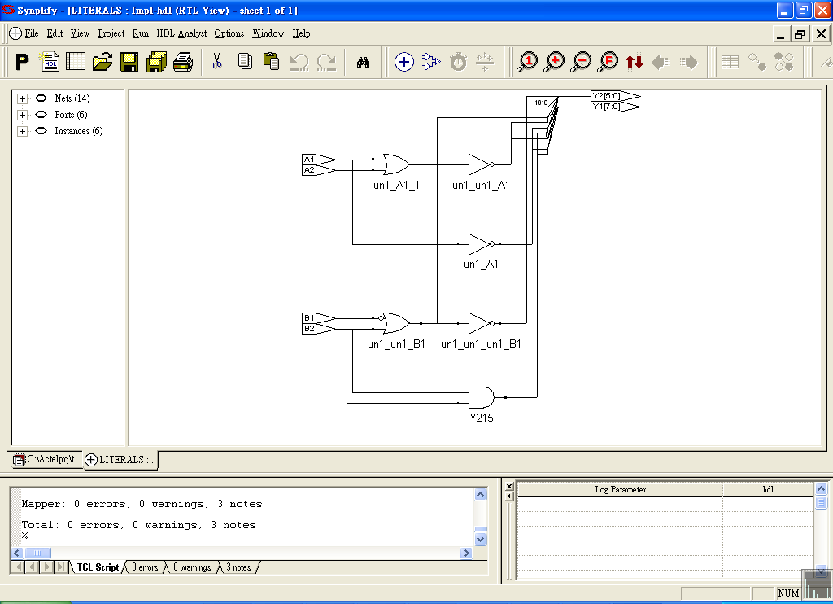
Identifier and Literal Operands (2/2)
parameter CST = 4’b 1010, TF=25;
if (A1 == 1)
Y1 = {CST, 4’b 0000};
else if (A2 == 1)
Y1 = {CST, 4’b 0101};
else
Y1 = {CST, 4’b 1111};
if (B1 == 0) Y2 = 10;
else if (B2 == 1) Y2 = 15;
else Y2 = TF +10 +15;
A1 | 0 | 1 | 0 | 1
A2 | 0 | 0 | 1 | 1
B1 | 0 | 1 | 0 | 1
B2 | 0 | 0 | 1 | 1
Y1 | 10101111 | 10100000 | 10100101 | 10100000
Y2 | 001010₂ (10) | 110010₂ (50) | 001010₂ (10) | 001111₂ (15)

Slide 55
Function Call Operands (1/4)
Function calls, which must reside in an expression, are operands. The single value returned from a function is the operand value used in the expression.
module FUNCTION_CALLS (A1, A2, A3, A4, B1, B2, B3, B4, Y1, Y2);
input A1, A2, A3, A4, B1, B2, B3,B4; output [2:0] Y1, Y2;
reg [2:0] Y1, Y2;
function [2:0] Fn1;
input F1, F2, F3;
begin
Fn1 = F1+F2+F3;
end
endfunction
always @(A1 or A2 or A3 or A4 or B1 or B2 or B3 or B4)
begin
Y1 = Fn1(A1, A2, A3)+A4;
Y2 = Fn1(B1, B2, B3)-B4;
end
endmodule
Function call operand

Slide 56
Function Call Operands (2/4)
function [2:0] Fn1;
input F1, F2, F3;
begin
Fn1 = F1+F2+F3;
end
endfunction
always @(A1 or A2 or A3 or A4 or B1 or B2 or B3 or B4)
begin
Y1 = Fn1(A1, A2, A3)+A4;
Y2 = Fn1(B1, B2, B3)-B4;
end
2‘s complement is implemented: A-B
A加上B的2補數
a.若有進位(carry),代表結果為正, 去
掉進位,剩下即為結果
b.若無進位(carry),代表結果為負, 取
結果的2補數,在前面加上負號
A1 | 0 | 0 | 1 | 1
A2 | 0 | 0 | 1 | 1
A3 | 0 | 0 | 0 | 0
A4 | 0 | 1 | 0 | 1
B1 | 0 | 1 | 0 | 1
B2 | 0 | 0 | 0 | 0
B3 | 0 | 0 | 1 | 1
B4 | 0 | 0 | 1 | 1
Y1[2:0] | 000 | 001 | 010 | 011
Y2[2:0] | 000 | 001 | 000 | 001
1-1 2-1
001 010
+111 +111
1000 1001

Slide 57
Function Call Operands (3/4)
module FUNCTION_CALLS (A1, A2, A3, A4, Y1, Y2);
input A1, A2, A3, A4; output [4:0] Y1, Y2;
reg [4:0] Y1, Y2;
function [4:0] Fn1;
input F1, F2, F3, F4;
begin
Fn1 = F1+F2+F3+F4;
end
endfunction
function [4:0] Fn2;
input F1, F2, F3, F4;
begin
Fn2 = (F1+F2)+(F3+F4);
end
endfunction
always @(A1 or A2 or A3 or A4)
begin
Y1 = Fn1(A1, A2, A3, A4)+10;
Y2 = Fn2(A1, A2, A3, A4)-5;
end
endmodule
A1 | 0 | 0 | 0 | 1
A2 | 0 | 0 | 0 | 1
A3 | 0 | 0 | 1 | 0
A4 | 0 | 1 | 0 | 0
Y1[4:0] | 01010 | 01011 | 01011 | 01100
Y2[4:0] | 11011 | 11100 | 11100 | 11101
00000+11011 (-5)=11011 - 00100+1= -00101(-5)
00001+11011 (-5)=11100 - 00011+1= -00100(-4)

Slide 58
Function Call Operands (4/4)
F1
＋
F2
＋
Fn1 = F1+F2+F3+F4;
F3
＋
Fn1
F4
Longer delay (3 stages)
Why ?
What is the different ?
F1
＋
F2
F3
＋
Fn2
Fn2 = (F1+F2)+(F3+F4);
＋
F4
Shorter delay

Slide 59
Index and Slice Name Operands (1/2)
Index operand specifies a single element of an array and slice operand specifies a sequence of elements within an array
module INDEX_SLICE_NAME (A, B, Y);
input [5:0] A, B;
output [11:0]Y;
parameter C = 3’b111;
reg [11:0] Y;
always @(A or B)
begin
Y[2:0] = A[2:0];
Y[3] = A[3] | B[3];
Y[5:4] = {A[5] | B[5], A[4] & B[4]};
Y[8:6] = B[2:0];
Y[11:9] = C;
end
endmodule

Slide 60
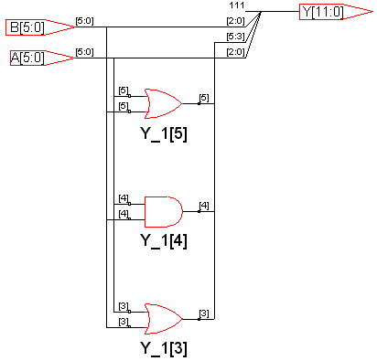
Index and Slice Name Operands (2/2)
parameter C = 3’b111;
Y[2:0] = A[2:0]; Y[3]= A[3] | B[3];
Y[5:4] = {A[5] | B[5], A[4] & B[4]};
Y[8:6] = B[2:0]; Y[11:9]= C;
A[2:0] | 000 | 010 | 100 | 101 | 110
A[3] | 0 | 1 | 0 | 1 | 0
A[4] | 0 | 1 | 0 | 1 | 0
A[5] | 0 | 1 | 0 | 1 | 0
B[2:0] | 110 | 111 | 101 | 001 | 000
B[3] | 0 | 0 | 1 | 1 | 0
B[4] | 0 | 0 | 1 | 1 | 0
B[5] | 0 | 0 | 1 | 1 | 0
Y[0:2] | 000 | 010 | 100 | 101 | 110
Y[3] | 0 | 1 | 1 | 1 | 0
Y[5:4] | 00 | 10 | 10 | 11 | 00
Y[8:6] | 110 | 111 | 101 | 001 | 000
Y[11:9] | 111 | 111 | 111 | 111 | 111

Slide 61
Operators (1/3)
Operators perform an operation on one or more operands within an expression. An expression combines operands with appropriate operators to produce the desired function expression.
Name | Operator
bit-select or part-select parenthesis | [ ] ( )
Arithmetic Operators multiplication division addition subtraction modulus | * / + - %
Sign Operators identity negation | + -

Slide 62
Operators (2/3)
Name | Operator
Relational Operators less than less than or equal to greater than greater than or equal to | < <= > >=
Equality Operators logic equality logic inequality case equality case inequality | == != === !==
Logical Comparison Operators NOT AND OR | ! && ||
Logical Bit-Wise Operators unary negation NOT binary AND binary OR binary XOR binary XNOR | ~ & | ^ ^~ or ~^

Slide 63
Operators (3/3)
Name | Operator
Shift Operators logical shift left logical shift right | << >>
Concatenation & Replication Operators concatenation replication | { } {{ }}
Reduction Operators AND OR NAND NOR XOR XNOR | & | ~& ~| ^ ^~ or ~^
Conditional Operator conditional | ?:

Slide 64
Arithmetic Operators
module ARITHMETIC(A, B, Y1, Y2, Y3);
input [2:0] A, B;
output [3:0] Y1;
output [4:0] Y3;
output [3:0] Y2;
reg [3:0] Y1;
reg [4:0] Y3;
reg [3:0] Y2;
always @(A or B)
begin
Y1 = A + B;
Y2 = A - B;
Y3 = A * B;
Y4 = A / B;
Y5 = A % B;
end
endmodule
Arithmetic operators:
+
-
*
/ (⁺⁺)non-syn.
% (⁺⁺)non-syn.
A[2:0] | 000 | 001 | 101 | 110
B[2:0] | 101 | 111 | 100 | 001
Y1[3:0] | 0101 | 1000 | 1001 | 0111
Y2[3:0] | 1011 (-5) | 1010(-6) | 0001(+1) | 0101(+5)
Y3[4:0] | 00000 | 00111 | 10100 | 00110
(不建議)

Slide 65
Sign Operators
module SIGN(A, B, Y1, Y2);
input [2:0] A;
input [2:0] B;
output [3:0] Y1;
output [3:0] Y2;
reg [3:0] Y1;
reg [3:0] Y2;
always @(A or B)
begin
Y1 = A + -B;
Y2 = -A + B;
end
endmodule
Sign operators:
+
-
A[2:0] | 000 | 001 | 100 | 101 | 110 | 111 | 000
B[2:0] | 110 | 101 | 100 | 010 | 000 | 001 | 101
Y1[3:0] | 1010 (-6) | 1100 (-4) | 0000 (0) | 0011 (3) | 0110 (6) | 0110 (6) | 1011 (-5)
Y2[3:0] | 0110 (6) | 0100 (4) | 0000 (0) | 1101 (-3) | 1010 (-6) | 1010 (-6) | 0101 (5)

Slide 66
Relational Operators
module RELATIONAL_OPERATORS(A, B, Y);
input [2:0] A;
input [2:0] B;
output [3:0] Y;
reg [3:0] Y;
always @(A or B)
begin
Y[0] = A > B;
Y[1] = A >= B;
Y[2] = A < B;
if ( A <= B)
Y[3] = 1;
else
Y[3] = 0;
end
endmodule
Relational operators:
<
<=
>=
>
A[2:0] | 1 | 2 | 3 | 4 | 5 | 6 | 7 | 3 | 0
B[2:0] | 3 | 5 | 6 | 7 | 2 | 1 | 0 | 3 | 6
Y[3] | 1 | 1 | 1 | 1 | 0 | 0 | 0 | 1 | 1
Y[2] | 1 | 1 | 1 | 1 | 0 | 0 | 0 | 0 | 1
Y[1] | 0 | 0 | 0 | 0 | 1 | 1 | 1 | 1 | 0
Y[0] | 0 | 0 | 0 | 0 | 1 | 1 | 1 | 0 | 0

Slide 67
Equality & Inequality Operators
module EQUALITY_OPERATORS(A, B, Y);
input [2:0] A;
input [2:0] B;
output [4:0] Y;
reg [4:0] Y;
always @(A or B)
begin
Y[0] = A != B;
Y[1] = A == B;
if ( A == B)
Y[4:2] = A;
else
Y[4:2] = B;
end
endmodule
Equality operators:
== (等於)
!= (不等於)
=== (⁺⁺) non-syn.
!== (⁺⁺) non-syn.
When comparison is true, the result is 1
When comparison is false, the result is 0
A[2:0] | 0 | 7 | 4 | 1 | 0
B[2:0] | 3 | 7 | 3 | 4 | 5
Y[0] | 1 | 0 | 1 | 1 | 1
Y[1] | 0 | 1 | 0 | 0 | 0
Y[4:2] | 3 | 7 | 3 | 4 | 5

Slide 68
Logical Comparison Operators (1/2)
module COMPARISON(A, B, C1,C2,C3);
input [2:0] A,B;
output [2:0] C1, C2, C3;
reg [2:0] C1, C2, C3;
always @(A or B)
begin
if (( A == 1) && ( B>2 ) )
C1= 2’b 00; else C1= 2’b 11;
if (( A>3) || ( B>1 ) )
C2= 2’b 00; else C2= 2’b 11;
if (!A)
C3= 2’b 00; else C3= 2’b 11;
end
endmodule
Logic comparison operators:
! (NOT)
&& (AND)
|| (OR)

Slide 69
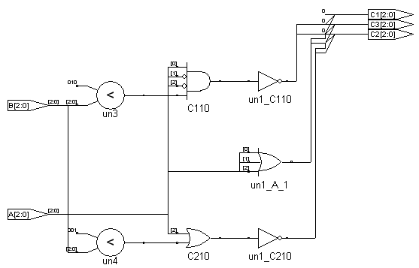
Logical Comparison Operators (2/2)
always @(A or B)
begin
if (( A == 1) && ( B>2))
C1= 2’b 00;
else C1= 2’b 11;
if (( A>3) || ( B>1 ) )
C2= 2’b 00;
else C2= 2’b 11;
if (!A)
C3= 2’b 00;
else C3= 2’b 11;
end
A[2:0] | 000 | 001 | 010 | 101
B[2:0] | 000 | 010 | 001 | 010
C1[2:0] | 011 | 011 | 011 | 011
C2[2:0] | 011 | 000 | 011 | 000
C3[2:0] | 000 | 011 | 011 | 011

Slide 70
Logical Bit-Wise Operators
module BITWISE(A, B, Y1, Y2, Y3, Y4, Y5);
input [3:0] A;
input [3:0] B;
output [3:0] Y1, Y2, Y3, Y4, Y5;
reg [3:0] Y1, Y2, Y3, Y4, Y5;
always @(A or B)
begin
Y1 = ~A;
Y2 = A & B;
Y3 = A | B ;
Y4 = A ^ B;
Y5 = A ^ ~ B;
end
endmodule
Logic bit-wise operators:
(1) ~ (unary NOT)
(2) & (binary AND)
(3) | (binary OR)
(4) ^ (binary XOR)
(5) ^~ or ~^ (binary XNOR)
0110
& 0011
0010
A[3:0] | 0000 | 0001 | 0010 | 0110
B[3:0] | 0000 | 0000 | 0001 | 0011
Y1[3:0] | 1111 | 1110 | 1101 | 1001
Y2[3:0] | 0000 | 0000 | 0000 | 0010
Y3[3:0] | 0000 | 0001 | 0011 | 0111
Y4[3:0] | 0000 | 0001 | 0011 | 0101
Y5[3:0] | 1111 | 1110 | 1100 | 1010
0110
| 0011
0111

Slide 71
Shift Operators
module SHIFT(A, Y1, Y2);
input [7:0] A;
output [7:0] Y1;
output [7:0] Y2;
reg [7:0] Y1;
reg [7:0] Y2;
parameter B=3;
always @(A)
begin
Y1 = A << B;
Y2 = A >> 2;
end
endmodule
Shift operators:
(1) << (left shift)
(2) >> (right shift)
A[7:0] | 00000000 | 00000001 | 00000011 | 00000100
Y1[7:0] | 00000000 | 00001000 | 00011000 | 00100000
Y2[7:0] | 00000000 | 00000000 | 00000000 | 00000001

Slide 72
Concatenation & Replication Operators
module CONCATENATION (A, B, Y);
input [2:0] A;
input [2:0] B;
output [14:0] Y;
reg [14:0] Y;
parameter C=3’b011;
always @(A)
begin
Y = { B, A, { 2 { C } }, 3’b 001};
end
endmodule
Concatenation {}
Replication {{}}
A[2:0] | 000 | 001 | 010 | 011
B[2:0] | 000 | 010 | 100 | 110
Y[14:0] | 000000011011001 | 010001011011001 | 100010011011001 | 110011011011001
3+3+2*3+3=15

Slide 73
Reduction Operators
module REDUCTION (A, Y);
input [3:0] A;
output [5:0] Y;
reg [5:0] Y;
always @(A)
begin
Y[0] = & A;
Y[1] = | A;
Y[2] = ~& A;
Y[3] = ~| A;
Y[4] = ^ A; // XOR,奇同位
Y[5] = ~^ A; //XNOR,偶同位
end
endmodule
Reduction operators:
& (2) |
(3)~& (4) ~|
(5) ^ (6) ~^
& A A[0] & A[1] & A[2] & A[3]
| A A[0] | A[1] | A[2] | A[3]
^ A A[0] ^ A[1] ^ A[2] ^ A[3]
A[3] | 0 | 0 | 0 | 0
A[2] | 0 | 0 | 0 | 0
A[1] | 0 | 0 | 1 | 1
A[0] | 0 | 1 | 0 | 1
Y[5:0] | 101100 | 010110 | 010110 | 100110

Slide 74
Conditional Operators
module ADD_SUB (A, B, SEL, Y);
input [7:0] A; input [7:0] B;
input SEL;
output [8:0] Y1,Y2;
reg [8:0] Y2,Y1;
always @( A or B)
begin
Y1 = ( SEL == 1 ) ? A + B : A – B ;
Y2 = (!SEL) ? A : B;
end
endmodule
Conditional operators:
? :
SEL | 0 | 0 | 1 | 1
A[7:0] | 00000100 | 00000001 | 00000100 | 00000001
B[7:0] | 00000001 | 00000010 | 00000001 | 00000010
Y1[8:0] | 00000011 | 11111111 | 00000101 | 00000011
Y2[8:0] | 00000100 | 00000001 | 00000001 | 00000010

Slide 75
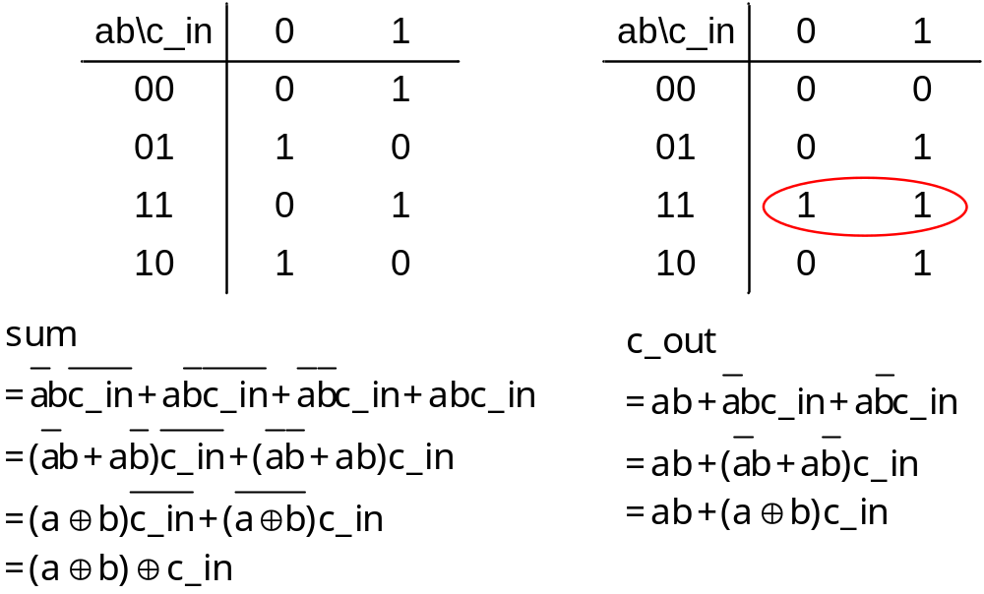
Full Adder (1/6)
Reduction is done by user or tool

Slide 76
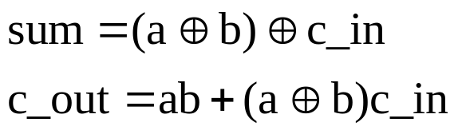
Full Adder (2/6)
module Add_full(c_in, sum, c_out, a, b);
input a, b, c_in;
output sum, c_out;
reg sum, c_out;
always @(a or b or c_in)
begin
sum = (a ^ b) ^ c_in;
c_out = (a&b) | ((a ^ b) &c_in);
end
endmodule
or
assign {c_out, sum} = a + b + c_in;
Save file as Add_full.v and Synthesize it

Slide 77
Full Adder (3/6)
(a⊕b) ⊕ c_in
c_in
a sum
Add_half
b c_out
sum
(a⊕b) c_in
w1
w3
a
a sum
Add_half
b c_out
c_out
(a⊕b)
M2
b
(a⊕b) c_in + ab
M1
ab
w2
module Add_full(sum, c_out, a, b, c_in);
input a, b, c_in;
output sum, c_out;
wire w1, w2, w3;
Add_half M1(w1, w2, a, b);
Add_half M2(sum, w3, c_in, w1);
or (c_out, w2, w3);
endmodule
module Add_half(sum, c_out, a, b);
input a, b;
output sum, c_out;
assign {c_out, sum} = a + b;
endmodule
in-order port mapping

Slide 78
Full Adder (4/6)
Implementation Issue:
module Add_full(sum, c_out, a, b, c_in);
input a, b, c_in;
output sum, c_out;
wire w1, w2, w3;
Add_half M1(w1, w2, a, b);
Add_half M2(sum, w3, c_in, w1);
or (c_out, w2, w3);
endmodule
module Add_half(sum, c_out, a, b);
input a, b;
output sum, c_out;
assign {c_out, sum} = a + b;
endmodule
If both modules (Add_full and Add_half) are saved
in the same file, then name and save the file as
Add_full.v (top module)
Compile Add_full.v and
synthesize it
Add_full.v

Slide 79
Full Adder (5/6)
`include “Add_half.v”
module Add_full(sum, c_out, a, b, c_in);
input a, b, c_in;
output sum, c_out;
wire w1, w2, w3;
Add_half M1(w1, w2, a, b);
Add_half M2(sum, w3, c_in, w1);
or (c_out, w2, w3);
endmodule
module Add_half(sum, c_out, a, b);
input a, b;
output sum, c_out;
assign {c_out, sum} = a + b;
endmodule
If modules Add_full and Add_half are saved
in the distinguish files (Add_full.v and Add_half
respectively), then the include command is necessary (otherwise ?..)
Compile Add_full.v and
synthesize it
Add_full.v
Add_half.v

Slide 80
Full Adder (6/6)
4-bit Adder
module Adder_4_RTL(sum, c_out, a, b, c_in);
input [3:0] a, b;
input c_in;
output [3:0] sum;
output c_out;
assign {c_out, sum} = a + b+ c_in;
endmodule
1
a
b
c_in
4
4
The synthesized circuit is dependent on
the tool you use (might be ripple-carry
Adder or other Adders).
4-bit Adder
1
4
c_out
sum

Slide 81
Hierarchical Description of Circuit
module Add_rca_4(sum, c_out, a, b, c_in);
input [3:0] a, b;
input c_in;
output [3:0] sum;
output c_out;
wire c_in2, c_in3, c_in4;
Add_full G1(sum[0], c_in2, a[0], b[0], c_in);
Add_full G2(sum[1], c_in3, a[1], b[1], c_in2);
Add_full G3(sum[2], c_in4, a[2], b[2], c_in3);
Add_full G4(sum[3], c_out, a[3], b[3], c_in4);
endmodule
Ripple-Carry
Adder
a[3]
b[3]
a[2]
b[2]
a[1]
b[1]
a[0]
b[0]
c_in
Add_full
Add_full
Add_full
Add_full
c_out
G4
G3
G2
G1
c_in4
c_in3
c_in2
sum[3]
sum[2]
sum[1]
sum[0]

Slide 82
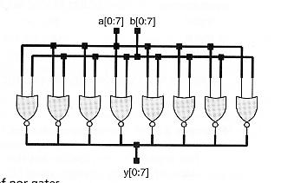
Array of Instances
module array_of_nor(y, a, b);
input [0:7] a, b;
output [0:7] y;
nor (y[0], a[0], b[0]);
nor (y[1], a[1], b[1]);
nor (y[2], a[2], b[2]);
nor (y[3], a[3], b[3]);
nor (y[4], a[4], b[4]);
nor (y[5], a[5], b[5]);
nor (y[6], a[6], b[6]);
nor (y[7], a[7], b[7]);
endmodule
module array_of_nor(y, a, b);
input [0:7] a, b;
output [0:7] y;
nor [0:7] (y, a, b);
endmodule

Slide 83
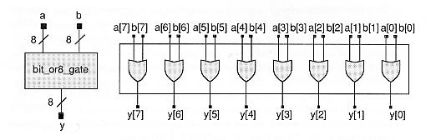
Two alternatives for Continuous Assignment
module bit_or8_gate1(y, a, b);
input [7:0] a, b;
output [7:0] y;
assign y = a | b;
endmodule
module bit_or8_gate2(y, a, b);
input [7:0] a, b;
output [7:0] y;
wire [7:0] y = a | b;
endmodule

Slide 84
Multiple Instantiations and Assignments
module Multiple_Gates(y1, y2, y3, a1, a2, a3, a4);
input a1, a2, a3, a4;
output y1, y2, y3;
nand #1 G1(y1, a1, a2, a3), (y2, a2, a3, a4), (y3, a1, a4);
endmodule
module Multiple_Assigns(y1, y2, y3, a1, a2, a3, a4);
input a1, a2, a3, a4;
output y1, y2, y3;
assign #1 y1 = a1 ^ a2, y2 = a2 | a3, y3 = a1 + a2;
endmodule

Slide 85
3 to 8 Decoder (1/4)
In[0]
3-8
decoder
Out[0]
In[0]
.
.
In[2]
E
Out[7]
E | In[2] | In[1] | In[0] | Out[7] | Out[6] | Out[5] | Out[4] | Out[3] | Out[2] | Out[1] | Out[0]
0 1 1 1 1 1 1 1 1 | X 0 0 0 0 1 1 1 1 | X 0 0 1 1 0 0 1 1 | X 0 1 0 1 0 1 0 1 | 0 0 0 0 0 0 0 0 1 | 0 0 0 0 0 0 0 1 0 | 0 0 0 0 0 0 1 0 0 | 0 0 0 0 0 1 0 0 0 | 0 0 0 0 1 0 0 0 0 | 0 0 0 1 0 0 0 0 0 | 0 0 1 0 0 0 0 0 0 | 0 1 0 0 0 0 0 0 0

Slide 86
3 to 8 Decoder (2/4)
Structural description
module decoder (E , In , Out);
input E; input [2:0] In;
output [7:0] Out;
wire [7:0] Out;
wire tmp0 , tmp1 , tmp2;
not not1(tmp0,In[0]); not not2(tmp1,In[1]);
not not3(tmp2,In[2]);
and and0(Out[0] , E , tmp0 , tmp1 , tmp2);
and and1(Out[1] , E , In[0] , tmp1 , tmp2);
and and2(Out[2] , E , tmp0 , In[1] , tmp2);
and and3(Out[3] , E , In[0] , In[1] , tmp2);
and and4(Out[4] , E , tmp0 , tmp1 , In[2]);
and and5(Out[5] , E , In[0] , tmp1 , In[2]);
and and6(Out[6] , E , tmp0 , In[1] , In[2]);
and and7(Out[7] , E , In[0] , In[1] , In[2]);
endmodule
Out[0]
In[0]
Out[1]
Out[2]
In[1]
Out[3]
In[2]
Out[4]
E
Out[5]
Out[6]
Out[7]

Slide 87
3 to 8 Decoder (3/4)
Data flow description
module decoder(E , In , Out);
input E;
input [2:0]In;
output [7:0]Out;
wire [7:0]Out;
assign Out = E ? 1'b1 << In : 8'h0;
endmodule
Out[0]
In[0]
Out[1]
Out[2]
In[1]
Out[3]
In[2]
Out[4]
E
true false
Out[5]
Out[6]
Synthesized and
optimized by tools
Out[7]

Slide 88
3 to 8 Decoder (4/4)
Behavioral description
module Decoder_Behavioral(E, In, Out);
  Input E;
  input [2:0] In;
  output [7:0] Out;
  reg [7:0] Out;
  always @(E or In)
  begin
  if(!E)
  Out = 8'h00;
  else
  begin
  case(In)
  3'b000: Out = 8'h01;
  3'b001: Out = 8'h02;
  3'b010: Out = 8'h04;
  3'b011: Out = 8'h08;
  3'b100: Out = 8'h10;
  3'b101: Out = 8'h20;
  3'b110: Out = 8'h40;
  default: Out = 8'h80;
  endcase
  end
  end
  endmodule
E
In
Out
0 X X X 0 0 0 0 0 0 0 0
1 0 0 0 0 0 0 0 0 0 0 1
1 0 0 1 0 0 0 0 0 0 1 0
1 0 1 0 0 0 0 0 0 1 0 0
1 0 1 1 0 0 0 0 1 0 0 0
1 1 0 0 0 0 0 1 0 0 0 0
1 1 0 1 0 0 1 0 0 0 0 0
1 1 1 0 0 1 0 0 0 0 0 0
1 1 1 1 1 0 0 0 0 0 0 0

Slide 89
Hierarchical Design of 3-8 decoder
module decoder_2_4(E , In , Out);
input E; input [1:0] In;
output [3:0]Out; wire [3:0] Out;
assign Out = E ? 1'b1 << In : 4'h0;
endmodule
module decode_3_8(E , In , Out);
input E; input [2:0] In;
output [7:0] Out; wire E1 , G1 , G2;
not u1(E1 , In[2]); and a1(G1 , E , In[2]);
and a2(G2 , E , E1);
decoder_2_4 M(G1 , In[1 : 0] , Out[7 : 4]);
decoder_2_4 L(G2 , In[1 : 0] , Out[3 : 0]);
endmodule
E
In[2]
In[1]
In[0]
E1
2 to 4 decoder
In[1]
In[0]
In[1]
In[0]
Decoder1
2- 4 decoder
Decoder 0
2- 4 decoder
G2
G1
Out[7:4]
Out[3:0]

Slide 90
Simulation
Response
Generation
Stimulus
and
Control
Verilog
Module
Verification
Waveform,
text reports
Waveform,
test patterns
Test Bench

Slide 91
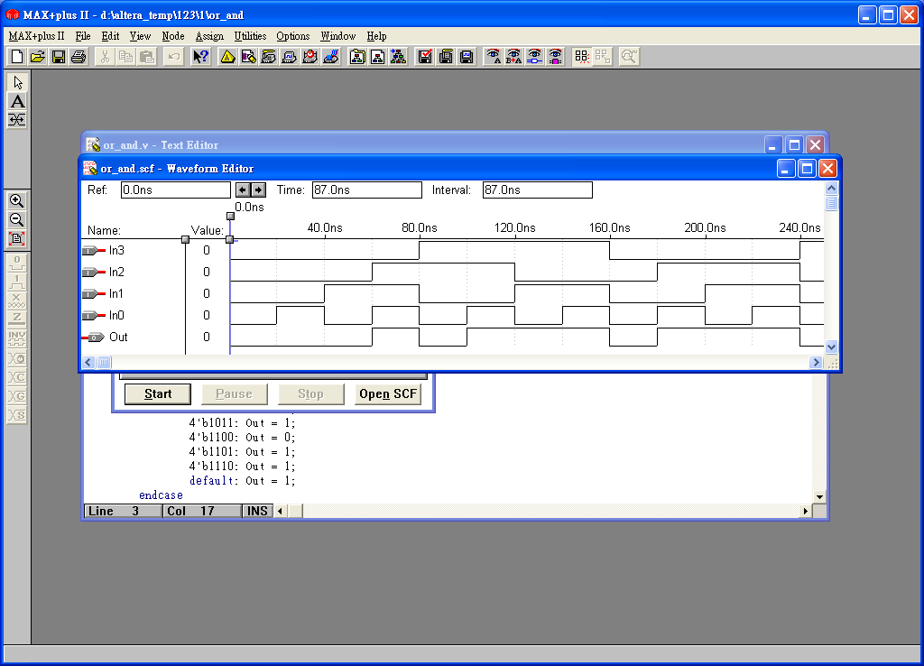
Waveform Simulation (1/3)
Most EDA tools support waveform simulation
The results by using Altera functional simulation
  module OR_AND_DATA_FLOW(in, out);
  input [3:0] in;
  output out;
  assign out = (in[0] | in[1]) & (in[2] | in[3]);
  endmodule

Slide 92
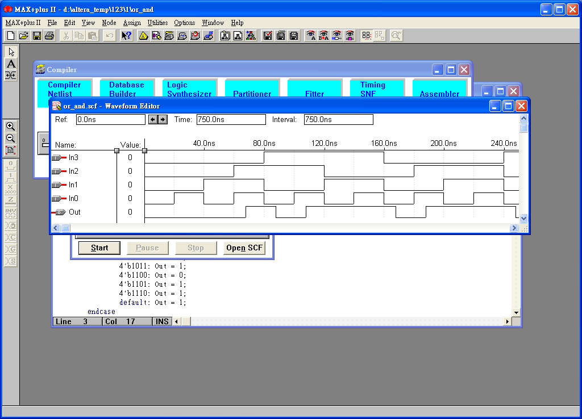
Waveform Simulation (2/3)
The results by using Altera functional simulation + timing simulation
delay (based on Altera Cell)
No delay is introduced if only functional simulation is used

Slide 93
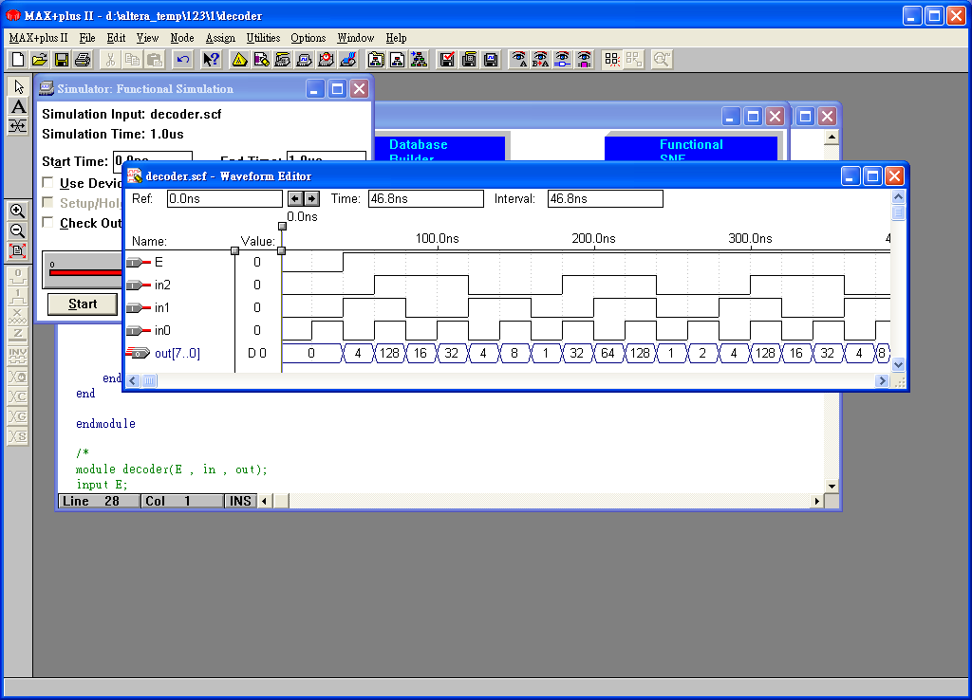
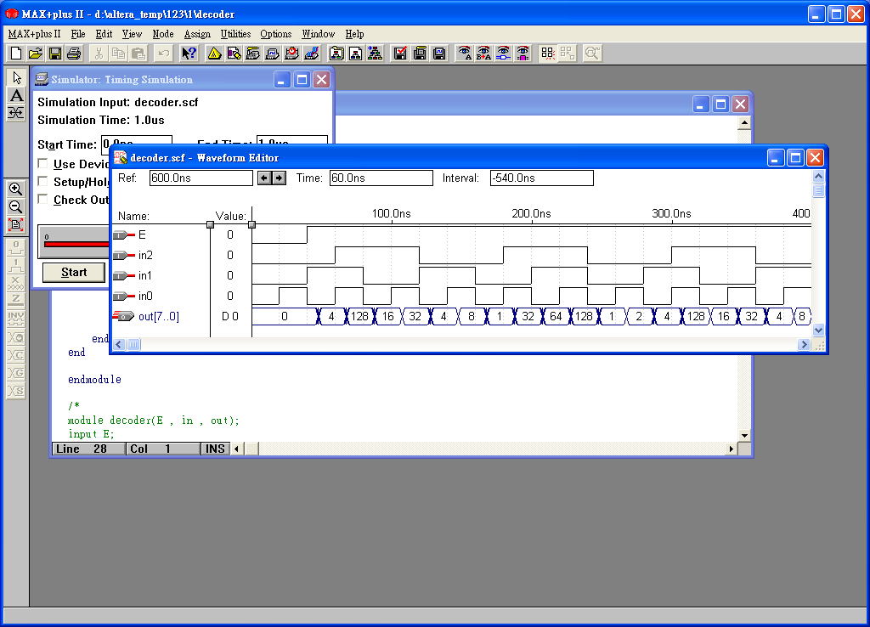
Waveform Simulation (3/3)
functional simulation for 3 to 8 decoder
functional simulation + timing simulation
delay
delay

Slide 94
ModelSim Test_Bench Simulation (1/4)
Test_bench
  module or_and_tb;
  reg in1, in2, in3, in4;
  wire out;
  or_and ok(.in1(in1), .in2(in2),
  .in3(In3), .in4(in4), .out(out));
  initial
  begin
  #0 in1=0; in2=0; in3=0; in4=0;
  #10 in1=0; in2=0; in3=0; in4=1;
  #10 in1=0; in2=0; in3=1; in4=0;
  #10 in1=0; in2=0; in3=1; in4=1;
  #10 in1=0; in2=1; in3=0; in4=0;
  #10 in1=0; in2=1; in3=0; in4=1;
  #10 in1=0; in2=1; in3=1; in4=0;
  #10 in1=0; in2=1; in3=1; in4=1;
#10 in1 = 1; in2 = 0; in3 = 0; in4 = 0;
#10 in1 = 1; in2 = 0; in3 = 0; in4 = 1;
#10 in1 = 1; in2 = 0; in3 = 1; in4 = 0;
#10 in1 = 1; in2 = 0; in3 = 1; in4 = 1;
#10 in1 = 1; in2 = 1; in3 = 0; in4 = 0;
#10 in1 = 1; in2 = 1; in3 = 0; in4 = 1;
#10 in1 = 1; in2 = 1; in3 = 1; in4 = 0;
#10 in1 = 1; in2 = 1; in3 = 1; in4 = 1;
end
endmodule
Altera does not support this kind of
simulation (inputs is activated by
commands in the test bench file).
ModelSim is a PC-based tool.
(workstation-like)

Slide 95
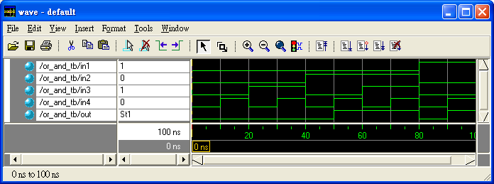
ModelSim Test_Bench Simulation (2/4)
Functional simulation only (no delay is introduced)
In ModelSim, Input: test patterns (using comds.) Output: waveform
In Altera, Input: waveform Output: waveform

Slide 96
ModelSim Test_Bench Simulation (3/4)
Test_bench
module decoder_3_8_tb;
reg E;
reg [2:0] in;
wire [7:0] out;
decoder ok(.E(E), .in(in), .out(out));
initial
begin
#0 E = 0; in = 3'b000;
#10 E = 1; in = 3'b000;
#10 E = 1; in = 3'b001;
#10 E = 1; in = 3'b010;
#10 E = 1; in = 3'b011;
#10 E = 1; in = 3'b100;
#10 E = 1; in = 3'b101;
#10 E = 1; in = 3'b110;
#10 E = 1; in = 3'b111;
end
endmodule
Exhaustive test or partial test for functional simulation in test_bench ? How about chip test ? Exhaustive or partial testing?

Slide 97
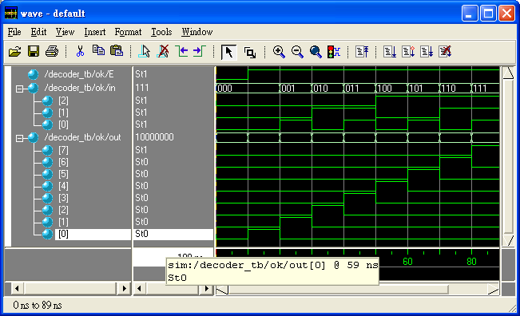
ModelSim Test_Bench Simulation (4/4)

Slide 98
Signalscan Simulation in WS (1/4)
Test_bench
module decoder_3_8_tb;
reg E;
reg [2:0] in;
wire [7:0] out;
decoder ok(.E(E), .in(in), .out(out));
initial
begin
#0 E = 0; in = 3'b000;
#10 E = 1; in = 3'b000;
#10 E = 1; in = 3'b001;
#10 E = 1; in = 3'b010;
#10 E = 1; in = 3'b011;
#10 E = 1; in = 3'b100;
#10 E = 1; in = 3'b101;
#10 E = 1; in = 3'b110;
#10 E = 1; in = 3'b111;
End
Initial
begin
$dumpfile(“decoder.fsdb”);
$dumpvars(0 , decoder_tb);
$shm_open(“ok”);
$shm_probe(“AS”);
end
endmodule

Slide 99
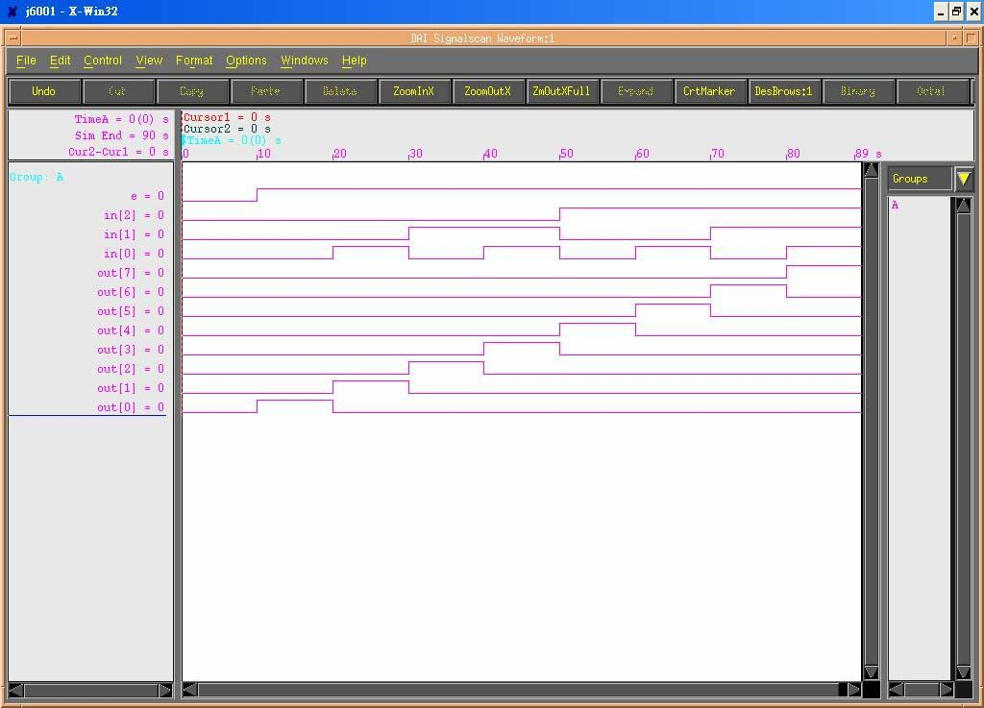
Signalscan Simulation in WS (2/4)

Slide 100
Signalscan Simulation in WS (3/4)
module decoder_tb;
reg E;
reg [2:0] in;
reg [3:0] i;
wire [7:0] out;
integer decoder_1;
decoder ok(.E(E), .in(in), .out(out));
initial //Open file_decoder
begin
decoder_1 = $fopen("decoder_out.txt");
end
initial
begin
for(i=0; i<8; i = i + 1)
begin
#10 E = 1 ; in[2:0] = i[3:0];
#1 $fdisplay(decoder_1," E = %d
in[2] =%d in[1] = %d in[0] = %d
out = %b",E,in[2],in[1],in[0],out[7:0]);
$monitor($time , " E = %d in[2] = %d
in[1] = %d in[0] = %d out = %b", E,
in[2], in[1], in[0], out[7:0]);
end
$dumpfile("sim_decoder.dump");
$dumpvars(1,decoder_tb);
$shm_open("sim_decoder");
$shm_probe("AC");
end
endmodule

Slide 101
Signalscan Simulation in WS (4/4)
decoder_out.txt
E = 1 in[2] = 0 in[1] = 0 in[0] = 0 out = 00000001
E = 1 in[2] = 0 in[1] = 0 in[0] = 1 out = 00000010
E = 1 in[2] = 0 in[1] = 1 in[0] = 0 out = 00000100
E = 1 in[2] = 0 in[1] = 1 in[0] = 1 out = 00001000
E = 1 in[2] = 1 in[1] = 0 in[0] = 0 out = 00010000
E = 1 in[2] = 1 in[1] = 0 in[0] = 1 out = 00100000
E = 1 in[2] = 1 in[1] = 1 in[0] = 0 out = 01000000
E = 1 in[2] = 1 in[1] = 1 in[0] = 1 out = 10000000
What should we do after HDL simulation ?
FPGA synthesis or ASIC synthesis

Slide 102
Synthesis Flow of VLSI design (1/3)
Behavioral requirement
Synthesis
High level synthesis
Functional design
Verification and analysis
Behavioral or functional simulation
Behavioral representation
Boolean equations and RTL
Verification and analysis
Logic verification, Logic simulation
Testing
Synthesis
Logic synthesis
Logic design
Structural representation
Logic gates, connections
Synthesis
Cell generators
Circuit design
Verification and analysis
Circuit simulation, Circuit analysis
Structural representation
Transistors and connections
Synthesis
Floorplanning,
Placement, Routing
Physical design
Verification and analysis
Design-rule checking
Circuit extraction
Physical representation
Mask layout rectangles

Slide 103
Synthesis Flow of VLSI design (2/3)
Synthesis:
  1. A transition from a single domain to another
  2. Add detail to the current state of the design
  3. Perform fully automatically by some synthesis
  tool or manually by the designer
  Verification tool:
  Check whether a synthesis step has left the
  specification intact
  Analysis tool:
  Provide data on the quality of the design (speed,area,..)

Slide 104
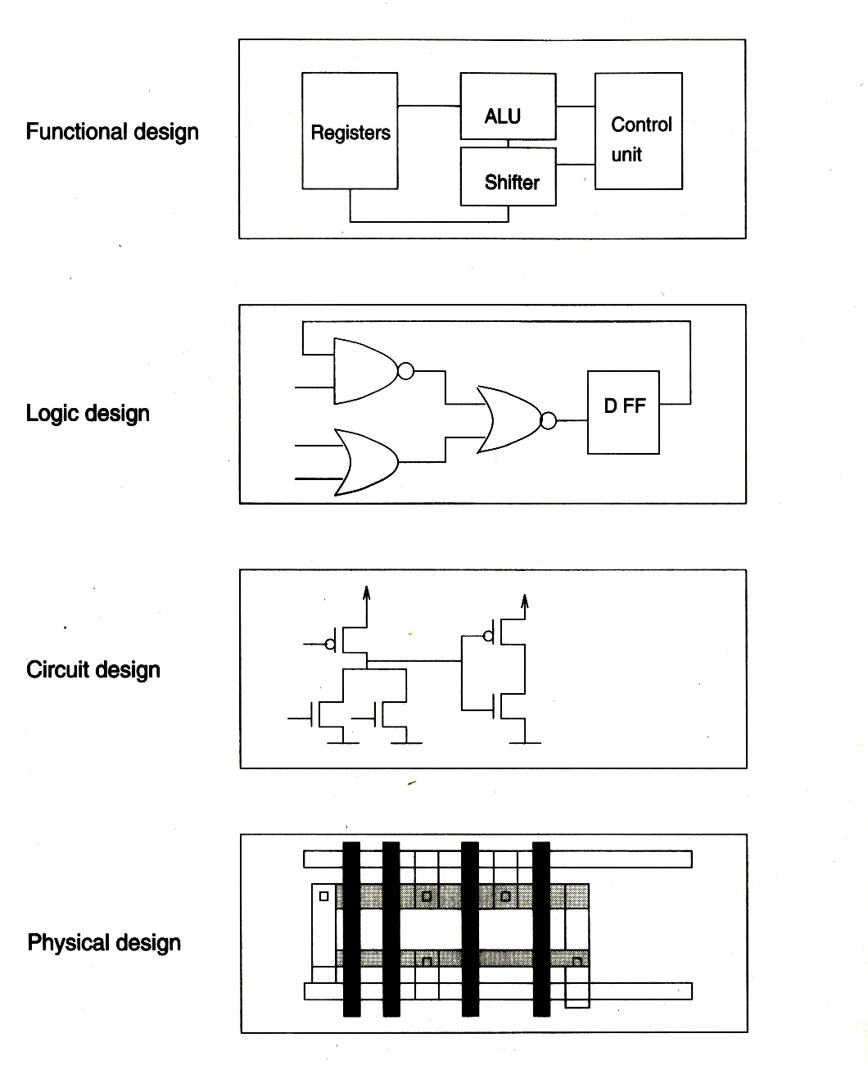
Synthesis Flow of VLSI design (3/3)
Behavioral
description
High level synthesis
RTL
Code
logic synthesis
gates
circuits synthesis
Physical synthesis:
Floorplanning & Placement
Fix the relative positions of the subblocks
b. Routing
Generate the interconnection wires between blocks
transistors
physical synthesis

