Slide 1
數位IC設計
RTL Coding – Part II

Slide 2
Begin_End Statements
Begin-end block statements:
begin [: block_name
reg local_variable_l ;
integer local_variable_2 ;
parameter local_variable_3 ;]
. . . statements . . .
end
Block statements is a way of syntactically grouping several statements into a single statement.
Sequential blocks are delimited by the keywords begin and end. These begin…end pairs are commonly used in conjunction with if, case, and for statements to group several statements.
Functions and always blocks that contain more than one statement require a begin…end pair to group the statements.
Verilog provides a construct called a named block.
Verilog allows you to declare variables (reg, integer and parameter) locally within a named block but not in an unnamed block.

Slide 3
Named Block (1/3)
module UNNAMED_BLOCK(A , B , E , Y);
parameter FI = 12;
input [3 : 0]A;
input [3 : 0]B;
input E;
output [4 : 0]Y;
reg [4 : 0]Y;
always @(A or B or E)
begin
if(E)
Y = (A + B) & FI;
else
Y = (A - B) & FI;
end
endmodule
module NAMED_BLOCK(A , B , E , Y);
input [3 : 0]A; input [3 : 0]B;
input E; output [4 : 0]Y; reg [4 : 0] Y;
always @(A or B or E)
begin
if(E)
begin: Add_And
parameter FI = 12; // in a named block
Y = (A + B) & FI;
end
else
begin: Sub_And
parameter FII = 2; // in a named block
Y = (A - B) & FII;
end
end
endmodule

Slide 4
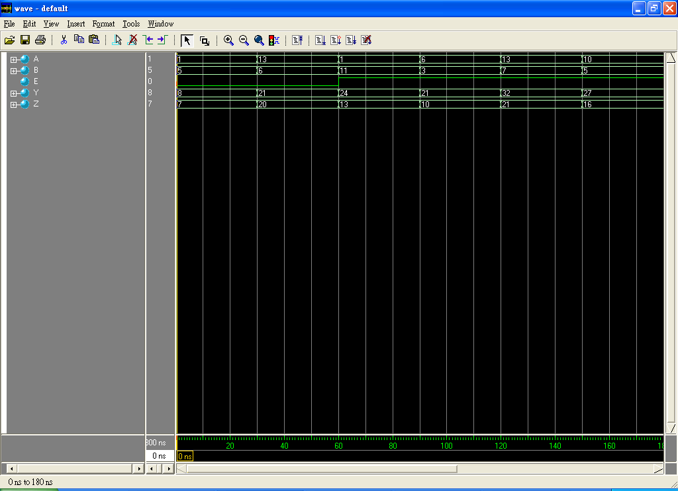
Named Block (2/3)
if(E)
begin: Add_And
parameter FI = 12;
Y = (A + B) + FI; //FI is 12 not 1
end
else
begin: Sub_And
parameter FII = 2;
Y = (A +B) + FII; //FII is 2 not 8
end end
assign Z = (A + B) + FI; //FI is 1
endmodule
module NAMED_BLOCK(A , B , E , Y);
input [3 : 0]A; input [3 : 0]B;
input E; output [4 : 0]Y;
reg [4 : 0]Y;
parameter FI = 1;
parameter FII = 8;
always @(A or B or E)
begin

Slide 5
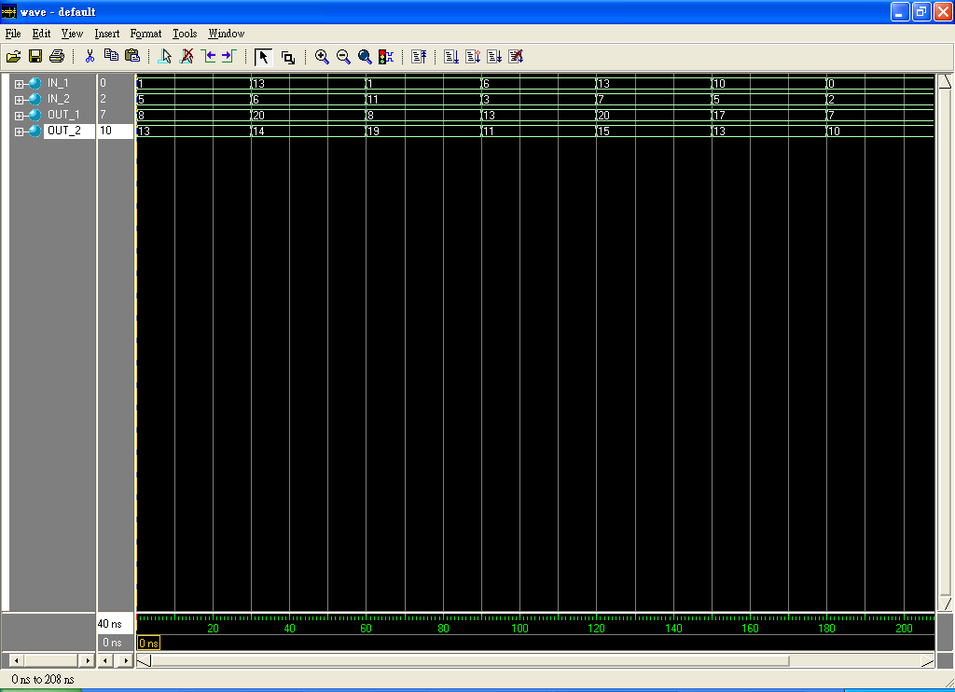
Named Block (3/3)
module LOCAL_GOL(IN_1 , IN_2 , OUT_1 , OUT_2);
input [3 : 0]IN_1;
input [3 : 0]IN_2;
output [4 : 0]OUT_1;
output [4 : 0]OUT_2;
reg [4 : 0]OUT_1;
reg [4 : 0]OUT_2;
always @(IN_1)
begin: Local_Value_1
parameter X = 7;
OUT_1 = IN_1 + X;
end
parameter X = 1;
always @(IN_2)
begin: Local_Value_2
parameter X = 8;
OUT_2 = IN_2 + X;
end
endmodule

Slide 6
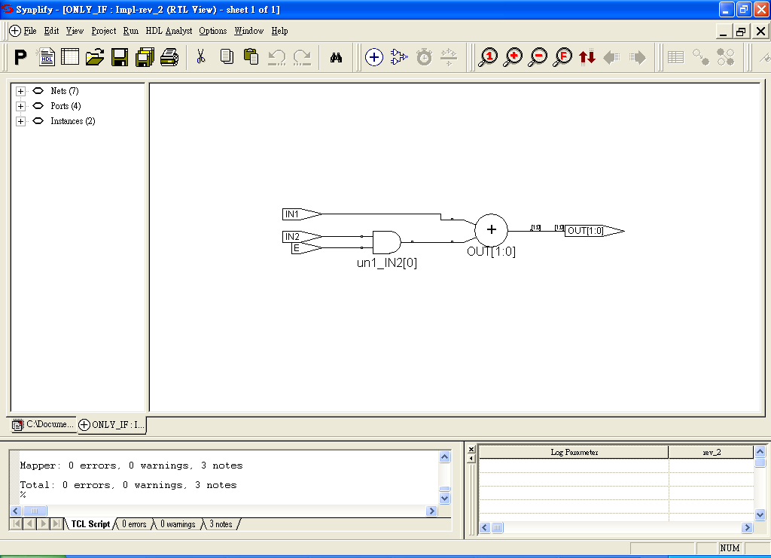
If-Else Statements (1/4)
The if statement is followed by a statement or block of statements enclosed by begin and end.
If the value of the expression is nonzero, the expression is true and the statement block that follows is executed. If the value of the expression is zero, the expression is false and the statement block following else is executed.
If..else statements can cause synthesis of latches.
If (expression)
begin
. . . statements . . .
end
[eIse
begin
. . . statements . . .
end]
module IF_ELSE(IN1 , IN2 , E , OUT);
input IN1, IN2, E;
output [1 : 0] OUT; reg [1 : 0]OUT;
always @(IN1 or IN2 or E)
begin
if(E == 1)
OUT = IN1 + IN2;
else
OUT = IN1; end
endmodule

Slide 7
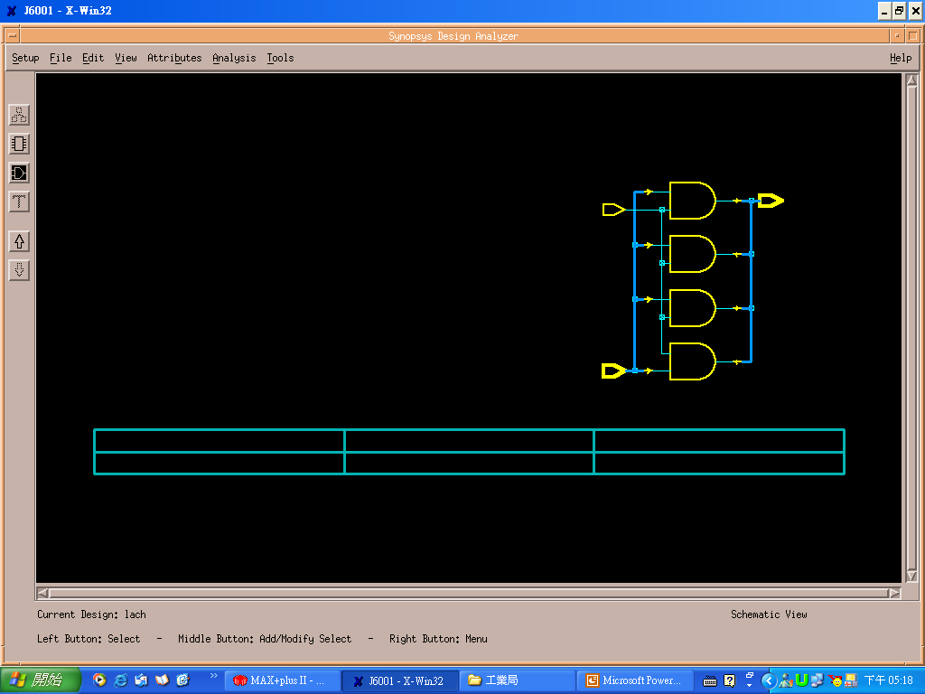
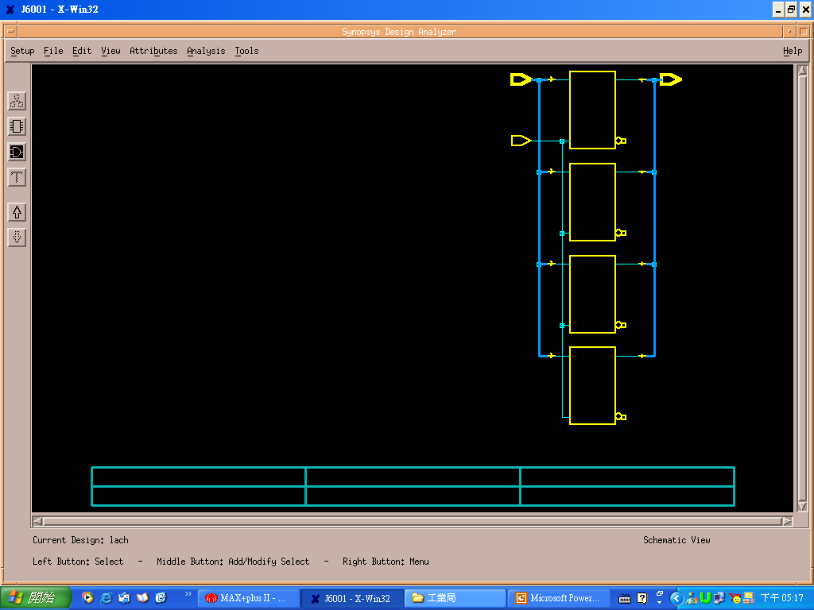
If-Else Statements (2/4)
Watch for unintentional Latches
Module Latch(In, Enable, Out);
input Enable;
Input [3:0] In;
output [3:0] Out;
always @(In or Enable)
begin
if(Enable)
Out=In;
else
Out=0;
end
endmodule
Module Latch(In, Enable, Out);
input Enable;
input [3:0] In;
output [3:0] Out;
always @(In or Enable)
begin
if(Enable)
Out=In;
end
endmodule
No latch inference
Always@ (In or Enable)
begin
Out=0;
if(Enable)
Out=In;
end // no latch
If Enable ==1
Out (new) = In
If Enable==0
Out (new) = Out (old)

Slide 8
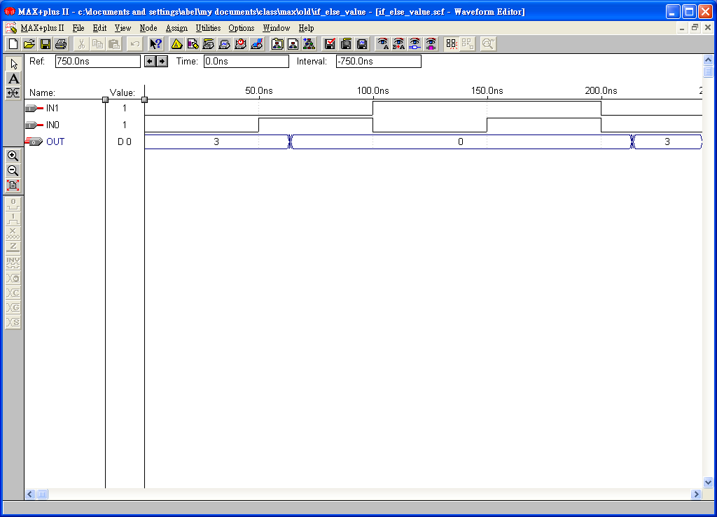
If-Else Statements (3/4)
module IF_ELSE_VALUE(IN , OUT);
input [1 : 0]IN;
output [1 : 0]OUT;
reg [1 : 0]OUT;
always @(IN)
begin
if(IN==1)
OUT = 2'b00;
else
OUT = 2'b11;
end
endmodule
module IF_ELSE_VALUE(IN , OUT);
input [1 : 0]IN;
output [1 : 0]OUT;
reg [1 : 0]OUT;
always @(IN)
begin
if(IN)
OUT = 2'b00;
else
OUT = 2'b11;
end
endmodule
IN=0,OUT=11
IN=1,OUT=00
IN=2,OUT=11
IN=3,OUT=11
IN=0,OUT=11
IN=1,OUT=00
IN=2,OUT=00
IN=3,OUT=00
true
nonzero true
false
zero false
What is the difference between them?

Slide 9
If-Else Statements (4/4)
if-then-else statement implies priority-encoded MUXs
d
0
always @(sel or a or b or c or d)
if (sel[2] == 1’b1)
out = a; //sel=1XX
else if (sel[1] == 1’b1)
out = b; //sel=01X
else if (sel[0] == 1’b1)
out = c; //sel=001
else
out = d; //sel=000
c
1
sel
sel[0] = ‘1’
0
b
1
sel[1] = ‘1’
0
out
a
1
sel[2] = ‘1’

Slide 10
Resource Sharing (1/2)
Assign similar operations to a common netlist cell
  reduce hardware
  may degrade performance
  resource sharing within the same always block
  resource sharing not done for conditional operator
Without resource sharing
Resource sharing
assign z = sel_a ? a+t : b+t;
if (sel_a)
z = a + t;
else
z = b + t;
a
+
1
t
z
b
0
+
t
sel_a
a
1
Hence, in this case you better use if
statement not conditional operator “?”
to save a lot of cost and area
+
z
b
0
sel_a

Slide 11
Resource Sharing (2/2)
module share(v, w, z,k);
input [2:0] k,v,w;
input x; output [3:0]z;
reg [3:0] y,z;
always@(x or k or v or w)
begin
if(x)
y=k+w;
else
y=k+v;
end
always@(y or x or w or v)
begin
if(x)
z=y+w;
else
z=y+v;
end
endmodule
module noshare(v, w, x, z, k);
input [2:0]k,v,w;
input x;
output [3:0]z;
wire [3:0]y;
assign y=x?k+w:k+v;
assign z=x?y+w:y+v;
endmodule
Without resource sharing
With resource sharing

Slide 12
Case Statements (1/4)
case (expression)
case_item 1:
begin
. statements . .
end
case_item 2:
begin
. statements. .
end
. . . . .
default:
begin
. statements. .
end
endcase
The case statement consists of the keyword case, followed by an expression in parentheses, followed by one or more case items (and associated statements to be executed), followed by the keyword endcase. A case item consists of an expression (usually a simple constant) or a list of expressions separated by commas, followed by a colon (: ).
module FULL_CASE(IN , OUT);
input [1 : 0]IN;output [3 : 0] OUT;
reg [3 : 0]OUT;
always @(IN)
begin
case(IN)
2'b00: OUT = 4'b0001;
2'b01: OUT = 4'b0010;
2'b10: OUT = 4'b0100;
2'b11: OUT = 4'b1000;
endcase
end
endmodule
module FULL_CASE(IN , OUT);
input [1 : 0]IN;output [3 : 0] OUT;
reg [3 : 0]OUT;
always @(IN)
begin
case(IN)
2'b00: OUT = 4'b0001;
2'b01: OUT = 4'b0010;
2'b10: OUT = 4'b0100;
endcase // not full-case, latches are inferred
end
endmodule

Slide 13
Case Statements (2/4)
If the conditional expression used is mutually exclusive (i.e. parallel) and the functional outputs are the same, then the hardware synthesized will be same.
a
00
b
01
out
c
10
d
11
always @ (sel or a or b or c or d)
begin
case (sel)
2’b00: out = a;
2’b01: out = b;
2’b10: out = c;
default : out = d;
endcase
end
2
always @(sel or a or b or c or d)
if (sel == 2’b00)
out = a;
else if (sel == 2’b01)
out = b;
else if (sel == 2’b10)
out = c;
else
out = d;
sel

Slide 14
Case Statements (3/4)
module FULL_CASE(IN , OUT);
input [1 : 0]IN; output [3 : 0] OUT;
reg [3 : 0]OUT;
always @(IN)
begin
case(IN)
2'b00: OUT = 4'b0001;
2'b01: OUT = 4'b0010;
2'b10: OUT = 4'b0100;
2'b11: OUT = 4'b1000;
endcase
end
endmodule
module FULL_CASE(IN , OUT);
input [1 : 0]IN; output [3 : 0] OUT;
reg [3 : 0]OUT;
always @(IN)
begin
case(IN)
2'b00: OUT = 4'b0001;
2'b01: OUT = 4'b0010;
2'b10: OUT = 4'b0100;
default: OUT = 4'b1000;
endcase
end
endmodule
It is always a good idea to use default-case-item in all conditions to
make sure no latch is inferred.

Slide 15
Case Statements (4/4)
Watch Out for Unintentional Latches
Completely specify all clauses for every case and if statement
Completely specify all output for every clause of each case or if statement
Failure to do so will cause latches or flip-flops to be synthesized
always @ (d)
begin
case (d)
2’b00: z = 1’b0;
2’b01: z = 1’b0;
2’b10: ;
endcase
end
Missing Case
Missing Outputs
d ==00 z = 0
d ==01 z=0
d ==10 z(new)=z(old)
d ==11 z(new)=z(old)

Slide 16
Casez and Casex Statements
casez (expression)
case_item 1:
begin
. statements . .
end
case_item 2:
begin
. statements. .
end
. . . . .
default:
begin
. statements. .
end
endcase
casex (expression)
case_item 1:
begin
. statements . .
end
case_item 2:
begin
. statements. .
end
. . . . .
default:
begin
. statements. .
end
endcase
casez:
The case item can use z or ?
casex:
The case item can use z, x, or ?
casez is one of the conditions in casex

Slide 17
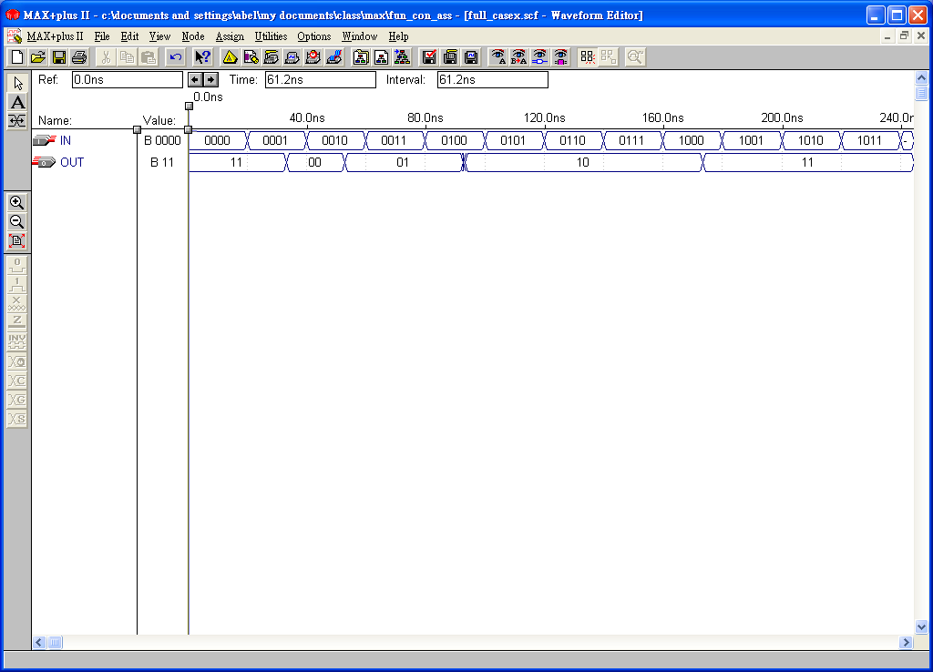
Casex Statement
always @(IN)
begin
casex(IN)
4'b0001: OUT = 2'b00;
4'b001?: OUT = 2'b01;
4'b01??: OUT = 2'b10;
default: OUT = 2'b11;
endcase
end
endmodule
module FULL_CASEX(IN , OUT);
input [3 : 0] IN;
output [1 : 0] OUT;
reg [1 : 0] OUT;

Slide 18
For Loop Statements (1/2)
The for loop repeatedly executes a single statement or block of statements. The repetitions are performed over a range determined by the range expressions assigned to an index. Two range expressions appear in each for loop: low_range and high_range. In the syntax lines that follow, high_range is greater than or equal to low_range. HDL Compiler recognizes incrementing as well as decrementing loops. The statement to be duplicated is surrounded by begin and end statements.
for (index = low_range; index < high_range; index = index + step)
for (index = high_range; index > low_range; index = index - step)
for (index = low_range; index <= high_range; index = index + step)
for (index = high_range; index >= low_range; index = index - step)
for (i = 0; i <= 31; i = i +1)
begin
s[i] = a[i] ^ b[I] ^ carry;
carry = (a[i] & b[i]) | (a[i] & carry) | (b[i] & carry);
end
For statement: unrolling the logic

Slide 19
For Loop Statements (2/2)
for loop are “unrolled”, and then synthesized.
integer i;
always @(a r b)
begin
for (i = 0; i < 6; i = i+1)
example[i] <= a[i] & b[5-i];
end
a[0]
example[0]
b[5]
a[1]
example[1]
b[4]
a[2]
Verilog for loop
example[2]
b[3]
a[3]
example[3]
example [0] <= a[0] and b[5];
example [1] <= a[1] and b[4];
example [2] <= a[2] and b[3];
example [3] <= a[3] and b[2];
example [4] <= a[4] and b[1];
example [5] <= a[5] and b[0];
b[2]
a[4]
example[4]
b[1]
a[5]
example[5]
b[0]
for loop synthesized to gates
for loop unrolled

Slide 20
Sorting Problem (1/2)
Bubble Sort: (four inputs)
1. (0)?(1) (compare temp[0] and temp [1],
then the bigger value is stored in temp[1])
(1)?(2) (compare temp[1] and temp [2],..)
(2)?(3) (compare temp[2] and temp [3],..)
2. (0)?(1), (1)?(2)
3. (0)?(1)
Totally, six comparators are needed
for parallel comparisons of 4 inputs
always@(a or b or c or d)
begin
temp[0]=a;
temp[1]=b;
temp[2]=c;
temp[3]=d;
for(i=2;i>=0;i=i-1)
for(j=0;j<=i;j=j+1)
if(temp[j]>temp[j+1])
begin
buffer=temp[j+1];
temp[j+1]=temp[j];
temp[j]=buffer;
end
out=temp[3];
end
endmodule
module for_loop(a,b,c,d,out);
input [3:0]a,b,c,d;
output [3:0]out;
reg [3:0] temp [3:0];
reg [3:0] buffer,out;
integer i,j;

Slide 21
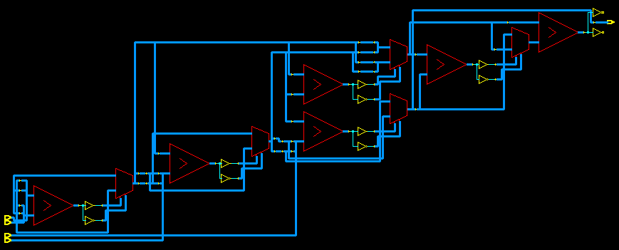
Sorting Problem (2/2)
Bubble Sort: (four inputs)
(0)?(1), (1)?(2), (2)?(3)
(0)?(1), (1)?(2)
(0)?(1) critical path=6.01 ns
Totally, 6 comparators are needed
for parallel comparisons
Bubble Sort: (five inputs)
(0)?(1), (1)?(2), (2)?(3), (3)?(4)
(0)?(1), (1)?(2), (2)?(3)
(0)?(1), (1)?(2)
(0)?(1) critical path=8.05 ns
Totally, 10 comparators are needed
The more inputs, the longer delay use one comparator and a suitable FSM

Slide 22
Always Block (1/3)
An always block can imply latches or flip-flops, or it can specify purely
combinational logic. An always block can contain logic triggered in
response to a change in a level (asynchronous triggers) or the rising or falling edge of a signal (synchronous triggers).
The syntax of an always block is
always @ (event-expression )
begin
. . . statements . . .
end (combinational circuit)
Completely specify sensitivity lists to avoid error
Asynchronous triggers
x is recalculated as soon as
any input (a or b or c) has a
level transition (0 to 1 or 1 to 0).
always@ (a or b or c)
begin
x=a | b | c;
end

Slide 23
Always Block (2/3)
always @ ( [posedge or negedge] event)
begin
. . . statements . . .
end (sequential circuit)
rising
edge
(posedge)
falling
edge
(negedge)
Rising edge or positive edge (posedge)
Falling edge or negative edge (negedge)
Synchronous triggers
x is recalculated as soon as
c changes from 0 to 1 or
d changes from 1 to 0.
always@ (posedge c or negedge d)
begin
x=a +b;
end
storage unit

Slide 24
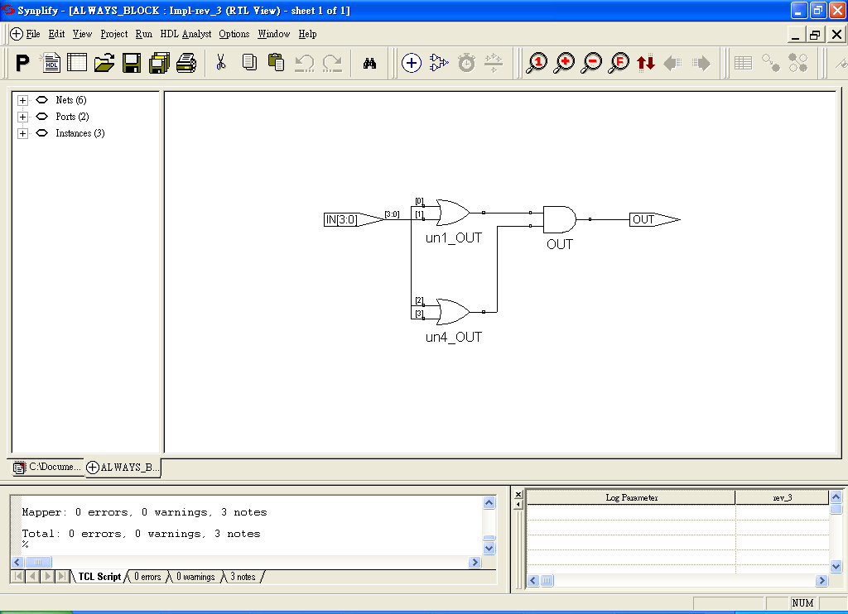
Always Block (3/3)
module ALWAYS_BLOCK(IN , OUT);
input [3 : 0]IN; output OUT; reg OUT;
always @(IN)
begin
OUT = (IN[0] | IN[1]) & (IN[2] | IN[3]);
end
endmodule
module D_FF(Clk, D, Q);
input Clk, D;
output Q;
Reg Q;
always @(posedge Clk)
begin
Q=D;
end
endmodule
D Q
Clk
At every positive edge of signal Clk,
Q is set as D.

Slide 25
Variables
Nets:
wire a; // 1-bit wire
wire [3:0] b; // 4-bit wire
Three types of common variables in Verilog:
register (default width is 1 bit)
integer (default width is 32 bit)
parameter (default width is 1 bit)
parameter [range] identifier=expression,
identifier=expression;
reg a; // 1-bit register
reg [3:0] b; // 4-bit register
integer c; // single 32-bit integer
parameter d=4, e=6;
Three variables (register, integer and parameter) are declared globally at the
module level, or locally at the function level and begin-end block.
Verilog allows you to assign the value of a reg variable only within a function
or an always block.

Slide 26
Function
function [range] name_of_function;
function declaration
statement
endfunction
Begin with function and end with endfunction
[Range] defines the width of the return value of the function (default is 1 bit) Contain one or more statements (enclosed inside a begin-end pair)
You can call function in a continuous assignment, always block or other functions
Function declaration:
Input declaration: specify the input signals for a function
Output: The output from a function is assigned to the function name.
Use concatenation operation to bundle several values for multi-outputs

Slide 27
Function Statements (1/4)
Procedure assignments are assignment statements used inside a function.
(It is similar to C language, Note: it cannot be used in module)
They are similar to the continuous assignments, except that the left side of
a procedural assignment can contain only reg and integer variables.
module FUN_STATE(A , B , C1 , C2 , C3 , C4 , C5);
input [3 : 0]A; input [3 : 0]B;
output [6 : 0]C1; //0
output [2 : 0]C2; //discard
output [4 : 0]C3; //always
output [4 : 0]C4; //assign
reg [6 : 0]C1; reg [2 : 0]C2;
reg [4 : 0]C3; reg [4 : 0]C4;
function [4 : 0]Fn1;
input [3 : 0]A; input [3 : 0]B;
Fn1 = A + B; // like C
endfunction
always @(A or B)
begin
C1 = Fn1(A , B);
end
always @(A or B)
begin
C2 = Fn1(A , B);
end
always @(A or B)
begin
C3 = A + B;
end
assign C4 = A + B;
endmodule
Three different ways to implement addition

Slide 28
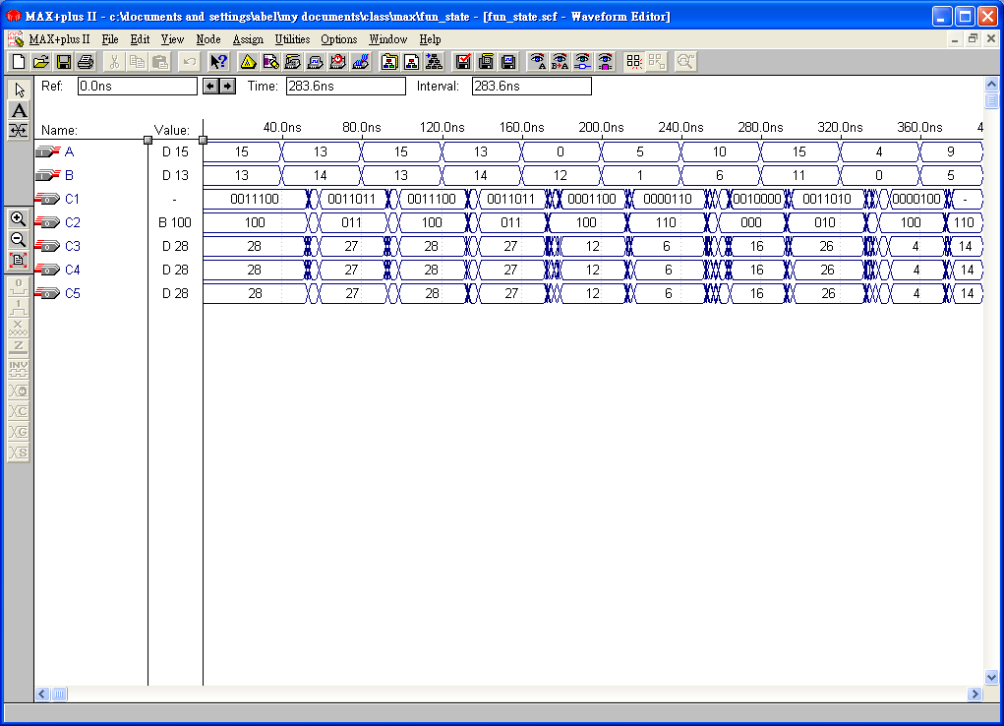
Function Statements (2/4)
input [3 : 0]A; input [3 : 0]B; // A and B are 4-bit values
output [6 : 0]C1; // C1 is 7-bit values
output [2 : 0]C2; // C2 is 3-bit values
always @(A or B)
begin
C1 = A +B; // insert “0” in the first two bits
end
begin
C2 = A + B ; // discard the first two bits
end

Slide 29
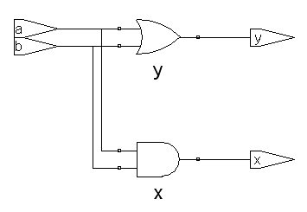
Function Statements (3/4)
module test_n(a, b, x, y);
input a, b;
output x, y;
assign x=a & b;
assign y=a | b;
endmodule
module test_n(a, b, x, y);
input a, b; output x, y;
reg x, y;
function Fn1;
input a, b;
Fn1 = a & b;
/* begin-end is required
for more statements */
endfunction
function Fn2;
input a, b;
Fn2 = a | b;
endfunction
always @(a or b)
begin
x = Fn1(a, b);
y = Fn2(a, b);
end
endmodule
module test_n(a, b, x, y);
input a, b;
output x, y;
reg x, y;
always @(a or b)
begin
x = a & b;
y = a | b;
end
endmodule
C language
x = a&b;
y = a | b;

Slide 30
Function Statements (4/4)
module test_n(a1, a, b, x, y);
input [7:0] a1;
input a, b;
output x, y;
reg x, y;
function Fn1;
parameter width=8;
input [width-1:0] a1; // OK
input a, b;
Fn1 = a & b;
endfunction
always @(a or b)
begin
x = Fn1(a1, a, b);
end
endmodule
module test_n(a1, a, b, x, y);
input [7:0] a1;
input a, b;
output x, y;
reg x, y;
function Fn1;
input [width-1:0] a1;
parameter width=8;//error message
input a, b;
Fn1 = a & b;
endfunction
always @(a or b)
begin
x = Fn1(a1, a, b);
end
endmodule
Can we input width with scanf or input ??
Why?

Slide 31
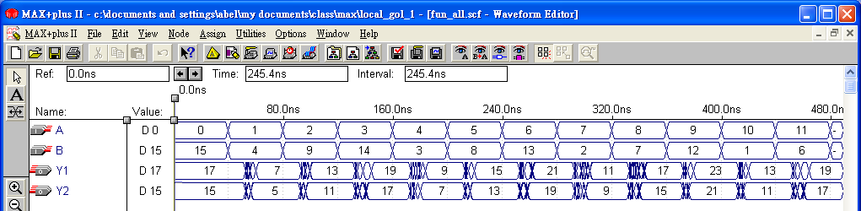
Example-Function
function [4 : 0] Fn1;
input [3 : 0]F1 , F2;
begin
Fn1 = Fn2(F1 , F2) + 2;
end
endfunction
always @(A or B)
begin
Y1 = Fn1(A , B);
Y2 = Fn2(A , B);
end
endmodule
module FUN_ALL(A , B , Y1 , Y2);
input [3 : 0] A,B;_x0001_output [4 : 0] Y1, Y2;
reg [4 : 0] Y1, Y2;
function [4 : 0] Fn2;
input [3 : 0] F1 , F2;
begin
Fn2 = F1 + F2;
end
endfunction
Y1=A+B+2
Y2=A+B

Slide 32
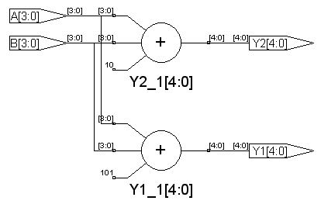
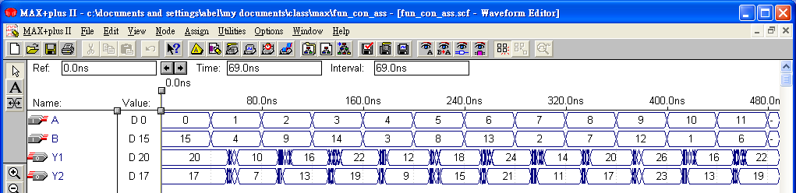
Example-Function with Many Outputs
function [9 : 0]Fn1;
input [3 : 0] F1 , F2;
reg [4 : 0] Y1_1; reg [4 : 0] Y2_1;
begin
Y1_1 = F1 + F2 + 5;
Y2 _1= F1 + F2 + 2;
Fn1 = {Y1_1 , Y2_1};
end
endfunction
assign {Y1 , Y2} = Fn1(A , B);
endmodule
Y1=A+B+5
Y2=A+B+2
Y1_1 and Y2_1 can be declared as
reg or integer, not wire

