Slide 1
數位IC設計
Digital System Design

Slide 2
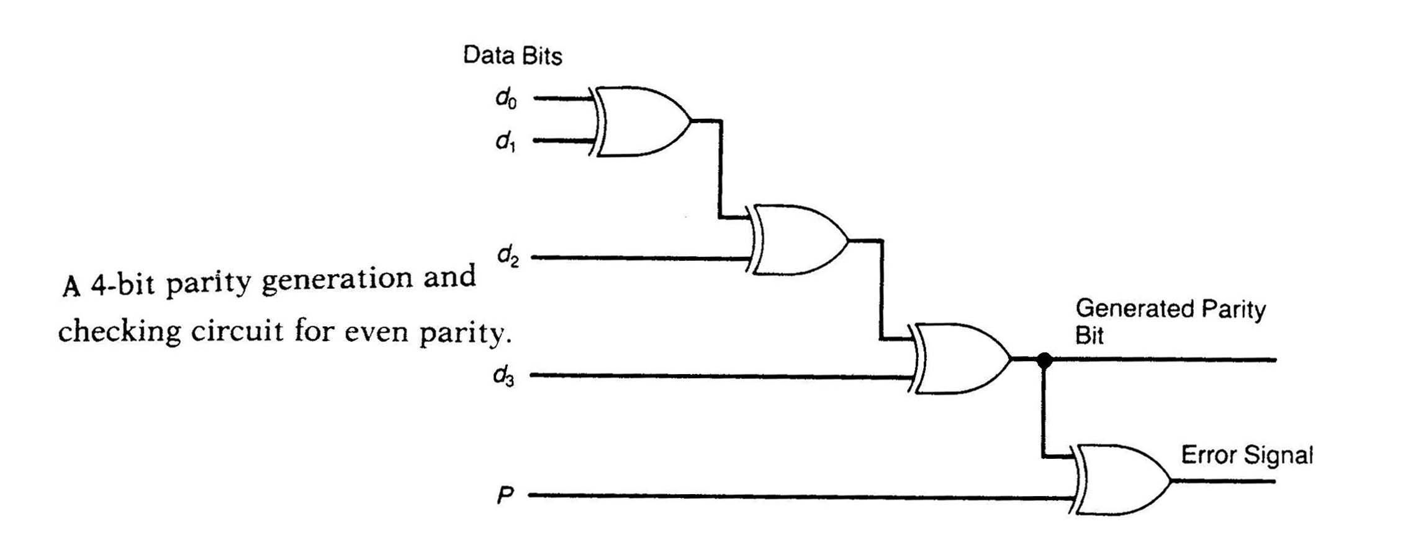
Combinational Circuit
A combinational circuit consists of logic gates whose outputs at any time are determined directly from the present combination of inputs without regard to previous inputs.
Combinational
Logic Circuit
n input
variables
m output
variables
..
..

Slide 3
Example – Alarm (1/2)
Assume that four persons might come. Alarm is activated when (1) more than three persons come or (2) the fourth person come together with other persons
module four(A , B , C , D , Out);
input A , B , C , D;
output Out;
reg Out , temp;
always @(A or B or C or D)
begin
case({A , B , C , D})
4’b0000: Out = 0;
4’b0001: Out = 0;
4’b0010: Out = 0;
4’b0011: Out = 1;
4’b0100: Out = 0;
4’b0101: Out = 1;
A | B | C | D | Out
0 | 0 | 0 | 0 | 0
0 | 0 | 0 | 1 | 0
0 | 0 | 1 | 0 | 0
0 | 0 | 1 | 1 | 1
0 | 1 | 0 | 0 | 0
0 | 1 | 0 | 1 | 1
0 | 1 | 1 | 0 | 0
0 | 1 | 1 | 1 | 1
1 | 0 | 0 | 0 | 0
1 | 0 | 0 | 1 | 1
1 | 0 | 1 | 0 | 0
1 | 0 | 1 | 1 | 1
1 | 1 | 0 | 0 | 0
1 | 1 | 0 | 1 | 1
1 | 1 | 1 | 0 | 1
1 | 1 | 1 | 1 | 1
4’b0110: Out = 0;
4’b0111: Out = 1;
4’b1000: Out = 0;
4’b1001: Out = 1;
4’b1010: Out = 0;
4’b1011: Out = 1;
4’b1100: Out = 0;
4’b1101: Out = 1;
4’b1110: Out = 1;
default: Out = 1;
endcase
end
endmodule
Optimization is done by tools

Slide 4
Example – Alarm (2/2)
module four(A , B , C , D);
input A , B , C , D;
output Out;
wire t1 , t2 , t3 , t4;
and a1(t1 , A , D);
and a2(t2 , B , D);
and a3(t3 , C , D);
and a4(t4 , A , B , C);
or o1(Out , t1 , t2 , t3 , t4);
endmodule
CD AB | 00 | 01 | 11 | 10
00 | 0 | 0 | 1 | 0
01 | 0 | 1 | 1 | 0
11 | 0 | 1 | 1 | 1
10 | 0 | 1 | 1 | 0
Out = AD + BD + CD + ABC
Traditional design method
(optimization is done by hand)
not suitable for HDL design

Slide 5
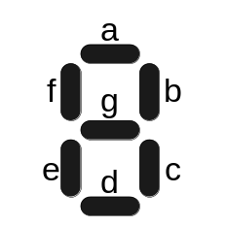
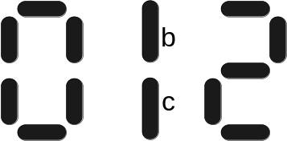




Example - Seven Segment Display
A BCD (Binary-Coded Decimal)-to-seven-segment decoder is a combinational circuit that accepts a decimal digit in BCD and generates the appropriate output for selection of segments in a display indicator used for displaying the decimal digit. The seven outputs of the decoder (a, b, c, d, e, f, g) select the corresponding segments in the display as shown in Fig. (a). The numeric designation chosen to represent the decimal digit is shown in Fig. (b). Design the BCD-to-seven-segment decoder circuit.
A B C D a b c d e f g
0 0 0 0 1 1 1 1 1 1 0
0 0 0 1 0 1 1 0 0 0 0
. . .
. . .

Slide 6
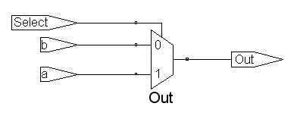
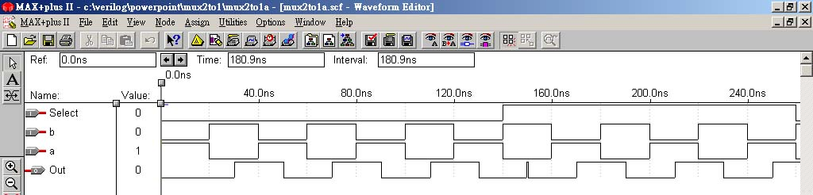
Example – Multiplexer (1/2)
Multiplexer = selector
2 to 1 selector
Select | Out
1 | a
0 | b
Χ | Χ
module mux2to1a(a, b, Select, Out);
input a, b, Select;
output Out;
reg Out;
always @(a or b or Select)
begin
if (Select)
Out = a;
else
Out = b;
end
endmodule
Put all inputs of the combinational circuit into the sensitivity list, otherwise .. error

Slide 7
Example – Multiplexer (2/2)
There are three ways to derive a 2-to-1 multiplexer
always @(a or b or Select)
begin
if (Select)
Out = a;
else
Out = b;
end
always @(a or b or Select)
begin
Out=b;
if (Select)
Out = a;
end
Method_3
assign Out = Select ? a : b;
Method_1
Method_2
always @(A or B or C or D or S1 or S0)
begin
case ({S1, S0})
2'b00: Out = A;
2'b01: Out = B;
2'b10: Out = C;
default: Out = D;
endcase
end
A
B
MUX
4-to-1
multiplexer
Out
C
D
S1
S0

Slide 8
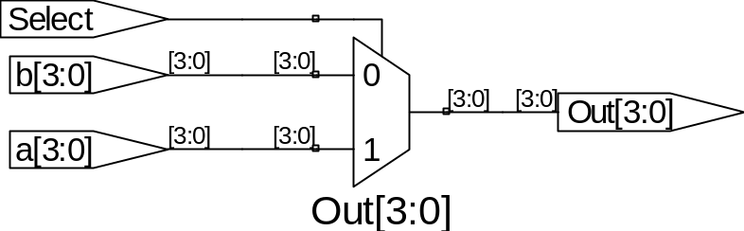
Example – Multi-Bit Multiplexer
module multibit2(a, b, Select, Out);
input [3:0] a, b;
input Select;
output [3:0] Out;
wire [3:0] Out;
assign Out = Select ? a : b;
endmodule
Actually four 1-bit 2-to-1 multiplexers are used here
module multibit2(a, b, Select, Out);
parameter width=8;
input [width-1:0] a, b;
input Select;
output [width-1:0] Out;
wire [width-1:0] Out;
assign Out = Select ? a : b;
endmodule
a
b
8
Out
8
8
1
Select
8-bit 2-to-1 multiplexer

Slide 9
Example – Encoder (4 to 2)
module encoder(A,Y);
parameter size=4;
input [size-1:0] A;
output [1:0] Y;
reg [1:0] Y;
always@(A)
begin
case(A)
4'b 0001 : Y=0;
4'b 0010 : Y=1;
4'b 0100 : Y=2;
4'b 1000 : Y=3;
default: Y=2'b00;
endcase
end
endmodule
4 to 2
encoder
inputs |  |  |  | outputs
A[3] | A[2] | A[1] | A[0] | Y[1] | Y[0]
0 | 0 | 0 | 1 | 0 | 0
0 | 0 | 1 | 0 | 0 | 1
0 | 1 | 0 | 0 | 1 | 0
1 | 0 | 0 | 0 | 1 | 1

Slide 10
Example – Priority Encoder (4 to 2)
module encoder (A,Valid,Y);
input [3:0] A;
output Valid;
output [1:0] Y;
reg Valid;
reg [1:0] Y;
always@(A)
begin
Valid=1;
casex(A)
4'b 1xxx : Y=3;
4'b 01xx : Y=2;
4'b 001x : Y=1;
4'b 0001 : Y=0;
default:
begin Valid=0; Y=2'b00; end
endcase
end
endmodule
inputs |  |  |  | outputs
A[3] | A[2] | A[1] | A[0] | Y[1] | Y[0] | Valid
0 | 0 | 0 | 0 | 0 | 0 | 0
0 | 0 | 0 | 1 | 0 | 0 | 1
0 | 0 | 1 | x | 0 | 1 | 1
0 | 1 | x | x | 1 | 0 | 1
1 | x | x | x | 1 | 1 | 1
x : don’t care

Slide 11
Example – Decoder (2 to 4)
module decoder(A,Y);
parameter size=4;
input [1:0] A;
output [size-1:0] Y;
reg [size-1:0] Y;
always@(A)
begin
case(A)
0:Y = 4'b0001;
1:Y = 4'b0010;
2:Y = 4'b0100;
default:Y = 4'b1000;
endcase
end
endmodule
2 to 4
decoder
inputs |  | outputs
A[1] | A[0] | Y[3] | Y[2] | Y[1] | Y[0]
0 | 0 | 0 | 0 | 0 | 1
0 | 1 | 0 | 0 | 1 | 0
1 | 0 | 0 | 1 | 0 | 0
1 | 1 | 1 | 0 | 0 | 0

Slide 12
Example – Decoder (3 to 6)
module decoder3_6_case1(A,En,Y);
input En; input [2:0] A;
output [5:0] Y; reg [5:0] Y;
always@(En or A)
begin
if(!En)
Y = 6'b0;
else
case(A)
0:Y = 6'b000001;
1:Y = 6'b000010;
2:Y = 6'b000100;
3:Y = 6'b001000;
4:Y = 6'b010000;
5:Y = 6'b100000;
default:Y = 6'b0;
endcase
end
endmodule
input En A2 A1 A0 | outputs Y5 Y4 Y3 Y2 Y1 Y0
0 X X X 1 0 0 0 1 0 0 1 1 0 1 0 1 0 1 1 1 1 0 0 1 1 0 1 1 1 1 0 1 1 1 1 | 0 0 0 0 0 0 0 0 0 0 0 1 0 0 0 0 1 0 0 0 0 1 0 0 0 0 1 0 0 0 0 1 0 0 0 0 1 0 0 0 0 0 0 0 0 0 0 0 0 0 0 0 0 0

Slide 13
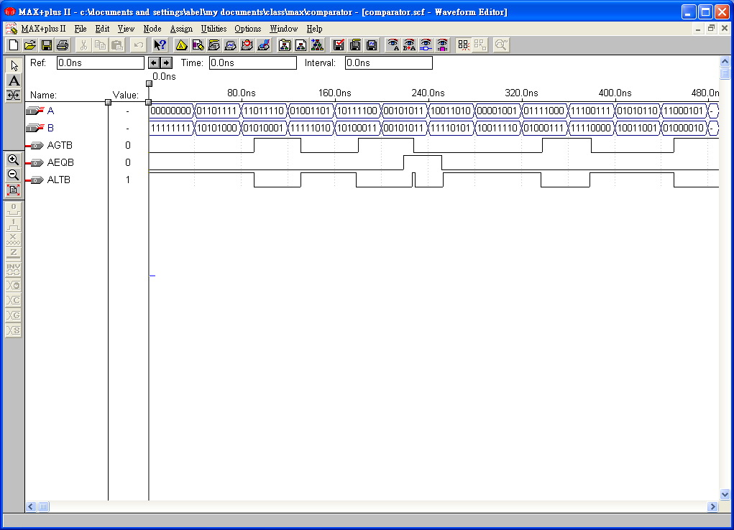
Comparator (1/4)
Combinational comparator
A
B
AGTB (A>B)
AEQB (A=B)
ALTB (A<B)
comparator
module comparator(A, B, CLK, AGTB,
AEQB, ALTB);
input [7:0] A, B;
output AGTB, AEQB, ALTB;
reg AGTB, AEQB, ALTB;
always @(A or B)
begin
AGTB = (A > B);
AEQB = (A == B);
ALTB = (A < B);
end
endmodule

Slide 14
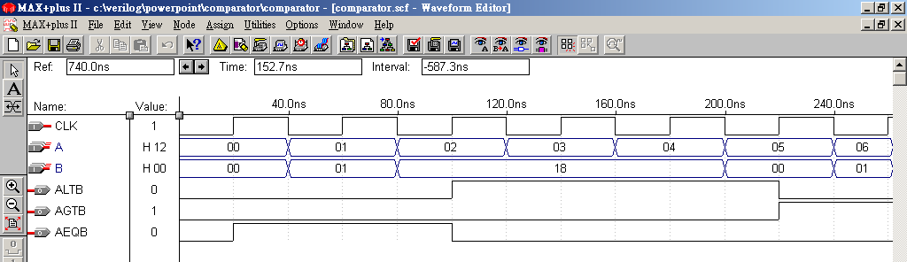
Comparator (2/4)
Sequential comparator
A
B
AGTB (A>B)
AEQB (A=B)
ALTB (A<B)
comparator
module comparator(A, B, CLK, AGTB,
AEQB, ALTB);
parameter size = 8;
input [size-1:0] A, B;
input CLK;
output AGTB, AEQB, ALTB;
reg AGTB, AEQB, ALTB;
always @(posedge CLK)
begin
AGTB = (A > B);
AEQB = (A == B);
ALTB = (A < B);
end
endmodule
Functional simulation without delay

Slide 15
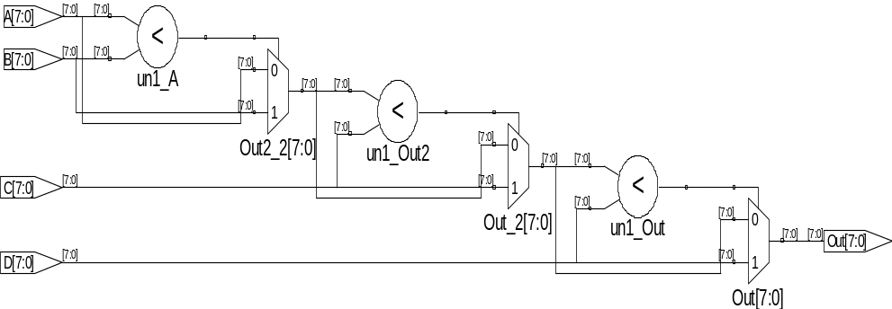
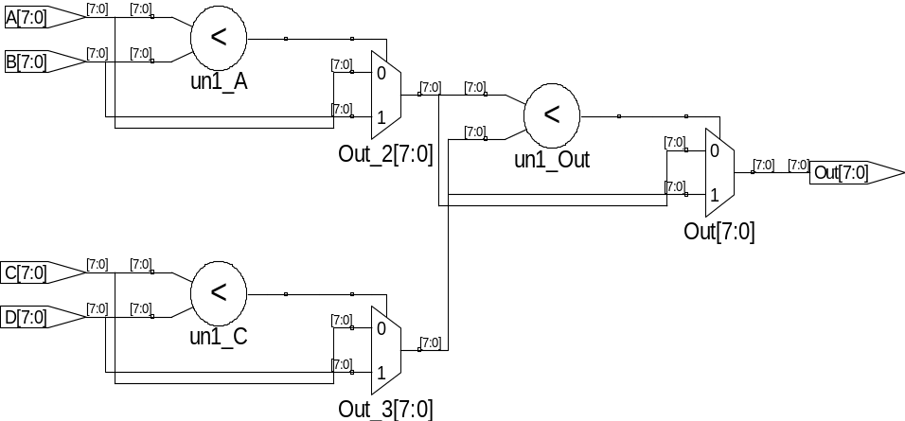
Comparator (3/4)
Decide the biggest value among A, B, C, and D.
A
A
Method_1:
always @(A or B or C or D)
begin
if(A >= B)
Out1=A;
else
Out1=B;
if(Out1 >= C)
Out2=Out1;
else
Out2=C;
if(Out2 >= D)
Out=Out2;
else
Out=D;
end
<
<
<
B
<
B
<
C
C
<
Method_2: (hierarchical tree structure)
always @(A or B or C or D)
begin
if(A >= B)
Out1=A;
else
Out1=B;
if(C >= D)
Out2=C;
else
Out2=D;
if(Out1 >= Out2)
Out=Out1;
else
Out=Out2;
end
D
D
Method_1 (three stages)
Method_2 (two stages)

Slide 16
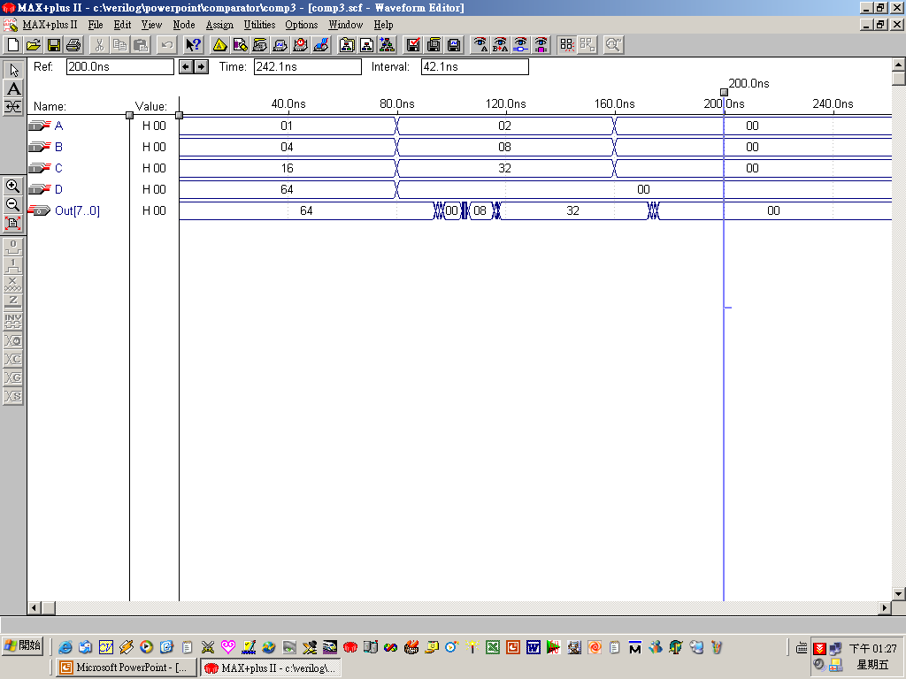
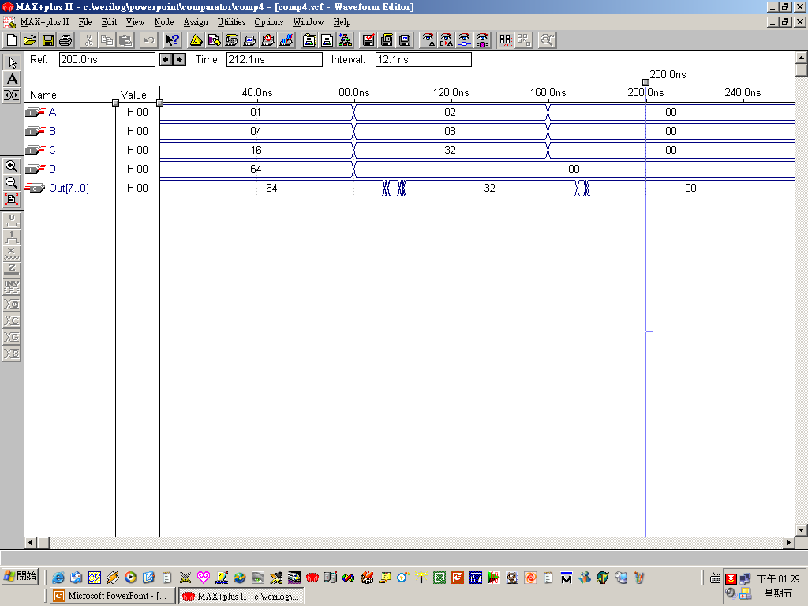
Comparator (4/4)
Method_1
delay
Hierarchical tree structure
Method_2
delay

Slide 17
Arithmetic Logic Unit (1/2)
S4 S3 S2 S1 S0 Cin | Operation | Function | Implementation
0 0 0 0 0 0 0 0 0 0 0 1 0 0 0 0 1 0 0 0 0 0 1 1 0 0 0 1 0 0 0 0 0 1 0 1 0 0 0 1 1 0 0 0 0 1 1 1 0 0 1 0 0 0 0 0 1 0 1 0 0 0 1 1 0 0 0 0 1 1 1 0 0 0 0 0 0 0 0 1 0 0 0 0 1 0 0 0 0 0 1 1 0 0 0 0 | Y <= A Y <= A + 1 Y <= A + B Y <= A + B + 1 Y <= A + Bbar Y <= A + Bbar + 1 Y <= A - 1 Y <= A Y <= A and B Y <= A or B Y <= A xor B Y <= Abar Y <= A Y <= shl A Y <= shr A Y <= 0 | Transfer A Increment A Addition Add with carry A plus 1’s complement of B Subtraction Decrement A Transfer A AND OR XOR Complement A Transfer A Shift left A Shift right A Transfer 0’s | Arithmetic Unit Arithmetic Unit Arithmetic Unit Arithmetic Unit Arithmetic Unit Arithmetic Unit Arithmetic Unit Arithmetic Unit Arithmetic Unit Logic Unit Logic Unit Logic Unit Logic Unit Shifter Unit Shifter Unit Shifter Unit Shifter Unit

Slide 18
Arithmetic Logic Unit (2/2)
module alu_case2(Sel,CarryIn,A,B,Y);
input [4:0] Sel;
input CarryIn;
input [7:0] A,B;
output [7:0] Y;
reg [7:0] Y;
always@(Sel or A or B or CarryIn)
begin
case({Sel[4:0],CarryIn})
6'b000000 : Y = A;
6'b000001 : Y = A + 1;
6'b000010 : Y = A + B;
6'b000011 : Y = A + B + 1;
6'b000100 : Y = A + !B;
6'b000101 : Y = A + !B + 1;
6'b000110 : Y = A - 1;
6'b000111 : Y = A;
6'b001000 : Y = A & B;
6'b001010 : Y = A | B;
6'b001100 : Y = A ^ B;
6'b001110 : Y = !A;
6'b010000 : Y = A << 1;
6'b100000 : Y = A >> 1;
6'b110000 : Y = 0;
default: Y = 8'bX;
endcase
end
endmodule

Slide 19
Example for IF (1/4)
Good style takes advantage of if-else priority to synthesize correct logic
Bad
Good
case (STATE)
IDLE:
if (LATE == 1’b1)
ADDR_BUS <= ADDR_MAIN;
else
ADDR_BUS <= ADDR_CNTL;
INTERRUPT:
if (LATE == 1’b1)
ADDR_BUS <= ADDR_MAIN;
else
ADDR_BUS <= ADDR_INT;
…..
if (LATE == 1’b1)
ADDR_BUS <= ADDR_MAIN;
else
case (STATE)
IDLE:
ADDR_BUS <= ADDR_CNTL;
INTERRUPT:
ADDR_BUS <= ADDR_INT;
…..
ADDR_MAIN
LATE
STATE
ADDR_BUS
ADDR_MAIN
ADDR_BUS
STATE
LATE

Slide 20
Example for IF (2/4)
A2:
begin
if(En)
Out_Data = In_Data;
else
Out_Data = In_Data + 1;
end
A3:
begin
if(En)
Out_Data = In_Data;
else
Out_Data = In_Data - 2;
end
A4:
begin
if(En)
Out_Data = In_Data;
else
Out_Data = In_Data + 2;
end endcase end endmodule
module style_bad(In_Data, State, Out_Data, En);
input En;
input [1:0] State;
input [2:0] In_Data;
output [3:0] Out_Data;
reg [3:0] Out_Data;
parameter A1=0, A2=1, A3=2, A4=3;
always @(In_Data or State or En)
begin
case(State)
A1:
begin
if(En)
Out_Data = In_Data;
else
Out_Data = In_Data - 1;
end
Bad Style

Slide 21
Example for IF (3/4)
module style_good(In_Data, State, Out_Data, En);
input En;
input [1:0] State;
input [2:0] In_Data;
output [3:0] Out_Data;
reg [3:0] Out_Data;
parameter A1=0, A2=1, A3=2, A4=3;
always @(In_Data or State or En)
begin
if(En)
Out_Data = In_Data;
else
begin
Good Style
case(State)
A1: Out_Data = In_Data - 1;
A2: Out_Data = In_Data + 1;
A3: Out_Data = In_Data - 2;
A4: Out_Data = In_Data + 2;
endcase
end
end
endmodule

Slide 22
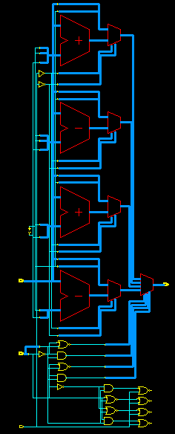
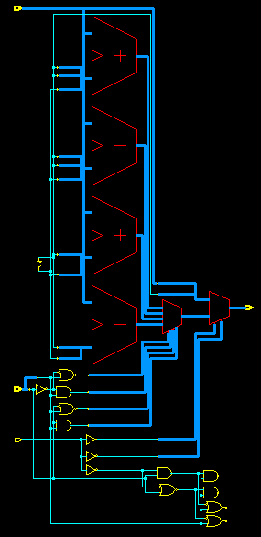
Example for IF (4/4)
Bad Style
Good Style

Slide 23
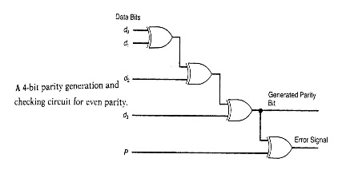
Sequential Circuit (1/2)
A sequential circuit is a system whose outputs at any time are determined from the present combination of inputs and the previous inputs or outputs.
Combinational Circuit
m output
variables
n input
variables
..
..
Memory
Elements
states
Sequential components contain memory elements
The output values of sequential components depend on the input values and the values stored in the memory elements
Example: Ring counter that starts the answering machine after 4 rings

Slide 24
Sequential Circuit (2/2)
Sequential components can be: asynchronous or synchronous
Asynchronous sequential circuit:
Change their states and outputs whenever a change in inputs occurs
Synchronous sequential circuit:
Change their states and outputs at fixed points of time (specified by clock signal)
Most circuits are synchronous circuits (easy and tool-supportable).
Synchronous storage components store data and perform some simple operations.
Synchronous storage components include: (1) registers (2) counters (3) register files (4) memories (5) queues (6) stacks

Slide 25
Clock Period
clock period
clock
width
rising
edge
falling
edge
Clock period (measured in micro or nanoseconds) is the time between successive transitions in the same direction
Clock frequency (measured in MHz or GHz) is the reciprocal of clock period
Clock width is the time interval during which clock is equal to 1
Duty cycle is the ratio of the clock width and clock period
Clock signal is active high if the changes occur at the rising edge or during the clock width. Otherwise, it is active low

Slide 26
Latch and Flip-Flop
rising
edge
falling
edge
Latches are level-sensitive since they respond to input changes during clock width. Latches are difficult to work with for this reason.
Flip-Flops respond to input changes only during the change in clock signal (the rising edge or the falling edge).
They are easy to work with though more expensive than latches.
Two basic styles of flip-flops are available: (1) master-slave (2) edge-triggered

Slide 27
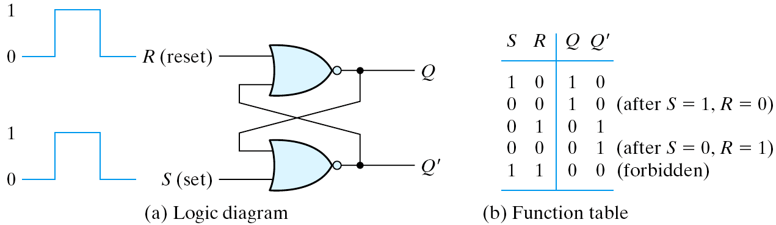
Latches (1/2)
The most basic types of flip-flops operate with signal levels ➔latch
All FFs are constructed from the latches introduced here
    A FF can maintain a binary state indefinitely until directed
    by an input signal to switch states
Two NOR gates
Set➔1, Reset➔0

Slide 28
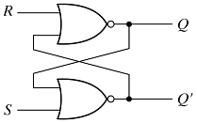
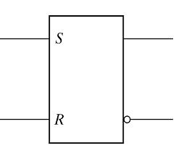
Latches (2/2)
S R P=Q’ Q
0 0 * * // a stable state in the previous state
1 0 0 1 // change to another stable state “Set”
0 0 0 1 // remain in the previous state
0 1 1 0 // change to another stable state “Reset”
0 0 1 0 // remain in the previous state
1 1 0 0 // oscillate (unpredictable) if next SR=00
  more complicated types can be built upon it
  an asynchronous sequential circuit
  (S,R)= (0,0): no operation
  (S,R)=(0,1): reset (Q=0, the clear state)
  (S,R)=(1,0): set (Q=1, the set state)
  (S,R)=(1,1): indeterminate state (Q=Q'=0)
  consider (S,R) = (1,1) ⇒ (0,0)
the condition
should be avoided
Q

Slide 29
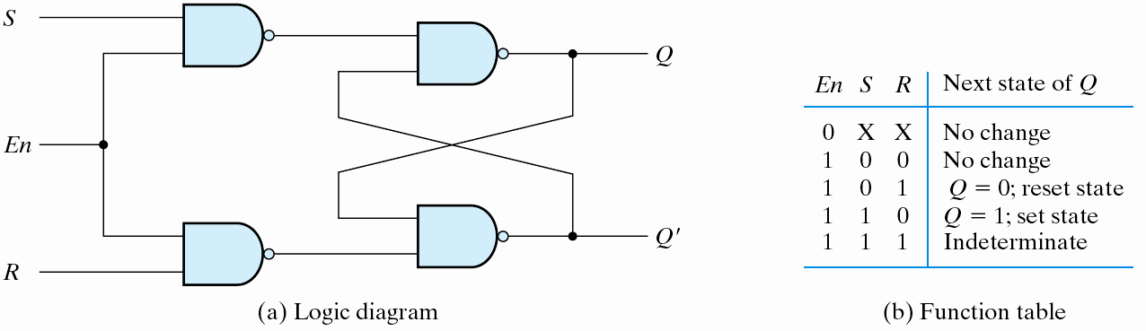
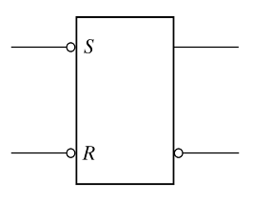
SR Latch with Control Input
The complement output of the
previous R’S’ latch.
S_
1/S'
0/1
R_
1/R'
En
En
En=0, no change
En=1, enable
En=1, no change
En=0, enable
(c) Graphic symbol
(c) Graphic symbol

Slide 30
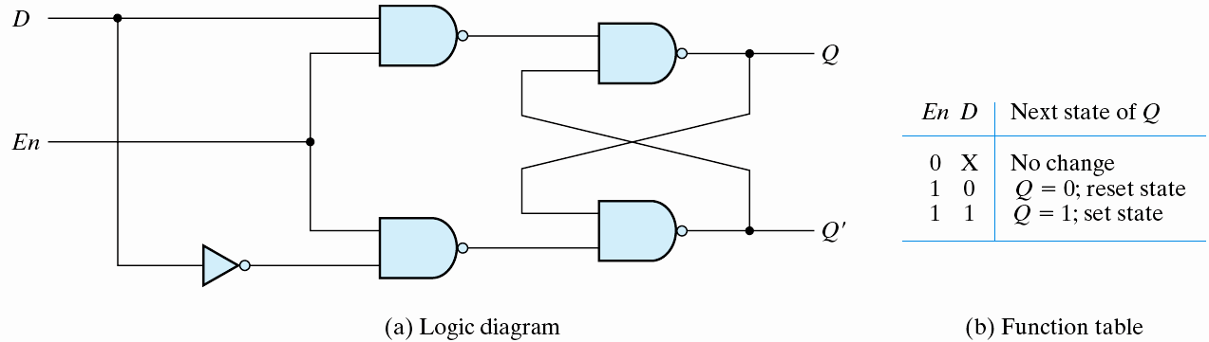

D Latch (Transparent Latch)
S_
1/D'
0/1
R_
1/D
  eliminate the undesirable conditions of the indeterminate state in the RS flip-flop
  D: data
  gated D-latch
  D ⇒ Q when En=1; no change when En=0
En
Q
D
Q
level triggered
(level-sensitive)

Slide 31
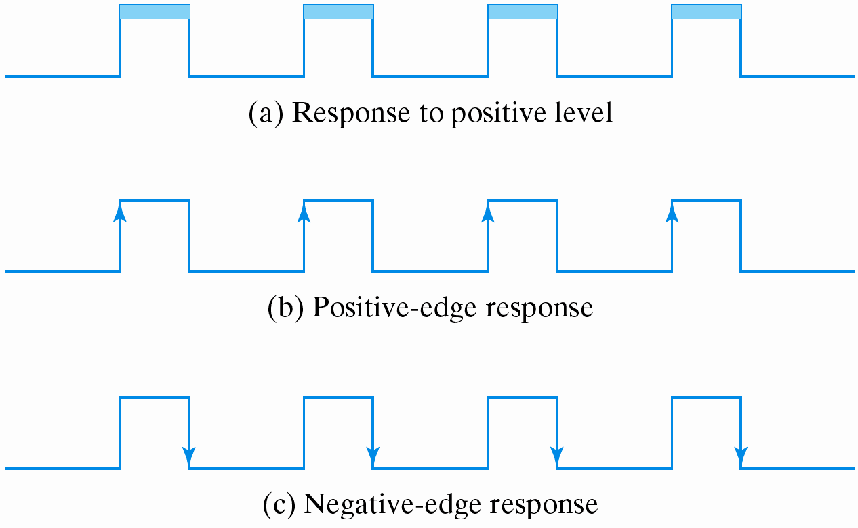
Flip-Flops
A trigger
  The state of a latch or flip-flop is switched by a change of the control input
Level triggered – latches
Edge triggered – flip-flops
Level triggered
Edge triggered
Edge triggered

Slide 32
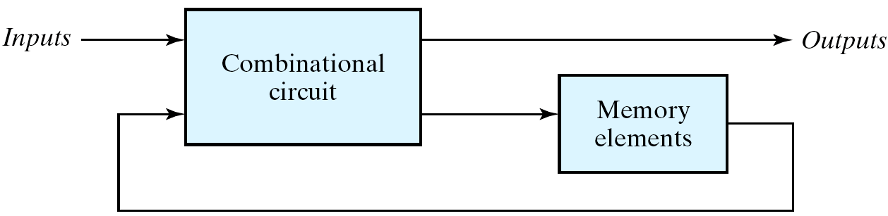
Problem of Latch
If level-triggered flip-flops are used
  the feedback path may cause instability problem (since the time interval of logic-1 is too long)
  multiple transitions might happen during logic-1 level
Edge-triggered flip-flops
  the state transition happens only at the edge
  eliminate the multiple-transition problem

Slide 33
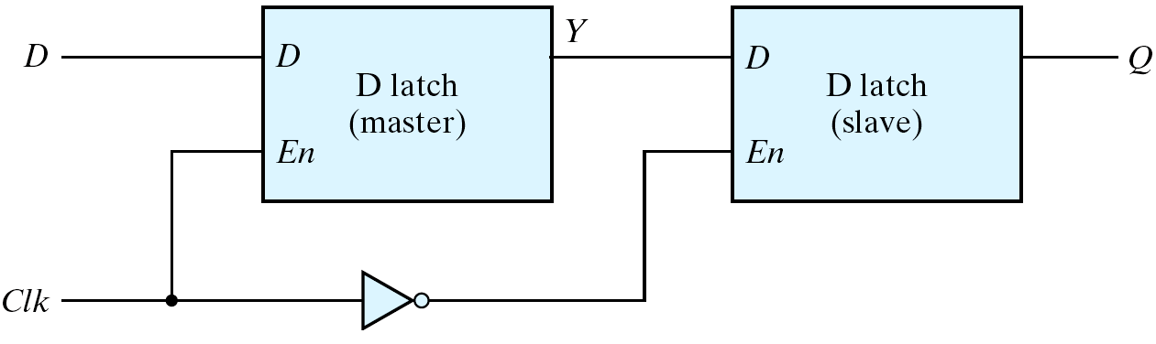
Edge-Triggered D Flip-Flop
Two designs to solve the problem of latch:
Master-slave D flip-flop
Edge-trigger D flip-Flop
Master-slave D flip-flop
  two separate flip-flops
  a master latch (positive-level triggered)
  a slave latch (negative-level triggered)

Slide 34
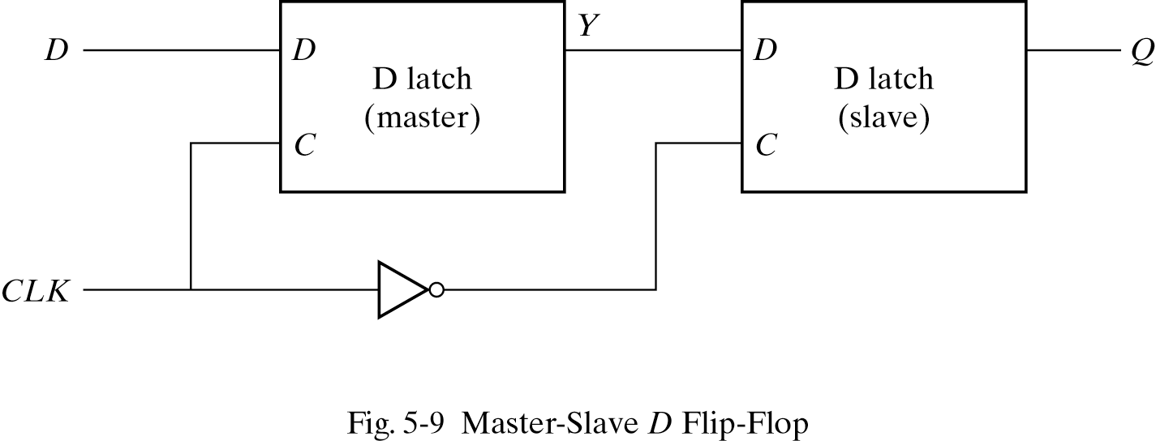

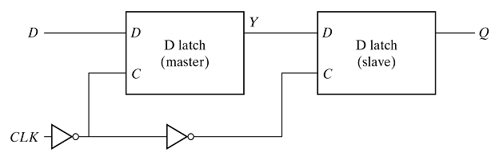
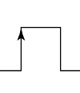
Master-slave D flip-flop (1/2)
  Two D latches and one inverter (8 gates)
  The circuit samples D input and changes its output Q only at the negative-edge of CLK
  isolate the output of FF from being affected while its input is changing
CLK=1, enabled
CLK=0, disabled
CLK=1, disabled
CLK=0, enabled

Slide 35
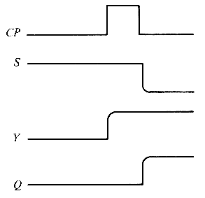
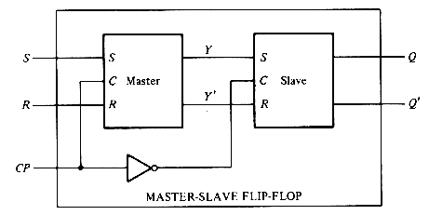
Master-slave D flip-flop (2/2)
  CP = 1: (S,R) ⇒ (Y,Y'); (Q,Q') holds
  CP = 0: (Y,Y') holds; (Y,Y') ⇒ (Q,Q')
  (S,R) could not affect (Q,Q') directly
  the state changes coincide with the negative-edge transition of CP

Slide 36
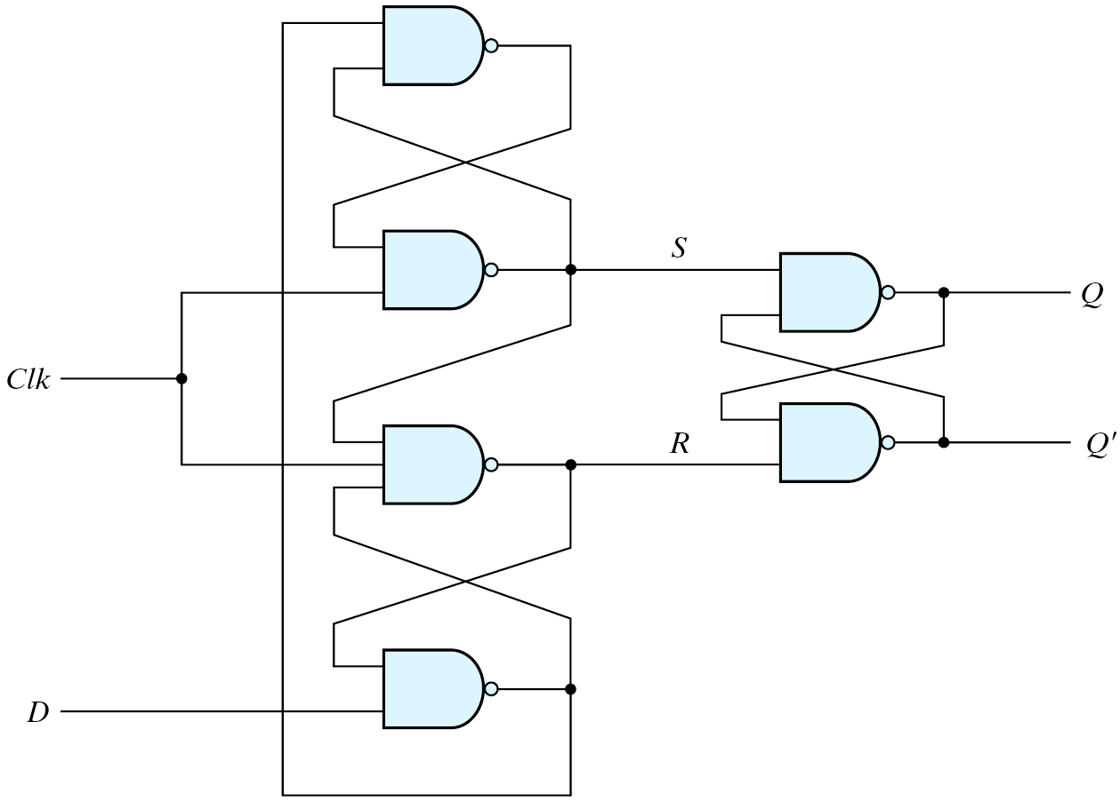
Edge-Triggered Flip-Flops (1/2)
the state changes during a clock-pulse transition
A D-type positive-edge-triggered
flip-flop
Three SR latches

Slide 37
Edge-Triggered Flip-Flops (2/2)
  (S,R) = (0,1): Q = 1 (S,R) = (1,0): Q = 0
  (S,R) = (1,1): no operation (S,R) = (0,0): should be avoided
0
#1
#2
#3
#4
1
If Clk=0 ➔S=1 and R=1 ➔ no operation.
Output Q remains in the present state.
1
1
0(new)
1
1(old)
1
0
If Clk=1 and D=0➔ R=0 ➔ Reset.
Output Q is 0. Then, if D changes to 1,
R remains at 0 and Q is 0.
Then, Clk=0 ➔ S=1, R=1 ➔ no operation (Q=0)
Then, if Clk=1 and D=1➔ S=0➔ Set.
Output Q is 1. (see the blue dot-line flow)
Then, if D changes to 0, S remains at 0 and Q=1;
1
1
0

Slide 38
Positive-Edge-Triggered Flip-Flops
Summary
  Clk=0: (S,R) = (1,1), no state change
  Clk=↑: state change once
  Clk=1: state holds
  eliminate the feedback problems in sequential circuits
All flip-flops must make their transition at the same time

Slide 39
Flip-Flops
A trigger
  The state of a latch or flip-flop is switched by a change of the control input
Level triggered – latches
Edge triggered – flip-flops
Level triggered
Edge triggered
Edge triggered

Slide 40
Setup Time and Hold Time
The setup time
  D input must be maintained at a constant value prior to the application of the positive Clk pulse
  = the propagation delay through gates 4 and 1
  data to the internal latches
The hold time
  D input must not changes after the application of the positive Clk pulse
  = the propagation delay of gate 3 (try to understand)
  clock to the internal latch

Slide 41
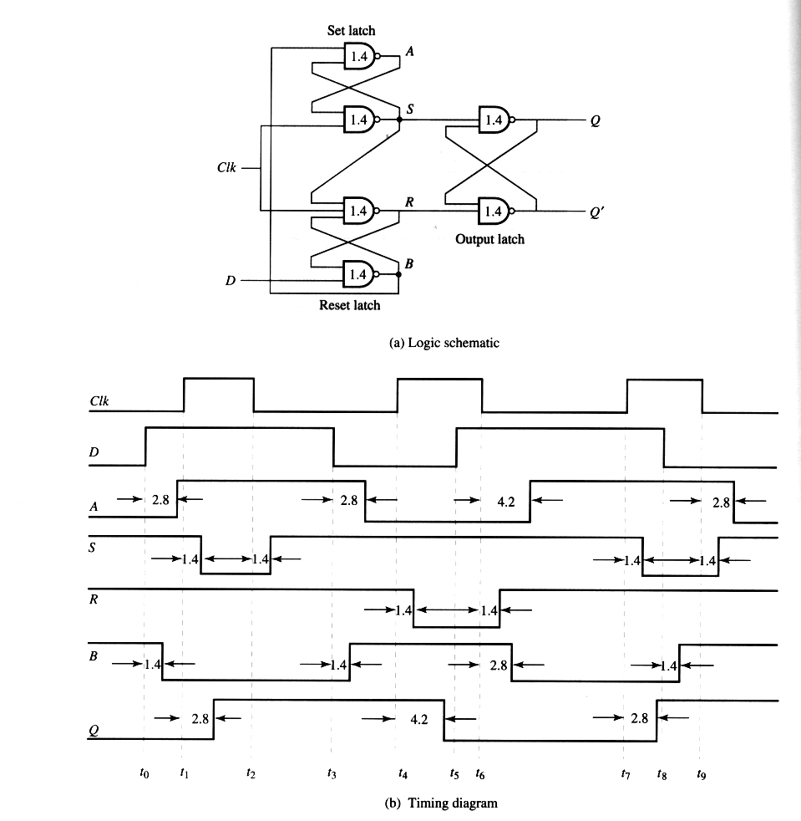
Timing Diagram
setup
time
hold
time
2.8 ns
1.4 ns

Slide 42
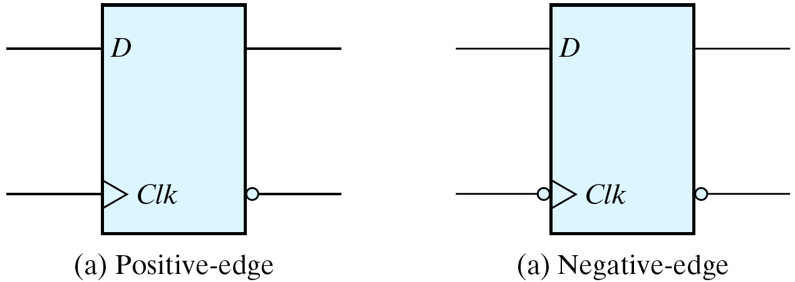
Positive-Edge vs. Negative-Edge
The edge-triggered D flip-flops
  The most economical and efficient
  Positive-edge and negative-edge

Slide 43
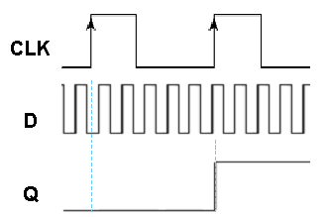
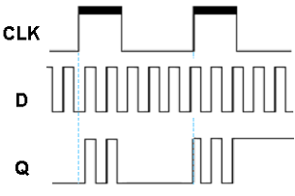
Latch vs. Flip-Flop
Level triggered
Edge triggered
positive-edge triggered
negative-edge triggered
Latch
CLK
Q
D
Q
CLK
CLK

Slide 44
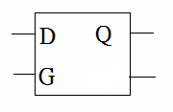

Latch
module p163(G, D, Q);
input G, D;
output Q; reg Q;
always @(D or G)
begin
if(G)
Q = D;
end
endmodule
D-type latch (ignoring delay)
D G | Q(t+1)
X 0 0 1 1 1 | Q (t) 0 1

Slide 45
Flip-Flop (1/2)
D flip-flop
D
Q
Clk
Edge-triggered
flip-flop

Slide 46
Flip-Flop (2/2)
characteristic table
excitation table
S | R | Q(t+1)
0 | 0 | Q(t)
0 | 1 | 0
1 | 0 | 1
1 | 1 | NA
Q(t) | Q(t+1) | S | R
0 | 0 | 0 | X
0 | 1 | 1 | 0
1 | 0 | 0 | 1
1 | 1 | X | 0
RS flip-flop
R
Q
Q(next)=S+R’Q
SR=0
Clk
M
S
J | K | Q(t+1)
0 | 0 | Q(t)
0 | 1 | 0
1 | 0 | 1
1 | 1 | Q’(t)
Q(t) | Q(t+1) | J | K
0 | 0 | 0 | X
0 | 1 | 1 | X
1 | 0 | X | 1
1 | 1 | X | 0
JK flip-flop
J
Q
Clk
M
Q(next)=JQ’+K’Q
K
Q(t) | Q(t+1) | D
0 | 0 | 0
0 | 1 | 1
1 | 0 | 0
1 | 1 | 1
D flip-flop
D | Q(t+1)
0 | 0
1 | 1
D
Q
Q(next)=D
M
Clk

Slide 47
Flip-Flop Inference
D | Q_{(t+1)}
0 | 0
1 | 1
module D_FF(Clk, D, Q);
input Clk, D;
output Q;
Reg Q;
always @(negedge Clk)
begin
Q=D;
end
endmodule
At every negative edge
of Clk, Q is set as D
D Flip-flop
module D_FF(Clk, D, Q);
input Clk, D;
output Q;
Reg Q;
always @(posedge Clk)
begin
Q=D;
end
endmodule
D Q
Clk
module Toggle (Clk, Q);
input Clk;
output Q;
Reg Q;
always @(posedge Clk)
begin
Q=~Q;
end
endmodule
At every positive edge
of Clk, Q is set as D
Toggle Flip-flop
D Q
Clk

Slide 48
JK Flip-Flop
J | K | Q _{(t+1)} | QB
0 | 0 | Q | Q’
0 | 1 | 0 | 1
1 | 0 | 1 | 0
1 | 1 | Q’ | Q
JK Flip-flop
J Q
Clk
2'b01:
Q=0;
2'b10:
Q=1;
2'b11:
Q=~Q;
endcase
end
endmodule
module JK_FF(Clk, J, K, Q);
input Clk, J, K;
output Q, Q_Bar;
reg Q, Q_Bar;
always @(posedge Clk)
begin
case({J,K})
2'b00:
Q=Q;
K

Slide 49
D Flip-flop with Reset
D Flip-flop with asynchronous reset
D Flip-flop with synchronous reset
If Reset changes from 1 to 0,
then reset D flip-flop anyway.
Otherwise, Q=D.
module DFF_AR(Clk, Reset, D, Q);
input Clk, Reset, D;
output Q; reg Q;
always @( posedge Clk or negedge Reset)
begin
if(!Reset)
Q=0;
else
Q=D; end
endmodule
At every positive edge of Clk,
if Reset==0, then reset D flip-flop
(if Reset==1, then Q=D).
module DFF_SR(Clk, Reset, D, Q);
input Clk, Reset, D;
output Q; reg Q;
always @(posedge Clk)
begin
if(!Reset)
Q=0;
else
Q=D; end;
endmodule
D Q
Reset
Q
Clk
D
Clk
Reset
Asynchronous -- Respond immediately !
D
D
Clk
Clk
Reset
Reset
Q
Q
reset immediately
reset here

Slide 50
D Flip-flop with Set
D Flip-flop with asynchronous set
D Flip-flop with synchronous set
If Set changes from 0 to 1,
then set D flip-flop to 1 anyway.
Otherwise, Q=D.
module DFF_AS(Clk, Set, D, Q);
input Clk, Set, D;
output Q;
reg Q;
always @( posedge Clk or posedge Set)
begin
if(Set)
Q=1;
else
Q=D;
end
endmodule
At every positive edge of Clk,
if Set==1, then set D flip-flop to 1
(if Set==0, Q=D).
module DFF_SS(Clk, Set, D, Q);
input Clk, Set, D;
output Q;
reg Q;
always @(posedge Clk)
begin
if(Set)
Q=1;
else
Q=D;
end
endmodule
Set
D Q
Set
Q
D
Clk
Clk

Slide 51
D Flip-flop with Set and Reset
module DFF_SRS(Clk, Set, Reset,
D, Q, QB);
input Clk, Set, Reset, D;
output Q, Q_Bar;
reg Q, Q_Bar;
always @(posedge Clk)
begin
if(!Reset)
Q = 0;
else if(Set)
Q=1;
else
Q=D;
end
endmodule
module DFF_ARS(Clk, Set,
Reset, D, Q);
input Clk, Set, Reset, D;
output Q;
reg Q;
always @(posedge Clk or
negedge Reset or posedge Set )
begin
if(!Reset)
Q=0;
else if(Set)
Q=1;
else
Q=D;
end
endmodule
D Flip-flop with asynchronous Set
and asynchronous Reset
D Flip-flop with synchronous Set
and synchronous Reset

Slide 52
D Flip-flop with Enable or Load
D Flip-flop with synchronous enable
D Flip-flop with synchronous load
module DFF_MAL(Clk, enable,
D, Q);
input Clk, enable;
input [3:0] D;
output [3:0] Q;
reg [3:0] Q;
always @(posedge Clk)
begin
if(enable)
Q = D;
end
endmodule
module DFF_MSL(Clk, Pre_Load,
Load, D, Q);
input Clk, Pre_Load;
input [3:0] Load, D;
Output [3:0] Q;
reg [3:0] Q;
always @(posedge Clk)
begin
if(Pre_Load)
Q = Load;
else
Q = D;
end
endmodule
If enable==1
Q(new)=D;
If enable==0
Q(new)=Q(old)
Pre_Load
enable
D
0
1
0
1
Q
Q
D
Load
Clk
Clk

Slide 53
Registers
4
module DFF_MAL(Clk, enable,
D, Q);
input Clk, enable;
input [3:0] D;
output [3:0] Q;
reg [3:0] Q;
always @(posedge Clk)
begin
if (enable)
Q = D;
end
endmodule
enable
0
1
Q
D
4
Clk
4-bit register = 4 flip-flops

Slide 54
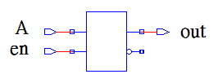
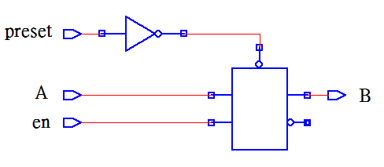
Watch Out for Unintentional Latches (1/6)
module latch_4(en, preset, A, B);
input en, preset, A;
output B;
reg B;
always @(en or preset or A)
begin
if(preset)
B = 1;
else if(en)
B = A;
end
endmodule
module latch_if1(en,A,out);
input en, A;
output out;
reg out;
always @(en)
begin
if(en)
out = A;
end
endmodule
If en ==1 out = A
else out (new) = out (old)

Slide 55
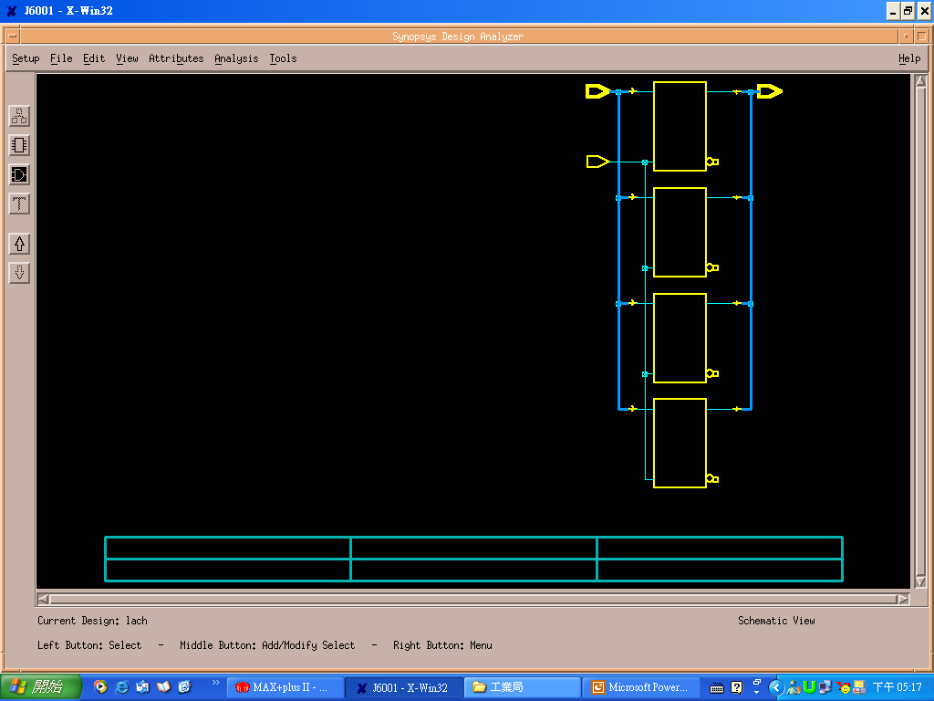
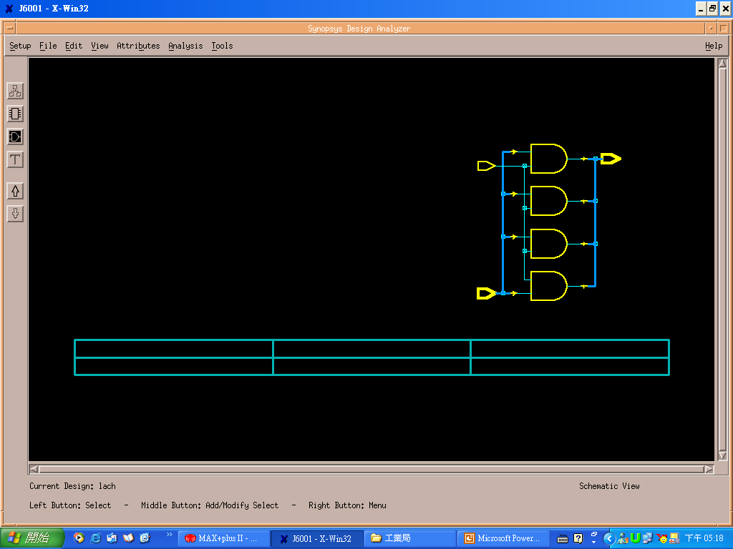
Watch Out for Unintentional Latches (2/6)
Module Latch(In, Enable, Out);
input Enable;
input [3:0] In;
output [3:0] Out;
always @(In or Enable)
begin
if(Enable)
Out=In;
end
endmodule
Module Latch(In, Enable, Out);
input Enable;
Input [3:0] In;
output [3:0] Out;
always @(In or Enable)
begin
if(Enable)
Out=In;
else
Out=0;
end
endmodule
Out=0;
if(Enable)
Out=In;
No latch inference
If Enable ==1
Out (new) = In
If Enable==0
Out (new) = Out (old)

Slide 56
Watch Out for Unintentional Latches (3/6)
Watch Out for Unintentional Latches
Completely specify all clauses for every case and if statement
Completely specify all output for every clause of each case or if statement
Fail to do so will cause latches or flip-flops to be synthesized
Always @ (d) begin
cased (d)
2’b00: z = 1’b0;
2’b01: z = 1’b0;
2’b10: ;
endcase
end
Missing Outputs
Missing Case

Slide 57
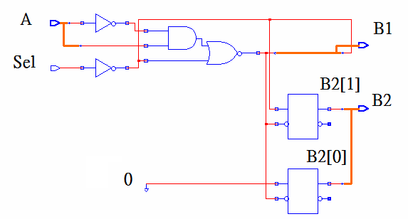
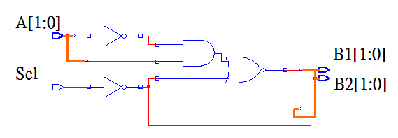
Watch Out for Unintentional Latches (4/6)
module code3(Sel , A , B1, B2);
input Sel, [1:0]A;
output [1:0] B1, B2; reg [1:0] B1,B2;
always @ (Sel or A)
if(Sel)
if(A == 1)
begin B1 = 0; B2 = 0; end
else
begin B1 = 1; B2 = 1; end
else
begin B1 = 2; B2 = 2; end
endmodule
module code4(Sel , A , B1, B2);
input Sel, input [1:0]A;
output [1:0] B1, B2; reg [1:0] B1, B2;
always @ (Sel or A)
if(Sel)
if(A == 1)
begin B1 = 0; B2 = 0; end
else
begin B1 = 1; end
else
begin B1 = 2; B2 = 2; end
endmodule
Two latches
(missing B2)

Slide 58
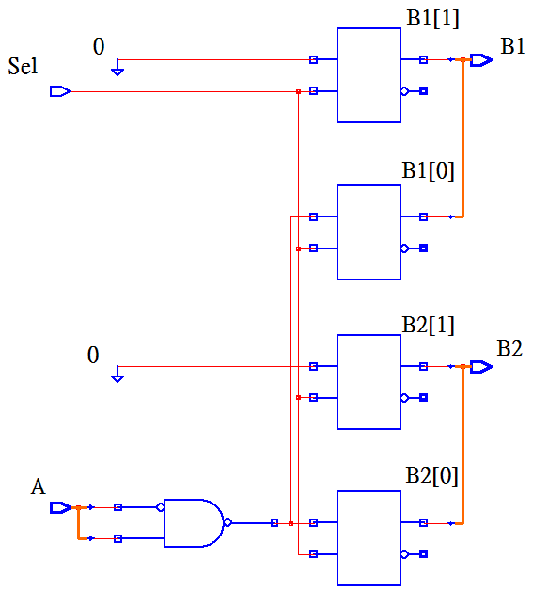
Watch Out for Unintentional Latches (5/6)
*
module code2(Sel , A , B1, B2);
input Sel;
input [1:0]A;
output [1:0] B1, B2;
reg [1:0] B1, B2;
always @ (Sel or A)
if(Sel)
if(A == 1)
begin
B1 = 0;
B2 = 0;
end
else
begin
B1 = 1;
B2 = 1;
end
endmodule
Outputs are enabled by Sel

Slide 59
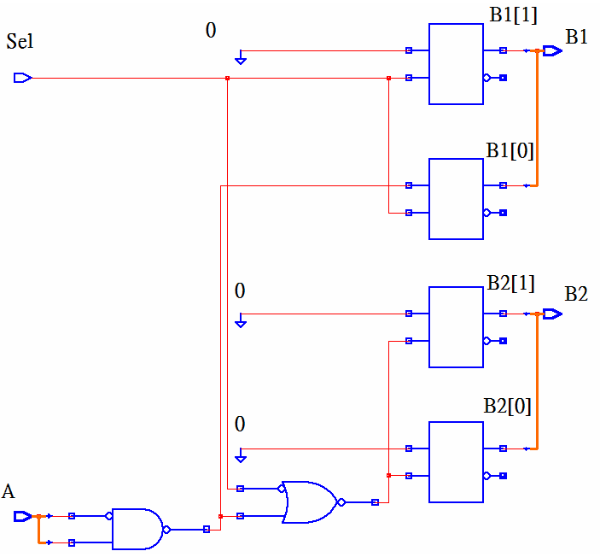
Watch Out for Unintentional Latches (6/6)
module code1(Sel , A , B1, B2);
input Sel, [1:0]A;
output [1:0] B1, B2;
reg [1:0] B1, B2;
always @ (Sel or A)
begin
if(Sel)
begin
if(A == 1)
begin
B1= 0; B2 = 0;
end
else
begin
B1 = 1;
end
end
end
endmodule
*
B1 are enabled by Sel

Slide 60
Blocking vs. Non-Blocking (1/10)
Blocking assignment ( = ) are order sensitive
Non-Blocking assignment ( <= ) are order independent
Blocking
assignment
Non-Blocking
assignment
Initial
begin
a=#12 1;
b=#3 0;
c=#2 3;
end
Initial
begin
d<=#12 1;
e<=#3 0;
f<=#2 3;
end
Time-unit
a b c d e f
0 x x x x x x
x x x x x 3
x x x x 0 3
12 1 x x 1 0 3
1 0 x 1 0 3
17 1 0 3 1 0 3

Slide 61
Blocking vs. Non-Blocking (2/10)
Initial
begin
. .
A=1;
B=0;
. .
A=B; // B=0 is used
B=A; // A=0 is used
Initial
begin
. .
A=1;
B=0;
. .
B=A; // A=1 is used
A=B; // B=1 is used
Blocking
assignment
Initial
begin
. .
A=1;
B=0;
. .
A<=B; // B=0 is used
B<=A; // A=1 is used
Initial
begin
. .
A=1;
B=0;
. .
B<=A; // A=1 is used
A<=B; // B=0 is used
Non-Blocking
assignment

Slide 62
Blocking vs. Non-Blocking (3/10)
Blocking
assignment
Non-Blocking
assignment
module test_n(clk, a, b, c, out);
input clk, a, b, c;
output out;
reg t1, t2;
reg out;
always @(posedge clk)
begin
t1 <= a&b;
t2 <= t1&c;
out <= t1 & t2;
end
endmodule
module test_n(clk, a, b, c, out);
input clk, a, b, c;
output out;
reg t1, t2;
reg out;
always @(posedge clk)
begin
t1 = a&b;
t2 = t1&c;
out = t1 & t2;
end
endmodule
1
1
assigned in order
2
assigned immediately
1
3
1
Blocking assignment
Non-blocking assignment

Slide 63
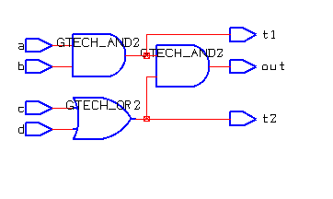
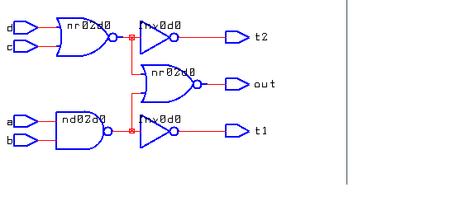
Blocking vs. Non-Blocking (4/10)
module test_n(a, b, c, d, t1, t2, out);
input a, b, c, d;
output out, t1, t2;
reg t1, t2, out;
always @(a or b or c or d)
begin
t1 = a&b;
t2 = c | d;
out = t1 & t2;
end
endmodule
module test_n(a, b, c, d, t1, t2, out);
input a, b, c, d;
output out, t1, t2;
reg t1, t2, out;
always @(a or b or c or d)
begin
t1 <= a&b;
t2 <= c | d;
out <= t1 & t2;
end
endmodule
Combinational
circuit
Combinational
circuit
Automatic
optimization (DC)

Slide 64
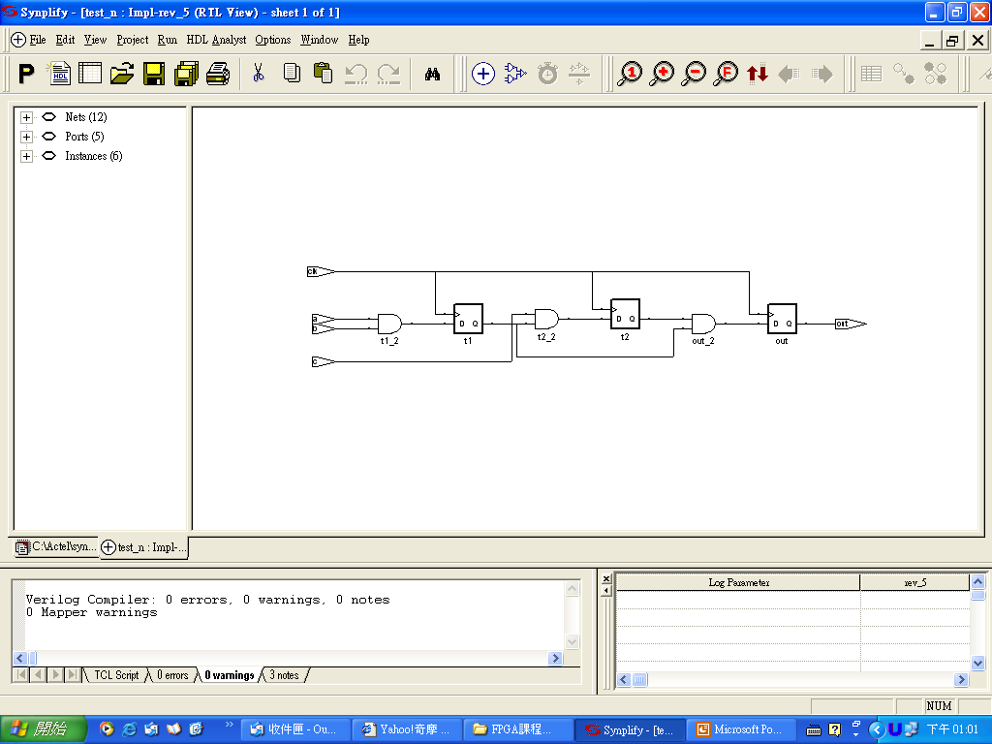
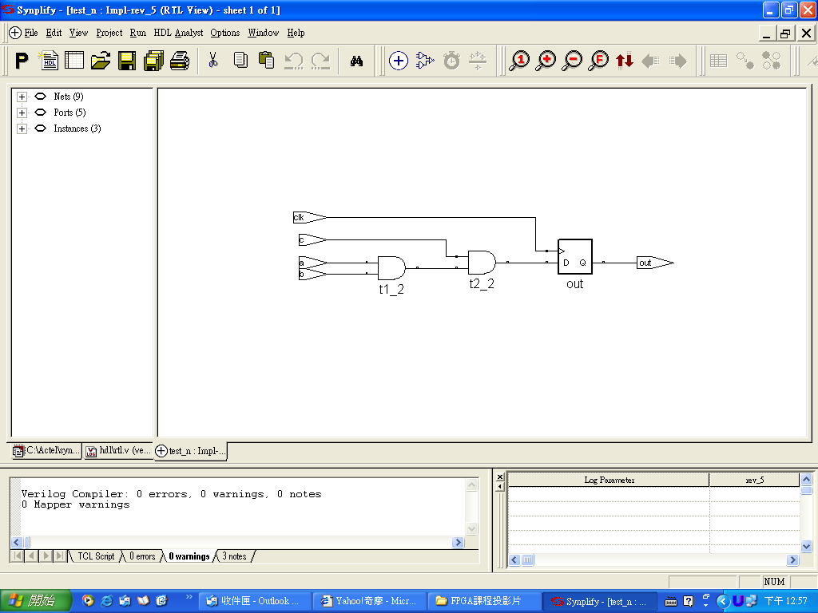
Blocking vs. Non-Blocking (5/10)
Blocking assignment
Non-blocking assignment
module test_n(clk, a, b, c, out);
input clk, a, b, c; output out;
reg t1, t2; reg out;
always @(posedge clk)
begin
t1 <= a&b;
t2 <= t1&c;
out <= t1 & t2;
end
endmodule
module test_n(clk, a, b, c, out);
input clk, a, b, c;
output out;
reg t1, t2;
reg out;
always @(posedge clk)
begin
t1 = a&b;
t2 = t1&c;
out = t1 & t2;
end endmodule
1
1
// old t1 is used
// old t1 and t2
are used
1
1
2
3
Three flip-flops are inferred

Slide 65
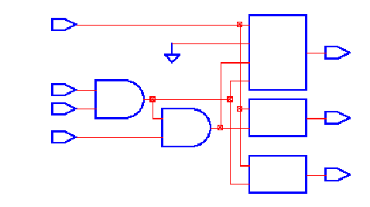
Blocking vs. Non-Blocking (6/10)
Blocking assignment
Blocking assignment
module test_n(clk, a, b, c, t1, t2, out);
input clk, a, b, c; output out, t1, t2;
reg t1, t2;reg out;
always @(posedge clk)
begin
t1 = a&b;
t2 = t1&c;
out = t1 & t2;
end
endmodule
module test_n(clk, a, b, c, out);
input clk, a, b, c;
output out;
reg t1, t2;
reg out;
always @(posedge clk)
begin
t1 = a&b;
t2 = t1&c;
out = t1 & t2;
end
endmodule
1
1
2
// new t1 is used
// new t1 and t2
are used
2
3
3
clk
out
a
b
c
t2
t1

Slide 66
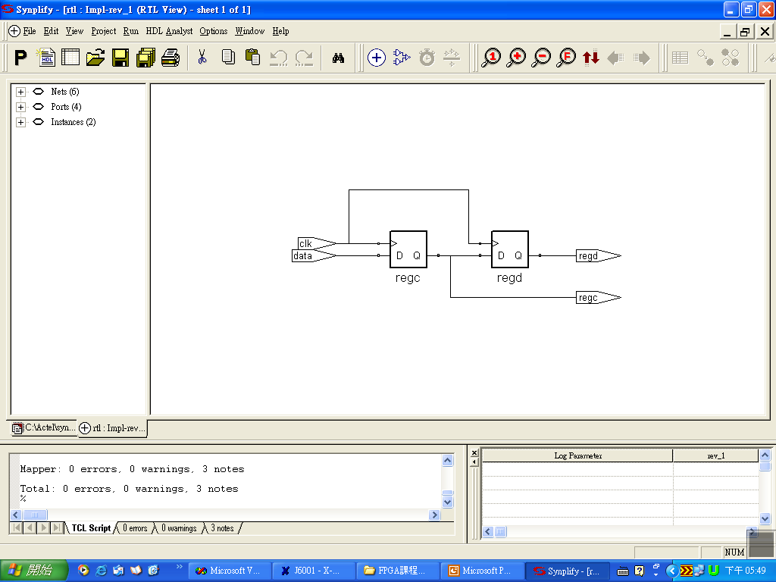
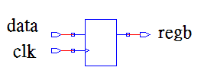
Blocking vs. Non-Blocking (7/10)
Blocking assignment
Non-blocking assignment
module rtl(clk, data, regc, regd);
input data, clk;
output regc, regd;
reg regc, regd;
always @(posedge clk)
begin
regc <= data;
regd <= regc;
end
endmodule
module rtl_1(clk, data, regb);
input data, clk;
output regb;
reg rega, regb;
always @(posedge clk)
begin
rega = data;
regb = rega;
end
endmodule
1
1
1
// old regc is used
2

Slide 67

Blocking vs. Non-Blocking (8/10)
Blocking assignment
Blocking assignment
module rtl_1(clk, data, regb);
input data, clk;
output regb;
reg rega, regb;
always @(posedge clk)
begin
rega = data;
regb = rega;
end
endmodule
module rtl_1(clk, data, regb);
input data, clk;
output regb;
reg rega, regb;
always @(posedge clk)
begin
regb = rega;
rega = data;
end
endmodule
1
1
2
2

Slide 68


Blocking vs. Non-Blocking (9/10)
Blocking assignment
Blocking assignment
module rtl_1(clk, data, rega, regb);
input data, clk;
output rega, regb;
reg rega, regb;
always @(posedge clk)
begin
rega = data;
regb = rega;
end
endmodule
module rtl_1(clk, data, regb);
input data, clk;
output regb;
reg rega, regb;
always @(posedge clk)
begin
rega = data;
regb = rega;
end
endmodule
1
1
2
2
// new regc is used
One flip-flop is inferred
Two flip-flops are inferred
rega
clk
regb
data

Slide 69


Blocking vs. Non-Blocking (10/10)
module latch_if2(en, A, B, C, out);
input en, A, B, C;
output out;
reg K, out;
always @(en or A or B or C)
if(en)
begin
K <=!(A&B);
out <=!(K|C);
end
endmodule
One latch is inferred
module latch_if3(en,A,B,C,out);
input en, A, B, C;
output out;
reg K, out;
always @(en or A or B or C)
if(en)
begin
K =!(A&B);
out =!(K|C);
end
endmodule
Two latches are inferred

Slide 70
Combinational Shifter (1/2)
module SHIFTER (Sel, A,Y);
input [1:0]Sel;
input [5:0]A;
output [5:0]Y;
reg [5:0]Y;
always@(Sel or A)
begin
case(Sel)
0: Y=A;
1: Y=A<<1;
2: Y=A>>1;
default: Y=6'b0;
endcase
end
endmodule
Sel | Operation | Function
0 | Y← A | no shift
1 | Y← shl A | shift left
2 | Y← shr A | shift right
3 | Y← 0 | zero outputs

Slide 71
Combinational Shifter (2/2)
module SHIFTER_SHIFTINOUT
(Sel,ShiftLeftIn,ShiftRightIn,A,ShiftLeftOut,ShiftRightOut,Y);
input [1:0]Sel;
input ShiftLeftIn, ShiftRightIn;
input [5:0]A; output [5:0]Y;
output ShiftLeftOut,ShiftRightOut;
reg ShiftLeftOut,ShiftRightOut;
reg [5:0]Y; reg [7:0]A_Wide, Y_Wide;
always@(Sel or ShiftLeftIn or
ShiftRightIn or A)
begin
A_Wide={ShiftLeftIn,A,ShiftRightIn};
case(Sel)
0: Y_Wide = A_Wide;
1: Y_Wide = A_Wide<<1;
2: Y_Wide = A_Wide>>1;
3: Y_Wide = 8'b0;
endcase
ShiftLeftOut = Y_Wide[7];
Y = Y_Wide[6:1];
ShiftRightOut = Y_Wide[0];
end
endmodule
Sel | Operation | Function
0 | Y← A ShiftLeftOut←0 ShiftRightOut←0 | no shift
1 | Y← shl A ShiftLeftOut←A[5] ShiftRightOut←0 | shift left
2 | Y← shr A ShiftLeftOut←0 ShiftRightOut←A[0] | shift right
3 | Y← 0 ShiftLeftOut←0 ShiftRightOut←0 | zero outputs

Slide 72
SISO Shifter (1/4)
module SISO_SR(clk, Clear, SI, SO);
input clk, Clear, SI;
output SO;
reg [3:0] Reg4;
always @(posedge clk or posedge Clear)
begin
if (Clear)
Reg4 = 4'b0;
else begin
Reg4[3] = Reg4[2];
Reg4[2] = Reg4[1];
Reg4[1] = Reg4[0];
Reg4[0] = SI;
end
end
assign SO = Reg4[3];
endmodule
sequential shifter
serial in serial out
Reg4[0]
Reg4[1]
Reg4[2]
Reg4[3]
SI
D
Q
D
Q
D
Q
D
Q
SO
clk
Clear

Slide 73

SISO Shifter (2/4)
1 1 0 0 1 0
1 1 0 0 1 0

Slide 74
SISO Shifter (3/4)
module SISO_SR(clk, Clear, SI, SO);
input clk, Clear, SI;
output SO;
reg [3:0] Reg4;
always @(posedge clk or posedge Clear)
begin : for_Local
integer i;
if (Clear)
Reg4 = 4'b0;
else begin
for (i = 3; i >= 1; i = i - 1)
Reg4[i] = Reg4[i-1];
Reg4[0] = SI;
end
end
assign SO = Reg4[3];
endmodule
Reg4[3] = Reg4[2];
Reg4[2] = Reg4[1];
Reg4[1] = Reg4[0];
Reg4[0] = SI;

Slide 75
SISO Shifter (4/4)
module SISO_SR (clk, Clear, SI, SO);
input clk, Clear, SI;
output SO;
reg [3:0] Reg4;
always @(posedge clk or posedge Clear)
begin
if (Clear)
Reg4 = 4'b0;
else begin
Reg4=Reg4<<1;
Reg4[0] = SI;
end
end
assign SO = Reg4[3];
endmodule

Slide 76
SIPO Shifter (1/2)
module SIPO__SR(clk, Clear, SI, Data_Out);
input clk, Clear, SI;
output [3:0] Data_Out;
reg [3:0] Data_Out;
always @(posedge clk or posedge Clear)
begin
if (Clear)
Data_Out = 4'b0;
else
begin
Data_Out = Data_Out << 1;
Data_Out[0] = SI;
end
end
endmodule
serial in parallel out

Slide 77

SIPO Shifter (2/2)
Data_Out[3]
Data_Out[2]
Data_Out[1]
Data_Out[0]
SI
D
Q
D
Q
D
Q
D
Q
clk
CK
CK
CK
CK
Clear
1 1 0 1 0 0 1
13
10
4

Slide 78
PISO (1/2)
parallel in serial out
module PISO__SR (clk, Clear, Load, Data_In, SO);
input clk, Clear, Load;
input [3:0] Data_In;
output SO;
reg SO;
reg [3:0] Reg4;
always @(posedge clk)
begin : for_Local
integer i;
if (Clear)
Reg4 = 4'b0;
else
if(Load)
Reg4 = Data_In;
else begin
SO = Reg4[3];
for (i = 3; i >= 1; i = i - 1)
Reg4[i] = Reg4[i-1];
Reg4[0] = 0;
end
end
endmodule

Slide 79

PISO (2/2)
1 1 0
If Load=1, Data_In=13
1 1 0 1 ----13
Reg4
SO
1 1 0 1 0 ----10
1 0 1 0 0 ---- 4
0 1 0 0 0 ---- 8

Slide 80

PIPO
module PIPO__SR (clk, Clear, Load, Data_In, Data_Out);
input clk, Clear, Load;
input [3:0] Data_In; output [3:0] Data_Out;
reg [3:0] Data_Out;
always @(posedge clk)
begin
if (Clear)
Data_Out = 4'b0;
else
begin
if(Load)
Data_Out = Data_In;
end
end
endmodule
parallel in parallel out
Bad load !! Be Careful
Data_In must be ready before posedge

Slide 81



Synchronous/Asynchronous Counter
Synchronous counter:
All flip-flops in a synchronous counter receive the same clock pulse and so change state simultaneously.
Asynchronous (Ripple) counter:
Flip-flops transitions ripple through from one flip-flop to the next in sequence until all flip-flops reach a new stable value (state). Each single flip-flop stage divides the frequency of its input signal by two.
S_C
AS_C
0 0 0 0
0 0 0 1
0 0 1 0

Slide 82

Counter Implementation
Synchronous counter
C(old) C(new)
0 0 0 0 0 1
0 0 1 0 1 0
0 1 0 0 1 1
….
1 1 0 1 1 1
1 1 1 0 0 0
combinational
C[2]
C[1]
C[0]
clk
reset
Asynchronous counter

Slide 83
Synchronous Counter(1/6)
module Counter1(Reset, Enable, clk, Out);
input Reset, Enable, clk;
output [2:0] Out;
reg [2:0] Out;
always @(posedge clk)
begin
if(Reset)
begin
Out = 3'b0;
end
else
if(Enable == 1'b1)
begin
if(Out == 3'd7)
Out = 3'b0;
else
Out = Out + 1'b1;
end
end
endmodule
What happens
if Out== 3'd5 ??
3
+
1
Out
clk
Reset=1 Out=000
Reset=0, Enable==1, Out=0 ➔1➔2➔3➔4➔5➔6➔7➔0➔1➔…..

Slide 84

Synchronous Counter(2/6)
Enable is active only when Reset is low. Then, the counter will begin count up.

Slide 85
Synchronous Counter (3/6)
module Counter2 (clk, Reset, Load, Enable, Data_In, Out);
input clk, Reset, Load, Enable;
input [7:0] Data_In;
output [7:0] Out;
reg [7:0] Out;
always @ (posedge clk)
begin
if (Reset)
Out = 0;
else
if (Load)
Out = Data_In;
else
if (Enable)
Out = Out + 1;
end
endmodule
Reset=1 Out=00000000
Reset=0, Load=1, Out=Data_In
Enable==1, Out=x ➔x+1➔…..➔255➔0
➔1➔……➔255➔0➔…
Out(old)
0
1
Out+1
0
1
Data_In
0
1
Out
0
Enable
Load
Reset

Slide 86

Synchronous Counter(4/6)
Out(old)
If
Case
0
1
00
01
10
11
Out+1
0
1
Data_In
0
1
Out
Out
0
Enable
Load
Reset
Enable is active only when Load is low. Then, the counter will begin count up.

Slide 87
Synchronous Counter(5/6)
module Counter6 (clk, Reset, Load, Enable, Up_Down, Data_In, Out);
input clk, Reset, Load, Enable, Up_Down;
input [7:0] Data_In;
output [7:0] Out;
reg [7:0] Out;
always @ (posedge clk)
begin
if (Reset)
Out = 0;
else
if (Load)
Out = Data_In;
else
if (Enable)
begin
if (Up_Down)
Out = Out + 1;
else
Out = Out - 1;
end
end
endmodule
If down-by-two
Out=Out-2;

Slide 88

Synchronous Counter(6/6)
Both Load and Up_Down are not set properly.

Slide 89


Asynchronous Counter(1/8)
module FreqMod2 (Reset, clk_In, clk_Mod2_Out);
input Reset, clk_In; output clk_Mod2_Out;
reg clk_Mod2_Out; wire Not_clk_Mod2_Out;
assign Not_clk_Mod2_Out = !clk_Mod2_Out;
always @(posedge Reset or posedge clk_In)
begin
if (Reset) clk_Mod2_Out = 0;
else clk_Mod2_Out = Not_clk_Mod2_Out;
end
endmodule
Each single flip-flop stage divides the frequency of its input signal by two.

Slide 90
Asynchronous Counter(2/8)
always@(posedge div4 or negedge reset)
if(!reset)
div8=0;
else
div8=!div8;
always@(posedge div8 or negedge reset)
if(!reset)
div16=0;
else
div16=!div16;
always@(posedge clk or negedge reset)
if(!reset)
Y=0;
else
Y=div16;
endmodule
Divide by 16 clock divider using an asynchronous (ripple) counter
➔frequency divider
Count-down counter
module CNT_ASYNC_CLK_DIV16(clk,reset,Y);
input clk,reset; output Y;
reg div2,div4,div8,div16, Y;
always@(posedge clk or negedge reset)
if(!reset)
div2=0;
else
div2=!div2;
always@(posedge div2 or negedge reset)
if(!reset)
div4=0;
else
div4=!div4;

Slide 91


Asynchronous Counter(3/8)
0 1 2 3 4 5 6 7 8 9 10 1112 13 1415 0
15 14 13 12 11
1 0 15 1413
Count-down counter 15➔14➔13➔…….1➔0➔15➔14➔…..

Slide 92
Asynchronous Counter(4/8)
always@(posedge div4_b or
negedge reset)
if(!reset)
div8=0;
else div8=!div8;
assign div8_b=!div8;
always@(posedge div8_b or
negedge reset)
if(!reset)
div16=0;
else
div16=!div16;
always@(posedge clk or
negedge reset)
if(!reset)
Y=0;
else
Y=div16;
endmodule
Count-up counter
module DIV16(clk,reset,Y);
input clk,reset; output Y;
reg div2,div4,div8,div16, Y;
always@(posedge clk or negedge reset)
if(!reset)
div2=0;
else
div2=!div2;
assign div2_b=!div2;
always@(posedge div2_b or negedge reset)
if(!reset)
div4=0;
else
div4=!div4;
assign div4_b=!div4;

Slide 93


Asynchronous Counter(5/8)
0 1 2 3 4 5 6 7 8 9 10 1112 13 1415 0
0 1 2 3 4 5 6 15 0
Count-up counter 0➔1➔2➔…….15➔0➔1➔2➔…..

Slide 94
Asynchronous Counter(6/8)
always@(posedge div2 or negedge
reset or posedge clear)
if(!reset)
div4=0;
else if(clear)
div4=0;
else
div4=!div4;
assign div4_b =!div4;
always@(posedge div4 or negedge
reset or posedge clear)
if(!reset)
div8=0;
else if(clear)
div8=0;
else
div8=!div8;
assign div8_b=!div8; … .
Divide by 13 clock divider using an asynchronous (ripple) counter
module CNT_ASYNC_CLK_DIV13(clk,reset,Y);
input clk,reset; output Y;
reg div2,div4,div8,div16,Y;
wire div2_b,div4_b,div8_b,div16_b,clear;
always@(posedge clk or negedge reset
or posedge clear)
if(!reset)
div2=0;
else if(clear)
div2=0;
else
div2=!div2;
assign div2_b=!div2;

Slide 95

Asynchronous Counter(7/8)
always@(div16_b or div8_b
or div4_b or div2_b)
begin
if(({div16_b , div8_b ,
div4_b , div2_b}==12))
clear=1;
else
clear=0;
end
always@(posedge clk or negedge reset)
if(!reset)
Y=0;
else if({div16_b,div8_b,div4_b,div2_b}==11)
Y=1;
else
Y=0;
end

Slide 96

Asynchronous Counter(8/8)
Divide by 16
Divide by 13

Slide 97
Loop Problem (1/2)
assign a=a+c;
always @(posedge clk)
a=a+c;
c
c
a
+
+
a
a
a
Error!
Good!
Why?

Slide 98




Loop Problem (2/2)
module adder1(c,a);
input c;
output a;
assign a=a+c;
endmodule
module adder2(c,b,a);
  input c,b;
  output a; reg a;
  always@(a or c or b)
  begin
  a=b;
  a=a+c;
  end
endmodule
Error!
OK!

Slide 99

Example of blocking and for (1/3)
PA[3]<=PA[2];PA[2]<=PA[1];PA[1]<=PA[0];
PA[0]<=Data; YA[0]<=PA[0]; YA[1]<=PA[1];
YA[2]<=PA[2]; YA[3]<=PA[3];
module test3(Clock, Data, YA, YB);
input Clock, Data;
output [3:0] YA;
reg [3:0] YA; reg [3:0] PA;
integer N;
always @(posedge Clock)
begin
for(N=3 ; N>=1 ; N=N-1)
PA[N] <= PA[N-1];
PA[0] <= Data;
YA <= PA;
end
endmodule

Slide 100

Example of blocking and for (2/3)
module test1(Clock, Data, YA, YB);
input Clock, Data;
output [3:0] YA;
reg [3:0] YA, PA;
integer N;
always@(posedge Clock)
begin
for( N=1 ; N<=3 ; N=N+1)
PA[N] = PA[N-1];
PA[0] = Data;
YA = PA;
end
endmodule
PA[1]=PA[0];
PA[2]=PA[1];
PA[3]=PA[2];
PA[0]=Data;
YA[0]=PA[0]
YA[1]=PA[1]
YA[2]=PA[2]
YA[3]=PA[3]

Slide 101

Example of blocking and for (3/3)
module test2(Clock, Data, YA, YB);
input Clock, Data;
output [3:0] YA;
reg [3:0] YA, PA;
integer N;
always@(posedge Clock)
begin
for(N=3 ; N>=1 ; N=N-1)
PA[N] = PA[N-1];
PA[0] = Data;
YA = PA;
end
endmodule
PA[3]=PA[2];
PA[2]=PA[1];
PA[1]=PA[0];
PA[0]=Data;
YA[0]=PA[0]
YA[1]=PA[1]
YA[2]=PA[2]
YA[3]=PA[3]

