Slide 1
數位IC設計
Case Study

Slide 2
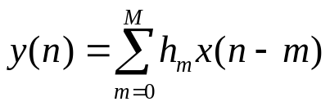









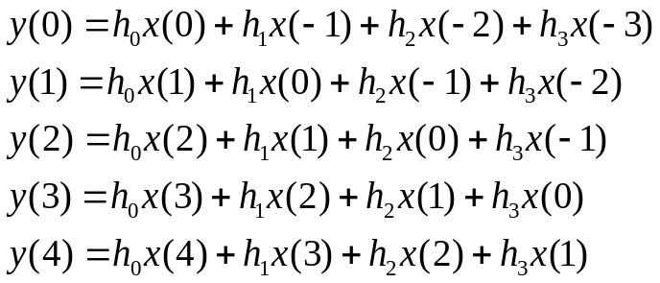





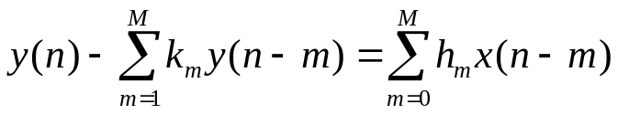



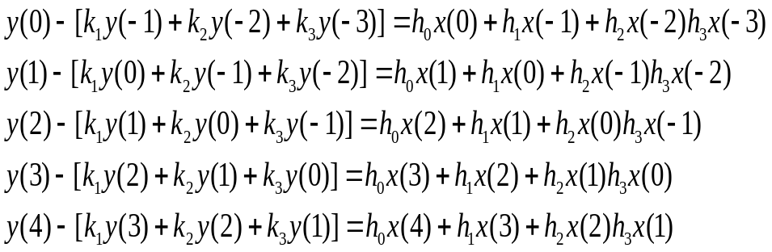






Case - Filter (1/8)
FIR
  
Filter tap=4
+
+
  
+
: delay
: multiplier
+
: adder
+
+
IIR
+
+
+
+
…
…
…
…

Slide 3
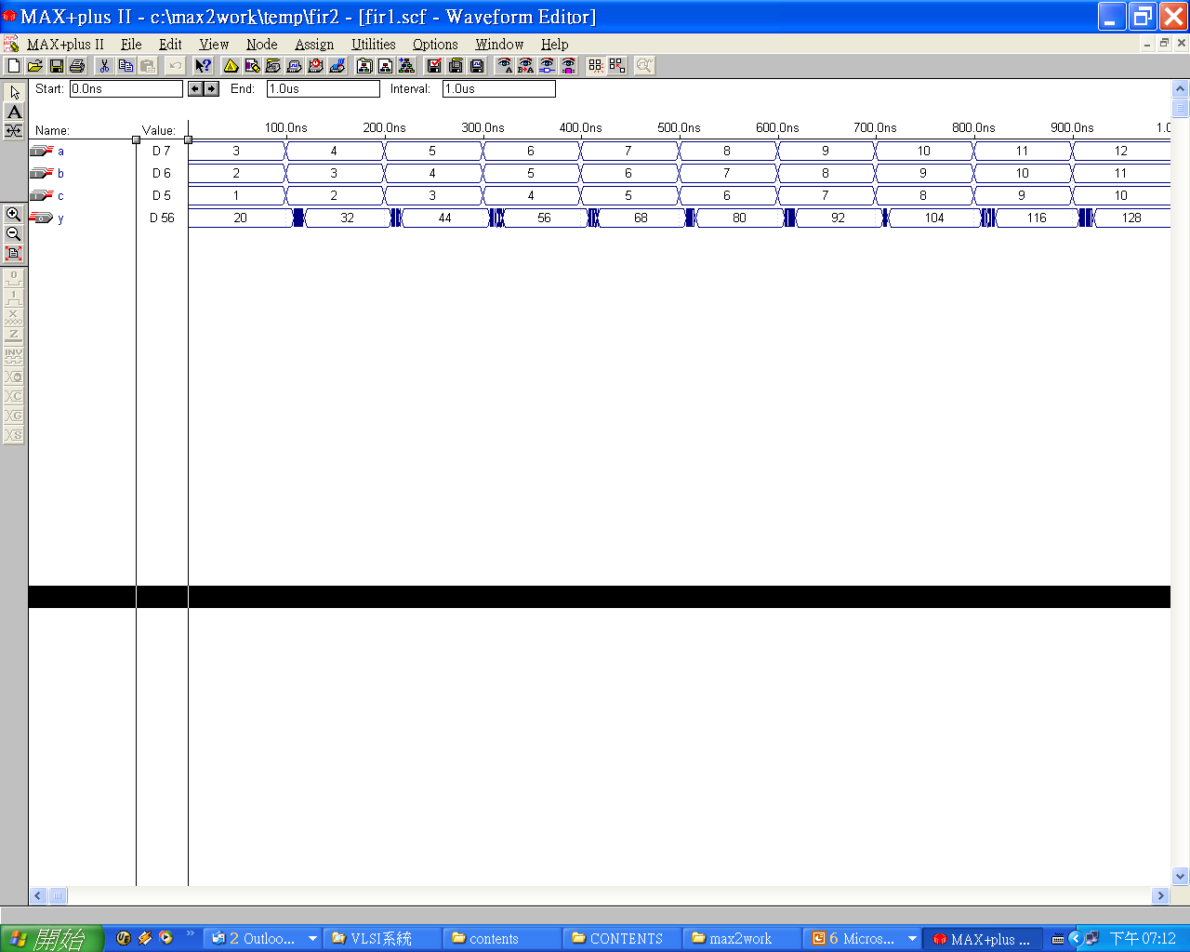
Case - Filter (2/8)
tap=3
h₀=2; h₁=4, h₂=6;
2
module fir2(a, b, c, y);
input [7:0] a, b, c;
output [11:0] y;
reg [11:0] y;
always @(a or b or c)
y = a*2+b*4+c*6;
endmodule
a
X
module fir1(a, b, c, y);
input [7:0] a, b, c;
output [11:0] y;
assign y = a*2+b*4+c*6;
endmodule
＋
4
X
y
b
＋
6
X
c
Output: 20, 32, 44, 56, 68, 80, 92, 104, ….
delay
delay

Slide 4
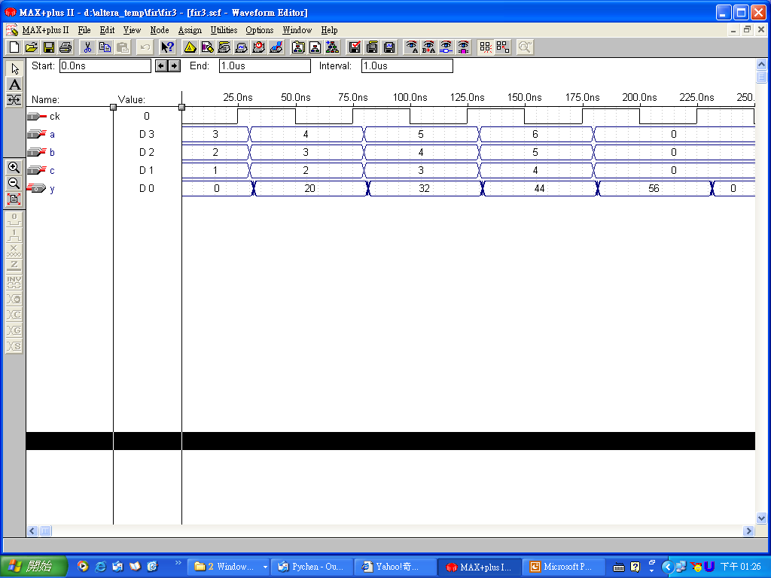
Case - Filter (3/8)
module fir3(a, b, c, y, ck);
input [7:0] a, b, c;
input ck;
output [11:0] y;
reg [11:0] y;
always @(posedge ck)
y = a*2+b*4+c*6;
endmodule
2
reg
a
X
4
＋
y
X
b
＋
6
ck
X
Stable output
c
Three inputs (a, b, c) must be entered concurrently (more pins, higher cost).
Output: 20, 32, 44, 56, 68, 80, 92, 104, ….
delay
delay
The stable output is generated at the positive edge of clock.

Slide 5
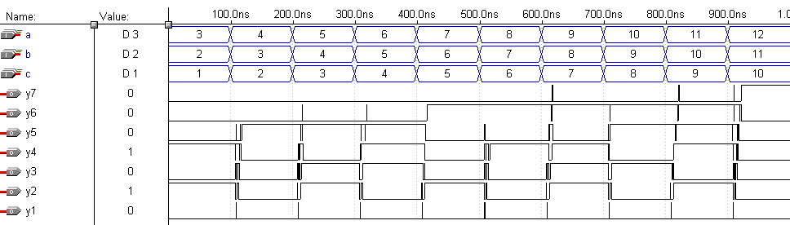
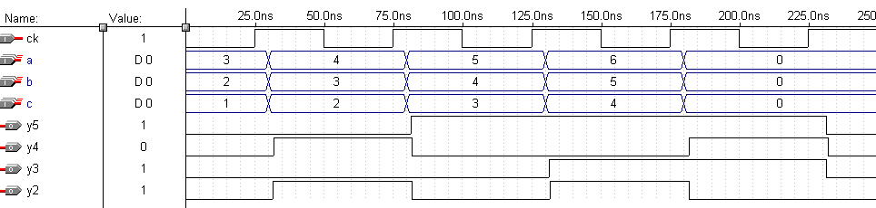
fir2
Case - Filter (4/8)
fir2
Unstable output
fir3
Stable output

Slide 6
Case - Filter (5/8)
T(n+1) ➔ 4 3 2
T(n) ➔ 3 2 1
module register(in, out, ck);
input [11:0] in;
input ck;
output [11:0] out;
reg [11:0] out;
always @(posedge ck)
out=in;
endmodule
x(3)
x(2)
x(1)
in
module ffir1_a(in, out, ck);
input ck;
input [11:0] in;
output [11:0] out;
reg [11:0] out;
reg [11:0] x4, x3, x2, x1;
always @(posedge ck)
begin
x3<=in;
x2<=x3;
x1<=x2;
out<=(x3*2+x2*4)+x1*6;
end
endmodule
2
＊
4
＊
6
＊
`include "register.v"
module ffir1(in, out, ck);
input [11:0] in;
input ck;
output [11:0] out;
wire [11:0] x4, x3, x2, x1;
register r1(in, x3, ck);
register r2(x3, x2, ck);
register r3(x2, x1, ck);
register r4(x4, out, ck)
assign x4=x1*6+x2*4+x3*2;
endmodule
+
ffir1
+
out
One input (in) is entered every clock cycle
(more suitable for memory access and pins’ cost)

Slide 7
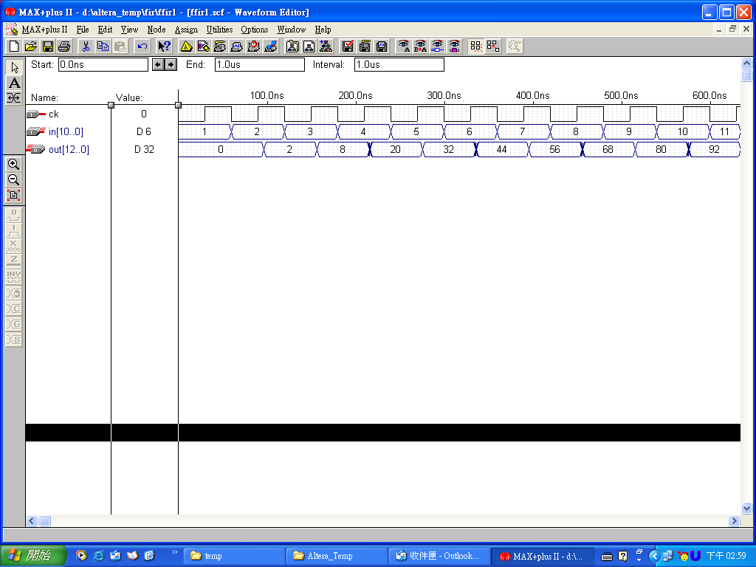
Case - Filter (6/8)
T(4) ➔ 4 3 2
T(3) ➔ 3 2 1
T(2) ➔ 2 1 X
T(1) ➔ 1 X X
T(0) ➔ X X X
To work well, every input must be ready before the positive edge of every clock
x(3)
x(2)
x(1)
in
2
＊
4
＊
6
＊
ffir1
+
+
out
Output: 20, 32, 44, 56, 68, 80, 92, 104, ….
Correct results start here (4th clock), why ?

Slide 8
Case - Filter (7/8)
x(3)
x(2)
x(1)
Datapath Pipelining
in
module ffir2_a(in, out, ck);
input ck;
input [11:0] in;
output [11:0] out;
reg [11:0] out;
reg [11:0] x3, x2, x1;
reg [11:0] y3, y2, y1;
always @(posedge ck)
begin
x3<=in;
x2<=x3;
x1<=x2;
y3<=x3*2;
y2<=x2*4;
y1<=x1*6;
out<=(y3+y2)+y1;
end
endmodule
`include "register.v"
module ffir2(in, out, ck);
input [11:0] in;
input ck;
output [11:0] out;
wire [11:0] x4, x3, x2, x1;
wire [11:0] t3, t2, t1;
wire [11:0] y3, y2, y1;
register r1(in, x3, ck); register r2(x3, x2, ck);
register r3(x2, x1, ck);
assign t3=x3*2; assign t2=x2*4; assign t1=x1*6;
register r4(t3, y3, ck); register r5(t2, y2, ck);
register r6(t1, y1, ck);
assign x4=y1+y2+y3;
register r7(x4, out, ck);
endmodule
2
＊
4
＊
6
＊
y3
y2
y1
+
+
ffir2
out

Slide 9
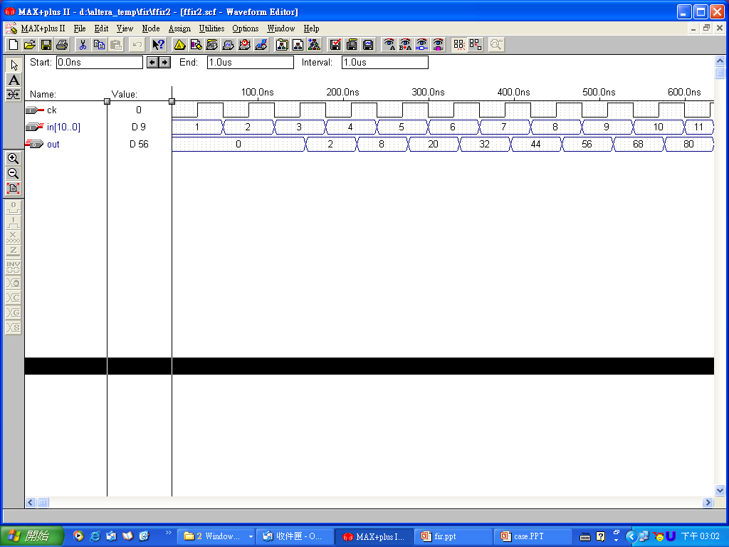
Case - Filter (8/8)
T(4) ➔ 4 3 2
T(3) ➔ 3 2 1
T(2) ➔ 2 1 X
T(1) ➔ 1 X X
Delay for is about 7.3 ns
Delay for register assign is about 6.1 ns
Delay for + is about 2.6 ns
*
x(3)
x(2)
x(1)
in
Total delay=7.3+6.1=13.4 ns (+ little wire delay)
2
＊
4
＊
6
＊
ffir2
+
Total delay=2.6*2+6.1=11.3 ns
+
Critical path=13.4 ns => clock rate less than
1/(13.4*10⁻⁹) ~= 74.6 MHz
out
Output: 20, 32, 44, 56, 68, 80, 92, 104, ….
Correct results start here (5th clock) ??

Slide 10
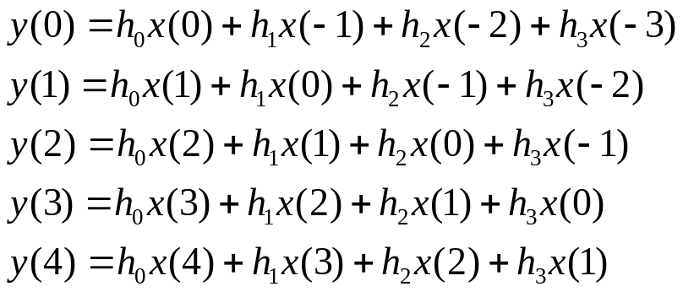










Case - Systolic Array (1/5)
Systolic Array (FIR)
Processing Element
x_{i}
R
x_{i+1}
h_{i}

+ : adder  : multiplier
R : register h_{i} : coefficient
y_{i}
R
+
y_{i+1}
PE₀
PE₁
PE₂
PE₃

Slide 11













Case - Systolic Array (2/5)
PE₀
PE₁
PE₂
PE₃
h₀
h₁
h₂
h₃
T₁
h₀
h₁
h₂
h₃
T₂
h₀
h₁
h₂
h₃
T₃
h₀
h₁
h₂
h₃
T₄
h₀
h₁
h₂
h₃
T₅
h₀
h₁
h₂
h₃
T₆

Slide 12



















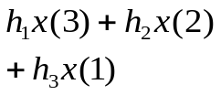


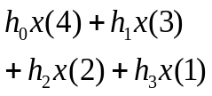


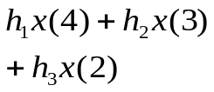



Case - Systolic Array (3/5)

Slide 13
Case - Systolic Array (4/5)
module pe(clk, reset, coeff, in_x, in_y, out_x, out_y);
parameter size = 8;
input clk, reset;
input [size-1:0] in_x, coeff;
input [size+size-1:0] in_y;
output [size-1:0] out_x;
output [size+size-1:0] out_y;
reg [size+size-1:0] out_y;
reg [size-1:0] out_x;
always@(posedge clk)
begin
if(reset) begin
out_x = 0;
out_y = 0;
end
else begin
out_y = in_y + (in_x * coeff);
out_x = in_x;
end
end
endmodule
Design_1
module pe(clk, reset, coeff, in_x, in_y, out_x, out_y);
parameter size = 8;
input clk, reset;
input [size-1:0] in_x, coeff;
input [size+size-1:0] in_y;
output [size-1:0] out_x;
output [size+size-1:0] out_y;
wire [size+size-1:0] mult_out, add_out;
reg_8 r1(clk, reset, in_x, out_x);
reg_16 r2(clk, reset, add_out, out_y);
assign mult_out = in_x * coeff;
assign add_out = mult_out + in_y;
endmodule
in_x
R
out_x
coeff

mult_out
out_y
R
+
in_y

Slide 14
Case - Systolic Array (5/5)
PE₀
PE₁
PE₂
PE₃
//***** main ****************************
module systolic(clk, reset, input_x, output_y);
parameter size = 8;
input clk, reset;
input [size-1:0] input_x;
output [size+size-1:0] output_y;
wire [size-1:0] pe0_x, pe1_x, pe2_x, pe3_x;
wire [size+size-1:0] pe1_y, pe2_y, pe3_y;
wire [size-1:0] h0 = 8'h01;
wire [size-1:0] h1 = 8'h01;
wire [size-1:0] h2 = 8'h01;
wire [size-1:0] h3 = 8'h01;
wire [size+size-1:0] pe4_y = 16'h0000;
pe pe_0(clk, reset, h0, input_x, pe1_y, pe0_x, output_y);
pe pe_1(clk, reset, h1, pe0_x, pe2_y, pe1_x, pe1_y);
pe pe_2(clk, reset, h2, pe1_x, pe3_y, pe2_x, pe2_y);
pe pe_3(clk, reset, h3, pe2_x, pe4_y, pe3_x, pe3_y);
endmodule
//***** register_8bits *******
module reg_8(clk,reset,in,out);
parameter size_in = 8;
input clk,reset;
input [size_in-1:0] in;
output [size_in-1:0] out;
reg [size_in-1:0] out;
always @(posedge clk )
begin
if(reset)
out=0;
else
out=in;
end
endmodule
//***** register_16bits *******
module reg_16(clk,reset,in,out);
parameter size_in = 16;
input clk,reset;
input [size_in-1:0] in;
output [size_in-1:0] out;
reg [size_in-1:0] out;
always @(posedge clk )
begin
if(reset)
out=0;
else
out=in;
end
endmodule

Slide 15
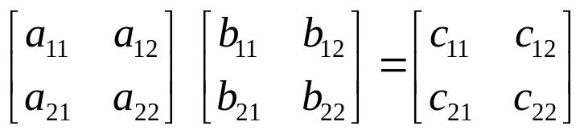








Case-Matrix Multiplication (1/2)
`include "reg_8.v"
`include "reg_16.v"
module PE(clk,reset,in_a,in_b,out_a,out_b,out_c);
parameter data_size=8;
input reset,clk;
input [data_size-1:0] in_a,in_b;
output [data_size-1:0] out_a,out_b;
output [2*data_size-1:0] out_c;
wire [2*data_size-1:0] out_c,ADD_out,out_MPY;
wire [data_size-1:0] out_a,out_b;
assign out_MPY=in_a*in_b;
assign ADD_out=out_MPY+out_c;
reg_16 reg_16_0(clk,reset,ADD_out,out_c);
reg_8 reg_delay_8_0(clk,reset,in_a,out_a);
reg_8 reg_delay_8_1(clk,reset,in_b,out_b);
endmodule_x0001_
Matrix Multiplication
c=c+(a*b)
R : Register
 : ADD
 : MPY

Slide 16
Case-Matrix Multiplication (2/2)
module PE_H(reset,clk,in_a,in_b,out_a,out_b,out_c);
parameter data_size=8;
input reset,clk;
input [data_size-1:0] in_a,in_b;
output [2*data_size:0] out_c;
output [data_size-1:0] out_a,out_b;
reg [2*data_size:0] out_c;
reg [data_size-1:0] out_a,out_b;
always @(posedge clk)
begin
if(reset)
begin
out_a=0;
out_b=0;
out_c=0;
end
else
begin
out_c=out_c+in_a*in_b;
out_a=in_a;
out_b=in_b;
end
end
endmodule
The rest of circuit can be designed easily….

